Slide 1
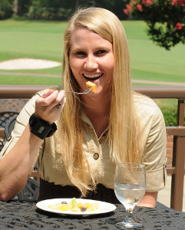

Bite measurement methods and models
Adam Hoover
Electrical & Computer Engineering Department

Slide 2
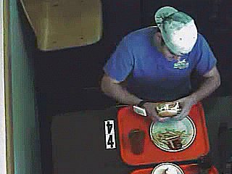
Outline
Wearables
Relating bites to calories
Instrumented environment

Slide 3
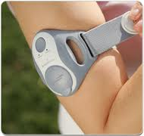
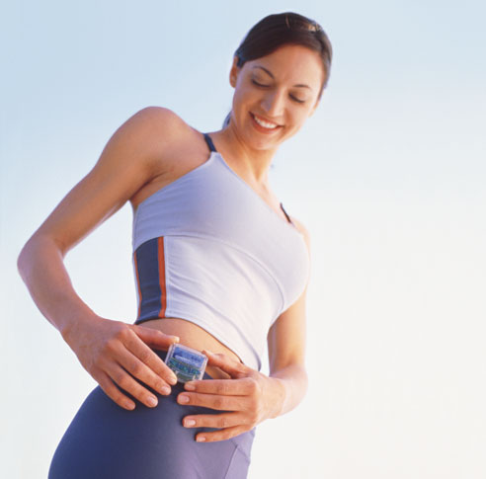
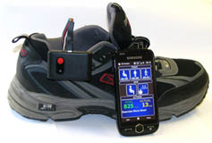
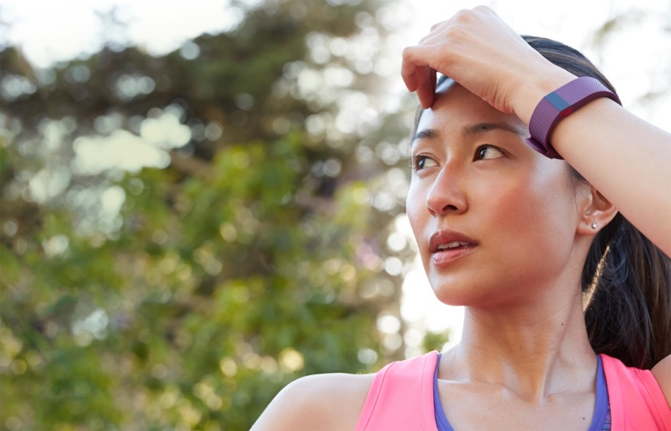
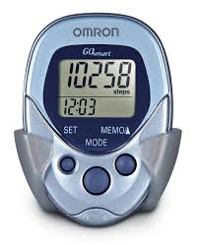
Wearables
Physical activity monitors, pedometers measure energy expenditure
Challenge: Develop similar body-worn sensors for energy intake

Slide 4

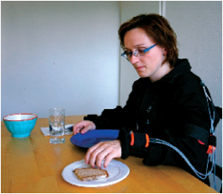
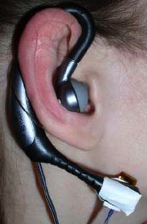
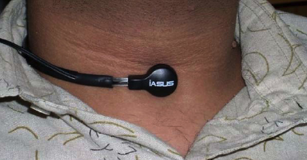
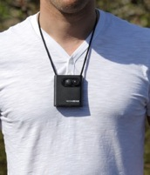
Wearable sensor-based approaches
  Throat and ear
  (e.g. Sazonov et al. 2010)
Detect swallows, chewing sounds
  Arms and back
  (e.g. Amft et al. 2008)
Recognize eating gestures
  Lanyard camera
  (e.g. Gemming et al. 2013)
  Video record eating activities
Challenges: Compliance (social stigma, comfort), accuracy

Slide 5
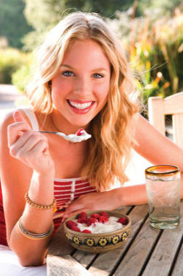
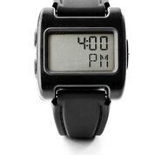
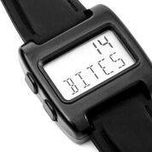
Our concept: Bite Counter
Audible alarms to queue behaviors such as slowing eating or portion control
Worn like a watch
Tracks wrist motion to detect eating activities and count bites (hand-to-mouth gestures)

Slide 6
Wrist Roll Motion
Wrist rolls to get food from table to mouth
Roll is independent of other axes of motion

Slide 7
Algorithm
The wrist undergoes a characteristic roll motion during the taking of a bite of food that can be tracked using a gyroscope
Biologically, this can be related to the necessary orientations for (1) picking food up, and (2) placing food into the mouth

Slide 8
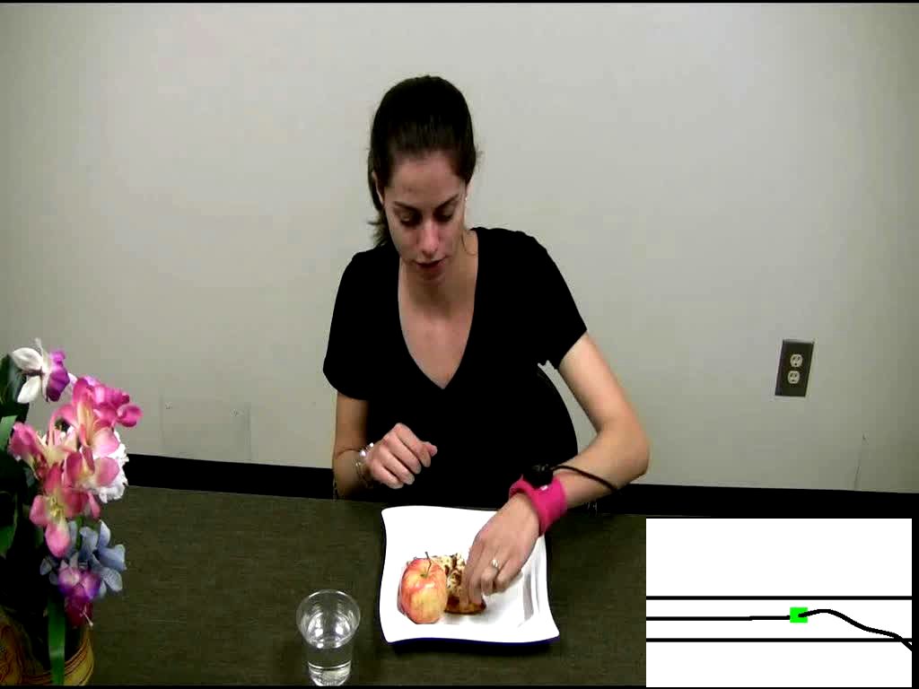
Demo of Bite Counting
Early test: 49 meals (47 participants), 1675 bites
86% bites detected, 81% positive predictive value
Talking and other actions between 67% of bites
Y. Dong, A. Hoover, J. Scisco and E. Muth, "A New Method for Measuring Meal Intake in Humans via Automated Wrist Motion Tracking", in Applied Psychophysiology and Biofeedback, vol 37, no 3, 2012, pp 205-215.

Slide 9
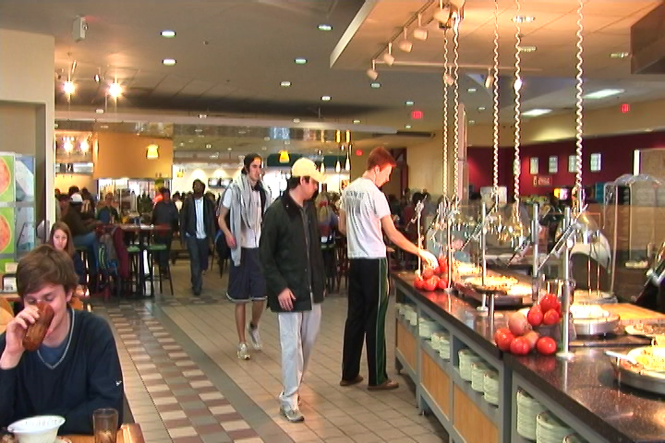
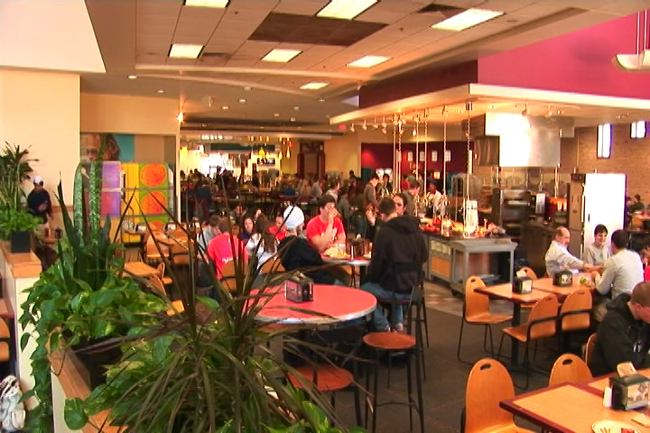
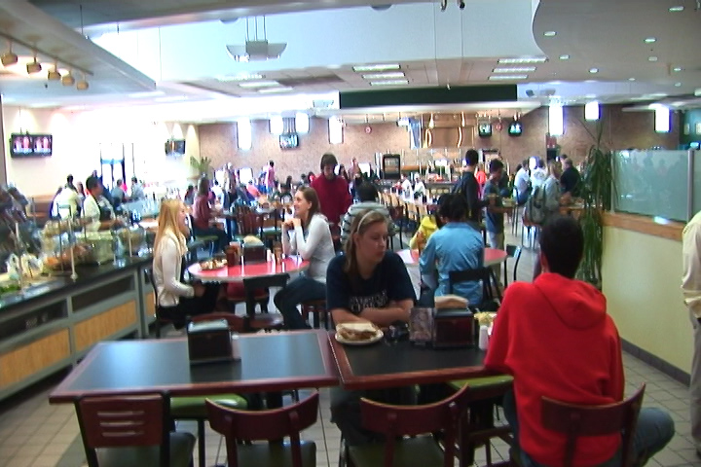
Cafeteria Experiment
Main food service for Clemson University
Seats ~800 people
Huge variety of foods and beverages

Slide 10
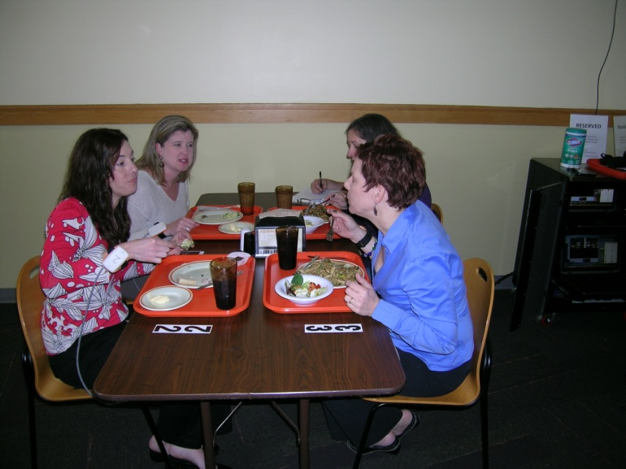
Cafeteria Experiment
276 participants (1 meal each)
374 different foods and beverages consumed
24,088 total bites
81% bites detected, 83% positive predictive value

Slide 11
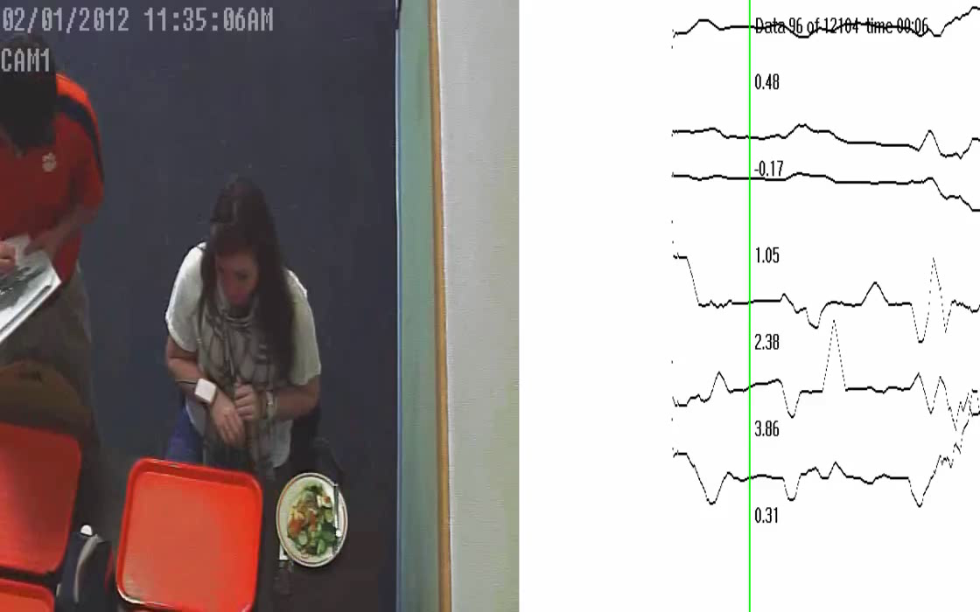
Cafeteria Demo

Slide 12
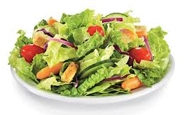
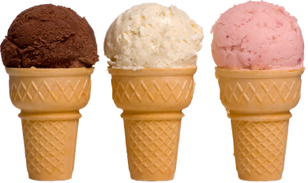
Bite Counting Accuracy
most accurate food:
salad bar (87%)
least accurate food:
ice cream cone (37%)
Accuracy increases as seconds per bite slows
(age, gender, ethnicity)
Accuracy modestly correlates with total wrist motion
(head-toward-plate vs hand-towards-mouth motion)

Slide 13
Outline
Wearables
Relating bites to calories
Instrumented environment

Slide 14
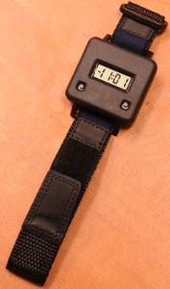

Embedded System Design
Audible alarm
On/off button
Stores time-stamped log of meals (bite count)
Lab model
Watch model

Slide 15
Bite-to-Calorie Correlation
each point = 1 meal
2 weeks data (~50 meals), 1 person

Slide 16
Correlation Test
83 subjects wore for 2 weeks, 3246 total meals
each plot = 1 person
0.4 correlation
0.7 correlation
J. Scisco, E. Muth and A. Hoover, "Examining the Utility of a Bite-Count Based Measure of Eating Activity in Free-Living Humans", in Journal of the Academy of Nutrition and Dietetics, vol. 114 no. 3, April 2014, pp. 464-469.

Slide 17
Correlation Comparison
Physical activity monitors ¹
Energy expenditure
Our device
Energy intake
76% ≥ 0.4
¹ Westerterp & Plasqui, 2007, "Physical Activity Assessment with Accelerometers: An Evaluation against Doubly Labeled Water", in Obesity, vol 15, pp 2371-2379.

Slide 18
Converting Bites to Calories
kpb = kilocalories per bite
Formula based on height (h), weight (w), age (a)
kpb (male) = 0.2455 h + 0.0449 w − 0.2478 a
kpb (female) = 0.1342 h + 0.0290 w − 0.0534 a
Formula fit using 83-people 2-week data set
Tested on 276 meals cafeteria data set
J. Salley, A. Hoover, M. Wilson and E. Muth, "A Comparison Between Human and Bite-Based Methods of Estimating Caloric Intake", in Journal of the Academy of Nutrition and Dietetics, in press.

Slide 19
Calories in Cafeteria Meals

Slide 20
Outline
Wearables
Relating bites to calories
Instrumented environment

Slide 21
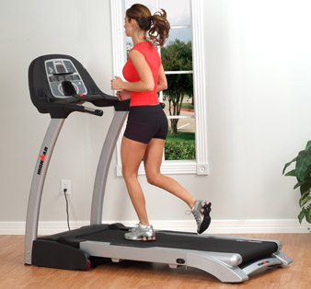
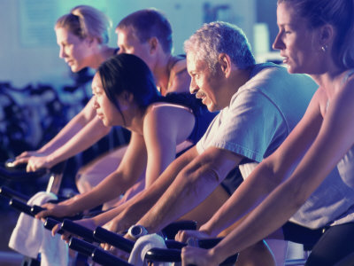
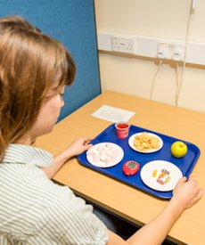
Instrumented environment
Instrumented exercise machines measure energy expenditure
Challenge: Develop instrumented table for energy intake

Slide 22
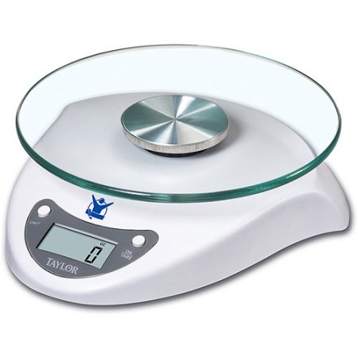
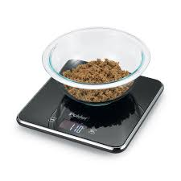
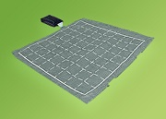
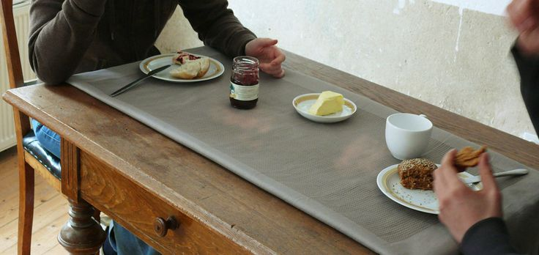
Hardware
Scales
Pressure sensor grid in tablecloth

Slide 23
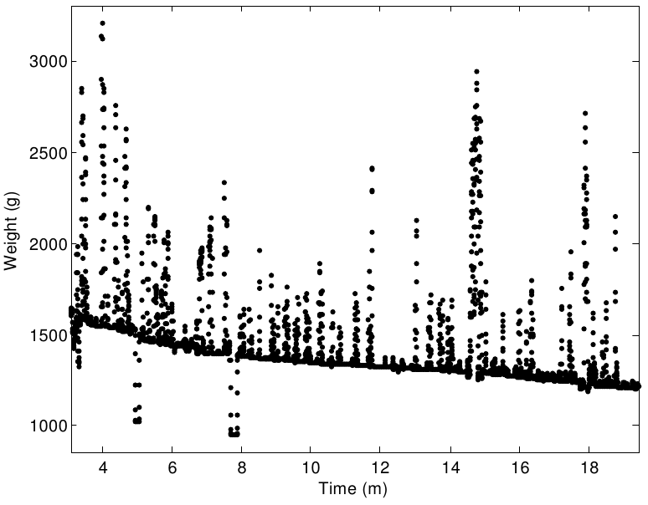
Signal Analysis
Fitted line = average consumption rate
Raw data

Slide 24
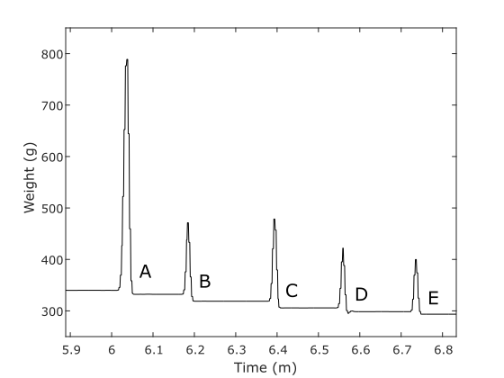
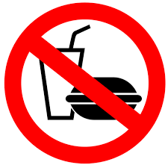
Individual Bites
Scripted/controlled eating:
No drinks
No food mass items (sandwich, pizza, etc.)
No mixing or stirring
No non-eating scale interaction
>=3 seconds between bites
Bites occur at every weight decrease
(Universal Eating Monitor algorithm)

Slide 25
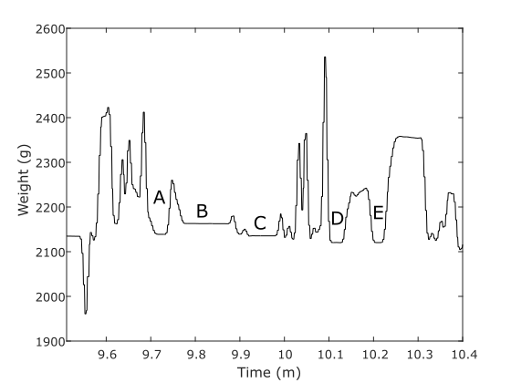


Individual Bites
Unscripted natural eating:
Bites occurred at A, C, D

Slide 26
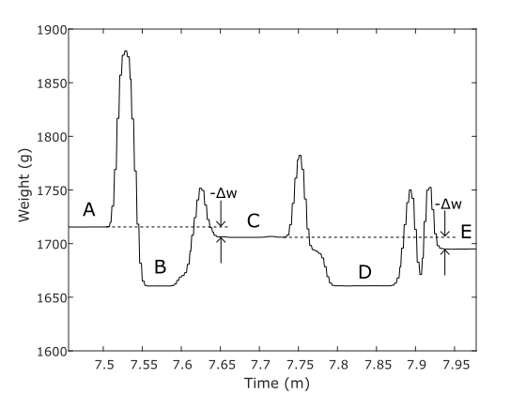
Patterns
Example: two food mass bites
Our algorithm:
Identify stable periods
Analyze surrounding context
Match to patterns for
  Single bite
  Food mass bite
  Drink bite
  Other
Bites occurred at A-B-C and C-D-E

Slide 27
Results
Cafeteria data set, 276 people, 24,088 bites
Method | Detected (valid weight) | Detected (invalid weight) | Multi (combined weight) | Missed | False positives
Universal eating monitor | 2,991 (12.4%) | 10,428 (43.2%) | 68 (0.3%) | 10,604 (44.0%) | 26,630
Our algorithm | 9,318 (38.7%) | 0 | 3,433 (14.2%) | 11,350 (47.1%) | 2,840
3x
0.1x

Slide 28

Conclusion
Wearables
Relating bites to calories
Instrumented environment

Slide 29
Acknowledgments
Collaborators
  Adam Hoover, Electrical & Computer Engineering Department, Clemson University
  Eric Muth, Psychology Department, Clemson University
  Students: Yujie Dong, Jenna Scisco, Raul Ramos-Garcia, James Salley, Mike Wilson, Surya Sharma, Ziqing Huang, Soheila Eskandari, Yiru Shen, Phil Jasper, Amelia Kinsella, Jose Reyes, Meredith Drennan, Xueting Yu, Michael Wooten, Megan Becvarik, Ryan Mattfeld
  Diana Thomas, Montclair State University
  Pat O’Neil, Weight Management Center, Medical University of South Carolina
  Graham Thomas, Brown University
  Brie Turner-McGrievy, University of South Carolina
  Corby Martin, Pennington Biomedical Research Center, LSU
Funding
  NIH NIDDK STTR 1R41DK091141-01A1, 2R42DK091141-02
  NIH NHLBI R01 HL118181-01A1
  NIH NCI R21 CA187929-01A1
  South Carolina Launch
  South Carolina Clinical and Translational Institute

Slide 30
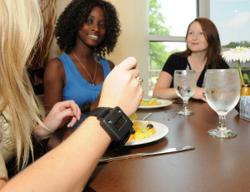
Questions?
For more info: www.ces.clemson.edu/~ahoover

