Slide 1
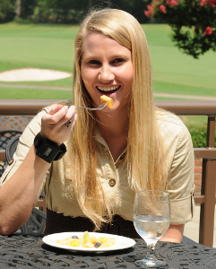

Tracking Wrist Motion to Monitor Energy Intake
Adam Hoover
Electrical & Computer Engineering Department

Slide 2

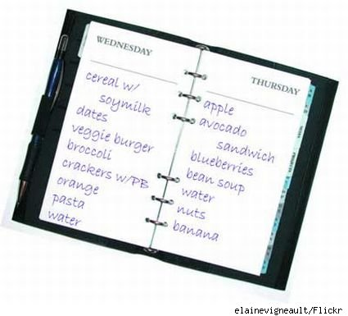

Current Tools
Manual counting
Calorie or food diary
24-hour recall (interview)
Problem #1: Not easy to use for long period of time
Problem #2: Underestimation/underreporting bias

Slide 3
Wrist Roll Motion
Wrist rolls to get food from table to mouth
Roll is independent of other axes of motion

Slide 4
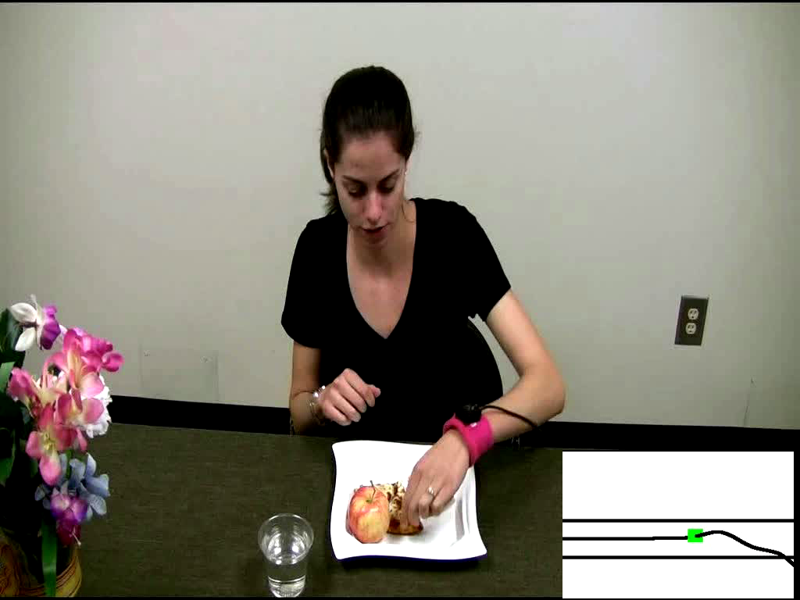
Demo of Bite Counting
Early test: 49 meals (47 participants), 1675 bites
86% bites detected, 81% positive predictive value
Talking and other actions between 67% of bites

Slide 5
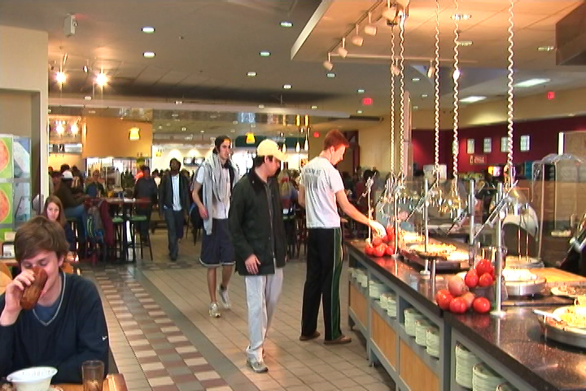
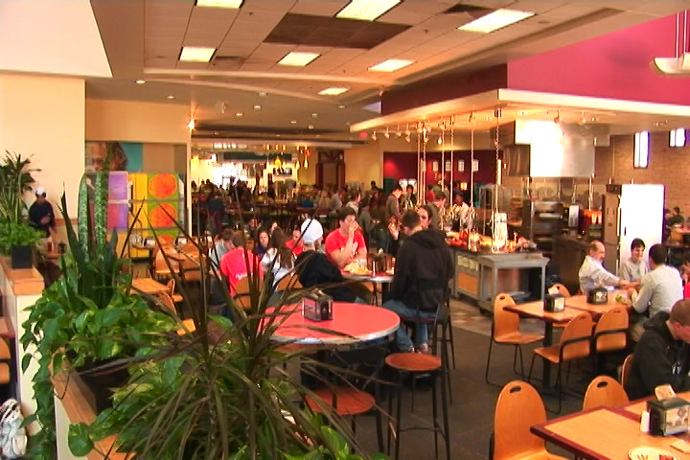
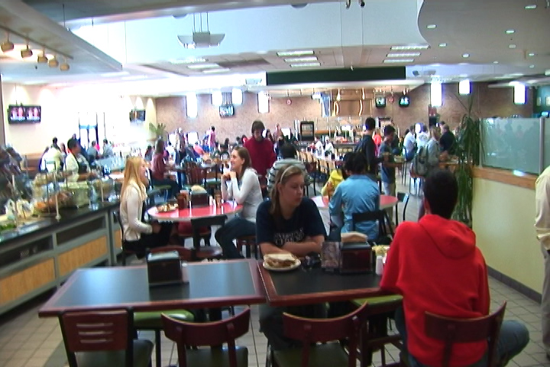
Harcombe Cafeteria
Main food service for Clemson University
Seats ~800 people
Huge variety of foods and beverages

Slide 6
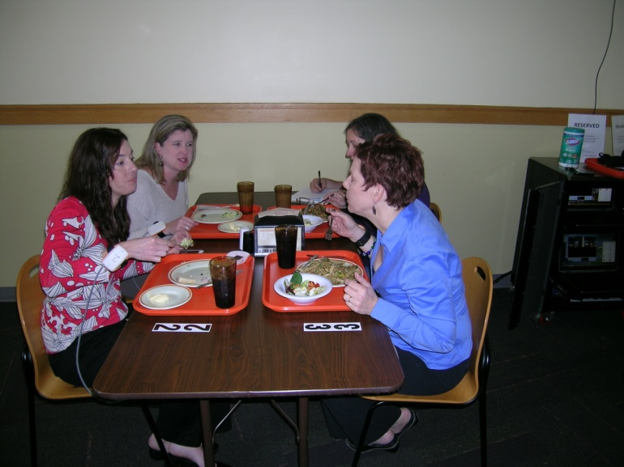
Cafeteria Experiment
276 participants (1 meal each)
380 different foods and beverages consumed
22,383 total bites
82% bites detected, 82% positive predictive value

Slide 7
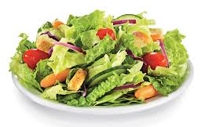
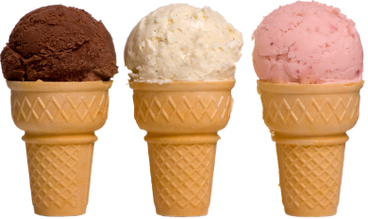
Bite Counting Accuracy
most accurate food:
salad bar (88%)
least accurate food:
ice cream cone (39%)
Accuracy increases with age (77% 18-30, 88% 50+)
Minor variations in accuracy due to utensil, container, gender, ethnicity
Currently studying this “Bite Database”

Slide 8
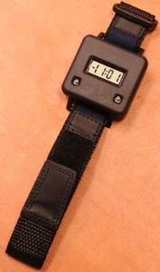

Embedded System Design
Audible alarm
On/off button
Stores time-stamped log of meals (bite count)
Lab model
Watch model

Slide 9
Bite-to-Calorie Correlation
each point = 1 meal
2 weeks data (~50 meals), 1 person

Slide 10
Correlation Test
83 subjects wore for 2 weeks, 3246 total meals
each plot = 1 person
0.4 correlation
0.7 correlation

Slide 11
Correlation Comparison
Physical activity monitors ¹
Energy expenditure
Our device
Energy intake
76% ≥ 0.4
¹ Westerterp & Plasqui, 2007, "Physical Activity Assessment with Accelerometers: An Evaluation against Doubly Labeled Water", in Obesity, vol 15, pp 2371-2379.

Slide 12
Converting Bites to Calories
kpb = kilocalories per bite
Formula based on height (h), weight (w), age (a)
kpb (male) = 0.2455 h + 0.0449 w − 0.2478 a
kpb (female) = 0.1342 h + 0.0290 w − 0.0534 a
Formula fit using 83-people 2-week data set
Tested on 276 meals cafeteria data set

Slide 13
Calories in Cafeteria Meals

Slide 14
Error: Mean and Variance

Slide 15

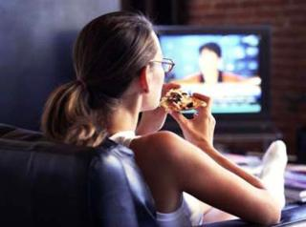
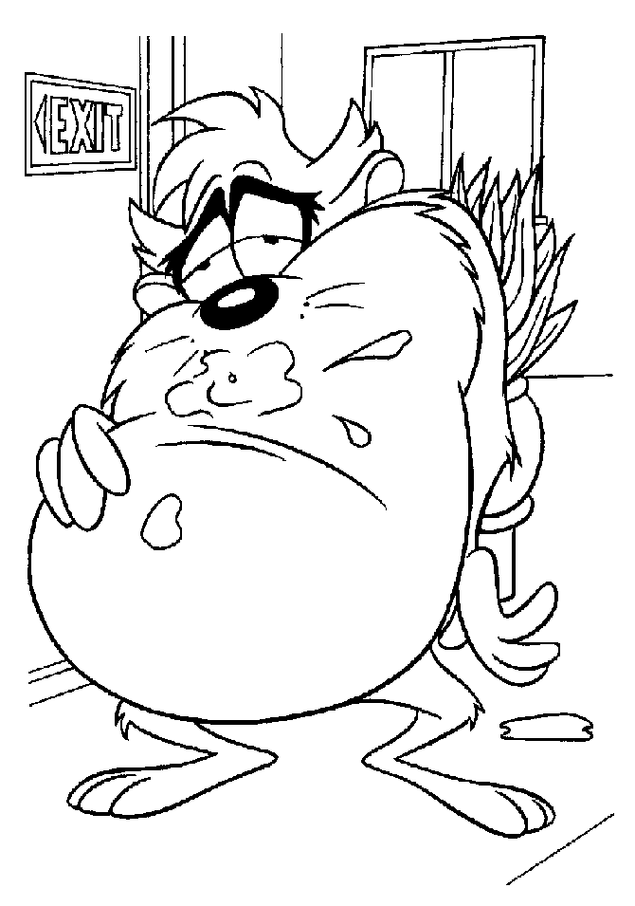
Applications
  Weight loss/maintenance
  Objective, automated monitoring
  Cognitive workload
  Offload energy intake monitoring
  Real-time feedback
  The device can give cues to stop eating

Slide 16
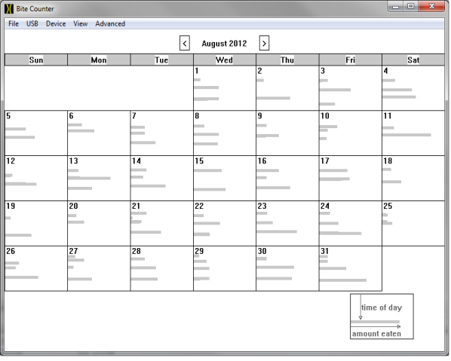
Observation Applications
time
of
day
#bites

Slide 17
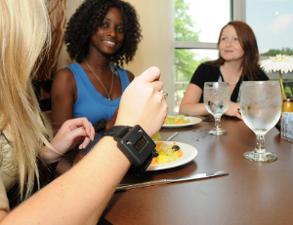
Questions?
For more info: www.ces.clemson.edu/~ahoover

