Slide 1
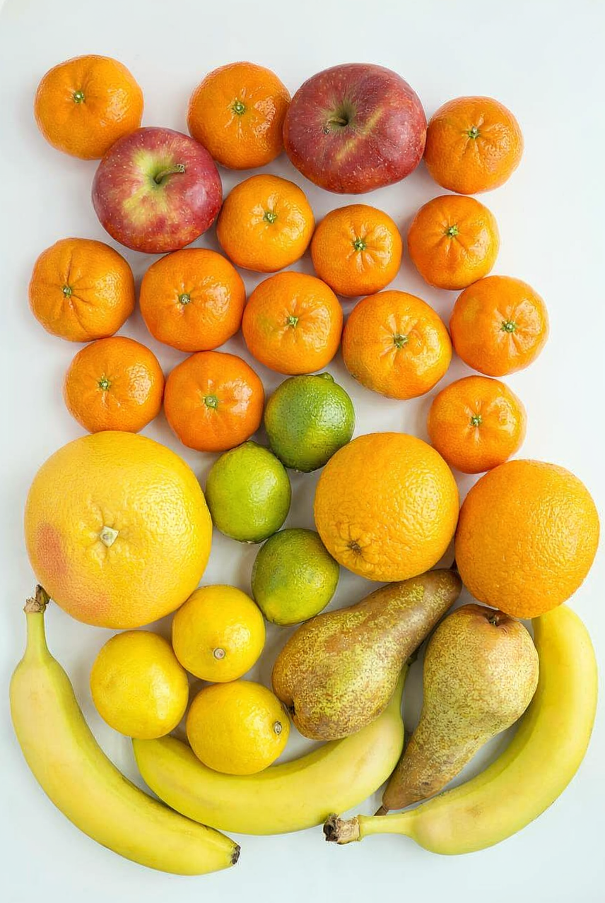
Image Data Labeling
Adam Hoover

Slide 2



Outline
No laptops, phones or screens during lecture.
Concepts in object labeling:
Labeling software
Object classes
Annotation primitives
Visualizing labels
Inter-rater reliability
Test these ideas live on your laptop camera

Slide 3
Data Labeling Software
Software | Features | Usage
CVAT (Computer Vision Annotation Tool) (Intel) | Advanced | Account required, monthly fee
Labelme (MIT CSAIL) | Advanced | Account required, monthly fee
Makesense (Open source) | Basic | Free, no account
There are several commercial image/data labeling tools, such as CVAT, Labelme, Encord, Scale AI, and Labelbox. They all require accounts, charge for their services, and tend to have advanced features that help large-scale labeling.
For this course, Makesense provides enough features for our labeling.

Slide 4
Object Classes
What do you see?
Tangerine
Apple
Lime
Grapefruit
Orange
Lemon
Pear
Banana

Slide 5
Annotation Primitives
Point
Lowest burden, least information.

Slide 6
Annotation Primitives
Rectangle
Medium effort, medium information.

Slide 7
Annotation Primitives
Polygon
Highest effort, highest information.

Slide 8
Makesense Demo

Slide 9
Checking GT
fruit-gt-points.csv
tangerine,130,147
tangerine,345,160
apple,507,183
tangerine,672,205
…
fruit-gt-rectangles.csv
tangerine,33,65,178,167
tangerine,250,75,174,169
apple,395,70,221,215
tangerine,593,111,160,167
…
How do we know if we labeled everything correctly?

Slide 10
Fruit-view-GT Demo

Slide 11
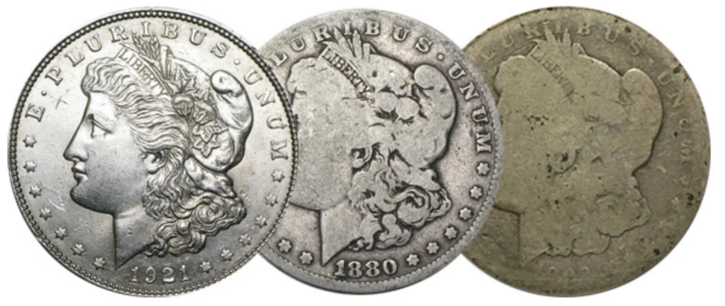
Inter-Rater Reliability (IRR)
Coin quality
Experts labeling a batch of coins
A
B
C
Coin | Rater 1 | Rater 2
1 | A | A
2 | C | C
3 | B | B
4 | B | A
5 | B | B
disagree, third rater picks
For many problems, it can be useful to have two or more people provide ground truth. The quality of the ground truth can be improved by finding places where the two raters disagree and then having a third rater decide.

Slide 12
IRR for Rater Performance
Rater 1 | Rater 2 | Rater 3 | Rater 4 | Rater 5
A | A | B | C | A
C | C | C | A | C
B | B | B | C | B
B | A | A | B | A
B | B | B | A | B
disagrees with other raters a lot
Which of these raters disagrees with others the most?
IRR can be used to monitor labeling quality between raters. A new rater can be compared to an established expert, or every rater can be compared to the group consensus. This can be useful during rater training.

Slide 13
IRR for Problem Difficulty
Coin | Rater 1 | Rater 2 | Rater 3 | Rater 4 | Rater 5
1 | A | A | B | A | A
2 | C | B | C | C | C
3 | B | B | A | C | B
4 | B | A | C | B | A
5 | B | B | B | A | B
No consensus, may be very difficult to label
Which of these coins has the worst agreement?
IRR can be used to identify problematic data. It can also be used to place a bound on how difficult the problem is in general, based on how much experts disagree.

Slide 14
In-Class Testing
Upload to canvas:
CSV content (paste into text/pdf).
Prompt(s).
Window capture showing GT display.
Output image from irr.py.
Download the fruit.png image from the course website. Label it 3 times using makesense.ai: all bananas using polygons, all tangerines using rectangles, and all fruits of every type using points. Save each as a separate .csv file.
Use your LLM to write code to view all your GT. Have it collate the 3 files, determining which type is available for each object. Only display GT for one fruit at a time, and use keypresses to scroll through them. Use different colors and/or text overlays for each class.
Create 3 errors in your points GT file: remove one, add an extra point at a non-fruit location, and change the class label of a fruit so it is wrong. Download the irr.py program and fruits-gt-points.csv from the course website, and run it against your GT to see rater differences.

