Slide 1
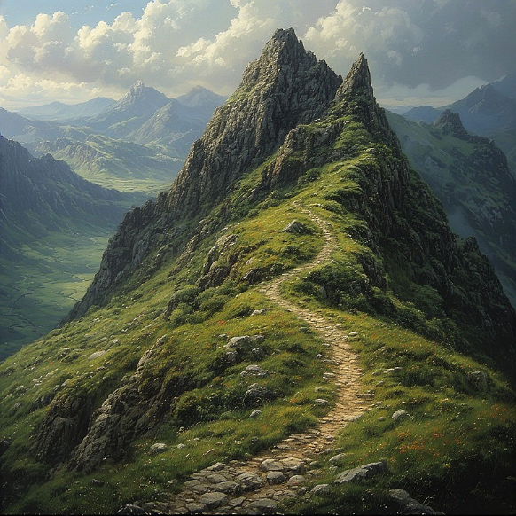
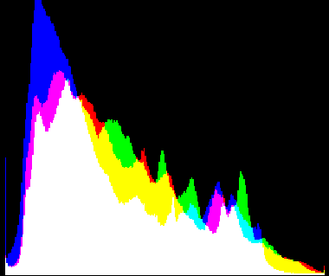
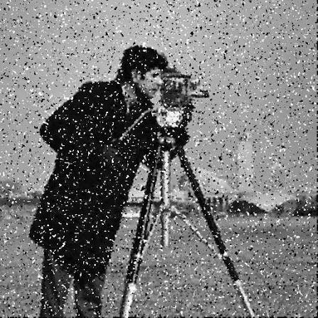
Histograms, Image Noise, Smoothing
Adam Hoover

Slide 2



Outline
No laptops, phones or screens during lecture.
Some basic image operations:
Histogram
Thresholding
Histogram equalization
Noise
Window size
Gaussian distribution
Noise types
Test these ideas live on your laptop camera

Slide 3
Histogram
pixel
value
count
0
3
0
1
0
1
4
Frequency (count)
3
1
0
2
1
1
1
2
3
1
image
histogram (array)
0
3
pixel value
histogram (plot)
A histogram is a frequency analysis of values in the data

Slide 4
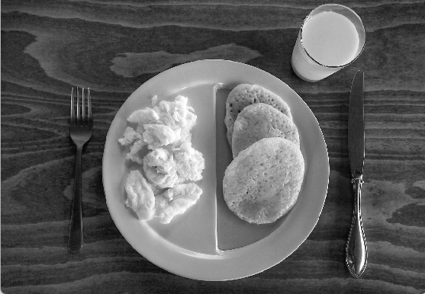
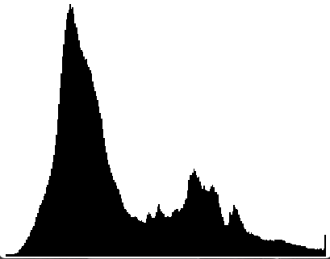
Histogram
large dark background
brighter objects in foreground
Frequency (count)
Image
0
255
Greyscale intensity
A histogram can highlight features of the data. What does this histogram show?

Slide 5
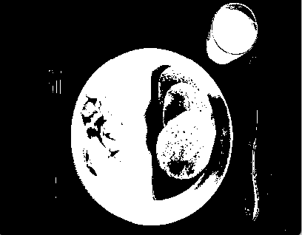
Thresholding
image
threshold (~120)
thresholded image
All pixels above the threshold are set to 255 (white),
all pixels below are set to 0 (black).
This is called background/foreground separation.

Slide 6
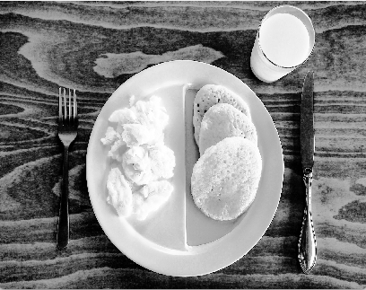
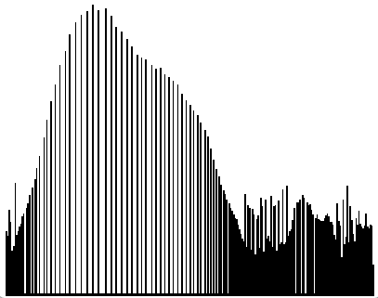
Histogram Equalization
image
histogram
Histogram equalization tries to make the frequency distribution uniform (flat).
The image more fully uses the complete range of pixel values.

Slide 7
Noise
125
153
135
151
132
125
153
135
151
132
115
151
214
95
123
115
151
214
95
123
97
135
17
99
99
97
135
186
99
99
128
15
172
115
135
128
15
172
115
135
86
134
135
116
128
86
134
135
116
128
125
153
135
151
132
125
153
135
151
132
115
151
214
95
123
115
151
255
95
123
97
135
186
0
99
97
135
186
99
99
128
15
172
115
135
128
15
172
115
135
86
134
135
116
128
86
134
135
116
128
image
Are there any pixel values here that stand out?

Slide 8
Window Size
125
153
135
151
132
125
153
135
151
132
115
151
214
95
123
115
151
214
95
123
97
135
17
99
99
97
135
186
99
99
3 x 3 window
128
15
172
115
135
128
15
172
115
135
5 x 5 window
86
134
135
116
128
86
134
135
116
128
7 x 7 window
125
153
135
151
132
125
153
135
151
132
115
151
214
95
123
115
151
255
95
123
97
135
186
0
99
97
135
186
99
99
128
15
172
115
135
128
15
172
115
135
86
134
135
116
128
86
134
135
116
128
image
Window = where to calculate statistics on center pixel.
Small windows work locally, may not fully capture statistics.
Large windows have more context, but may extend into other stuff in image.
Best window size is application dependent.

Slide 9
Window Statistics
97
135
186
97
135
186
97
135
186
128
15
172
128
15
172
128
15
172
86
134
135
86
134
135
86
134
135
Mean = 121 (97+135+186+128+15+172+86+134+135) /9 = 121
Median = 134
Mode = 135
Different statistics are better for different kinds of noise.
Random noise? => mean
Salt and pepper noise? => median
Threshold/segmentation noise? => mode

Slide 10
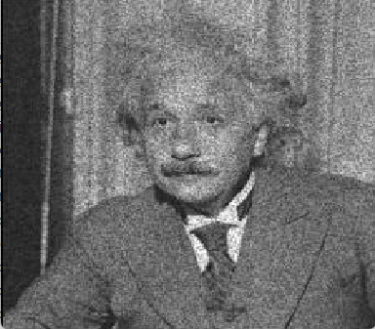
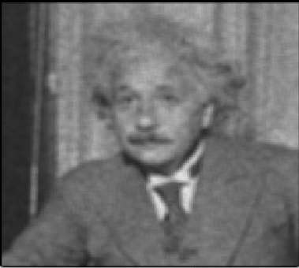
Noise Type: Random
image with noise
after smoothing
Mean is good for eliminating random noise.
But do you notice anything else about the result?

Slide 11
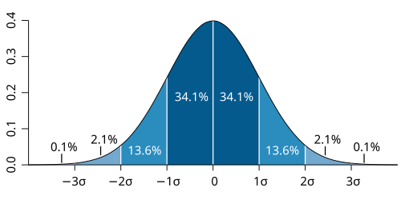
Noise Distributions
1/n
0
n-1
uniform distribution
normal (Gaussian) distribution
Weights all values in window equally
Weights values in center higher than values towards edges

Slide 12
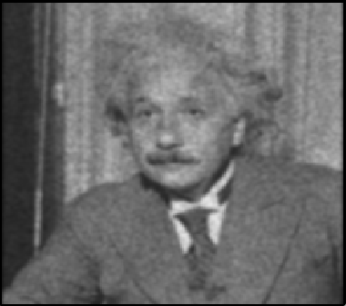
Mean vs Gaussian Smoothing
image with noise
mean smoothing
Gaussian smoothing
Which looks better to you?
Lots of noises in the world are Gaussian.
Mean smoothing is faster, and if noise is “small”, can be similar.
Best choice depends on application.

Slide 13
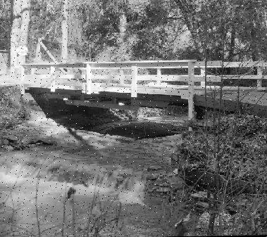
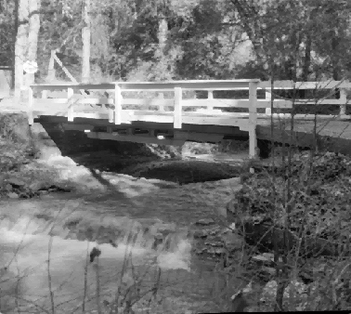
Noise Type: Salt And Pepper
image with noise
after smoothing
Median is good for eliminating sensor-dropout values (high or low)

Slide 14


Noise Type: Threshold/Label
before
after smoothing
Mode is good for “filling in” and “erasing” small imperfections

Slide 15
In-Class Testing
Upload to canvas:
Prompt.
Prompt, image save.
Prompt(s).
Image save.
Prompt, image save.
Prompt, image save.
Ask your LLM to write python code using OpenCV to read and display live video. This is your baseline.
Next try to display a histogram. Aim your camera at something with a solid color. Can you see it in the histogram?
What if you try greyscale instead of color? Is it easier to overlay the histogram in the same image, or display it in a second window? Using RGB or some other color model?
Next try to add one of the noise types to your live webcam feed. Can you see it? Adjust as necessary.
Lastly, ask your LLM to implement one of the smoothing techniques. Which works best on the noise you tried?

