Slide 1
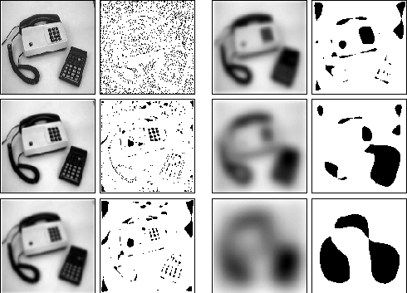
Hysteresis and Scale Space
Adam Hoover

Slide 2

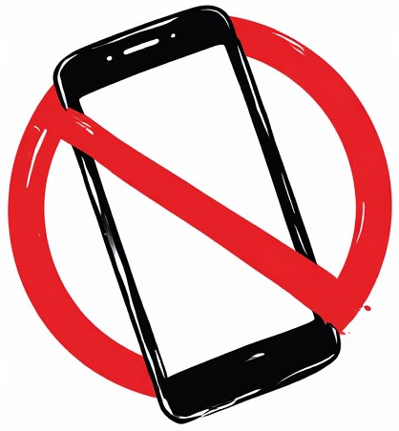

Outline
No laptops, phones or screens during lecture.
Some basic image operations:
Pixel convolution
Image convolution
Kernels (filters)
Edges and gradients
Laplacian operators
Test these ideas live on your laptop camera

Slide 3



Threshold Selection
$$I$$
object
noise
$$T_{1}$$
$$T_{2}$$
detection using T₁
detection using T₂
Sometimes no good threshold can be found. In this case, T₁ detects only part of the desired object. T₂ detects the whole object but also noise.

Slide 4
Hysteresis (Dual) Thresholding
$$I$$
object
noise
$$T_{1}$$
$$T_{2}$$
x
Hysteresis thresholding requires a pixel either be above T₁
or above T₂ and contiguously connected to a pixel above T₁
detection
Hysteresis thresholding is an excellent tool for suppressing noise and improving foreground detection.

Slide 5

Gradient Scale
gradient width
two gradient widths
$$I$$
A small width window finds a strong gradient. Wider windows do not.
A small width window finds a moderate gradient. A wider window finds a stronger gradient.
In some applications it may not be clear what size window to use for processing (for smoothing and/or gradient detection).

Slide 6

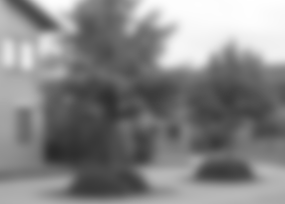
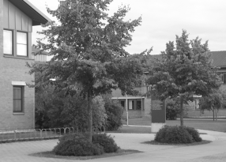
Scale Space Example
How many objects do you see?
What are they?
How about now?
And now?

Slide 7









Scale Space
$$k\left[r,c,σ\right]=\frac{1}{2πσ}e^{−(r^{2}+c^{2})/2σ}$$
original image
Gaussian smoothing $σ$=1
Gaussian smoothing $σ$=4
Gaussian smoothing $σ$=16
Gaussian smoothing $σ$=64
Gaussian smoothing $σ$=256
Analyzing an image at different scales reveals different features.

Slide 8
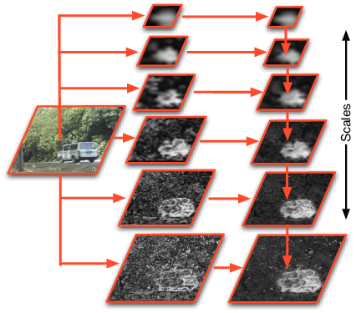
Scale Space Processing
Truck on road surrounded by trees
Scale space processing combines features from multiple scales into final result.

Slide 9
In-Class Testing
Upload to canvas:
Prompt(s).
Image save.
Prompt(s).
Image save.
Prompt(s).
Image save.
Ask your LLM to write python code using OpenCV to read and display live video along with Laplacian gradients. Threshold the gradients. You can try in a separate panel, or overlaid somehow. Add a GUI element that lets you interactively change the threshold.
Now ask it to adjust the code to use hysteresis thresholding. Use 2 GUI elements to control. Try to get the program to display solid, contiguous edges that are obvious, while suppressing as many minor edges as possible.
Write new code that displays the original video plus 3 versions Gaussian smoothed at different sigma scales. Try to get it to show an extreme range of smoothing, from none up to almost completely blurred. What happens at the extremely large range of smoothing? Is there anything you can think of to improve performance?

