Slide 1
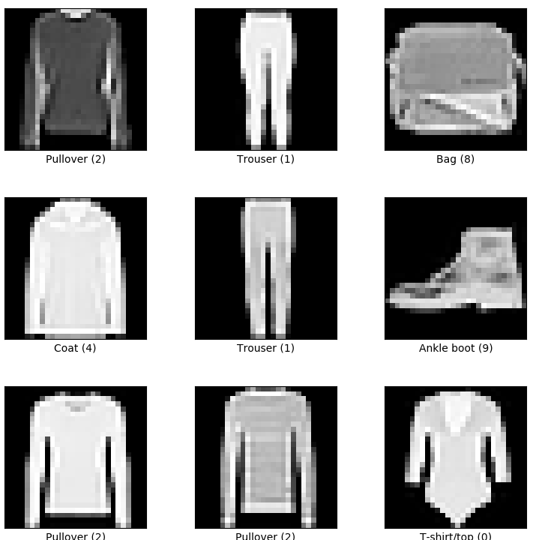
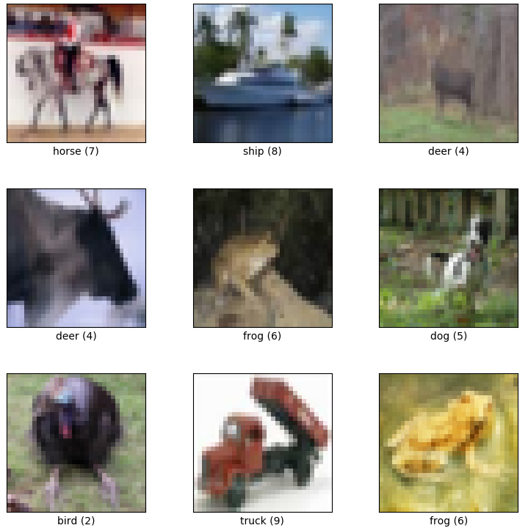
Image Classification
Adam Hoover

Slide 2



Outline
No laptops, phones or screens during lecture.
Machine learning concepts:
Layered learning
2-layer live demo
Image classification layers
Hardware and software
When to use ML vs classic CV
MNIST and CIFAR10(small)
Test these ideas live on your laptop camera

Slide 3
Layers
0
2
1
0
1
1
1
-1
0
-1
1
1
2
-1
0
3
0
1
input data
0
1
7
5
-1
2
3
4
0
layer 1
-6
3
4
layer 2
5
layer 3
Classifier can have multiple layers of weights
Early layers learn low-level features, deeper layers learn feature patterns
Classifier design depends on problem

Slide 4
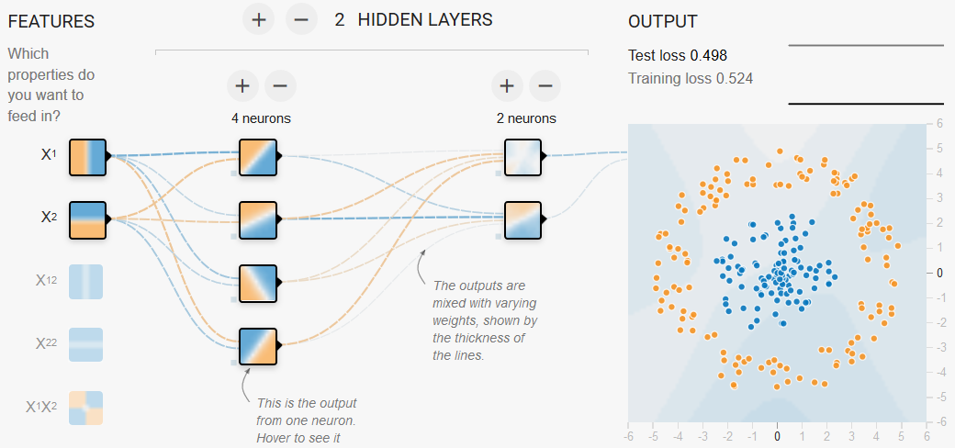
Live Demo
“playground” (http://playground.tensorflow.org/)
two classes (orange, blue), two features (x, y)
two layers (4 weights, 2 weights)

Slide 5
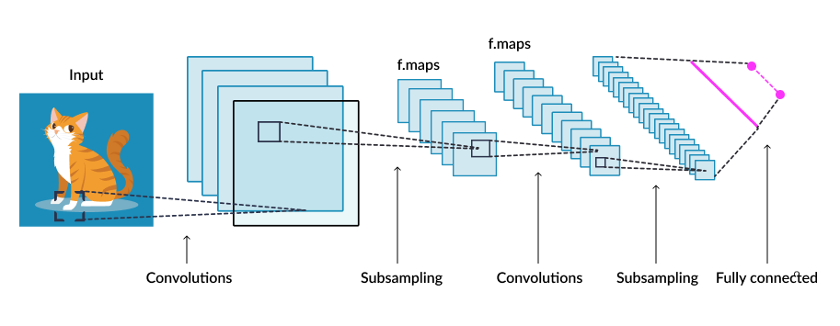
Images
Image analysis uses 2D filters of different sizes in multiple layers

Slide 6
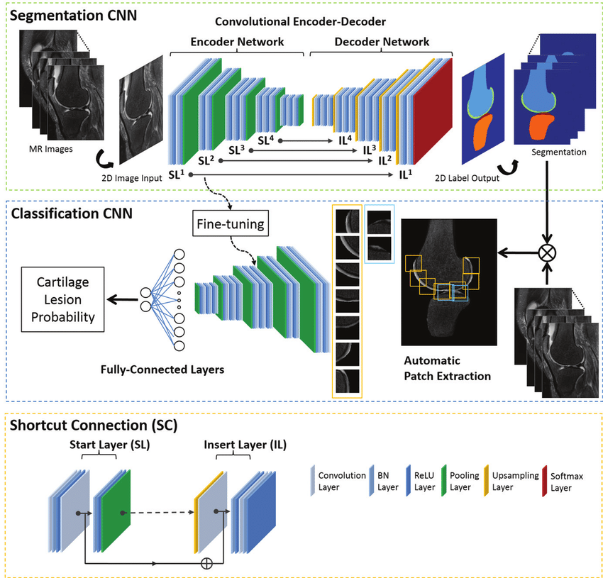
Layer Types
Different types of layers provide different calculations:
Fully connected = all input feeds to output
Convolution = local window feeds to output
Recurrent = input + previous output feeds to next output
Many other types

Slide 7
Example Classifiers
Deep learning classifiers can have complex series of layers and connections depending upon the specific problem

Slide 8
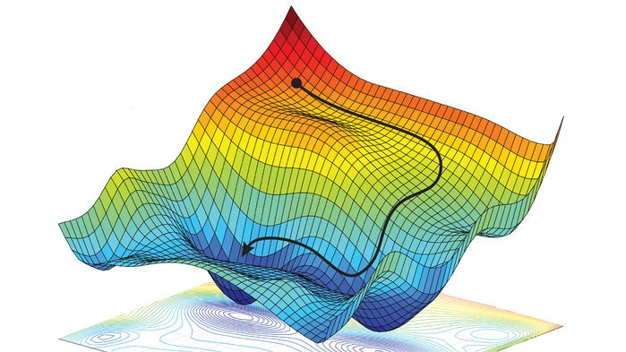
Multidimensional Search
Classifiers learn lots of weights simultaneously
Number of weights = “model parameters” of classifier
Search can be complex including multiple local minima/maxima
Training can take days or longer …

Slide 9
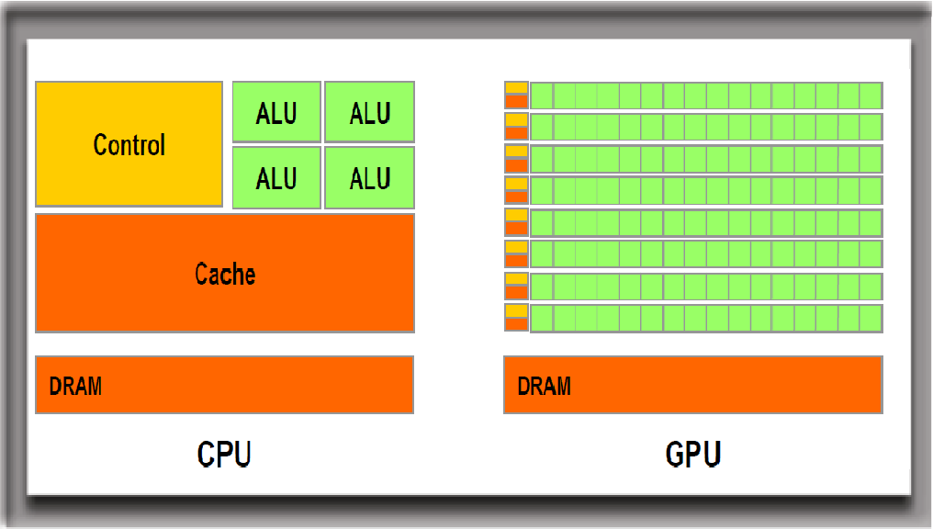
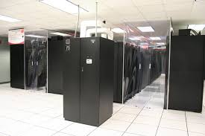
Hardware
GPUs are ideal for deep learning
  Highly parallelizable matrix math
Cluster computing is common for deep learning
  Clemson’s Palmetto cluster

Slide 10
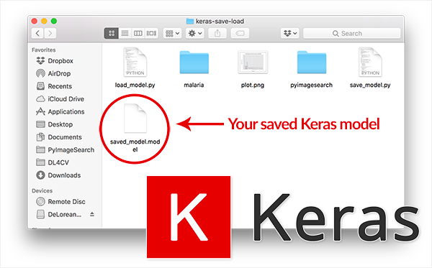

Programming Language
Classifier training done using Python programming
Classifier models (saved weights) can be loaded from a file into any program and used for new classifications (C, Python, Android, …)

Slide 11



Software Packages
TensorFlow (Google) most popular
Keras simplifies TensorFlow
PyTorch most popular with experts (scientists)
Comparison of packages

Slide 12
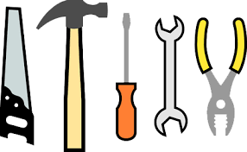
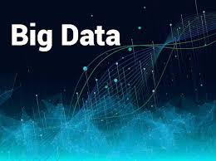
When to use?
Deep learning is just another tool
Don’t use it for every problem!
Good when features/patterns are complex
  Don’t use for simpler problems!
  Requires “big data” (lots of labeled samples)
  If you don’t have data, forget it

Slide 13
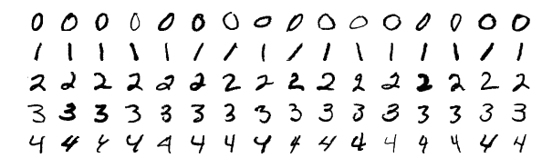
MNIST Image Classification
“MNIST” (https://www.tensorflow.org/datasets/keras_example)
The “hello world” problem for deep learning
60,000 training images; 10,000 test images; 28x28 pixels per image
Takes appx 10 minutes to fully train (average computer)
How can we reduce the time for a simple test?

Slide 14
In-Class Testing
Upload to canvas:
Accuracies for epochs 1 to 5.
Prompt(s).
Image save of a failure case.
Promt(s).
Accuracy after 20 epochs.
Prompt(s).
Image save (any).
Download mnist.py from the course website. Run it for 5 epochs. What accuracy do you see across epochs?
Use your LLM to write code that uses tensorflow and opencv to train on MNIST for 3 epochs. Display the images for which classification fails, including the true class, predicted class, and confidence. Failures will not all fit on one window so use keypresses to scroll through them.
Download the cifar10-small.npz dataset from the course website. Use your LLM to write code to load it (see next slide) and train a classifier for 20 epochs, saving the model to the file cifar10-small.keras. What do you notice about the accuracy on this data compared to MNIST?
Use your LLM to write another program that reads the model file, classifies images, and displays them one at a time including the true and predicted class, and confidence.

Slide 15
Code to Load CIFAR10-small
# Load the reduced CIFAR-10 dataset
data = np.load("cifar10-small.npz")
x_train = data["x_train"]
y_train = data["y_train"]
x_test = data["x_test"]
y_test = data["y_test"]
# CIFAR-10 labels are class IDs from 0 to 9.
# Flatten them in case they have shape (N, 1).
y_train = y_train.reshape(-1)
y_test = y_test.reshape(-1)
# Normalize pixel values from [0, 255] to [0, 1]
x_train = x_train.astype("float32") / 255.0
x_test = x_test.astype("float32") / 255.0

