Slide 1
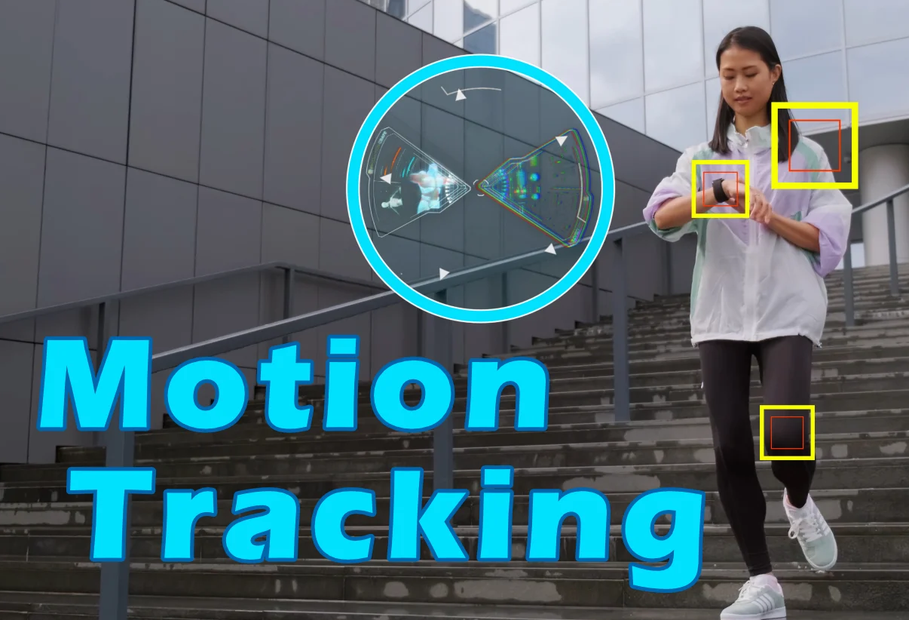
IMU Tracking Algorithms
Adam Hoover

Slide 2
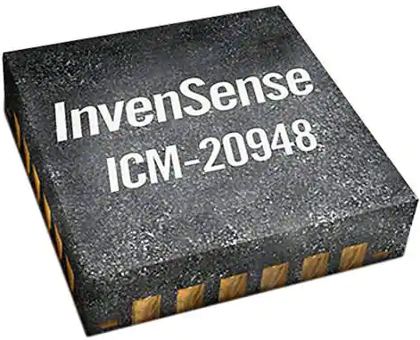
Outline
InvenSense intro
Strengths and weaknesses of IMU component sensors
InvenSense data fusion
ZUPT algorithm
AHRS algorithm
Kalman filter (and related filters)

Slide 3


MEMS IMU Manufacturers
founded 2003
focuses on motion tracking
digital sensors
chips include integrated processing
library for application programming
host conferences for developers
founded 1957
makes a lot of stuff
analog sensors
[InvenSense Conference Talk (intro)]

Slide 4
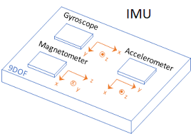
IMU Sensor Components
IMU = accelerometer + gyroscope + magnetometer
[InvenSense Conference Talk (sensors)]

Slide 5
Strengths and Weaknesses
Sensor type | What it can tell us | Problems | Strengths
Accelerometer | “down” if sensor is still “collision” from acceleration spike | Noisy (due to double integration) Human motion accelerations are small | Absolute reference point (Earth)
Gyroscope | rotation relative to starting orientation | Drifts (due to single integration) | Least noisy sensor
Magnetometer | “north” | Magnetic field distortions True north vs magnetic north Declination, dip | Absolute reference point (Earth)

Slide 6
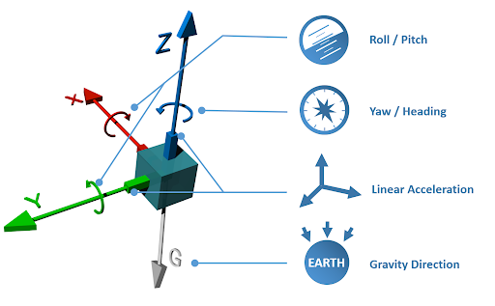
Sensor Fusion
Output:
Global (Earth) coordinate yaw/pitch/roll
Direction of gravity vector
Linear acceleration
[InvenSense Conference Talk (fusion)]

Slide 7
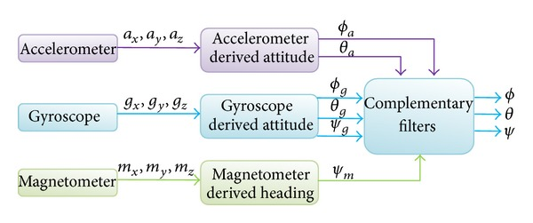
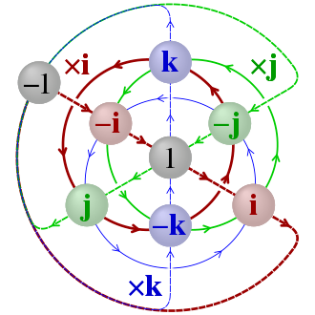
AHRS
(attitude reference heading system)
combine heading estimates from available sensors to estimate global (Earth) heading
uses quaternions (4D vectors) to avoid math ambiguity at quadrant boundaries
[reference]

Slide 8
ZUPT
(zero velocity updates)
Test for motion…
moving?
reset
heading
not moving?
ignore gyro, turn off filtering, reset heading estimate

Slide 9
Kalman Filter
(and related)
Reduces noise, improves output
Uses equations to model expected motion
  Different equations for different expected motions
“Smoothing” combines sensor measurements with model equations
Happens in “filtering” box
Taught in ECE 8540 Analysis of Tracking Systems

