Slide 1
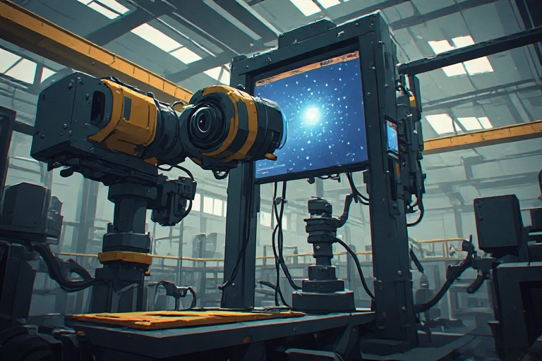
Industrial Computer Vision Inspection Systems
Adam Hoover

Slide 2



Automatic Visual Inspector
Adam Hoover, JP Kwon, Raul Ramos,
Ryan Mattfeld
Joerg Schulte, Brenden MacAskill,
Katie Jurewicz

Slide 3

BMW Spartanburg
Opened in 1994, 1,150 acre facility
$12 billion cost to build (more since then)
~11,000
employees
500,000
vehicles
per year

Slide 4

Cars are Custom
Sun roof
Roof rack
Entertainment
Seats
Engine
Proximity sensors
Tires
Thousands of custom part options

Slide 5
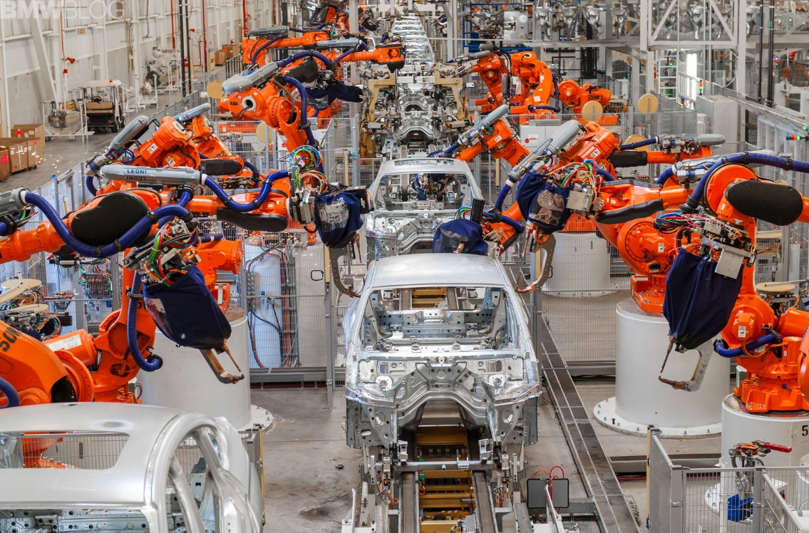
BMW Assembly Line - Robots
Reliable for repeated operations

Slide 6
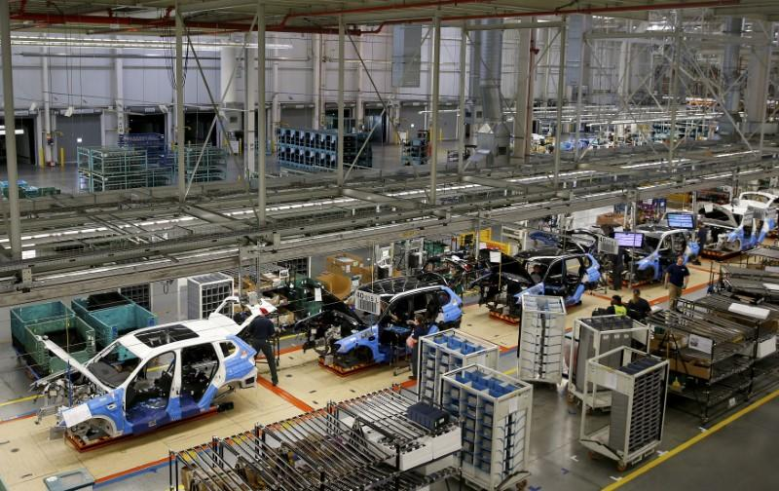
BMW Assembly Line - Humans
Better at flexible assembly

Slide 7
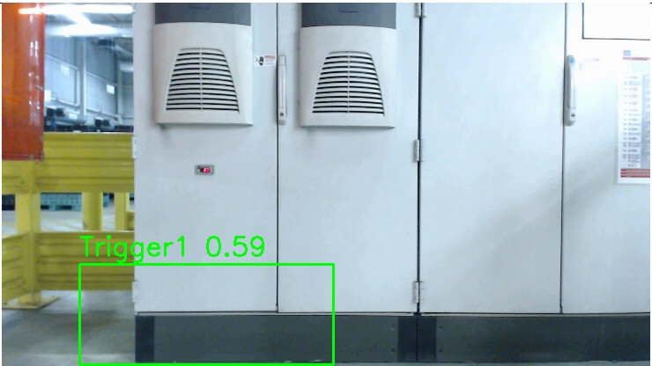
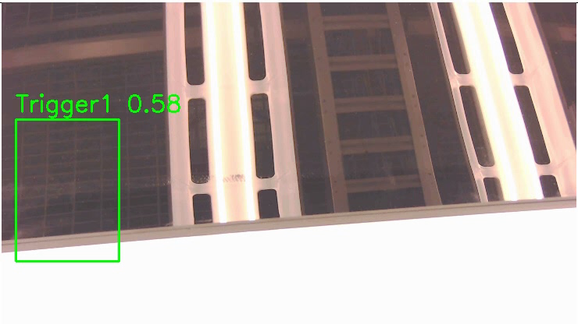
Car inspection: example problems
Check badge installation
Check tool kit installation
Badge identifies engine model
Wrong badge installed ~1-2% of cars
Hex attachment included in some cars
Depends on tire selected
Problems manually inspected by human
Human catches ~80% errors
Lots of similar problems

Slide 8

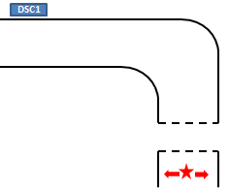
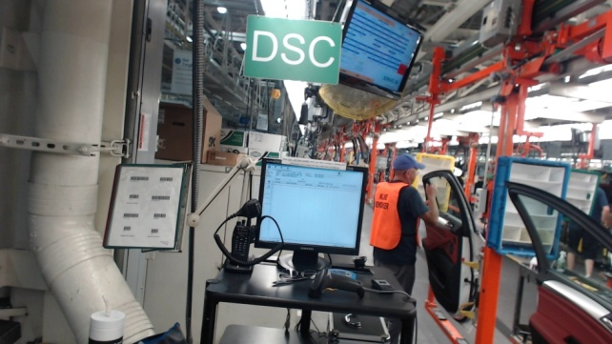
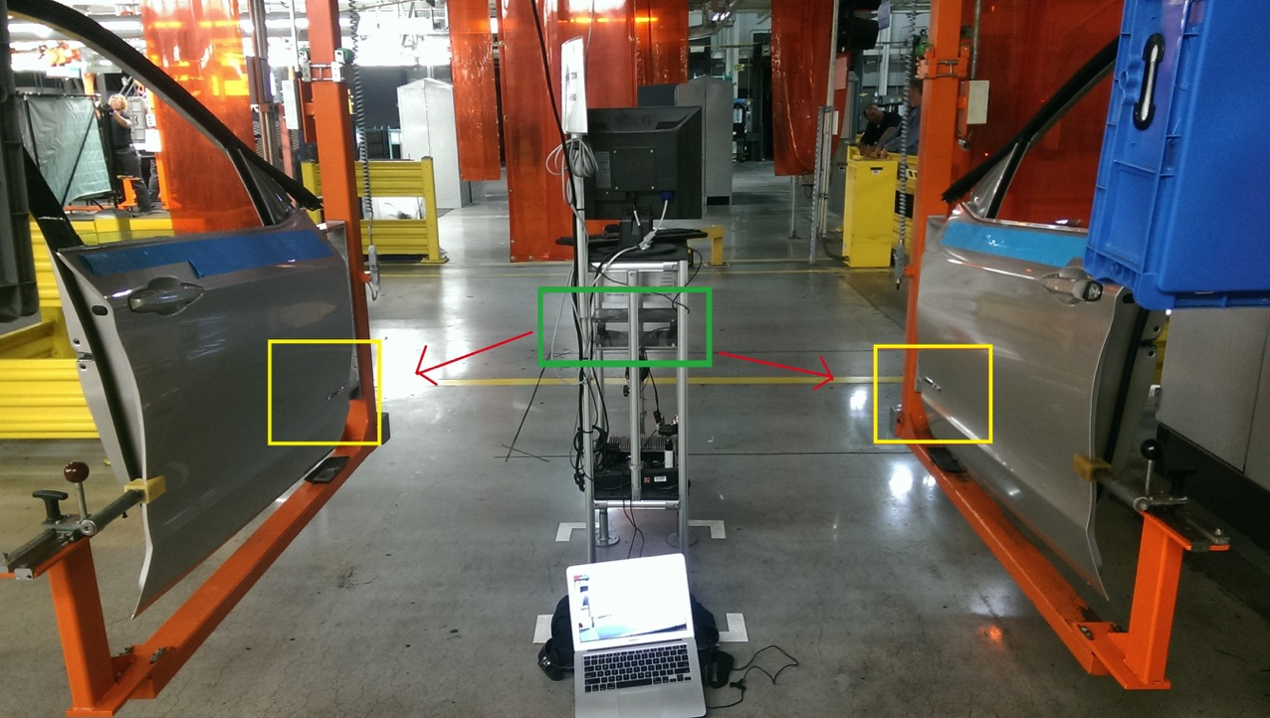
Goal: Assist Human Inspector
Result indicator
01023
workflow
01017
Goal: Human inspector is still in charge of final result; machine inspector saves time by prompting only when problem spotted
cameras
workflow
Door assembly work
IPS -> car information (options)
Site: Hall 50,
door assembly

Slide 9
System Setup

Slide 10
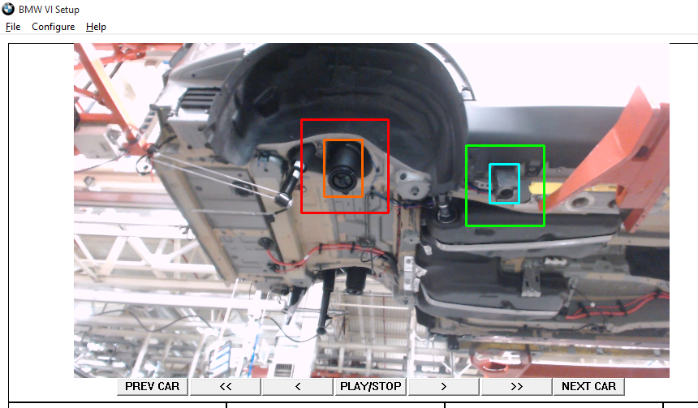
Setup Program
Replay video, pause at examples of inspection problem, draw rectangles.

Slide 11
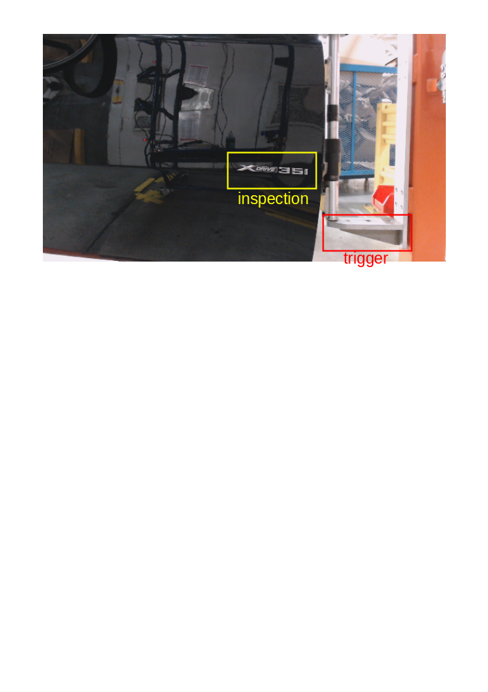
Why two search areas?
Inspection = thing to be inspected. Can vary.
Trigger = nearby part that can be expected to always be there. Does not vary.

Slide 12
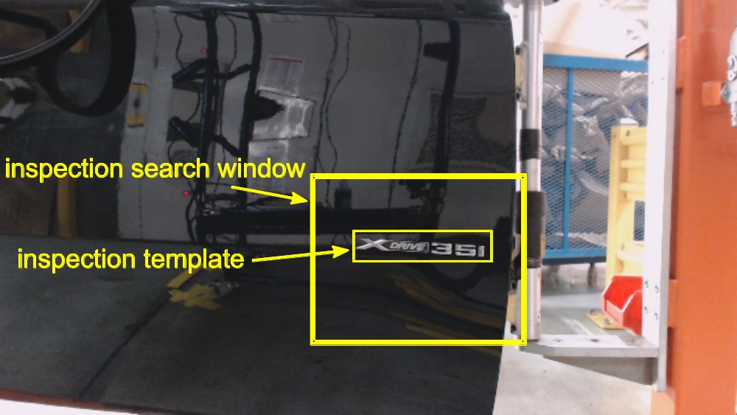
Why two rectangles?
Search window allows for variability in positioning.
Template is appearance of thing to be inspected.

Slide 13




Image processing core
Normalized cross correlation
Template
Search area
Matching score (brighter = higher)
Highest match

Slide 14
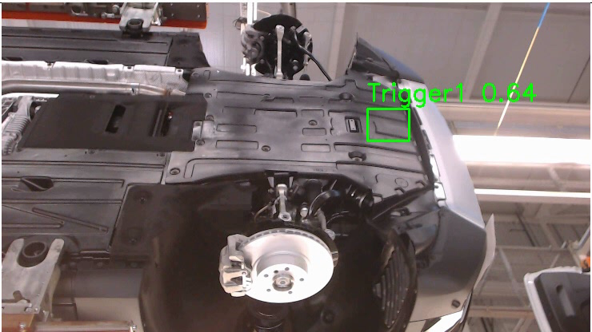
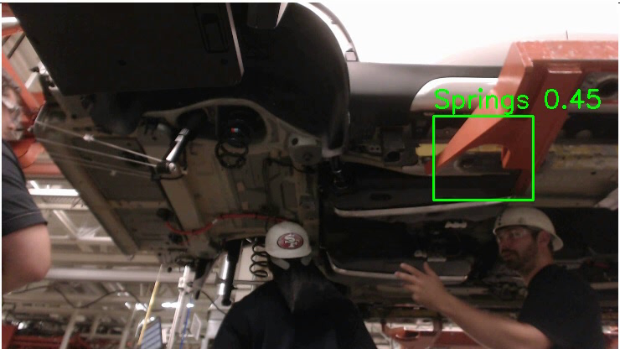
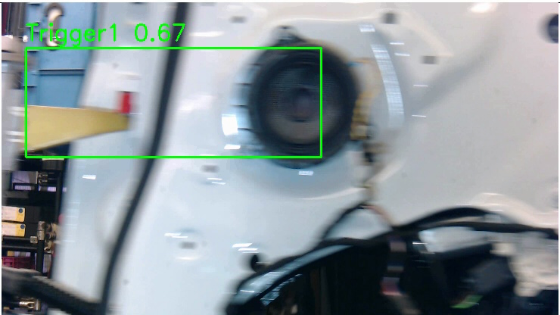
More examples

Slide 15

Image Processing Challenges - Occlusion
Inspecting shock absorbers
Inspecting bolts on underbody
Occlusion of camera or lighting (shadows) can hinder inspection process

Slide 16
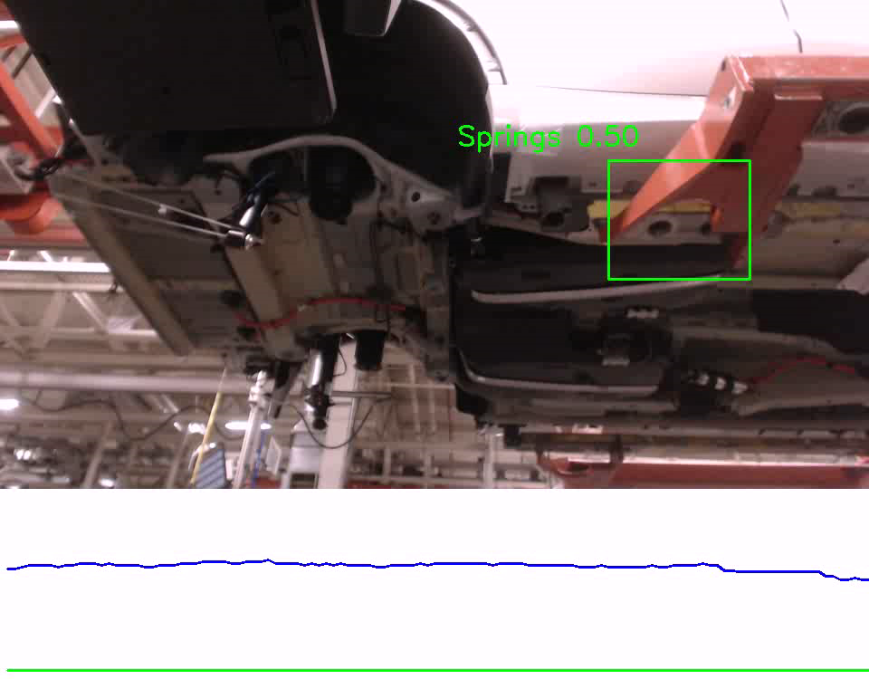
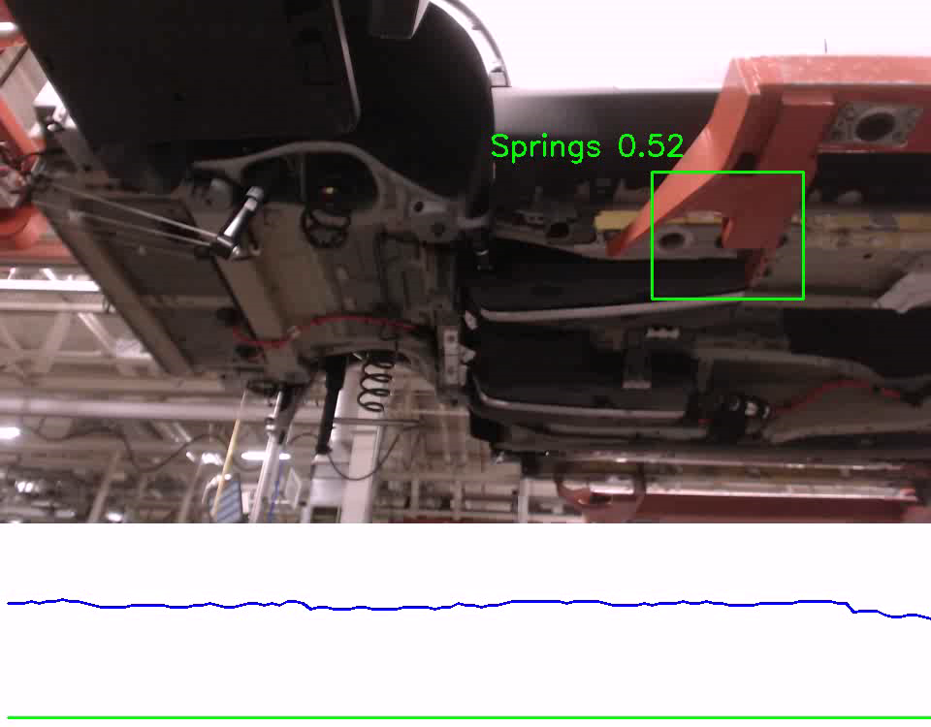
Image Processing Challenges - Occlusion
Comparison of class matching over time
No occlusion
Intermittent occlusion
Variance of class matching is a strong indicator of occlusion
Algorithm developed to use this concept to detect occlusions

Slide 17
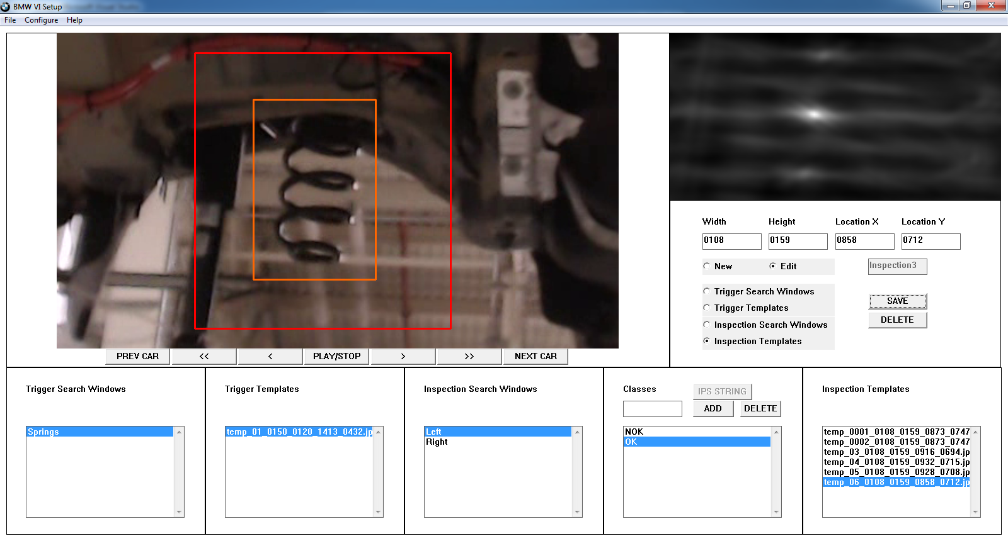
Setup Challenges for New Problems
“detectability” (single bright dot = good)
The engineer installing our system for a new problem has no computer vision expertise. We built this interface to help them visualize the quality of their setup (training data).

Slide 18
Child safety lock inspection

Slide 19
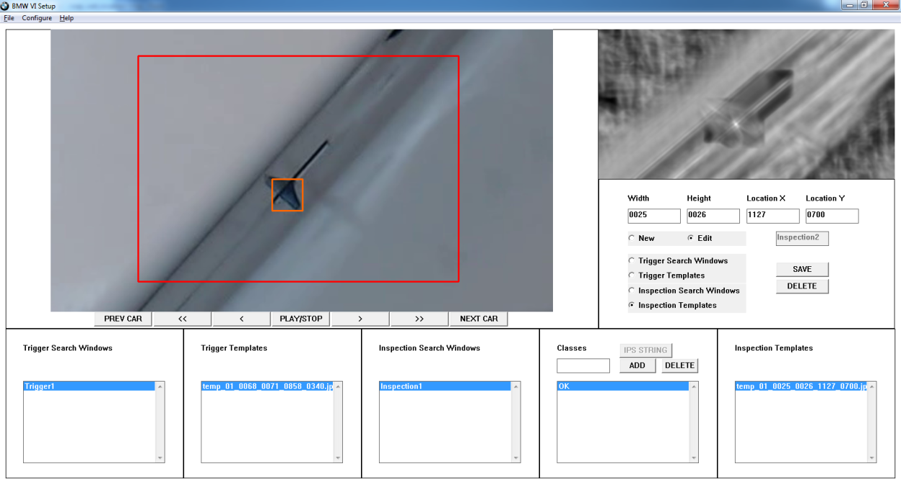
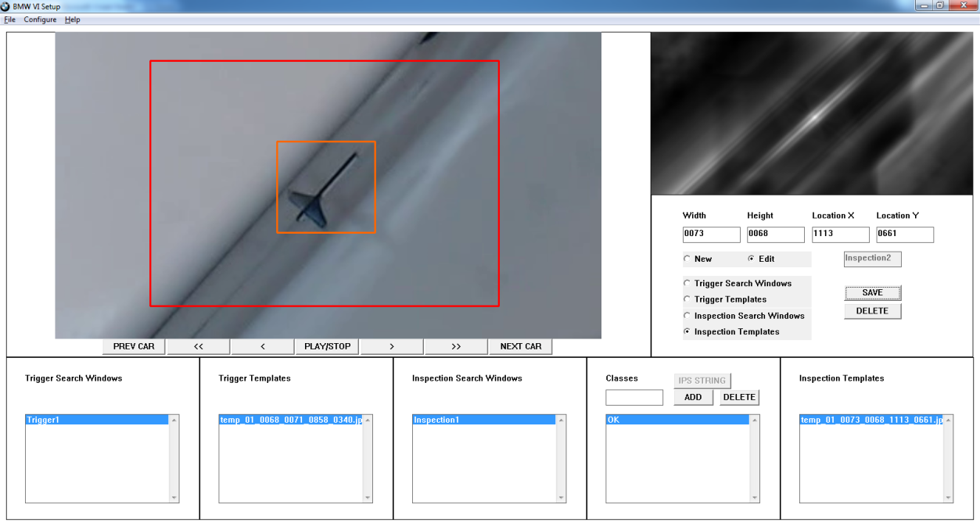
Detectability vs Window Size
Bad detectability
This template is too small and matches many areas across the whole search window.
Better detectability
This template is better, but still shows the difficulty of this inspection problem. The shape best matches in the center but partially matches in other places.

Slide 20
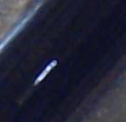
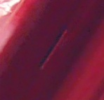
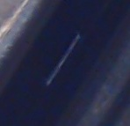
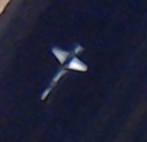
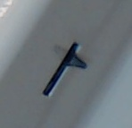
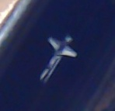
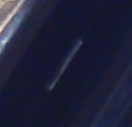
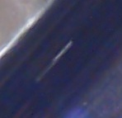

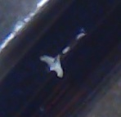
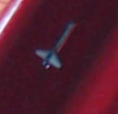
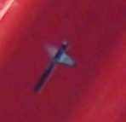
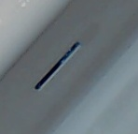
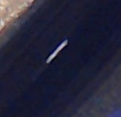

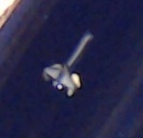
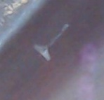
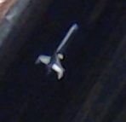
Training Data Quantity vs Class Similarity
Templates of child safety lock not present
Templates of child safety lock present
While training VI, templates are provided of each class (e.g. present versus absent). The templates should cover the variability expected (e.g. shape, placement, color).

Slide 21
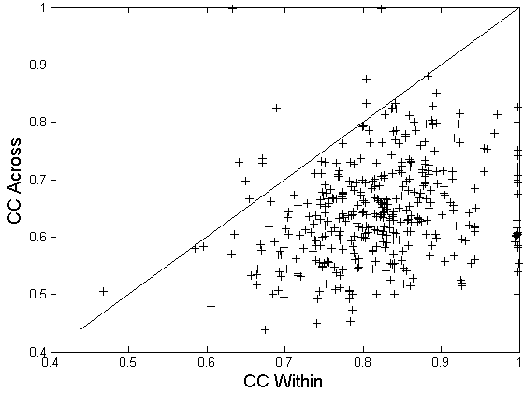
Cross-comparing all training data
Source: child safety lock, present vs absent
CC = cross correlation, defines how well each template matches within its class versus other classes
Some inadvertent training data led to diminished accuracy.

Slide 22
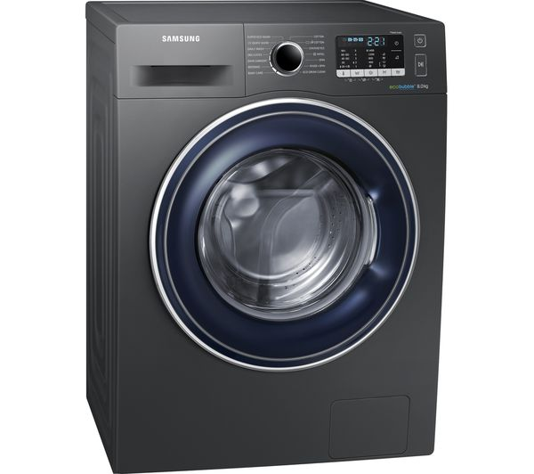


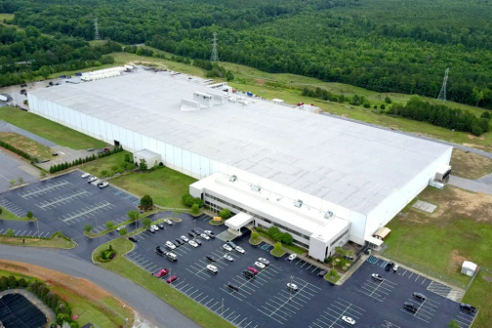
Appliance Inspection System
Adam Hoover
Surya Sharma
Ben Shumpert
Zeyu Tang
Anatole Figueroa
Simon Brown
Vihang Khare
Factory in Newberry, SC, USA

Slide 23
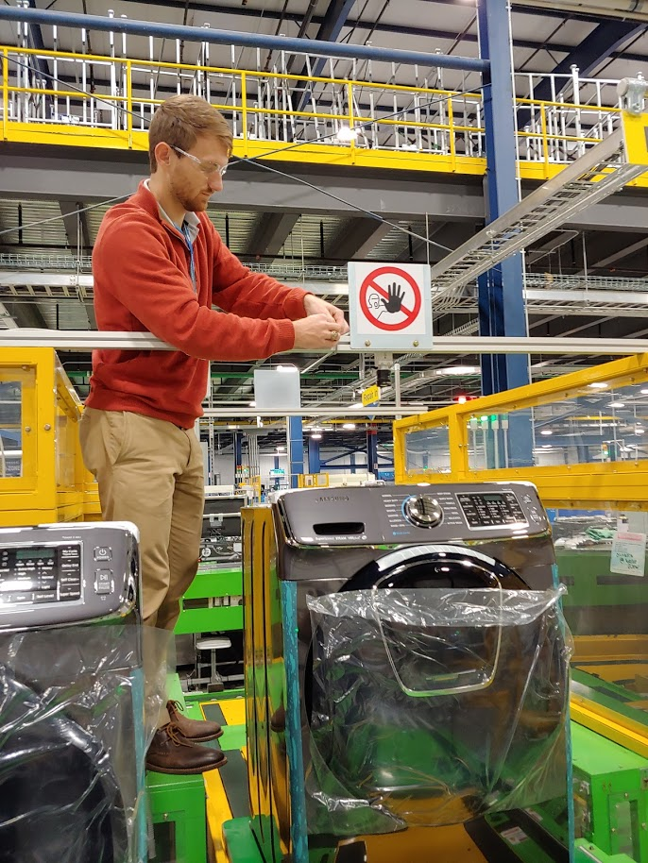
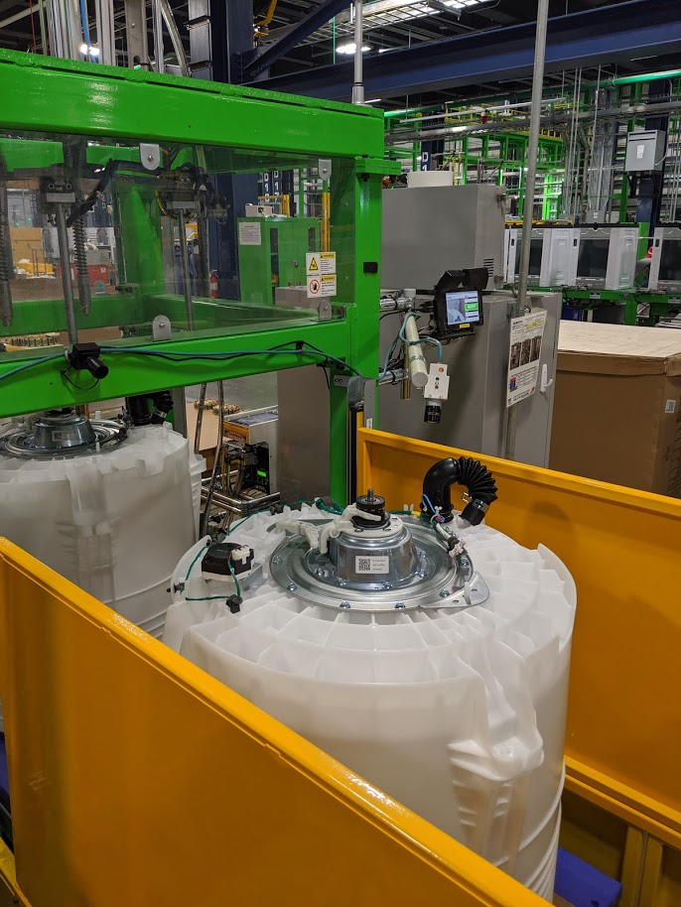
Camera locations

Slide 24
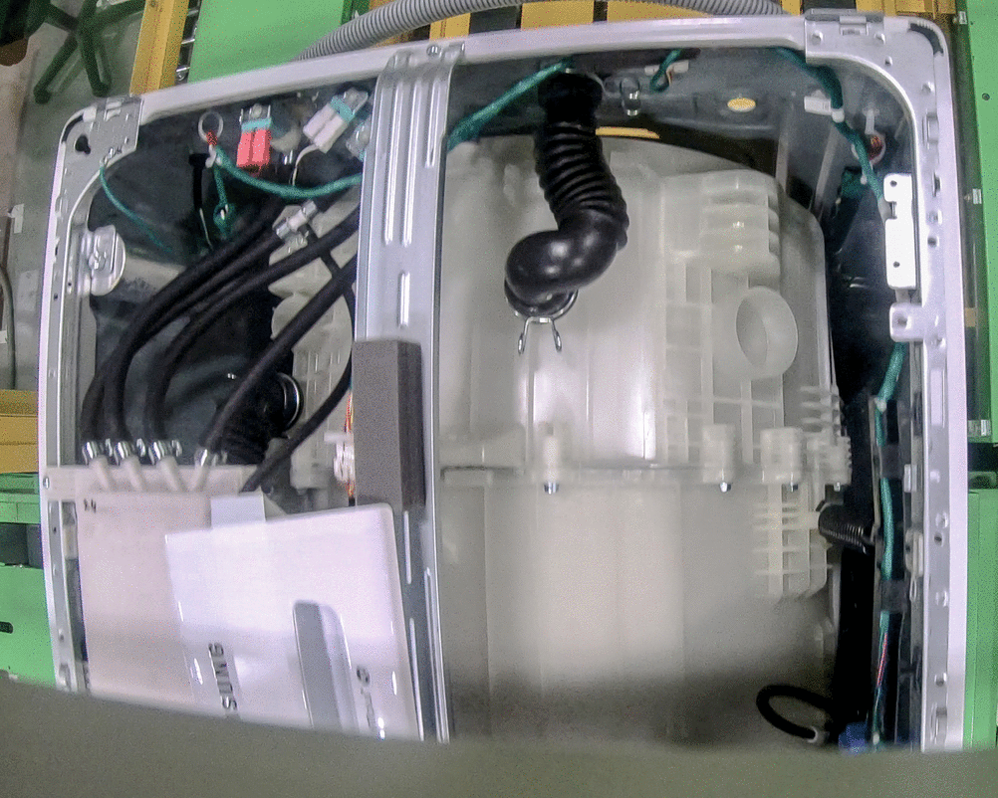
Inspection with varying appearance

Slide 25
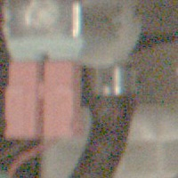
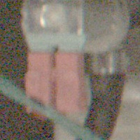
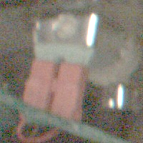
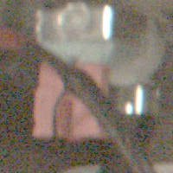
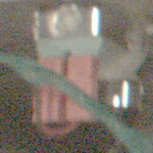
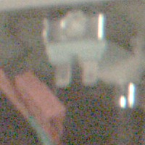
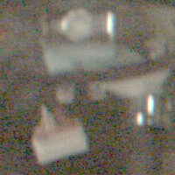
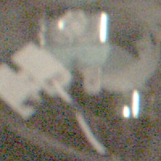
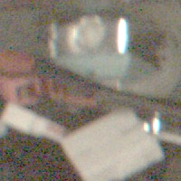

Red water valve connector
Five examples: variability in position, orientation, and occlusion
Variability when not properly installed

Slide 26

Inspection Problems
Wire Holder
White Water Valve
Red Water Valve
EMI Filter
Hose Clamp
Pressure Sensor

Slide 27

Inspection Problems

Slide 28
Results
Inspection problem | Images | Defects (manual review) | Defect rate | Percent of defects detected | False alarms per defect
EMI filter | 39,268 | 31 | 0.08% | 97% | 4
Red water valve | 38,447 | 89 | 0.23% | 98% | 1.8
White water valve | 32,250 | 83 | 0.26% | 100% | 0.1
Hose clamp | 39.268 | 31 | 0.07% | 100% | 2.5
Wire holder | 36,658 | 180 | 0.49% | 35% | 5
Pressure sensor | 13,009 | 2 | 0.02% | 100% | 0
Thermistor | 23,247 | 12 | 0.05% | 92% | 2
Screw near thermistor | 23,245 | 23 | 0.10% | 100% | 0.6
Defect types
Note this is after human inspections
Our system performance on what the humans missed
Part absent
Wrong part installed
Part not tightened
Trigger failure (washing machine not in camera’s field-of-view)
Occlusion (part completely obscured)

Slide 29



Drum ring
Installed correctly
Missing

Slide 30

Q-eye inspecting top left

Slide 31

Q-eye inspecting top right

Slide 32
Results
Inspection problem | Images | Defects (manual review) | Defect rate | Percent of defects detected | False alarms per defect
Drum ring* | 32,903 | 18,387 | 55.9% | 96% | 0.3
Upper screw assembly | 15,942 | 124 | 0.78% | 100% | 1.2
Screw 3 | 15,942 | 130 | 0.82% | 98% | 4.2
Screw 4 | 15,942 | 54 | 0.34% | 100% | 3.4
Screw 5 | 15,942 | 236 | 1.48% | 97% | 4.4
Screw 6 | 15,942 | 225 | 1.41% | 100% | 4
Screw 7 | 15,942 | 225 | 1.41% | 100% | 0.6
Defect types
Our system performance
Part absent
Part not tightened
Extra drum ring installed (double)
Trigger failure (part not in camera’s field-of-view)
*Drum ring: an associate was assigned to add the drum ring after the camera location during our data collection, which caused a large number of detects to be observed

Slide 33

NEXIS vs Q-Eye
Our NEXIS inspection system had similar success in finding defects to their Q-Eye systems, but with up to 10x less false positives.
Note: these inspection problems are MUCH easier than the variable appearance problems, which Q-Eye could not handle at all.

Slide 34




Computer Vision Across Industries
Package Routing
Chip Inspection

