Slide 1
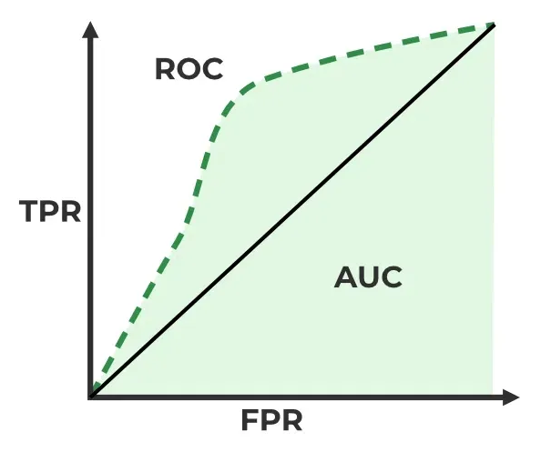
Metrics and ROC curve
Adam Hoover

Slide 2

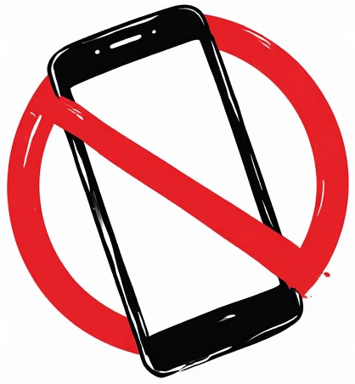

Outline
No laptops, phones or screens during lecture.
Concepts in classifier evaluation:
Ground truth
Evaluation table
Metrics
ROC curve
Confusion matrix
Test these ideas live on your laptop camera

Slide 3
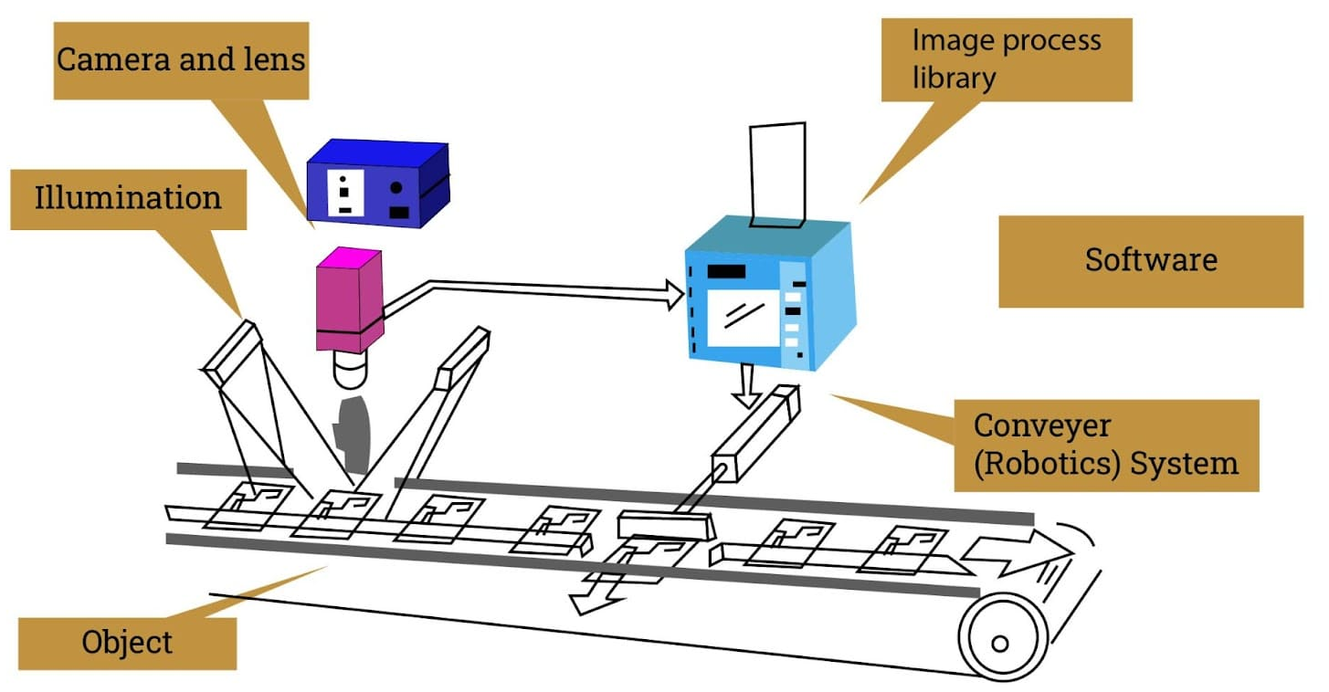
Computer Vision System
This system is evaluating objects to determine which are okay and which are defective. Defects get discarded. How do we evaluate the system?

Slide 4
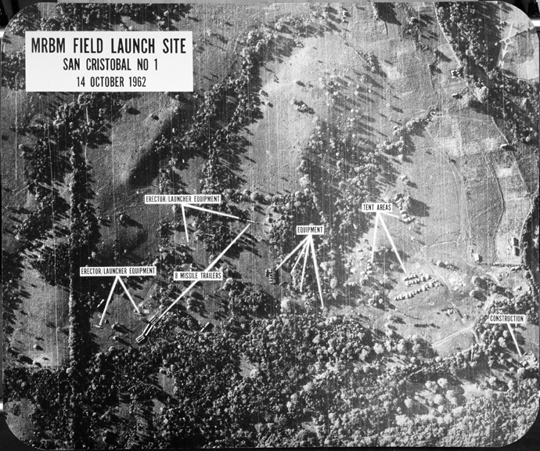
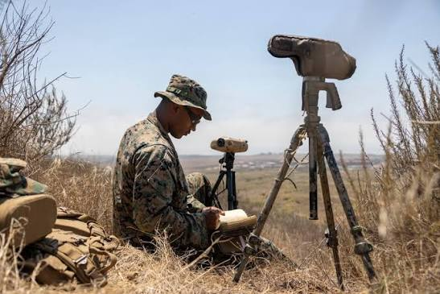
Ground Truth
The term originates from (human) analysis of satellite images. In order to confirm the analysis, intelligence agents were deployed to observe what was happening on the ground. Hence, “ground truth”.

Slide 5
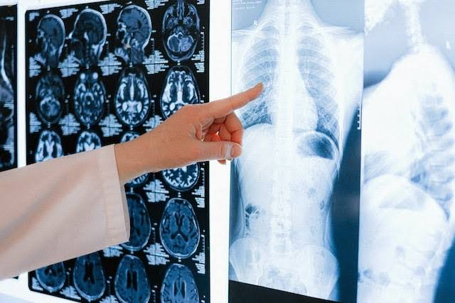
Gold Standard
In some situations, such as medicine, there is no ground truth. Instead we rely upon a “gold standard” which is the best available diagnostic test currently available, or sometimes the best human opinion available.

Slide 6
Evaluation Table
ground truth
yes
no
true positive (TP)
false positive (FP)
yes
error
system response
false negative (FN)
true negative (TN)
no
error
Evaluating a system performing a binary classification. For example, “is this object on the assembly line defective (yes) or okay (no)?”

Slide 7


Performance Metrics
ground truth
yes
no
true positive (TP)
false positive (FP)
yes
system response
false negative (FN)
true negative (TN)
no
$$TPR=\frac{TP}{TP+FN}$$
What % of the defects is being detected?
Larger = better
$$FPR=\frac{FP}{FP+TN}$$
What % of the good objects are being discarded?
Smaller = better
The most common metrics are true positive rate (TPR) and false positive rate (FPR). In the medical domain these are called sensitivity (TPR) and specificity (1-FPR).

Slide 8

When TNs are unknown
ground truth
yes
no
true positive (TP)
false positive (FP)
yes
system response
false negative (FN)
true negative (TN)
no
$$PPV=\frac{FP}{TP+FP}$$
How often is a +test result wrong as a percentage of all +test results?
Sometimes, TNs are impossible to measure (e.g. medical test for cancer, we may never determine the actual condition of everyone tested; or cybersecurity test, we may never know if the system is truly attack-free).
For these problems we measure positive predictive value (PPV).
In these scenarios, we often refer to our metrics as “recall” (TPR) and “precision” (PPV).

Slide 9

Single Metric
ground truth
yes
no
true positive (TP)
false positive (FP)
yes
system response
false negative (FN)
true negative (TN)
no
$$F1=2\frac{precision ∙recall}{precision+recall}=\frac{2TP}{2TP+FP+FN}$$
What is the balanced performance?
Performance can be measured using a single metric “F1” if the two types of wrong outcomes (FP and FN) are equally important.

Slide 10
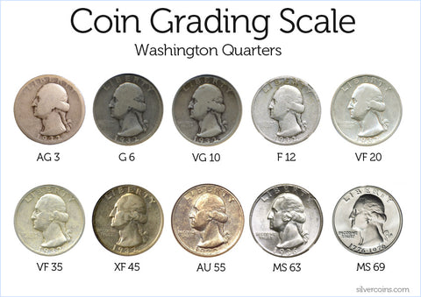
Imbalanced Classes
Assuming all coins are classified as (lower quality), what is the overall accuracy?
95%
Imbalanced classes require careful application of metrics!

Slide 11

Weighted Metrics
ground truth
yes
no
true positive (TP)
false positive (FP)
yes
system response
false negative (FN)
true negative (TN)
no
$$wAcc=\frac{wTP+TN}{w\left(TP+FN\right)+(TN+FP)}$$
Assuming TPs matter more than TNs (w:1), what is the overall accuracy?
Weighted accuracy (wAcc) can measure overall performance in a single metric if the weight between positive class and negative class is known (e.g. w:1).
In the previous slide example, w=19 (there is a 19:1 ratio of data in each class).

Slide 12
ROC Curve
Where is the “best” decision threshold for a drone recognizing a person as a combatant?
1
“knee”=balanced
TPR vs FPR at one decision threshold
TPR
Where is the “best” decision threshold for a driverless car detecting a human is crossing the street in front of the car?
TPR vs FPR at another decision threshold
0
0
FPR
1
An ROC curve plots TPR vs FPR across a variable (for example a threshold for determining if an object is defective or not).

Slide 13
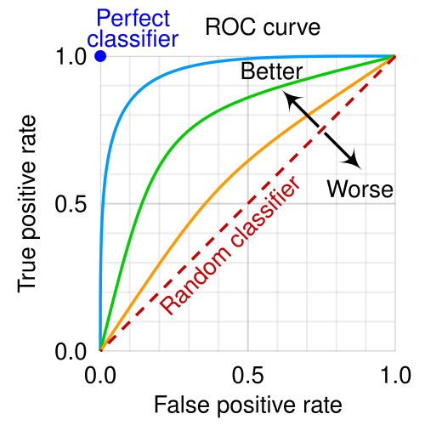
Comparing Systems (Classifiers)
Two systems can be compared by their ROC curves. “Better” is generally up-and-to-the-left, with “ideal” at the top left.

Slide 14
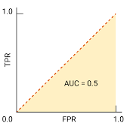
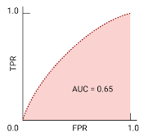
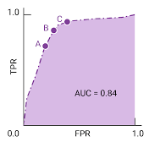
Comparing Systems (Classifiers)
ROC plots are used for visual evaluation. We can calculate “area under the curve” (AUC) for a quantitative measure. It estimates performance across all possible decision thresholds.
AUC=0.5 is “random”, assuming data is balanced. Larger values = better.

Slide 15
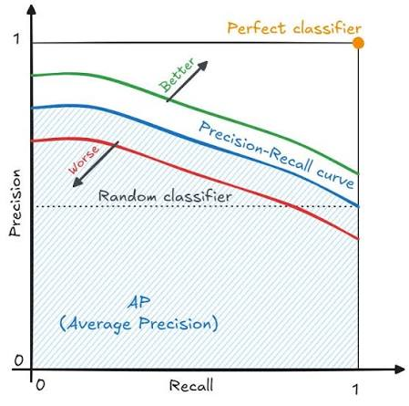
Precision-Recall Curve
A precision-recall curve is very similar to an ROC curve, but plots TPR (recall) vs PPV (precision) instead of TPR vs FPR (also note axes are switched).
The main difference is both metrics are “better” with larger values.

Slide 16
Confusion Matrix
 | ground truth
system response |  | i | l | m | n | x
 | i | 80 | 11 | 1 | 3 | 1
 | l | 15 | 85 | 1 | 3 | 2
 | m | 2 | 1 | 85 | 12 | 0
 | n | 2 | 1 | 12 | 82 | 2
 | x | 1 | 2 | 1 | 0 | 95
Where is the most confusion? Why?
Given 100 occurrences of each class in the dataset, do the system response rows all need to add up to 100?
For multi-class problems, a confusion matrix shows the number of occurrences of each ground truth class that were labeled as each class by the system.

Slide 17


In-Class Testing
Write a program that uses the template on the left to analyze the above image using normalized cross correlation. Evaluate the program performance using metrics. See next slide for details.

Slide 18
In-Class Testing
Upload to canvas:
Prompt(s).
Image save.
Prompt(s).
Image save.
Prompt(s).
Image save of ROC and precision-recall curve.
Install matplotlib:
python -m pip install matplotlib
Ask your LLM to write python code using OpenCV to read the template image “puzzle-top-border-piece” and use normalized cross correlation on “puzzle”. Look at the NCC output (no detections yet).
Threshold the NCC output so that only the 3 strongest locations are retained. What do you observe? How about the 10 strongest locations. What do you observe?
Have your program read “puzzle-gt-points.csv” (at course website) as the ground truth. The program should compare every detection against the class in the ground truth. You may have to tell the LLM how the data is formatted. Evaluate detections across a range of thresholds and plot an ROC curve and a precision-recall curve.

