Slide 1
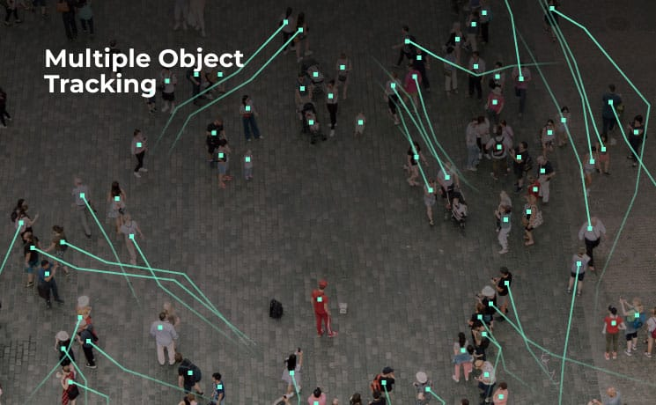
Object Tracking
Adam Hoover

Slide 2




Outline
No laptops, phones or screens during lecture.
Concepts in multi-object tracking:
Set matching
Hungarian algorithm
Detection metrics
Tracking metrics
Test these ideas live on your laptop

Slide 3
Matching Score Table
time = t-1
time = t
A
B
D[#] = detection index
C
D[1]
D[2]
D[3]
Matching table for each track
Track A | Distance | IoU | Appearance | Motion | Score
D[1] | 20 | 0.1 | 0.8 | 10 | 16
D[2] | 50 | 0.0 | 0.2 | 40 | 42
D[3] | 70 | 0.0 | 0.2 | 100 | 57
Different units
Smaller = better

Slide 4
Matching Score Table
time = t-1
time = t
A
B
D[#] = detection index
C
D[1]
D[2]
D[3]
Matching table scores for all objects<->detections
 | Track A | Track B | Track C
D[1] | 16 | 33 | 75
D[2] | 42 | 21 | 38
D[3] | 57 | 33 | 28
What is the best (lowest total score) set match?

Slide 5
Hungarian Algorithm
Jobs
 | Clean kitchen | Sweep floors | Wash windows
Alice | 14 | 11 | 13
Bob | 12 | 10 | 15
Carol | 13 | 12 | 12
Workers
Cost ($) each worker charges for each job
What is the best (lowest total cost) set match?

Slide 6
Step 1
 | Clean kitchen | Sweep floors | Wash windows
Alice | 14 | 11 | 13
Bob | 12 | 10 | 15
Carol | 13 | 12 | 12
For each row, subtract the minimum element.
 | Clean kitchen | Sweep floors | Wash windows
Alice | 3 | 0 | 2
Bob | 2 | 0 | 5
Carol | 1 | 0 | 0

Slide 7
Step 2
 | Clean kitchen | Sweep floors | Wash windows
Alice | 3 | 0 | 2
Bob | 2 | 0 | 5
Carol | 1 | 0 | 0
For each column, subtract the minimum element.
 | Clean kitchen | Sweep floors | Wash windows
Alice | 2 | 0 | 2
Bob | 1 | 0 | 5
Carol | 0 | 0 | 0

Slide 8
Step 3
 | Clean kitchen | Sweep floors | Wash windows
Alice | 2 | 0 | 2
Bob | 1 | 0 | 5
Carol | 0 | 0 | 0
Cover all zeros with the fewest possible lines.
If the number of lines = matrix rank, then skip to step 5.
Otherwise go to step 4.

Slide 9
Step 4
 | Clean kitchen | Sweep floors | Wash windows
Alice | 2 | 0 | 2
Bob | 1 | 0 | 5
Carol | 0 | 0 | 0
Find the minimum non-covered value.
For each non-covered element, subtract that value, and for every element covered twice, add that value.
 | Clean kitchen | Sweep floors | Wash windows
Alice | 1 | 0 | 1
Bob | 0 | 0 | 4
Carol | 0 | 1 | 0

Slide 10
Step 5
 | Clean kitchen | Sweep floors | Wash windows
Alice | 1 | 0 | 1
Bob | 0 | 0 | 4
Carol | 0 | 1 | 0
Identify independent zeros in each row. Assign those jobs to those workers.
Eliminate assigned jobs from consideration for remaining workers.
Repeat.

Slide 11
Solution
Jobs
 | Clean kitchen | Sweep floors | Wash windows
Alice | 14 | 11 | 13
Bob | 12 | 10 | 15
Carol | 13 | 12 | 12
Workers
Cost ($) each worker charges for each job
What is the best (lowest total cost) set match?
Alice = sweep floors, Bob = clean kitchen, Carol = wash windows.
Total cost = 11+12+12 = 35.

Slide 12
Detection Metrics
Ground truth
Detections
A
B
D[#] = detection index
D[1]
D[2]
C
D[3]
Track | Detection
A | D[1]
B | D[2]
C
 | D[3]
Detections are evaluated independent of tracking. The only question is if a track has an associated detection in the given frame, or not.
In this example TP=2 A and B
FN=1 C
FP=1 D[3]

Slide 13
Detection Metrics
Ground truth
Detections
A
B
A
B
D[#] = detection index
D[1]
D[2]
C
D[3]
Detection | IoU
A<->D[1] | 0.9
B<->D[2] | 0.8
MOTP (multiple object tracking precision) is the average IoU of all detections.
In this example MOTP = (0.9 + 0.8) / 2 = 0.85
This scores how well objects are being detected throughout tracking.

Slide 14
Tracking Metrics
t₁
t₂
t₃
t₄
t₅
t₆
t₇
Ground truth
MOTA counts 3 types of errors:
FN = false negative (not tracked) 1
FP = false positive (hallucination) 3
IDS = ID switch (mis-association) 2
MOTA = 1 - (FN + FP + IDS) / GT 1 - (1 + 3 + 2)/21 = 1-0.29 = 0.71
Track results
This scores how well objects are being associated throughout tracking.

Slide 15
Tracking Metrics
t₁
t₂
t₃
t₄
t₅
t₆
t₇
IDF1 uses Hungarian algorithm to find best matching set of GT to tracks
2 + 3 + 4 = 9 is larger than any other combination
Ground truth
Track results
This finds the longest set of correct tracks throughout tracking.

Slide 16
Tracking Metrics
t₁
t₂
t₃
t₄
t₅
t₆
t₇
Ground truth
IDF1 then calculates:
IDTP = correct detections 9
IDFN = missed/mismatch 12
IDFP = hallucinations 3
IDF1 = 2 x IDTP / (2 x IDTP + IDFP + IDFN) = 2 x 9 / (2 x 9 + 3 + 12) = 0.55
Track results
This measures (rewards) better associations more than MOTA.

Slide 17
Tracking Metrics
There are several other metrics:
HOTA (higher order tracking accuracy) = MOTA/IDF1 compromise
MT (mostly tracked) = share of ground truth tracked >= 80%
ML (mostly lost) = share of ground truth tracked <= 20%
Frag (fragmentations) = number of times a ground truth track is interrupted
MOTA/MOTP are “standard” metrics.
IDF1/HOTA are becoming more popular.
Other metrics are application dependent.
Typically, just report a lot of metrics for reader to interpret as they wish.

Slide 18
In-Class Testing
Upload to canvas:
Image save of incorrect guess. Image save of correct guess. Keep playing until you get one right!
Prompt(s). Example image save from video.
Prompt(s). Metrics.
Example image save from video.
Create a program that lets you play a game of guessing Hungarian algorithm solutions. Display a 5x5 grid of workers and jobs. Let the user select one job per worker, then press “Done”. The game should show the Hungarian solution and show it to the user, telling them if their solution was right. Include a “Play again” button.
Download these files from the course website: MOT17-09-DPM.mp4 and MOT17-09-DPM-gt.csv. Write a program to track people in the video file using the YOLO person detector and lessons from this week’s lectures, saving the track results in a csv file and creating a copy of the video file with the tracks overlaid so you can visualize them.
Write another program that evaluates your detected tracks vs the ground truth. Calculate several multi-object tracking metrics. Create a video that color codes the ground truth according to how well you detected it: green=correct, red=missed, yellow=mis-associated.

