Slide 1
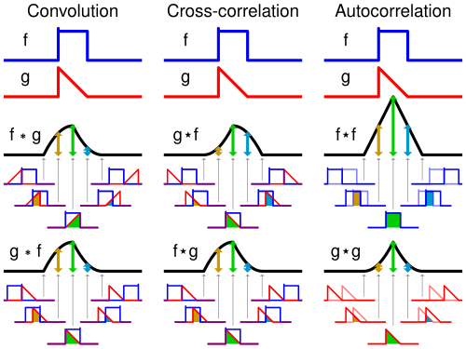
Normalized Cross Correlation
Adam Hoover

Slide 2

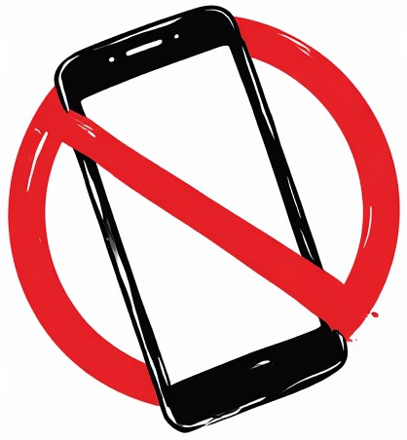

Outline
No laptops, phones or screens during lecture.
Some basic image operations:
Template
Template matching
Appearance variations
Normalization
Normalized cross correlation
Test these ideas live on your laptop camera

Slide 3
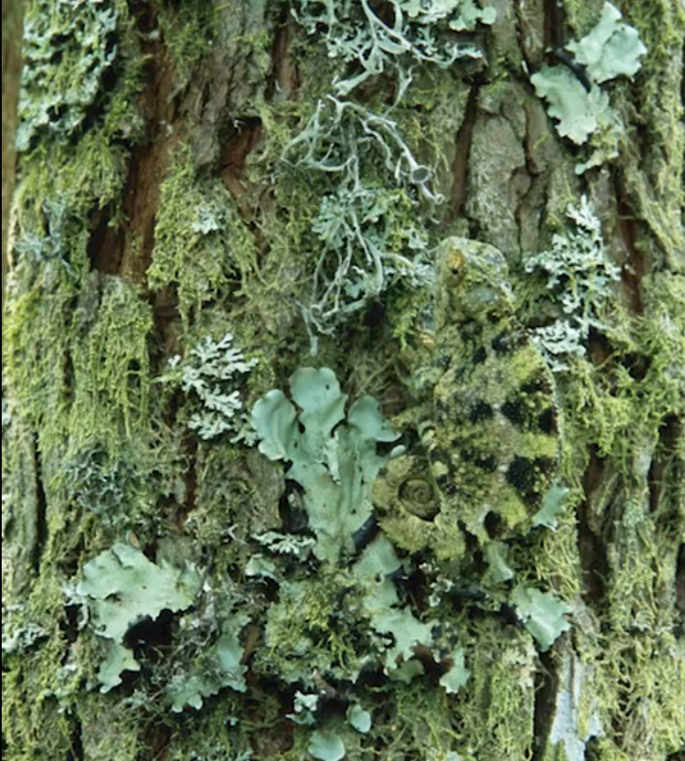
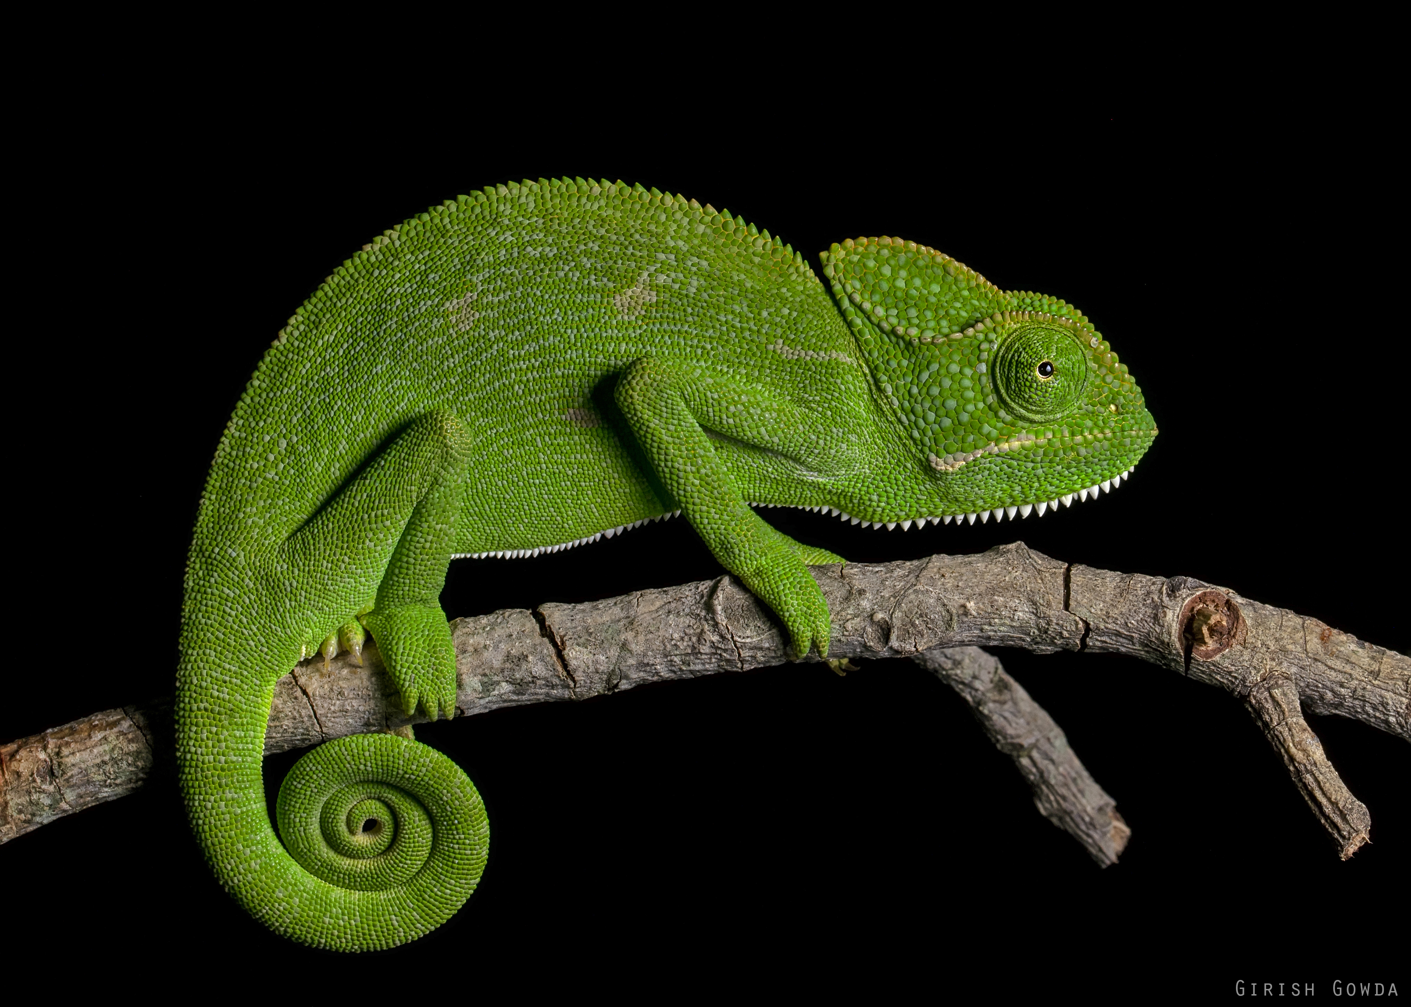
Looking at images...
Chameleon
What do you see here?
Does this help?

Slide 4
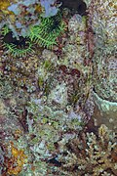
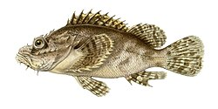
Looking at images...
Tasseled scorpionfish
Does this help?
What do you see here?

Slide 5
Template
6
12
6
6
12
6
6
12
6
Tasseled scorpionfish
The simple example we will use
An example “template” is a known appearance of a thing of interest.
It can be used to search an image for occurrences of that thing.

Slide 6
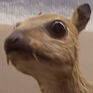
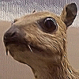

Template vs Kernel
6
12
6
6
12
6
0
0
0
0
-1
0
1
1
1
6
12
6
0
1
0
-1
5
-1
1
1
1
0
0
0
0
-1
0
1
1
1
appearance of thing of interest
identity
sharpen
smooth (mean)
An object template is similar to a kernel window, but it stores the appearance of a thing we want to detect, instead of weights to filter an image.

Slide 7
Template Matching
(25-6)+(22-12)+…
25
22
22
23
132
17
38
23
21
24
135
123
8
98
116
217
411
405
543
21
24
6
12
6
21
172
213
307
258
296
580
21
139
6
12
6
45
173
423
279
0
145
465
138
134
6
12
6
97
11
450
314
147
338
533
32
24
22
31
118
83
66
Image
Template matched output
6
12
6
6
12
6
Low value indicates a detection
6
12
6
Template
Template matching takes the sum of differences between the template and image at each location.

Slide 8
Template Matching is Brittle
6
12
6
23
132
17
38
6
12
6
135
123
8
98
0
152
389
408
546
6
12
6
12
18
12
172
167
293
289
278
562
21
139
31
12
18
12
173
431
302
71
54
374
138
134
16
12
18
12
11
485
349
206
244
439
32
24
22
31
118
83
66
Image
Template matched output
6
12
6
6
12
6
Similar appearance to template but output match is worse
6
12
6
Template
Template matching is brittle to variations in intensity, e.g. lighting changes, or darker or brighter appearances of the template.

Slide 9

Min-Max Normalization
0
3
10
0
30
100
Rescale range to 0…100
0
3
10
1
30.7 => 31
100
Rescale range to 1…100
Normalizing a set of numbers rescales them to the given new range.
The general formula for scaling a set of values x to the new range [a,b] is:
$$x_{norm}=a+\frac{(x−x_{min})(b−a)}{x_{max}−x_{min}}$$

Slide 10
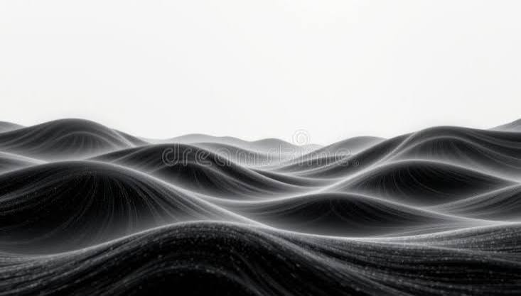
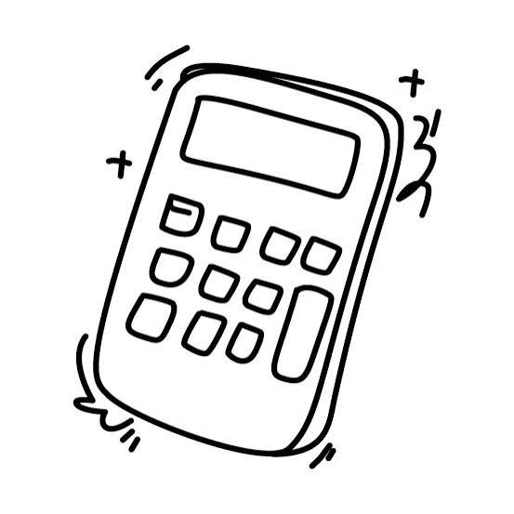
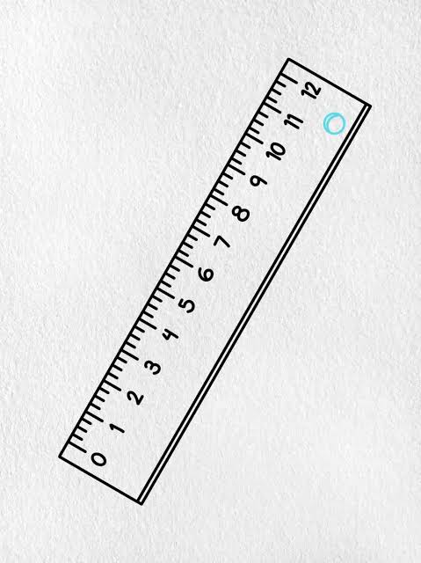
Common Normalizations
0
3
10
0
76.5 => 77
255
Rescale range to 0…255
Allows us to visualize arbitrary ranges of numbers in greyscale
0
3
10
-1.0
-0.4
1.0
Rescale range to -1…1
Keeps numbers in computational range (no overflow/underflow)
Standardizes numbers to common range so units do not matter as much

Slide 11




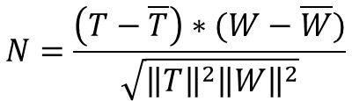
Normalized Cross Correlation
Let T be the template, and W be a local image window of the same size
$\overline{T}=$ mean template value
$\overline{W}=$ mean image window value
$\left\|T\right\|=$ template norm
$\left\|W\right\|=$ image window norm
convolution
$$N=\frac{\left(T−\overline{T}\right)∗(W−\overline{W})}{\sqrt{{\left\|T\right\|}^{2}{\left\|W\right\|}^{2}}}$$
for each pixel
in the image
calculated
only once
calculated anew for every pixel (local window)
The effect is that the “matching” is normalized across at each image location.

Slide 12
Normalized Cross Correlation
6
12
6
23
132
17
38
6
12
6
135
123
8
98
1.00
-0.34
0.07
0.49
-0.67
6
12
6
12
18
12
172
0.48
-0.36
0.19
0.21
-0.63
21
139
31
12
18
12
173
0.48
-0.33
-0.42
1.00
-0.40
138
134
16
12
18
12
11
0.49
-0.35
-0.28
0.32
-0.27
32
24
22
31
118
83
66
Image
NCC output
6
12
6
6
12
6
High value indicates a detection
6
12
6
Template
Normalized cross correlation is robust to local changes intensity, e.g. due to lighting.

Slide 13
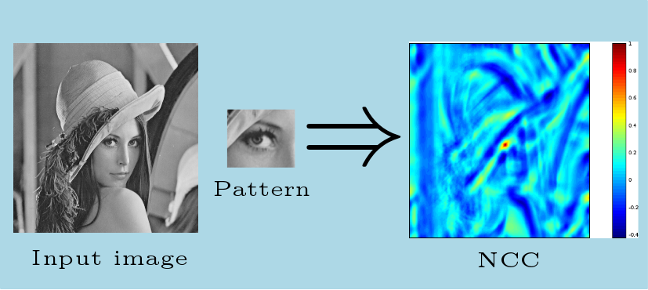
Visualizing NCC
1.00
-0.34
0.07
0.49
-0.67
0.48
-0.36
0.19
0.21
-0.63
Must be normalized for display
0.48
-0.33
-0.42
1.00
-0.40
0.49
-0.35
-0.28
0.32
-0.27
Example of color mapping the range -1…+1 for visualization

Slide 14
Visualizing NCC (Greyscale)
Input image
template
NCC output range -1…+1 mapped to 0-255 for visualization

Slide 15
In-Class Testing
Upload to canvas:
Prompt(s).
One or more image saves.
Prompt(s).
Image save.
Prompt(s).
Image save.
Download the templates given at the course website for “x”. Ask your LLM to write python code using OpenCV to read and display live video along with normalized cross correlation output against this template.
Run the program and move the test sheet (I will provide a printout, also available at course website) in front of your camera. Try to position the test sheet so that the X shapes become noticeably detected in the NCC.
Now ask it to adjust the code to load all 4 templates from the course website (“x”, “o”, “plus” and “bar”). Modify the code so you can pick which template is active while the program is running. What do you observe?
Last, ask the LLM to threshold the NCC values so that only the strongest are displayed. Try different thresholds. What do you observe, especially for “bar”?

