Slide 1
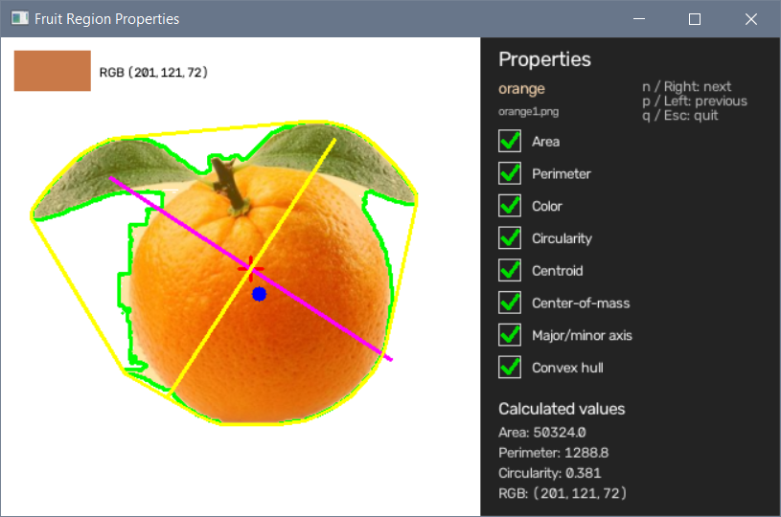
Region Properties
Adam Hoover

Slide 2
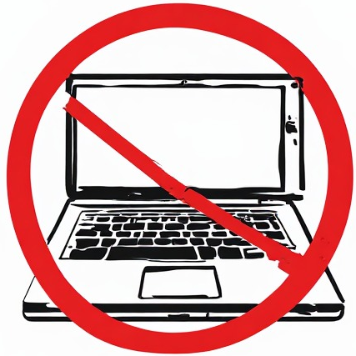
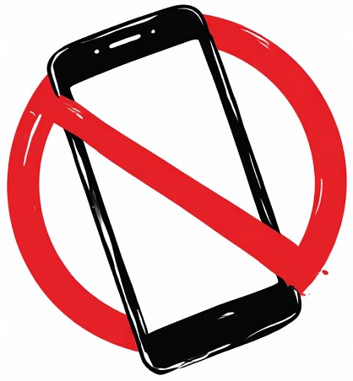

Outline
No laptops, phones or screens during lecture.
Concepts in object labeling:
Labeling software
Object classes
Annotation primitives
Visualizing labels
Inter-rater reliability
Test these ideas live on your laptop camera

Slide 3
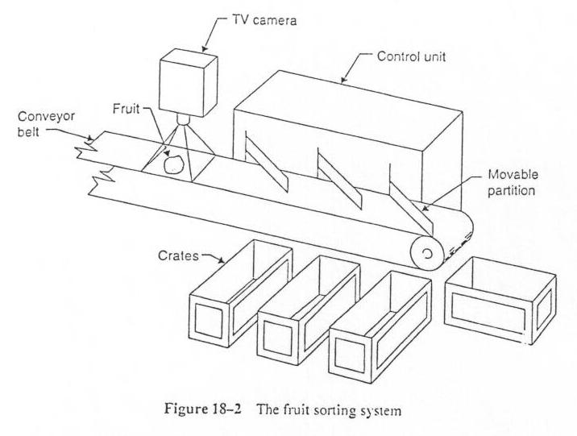
Computer Vision System
This system is sorting fruit. Each piece is well separated. What do we measure?

Slide 4
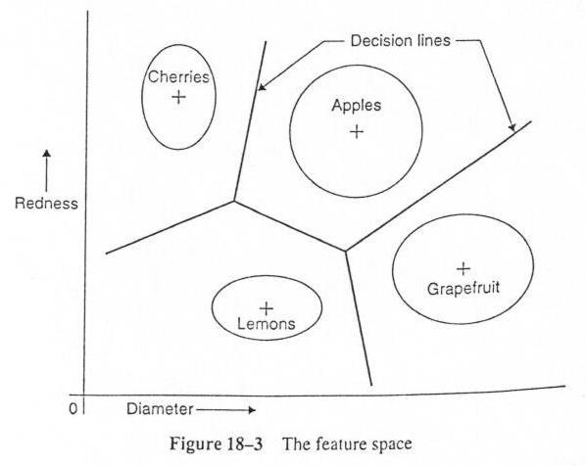
Fruit Classifier
Some region properties can be used to determine the type of fruit.

Slide 5
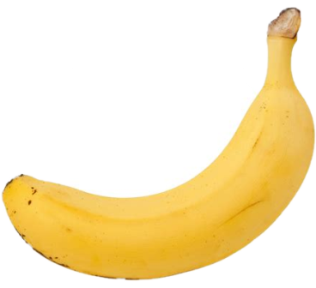
Region Mask
The region mask defines which pixels belong to the region of interest.
Only pixels with a non-zero value in this mask are used in region calculations.
Area = number of pixels in the mask. Size can help identify fruit type.

Slide 6
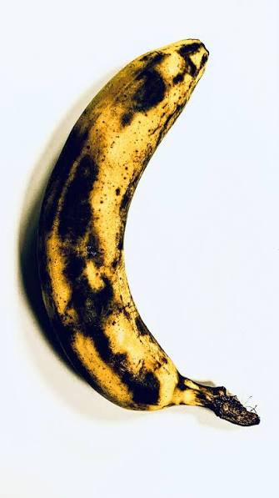
Region Color and Variance
Average color can help identify the fruit type.
Standard deviation in color can help identify the fruit quality (e.g rotten).

Slide 7
Region Perimeter and Orientation
major axis
minor axis
perimeter
Perimeter identifies the region boundary.
Major and minor axes identify the longest and orthogonal extents.
These region properties help identify where and how to grab an object.

Slide 8
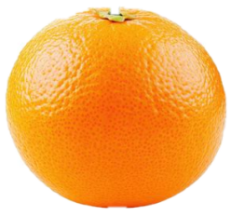
Centroid and Center of Object
centroid
+
+
center
Centroid = average x,y in mask. It can be a good approximation of the center of an object, but not always. Sometimes we need to calculate the “center” of an object as the point farthest from the perimeter.
These properties help identify how to balance an object during manipulation.

Slide 9
Convex Hull
The convex hull is the smallest contour with no concavities that encloses the region.
It can help identify the maximum space the object might occupy in any orientation.

Slide 10

Circularity
circularity = 0.9
circularity = 0.1
Circularity = 4 area / perimeter²
It provides a measure of the “compactness” of an object.
$$π$$

Slide 11
Fruit Viewer Demo
Fruit Classifier Demo

Slide 12
In-Class Testing
Upload to canvas:
Prompt(s).
Window capture showing region properties display.
Prompt(s). Window capture or saved image of plot.
Download the fruits.zip set of images from the course website, and unzip to a folder having no other images.
Use your LLM to write code to view all these images by telling it to scan the folder for all png files. Have it display them one at a time, using keystrokes to go through the set. Have it calculate and display region properties, including average color, centroid, center of object, major and minor axes, convex hull, area, and circularity. It does not have to be perfect given the limited class-time.
Use your LLM to write code to read all the images, calculate region properties for each, and create a plot of average green color vs circularity (similar to my demo).

