Slide 1
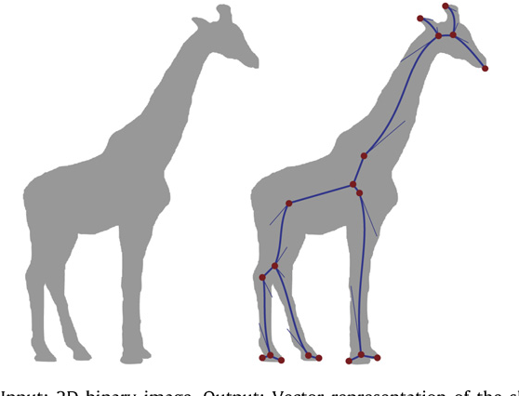
Object Skeletons
Adam Hoover

Slide 2



Outline
No laptops, phones or screens during lecture.
Concepts in skeletons:
Thinning
Thinning algorithm
Branchpoints and endpoints
Test these ideas live on your laptop camera

Slide 3
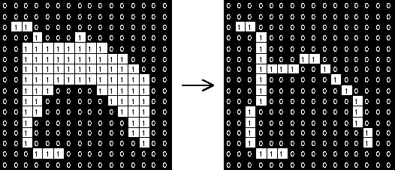
Thinning
Image
Skeleton Image
Thinning is the process of reducing a foreground object to a “skeleton” that is 1 pixel wide.

Slide 4
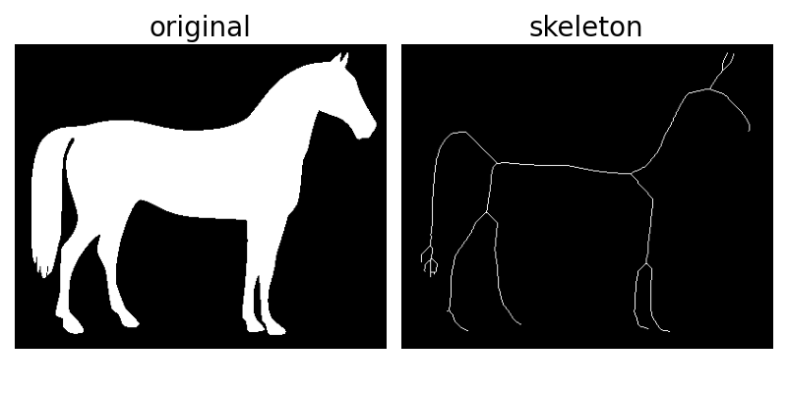
Skeleton
The skeleton is roughly located in the middle of the object and covers its original extent.

Slide 5
Thinning Algorithm
X
X
Clockwise transitions
X
X
X
X
X
X
X
X
X
X
X
X
X
X
X
X
X
X
X
Foreground neighbors
X
X
X
X
X
X
X
X
X
X
X
A
Image
(X = foreground)
D
B
Compass test
C
Thinning algorithms typically use these 3 calculations (explained in detail on next slides).

Slide 6
Clockwise Transitions
X
X
X
X
X
X
X
X
X
X
X
X
Clockwise path around center pixel (red X)
Foreground to background transition
Foreground to background transition
This example has 2 foreground-to-background transitions.
To be thinned, a pixel must have 1.

Slide 7
Foreground Neighbors
X
X
X
X
X
X
X
X
X
X
X
X
X
X
X
Foreground neighbors = 3
Foreground neighbors = 4
Foreground neighbors = 6
Count the number of foreground pixels that are “8-connected”. To be thinned, a pixel must have 2 to 6 (inclusive).

Slide 8
Compass Test
A
X
X
X
D
X
B
X
X
X
X
X
C
X
X
X
X
A or B or (C and D) must be background
?
?
Passes test
Fails test
To be thinned, a pixel must pass this compass test.

Slide 9
Thinning
A pixel is marked for deletion if …
1 clockwise transition
X
X
X
X
X
X
X
X
X
X
X
X
X
X
X
X
X
X
X
2<= foreground neighbors <=6
X
X
X
X
X
X
X
X
X
X
X
A
X
X
A or B or (C and D) = background
D
B
Image
(X = foreground)
C
Pixels marked for deletion will be highlighted in yellow in this example.

Slide 10
Thinning
A pixel is marked for deletion if …
1 clockwise transition
X
X
X
X
X
X
X
X
X
X
X
X
X
X
X
X
X
X
X
2<= foreground neighbors <=6
X
X
X
X
X
X
X
X
X
X
X
A
X
X
A or B or (C and D) = background
D
B
Image
(X = foreground)
C
Pixels marked for deletion will be highlighted in yellow in this example.

Slide 11
Iteration 2
A pixel is marked for deletion if …
1 clockwise transition
X
X
X
X
X
X
X
X
X
2<= foreground neighbors <=6
X
X
X
X
X
X
X
A
D
B
A or B or (C and D) = background
Image
(X = foreground)
C
Delete marked pixels, and re-iterate over image, until no pixels marked. For this example, no pixels are marked on this second iteration.

Slide 12
Branchpoints and Endpoints
X
X
X
X
X
X
X
X
Endpoints have 1 transitions
Branchpoints have 3+ transitions
Branchpoints and endpoints can be calculated on a skeletonized image.

Slide 13
Branchpoints and Endpoints
X
letter | endpoints | branchpoints
i
l
m
n
x
X
X
X
3
0
X
X
X
X
X
2
0
X
X
4
2
X
3
1
Endpoints (red) and branchpoints (blue)
(X = foreground)
4
1
Branch/endpoints can be useful features to distinguish between objects.
Letters, animals, plants, etc.

Slide 14
In-Class Testing
Upload to canvas:
Prompt. Thresholded image and skeletonized image.
Prompt.
Zoom of small area showing detected branch/endpoints.
Prompt. Zoom of small area showing new detections.
Prompt. Image save.
Download the parenthood.png image from the course website. Use your LLM to write code to threshold it and skeletonize it. Save both images and confirm they look okay.
Use your LLM to write code to identify branchpoints and endpoints in the skeletonized image. Overlay them with colors (e.g. yellow and red) on the skeletonized image. Save the output and zoom to look at it. Is it correct?
You may have to teach your LLM how to properly calculate branchpoints and/or endpoints. Inform of the correct criteria and how to calculate them. Rerun and check zoom.
Have your LLM write code that implements thresholding, skeletonization and branch/endpoint identification on live video from your webcam. You may have to tell it to optimize loops for real-time processing. Adjust the threshold so you detect a small amount of foreground.

