Slide 1
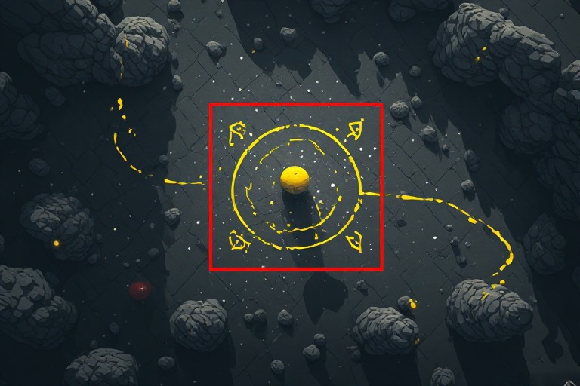
Object Tracking
Adam Hoover

Slide 2

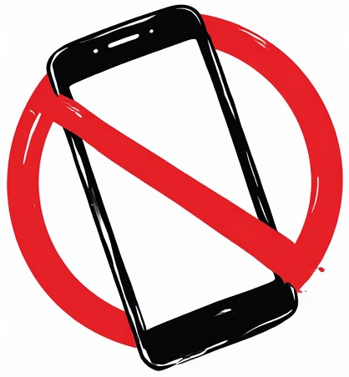


Outline
No laptops, phones or screens during lecture.
Concepts in object tracking:
Track table
Detection associations
Matching criteria
Difficulties
Examples
Test these ideas live on your laptop

Slide 3
Object Track Table
Current image
A
B
Track table
Track features can include:
Current position
Visual appearance
Duration tracked
Motion vector
…
Object ID | Position | Appearance | …
A | 50,300
B | 600,80
…

Slide 4
Object Tracking Approach
time = t-1
time = t
A
D[#] = detection index
B
D[1]
D[2]
Obtain new detections at time t
  D[1], D[2]
Associate detections with existing tracks
  D1<->A D2<->B
Update object tracks
  A(position)=300,200; A(appearance)=[updated]; …
  B(position)=350,50; B(appearance)=[updated]; …
Core loop in object tracking

Slide 5
Matching by Distance
time = t-1
time = t
A
A
B
D[1]
B
D[2]
“Greedy” associations in order of tracks (or detections):
A is closest to D[1]; B is closest to D[2]
Best “set” of associations according to global cost:
A<->D[2] + B<->D[1] is worse than A<->D[1] + B<->D[2]
What are the advantages and disadvantages of each of these approaches?
(Greedy=quicker (less computation); set=more accurate in complex situations)

Slide 6
Matching by IoU
time = t-1
time = t
A
A
B
D[1]
B
D[2]
Intersections over unions:
A,D[1]=0.1 A,D[2]=0.0
B,D[1]=0.0 B,D[2]=0.3
Largest values assigned using “greedy” strategy or global “set” strategy
When does this work well? When is it prone to failure?
(Works well on small motions; prone to failure when objects cross or overlap)

Slide 7
Matching by Appearance
time = t-1
time = t
A
A
B
D[1]
B
D[2]
Normalized cross correlation matches:
A,D[1]=0.8 A,D[2]=0.3
B,D[1]=0.2 B,D[2]=0.7
Largest values assigned using “greedy” strategy or global “set” strategy
When does this work well? When is it prone to failure?
(Works well when objects do not change much in appearance;
prone to failure when multiple objects have similar appearances)

Slide 8
Matching by Motion
time = t-1
time = t
A
A
B
D[1]
B
D[2]
Distances between predicted locations and detections:
A(predicted),D[1]=10 A(predicted),D[2]=250
B(predicted),D[1]=300 B(predicted),D[2]=20
Smallest values assigned using “greedy” strategy or global “set” strategy
When does this work well? When is it prone to failure?
(Works well on constant vector motion; prone to failure on random changes)

Slide 9
Collision Demo
Demonstrates each of the object association strategies

Slide 10
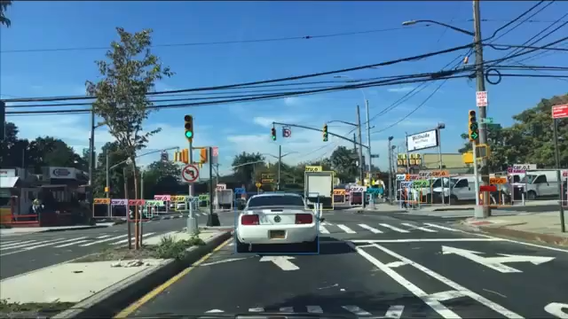
Matching Challenges
Multiple objects (the more, the harder)
Overlapping positions during tracking
Occlusion (object hidden behind something temporarily)
Missed detections (maintaining memory of tracks for some period of time)
New objects entering field-of-view (new tracks)
Objects departing field-of-view (expiring tracks)

Slide 11
Kalman Filter Concepts
time = t
time = t+1
measurement(t+1)
position(t)
range of possible positions
predicted position(t+1)
predicted position(t+1)
position(t+1) weighting the prediction more than the measurement
The Kalman filter operates in a predict-update loop. At each update, the new state position is weighted somewhere between the prediction and measurement.
Large weight on the prediction favors the motion model, while large weight on the measurement favors the sensor system. When should each weight be emphasized?
(Weight predictions more when sensors are very noisy;
weight measurements more when prediction model is very imprecise)

Slide 12
Kalman Filter Demo
Demonstrates effects of dynamic noise and measurement noise

Slide 13
In-Class Testing
Upload to canvas:
Prompt(s). Image save of detected object.
Prompt(s). Image save during occlusion (ask a classmate for assistance).
Prompt(s).
Example image save.
Create a program that detects a user-selected range of color. Use HSV to select and display the color range. Display a live detection of that color from your webcam. Pick an object you have handy and tune your detector until it is detecting the object fairly well, with minimal other stuff.
Modify the program to use a Kalman filter during tracking. Display the predicted motion vector. Highlight the object in green when it detects your object directly, and in red when it can only rely upon the predicted motion. Move the object back and forth behind an occlusion. What do you observe?
Use the YOLO onnx object detection model. Create a program that detects and tracks people. This should be the only class. With each person, show the number of frames they have been detected. Highlight them in red for 0-49 frames, yellow for 50-99 frames, and green for 100+ frames. Pan around the classroom. What do you observe?

