Slide 1
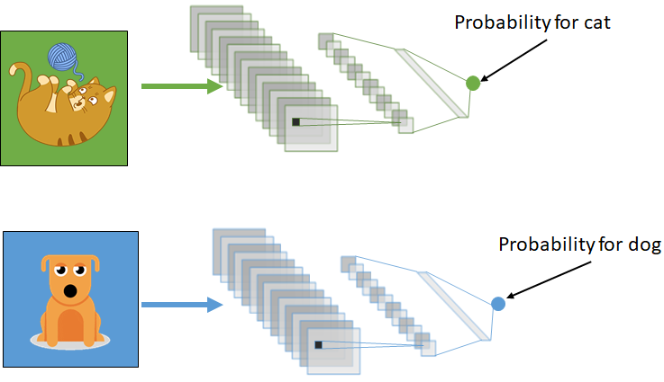
Transfer Learning
Adam Hoover

Slide 2
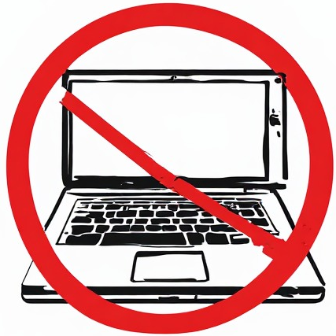
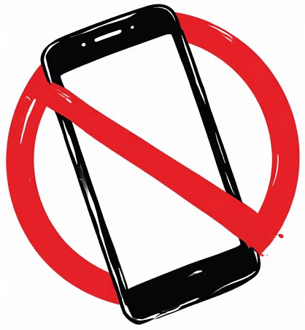


Outline
No laptops, phones or screens during lecture.
Concepts in transfer learning:
Common features
Freezing, fine tuning
Where to get models
YOLO model transfer setup
Examples
Test these ideas live on your laptop

Slide 3
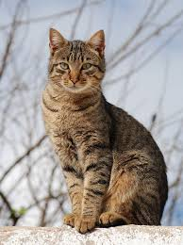
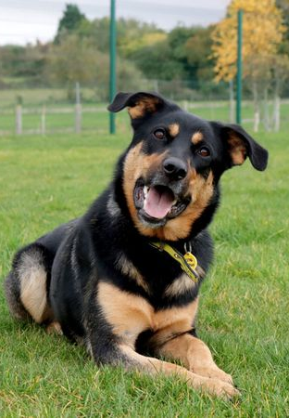
What does a model learn?
color
edge
texture
Stuff in local windows: color distributions, edges, textures.
Do these calculations differ between cats and dogs?

Slide 4
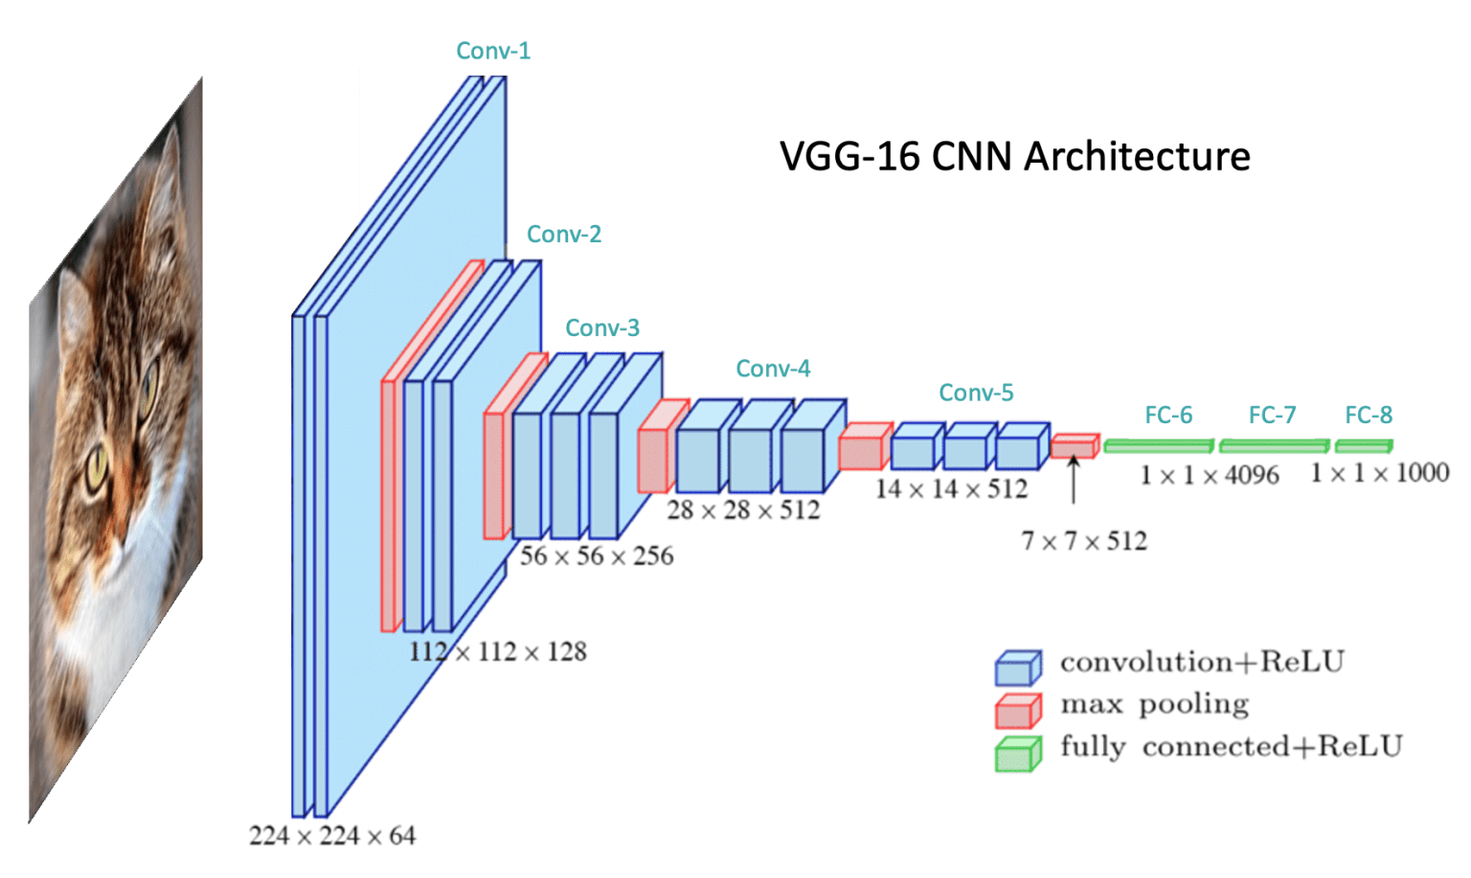
Where does this happen?
early layers
Local features are mostly calculated in the early layers.

Slide 5
What more does a model learn?
ear
back
paw
Stuff in larger windows: ears, face, back, paws.
Do these grouping calculations differ between cats and dogs?

Slide 6
Where does this happen?
middle layers
Area features are mostly calculated in the middle layers.

Slide 7
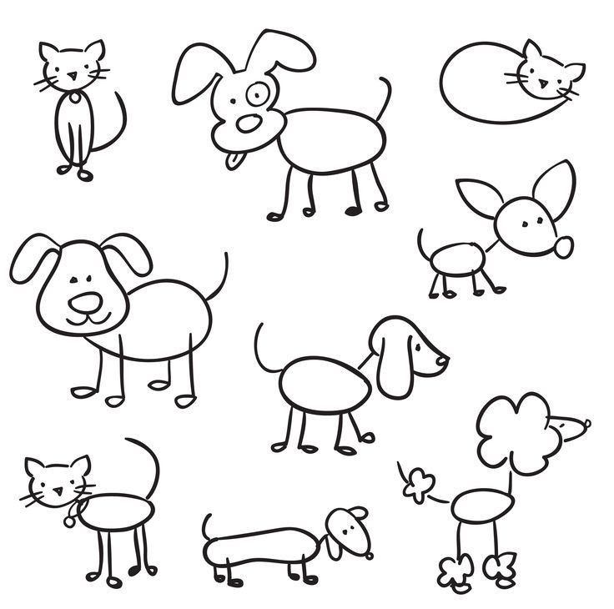
What decides cat vs dog?
Which of these are cats? Dogs?
How can you tell?
The “whole configuration”, or how all the parts are put together, decides the class.

Slide 8
Where does this happen?
late layers
Whole-image feature groupings and final classifications are made in late layers.

Slide 9
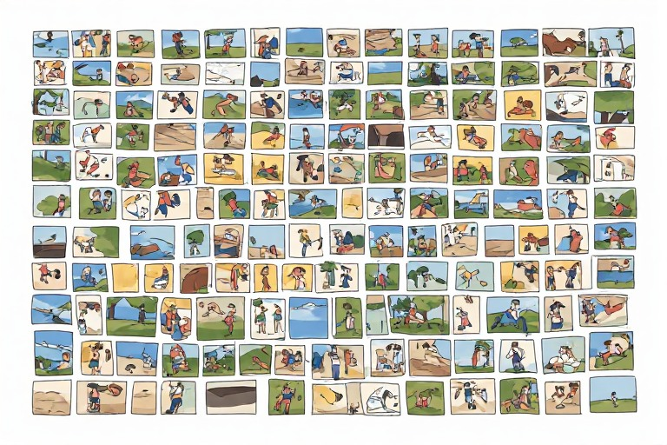
The Challenge
We want to train a new model to detect dogs in images.
What’s the most difficult step?
Collecting and labeling 1000’s of images.

Slide 10
The Solution
If we already have a model for a similar problem, we do not have to start from scratch.
Collect and label a small amount of data, and transfer learn.
already exists
new data (dogs)
cat model
dog model

Slide 11
Transfer (Incremental) Learning
learn (adjust)
freeze
Model has already learned good weights from 1000’s of cat images.
Only adjust the weights in the late layers.

Slide 12
Fine Tuning
slow gradient descent
Fine tuning allows all weights to change, but much more slowly than during normal training. This prioritizes the knowledge in the weights (prior knowledge) more heavily, but still allows for minor adjustments everywhere.

Slide 13
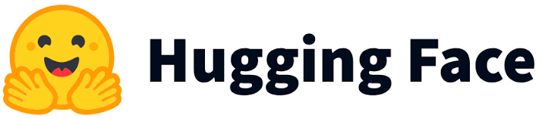
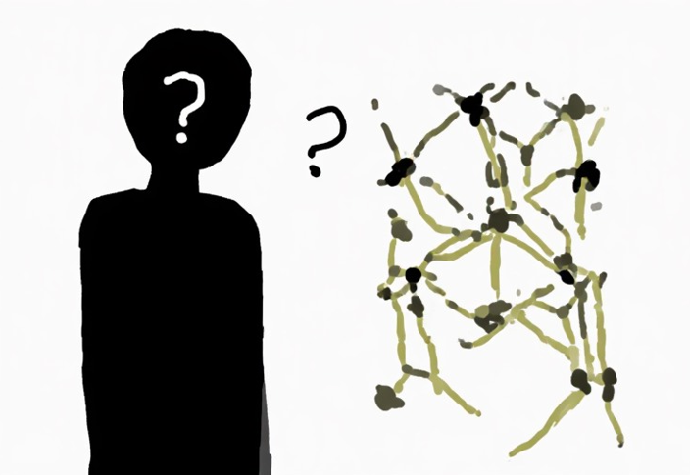

Models
Commercial vendors:
Hugging Face
Kaggle
TensorFlow Hub
PyTorch Hub
Ultralytics
Individual contributors:
Research papers
Github
Blogs, personal websites
Commercial sites also commonly offer datasets.
And model fitting software pipelines (GUIs).
They also typically require accounts and charge fees.

Slide 14
Folder Structure
|yolo26n.pt
|transfer.py
|NEW
|__data.yaml
|__train
| |__images
| | |__1.jpg
| | |__2.jpg
| | |__...
| |__labels
| | |__1.txt
| | |__2.txt
| | |__...
base (existing) model
code that performs transfer learning
YOLO
|__test
| |__images
| | |__a.jpg
| | |__b.jpg
| | |__...
| |__labels
| | |__a.txt
| | |__b.txt
| | |__...
YOLO
|__valid
| |__images
| | |__A.jpg
| | |__B.jpg
| | |__...
| |__labels
| | |__A.txt
| | |__B.txt
| | |__...
new data configuration (folders, number of classes, class labels)
Train data used to build model. Test data used to evaluate its performance.
Validation data (optional) used to “mini-test” at the end of each epoch.

Slide 15
Traffic Light Demo
Starting it now, takes appx 2 min to train, will go through results after the following example

Slide 16
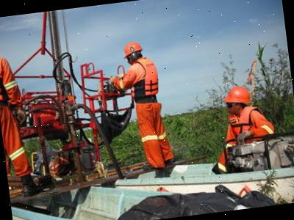
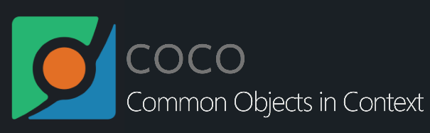
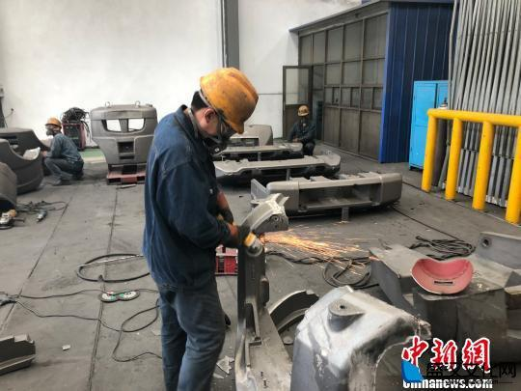
Example
Base model = yolo26n.pt
Trained on COCO: 80 classes (dog, horse, car, etc.)
Training a model to detect safety gear.
Four new classes: helmet (yellow), vest (purple), absence of helmet (not pictured) and vest (red).
New data = 6,000 images, 23,105 instances (rectangles), 2 hours to train 50 epochs.

Slide 17
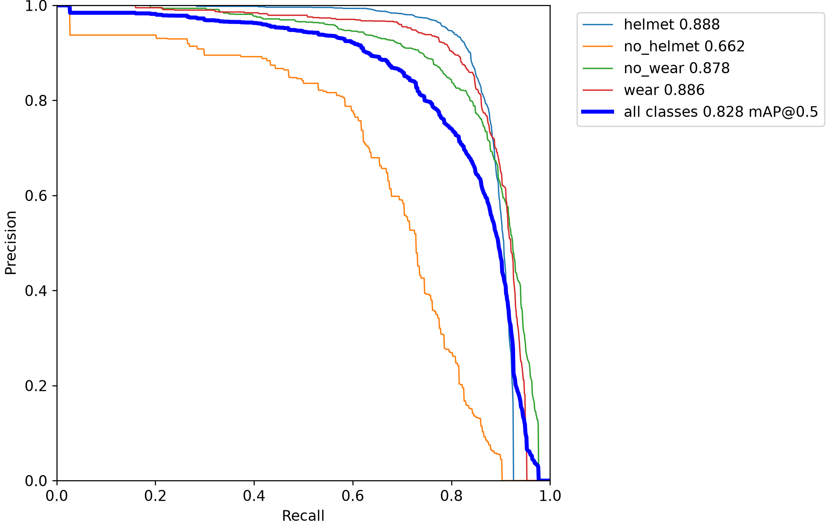
Results: Precision-Recall Curve
Appx 83% accuracy
Helmet = best class

Slide 18
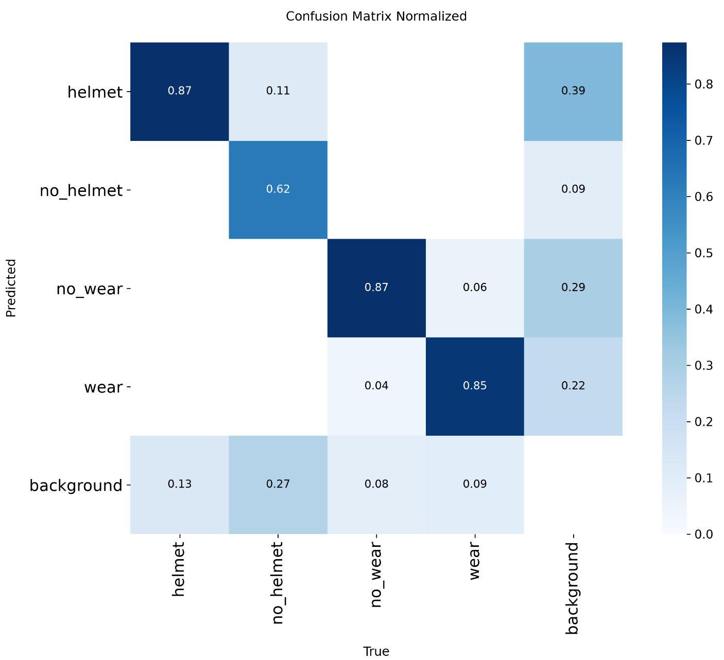
Results: Cross Confusion
Largest confusion is missing any of the 4 classes (background).
Classes are rarely confused with each other.

Slide 19
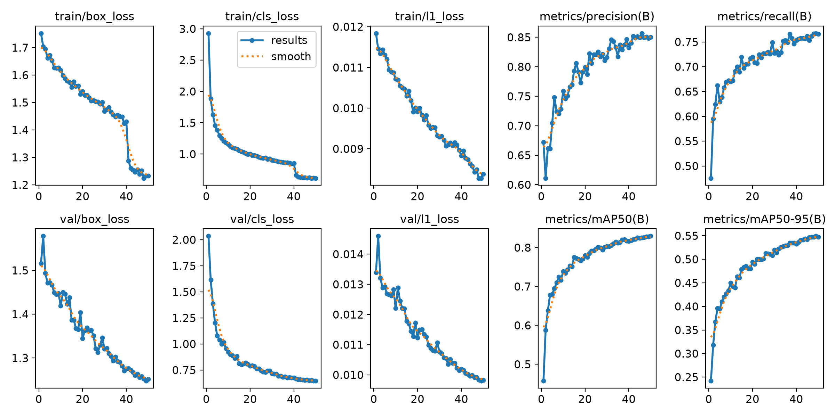
Results: Learning Rates
Box loss = measure of getting rectangles correct position/size.
Class loss = measure of predicting correct classes for rectangles.
Model was still improving after 50 epochs. Plateaus suggest not worth further training, but sometimes can be premature!

Slide 20
Setup
To transfer learn on YOLO, install the Ultralytics and Python packages:
python –m pip install –U ultralytics
You may also need to install PyTorch and support packages:
python –m pip install torch torchvision
Create a folder where you plan to store data and models. For example:
C:\ComputerVision\YOLO\
I suggest making a new subfolder in that location for each new model you train.
Download these files from the course website, and unzip:
yolo26n.pt
transfer.py
safety.zip
chess.zip

Slide 21
In-Class Testing
Upload to canvas:
Example validation image w/labels, compared to GT.
Overall accuracy.
Best class.
Overall accuracy.
Class(es) with most cross-confusion.
Prompt(s).
Example image save.
Run the transfer.py program on the safety dataset. Try varying the EPOCHS, IMAGE_SIZE, and FREEZE_LAYERS. If it looks like it will not finish training in under 5 minutes then halt, change parameters, and try again. What overall accuracy do you get? What is the best recognized individual class?
Do the same thing for the chess dataset. Report the best accuracy you get. In general, where is the most cross-confusion (can be more than one class)?
Once you have an onnx model saved, have your LLM write code that uses it for detections. Tell it to scan the relevant dataset test folder, read and display each image one at a time with its detections, and allow the user to press keys to scroll through all the images. Have it read the ground truth from the dataset labels folder for comparison.

