Slide 1
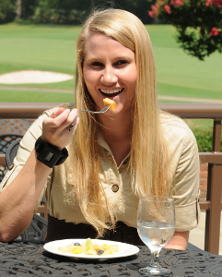

Building the Bite Counter
Adam Hoover
Electrical & Computer Engineering Department

Slide 2
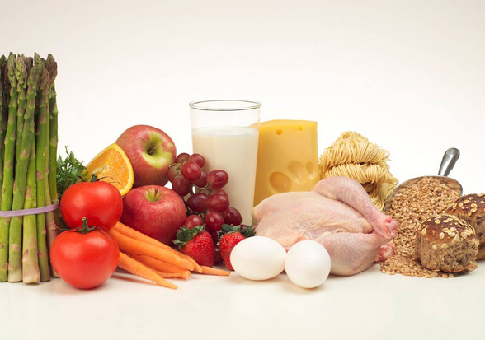
Outline
Motivation, existing tools, related work
Tracking wrist motion to count bites
Relating bites to calories
Design and manufacturing

Slide 3

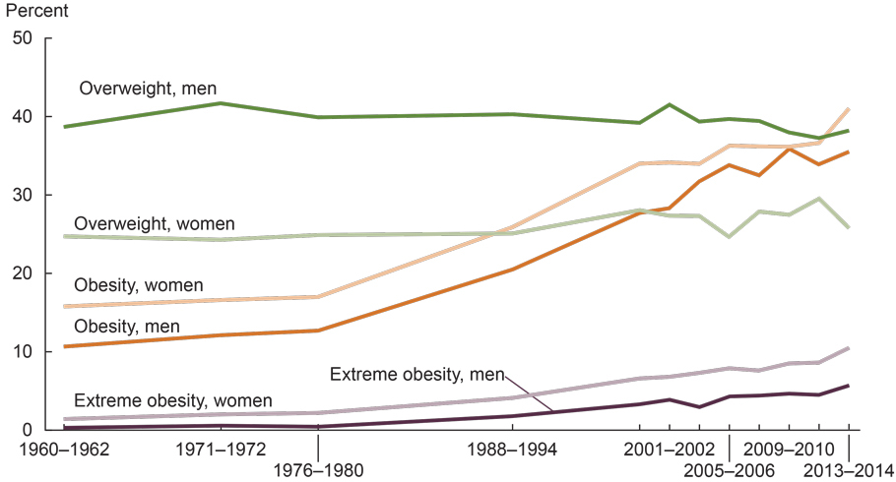
Motivation
Prevalence of obesity
  Worldwide: 1.9 billion adults (39%) are overweight and 650 million adults (13%) are obese (WHO 2016). Meter.
  USA: 37.7% of adults are obese and 17.2% of children are obese (Ogden et al. 2016).
Source:
NIDDK, 2018

Slide 4
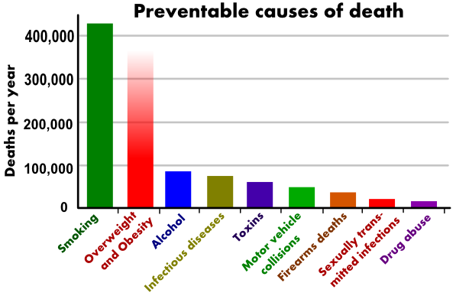
Costs
Comorbidities: Diabetes, heart disease, high blood pressure, stroke, and higher rates of certain cancers (Wellman et al. 2002)
Annual medical cost in the United States: $147 billion in 2008 (Finkelstein et al. 2009)
(Mokdad et al, Actual causes of death in the United States, 2004, JAMA)

Slide 5
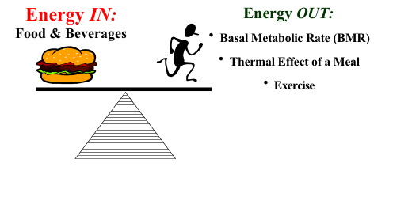
Energy Measures
Energy Intake (Calories or Joules) | Energy Expenditure (Calories or Joules)
Energy absorbed through food intake. | Homeostasis (body maintenance), exercise.
<- weight change ->

Slide 6
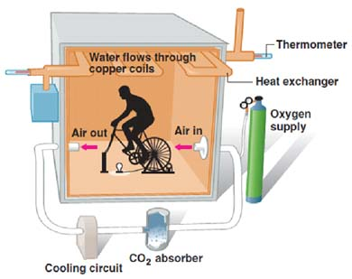
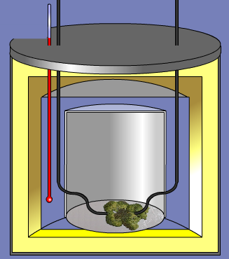
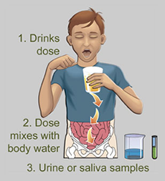
Clinical Tools
Calorimetry Chamber
(measures EE)
Bomb Calorimeter
(measures EI if exact same serving fully consumed)
Doubly Labeled Water
(measures EE directly, EI indirectly*)
*Over a week, EI – EE = weight change

Slide 7
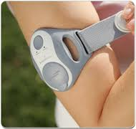
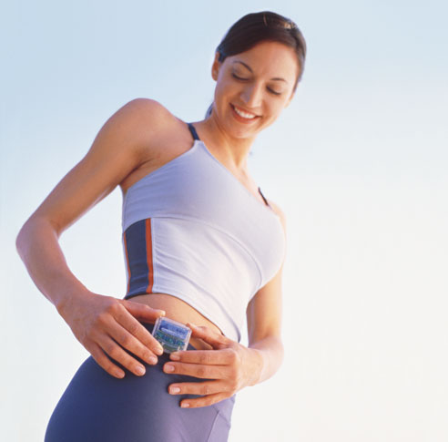
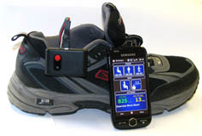
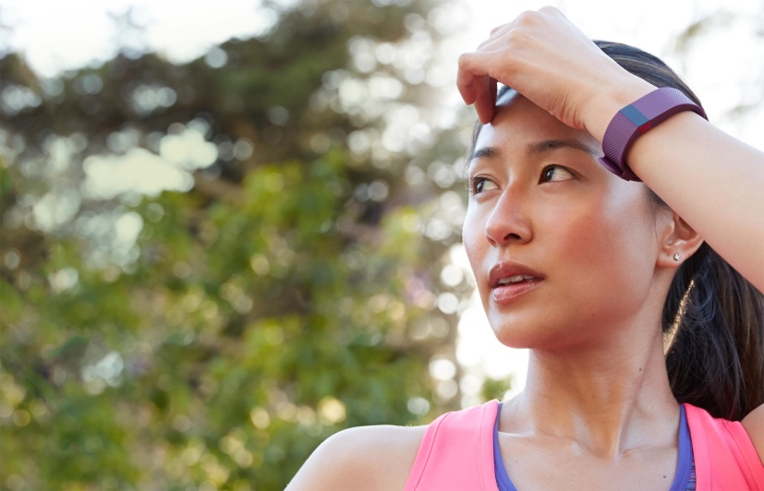
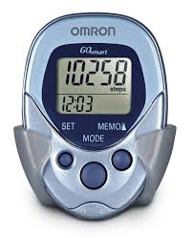
Free-Living Tools: EE
EE: physical activity monitors, pedometers

Slide 8
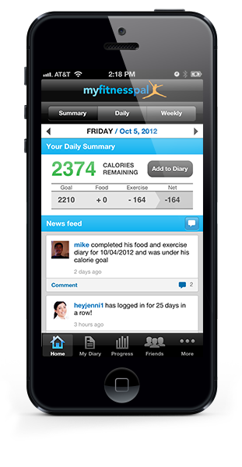

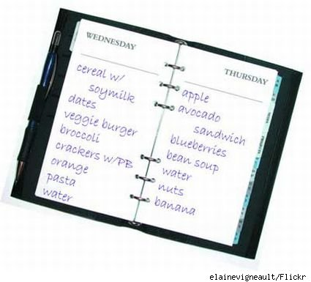
Free-Living Tools: EI
EI: food diary, manual counting, database-assisted logs
Problem #1: Compliance (not easy to use for long period of time)
Problem #2: Underestimation/underreporting bias (dozens of studies have found it ranges 10-50%, evaluated using doubly labeled water)
Challenge: Develop body-worn sensors similar to activity monitors

Slide 9
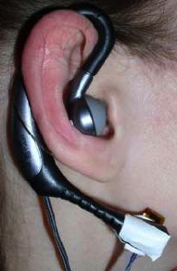
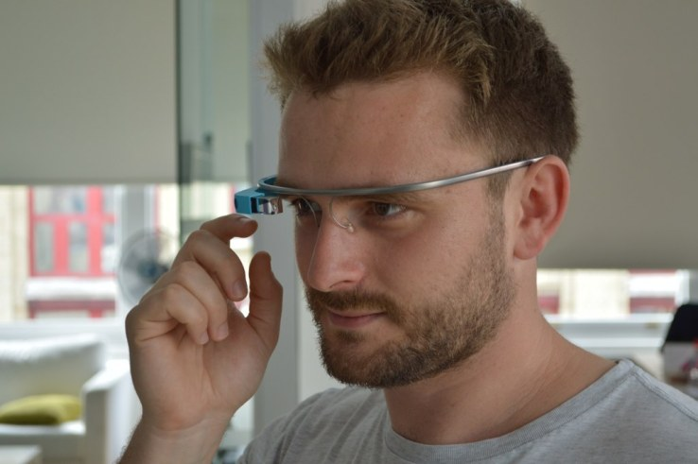
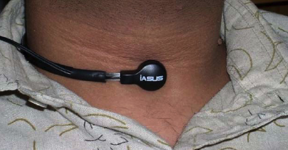
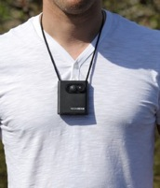
Wearable sensor-based approaches
  Throat and ear
  (e.g. Sazonov et al. 2010)
Detect swallows, chewing sounds
  Glasses
  (e.g. Kleinberg et al. 2015)
Head movements
  Lanyard camera
  (e.g. Gemming et al. 2013)
  Video record eating activities
Free-living challenges: Accuracy, compliance (social stigma, comfort, ruggedness, battery life)

Slide 10
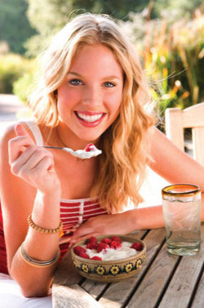
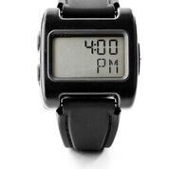
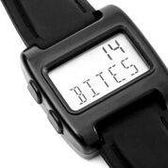
Our concept: Bite Counter
Audible alarms to queue behaviors such as slowing eating or portion control
Worn like a watch
Tracks wrist motion to detect eating activities and count bites (hand-to-mouth gestures)

Slide 11
Outline
Motivation, existing tools, related work
Tracking wrist motion to count bites
Relating bites to calories
Design and manufacturing

Slide 12
Wrist Roll Motion
Wrist rolls to get food from table to mouth
Roll is independent of other axes of motion

Slide 13
Algorithm
The wrist undergoes a characteristic roll motion during the taking of a bite of food that can be tracked using a gyroscope
Biologically, this can be related to the necessary orientations for (1) picking food up, and (2) placing food into the mouth

Slide 14
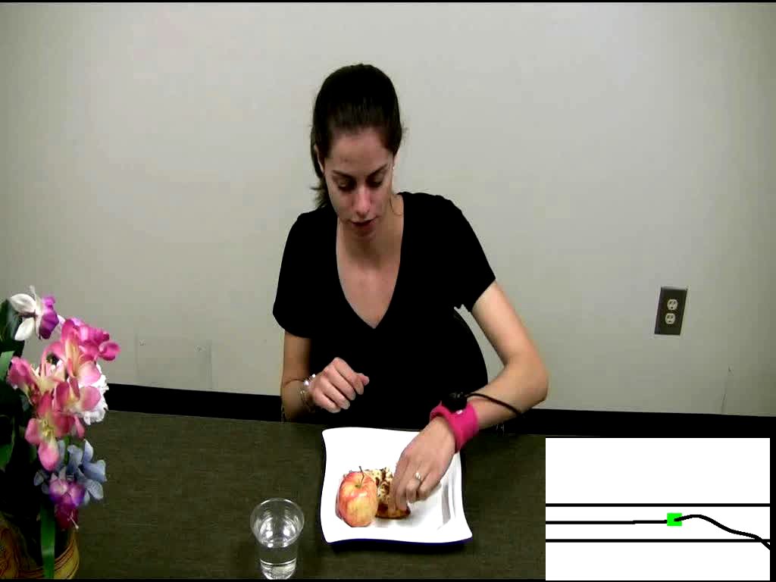
Demo of Bite Counting
Early test: 49 meals (47 participants), 1675 bites
86% bites detected, 81% positive predictive value
Talking and other actions between 67% of bites
Y. Dong, A. Hoover, J. Scisco and E. Muth, "A New Method for Measuring Meal Intake in Humans via Automated Wrist Motion Tracking", in Applied Psychophysiology and Biofeedback, vol 37, no 3, 2012, pp 205-215.

Slide 15
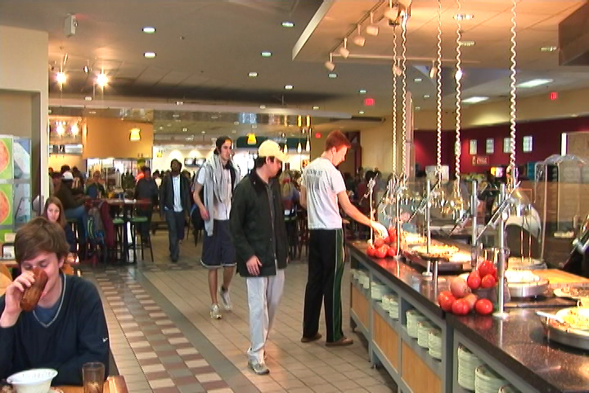
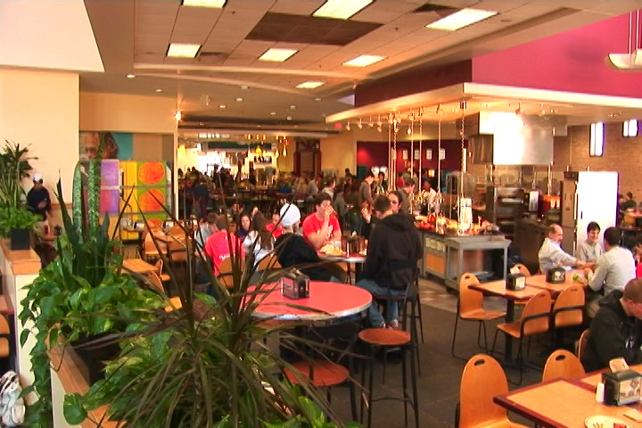
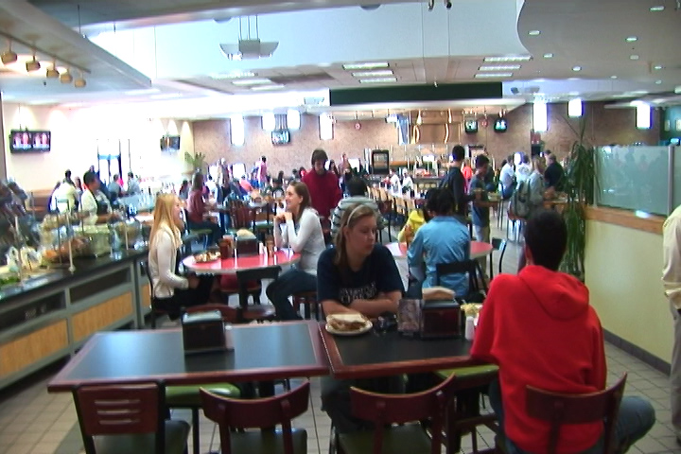
Cafeteria Experiment
Main food service for Clemson University
Seats ~800 people
Huge variety of foods and beverages

Slide 16
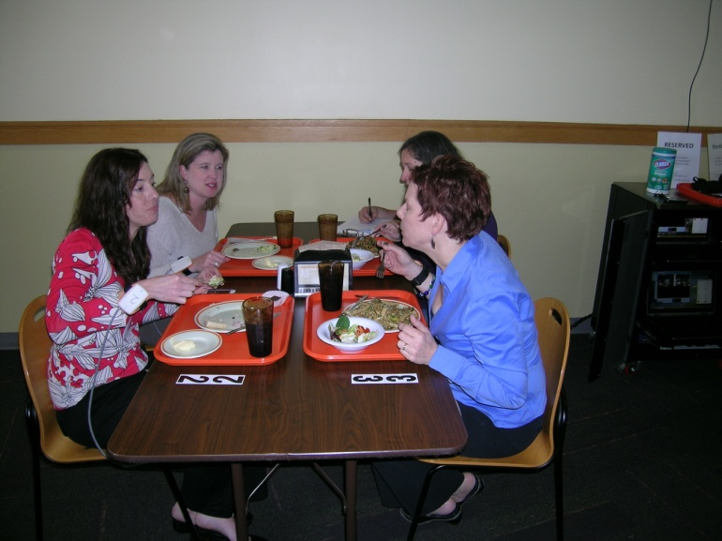
Cafeteria Experiment
276 participants (1 meal each)
374 different foods and beverages consumed
24,088 total bites
81% bites detected, 83% positive predictive value
Y. Shen, J. Salley, E. Muth and A. Hoover, "Assessing the Accuracy of a Wrist Motion Tracking Method for Counting Bites across Demographic and Food Variables", in IEEE Journal of Biomedical and Health Informatics, vol. 21 no. 3, March 2017, pp. 599-606.

Slide 17
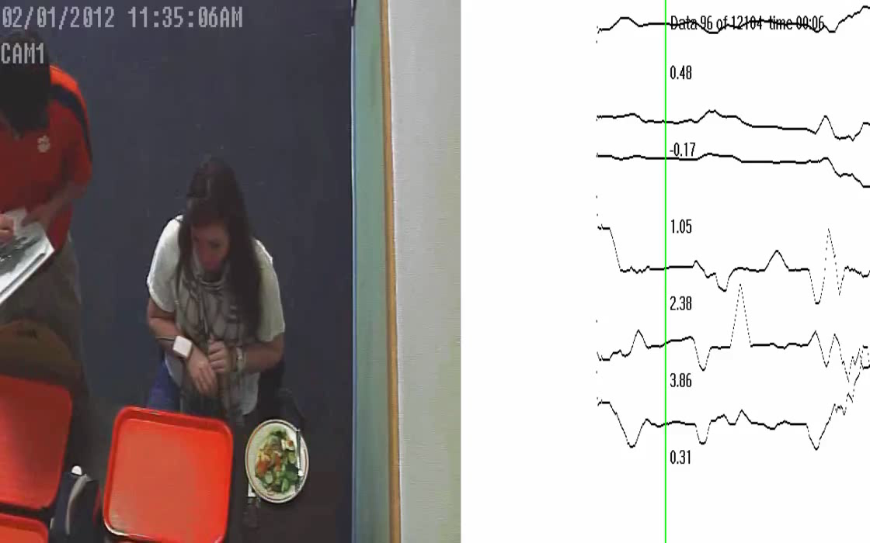
Cafeteria Demo

Slide 18
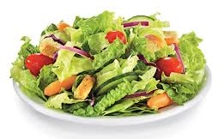
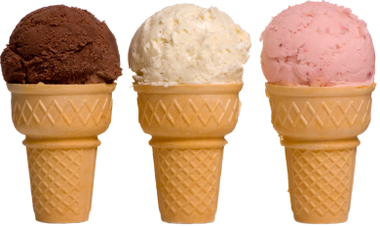
Bite Counting Accuracy
most accurate food:
salad bar (87%)
least accurate food:
ice cream cone (37%)
Accuracy increases as seconds per bite slows
(age, gender, ethnicity)
Accuracy modestly correlates with total wrist motion
(head-toward-plate vs hand-towards-mouth motion)
Y. Shen, J. Salley, E. Muth and A. Hoover, "Assessing the Accuracy of a Wrist Motion Tracking Method for Counting Bites across Demographic and Food Variables", in IEEE Journal of Biomedical and Health Informatics, vol. 21 no. 3, March 2017, pp. 599-606.

Slide 19
Outline
Motivation, existing tools, related work
Tracking wrist motion to count bites
Relating bites to calories
Design and manufacturing

Slide 20
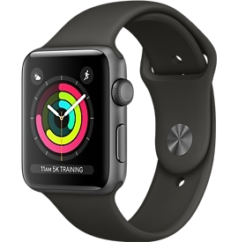


Embedded System Design
Stores time-stamped log of meals (bite count)
On/off button
Lab model
Watch model
Free app

Slide 21
Bite-to-Calorie Correlation
each point = 1 meal
2 weeks data (~50 meals), 1 person

Slide 22
Correlation Test
83 subjects wore for 2 weeks, 3246 total meals
each plot = 1 person
0.4 correlation
0.7 correlation
J. Scisco, E. Muth and A. Hoover, "Examining the Utility of a Bite-Count Based Measure of Eating Activity in Free-Living Humans", in Journal of the Academy of Nutrition and Dietetics, vol. 114 no. 3, April 2014, pp. 464-469.

Slide 23
Correlation Comparison
Physical activity monitors ¹
Energy expenditure
Our device
Energy intake
76% ≥ 0.4
¹ Westerterp & Plasqui, 2007, "Physical Activity Assessment with Accelerometers: An Evaluation against Doubly Labeled Water", in Obesity, vol 15, pp 2371-2379.

Slide 24
Converting Bites to Calories
kpb = kilocalories per bite
Formula based on height (h), weight (w), age (a)
kpb (male) = 0.2455 h + 0.0449 w − 0.2478 a
kpb (female) = 0.1342 h + 0.0290 w − 0.0534 a
Formula fit using 83-people 2-week data set
Tested on 276 meals cafeteria data set
J. Salley, A. Hoover, M. Wilson and E. Muth, "A Comparison Between Human and Bite-Based Methods of Estimating Caloric Intake", in Journal of the Academy of Nutrition and Dietetics, vol. 116 no. 10, pp. 1568-1577.

Slide 25
Calories in Cafeteria Meals

Slide 26
Outline
Motivation, existing tools, related work
Tracking wrist motion to count bites
Relating bites to calories
Design and manufacturing

Slide 27
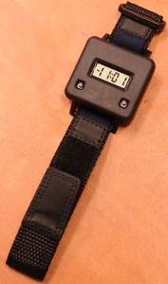
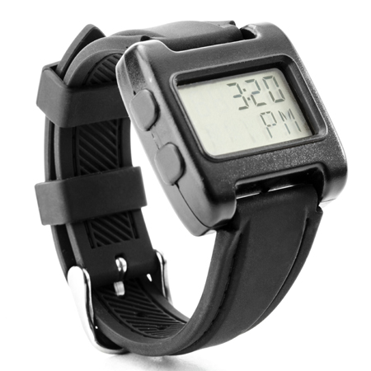
Embedded System Design
Laboratory
experiments
(2007)
2nd gen (2015)
($125k + labor)
1st gen (2011)
($35k + labor)

Slide 28
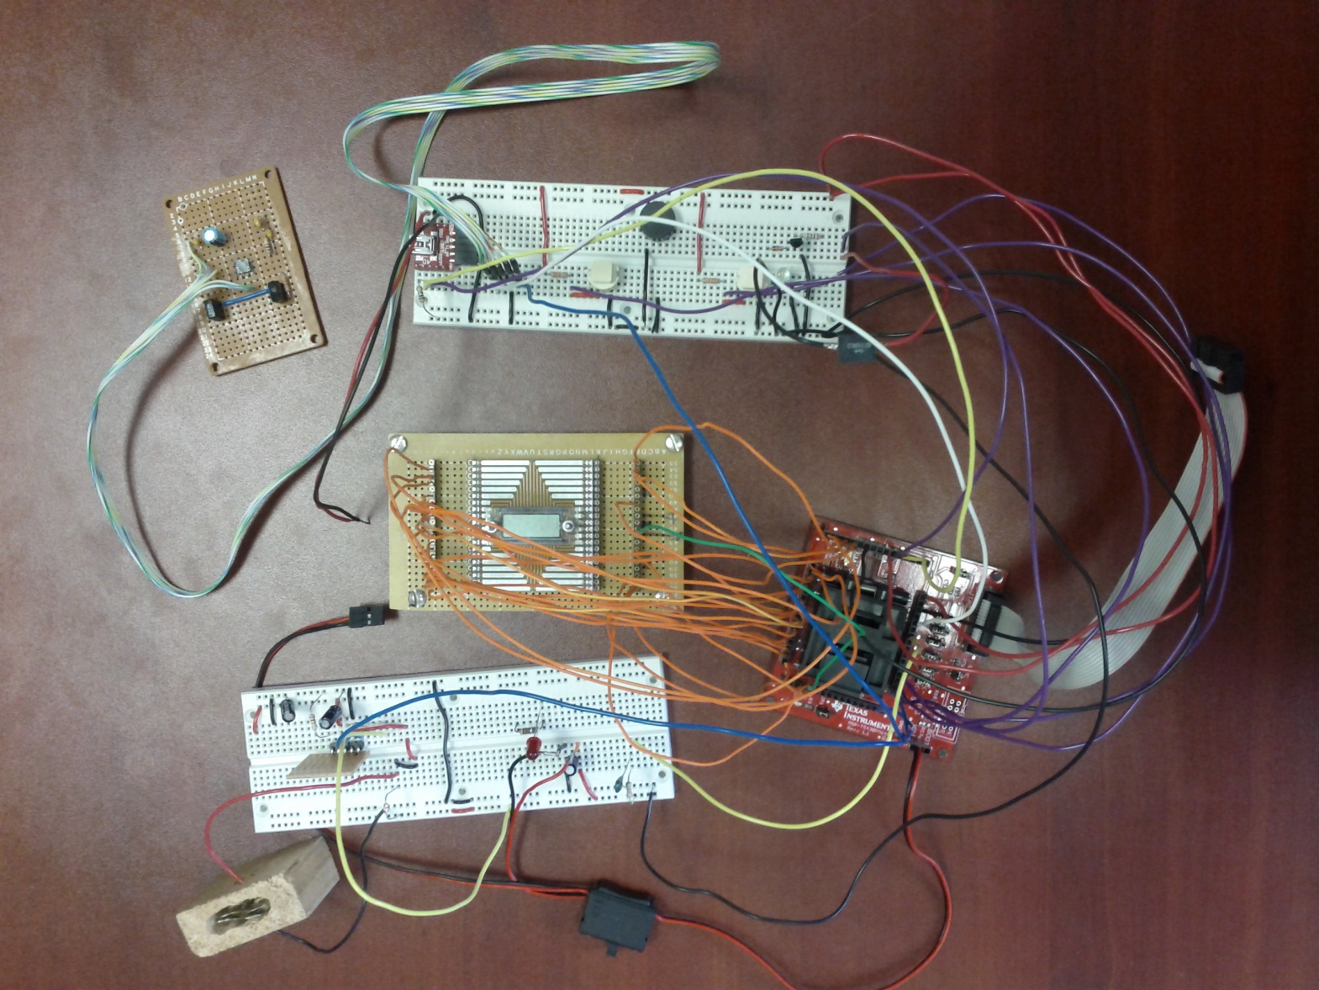
Breadboarding and parts selection
I/O (buttons, speaker, vibratory motor, USB port)
gyroscope
LCD
charger
processor
battery, holder

Slide 29
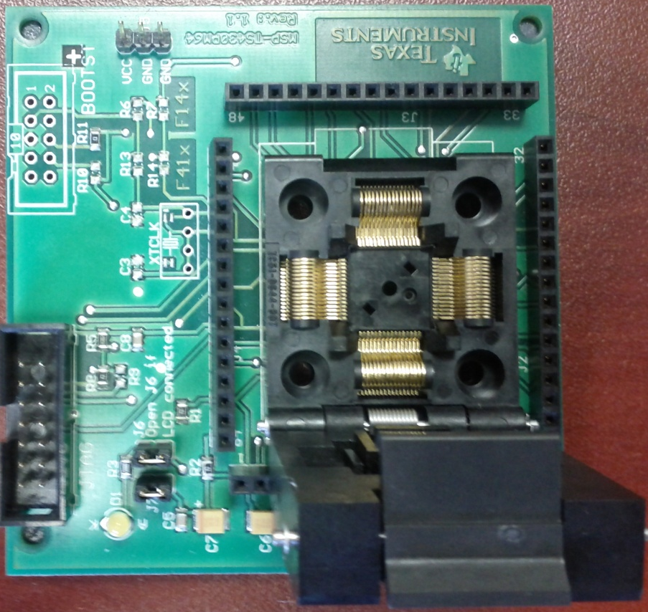
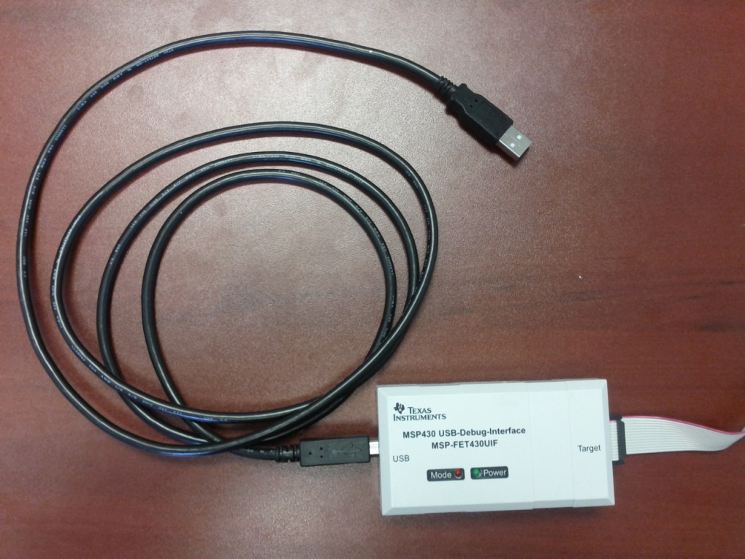
Processor
development board
dev board JTAG-USB
Texas Instruments MSP430 selection guide

Slide 30
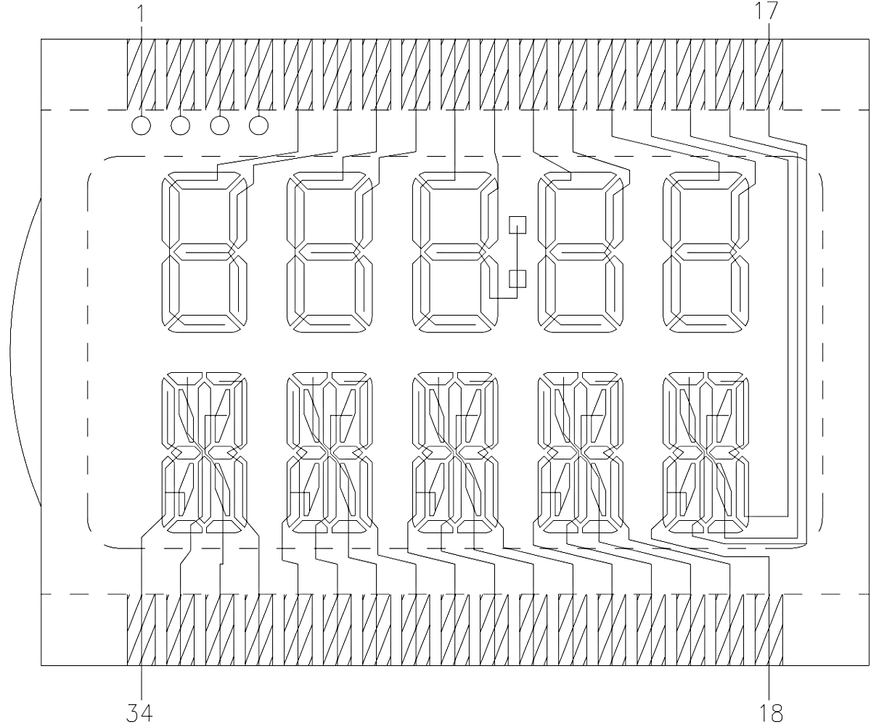
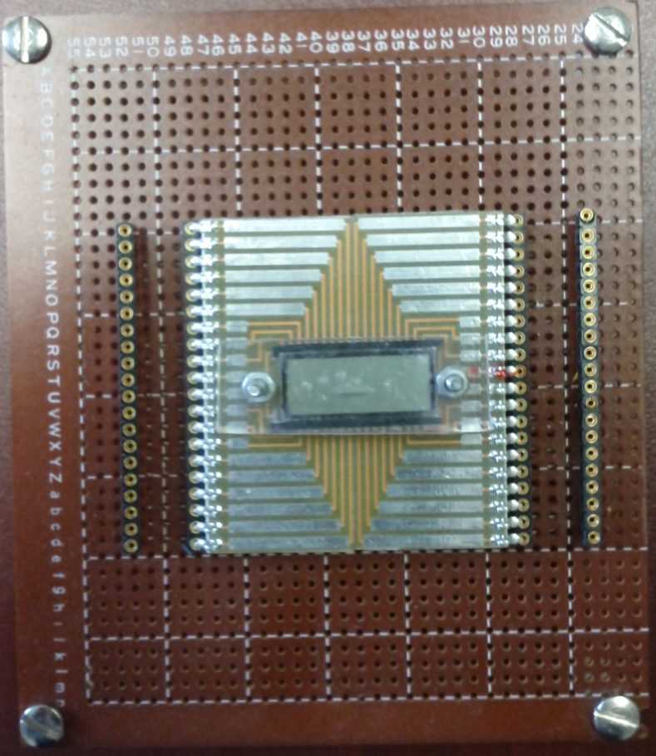
LCD
surfboard and custom
breakout board
pins
2nd gen custom LCD design
top row 7 seg (values), bottom row 16 seg (units)

Slide 31
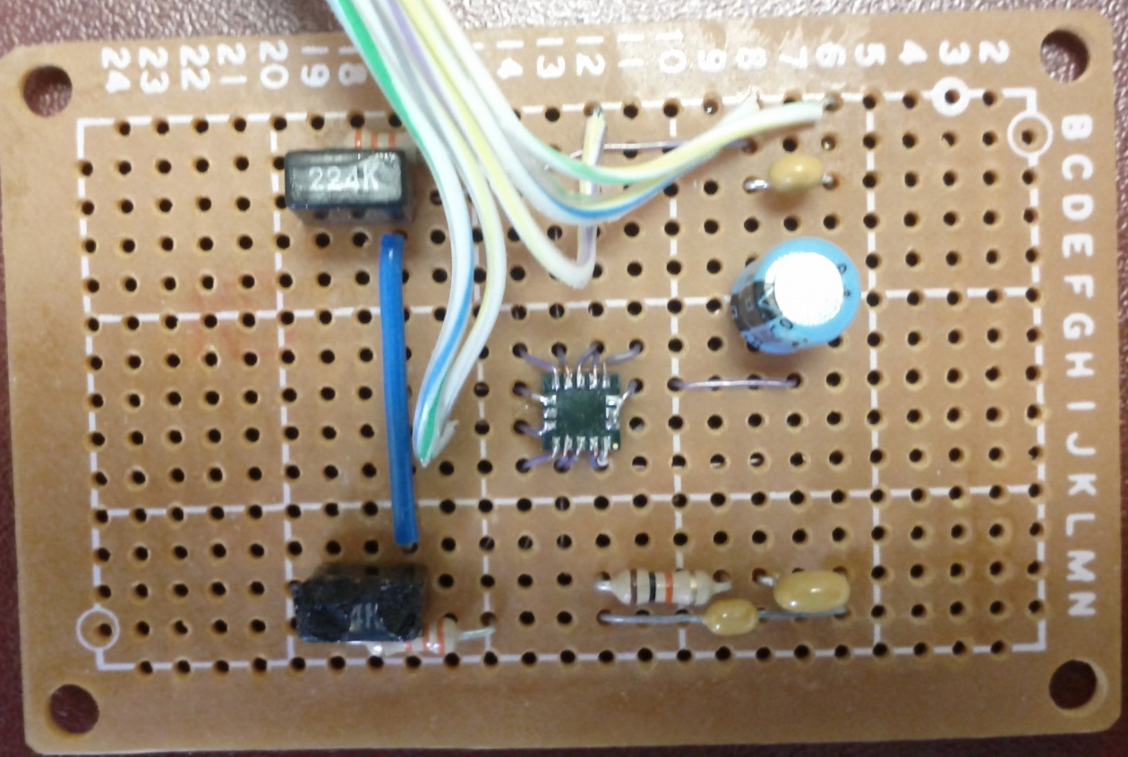
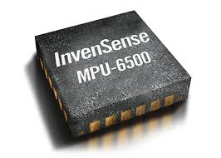
Gyroscope
2nd gen includes accelerometer,
used for pedometer function
typically follow “application circuit” from manual

Slide 32
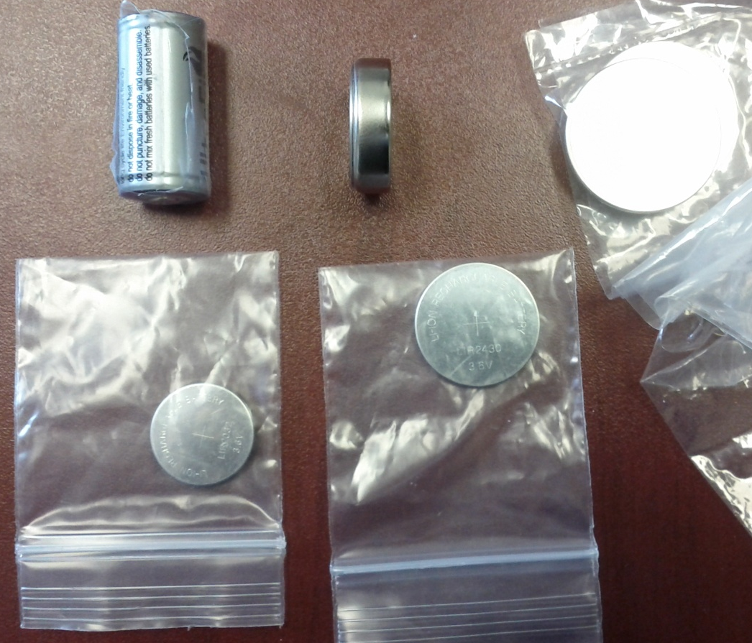
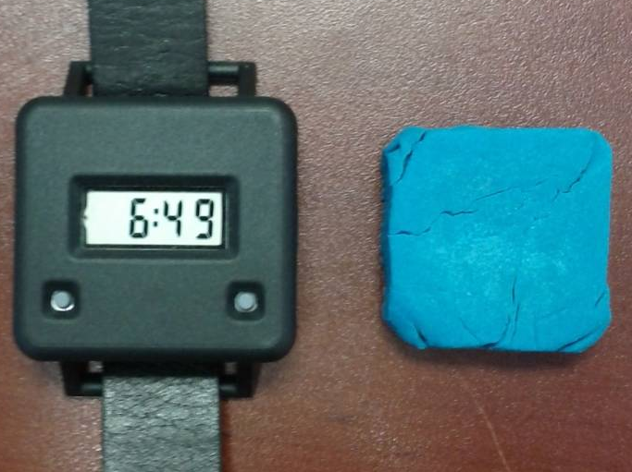
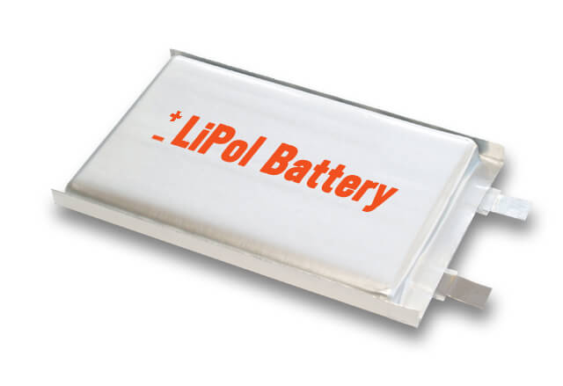
Battery
What can you wear?
How long will it run?
1st gen used coin package
2nd gen used square package
(wearables industry)

Slide 33
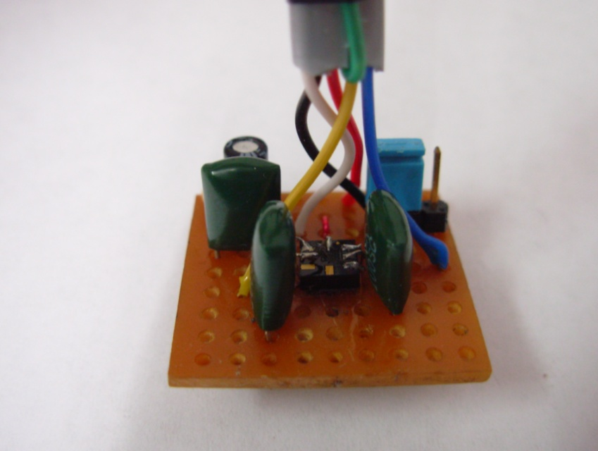
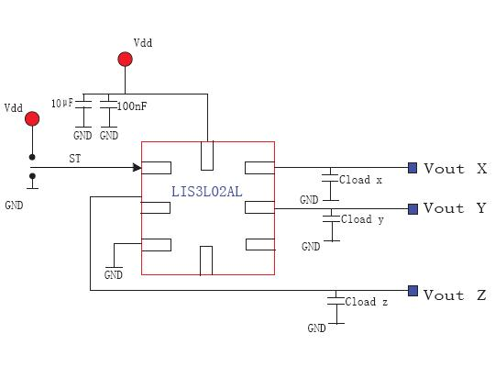


Design stages
Breadboard
Circuit diagrams

Slide 34
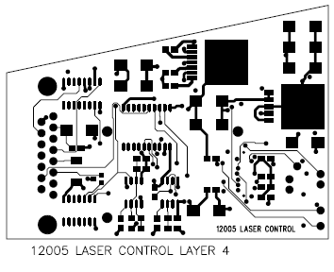
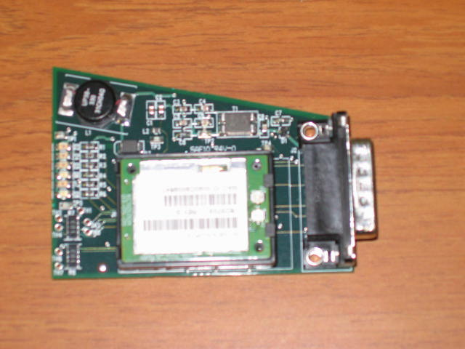

Design stages
Circuit diagrams
Printed circuit board (PCB) & manufacturing

Slide 35
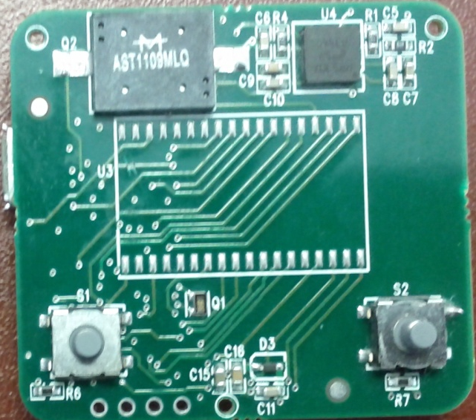
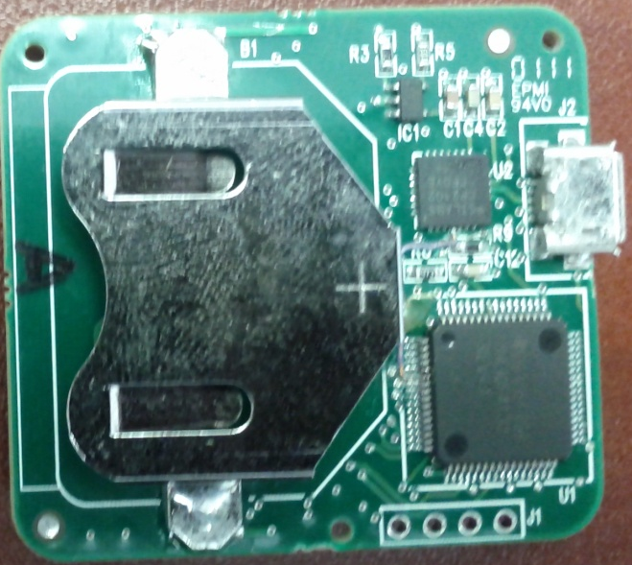
Bite counter PCB
gyroscope
charger
speaker
USB port
LCD
battery
processor
buttons
USB-RS232 bridge
JTAG
1st gen PCB

Slide 36
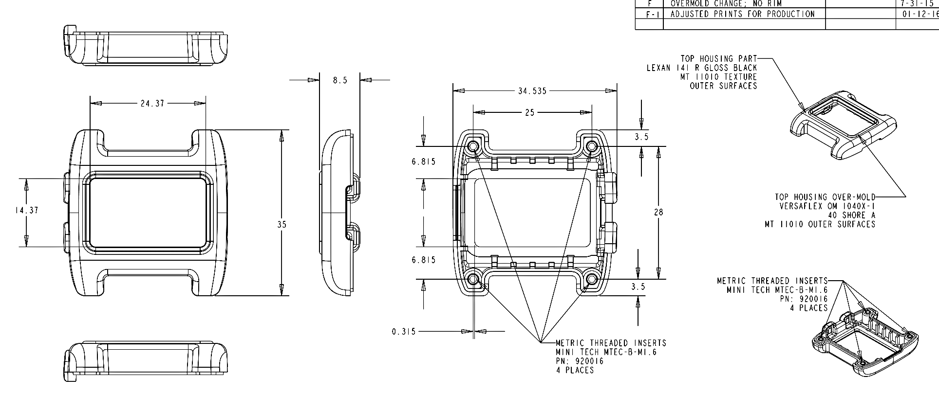

Design stages
Industrial designer

Slide 37


Design stages
Industrial designer
PCB design
Molding and case production

Slide 38

Design stages
Molds cost $10k (1st gen), $40k (2nd gen)

Slide 39


Design stages
PCB, case
Assembly

Slide 40


Design stages
Package design and manufacturing

