Slide 1
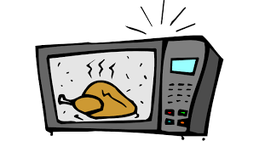
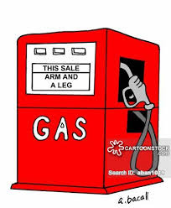
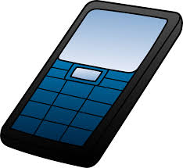
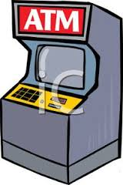
Introduction to Embedded Computing
Adam Hoover

Slide 2
Computing Fundamentals
All these devices include:
Processor(s)
Memory
Bus
Input/output (I/O)
All computations use:
Binary data (1’s and 0’s)
Fetch/Decode/Execute
Instruction Set Architecture (ISA)
How do they differ?

Slide 3
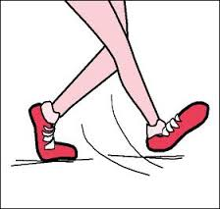
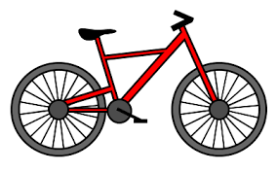
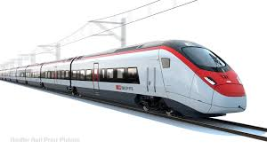
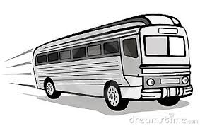
Design Axes
Suppose you have a travel problem…
Transportation modes differ in:
Size
Cost
Fuel
Origination/Destination
…

Slide 4
Distance as the design axis
mode
Distance to be travelled

Slide 5
Computing Design Axes
Differences could include:
Size
Cost
“Processing power”
Processor clock speed
Computations/second
Memory bandwidth
# processing elements (cores)
“Display power”
Frame rate
Triangles/second
Screen size
These are classic axes for desktops,
laptops, etc.

Slide 6
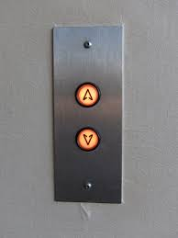
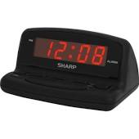
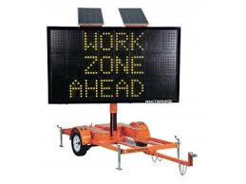
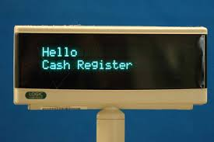
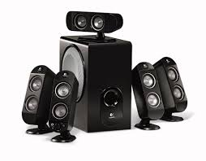
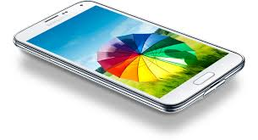
Data Type Axis
Data type | Example product
Boolean
Numeric
Text
Transaction
Sound
Image/video
Elevator
Clock, pedometer
Airport departures,
highway message
boards
ATM (banking),
cash register
Smoke alarm,
surround sound
Video player,
smartphone

Slide 7
Data Type Axis
Data type | Example product | Input | Output | Computing components
Boolean | Elevator
Numeric | Clock, pedometer
Text | Airport departures, highway message boards
Transaction | ATM (banking), cash register
Sound | Smoke alarm, answering machine
Image/video | Video player, smartphone
Push buttons
On/off lights
Switches, dials
Segmented
display
Dot matrix
display
?
Keyboard
Keypad
Text display
(font)
Microphone
Speakers
Graphics display
(pixels)
Camera

Slide 8
Data Types
What is 10011?
Boolean:
0 => false
1 => true
TFFTT
Unsigned magnitude:
each bit => 2^{n}
1+2+16=19
Signed magnitude:
1st bit => sign
remaining bits => 2^{n}
-3
Two’s complement:
positive integers => unsigned mag
negative integers => reverse bits, add 1
01100+00001 = 01101
-(1+4+8) = -13

Slide 9
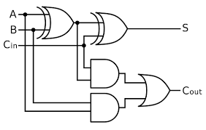
Data Types
Why use two’s complement?
Makes addition/subtraction easy.
Positive/negative numbers handled the same.
Example:
5 + (-2) = 3
5 => 00101
+2 => 00010
-2 => 11101 + 00001 => 11110
5 + (-2) => 00101
+ 11110
---------
1 00011 (throw away carry bit) = 3
circuit in chip
Computing chips customized to work with different data types

Slide 10
Data Types
What is 10011?
Fixed point:
n spans - to + in 2^{n}
decimal point fixed
example: 2² 2¹ 2⁰ 2⁻¹ 2⁻²
4.75
Signed fixed point:
as above, 1st bit => sign
-0.75
Floating point:
sign bit
s bits for significand
e bits for exponent
formula varies but basic idea is
number = (sign) 1.s × 2e
-1.00 × 2³ = -8.0

Slide 11
Data Types
What is 10011?
ASCII:
7-bit patterns of alphanumeric and control signals
examples:
0100 0001 => 65 => A
0101 1101 => 93 => a
0000 1001 => 9 => horizontal tab
5/8 of a character?
UNICODE:
32-bit patterns (all language symbols)
example:
0000 0011 1100 0000 => 03C0 (hex) => π
5/32 of a character?

Slide 12
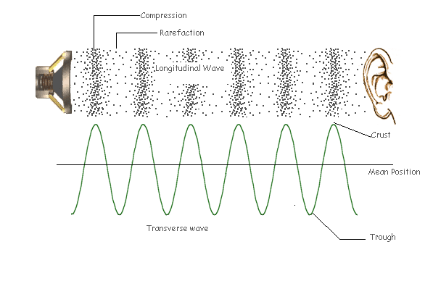
Data Types
Sound: air pressure measured over time

Slide 13
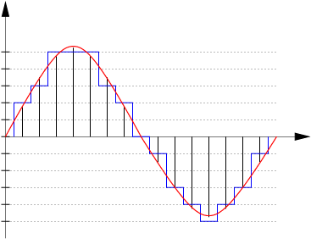
Data Types
Digitizing sound
Design choices include:
Sampling rate
44 KHz common
Bit depth
8, 16, 24, 32
Encoding:
Pulse code modulation (PCM)
differential PCM
#channels
1 => mono
2 => stereo
6 or 7 => surround
Bit depth
Sampling rate

Slide 14
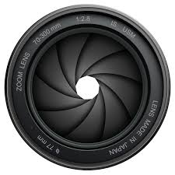
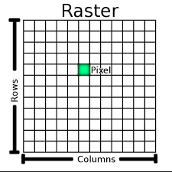
Data Types
Image: visible light measured over space
similar phenomenon to sound, but
(a) much faster! 390-700 nm waves => 430-790 teraHz
computing circuits cannot sample this fast
instead, accumulate total power during open shutter
(b) many more channels! 480x640, 1024x768, etc.
digitize each channel separately into “pixel”
Design choices include:
Wavelength frequencies (RGB, greyscale, IR)
Raster size
Sampling rate (for video)
Pixel encoding (lots of choices)

Slide 15
Data Type Axis
Data type | Example product | Input | Output | Computing components
Boolean | Elevator | Push buttons | On/off lights | Different types of processors, memories, buses, data compression, operating systems, and I/O interfacing
Numeric | Clock, pedometer | 0-9 keypad | Segmented display
Text | Airport departures, highway message boards | Keyboard | Dot matrix display
Transaction | ATM (banking), cash register | Keypad | Text display (font)
Sound | Smoke alarm, answering machine | Microphone | Speakers
Image/video | Video player, smartphone | Camera | Graphics display (pixels)

