Slide 1
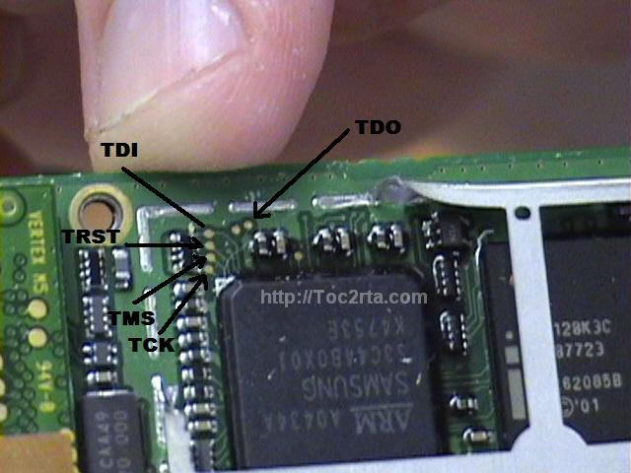
JTAG
Chip and Circuit Board Debugging
Adam Hoover

Slide 2
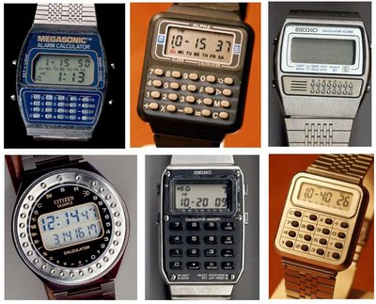
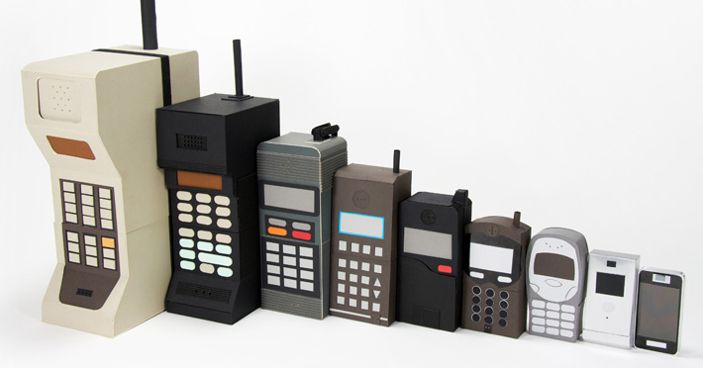
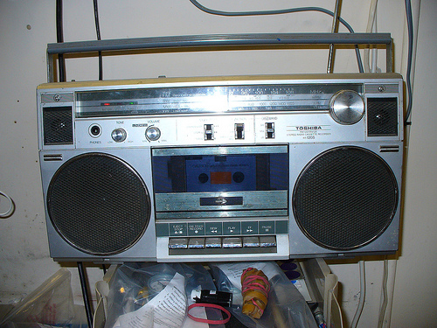
Background
1980’s explosion of embedded computing products

Slide 3
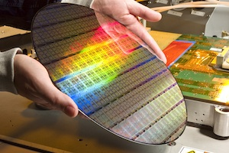
Background
Mass production of chips … how to test in bulk?
Mass production of products … how to test in bulk?

Slide 4
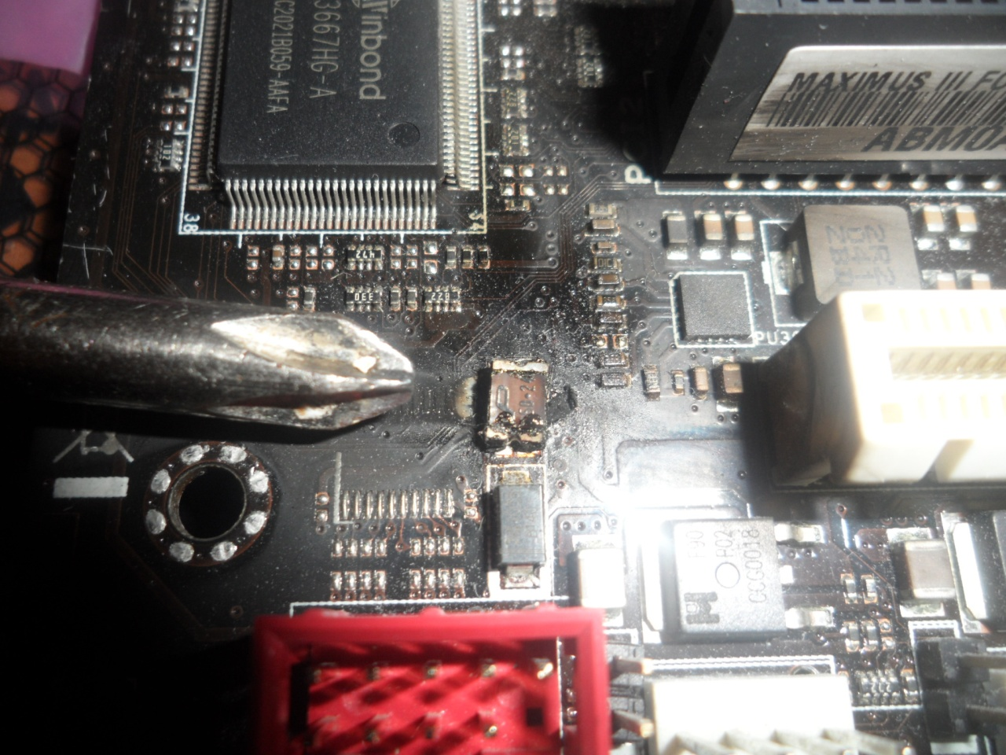
Background
Chip fails in a product … how to find which part failed?

Slide 5
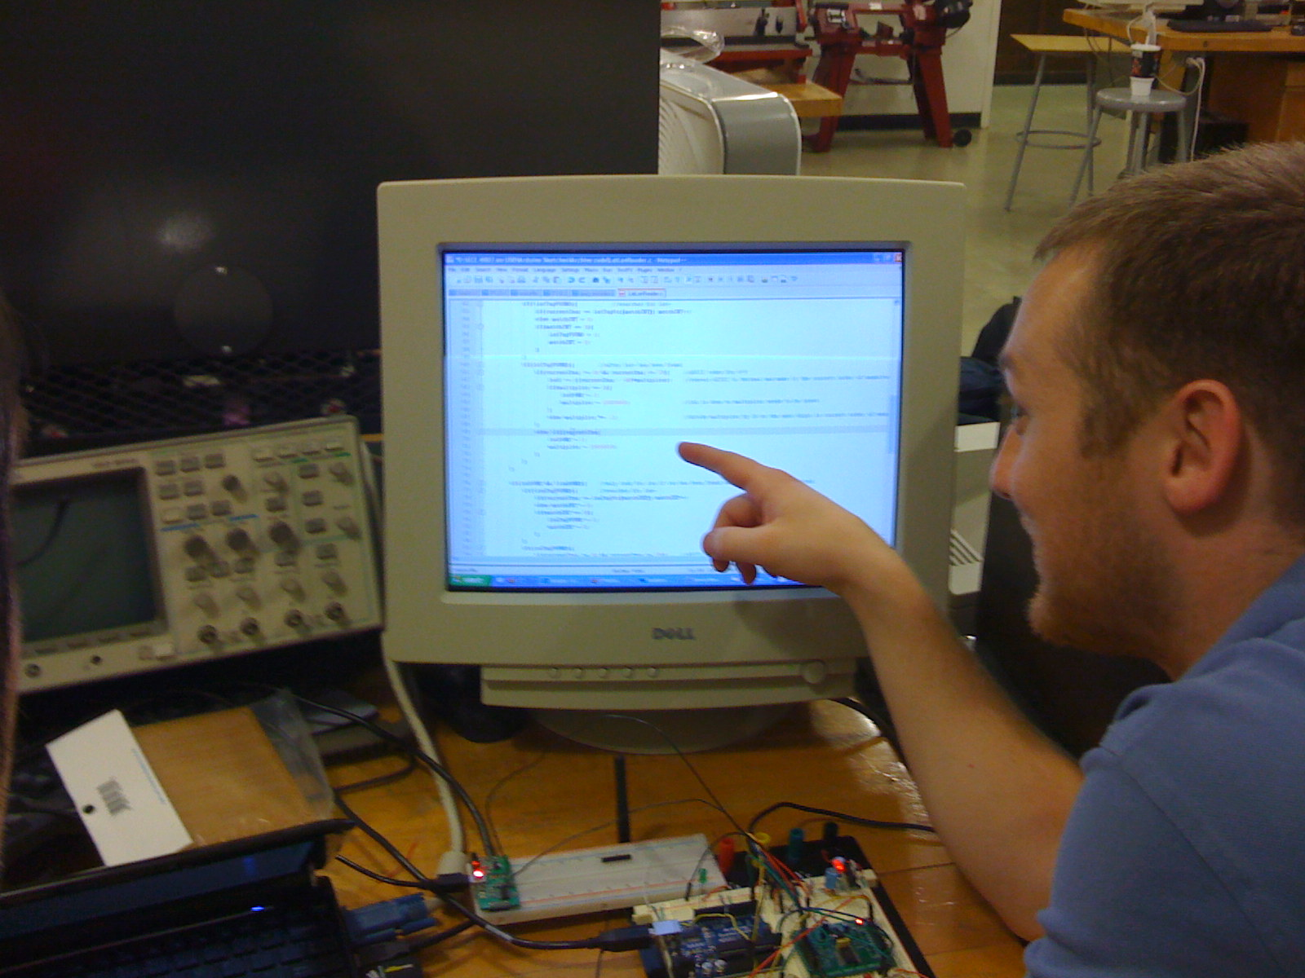
Background
During product development … how to debug/observe code?

Slide 6
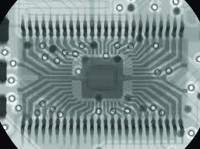
How to see inside a chip?
X-ray
Can see traces, detect breaks How to test functionality?
Used for inspection Non-break failures?

Slide 7
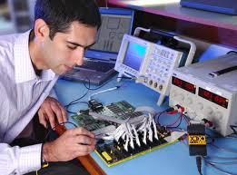
How to see inside a chip?
Oscilloscope
Pins getting smaller and smaller Lots of pins!
Pins underneath the chips How to affect, record?

Slide 8
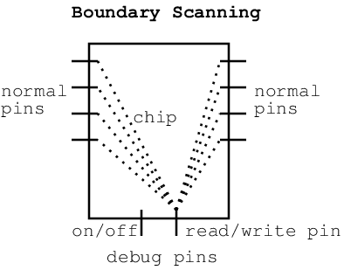
Boundary Scanning
Dedicate some pins to test and debug
Read voltages from other pins or circuitry inside chip via debug pins
When turned on, in debug mode; when turned off, operate normally

Slide 9
Background
Industry manufacturers were all making custom solutions
JTAG = Joint Test Action Group
IEEE 1149.1 Standard Test Access Port (TAP) and Boundary-Scan Architecture
(mouthful, let’s just call it JTAG)

Slide 10
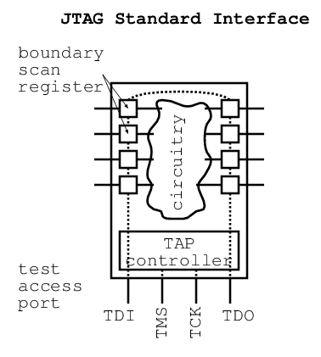
JTAG pins
Input/output voltages
Shifted through latches
on pins around the
boundary of the chip
TDI = input TDO = output
TCK = clock TMS = test mode select (turn JTAG on/off)

Slide 11
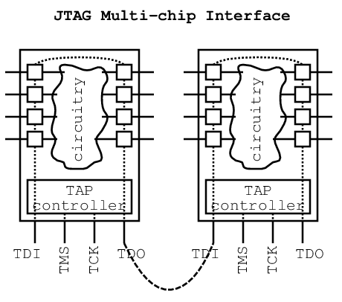
Multiple chips
Connect chips in series

Slide 12
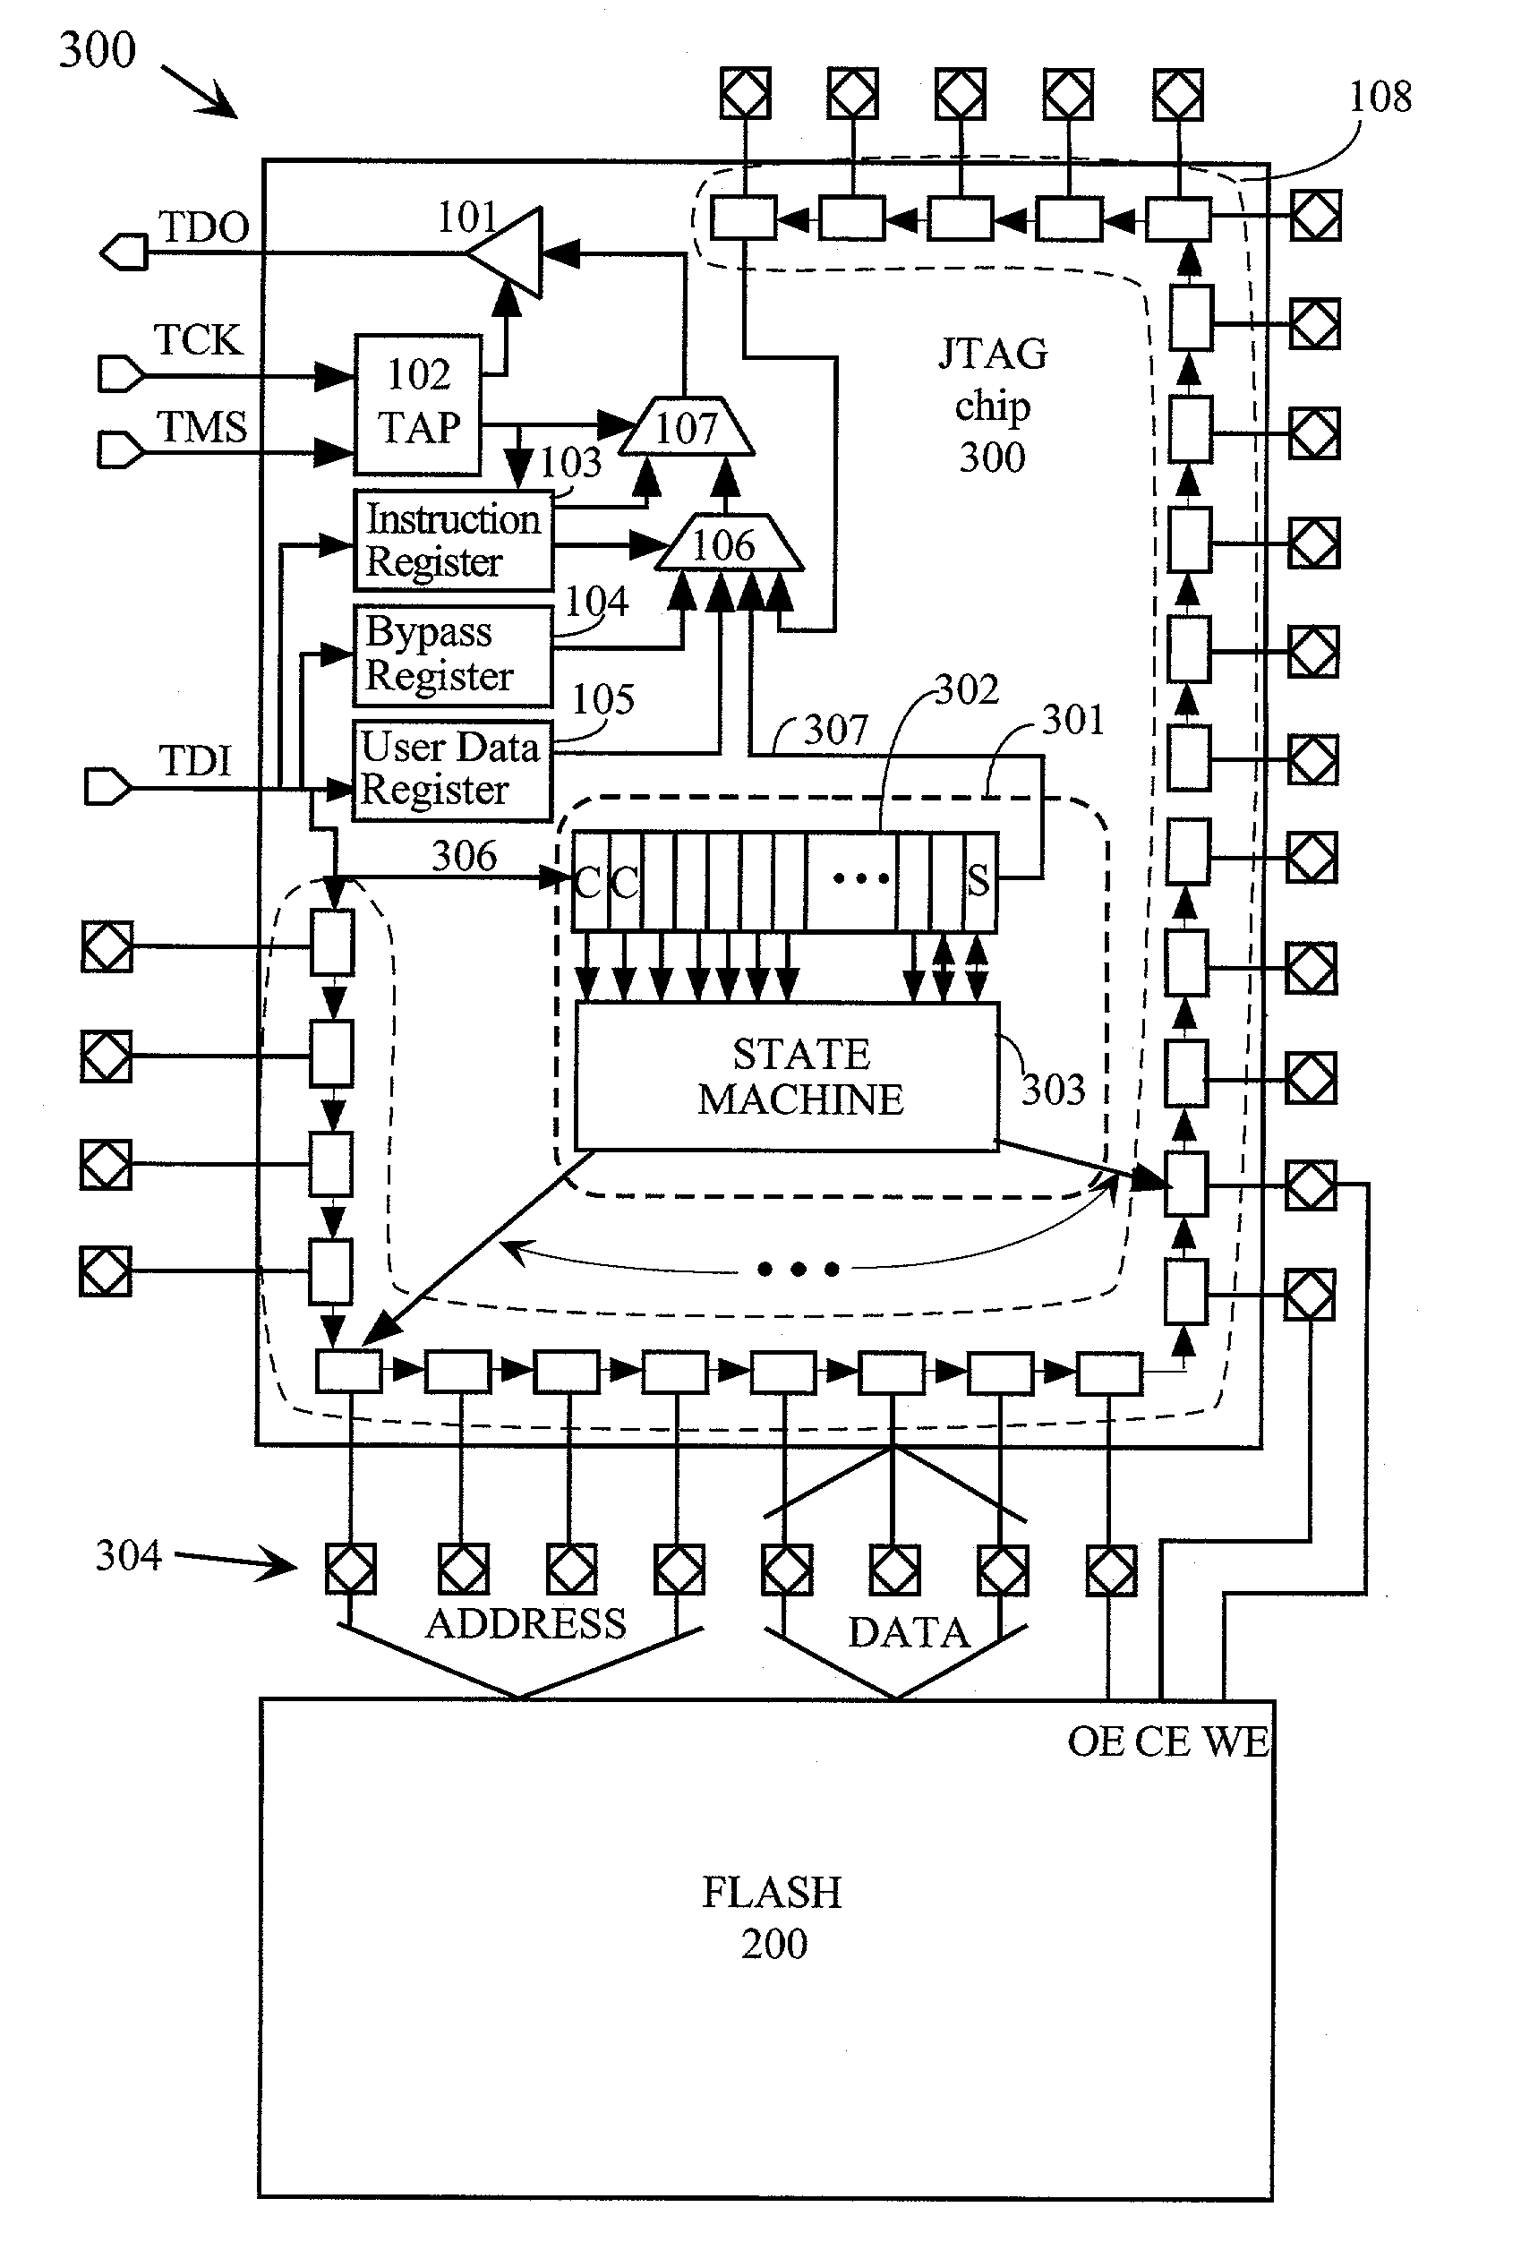
Details
Some default instructions:
BYPASS (TDO = TDI)
SAMPLE/PRELOAD
IDCODE (chip ID)
INTEST (run internally hold pins)
CLAMP/HIGHZ (voltage test)
RUNBIST (built-in self test)
…
Shift in/out
1 bit at a time
Buffer bits to form JTAG instruction
(slow!)
Execute JTAG instruction
Dual-use some pins for
more debugging options

Slide 13
JTAG variations
Manufacturer | Processor family | Debug interface | #pins
Atmel | AT91 ARM Thumb | JTAG | 4
Atmel | megaAVR | JTAG | 4
Atmel | tinyAVR | debugWIRE | 1
Silicon Labs | 8051 (small) | C2 | 2
Silicon Labs | 8051 (larger) | JTAG | 4
Zilog | eZ80 | ZDI | 2
Freescale | MC68HC12 | BDM | 1
Freescale | MPC500 | Nexus 5001 | 16
ST Micro | STR710 ARM | JTAG | 4
LSI Logic | MiniRISC MIPS | EJTAG | 4
Toshiba | TX system MIPS | EJTAG | 4

Slide 14
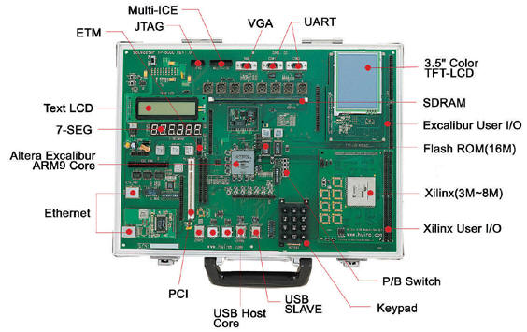
On a development board

Slide 15
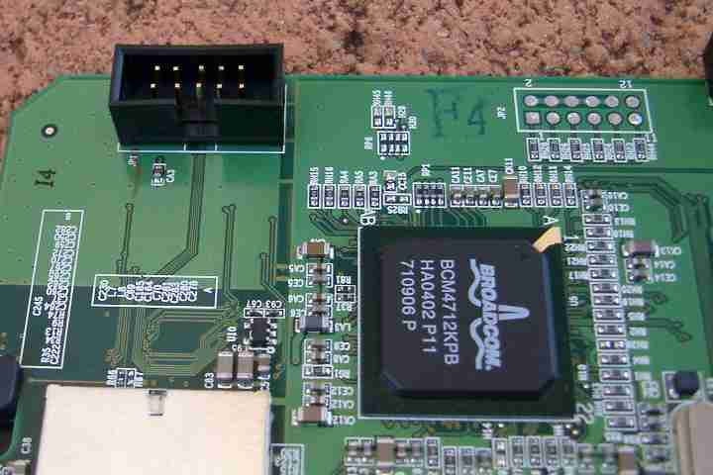
On a product
through-holes
header

Slide 16
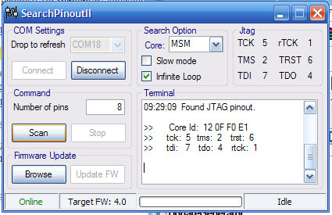
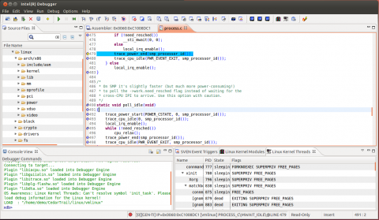
Software interface
Low-level (non-processor chips)
High-level IDE for processor
programming and debugging
Custom, anything in-between

