Slide 1
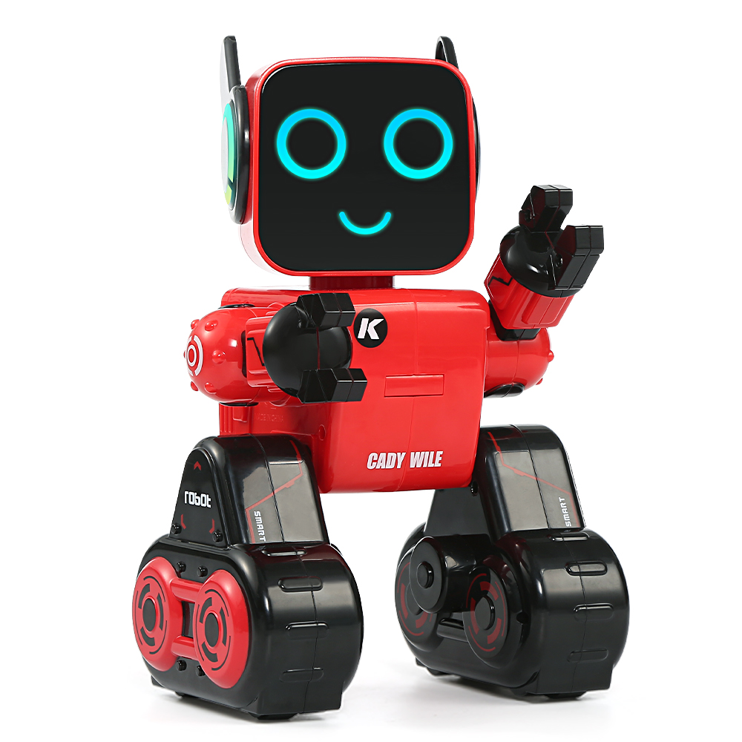
MATH
Behavior Based Robotics
Adam Hoover

Slide 2
Stimulus-Response
Basic operation of behavior-based robot:
stimulus
sensor
response
controller
Examples:
light
photodiode
avoid
move away
sound
microphone
alert
scan around
touch
force sensor
turn
rotate/forward

Slide 3
Behavior Modeling
Assume task can be decomposed into multiple behaviors
Example task = move from one room to another
Component behaviors:
Move towards destination
Do not bump into walls, doors, fixed obstacles along the way
Negotiate around moving obstacles (people)
Observe cultural norms
Stay to right
Let elders go first
Cope with unexpected changes

Slide 4
Combining Behaviors
stimulus
response
behavior
room location
move towards room
detected object
avoid object
controller
detected person
dodge person
detected elder
defer/wait
Each response yields a desired action; the controller must decide output

Slide 5
Cooperative Controller
Each behavior contributes a portion to final output
controller
output action
move towards room
avoid object
dodge person
defer/wait

Slide 6
Competitive Controller
Each behavior has a priority
priority
controller
output action
4
move towards room
1
avoid object
2
dodge person
3
defer/wait

Slide 7
Reset
If sensors detect unviable situation, what to do?
room location
move towards room
detected object
avoid object
controller
detected person
dodge person
detected elder
defer/wait
unexpected problem
reset

Slide 8
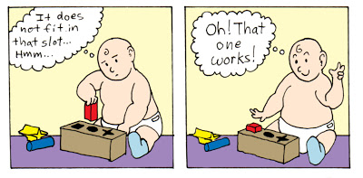
Design
Trial and error. Essentially how evolution works.
We are going to try this in the “Emerge” simulated robot world.

