Slide 1
Fast and Accurate PoseSLAM by Combining Relative and Global State Spaces
Brian Peasley and Stan Birchfield
Microsoft Robotics
Clemson University

Slide 2
PoseSLAM
Problem: Given a sequence of robot poses and loop closure(s), update the poses
Update
loop closure
edge
pose at a:
relative measurement
between a and b:
p_{b}=(x_{b},y_{b},θ_{b})
pose at b:
end
p_{a}=(x_{a},y_{a},θ_{a})
δ_{ab} = (δx_{ab},δy_{ab},δθ_{ab})
{
error caused by
sensor drift
start
Initial (noisy) pose estimates
Final pose estimates

Slide 3
Video

Slide 4
PoseSLAM as graph optimization
Key: Formulate as graph
Nodes = poses
Edges = relative pose measurements
Solution: Minimize an objective function where
state
residual for single edge
total
error
info matrix
observed
measurement
predicted
by model
Question: How does state x
relate to poses p?

Slide 5
PoseSLAM as nonlinear minimization
With a little math,
becomes
A
x
=
b
Jacobian
current
state estimate
increment
to
state
estimate
Repeatedly solve this linear system till convergence

Slide 6
How to solve linear system?
Use sparse linear algebra
Perform gradient descent
Solve the equation directly
Drawback:
Solving equation requires external sparse linear algebra package (e.g., CHOLMOD)
Update based on single edge
Drawback:
Requires many iterations* *With global state space
where is preconditioning matrix
where is learning rate
Example: g2o (Kummerle et al. ICRA 2011)
Example: TORO (Olson et al. ICRA 2006; Grisetti et al. RSS 2007)

Slide 7
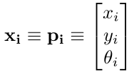
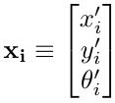
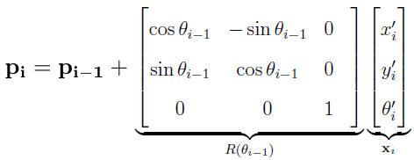
Choosing the state space
Global state space (GSS) allows fine adjustments
Incremental state space (ISS)
simple Jacobian, decoupled parameters, slow convergence
Relative state space (RSS) simple Jacobian, coupled parameters,
fast convergence
(Olson et al. ICRA 2006)
(our approach)
state
pose

Slide 8
Global state space (GSS)
Global State Space (x, y, θ)
$$x_{0}=\left[\begin{matrix}0 \\ 0 \\ 0\end{matrix}\right]$$
$$x_{1}=\left[\begin{matrix}2 \\ 0 \\ 0\end{matrix}\right]$$
$$x_{2}=\left[\begin{matrix}4 \\ 0 \\ 0\end{matrix}\right]$$
$$x_{3}=\left[\begin{matrix}6 \\ 0 \\ 0\end{matrix}\right]$$
$$x_{0}=\left[\begin{matrix}0 \\ 0 \\ 0\end{matrix}\right]$$
$$x_{1}=\left[\begin{matrix}2 \\ 0 \\ 45\end{matrix}\right]$$
$$x_{2}=\left[\begin{matrix}4 \\ 0 \\ 0\end{matrix}\right]$$
$$x_{3}=\left[\begin{matrix}6 \\ 0 \\ 0\end{matrix}\right]$$
$$p_{i}=x_{i}$$

Slide 9
Incremental state space (ISS)
Incremental State Space (Δx, Δ y, Δ θ)
$$x_{0}=\left[\begin{matrix}0 \\ 0 \\ 0\end{matrix}\right]$$
$$x_{1}=\left[\begin{matrix}2 \\ 0 \\ 0\end{matrix}\right]$$
$$x_{2}=\left[\begin{matrix}2 \\ 0 \\ 0\end{matrix}\right]$$
$$x_{3}=\left[\begin{matrix}2 \\ 0 \\ 0\end{matrix}\right]$$
$$x_{0}=\left[\begin{matrix}0 \\ 0 \\ 0\end{matrix}\right]$$
$$x_{1}=\left[\begin{matrix}2 \\ 0 \\ 45\end{matrix}\right]$$
$$x_{2}=\left[\begin{matrix}2 \\ 0 \\ 0\end{matrix}\right]$$
$$x_{3}=\left[\begin{matrix}2 \\ 0 \\ 0\end{matrix}\right]$$
$$p_{i}=\sum_{j=0}^{i−1}{x_{j}}$$

Slide 10
Relative state space (RSS)
Relative State Space (Δx, Δ y, Δ θ)
$$x_{0}=\left[\begin{matrix}0 \\ 0 \\ 0\end{matrix}\right]$$
$$x_{1}=\left[\begin{matrix}2 \\ 0 \\ 0\end{matrix}\right]$$
$$x_{2}=\left[\begin{matrix}2 \\ 0 \\ 0\end{matrix}\right]$$
$$x_{3}=\left[\begin{matrix}2 \\ 0 \\ 0\end{matrix}\right]$$
$$x_{0}=\left[\begin{matrix}0 \\ 0 \\ 0\end{matrix}\right]$$
$$x_{1}=\left[\begin{matrix}2 \\ 0 \\ 45\end{matrix}\right]$$
$$x_{2}=\left[\begin{matrix}2 \\ 0 \\ 0\end{matrix}\right]$$
$$x_{3}=\left[\begin{matrix}2 \\ 0 \\ 0\end{matrix}\right]$$
$$p_{i}=\sum_{j=0}^{i−1}{R(}\sum_{k=0}^{j}{θ_{k}})x_{j}$$

Slide 11
Proposed approach
Two Phases:
Non-Stochastic Gradient Descent with Relative State Space (POReSS)
RSS allows many poses to be affected in each iteration
nSGD prevents being trapped in local minima
Result: Quickly gets to a “good” solution
Drawback: Long time to convergence
Gauss-Seidel with Global State Space (Graph-Seidel)
Initialize using output from POReSS
GSS only changes one pose at a time in each iteration
Gauss-Seidel allows for quick calculations
Result: Fast “fine tuning”

Slide 12
Pose Optimization using a Relative State Space (POReSS)
$$Δx={\left(J^{T}(\tilde{x})ΩJ(\tilde{x})\right)}^{−1}J^{T}(\tilde{x})Ωr(\tilde{x})$$
nSGD only considers one edge at a time:
$$Δx=M^{−1}J_{ab}^{T}\left(\tilde{x}\right)Ω_{ab}r_{ab}(\tilde{x})$$
ISS
RSS
$$J_{ab}=\left[\begin{matrix}0 & ⋯ & I & ⋯ & I & 0 & ⋯\end{matrix}\right]$$
$$J_{ab}=\left[\begin{matrix}0 & ⋯ & I & ⋯ & I & 0 & ⋯\end{matrix}\right]$$
a+1 b
a+1 b
(between consecutive nodes)
(between non-consecutive nodes)

Slide 13
How edges affect states
3
e₂₃
e₃₀
x₀
e₀₁
x₁
e₁₂
x₂
e₂₃
x₃
2
e₁₂
0
e₀₁
1
e₀₃
e₀₁ affects x₁
e₁₂ affects x₂
e₂₃ affects x₃
e₀₃ affects x₀, x₁, x₂, x₃

Slide 14
Gauss-Seidel
Repeat: Linearize about current estimate, then solve Ax=b. → A is updated each time
A
x
b
A is sparse, so solve
$$x_{i}=\frac{1}{a_{ii}}{\left(b_{i}−\sum_{j ≠i}{a_{ij}x_{j}}\right) }_{}$$
Row i:
$$a_{ii}x_{i}+\sum_{j ≠i}{a_{ij}x_{j}}=b_{i}$$

Slide 15
Graph-Seidel
Do not linearize! Instead assume θs are constant → A remains constant
A
x
b
A: Diagonal: Connectivity of node (sum of off-diagonals)
Off-diagonal: Connectivity between nodes ($−$ if connected, 0 otherwise)
b: Sum of edges in minus sum of edges out

Slide 16
Refining the estimate using a Global State Space (Graph-Seidel)
$$\sum_{(i,b)∈ε_{i}}{{−Ω}_{ib}x_{b}}$$
$${diag\left(\sum_{(i,b)∈ε_{i}}{Ω_{ib}}\right)}^{−1}$$

Slide 17
Refining the estimate using a Global State Space (Graph-Seidel)
Form linear system
$$Ax=b$$
$$Ax=b$$
Compute new state
Using Graph-Seidel

Slide 18
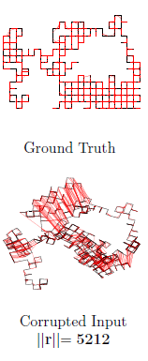
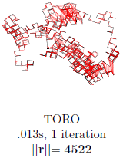
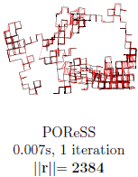
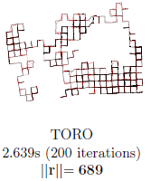
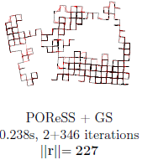
Results: Manhattan world
On Manhattan World,
our approach is
faster and more powerful than TORO
faster and comparable with g2o

Slide 19
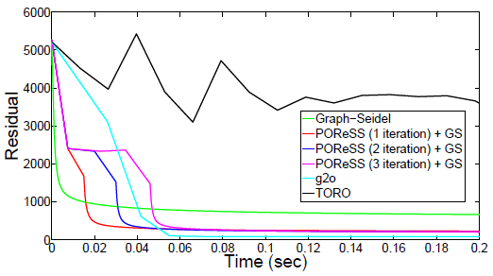
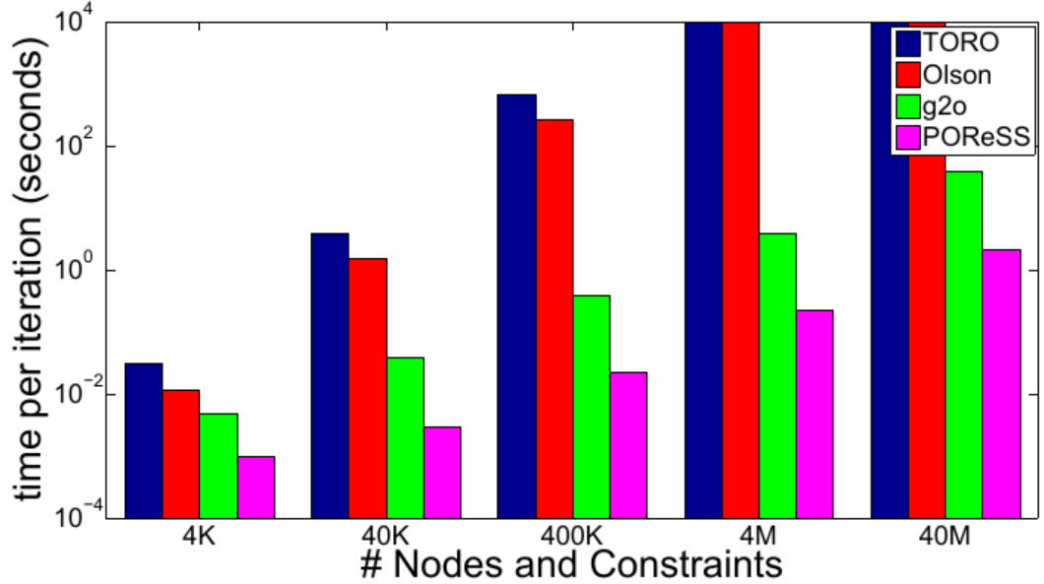
Performance comparison
Residual vs. time
Time vs. size of graph
(Manhattan world dataset)
(corrupted square dataset)
Our approach combines the
Minimization capability of g2o (with faster convergence)
Simplicity of TORO

Slide 20
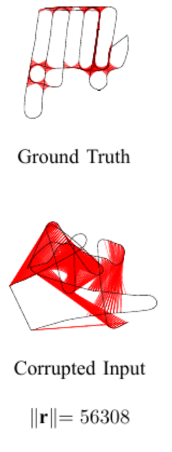
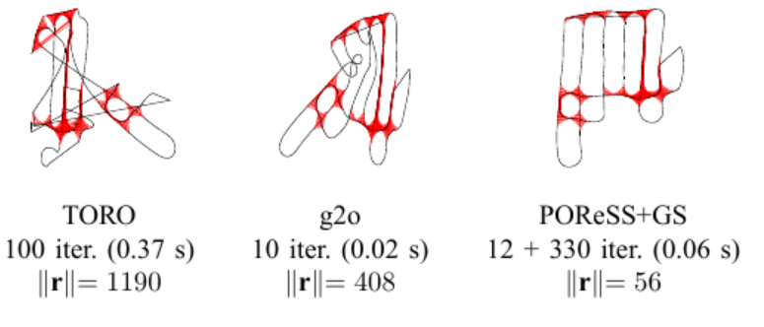
Results: Parking lot
On parking lot data (Blanco et al. AR 2009), our approach is
faster and more powerful than TORO
more powerful than g2o

Slide 21
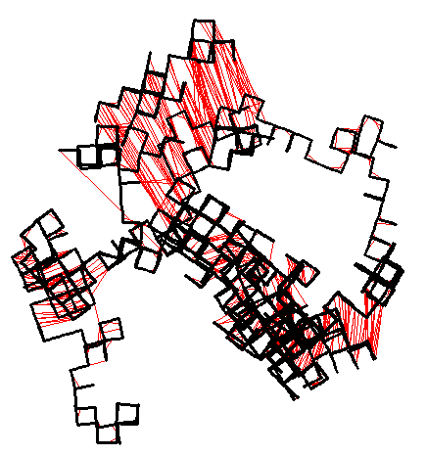
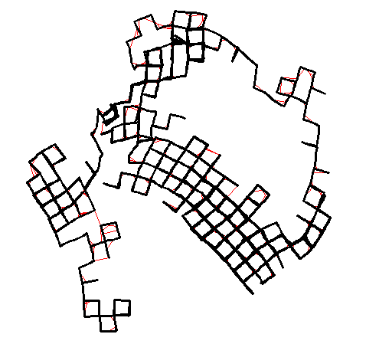
Graph-Seidel

Slide 22
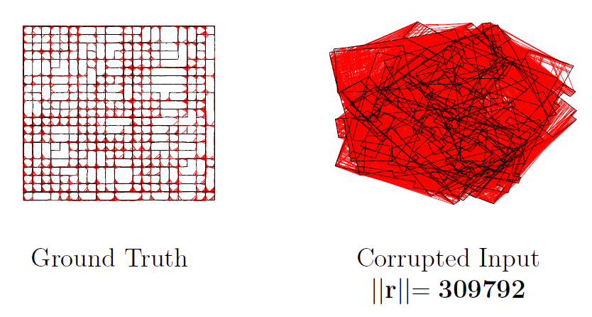
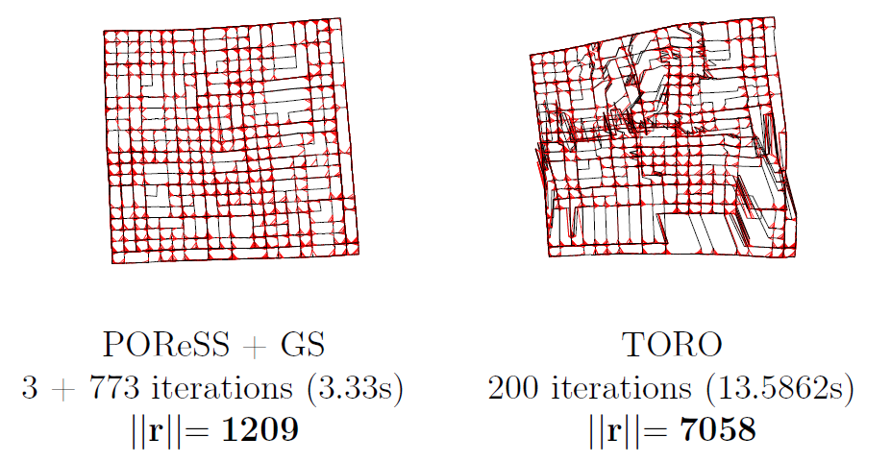
Results: Simple square

Slide 23
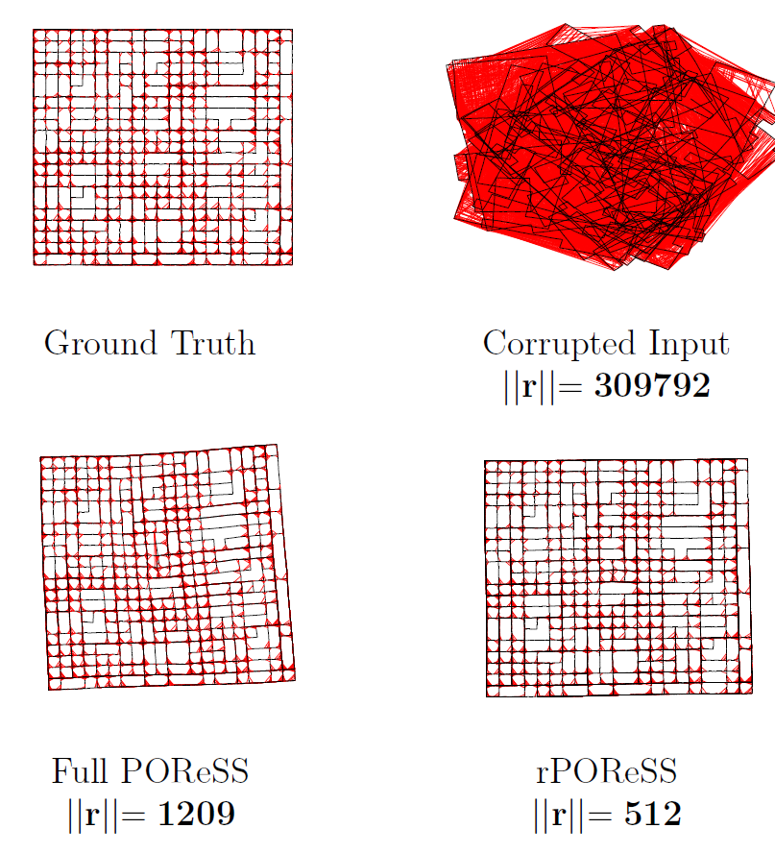
Rotational version (rPOReSS)
Majority of drift is caused by rotational errors
Remove rotational drift
Treat (x,y) components of poses as constants
Greatly reduces complexity of Jacobian derivation

Slide 24
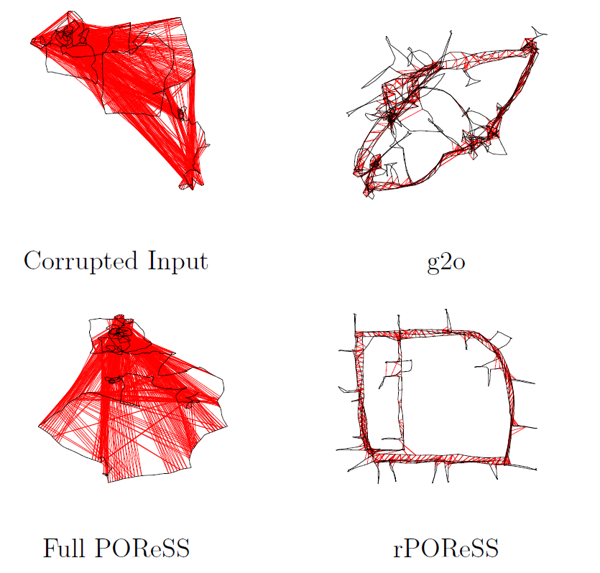
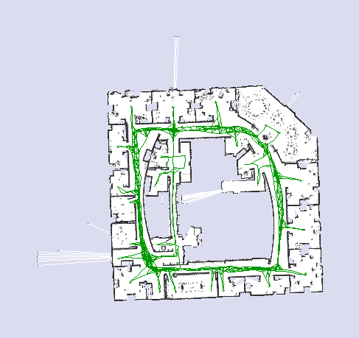
Results of rPOReSS: Intel dataset

Slide 25
Incremental version (irPOReSS)
Incremental:
Rotational POReSS can be run incrementally
Goal is to keep graph “close” to optimized
Run Graph-Seidel whenever a fully optimized graph is desired
(Note: Further iterations of POReSS will undo fine adjustments made by Graph-Seidel)

Slide 26
Video

Slide 27
Conclusion
Introduced a new method for graph optimization for loop closure
Two phases:
POReSS uses
relative state space
non-stochastic gradient descent
→ fast but rough convergence
Graph-Seidel
does not linearize about current estimate
instead assumes orientation constant
→ very fast iterations, refines estimate
No linear algebra needed! ~100 lines of C++ code
Natural extensions:
rotational
incremental
Future work:
Landmarks
3D

Slide 28
Thanks!

Slide 29
Video

