Slide 1
Concentration polarization modeling for reverse osmosis membranes with engineered surface features
Zuo Zhou¹, David A. Ladner¹, Negin Kananizadeh¹, Sapna Sarupria¹, Scott M. Husson¹, Illenia Battiato²,
¹Clemson University
²Stanford University

Slide 2
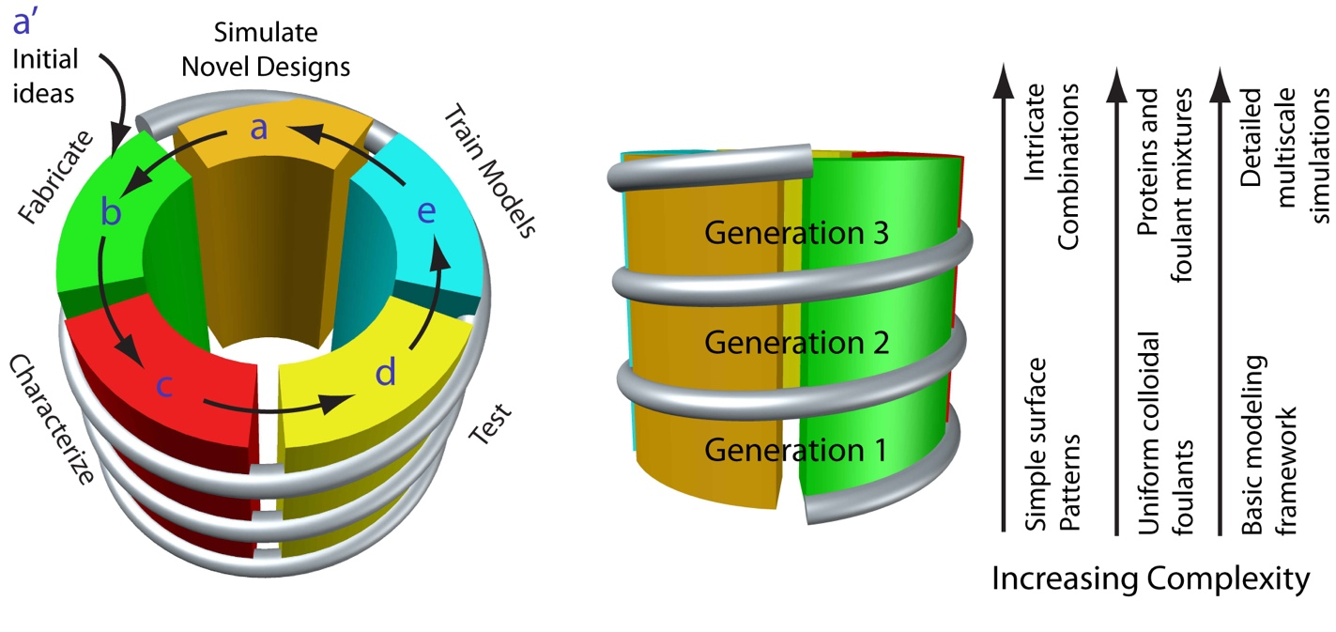
Overall Approach

Slide 3
Motivation from experiments

Slide 4
Membrane: Polyamide thin-film composite nanofiltration membrane.
Nanoscale patterning
Chemical coating
Line & groove silicon stamp
Thermal embossing
PEGDE (5 wt% and 15 wt%)
Reaction

Slide 5
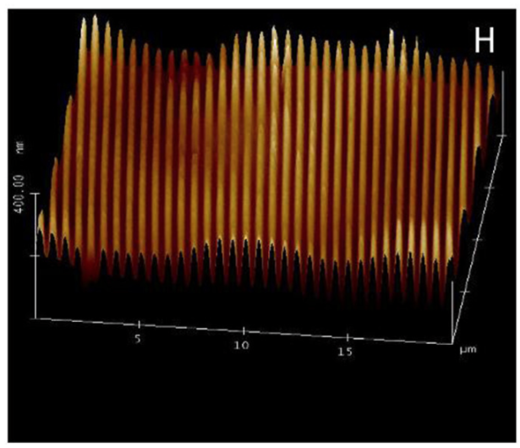
Weinman & Husson, Journal of Membrane Science 513 (2016) 146–154

Slide 6
Modeling methods

Slide 7
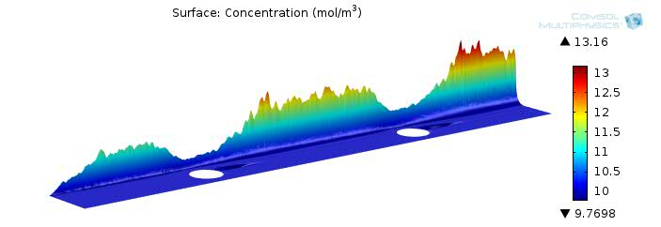
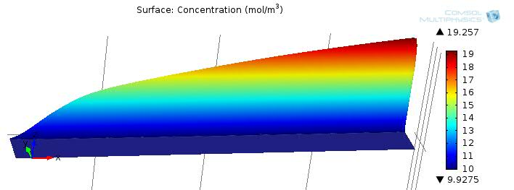
Goals
This research is to study concentration polarization (CP) on patterned membranes.
The goal is to learn the mechanisms behind CP development.
membrane
membrane
Notes:
Editorial Guidelines on Bullets:
1. Vertical lists are best introduced by a grammatically complete sentence followed by a colon. No periods
are required at the end of entries unless at least one entry is a complete sentence, in which case a period
is necessary at the end of each entry.
Example: A university can be judged by three measures:
· The quality of its students
· The quality of it faculty
· The quality of its infrastructure
2. If a list completes the sentence that introduces it, items begin with lowercase letters, commas or semicolons
(if individual items contain commas) are used to separate each item, and the last item ends with a period.
Note that the introductory clause does not end with a colon.
Example: A university can be judged by
· the quality of its students,
· the quality of its faculty,
· the quality of its infrastructure.
3. Avoid mixing sentence and nonsentence items in a bulleted list.
7

Slide 8
Model Introduction
Introduction
Computational fluid dynamics (CFD) uses numerical analysis to analyze fluid flow problems.
All the models are built with COMSOL Multiphysics (version 5.3).
Governing equations
Conservation of momentum
Conservation of mass
Convection diffusion
$$∇∙c=D∇^{2}c$$

Slide 9
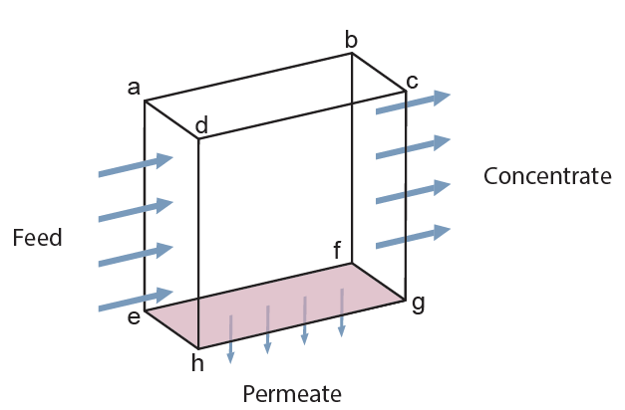
3D Conceptual Model
Concentrate boundary
2800 kPa
Feed boundary
0.1m/s
Inflow concentration: 25 mol/m³
Permeate: A(Δp-Δπ)
π=f_{os}C
Laminar flow
Convective-diffusion
Parameters
Name | Value | Description
A | 5.24·10⁻¹² [m/(s·Pa)] | Permeability coefficient
f_{os} | 4872[Pa·m³/mol] | Osmotic coefficient

Slide 10
Patterns
(a)
(b)
(c)
(e)
(f)
(d)
(g)
(h)

Slide 11
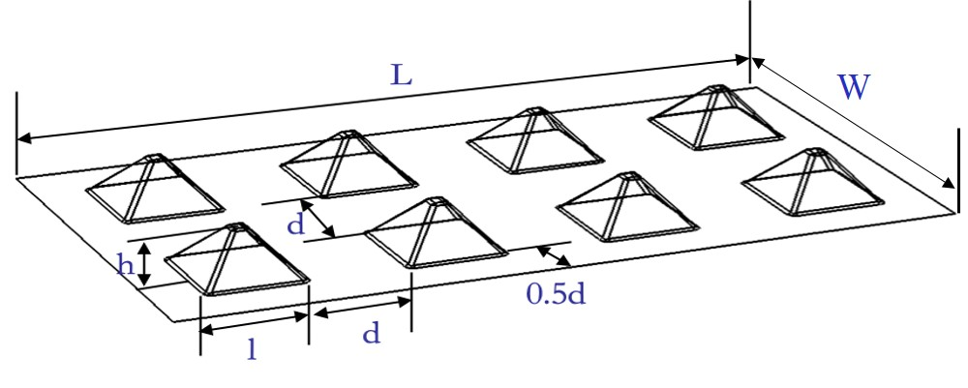
Pattern Sizes
Feature Length, l (µm) | Feature Height, h (= 0.5·l) (µm) | Between-Feature Distance, d (= l) (µm) | Total Length, L (µm) | Total Width, W (µm)
2 | 1 | 2 | 16 | 8
8 | 4 | 8 | 64 | 32
32 | 16 | 32 | 256 | 128
128 | 64 | 128 | 1024 | 512
512 | 256 | 512 | 4096 | 2048

Slide 12
Pattern Sizes
Pattern length: 2 µm
Pattern length: 128 µm
Pattern length: 8 µm
Pattern length: 32 µm
Pattern length: 512 µm

Slide 13
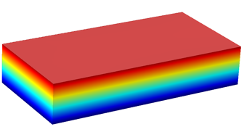
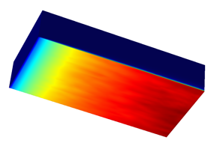
CP Factor
m/s
The Concentration Polarization Factor (CP factor) can be defined as a ratio of salt concentration at the membrane surface (C_{m}) to bulk concentration (C_{b}).
Velocity profile
mol/m³
$$CP factor=\frac{C_{m}}{C_{b}}$$
Flat 512 membrane CP factor = 1.86
Concentration profile

Slide 14
Velocity Normalization
$$u(y)=\frac{3}{2}u_{ave}[1−{\left(\frac{H−y}{H}\right)}^{2}]$$

Slide 15
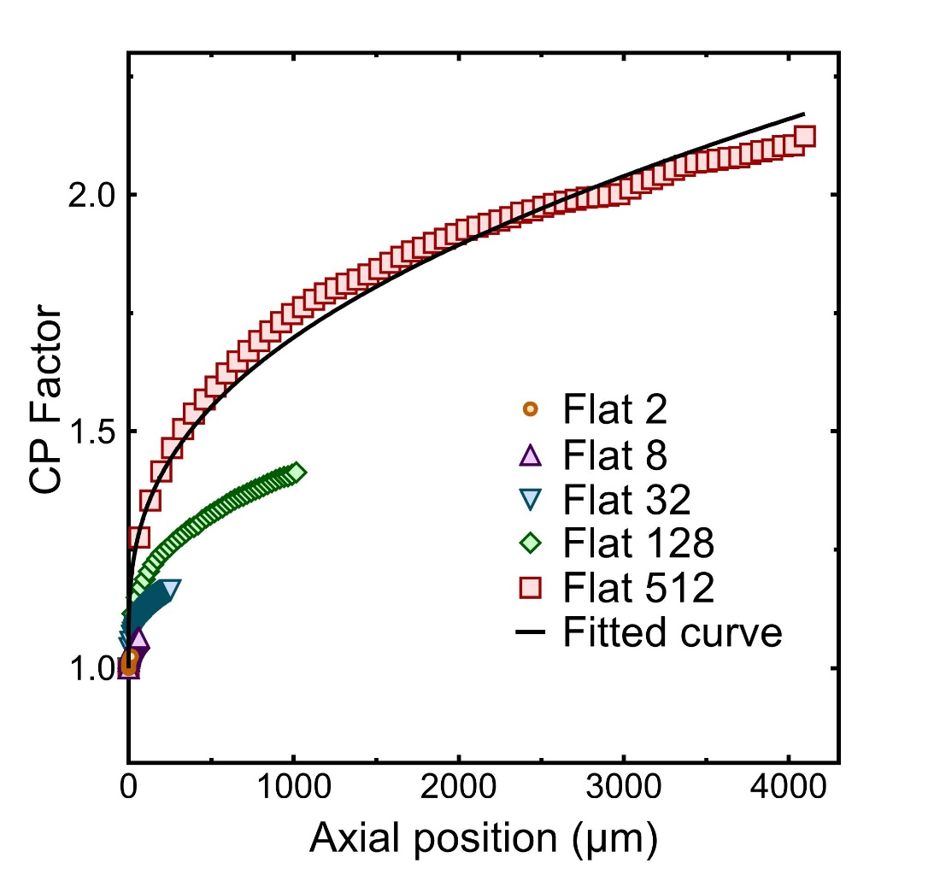
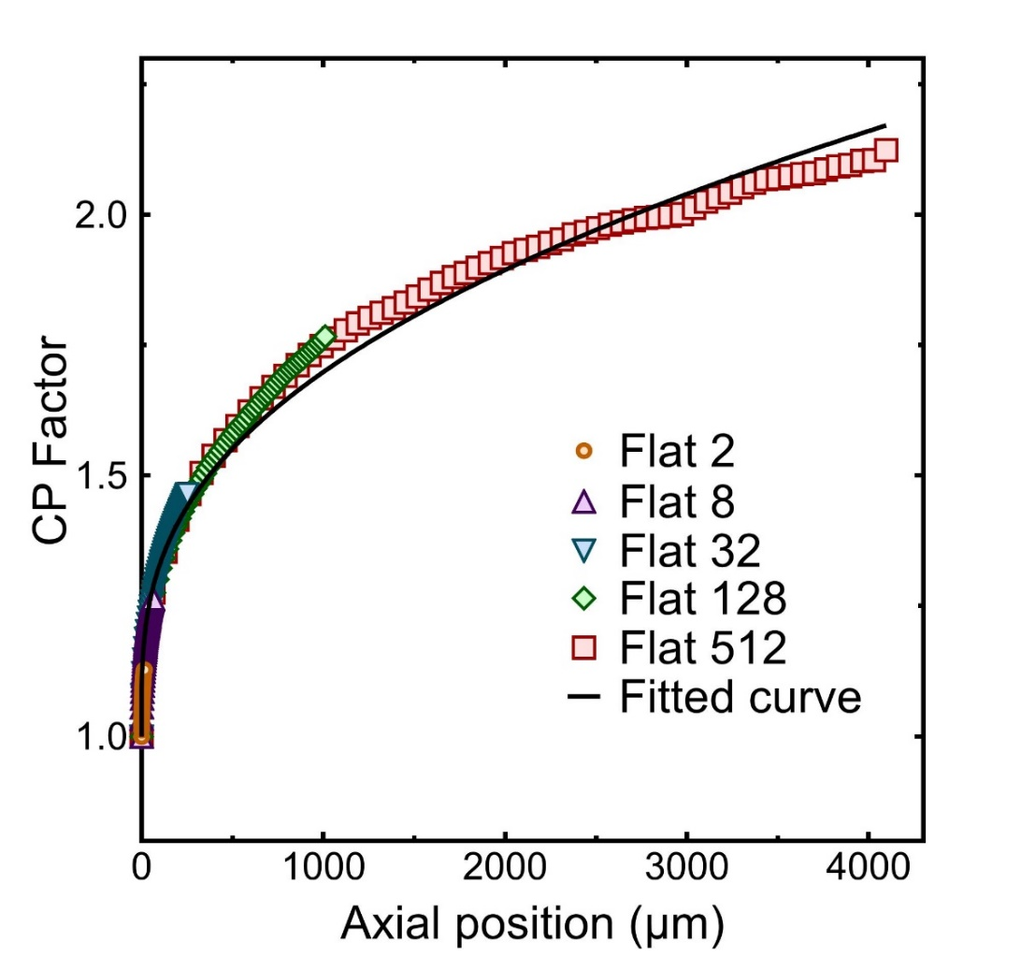
Numerical Solutions without Velocity Adjustment

Slide 16
Numerical Solutions vs. Sherwood Correlation
Sherwood correlation
$$Sh=1.85{\left(Re∙Sc∙\frac{d_{h}}{L}\right)}^{0.275}$$
$$k=\frac{ShD}{d_{h}}$$
$$\frac{c_{m}}{c_{b}}=\exp\left(\frac{J}{k}\right)$$

Slide 17
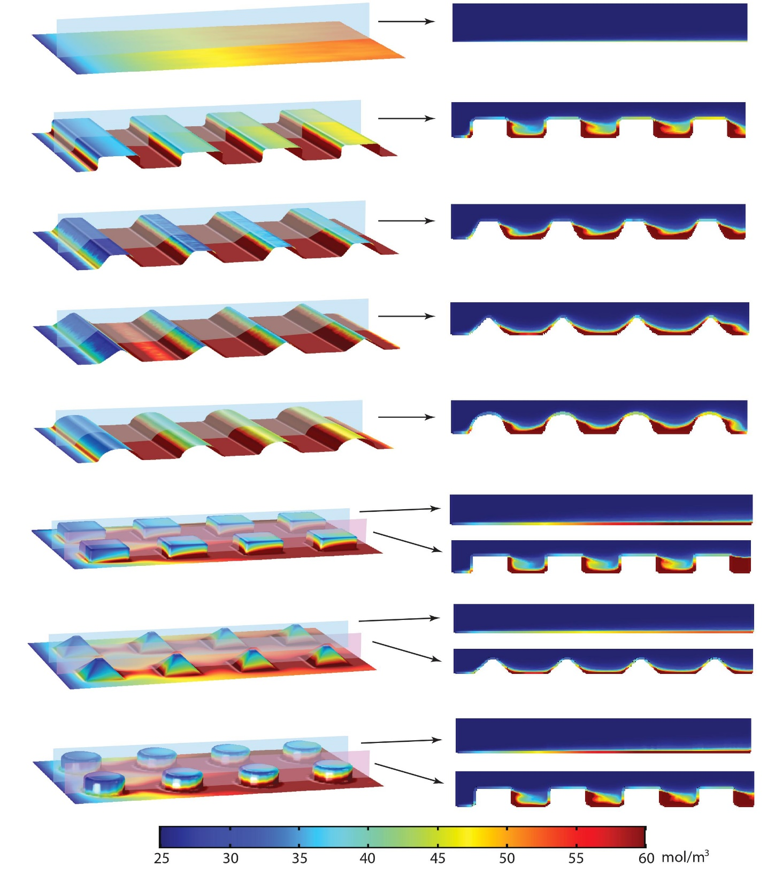
CP Results

Slide 18
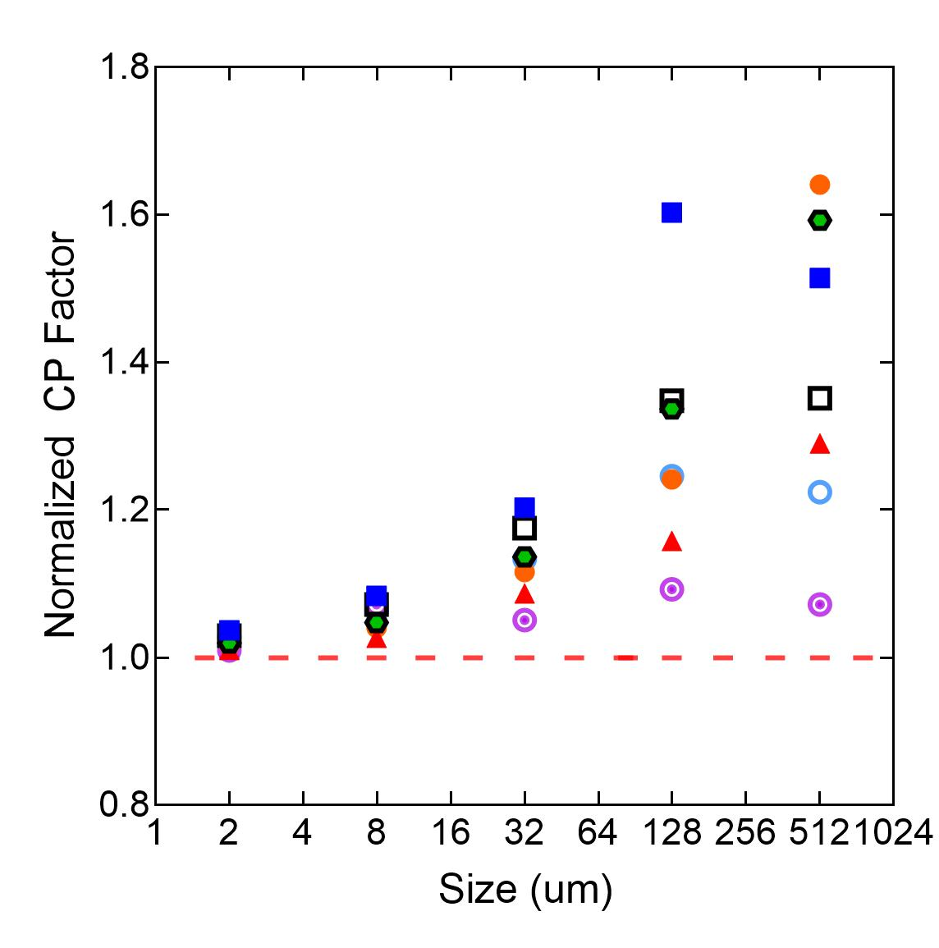
Normalized CP Factor

Slide 19
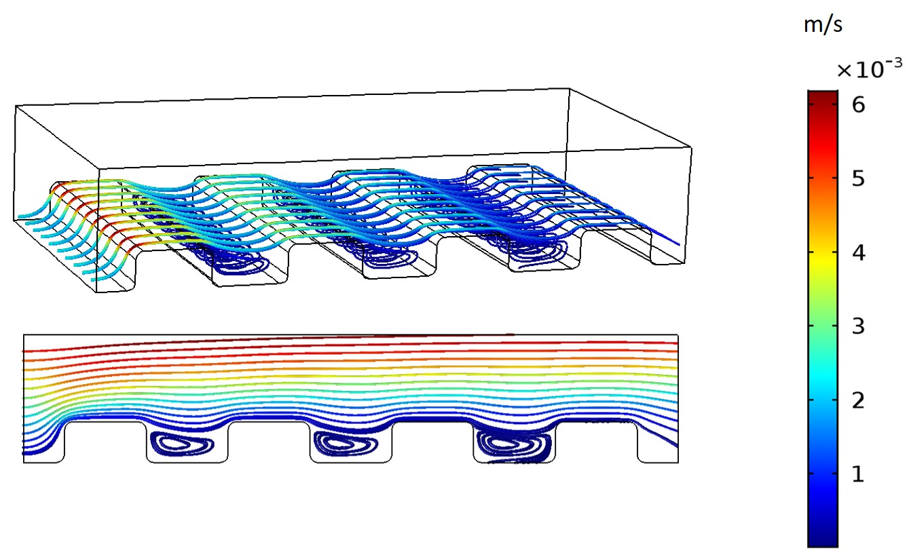
Streamlines

Slide 20
Permeate Flux Results
m/s

Slide 21
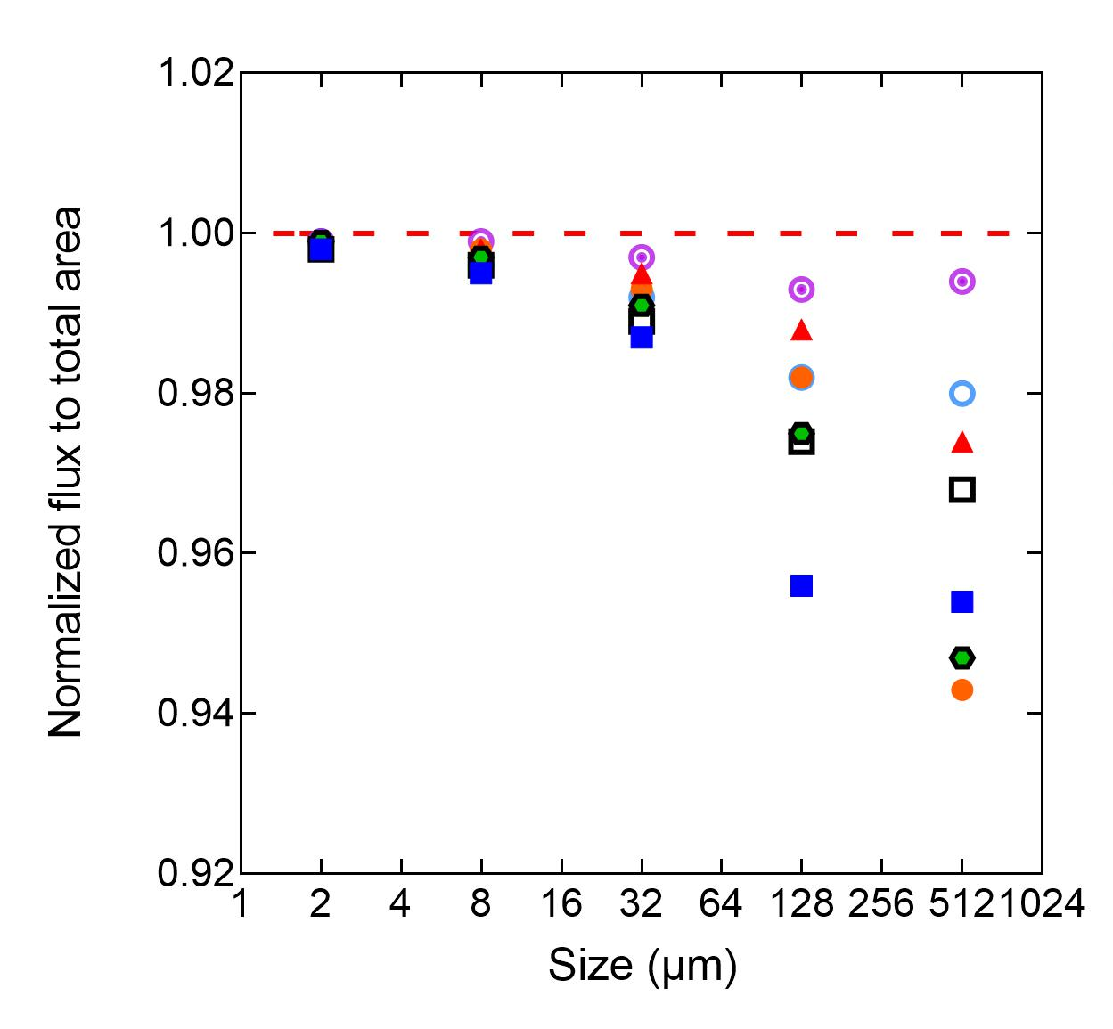
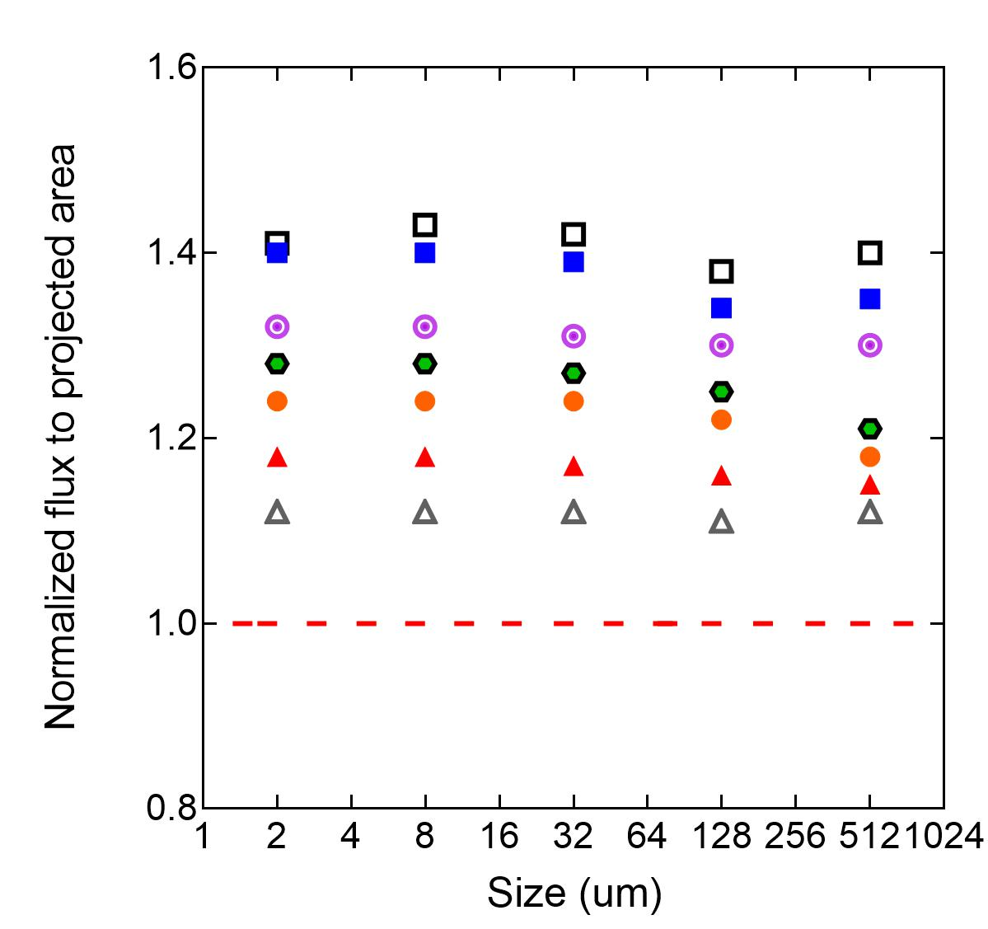
Normalized Permeate Flux

Slide 22
Definition of Roughness
$$R_{a}=\frac{1}{L}\int_{0}^{L}{|z(x)|dx}$$
z$(x)$
L = evaluation length
$z(x)$= the profile height function
h=256 µm
L
Roughness = 128 µm
Roughness normalized to pattern height = 128 µm/256 µm = 0.50
Roughness = 103 µm
Roughness normalized to pattern height = 103 µm/256 µm = 0.40
Roughness = 84 µm
Roughness normalized to pattern height = 84 µm/256 µm = 0.33

Slide 23
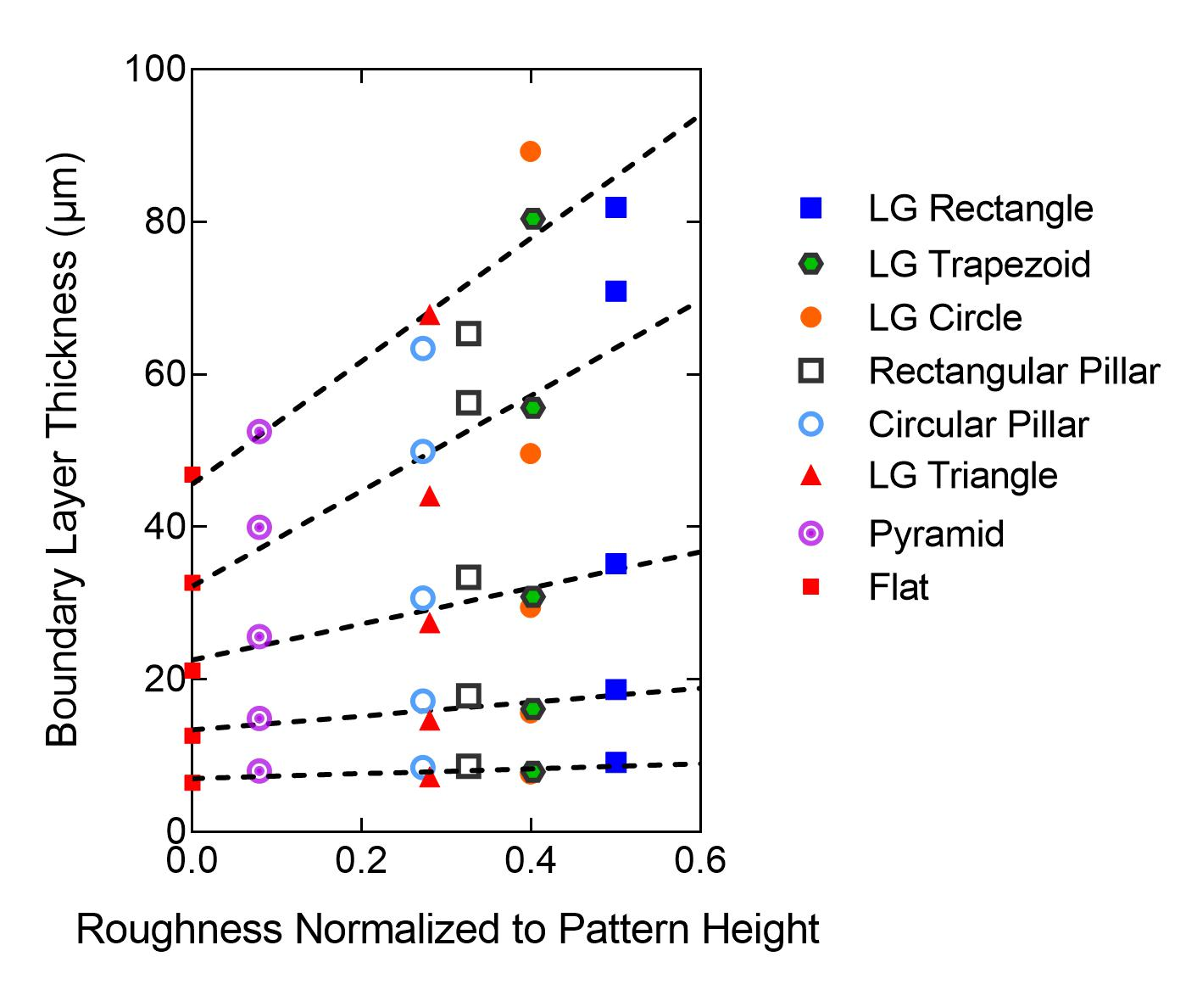
Roughness vs. Boundary Layer Thickness
Roughness normalized to pattern height: total roughness (Ra) projected to pattern height.
Boundary layer thickness (BLT): BLT is calculated through diffusion coefficient and mass transfer coefficient.
$$δ=\frac{D}{k}$$

Slide 24
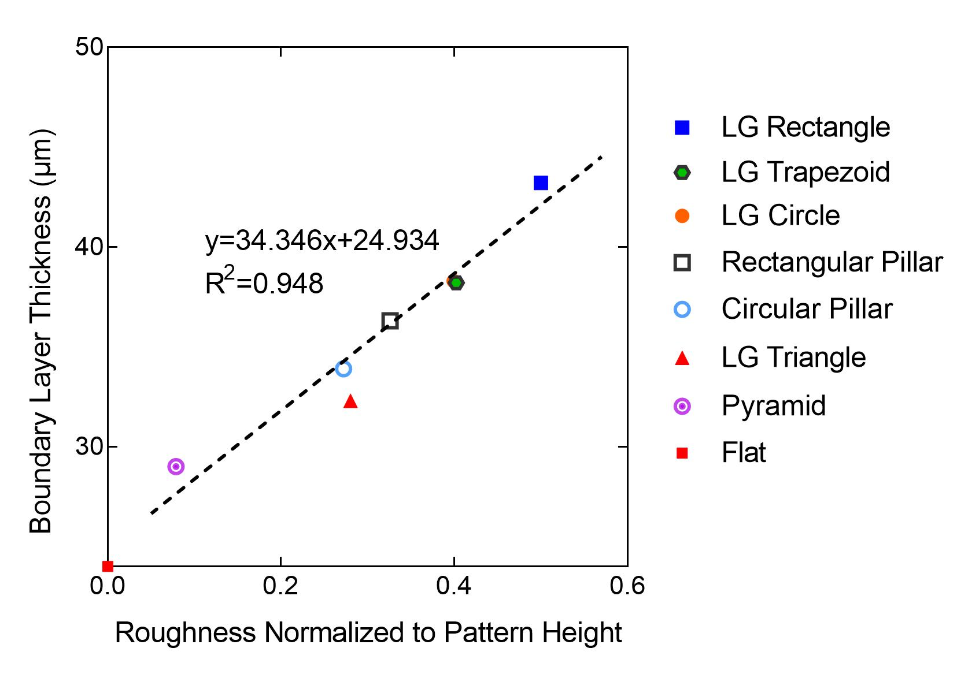
Roughness vs. Average Boundary Layer Thickness

Slide 25
Conclusions
Lower average shear stress gives higher CP.
In general, adding patterns does not decrease CP.
The fouling mitigation seen in experiments is likely due to other factors.
Adding patterns increased roughness, and therefore decreased mass transfer coefficient and increased boundary layer thickness.

Slide 26
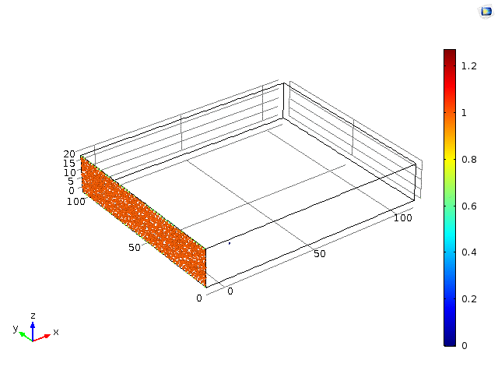
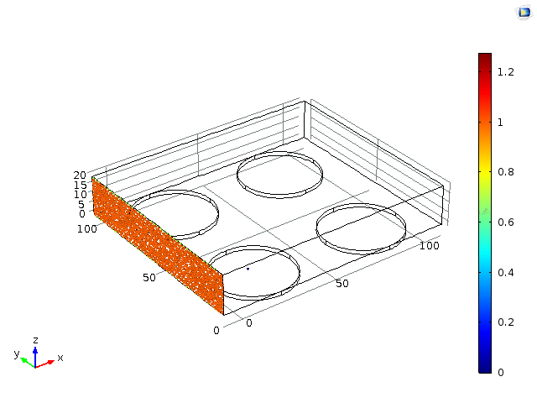
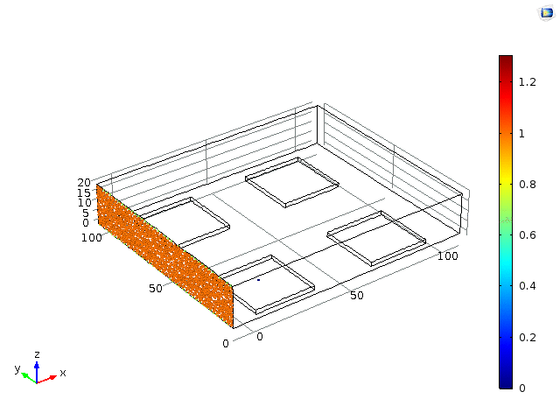
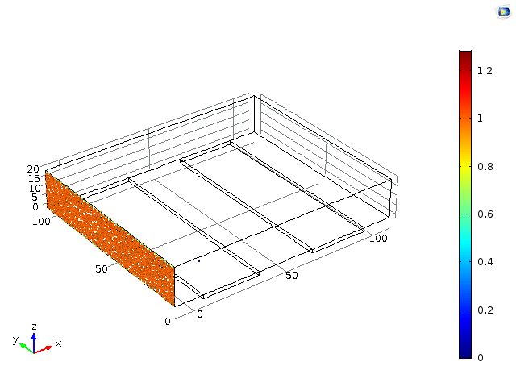
Future Work
Future studies will also use particle tracing.

Slide 27
Overall Approach

Slide 28
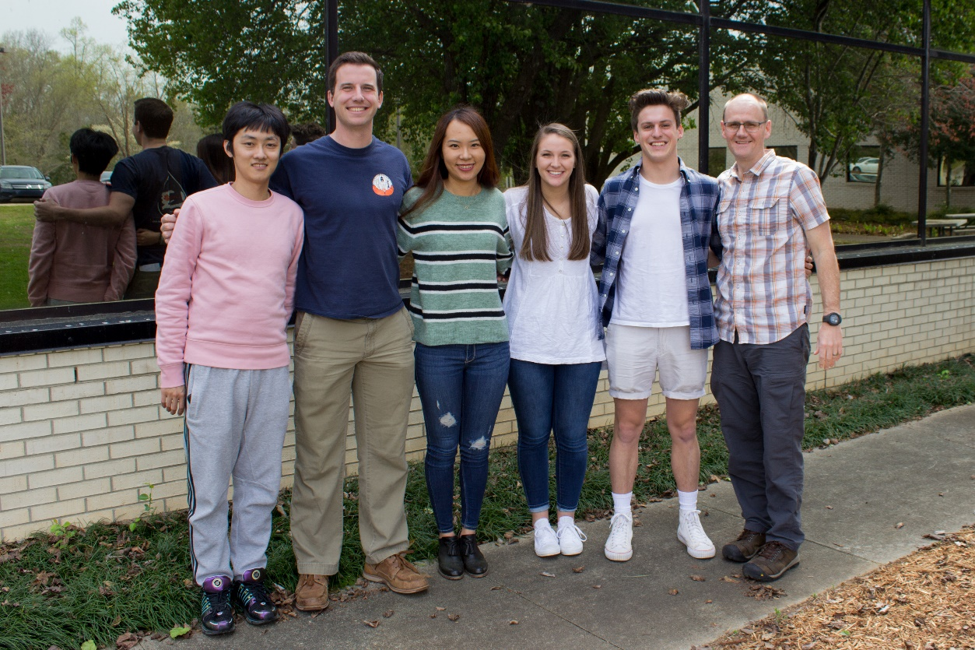
Acknowledgements
Peng Xie, Clemson U.
Rasna Sharmin, Clemson U.
Illenia Battiato, Stanford U.
National Science Foundation
Grant No. CBET-1236070
Grant No. CBET-1534304

Slide 29
Supplemental Materials
Constant flow: all the 512 um models maintain the same total flow: 1.31E-10 m³/s.
Flux for each geometry (m/s)
Flat | LG Rectangle | LG Trapezoid | LG Triangle | LG Circle | Rectangular pillar | Pyramid | Circular pillar
1.56E-05 | 1.11E-05 | 1.22E-05 | 1.32E-05 | 1.25E-05 | 1.08E-05 | 1.39E-05 | 1.18E-05

Slide 30
