Slide 1
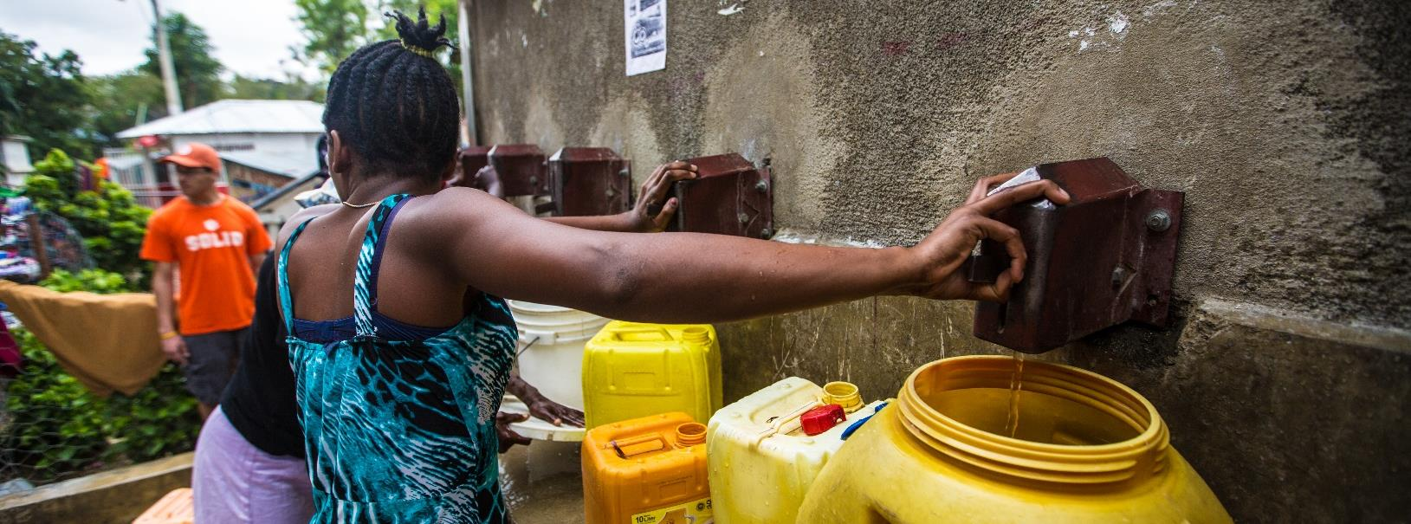
Computational modeling to improve chlorinator design in a Haitian drinking water system
Ashley Martin, Colby Cash, and David A. Ladner
AEESP Conference, Tempe, Arizona. May 16, 2019

Slide 2
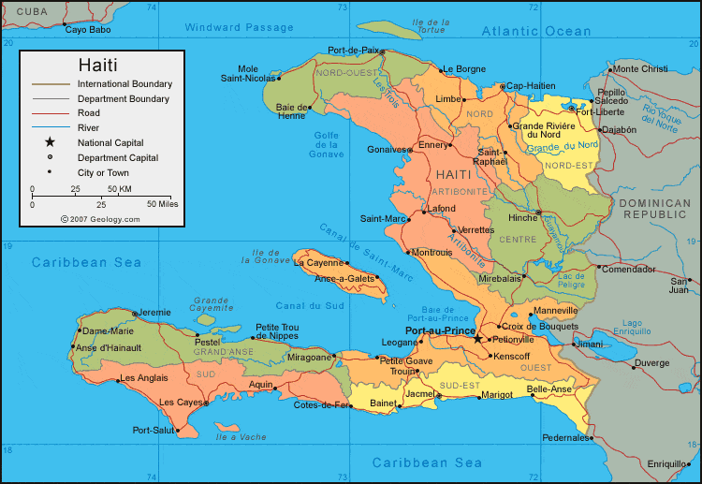
Clemson Engineers for Developing Countries (CEDC) has worked in Cange, Haiti, since 2009.

Slide 3
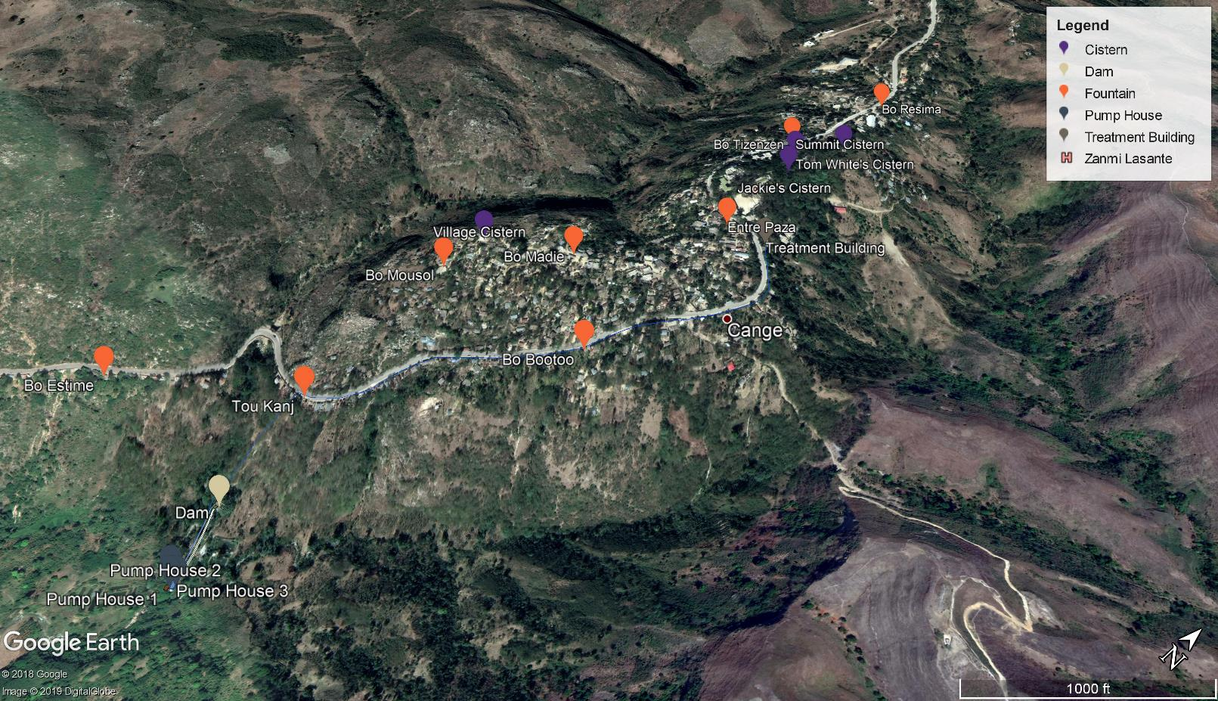
A hydraulic pump sends water up the canyon and through a treatment system.
Notes:
EDUSC: episcopal diocese of upper south Carolina:
1000 feet to the treatment building. More to the cisterns.
4000 people

Slide 4
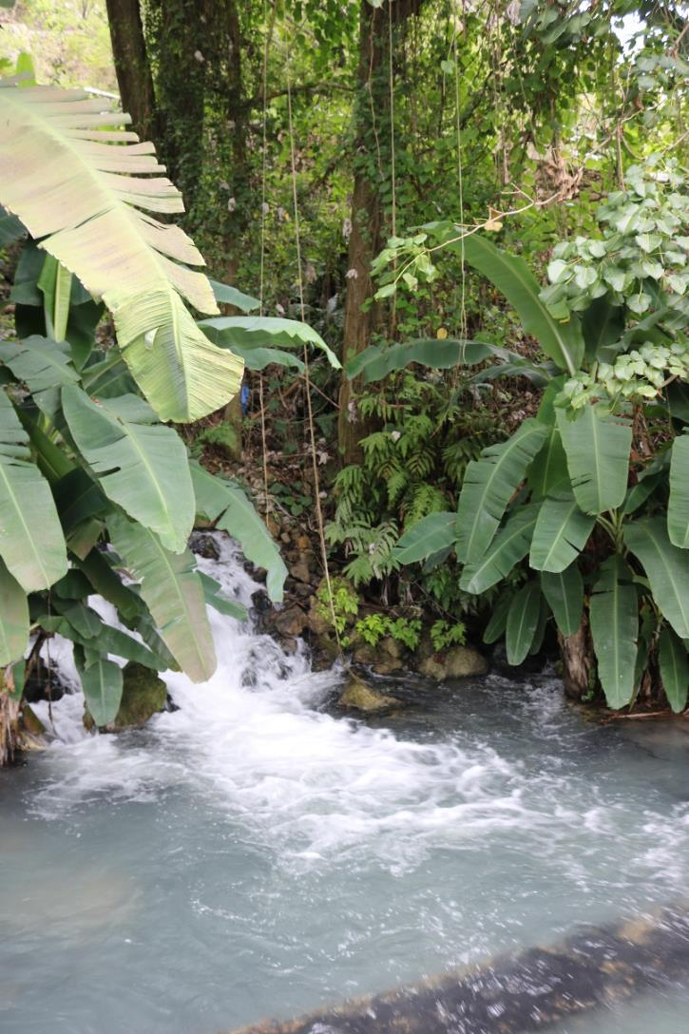
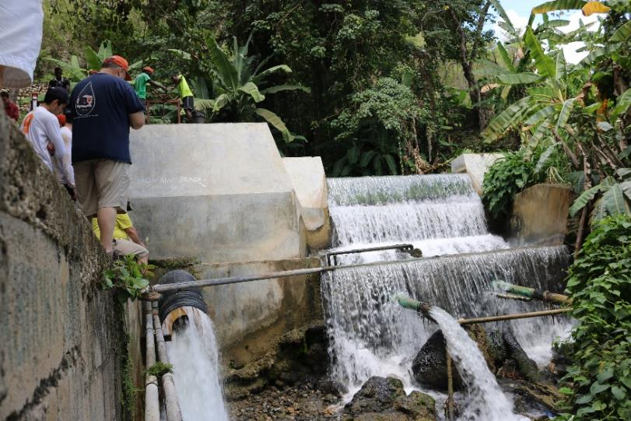
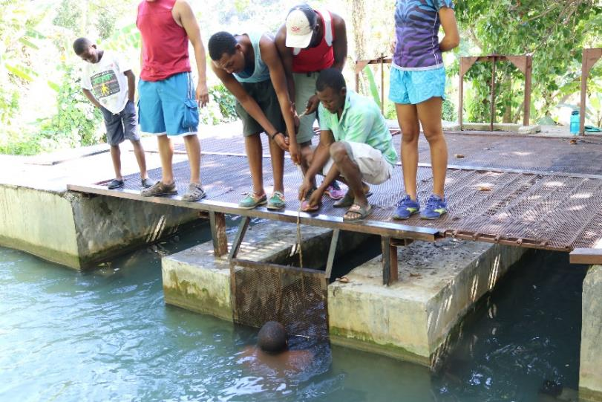

Slide 5
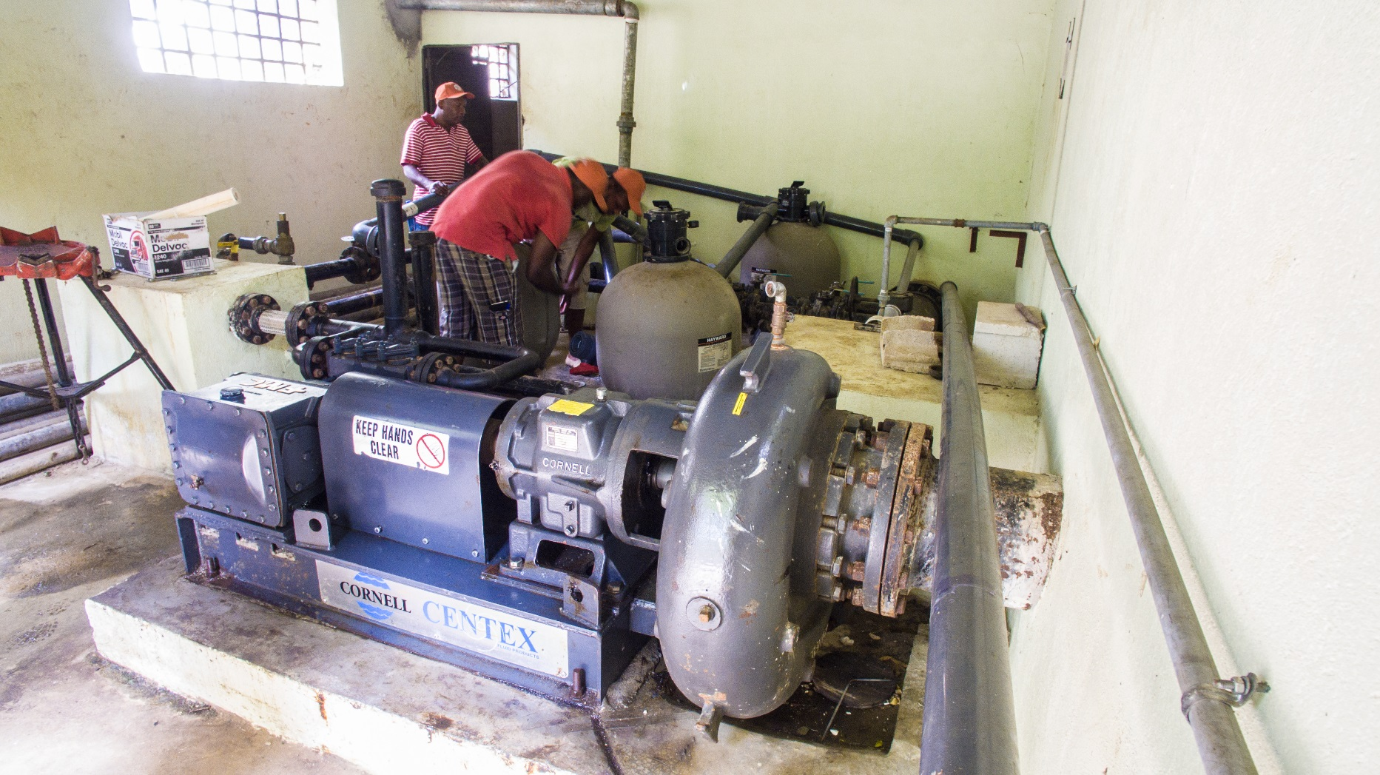

Slide 7
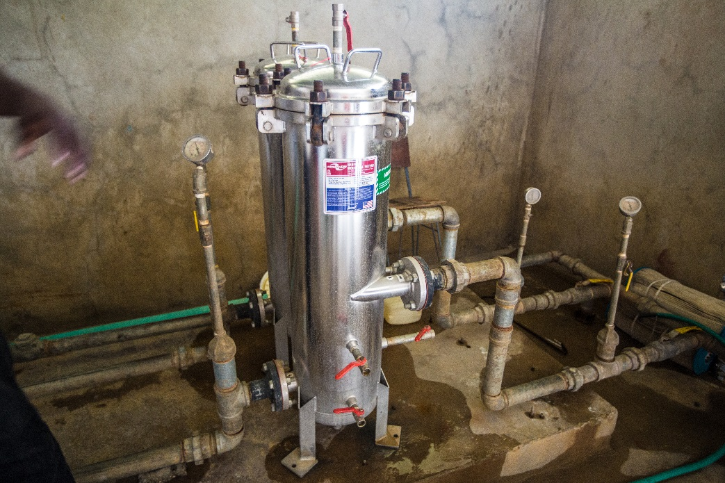

Slide 8
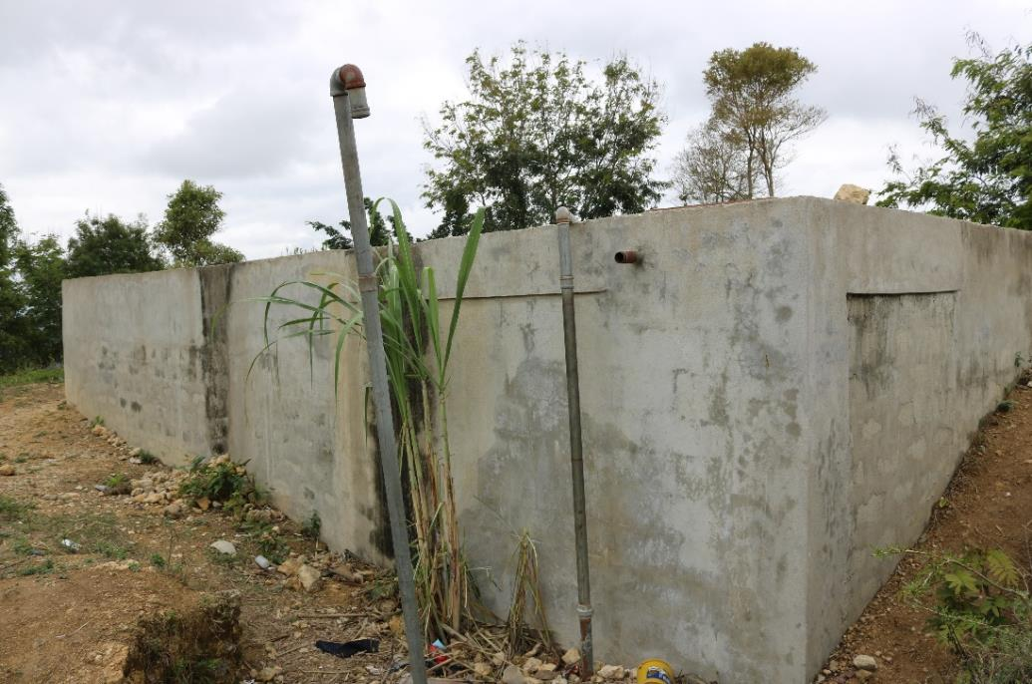
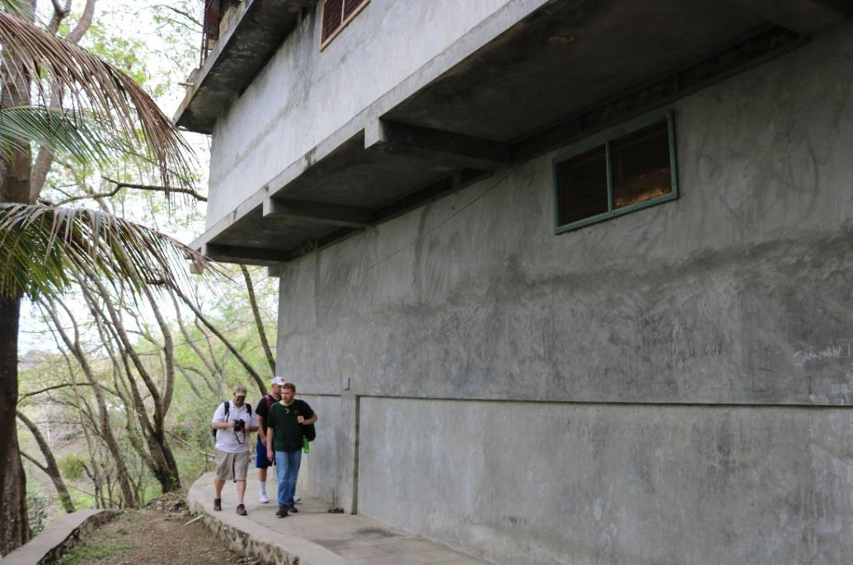

Slide 9
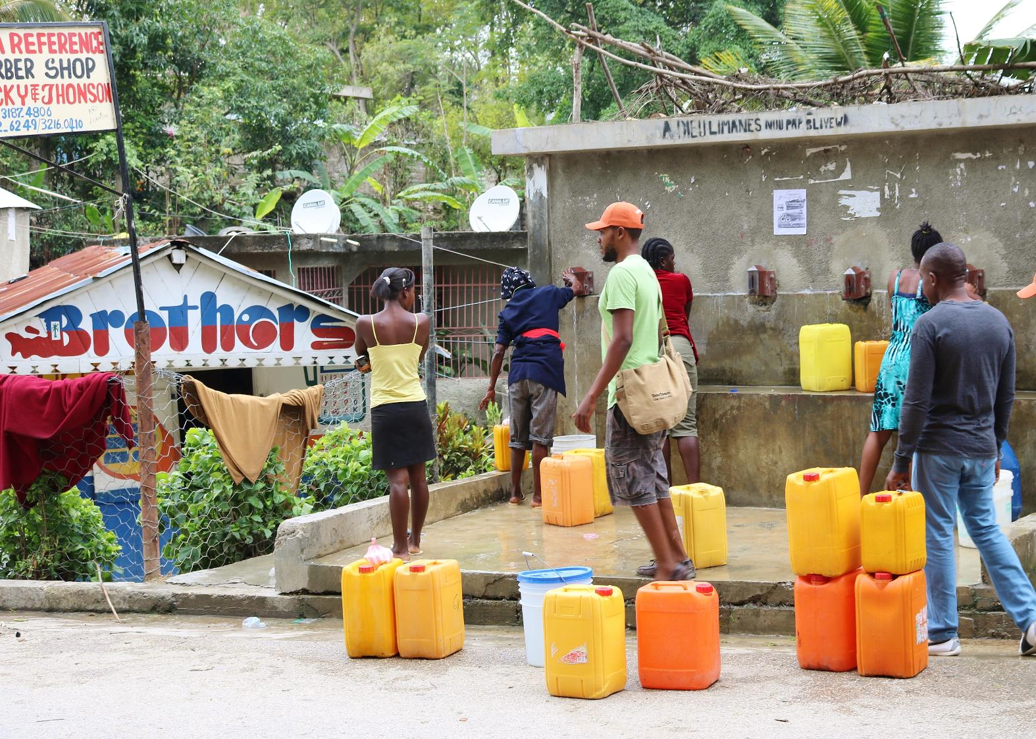

Slide 11
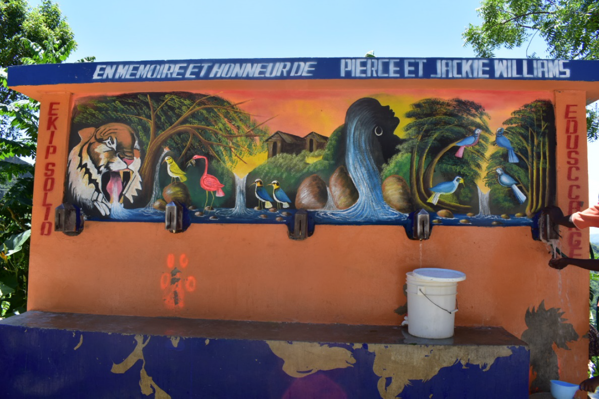

Slide 12
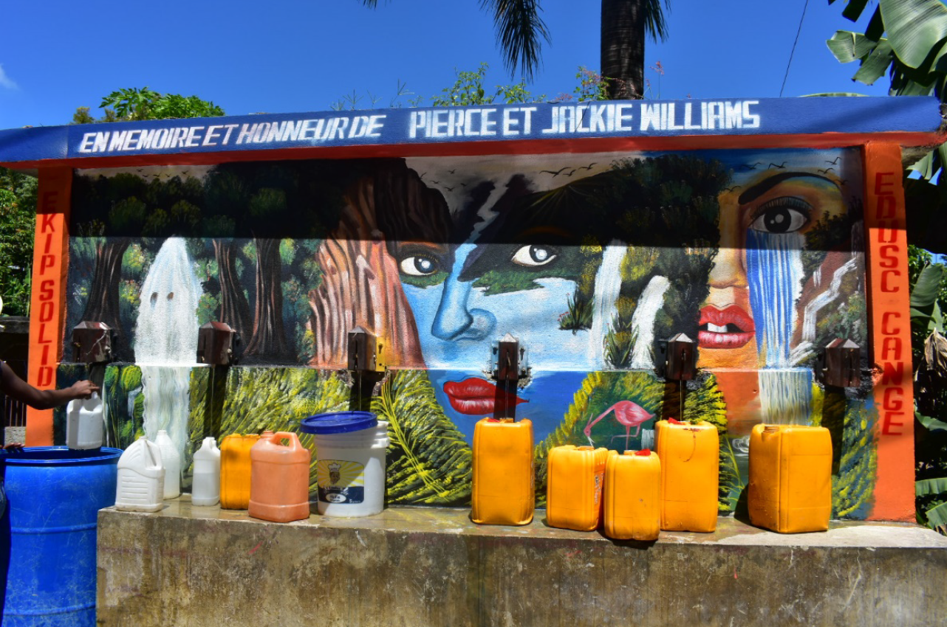

Slide 13
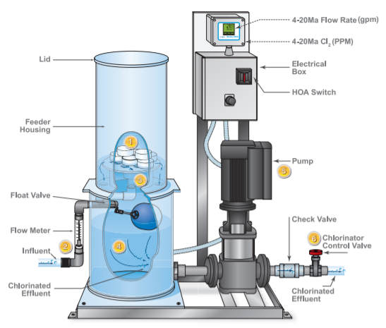
Chlorination has taken several forms at different times.

Slide 14
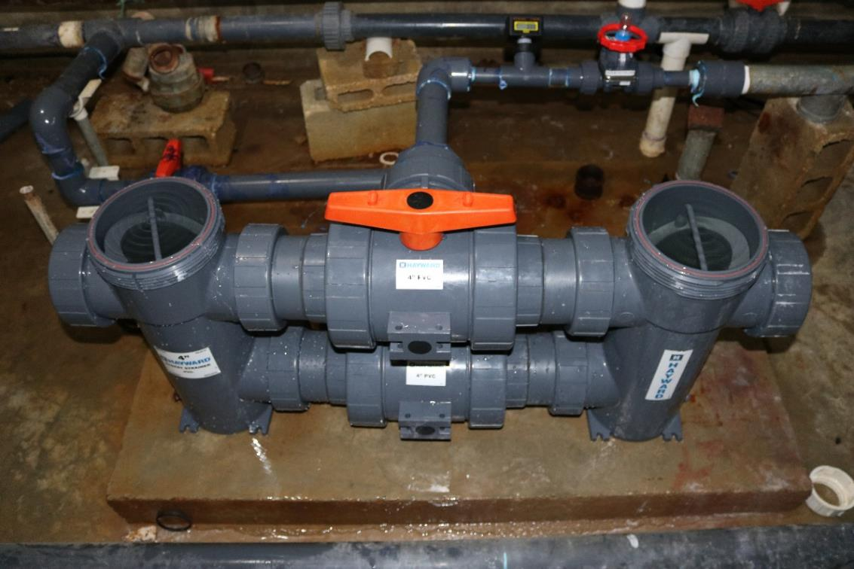
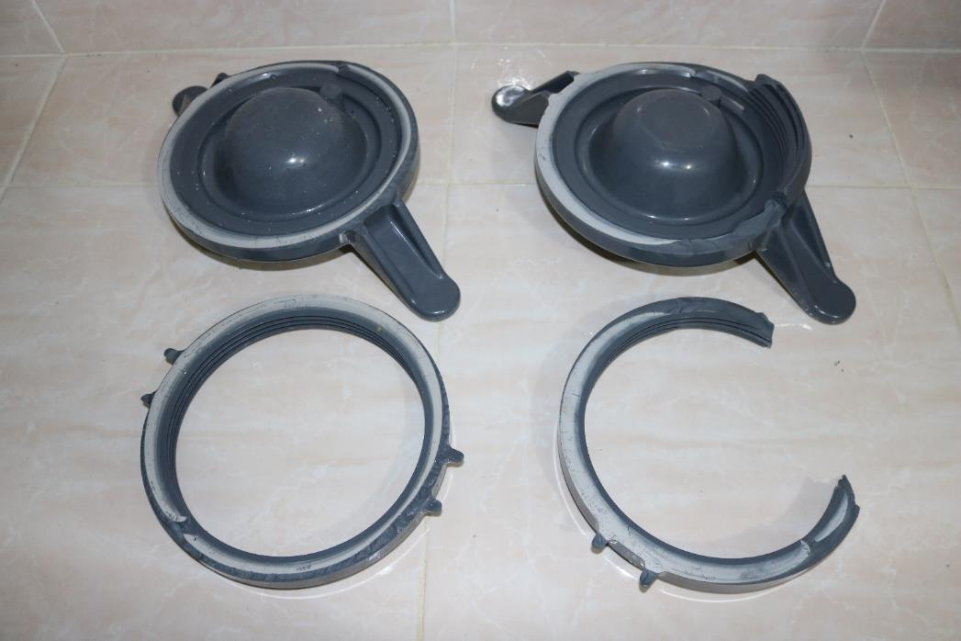

Slide 15
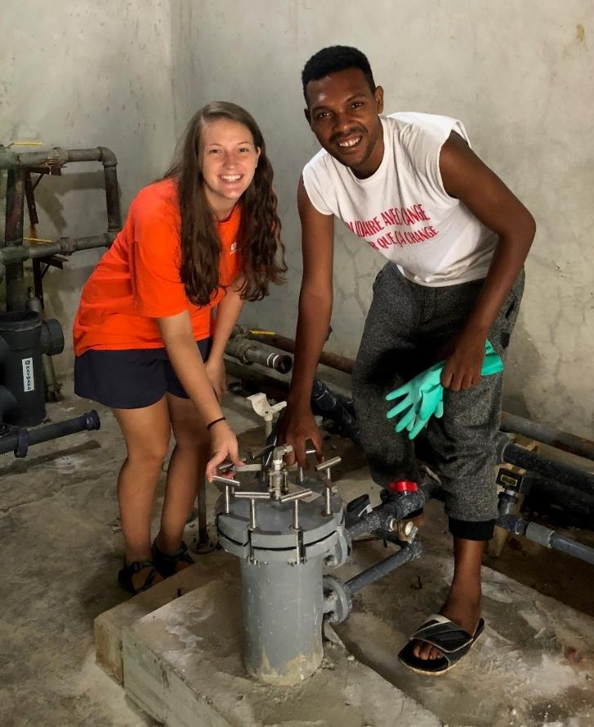
The most recently installed chlorinator is a tablet feeder built to handle the high system pressure (>100 psi).
Notes:
AKA erosion chlorinator.

Slide 16
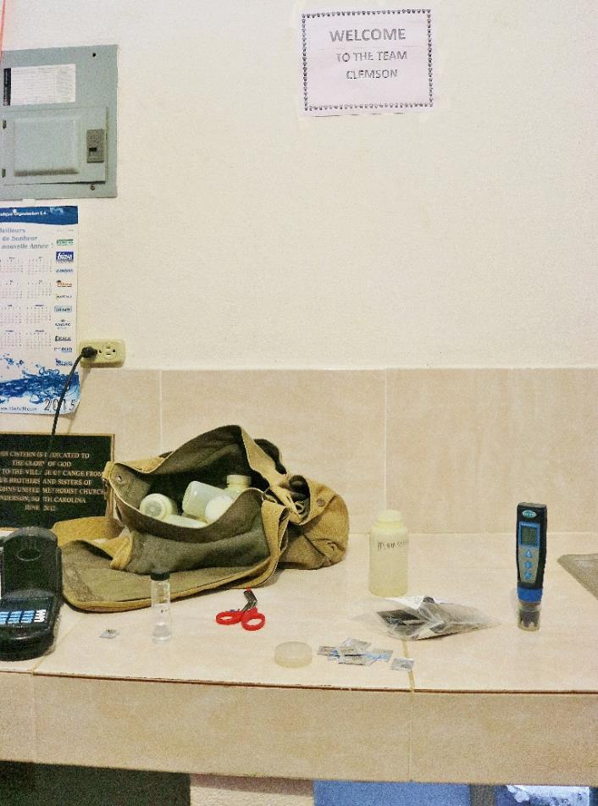
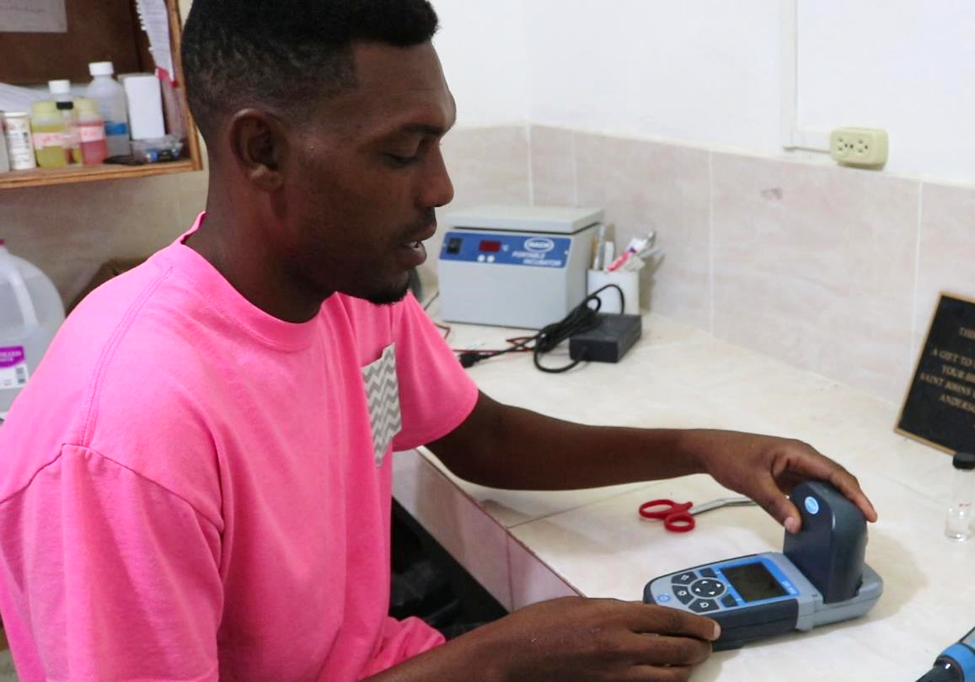
Residual chlorine measurements are taken every other day.

Slide 17
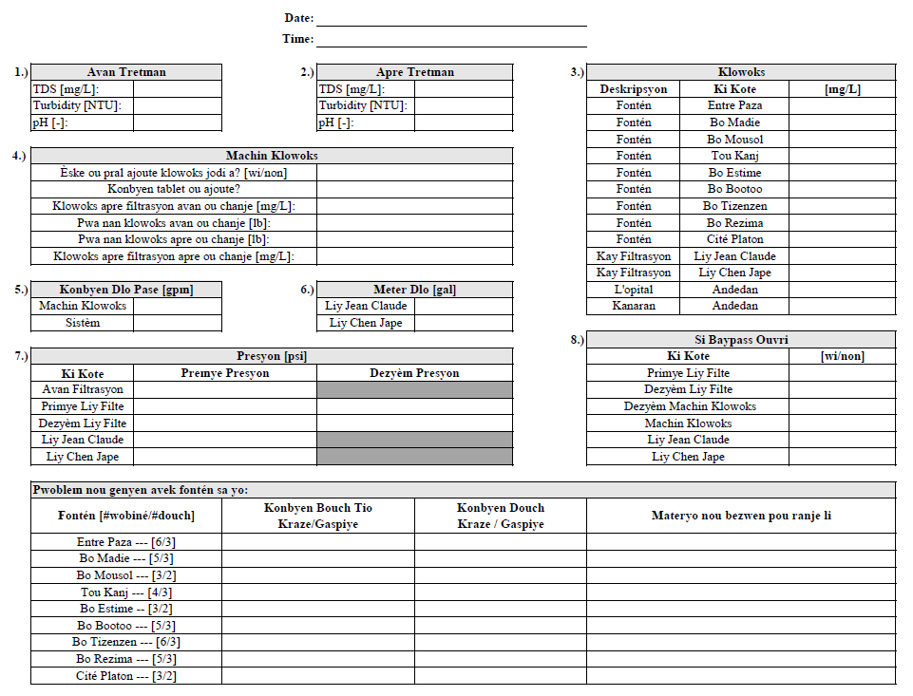

Slide 18
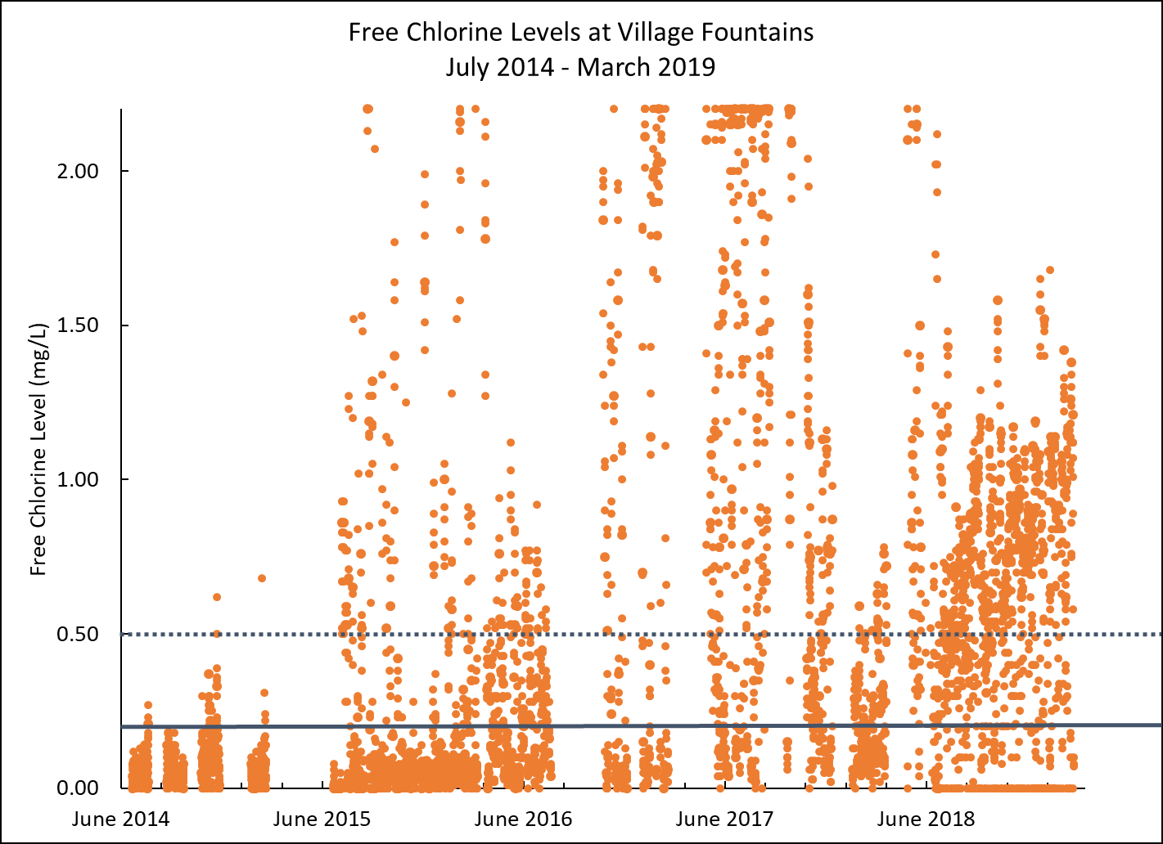
Achieving stable chlorine concentrations has been challenging.
Notes:
2009: Jeff Plumbly started the work on treatment system
2013: cartridge filters and UV. Treatment (chlorination; accutab)
June 2014: built water testing lab
June 2014: Accutab (didn’t work well)
June 2015: tablets inserted in the old filter housings

Slide 19
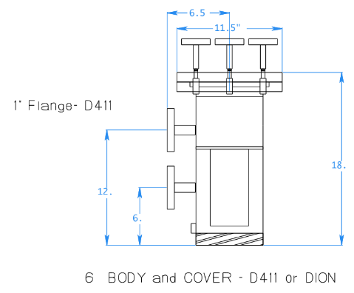
We are investigating mass transport within the tablet feeder to achieve consistent chlorine doses.
Flow through the chlorinator
Dissolution of chlorine tablets
Transport of free chlorine

Slide 20
Mathematical Model
Conservation of Mass
Conservation of Momentum
Dissolved Mass in Fluid
Important Boundary Conditions
Higher initial concentration at tablet surface
Inlet
Outlet
Initial Conditions
No initial concentration in chlorinator

Slide 21
COMSOL Model
Laminar Flow Physics
$ρ(u⋅∇)u=∇⋅[−PI+μ(∇u+{(∇u)}^{T})]$
$ρ∇⋅\left(u\right)=0$
Transport of Diluted Species Physics
$\frac{∂C_{i}}{∂t}+∇⋅J_{i}=R_{i}$
$J_{i}=−D_{i}∇c_{i}$
Moving Mesh

Slide 22
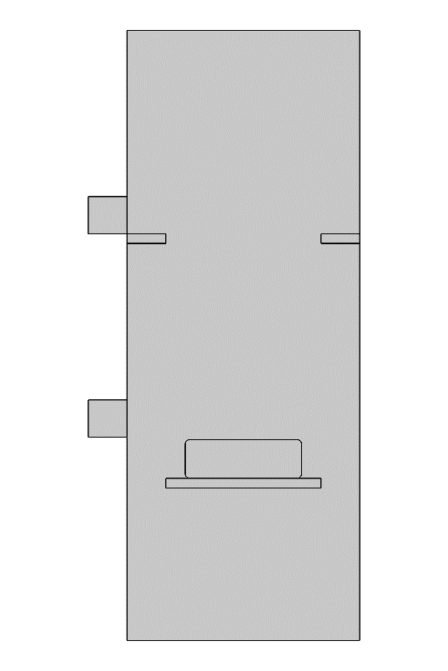
COMSOL Model
Laminar Flow
Run in Stationary Model
Inlet
Normal inflow velocity
All remaining lines set as walls
Outlet
Zero Pressure

Slide 23
COMSOL Model
Transport of Diluted Species
Diffusion Coefficient
1E-9 m²/s
Inlet
Normal inflow velocity
All remaining lines set as no flux boundary
Outlet
Zero Pressure
Concentration
1 mol/m³
Run in Time Dependent Model

Slide 24
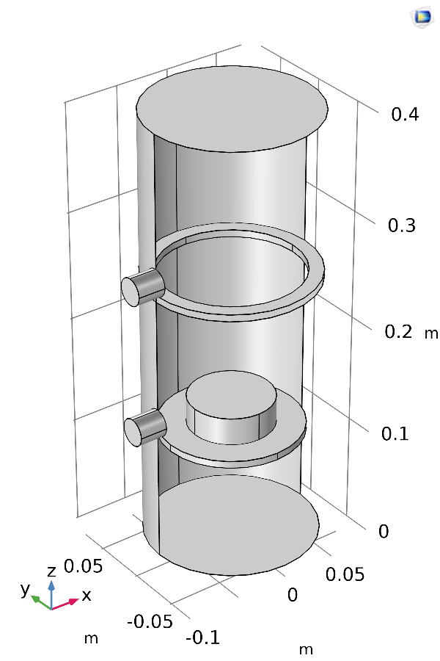
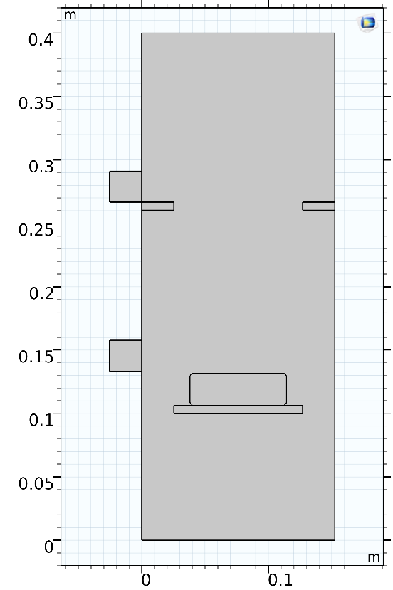
COMSOL Model

Slide 25
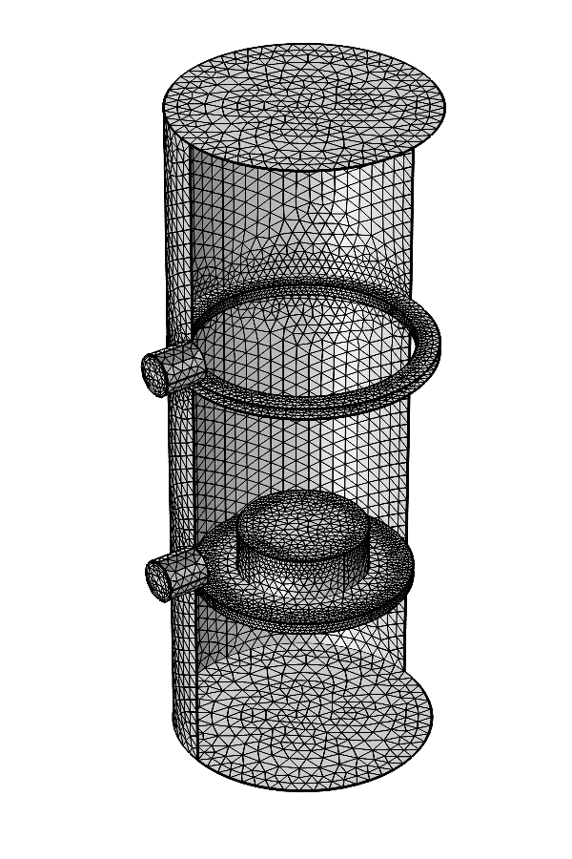
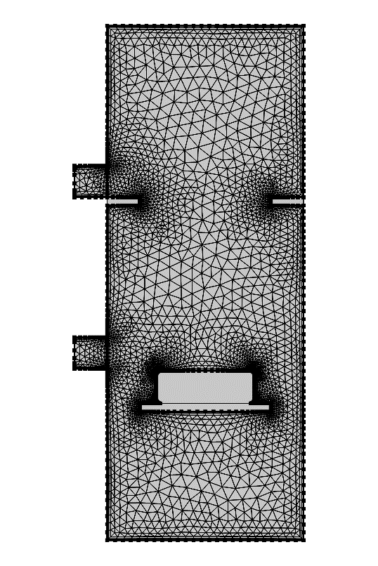
COMSOL Model

Slide 26
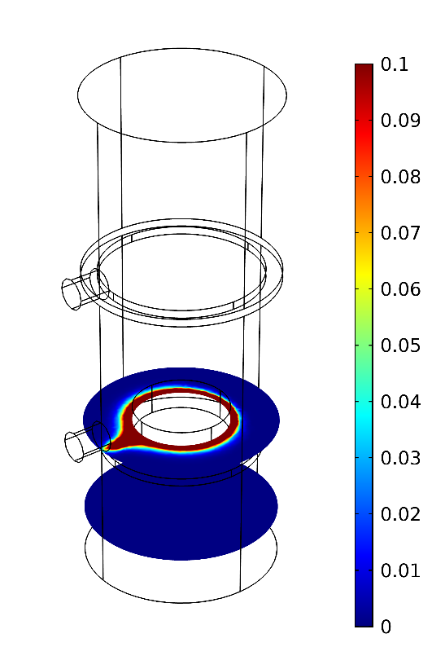
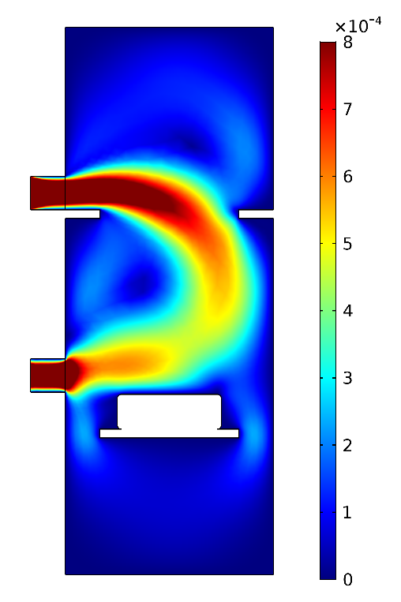
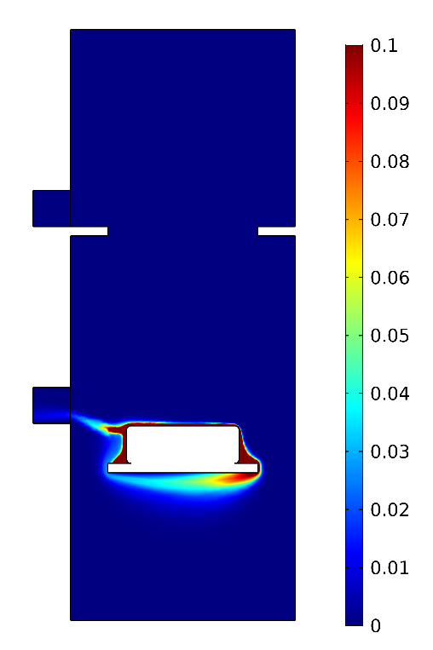
2D and 3D give similar results, though 2D has fewer degrees of freedom for chlorine flow.

Slide 27
Tablet dissolution is modelled with a moving mesh.

Slide 28
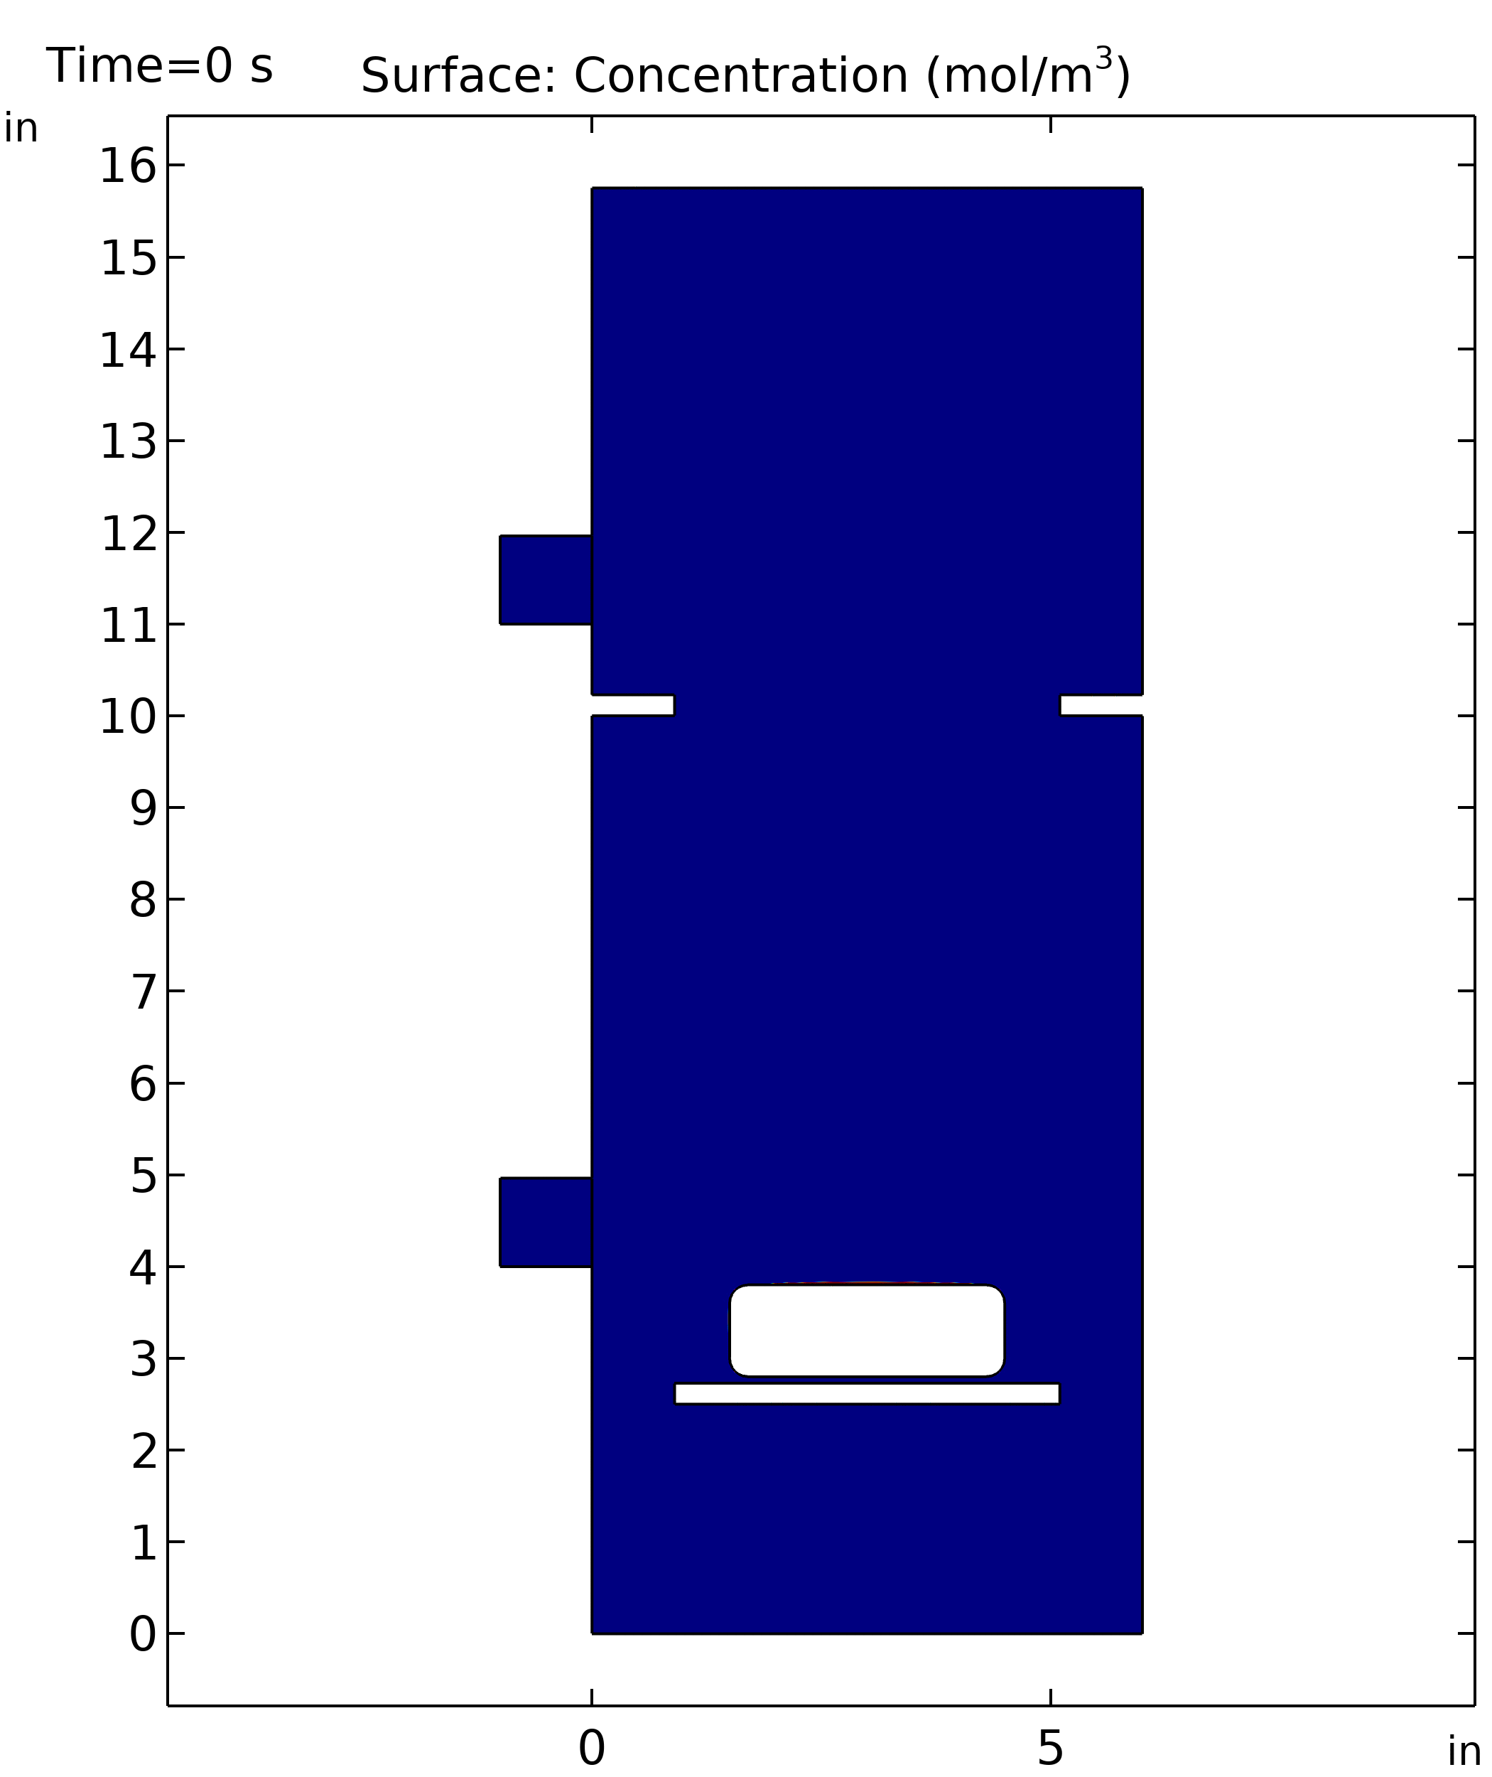
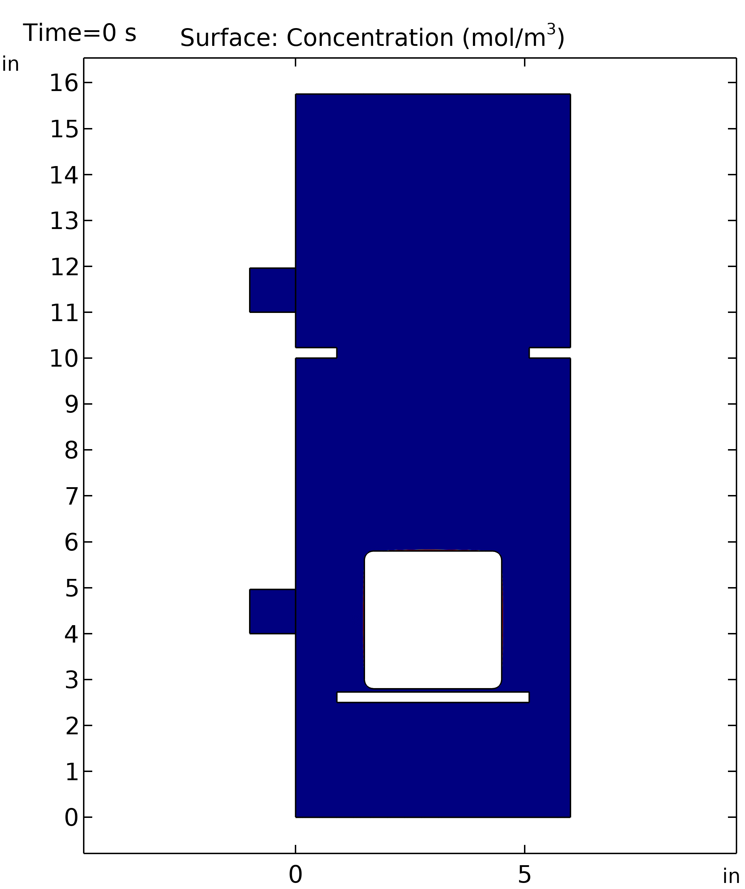
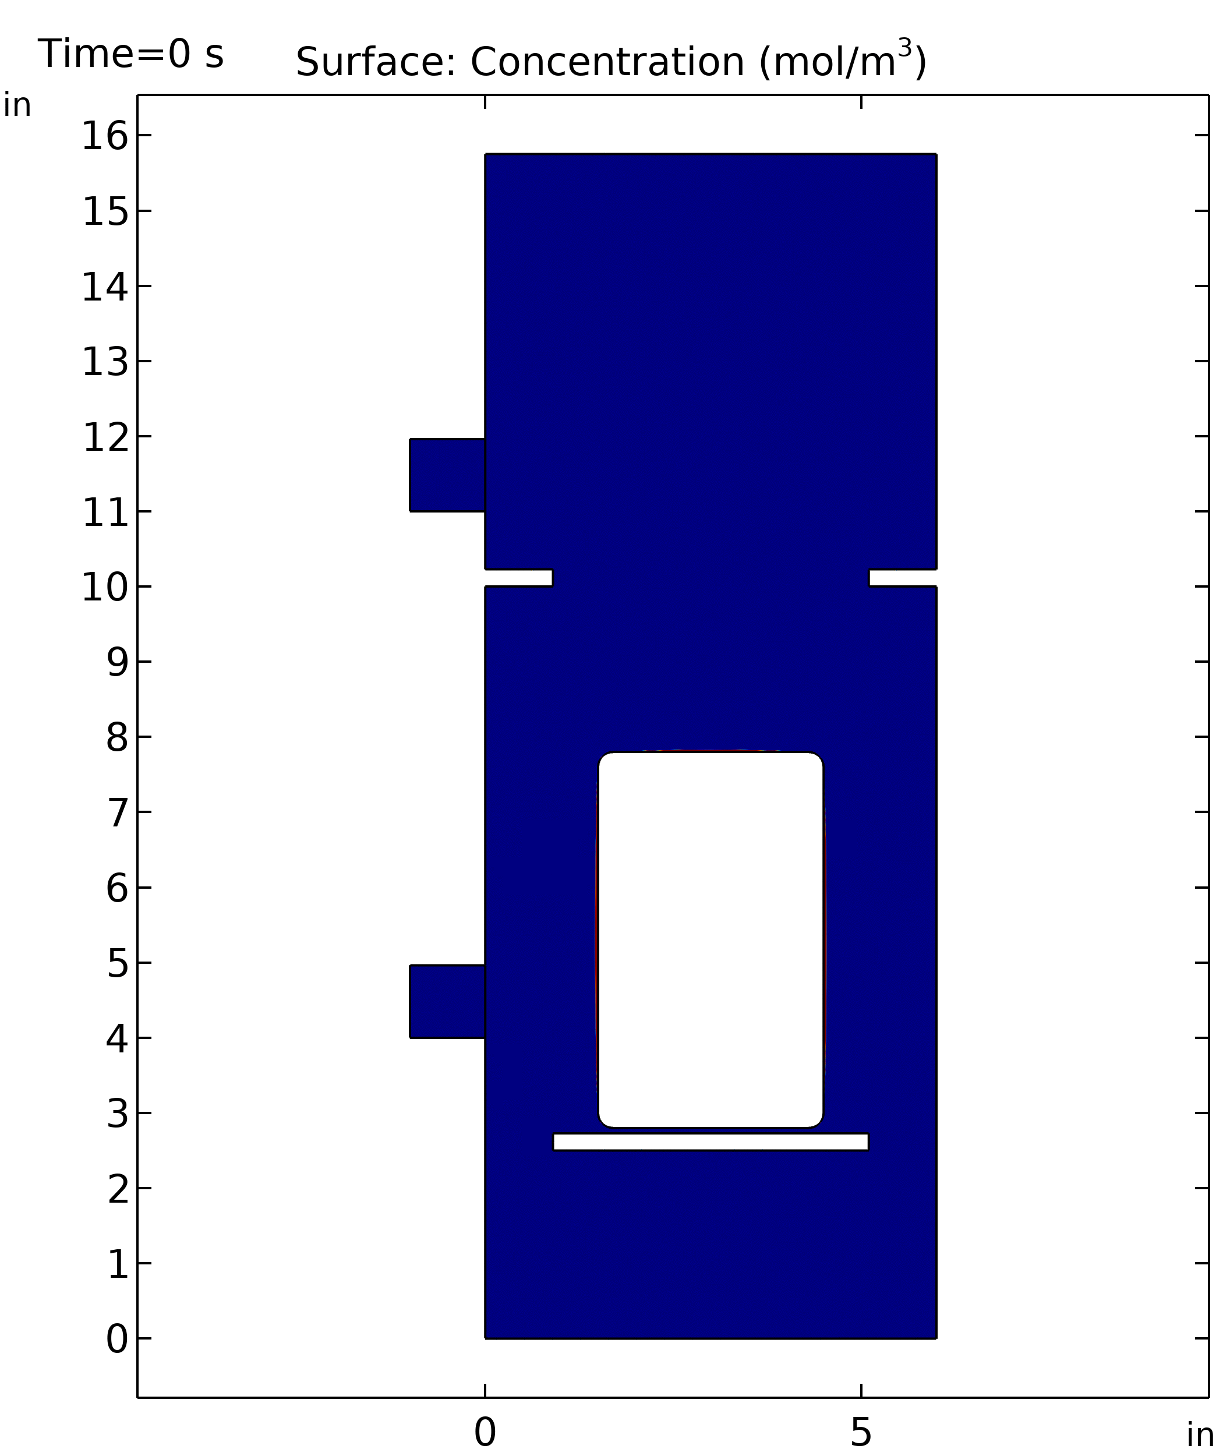
We compared simulations with 1, 3, and 5 tablets.

Slide 29
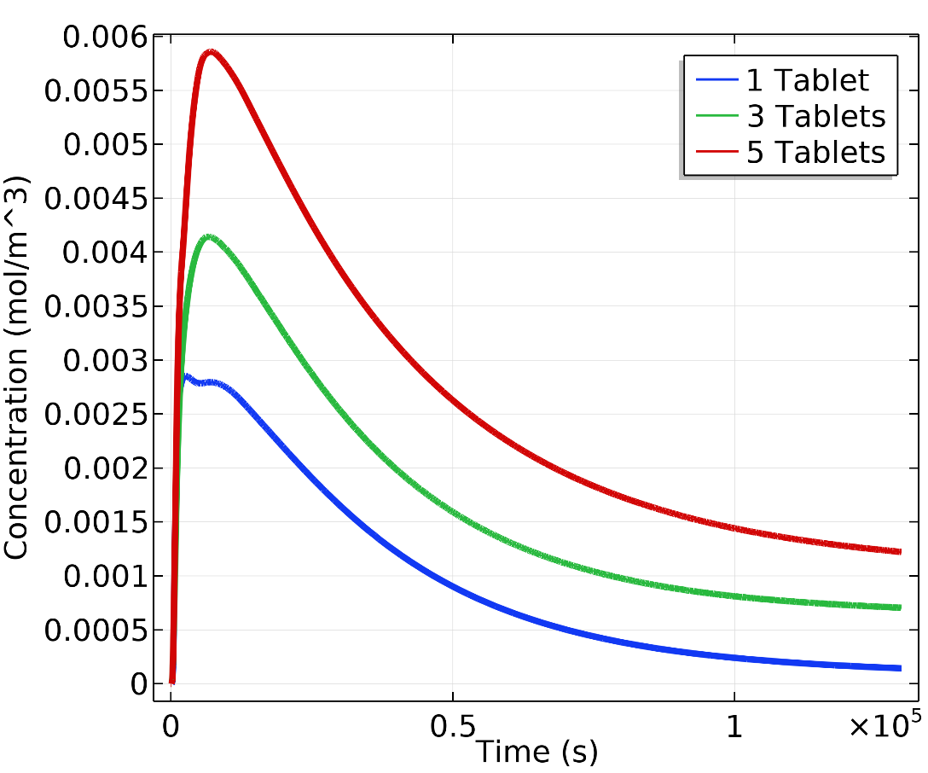
Chlorine concentrations peak early then taper off over time.

Slide 30
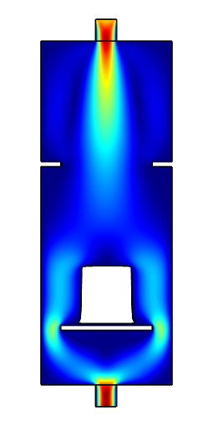
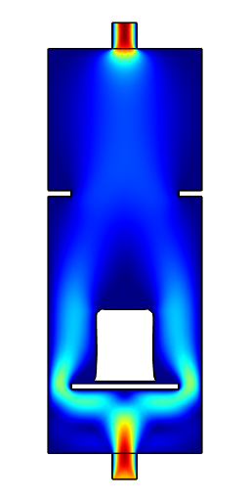
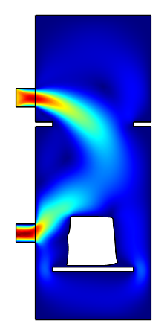
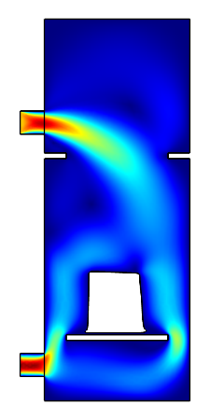
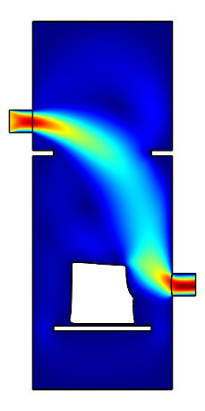
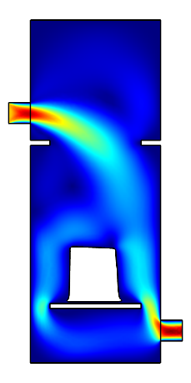
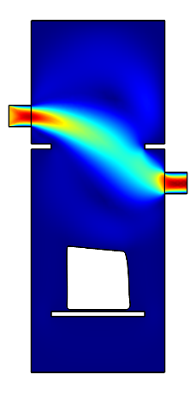
We changed the inlet and outlet locations to explore benefits to chlorine dose stability.
1
2
3
4
5
6
7

Slide 31
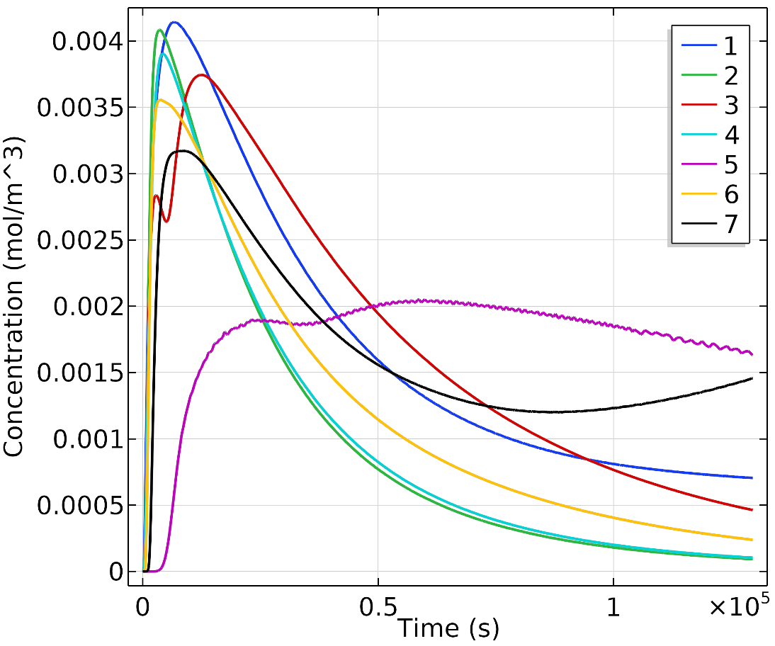
Scenario 5 (inlet and outlet above tablets) gave most consistent chlorine levels.

Slide 32
With less fluid flow directed at the tablets, convection plays a smaller role than diffusion. Tablet surface area is less important.

Slide 33
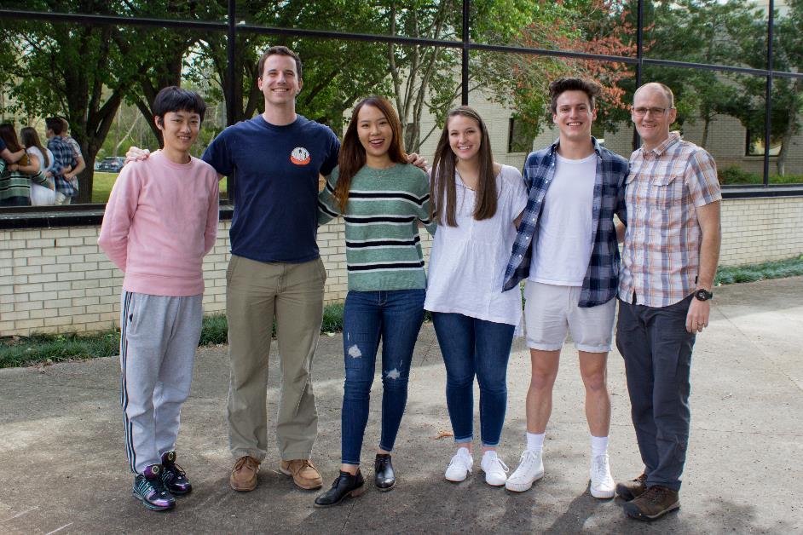
Acknowledgements
Clemson Engineers for Developing Countries (CEDC)
David Vaughn
Paris Stringfellow
Jeff Plumbley
Larry Murdoch

