Slide 1
Toward Optimized Membrane Unit Processes Via Multi-Scale Modeling David A. Ladner,¹ Zuo Zhou,¹ Colby Cash¹
Salman Bin Kashif,² Anna Malakian,² Bowen Ling,³
Ilenia Battiato,³ Scott Husson,² Sapna Sarupria²
¹Environmental Engineering and Earth Sciences, Clemson University
²Chemical and Biomolecular Engineering, Clemson University
³Energy Resources Engineering, Stanford University
Notes:
Speaker Name – Topic Title

Slide 2
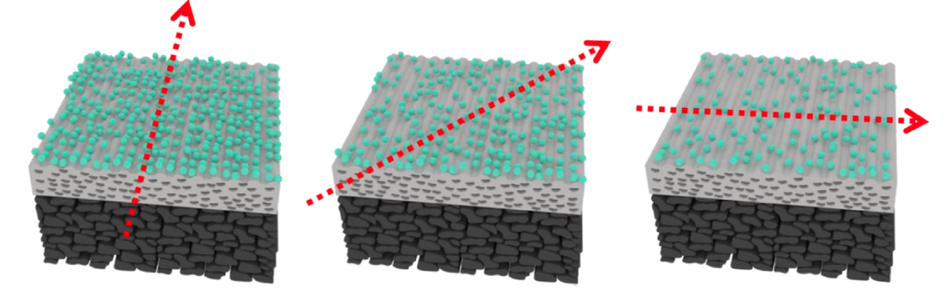
Patterned membranes are showing promise as foulant mitigators.

Slide 3
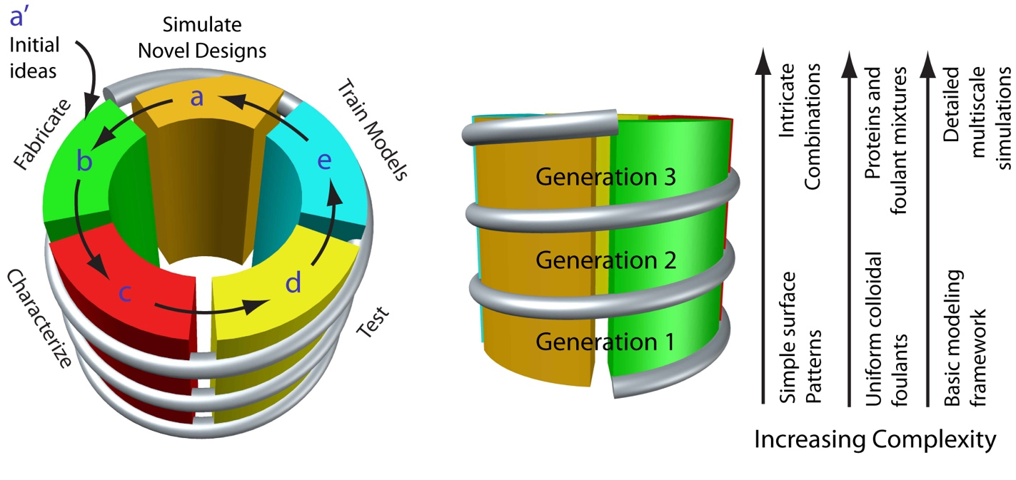
This DMREF* project combined computational modeling with experiments to discover the best pattern geometries.
* DMREF: Designing Materials to Revolutionize and Engineer our Future

Slide 4
Initial Ideas

Slide 5
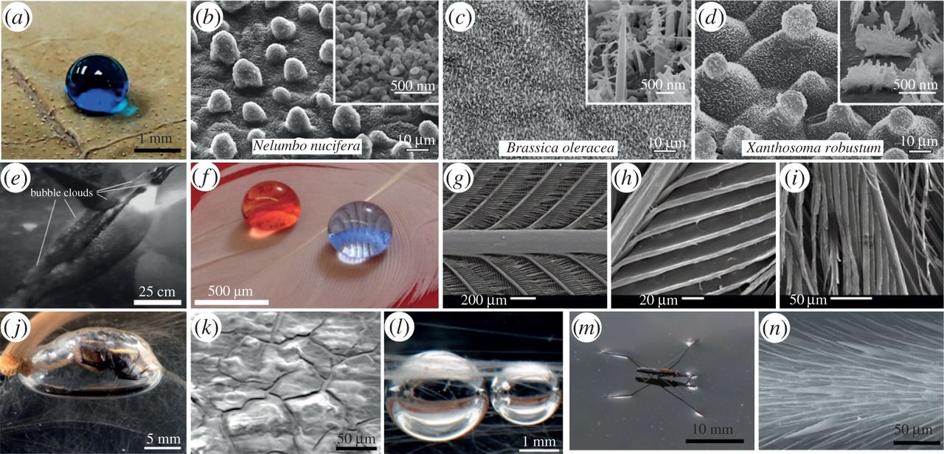
Biology is one source of inspiration.
Golovan et al., Phyl. Trans. Royal Soc. A, 2016. DOI: 10.1098/rsta.2016.0189.

Slide 6
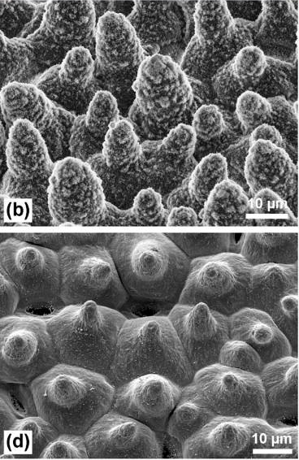
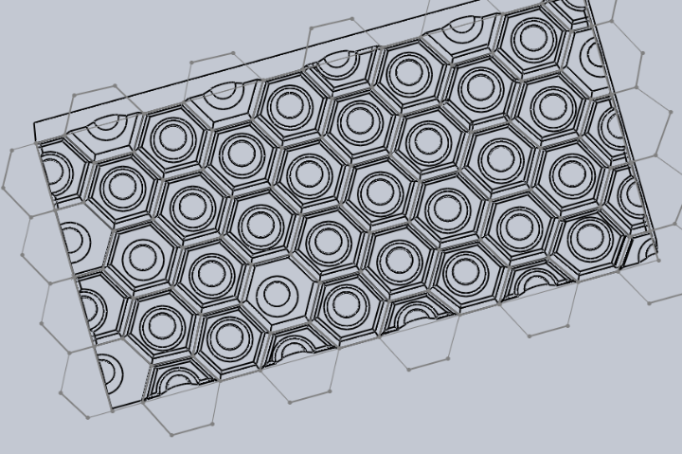
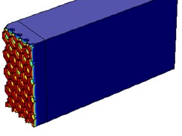
Lotus leaves are ultrahydrophobic and self-cleaning.
Depth: 0.256 mm, No fillets, CP factor=19
Depth: 0.256 mm, partial fillets, CP factor=13.7

Slide 7
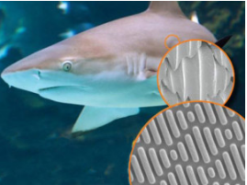
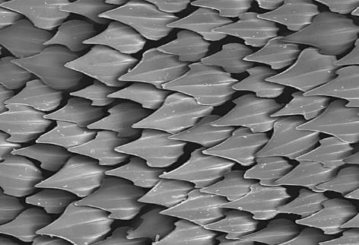
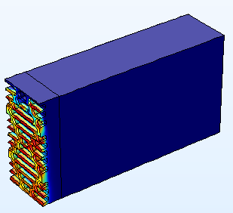
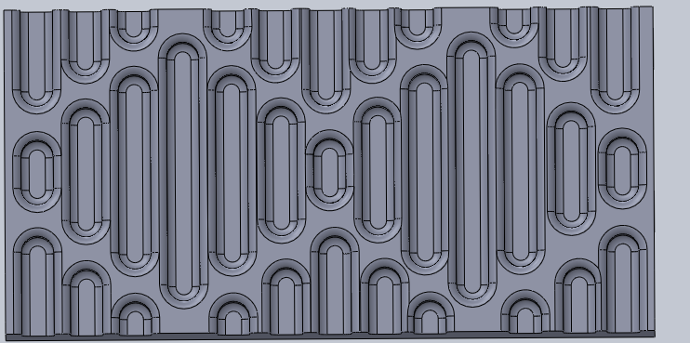
Shark-skin-inspired patterns result in low drag.
Depth: 0.256 mm CP factor=11.77
Depth: 0.128 mm CP factor=7.64

Slide 8
Fabricate

Slide 9
Polyamide thin-film composite membranes are patterned with a direct-press method.
Nanoscale patterning
Chemical coating
Line & groove silicon stamp
Thermal embossing
PEGDE (5 wt% and 15 wt%)
Reaction

Slide 10
Woven mesh can also be used to generate patterns.
10x
40x

Slide 11
Characterize and test

Slide 12
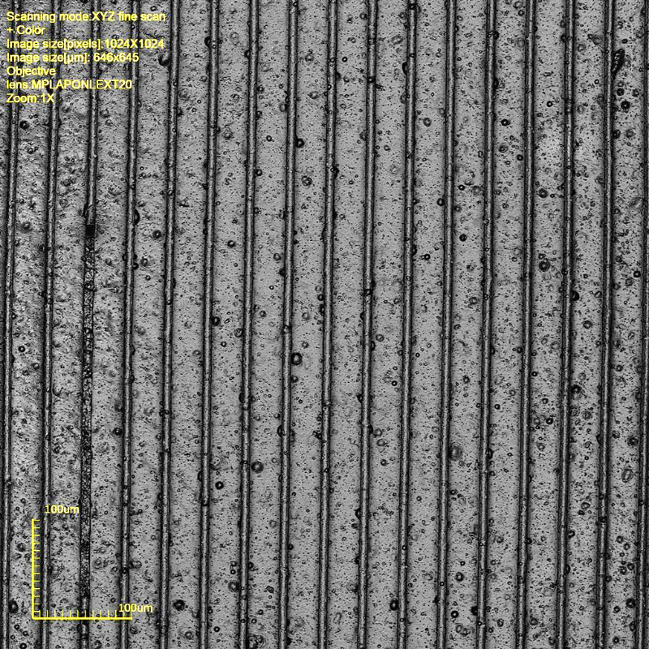
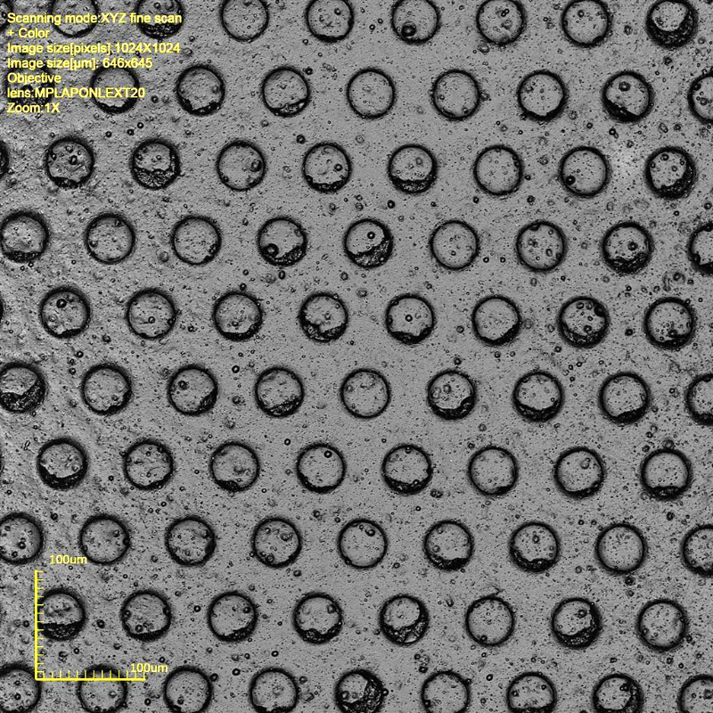
SEM* allows us to visualize the quality of pattern imprinting.
*SEM: Scanning electron microscopy

Slide 13
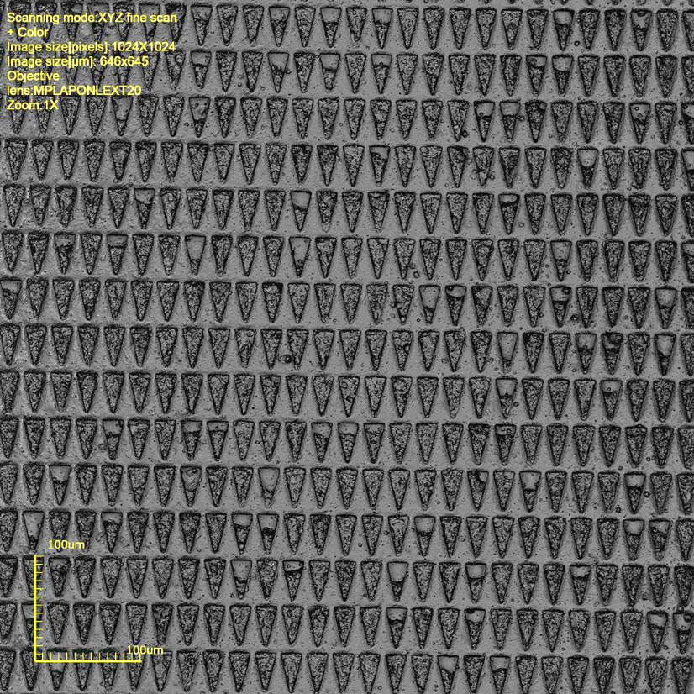
SEM allows us to visualize the quality of pattern imprinting.

Slide 14
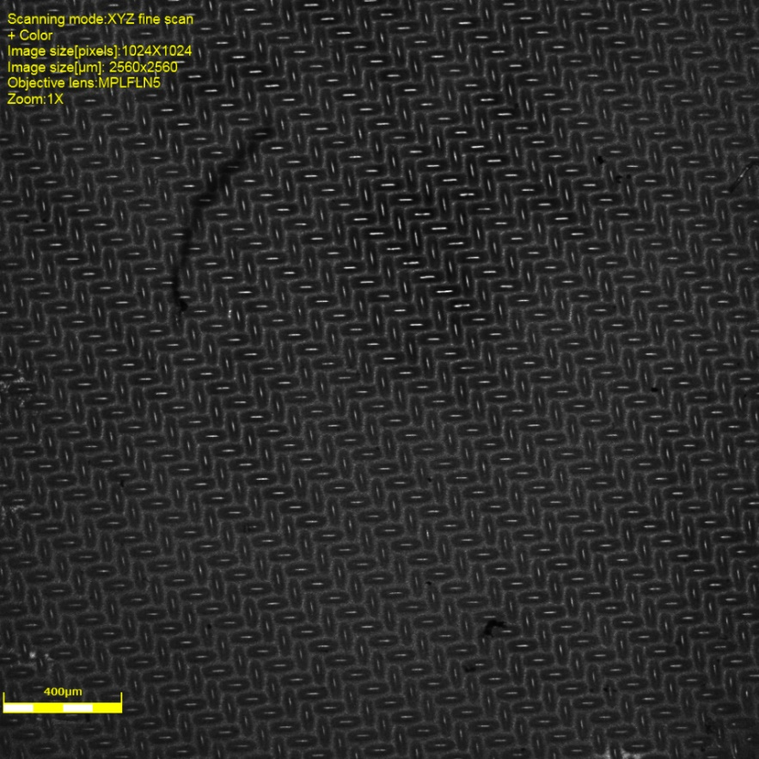
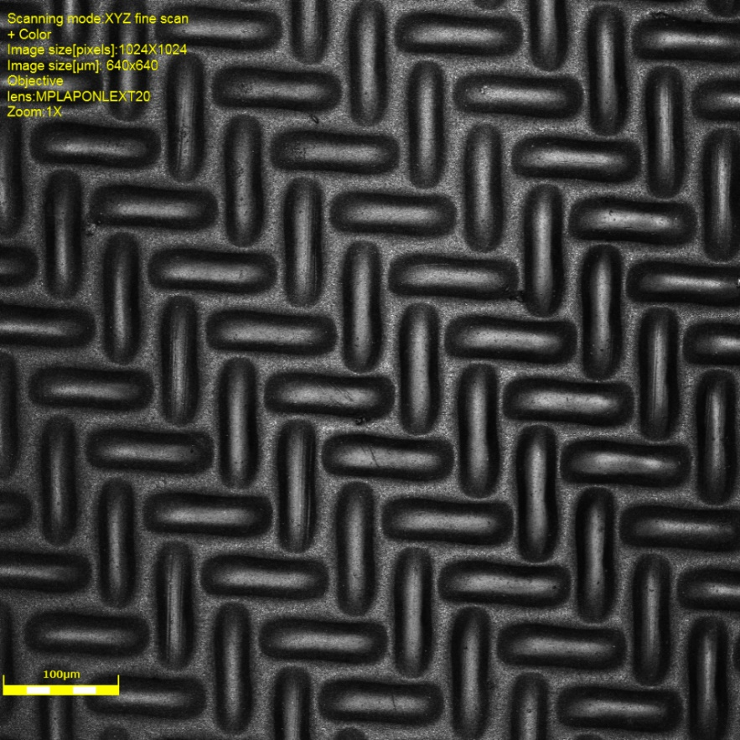
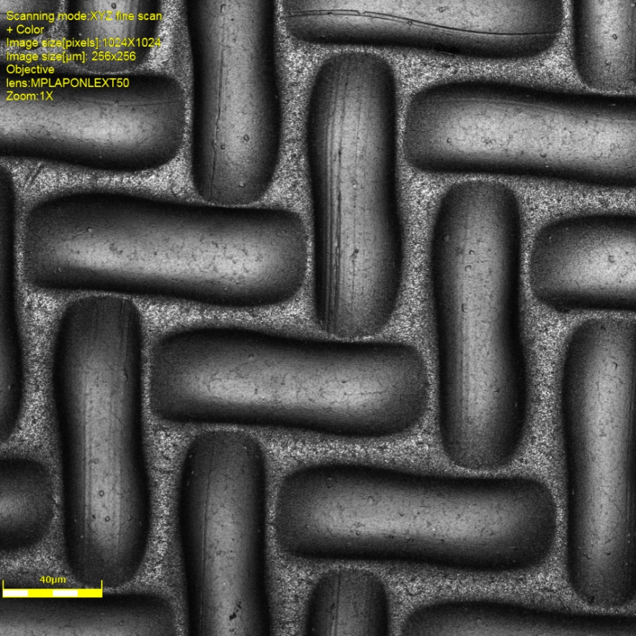
A LEXT* 3D Laser Measuring Microscope allows quantification of pattern depth and size.
5x
20x
50x
*LEXT: Product name with no acronym meaning (that we’ve found!).

Slide 15
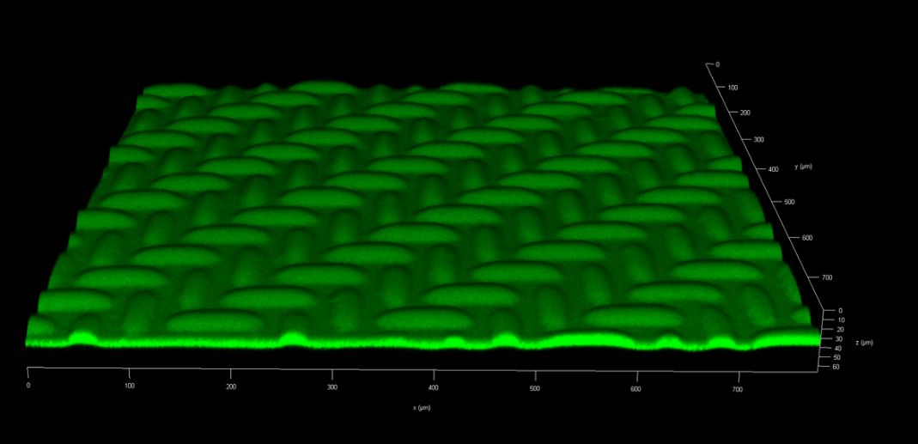
Confocal microscopy of stained membranes will allow us to visualize fouling patterns.
Stained pristine PVDF membrane
Stained patterned PVDF membrane

Slide 16
Train Models
at multiple scales

Slide 17
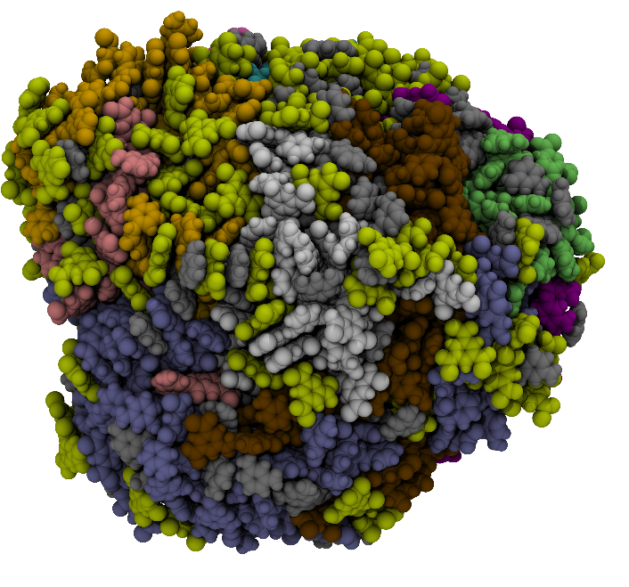
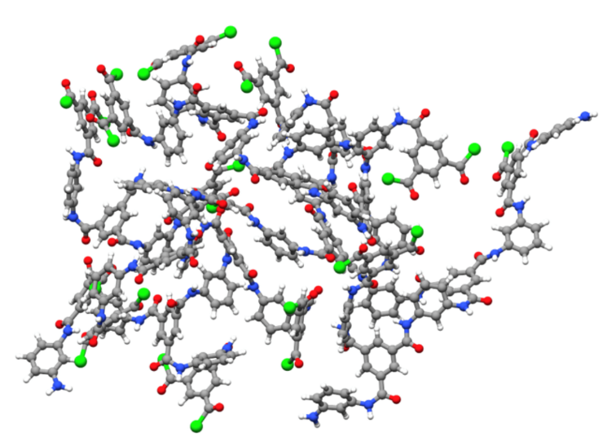
Our smallest-scale is at the molecular level. We model the membrane.
Begin with a
polyamide cluster
Each color represents
a different cluster.

Slide 18
We also model the foulants at the molecular level.

Slide 19
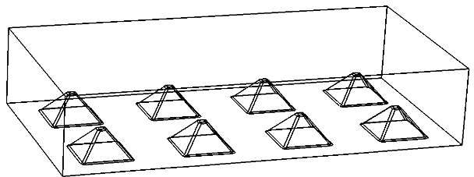
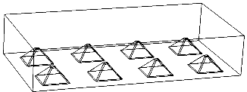
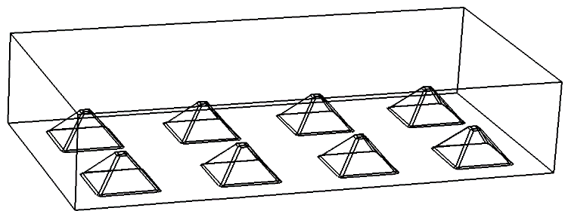
We scale up the modeling effort via CFD*.
Pattern length: 2 µm
Pattern length: 128 µm
Pattern length: 8 µm
Pattern length: 32 µm
Pattern length: 512 µm
*CFD: Computational fluid dynamics.

Slide 20
CFD reveals how salt builds up within depressions.

Slide 21
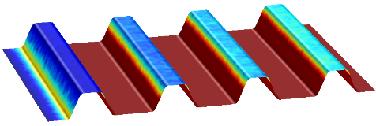
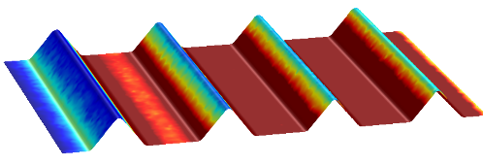
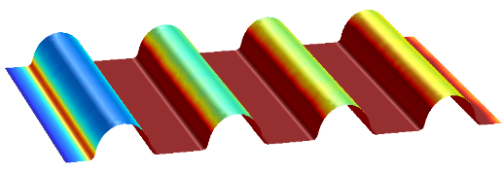
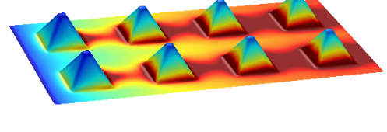
CFD reveals how patterns affect fluid flow and concentration polarization.
mol/m³

Slide 22
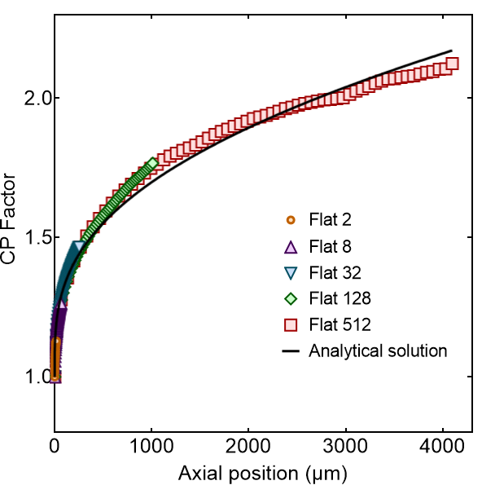
We validate the CFD models using analytical results.
$$Sh=1.85{\left(Re∙Sc∙\frac{d_{h}}{L}\right)}^{0.275}$$
$$k=\frac{Sh∙d}{d_{h}}$$
$$\frac{c_{m}}{c_{b}}=\exp\left(\frac{J}{k}\right)$$

Slide 23
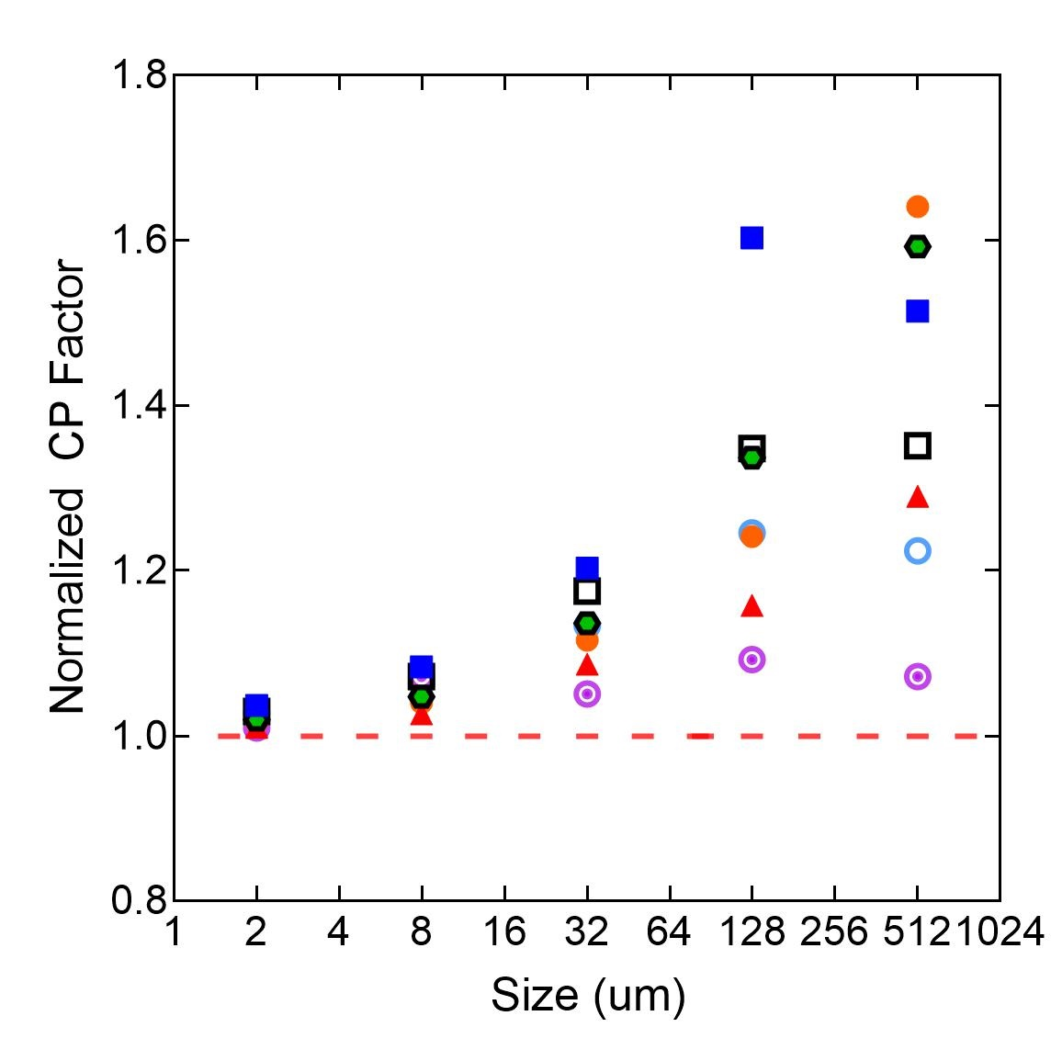
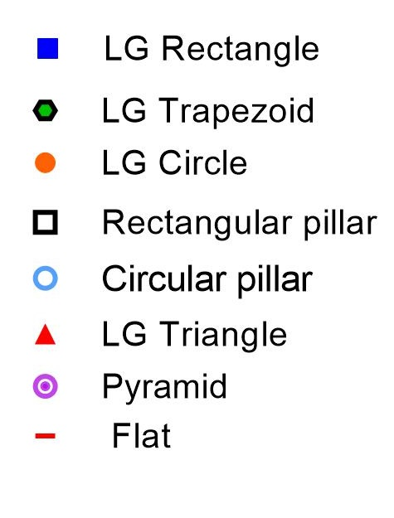
CP increases as feature size increases.

Slide 24
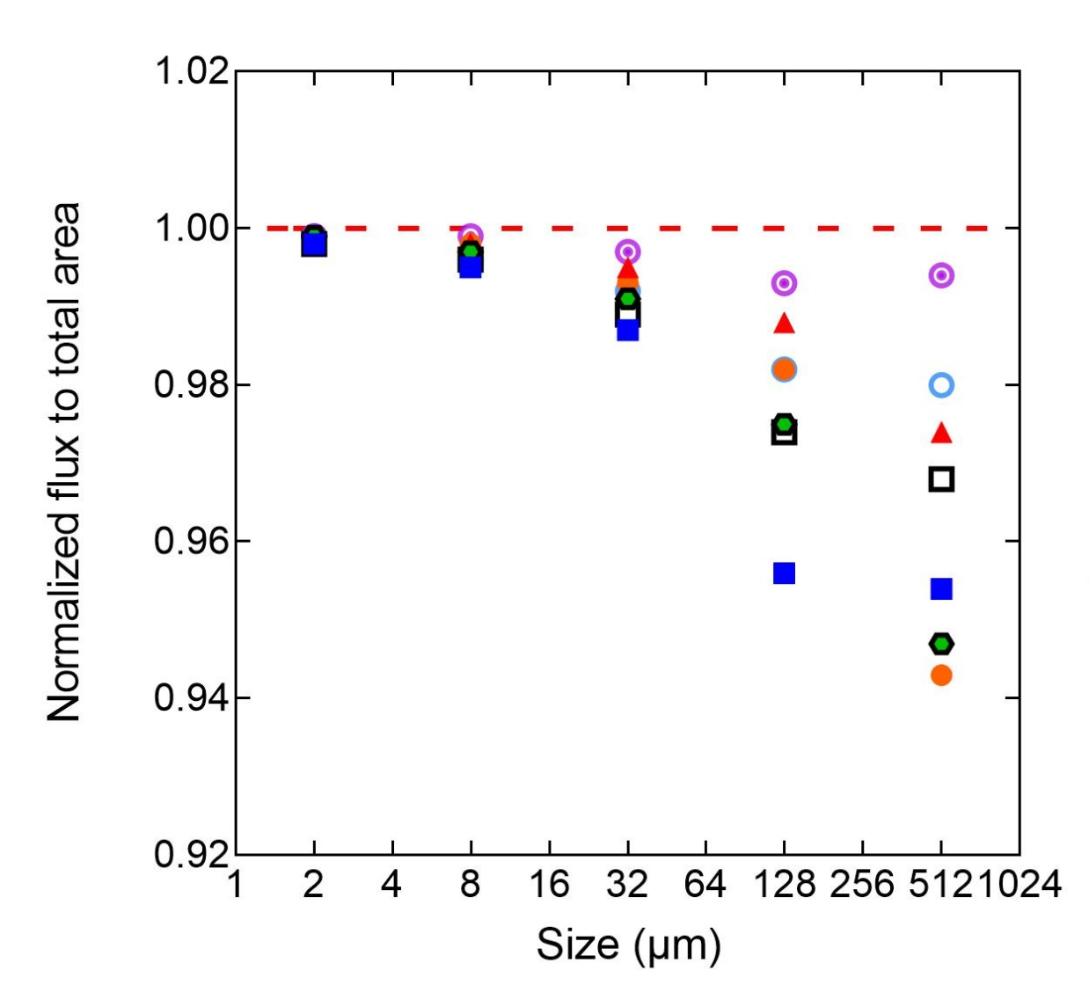
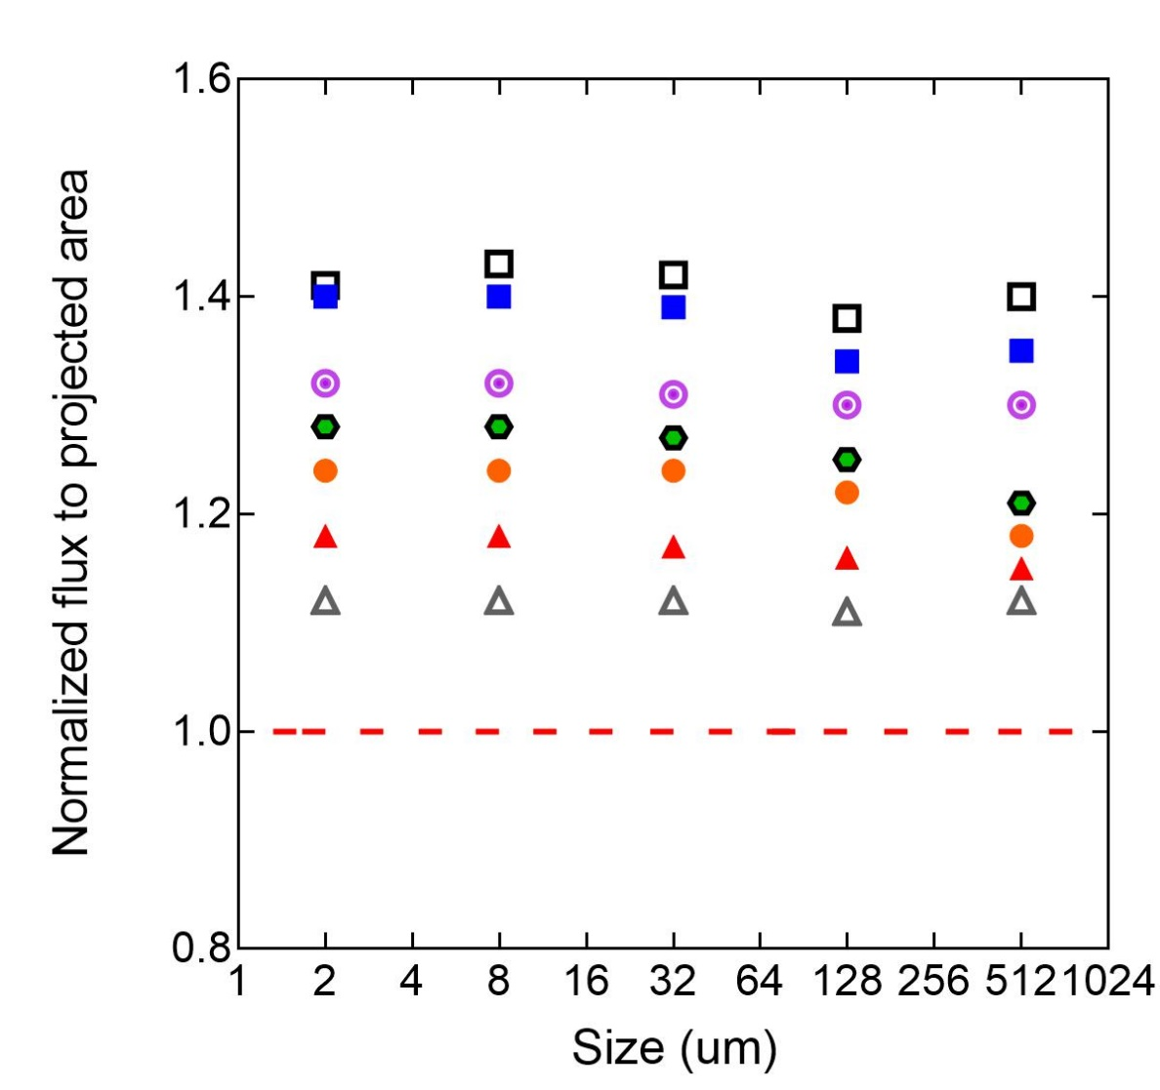
Flux improvements may be related to the increase in area.

Slide 25
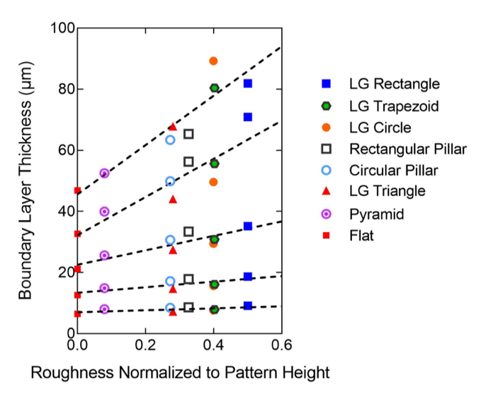
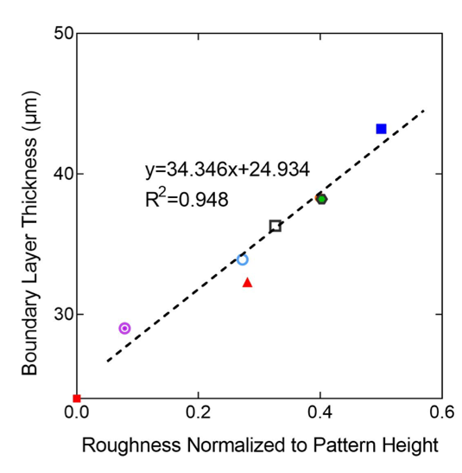
Boundary layer thickness correlates with roughness.

Slide 26
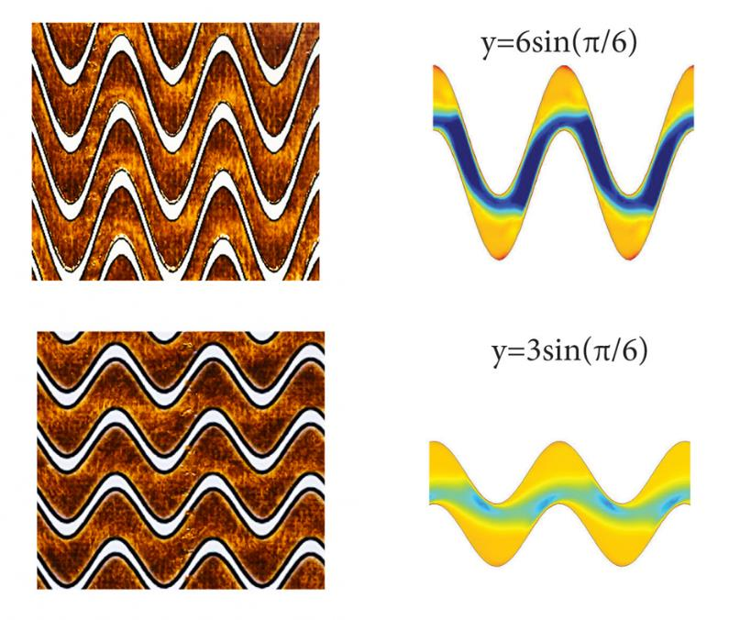
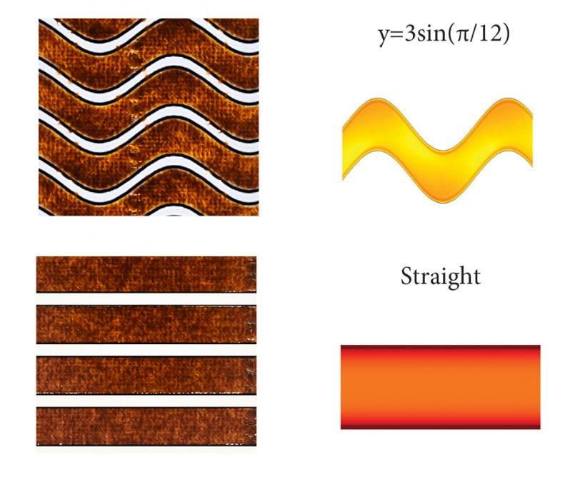
We train the models by comparing fouling experiments to model results.

Slide 27
Simulate Novel DeSigns

Slide 28
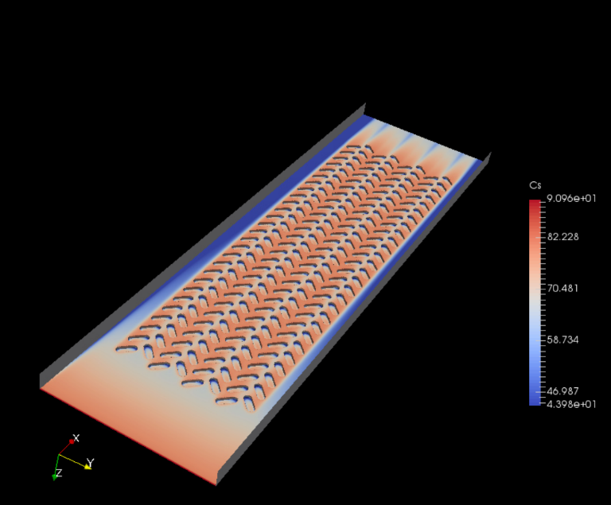
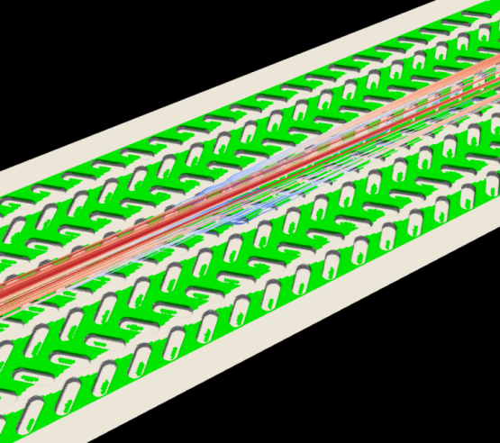
We noticed some interesting behavior with the tire-tread pattern.

Slide 29
The fouling pattern was flow-direction dependent (anisotropic).

Slide 30
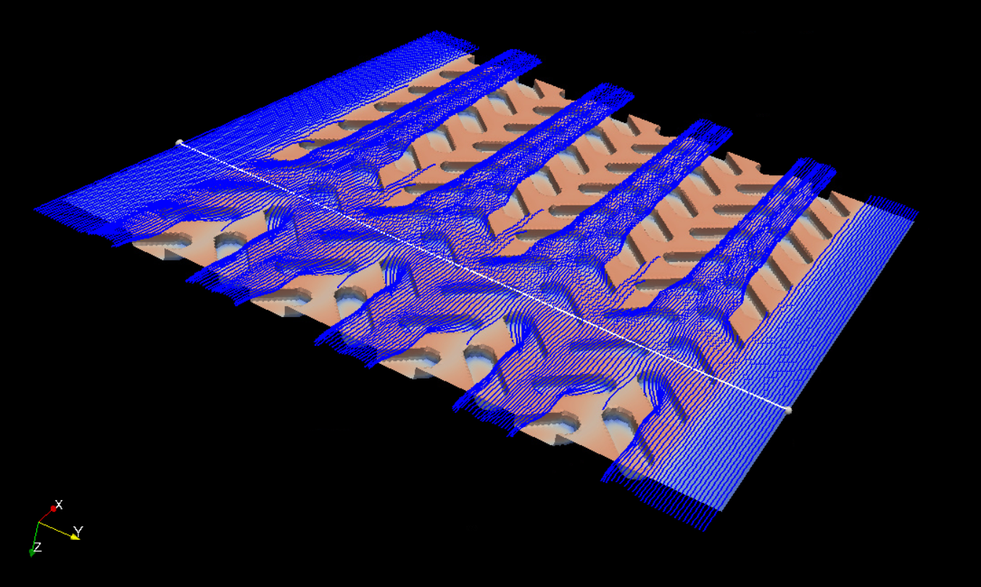
The pattern is able to make the flow field converge.

Slide 31
Current and future efforts will move us up the helix.

Slide 32
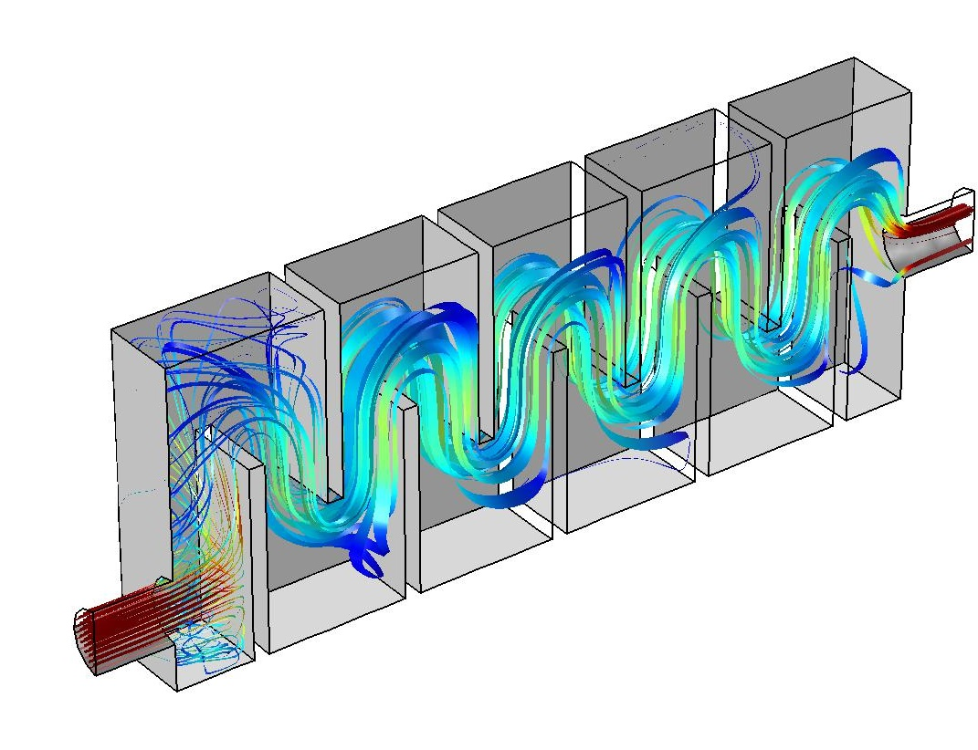
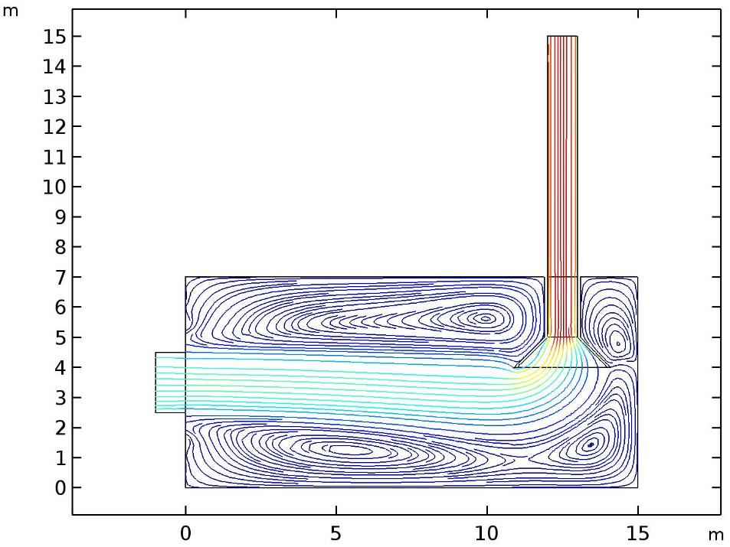
CFD is a useful tool for characterizing various unit processes.

Slide 33
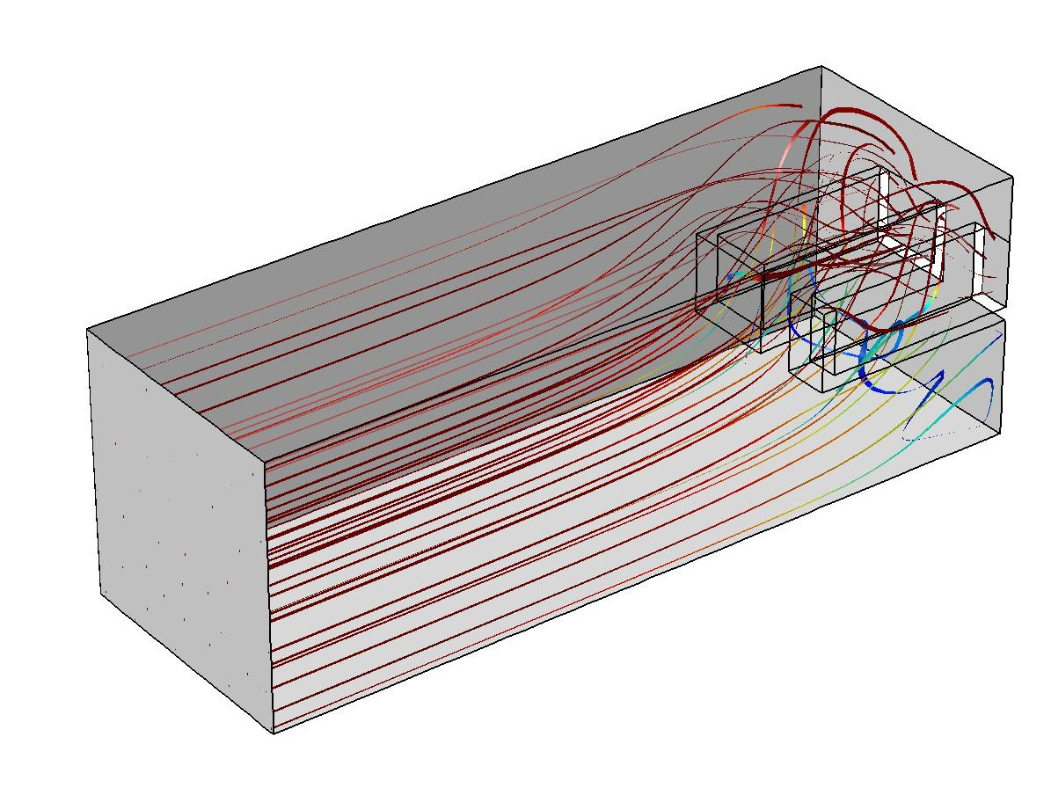
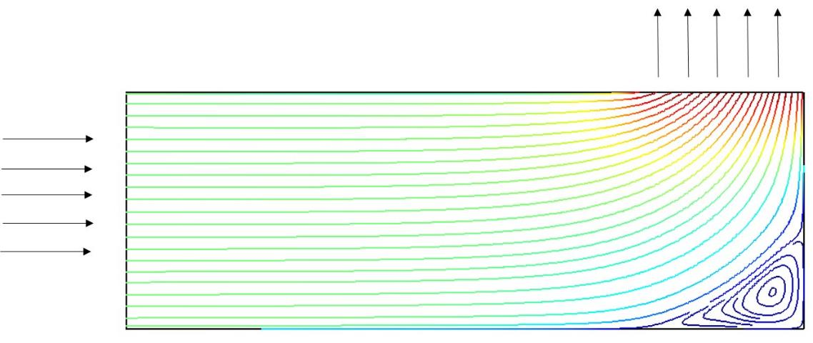
CFD is a useful tool for characterizing various unit processes.

Slide 34
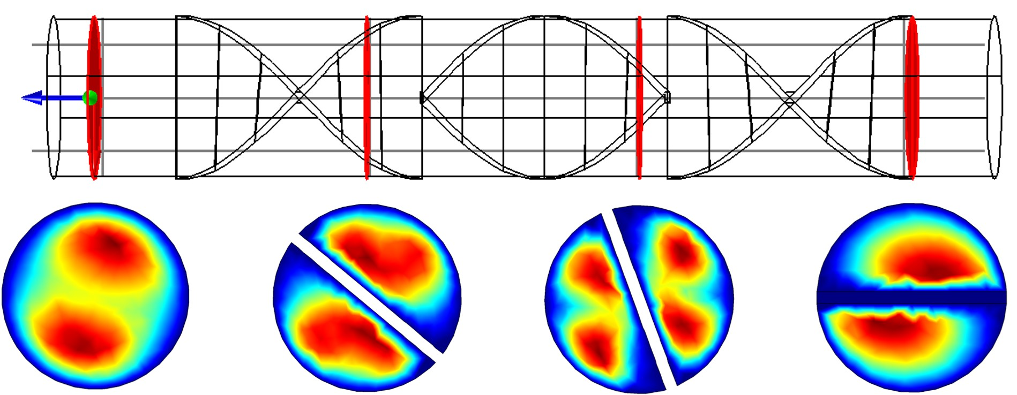
CFD is a useful tool for characterizing various unit processes.

Slide 35
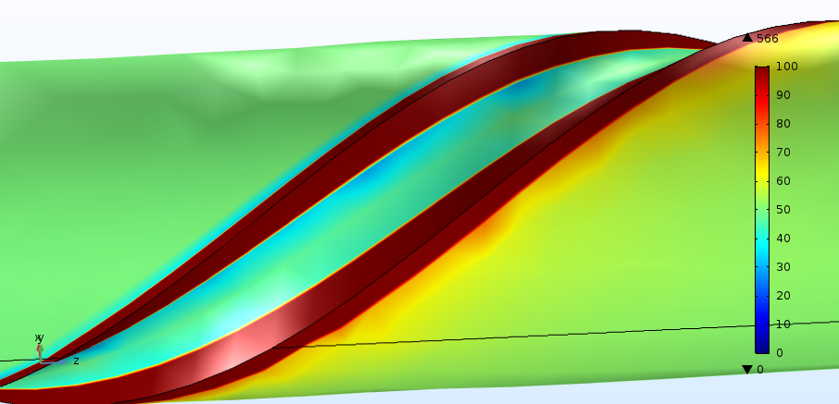
CFD is a useful tool for characterizing various unit processes.

Slide 36
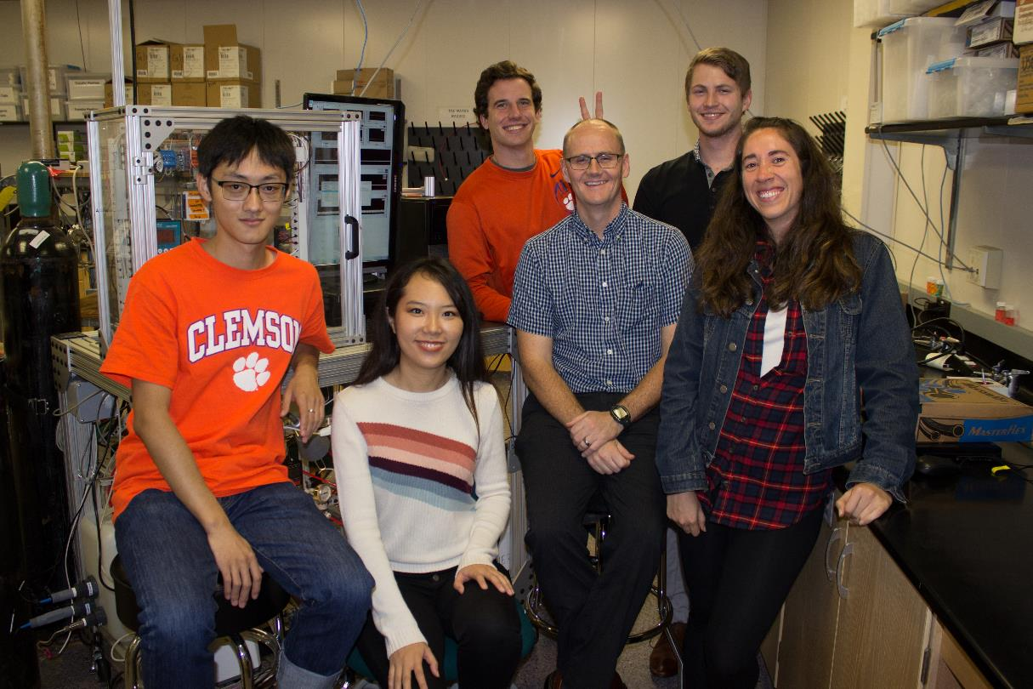
Acknowledgements
Clemson Light Imaging Facility
Clemson Electron Microscopy Facility
Palmetto Cluster
NSF
CBET-1236070
CBET-1534304
Research Group Website: http://davidladner.org

