Slide 1
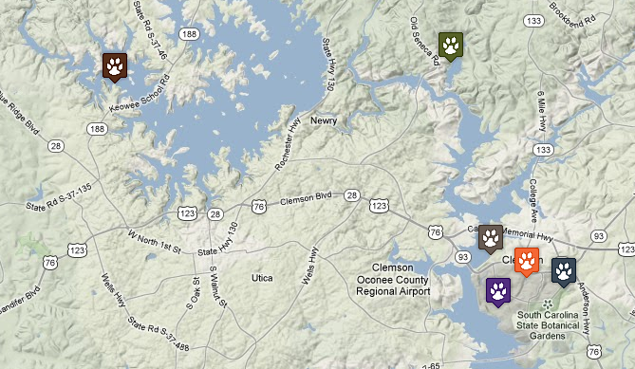
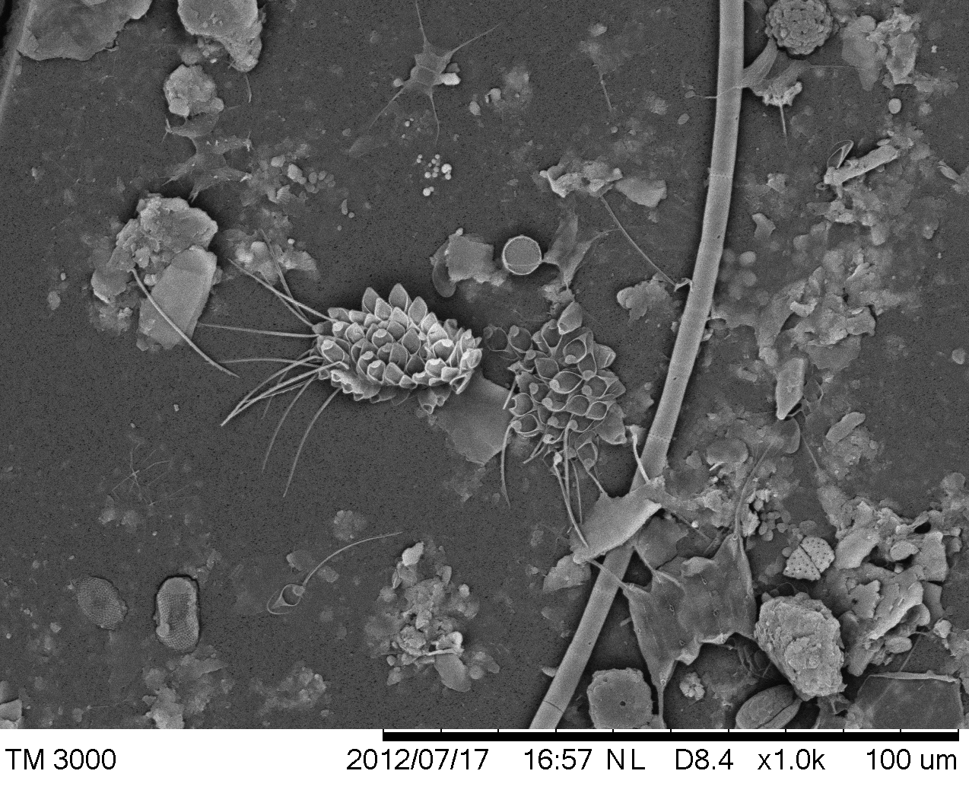
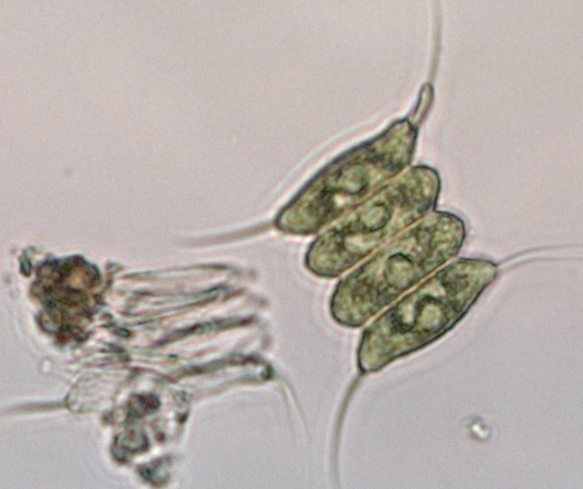
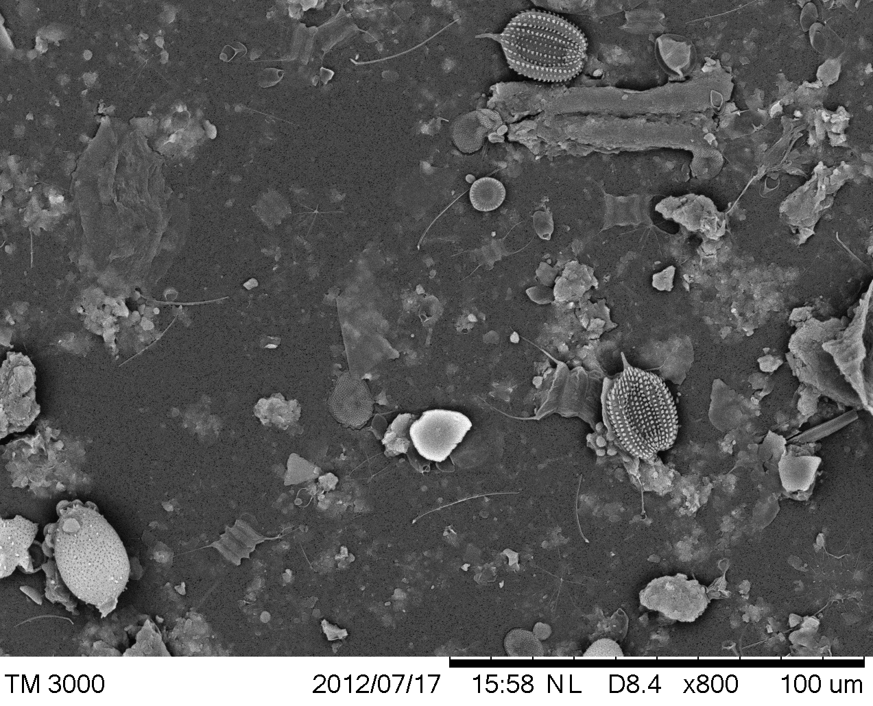
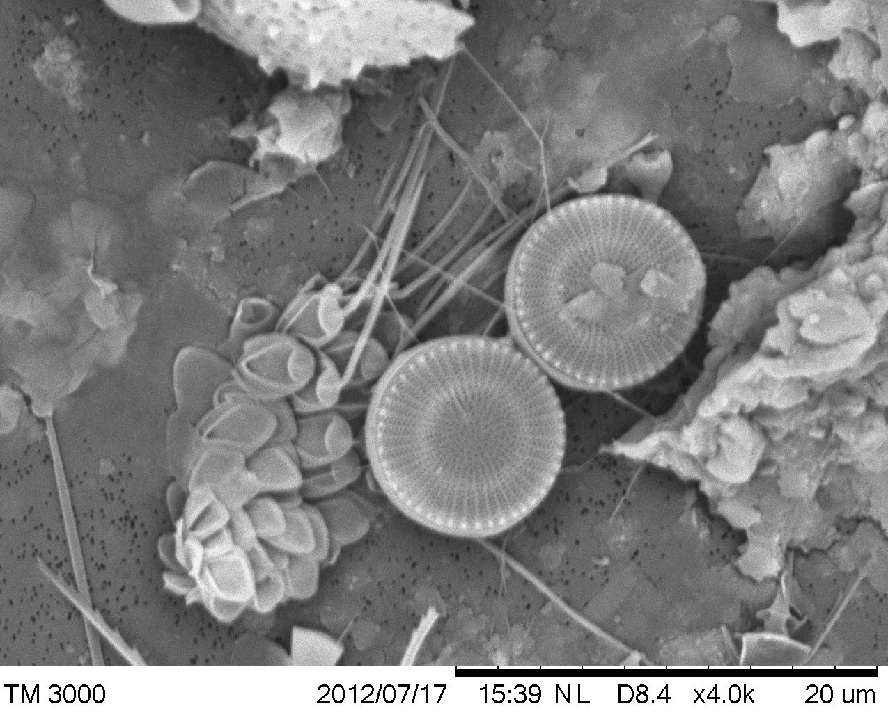
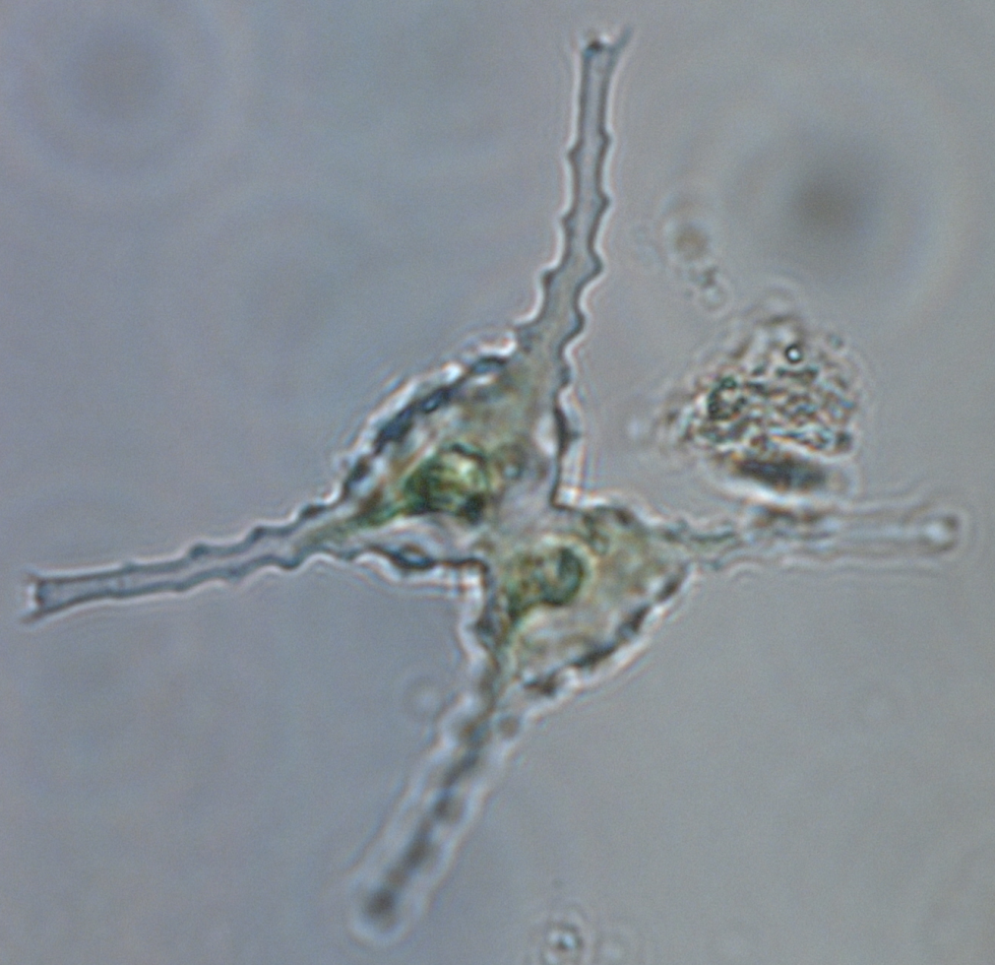
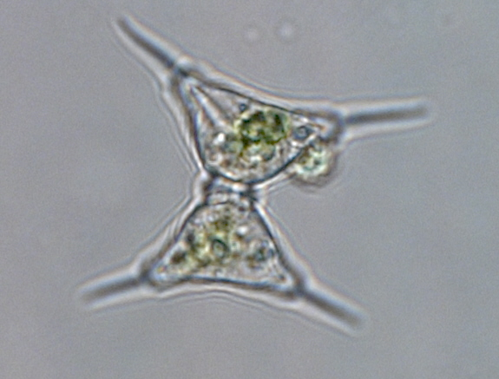
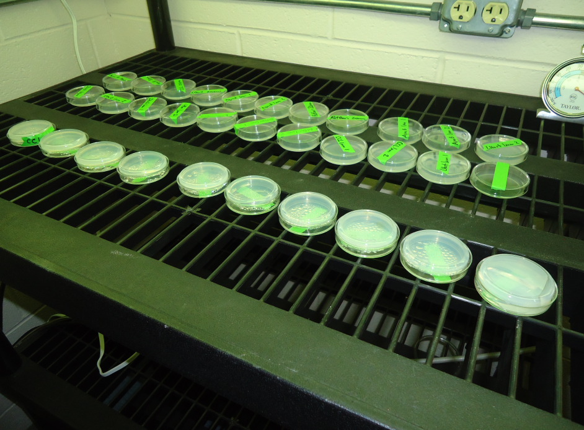
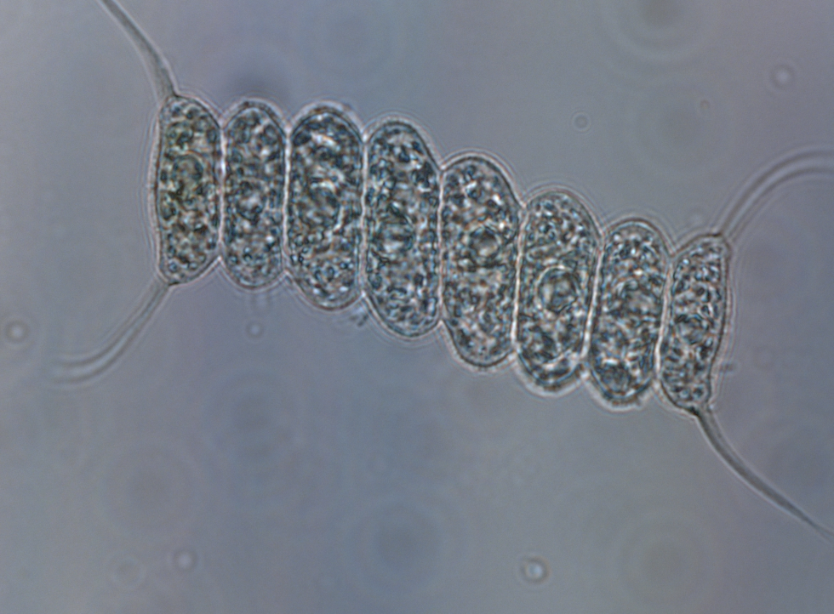
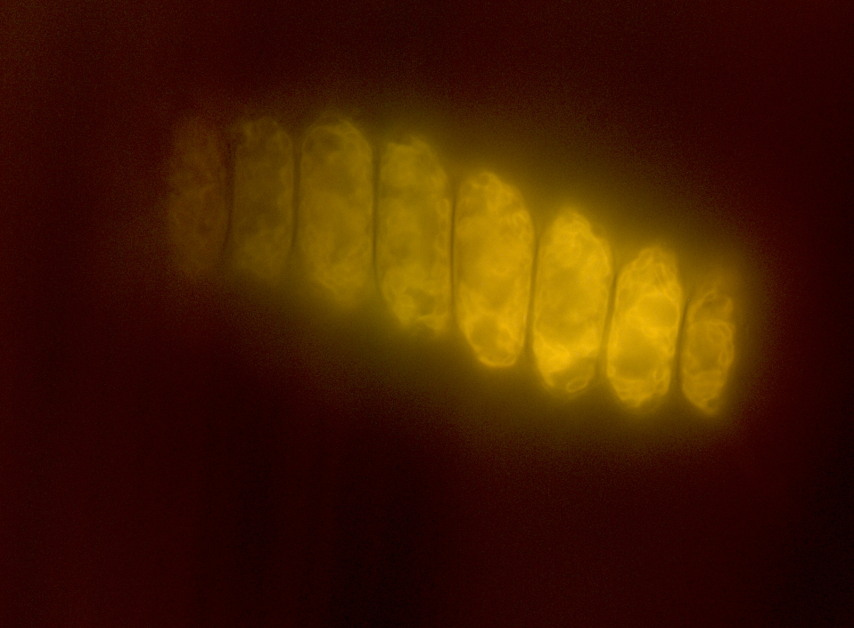
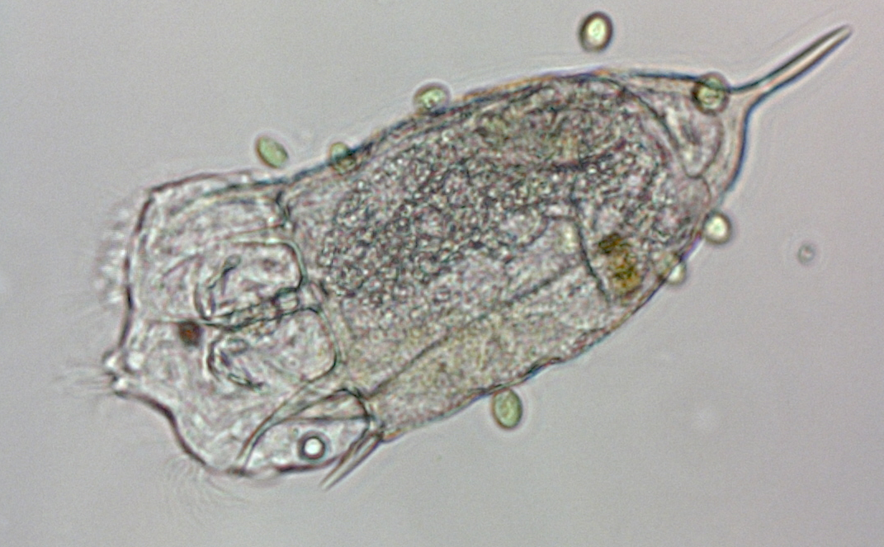
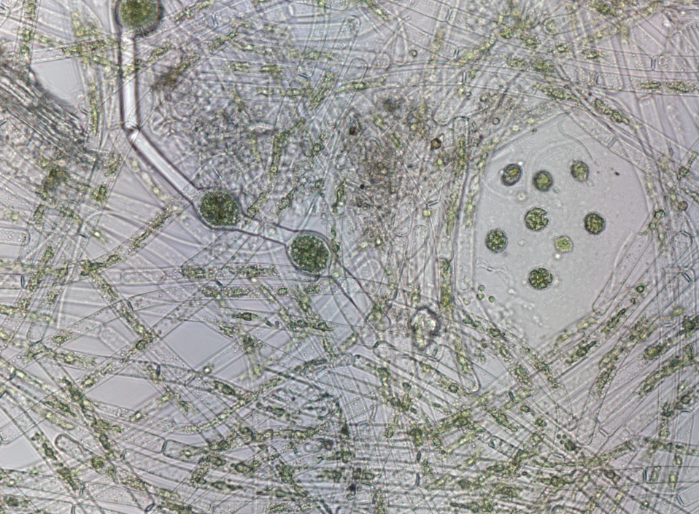
Bioprospecting to Discover Local Algae for Biofuel Production Cassidy Laird, Muriel Steele, and Dr. David Ladner Department of Environmental Engineering and Earth Sciences
Abstract
Results
Discussion
Biofuel production from microalgae is a promising renewable energy endeavor. Most investigations to discover useful algal species focus on lipid production and growth rate but a challenge that receives less attention is harvesting the small cells in a low-energy manner. This project was the starting point for discovering algal species that could be easily removed from water by membrane filtration. Samples were taken from local water bodies to simultaneously evaluate dozens of non-invasive species. Algal genera were identified through bright-field microscope and scanning electron microscope (SEM) images. Scenedesmus was the most common genus identified, with Euglena and Staurastrum appearing repeatedly. After identification, agar plates were inoculated and algal growth was monitored to determine which species could be easily cultured. Filamentous algae like Oedogonium gracilis and Fischerella were the first to visibly grow in the agar plates out of the 21 genera identified. Scenedesmus was the next most prominent type. It is hypothesized that the filamentous algae are good candidates for harvesting because they can be filtered with minimal pore blocking. Mallomonas is another interesting species because its spiny structure would allow water passage. This project sets the stage for bench-scale harvestability tests to be conducted by the research group in the future, now that culturable genera with promising morphology have been identified.
The Botanical Gardens had the highest biodiversity, most likely because it is somewhat stagnant and nutrient-rich.
The benefits of growing local algae is that there would be less contamination (e.g. by invasive species) and it would be far more sustainable.
The ideal algae for biofuels are Chlorophyceae (green algae) because of their high lipid content and quick reproduction time².
Chlorella and Dunaliella are preferred, but were not found at the sites
Scenedesmus, a Chlorophyceae, was found at four of the sites.
This species is viewed as a feasible option for biofuels conversion³.
Another Chlorophyceae, Oedogonium gracilis, was found a two of the sights, and also is one of the filaments that is growing the quickest in the agar plated cultures.
Symbol | Site
 | Aquaculture Center
 | Botanical Garden
 | Cane Creek Landing
 | Issaqueena Lake
 | Lake Hartwell
 | Reflection Pond
Class | Genus | Location
Bacillariophyceae – diatoms (centric) | Cyclotella comta
 | Centric Filaments
 | Podosira
Charophyceae | Staurodesmus
Chlorophyceae | Closterium
 | Cosmarium
 | Eudorina or Pleodorina
 | Kirchneriella
 | Oedogonium gracilis
 | Pediastrum
 | Scenedesmus
 | Staurastrum
 | Tetraedron
 | Treubaria
Chrysophyceae | Mallomonas
Cyanobacteria (Cyanophyceae) | Fischerella
 | Microcystis
Euglenophyceae | Euglena
 | Phacus
 | Trachelomonas
Various | Eladocera
 | Keratella
Xanthophyceae | Tribonema
Introduction
Algae are transformed into biofuel using three steps: cultivation, harvesting, and conversion.
Harvesting (dewatering) is a major bottleneck in the process¹.
Harvesting can be done in various ways: Sedimentation, dissolved air flotation, or filtration
Membrane microfiltration can be beneficial because it accomplishes near complete separation without chemical addition.
A major problem with microfiltration is the energy cost, especially when fouling occurs.
The overall goal of this work is to find algal species that are low fouling, then learn what makes them that way.
The specific goal of this EUREKA! Project was to collect, identify, and culture local algal species.
Figure 2 (below): SEM image of Phacus and others.
Figure 11 (below): SEM image of Mallomonas and Cyclotella comta.
Figure 1 (above): SEM image of Mallomonas and others.
Figure 10 (above): Bright field microscope image of Scenedesmus.
For more images, scan the QR code (above) to access the online gallery.
Conclusion
Figure 4 (below): Bright field microscope image of Staurodesmus.
The investigation into the harvesting process for biofuels is an ongoing process that will require significantly more data, particularly in regards to filtrations and biomasses of various algae. This project, however, is a starting point for investigations regarding the harvestability of local algae, and demonstrates that using local algae has benefits, such as relatively easy access to it. Certain algae prefer certain conditions, and the diversity found within this radius exhibits the variety of environments that are available locally. The most prevalent local species was the Scenedesmus, having been noted at four of the six sites, and Staurastrum and Euglena were seen at three of the sites. The filamentous algae (Oedogonium gracilis) found at a couple of the sites seems to be the best suited for growing in the plated cultures.
Methods
Figure 3 (above): Bright field microscope image of Staurastrum.
Collect algae samples from various sites.
View under microscope and determine species to form a generalized idea of the algal community.
Create agar-based growth plates in which to grow the cultures.
BG-11 Media was used in plates
Inoculate plates and examine growing cultures.
Analyze and interpret data in relation to the question of which is best for harvesting for biofuels.
Figure 5: Petri dishes containing inoculated agar plates in the lab.
Figure 6 (left): Bright field microscope image of Scenedesmus.
Figure 7: Same image as Figure 5, but in fluorescence.
Acknowledgements
Bibliography
Figure 8 (left): Bright field microscope image of Keratella.
Figure 9: Bright field Microscope image of Oedogonium gracilis.
Clemson University and the Calhoun Honors College are gratefully acknowledged for support of the EUREKA! Program. Special thanks are given to Graham von Oehsen and Scott Davis for their help.
1 Wiley, Patrick, J. Elliott Campbell, and Brandi McKuin. (2011). Production of Biodiesel and Biogas from Algae: A Review of Process Train Options. Water Environment Research, 83 (4). Retrieved on June 28, 2012 from online database.
2 Kenyon College. (2011, July 23). Biodiesel from Algae Oil. Retrieved July 29, 2012, from: http://microbewiki.kenyon.edu/index.php/Biodiesel_from_Algae_Oil.
3 Mandal, S. and N. Mallick. “Microalga Scenedesmus obliquus a potential source for biodiesel production.” Appl Microbiol Biotechnol, March 28, 2009. Accessed July 29, 2012. Abstract retrieved from http://www.ncbi.nlm.nih.gov/pubmed/19330327.

