Slide 1
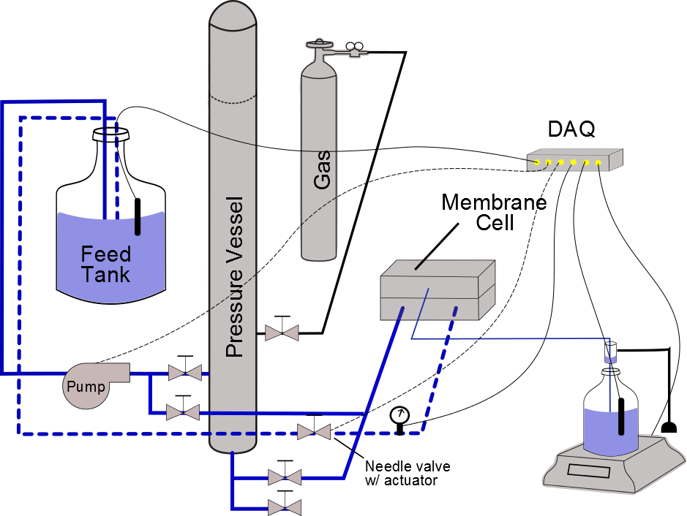
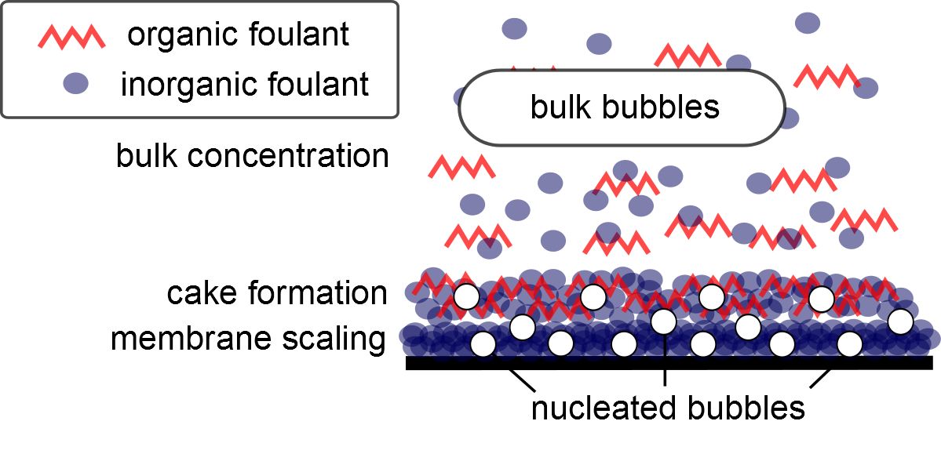
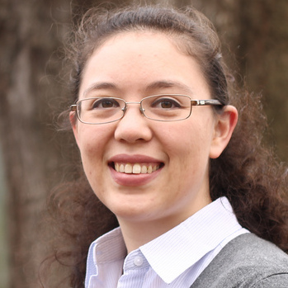
Dissolved CO₂ – An Alternative for Cleaning Inorganic Scale from RO Membranes
ERIN PARTLAN, DAVID LADNER
Clemson University
Background
Membrane fouling is a major operational issue in reverse osmosis desalination plants. In particular, plants treating brackish surface waters or groundwater can encounter troublesome inorganic scales that cling to membranes and are difficult to remove.
While many efforts focus on methods to prevent fouling, it is inevitable in a major plant. Here, dissolved CO₂ is proposed as a novel cleaning method to remove scales from inorganically fouled membranes.
Materials
CPA2 Hydranautics Low-pressure Reverse Osmosis Membrane
Plate-and-frame membrane cell (GE SEPA)
CaCO₃ solution: 200 ppm CaCl₂, 200 ppm Na₂CO₃, 10 g/L NaCl
Silicate solution: 400 ppm CaCl₂, 300 ppm SiO₂, 10 g/L NaCl
Results
Calcium Carbonate The best cleaning resulted from dissolved CO₂. When cleaned with acid – the standard for removing many types of inorganic scale – similar results were observed. Lastly, clean water provided minimal cleaning.
Calcium Silicates None of the attempted cleaning solutions were able to remove silicate scale. Silica is known to be problematic and typically handled with pretreatment to reduce concentration levels. For cleaning, industrial standards vary between acid and alkaline cleaning solutions.
Discussion
The fact that dissolved CO₂ works to remove CaCO₃ poses questions about the mechanism by which it cleans. The cell is opaque, so visual confirmation of bubble formation is not possible. Other possible methods by which cleaning can occur include pH effects and reactivity. These are especially true for calcium carbonate scale since the cleaning solution drops to pH 4 after carbonation, and the addition of CO₂ itself stimulates changes in carbonate equilibrium. Further work can be done to explore more of these interactions to arrive at the dominant mechanism.
Applications
Green Alternative Dissolved CO₂ can replace conventional antiscalants and/or cleaning solutions. Antiscalants are typically costly and pose a question of disposal. Acidic and caustic cleaning solutions are often prepared on site and require storage of toxic chemicals.
Carbon Sequestration For an in-line CO₂ application with concentrate disposal through underground well injection, this process could have the added benefit of carbon sequestration.
Theory
The use of gas for membrane cleaning uses contact between the bubble surface and foulants to shear material from the membrane. Various applications of air flowing over and through membranes have been applied to micro- and ultrafiltration membranes,¹
Procedure
(Clean water flux taken after each step)
Membrane compaction
Reference salt flux
Membrane scaling
Membrane cleaning
Figure 2: Sketch of bench-scale testing apparatus.
Dissolved CO₂ Cleaning
Carbonate water for cleaning solution. Accomplished by bubbling CO₂ into the water column in a vertical pressure vessel. Water volume is 7.5 liters.
Open valve to divert water in pressure vessel through membrane cell. Water exits under headspace pressure until empty, a process which takes less than 10 minutes.
Figure 4: Comparison of cleaning efficiencies for membranes scaled by CaCO₃. Cleaning with dissolved CO₂ returned the most flux, followed by acid cleaning.
Figure 1: Depiction of gas cleaning mechanism for fouled membranes. Nucleated bubbles form on the membrane and particulates while gas phase bubbles stay in the bulk.
The difference with dissolved CO₂ is that it is not present as gas until it reaches the membrane. The membrane surface provides nucleation sites for gas bubbles to form. This produces bubbles that are smaller and closer to the scales than any type of two-phase air cleaning. This method was shown to be effective in removing biofilms from reverse osmosis membranes by Vitens Water Technology, a company in the Netherlands.²
Figure 3: An example of a scaling experiment. NaCl does not produce scales and flux decline is linear with increasing concentration. In scaling solutions, flux decreases both due to increasing concentration and scale formation.
Figure 5: Comparison of cleaning efficiencies for membranes scaled by silicates. None of the attempted cleaning procedures regenerated flux.
References
1. Cui, Z. F., S. Chang, and A. G. Fane. "The use of gas bubbling to enhance membrane processes." Journal of Membrane Science 221.1 (2003): 1-35.
2. Ngene, Ikenna S., et al. "CO2 nucleation in membrane spacer channels remove biofilms and fouling deposits." Industrial & Engineering Chemistry Research 49.20 (2010): 10034-10039.
3. Mi, Baoxia, and Menachem Elimelech. "Organic fouling of forward osmosis membranes: Fouling reversibility and cleaning without chemical reagents."Journal of membrane science 348.1 (2010): 337-345.
Acknowledgements Clemson University Dept. of Environmental Engineering and Science
Contact epartla@clemson.edu

