Slide 1
Lab space etiquette
Dr. Dean’s Lab
Rhodes 515

Slide 2
Lab Tools
Pipettes
Use the right size for what you need to measure
Don’t over pull liquids - don’t keep using the pipette if you get liquid in the filter
Use a new tip for anything new, or anytime the tip touches anything
Plug the guns back in when you’re done
Tips go in the bin behind biohazard bin
Scales
Zero first – with a tray if you’re measuring something dry
Water Bath
Never fully submerge anything – use trays or test tube racks
Use weights to keep bottles from floating up
Filter system
Use the one in the tissue culture lab on the fourth floor (416 back room)

Slide 3
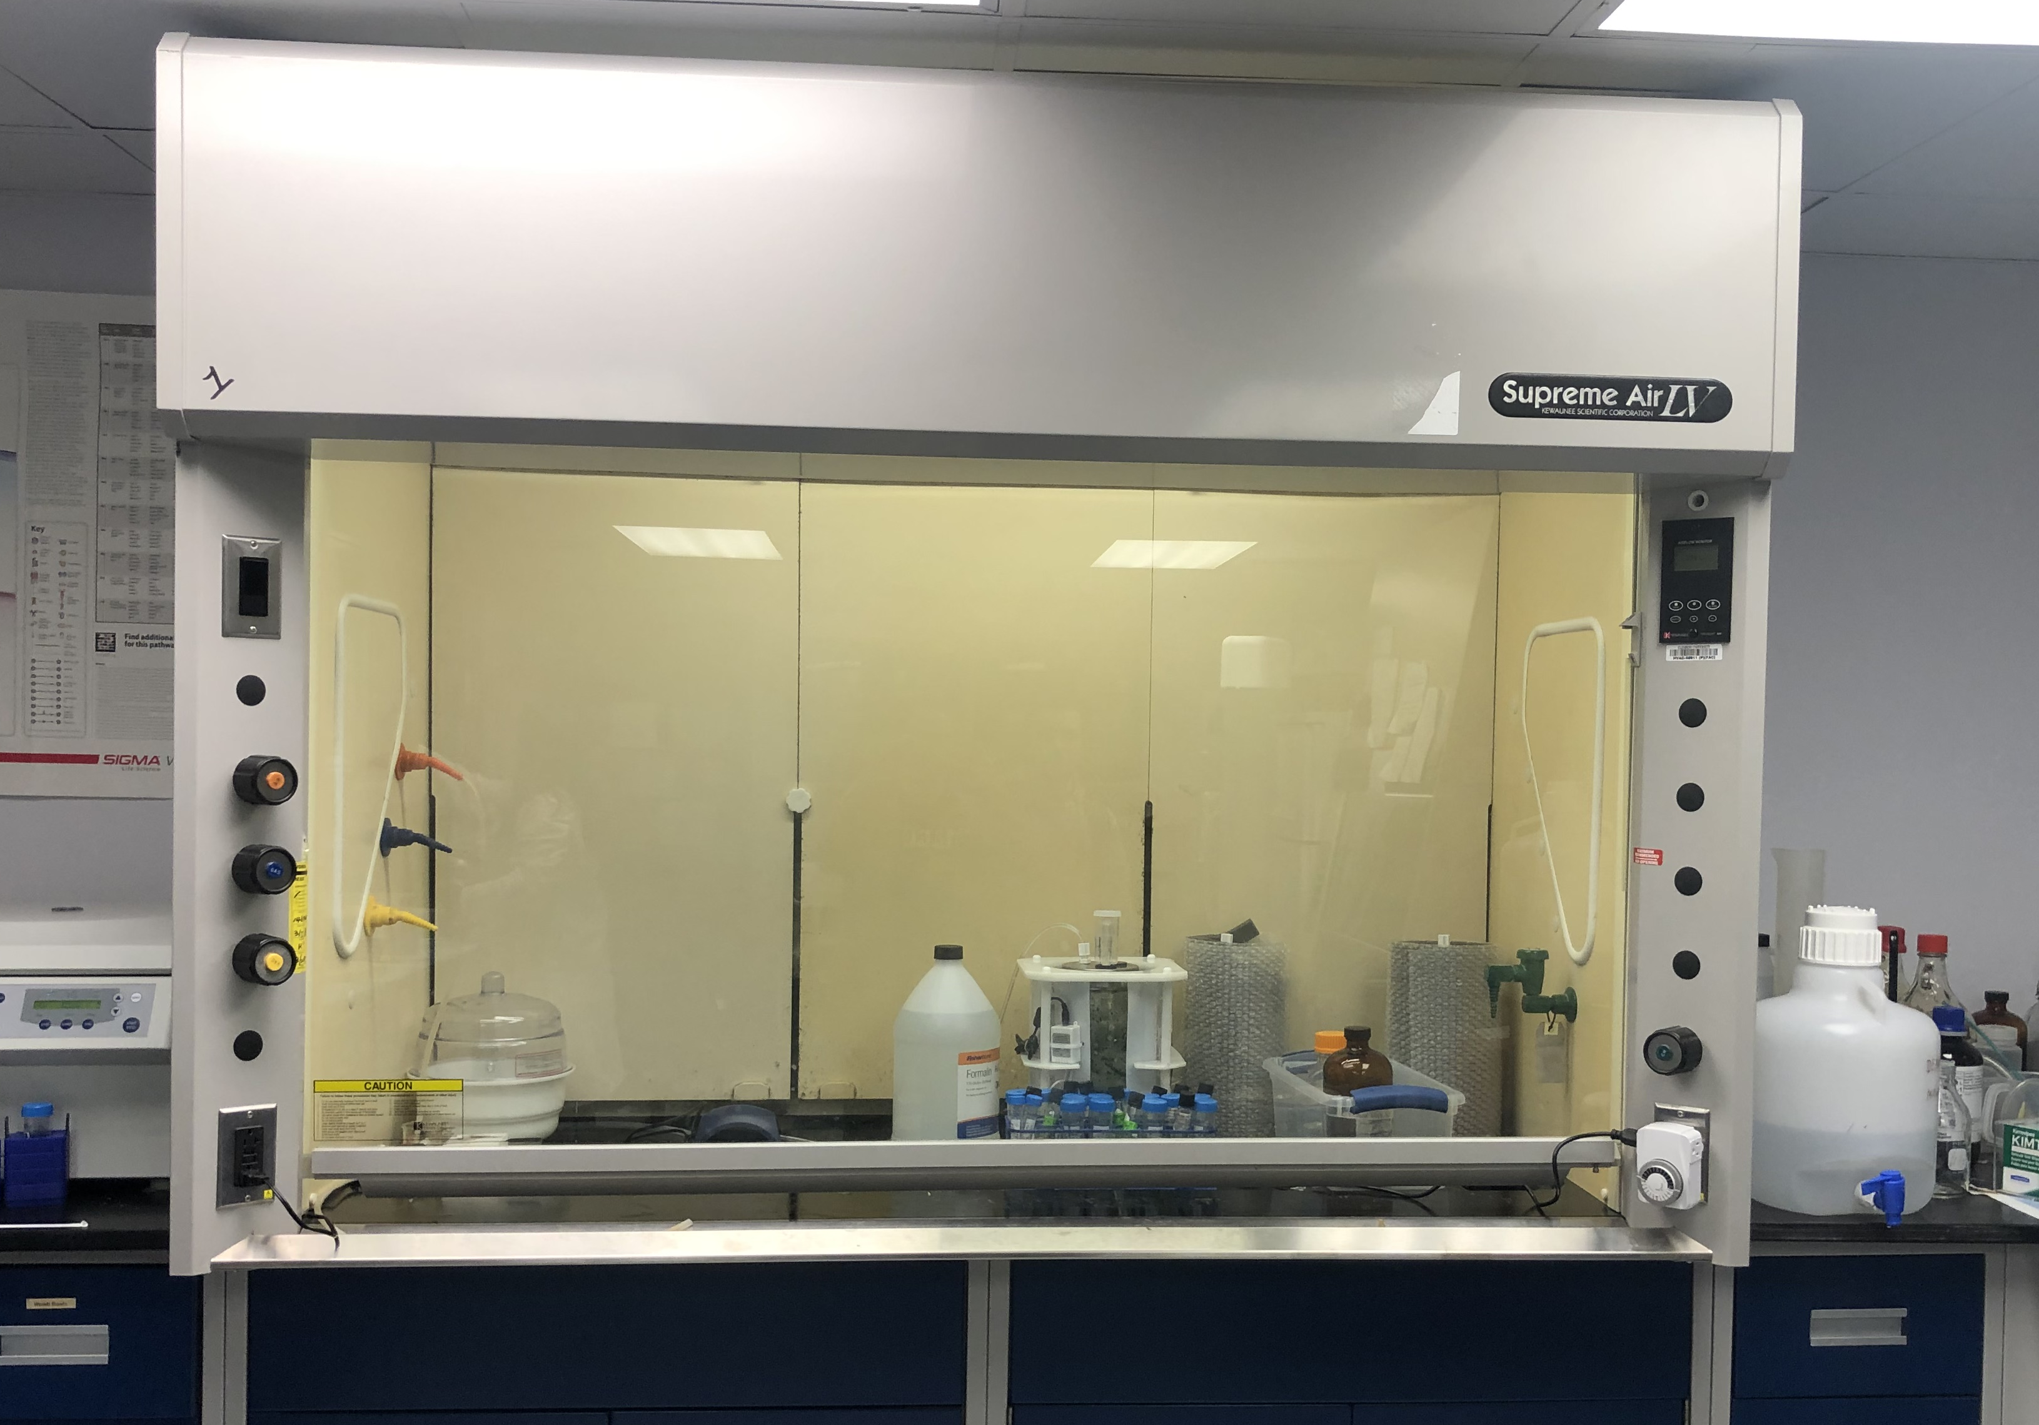
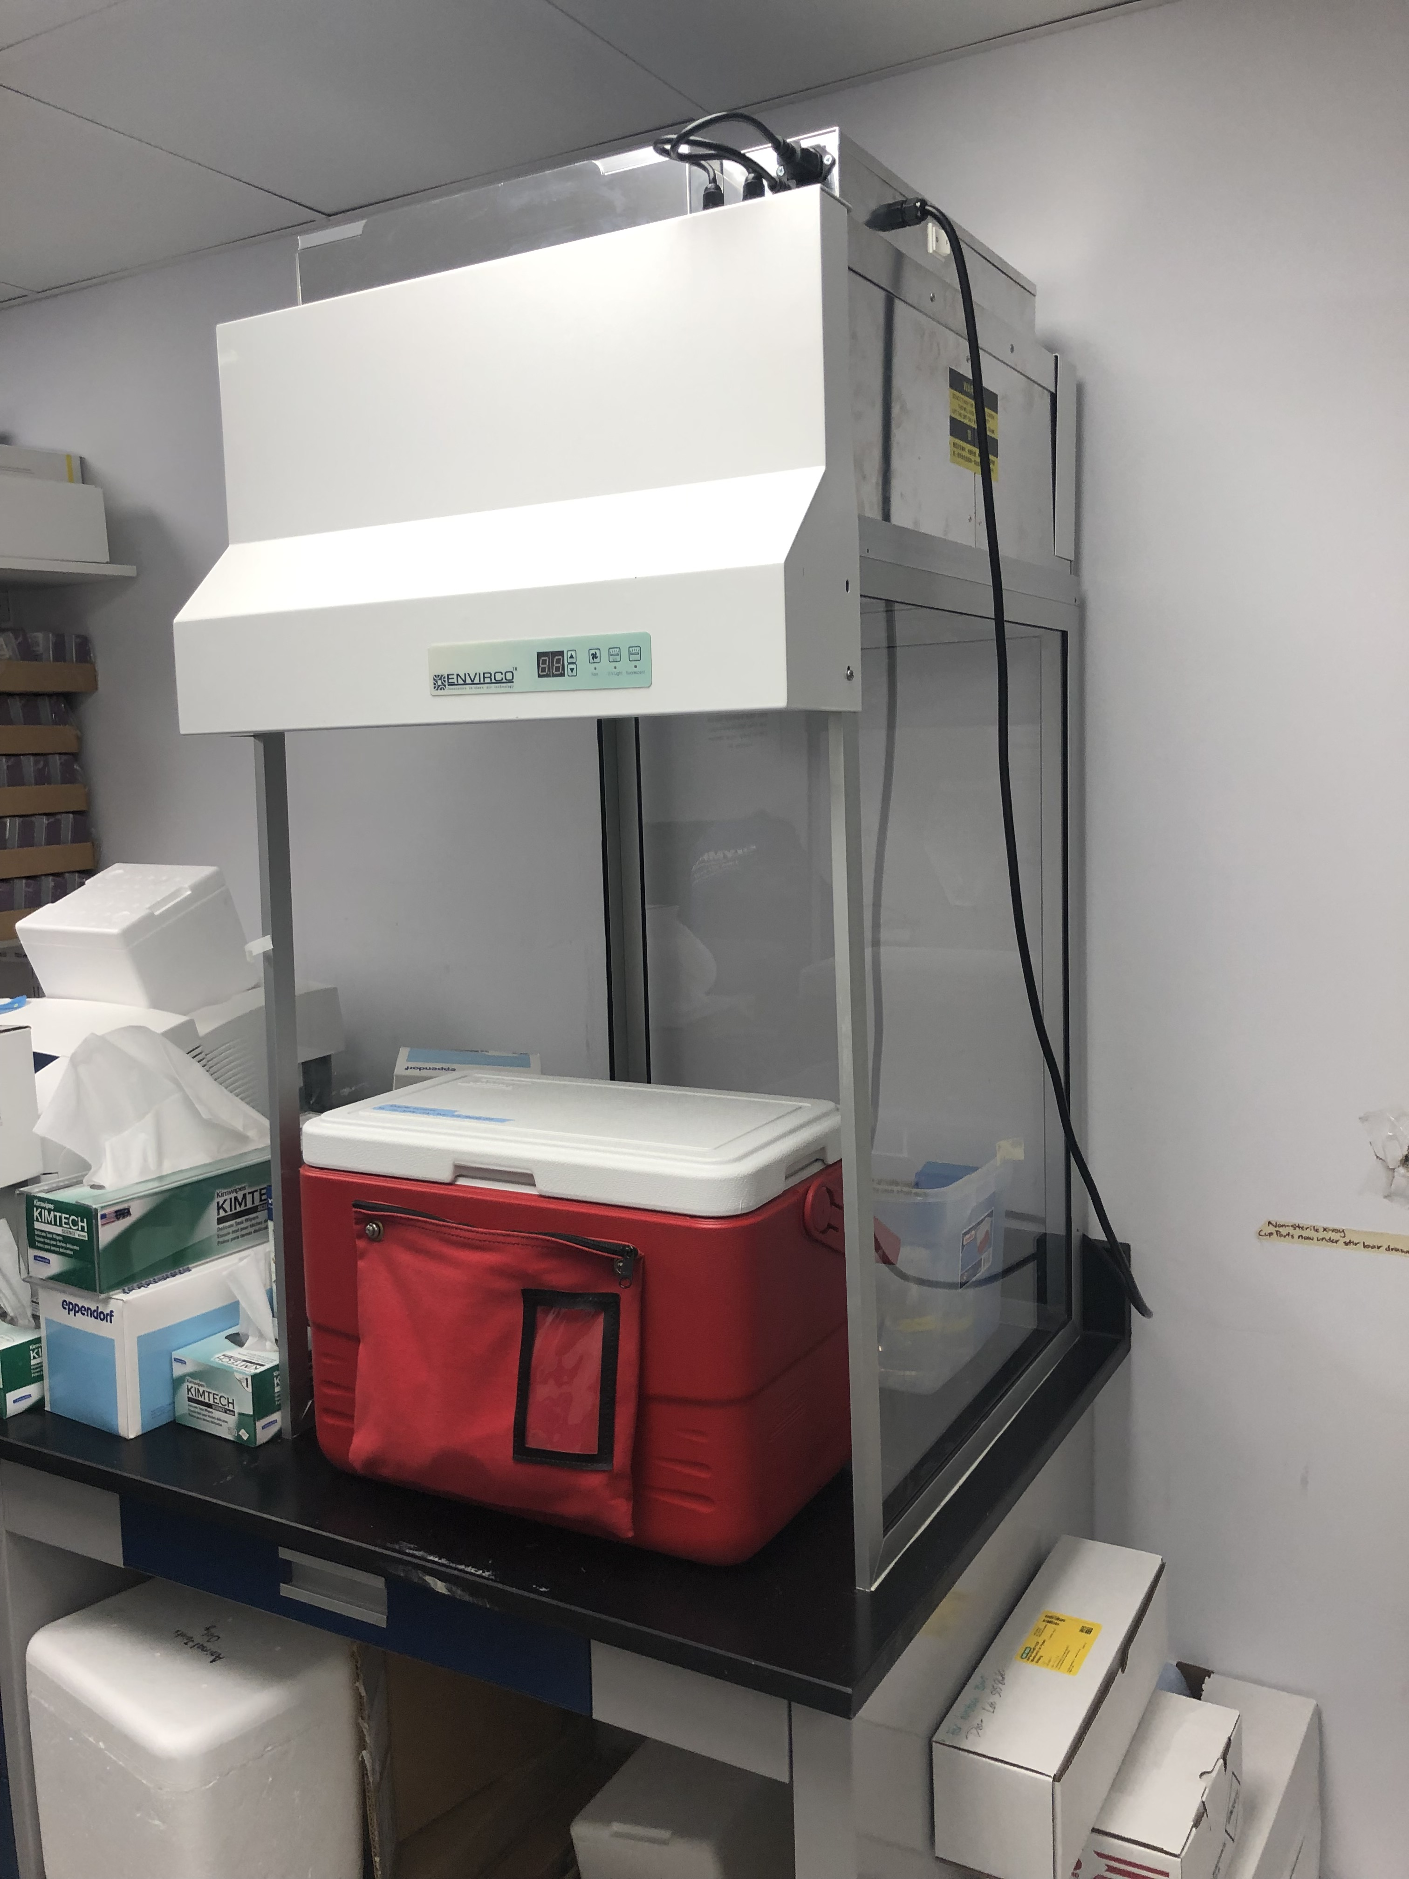
Lab Equipment
Bio-Hood
STERILE! – you have to use proper aspectic technique
Always have a waste container – keep it separate from anything clean
Chemical Hood
NOT STERILE
For anything with potentially dangerous fumes
Dissection Hood
NOT STERILE
Make sure the fan is on
Let the fan run for 10-15 minutes before and after dissection
Incubator
CLEAN! - you have to use proper aseptic technique
Sign the sheet on the door
Double check that the inner door is closed and latched

Slide 4
Aseptic technique
Gloves
Take off rings that could cause tears
Lab Coats
No exposed skin!
Be careful of watches, hair ties, bracelets etc.
Spray everything down with 70% ethanol
Wipe things dry with a kimwipe
Do not spray the filter on a flask with a filter cap.
Open things inside the hood
General note: glass ware isn’t sterile because we don’t autoclave it
Every time you go into the Bio-hood or Incubator
This is so crucial to minimize contamination risk and keep everything sterile and alive

Slide 5
Dissections
All dissections in the dissection hood!
Keep everything in the biohazard bag or on the dissection mats
Keep joints on ice in Styrofoam
Always turn on the hood before you start
Make sure the fan is on
Smaller pieces
Easier to keep alive
We’ll be standardizing
Always tendon wash and media rinse
Spray down the joints with ethanol while you go
Cut tendon ends
That’s where contamination happens

Slide 6
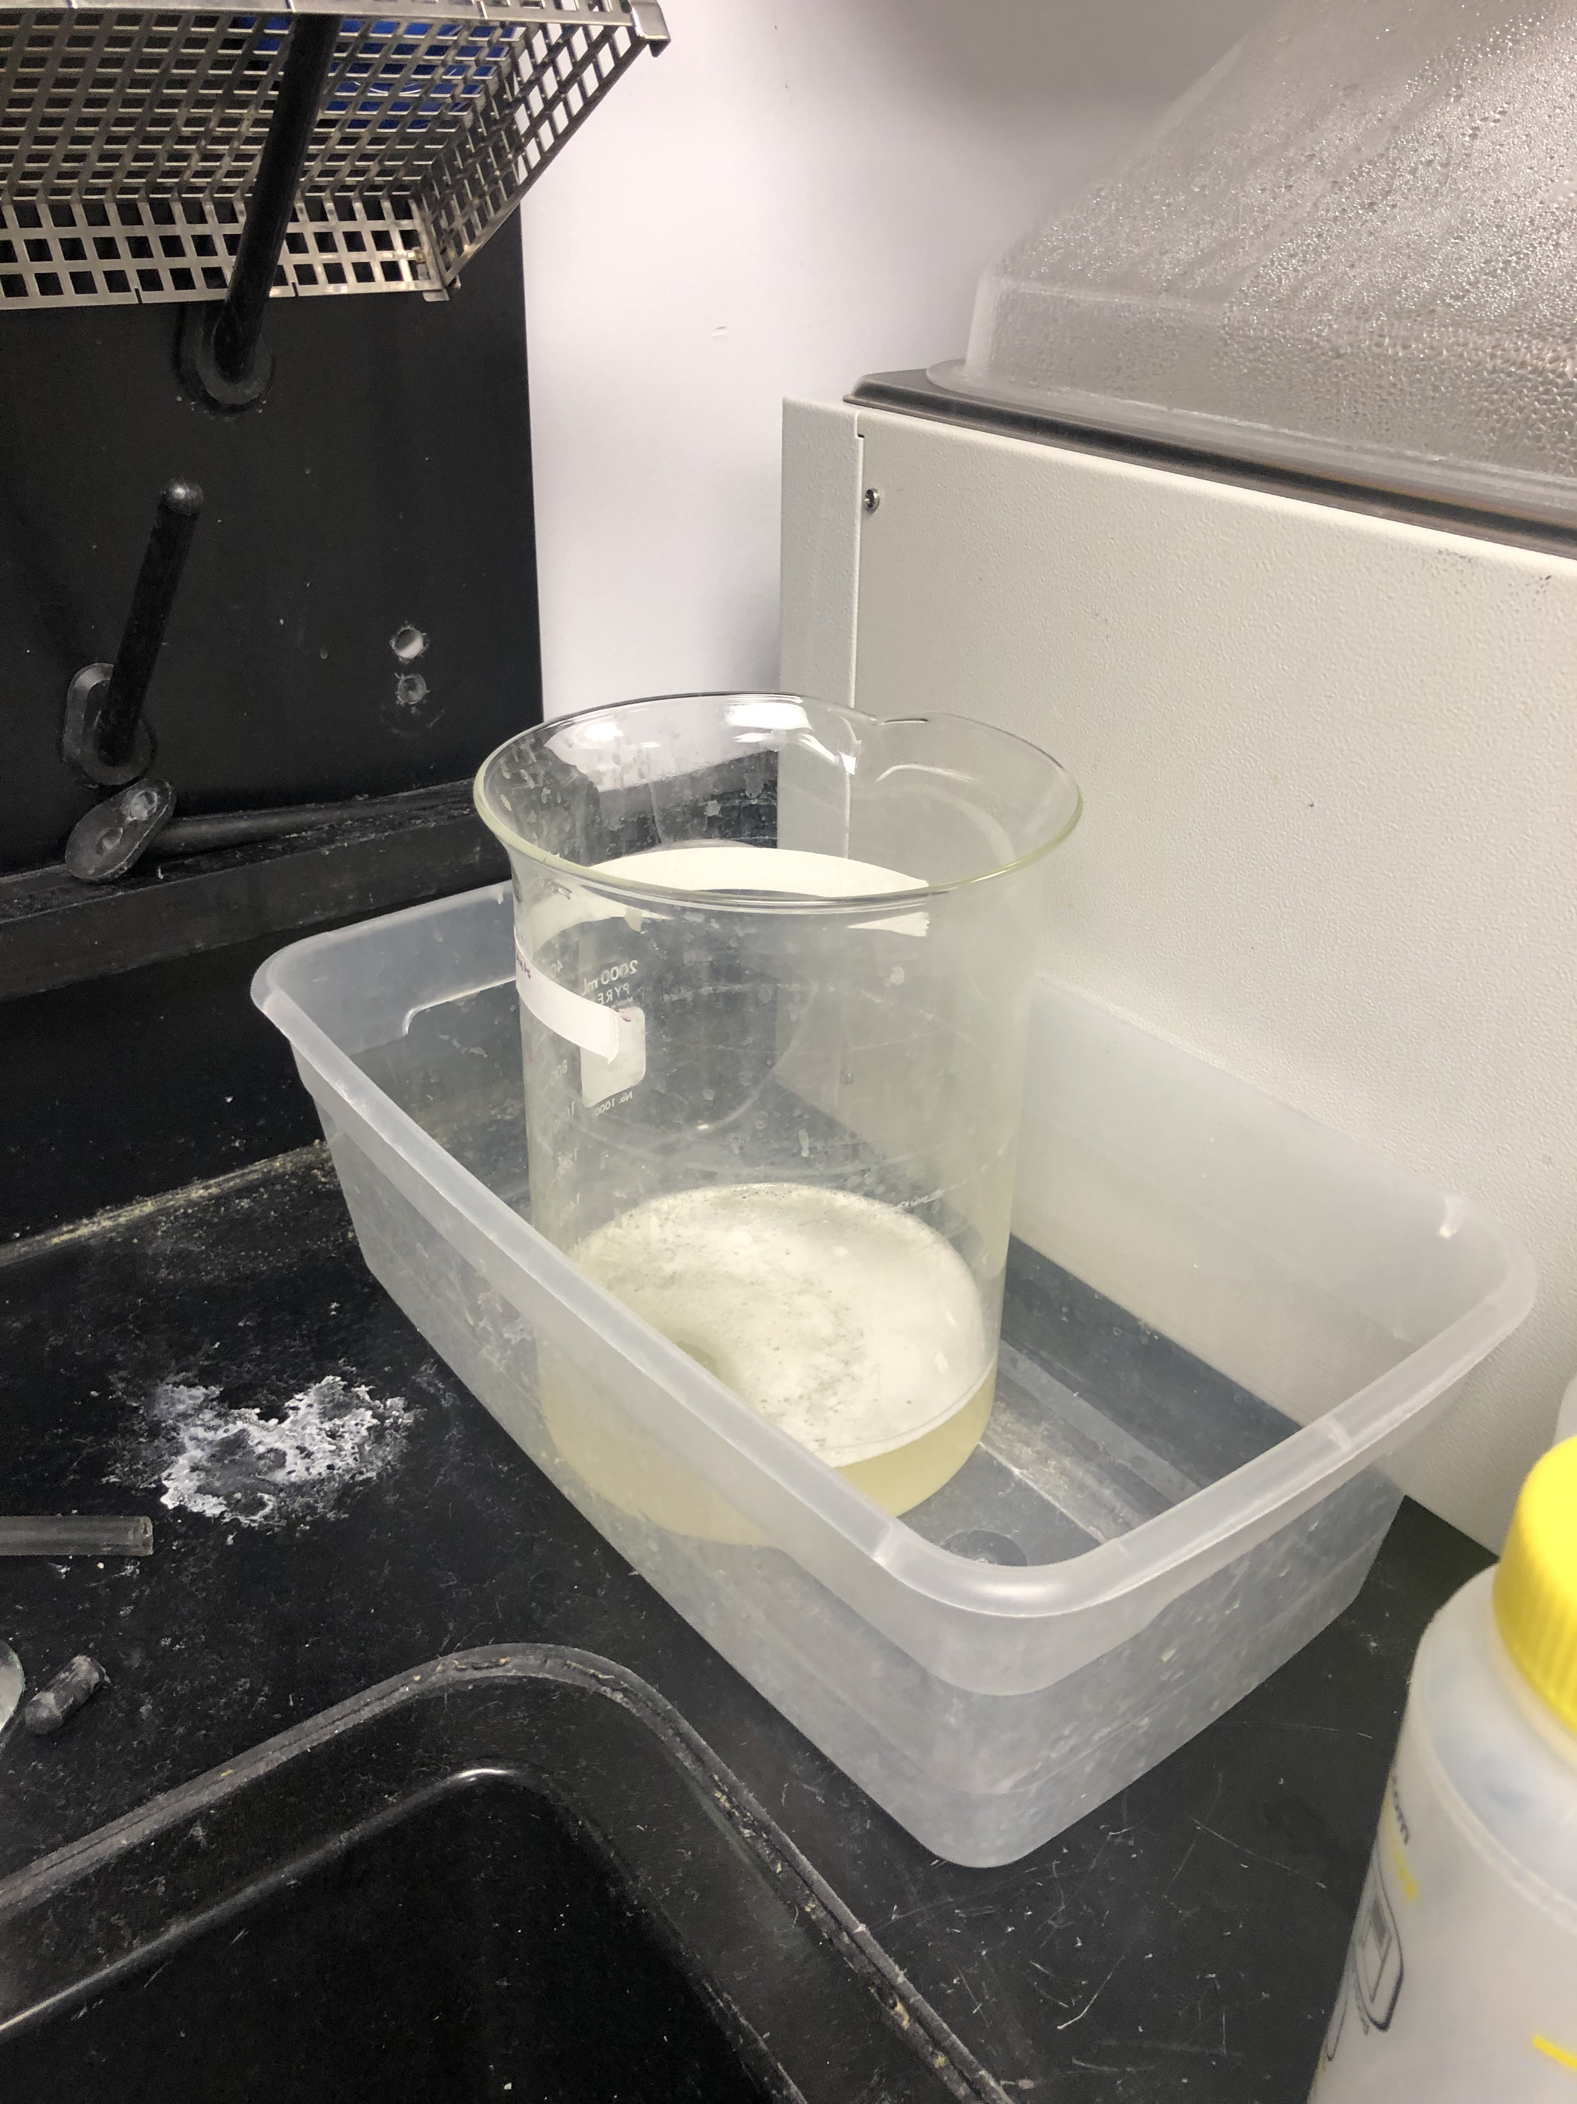
biohazard
Bin vs. Freezer?
Bin:
gloves that touched tendons, petri dishes, empty flasks etc.
No liquids!
Freezer:
joints after dissection, pieces of tissue, blood
Has to be frozen for 24 hours
Has to be in a red bag
Label and put in the drawer
Liquid waste gets put in the waste container
Squirt bleach from bottle by sink
Pour in 4-L beaker then rinse

Slide 7
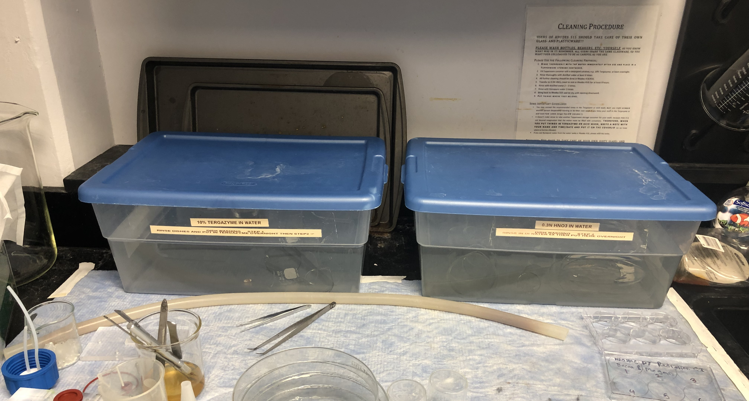
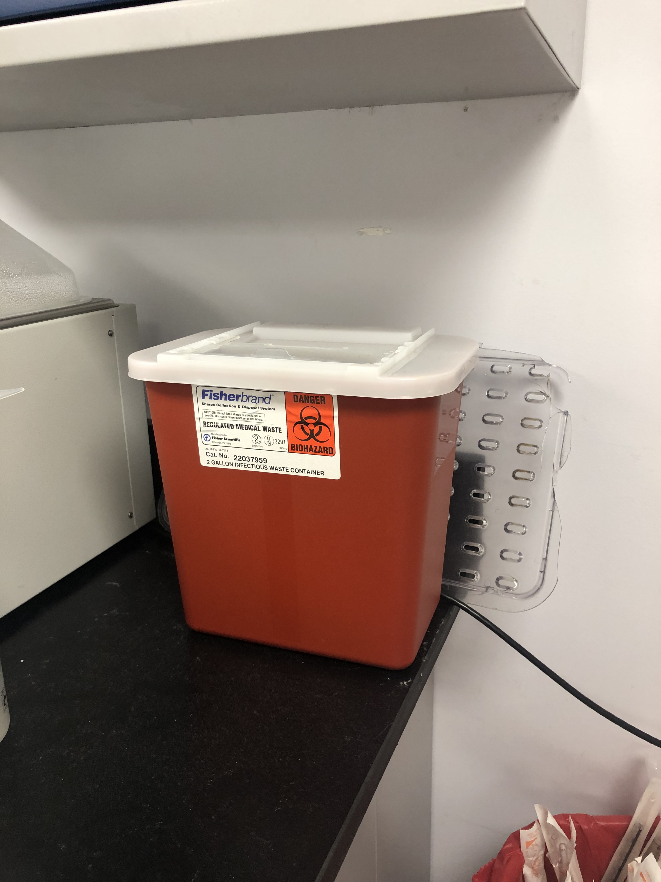
Clean up
Dishes
Rinse everything out and put it in the first bin
NEVER put metal in the second container
Surfaces
Spray with ethanol and wipe with kimwipe
Sharps (like disposable scalpel blades)
Put in the sharps container by the water bath
Broken Glass
Broken glass container by the CO2 tanks
1
2

Slide 8
Putting things away
LABEL EVERYTHING!!!
Everything has to have:
Your name (or initials)
The date
What it is
Project or CI name
Make a note in your lab notebook – what and where it is
Don’t leave anything on counters or in the bio-hood

Slide 9
More General Things
If we run out of something? Tell whoever is in charge of your lab time or request it on Quartzy!
*As a general rule, it is always okay to ask any of the grad students (Hannah, Aniqa, Nardine, Scott, Michael, Liv) for help if you need it or have a problem and they are in the lab
Leave backpacks outside
No food in the lab
Keep surfaces clear
Keep cabinets and fridge closed
When you leave, turn off the lights, lower hood sashes, and turn off hood lights
Remember that we are sharing this space!!

