Slide 1
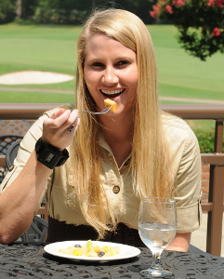

Measuring Human Energy Intake
Adam Hoover
Electrical & Computer Engineering Department

Slide 2
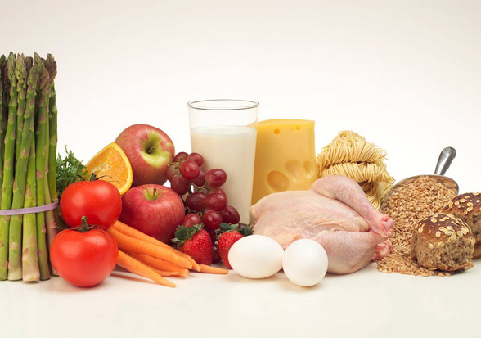
Outline
Motivation, existing tools, related work
Tracking wrist motion to count bites
Relating bites to calories
Detecting eating activities during the day
The “Language of Eating”
Conclusion

Slide 3

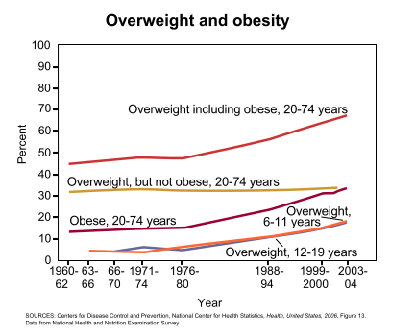
Motivation
Prevalence of obesity
  Worldwide: 1.9 billion adults (39%) are overweight and 600 million adults (13%) are obese (WHO 2014).
  USA: 34.9% of adults are obese and 17% of children are obese (CDC 2010, Flegal et al. 2010).

Slide 4
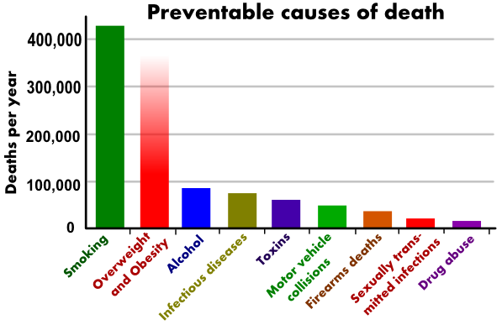
Costs
Comorbidities: Diabetes, heart disease, high blood pressure, stroke, and higher rates of certain cancers (Wellman et al. 2002)
Annual medical cost in the United States: $147 billion in 2008 (Finkelstein et al. 2009)
(Mokdad et al, Actual causes of death in the United States, 2004, JAMA)

Slide 5
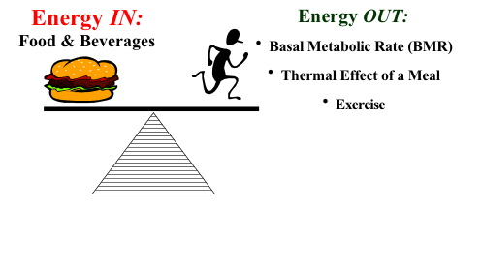
Energy Measures
Energy Intake (Calories or Joules) | Energy Expenditure (Calories or Joules)
Energy absorbed through food intake. | Homeostasis (body maintenance), exercise.
<- weight change ->

Slide 6
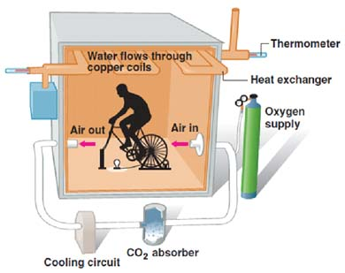
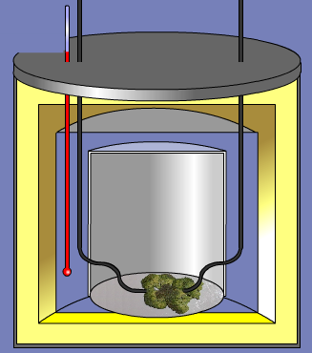
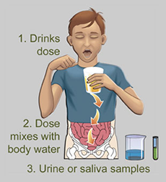
Clinical Tools
Calorimetry Chamber
(measures EE)
Bomb Calorimeter
(measures EI if exact same serving fully consumed)
Doubly Labeled Water
(measures EE directly, EI indirectly*)
*Over a week, EI – EE = weight change

Slide 7
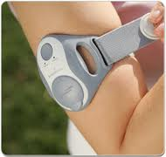
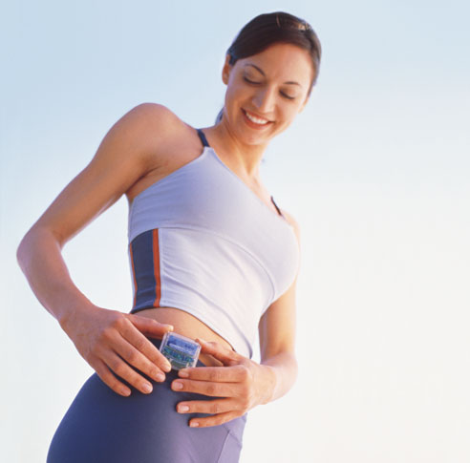
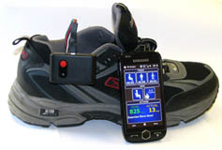
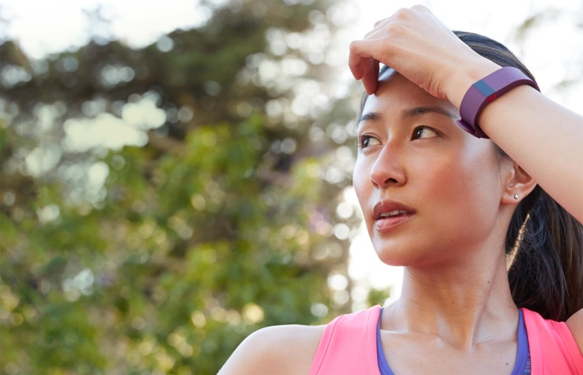
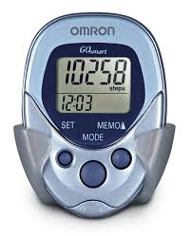
Free-Living Tools: EE
EE: physical activity monitors, pedometers

Slide 8
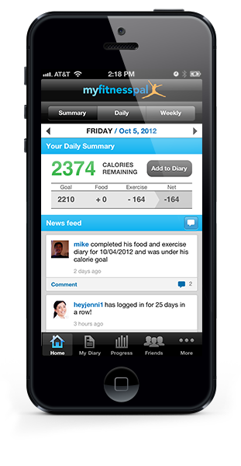

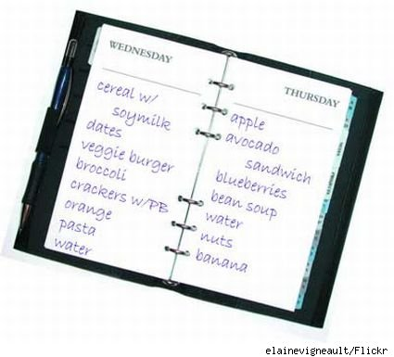
Free-Living Tools: EI
EI: food diary, manual counting, database-assisted logs
Problem #1: Compliance (not easy to use for long period of time)
Problem #2: Underestimation/underreporting bias (dozens of studies have found it ranges 10-50%, evaluated using doubly labeled water)
Challenge: Develop body-worn sensors similar to activity monitors

Slide 9
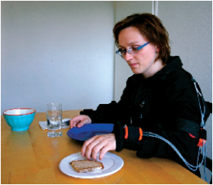
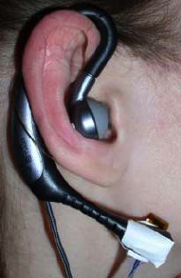
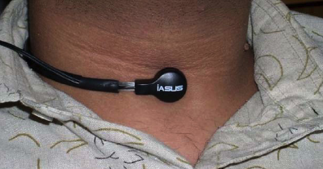
Related work
Wearable sensor-based approaches
  Throat and ear (Sazonov et al. 2010)
  Lanyard camera (Gemming et al. 2013)
  Arms and back (Amft et al. 2008)
Detect swallows, chewing sounds
Recognize eating gestures
Challenges: Compliance (social stigma, comfort), accuracy

Slide 10
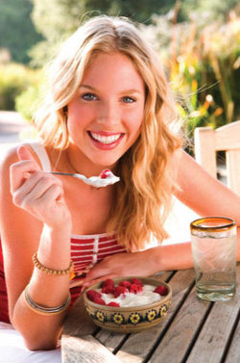
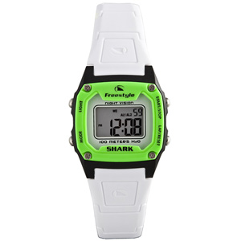
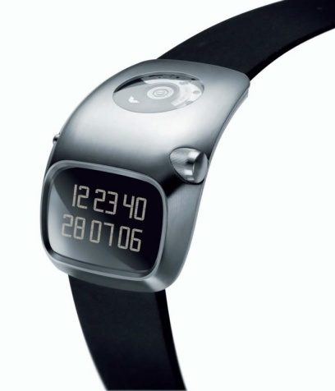
Our concept: Bite Counter
Audible alarms to queue behaviors such as slowing eating or portion control
Worn like a watch
Tracks wrist motion to detect eating activities and count bites (hand-to-mouth gestures)

Slide 11
Outline
Motivation, existing tools, related work
Tracking wrist motion to count bites
Relating bites to calories
Detecting eating activities during the day
The “Language of Eating”
Conclusion

Slide 12
Wrist Roll Motion
Wrist rolls to get food from table to mouth
Roll is independent of other axes of motion

Slide 13
Algorithm
The wrist undergoes a characteristic roll motion during the taking of a bite of food that can be tracked using a gyroscope
Biologically, this can be related to the necessary orientations for (1) picking food up, and (2) placing food into the mouth

Slide 14
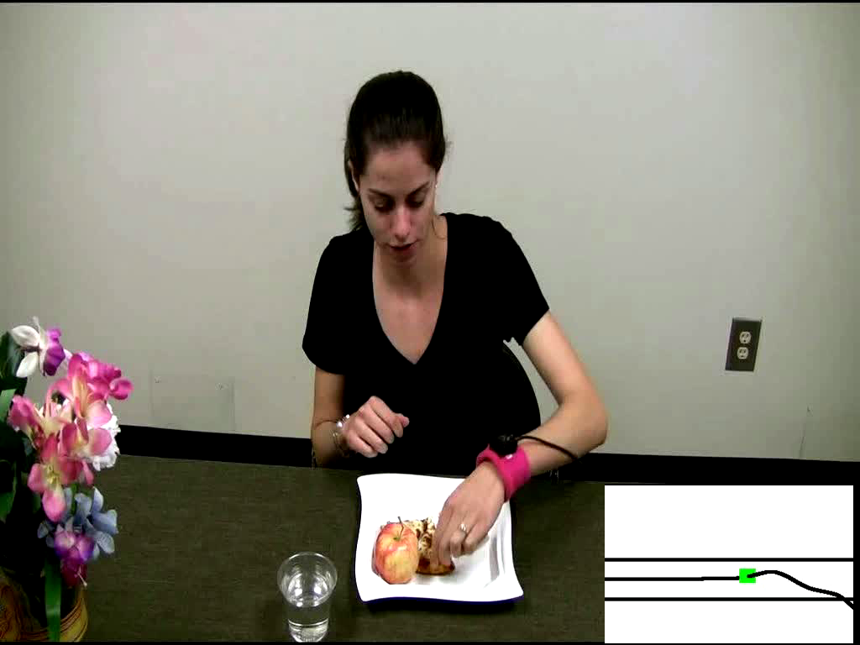
Demo of Bite Counting
Early test: 49 meals (47 participants), 1675 bites
86% bites detected, 81% positive predictive value
Talking and other actions between 67% of bites

Slide 15
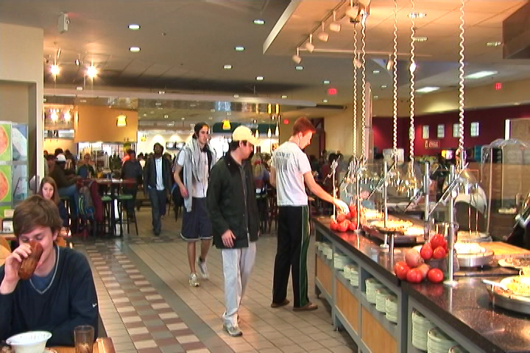
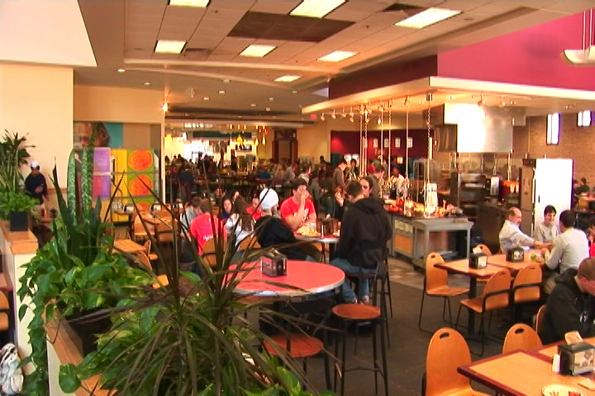
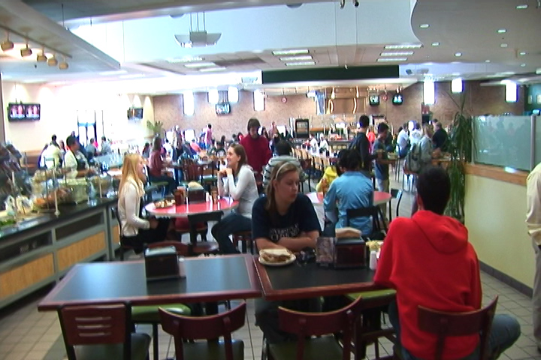
Cafeteria Experiment
Main food service for Clemson University
Seats ~800 people
Huge variety of foods and beverages

Slide 16
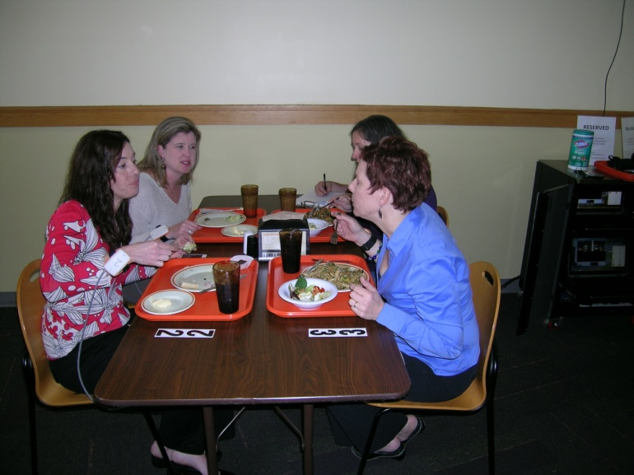
Cafeteria Experiment
276 participants (1 meal each)
380 different foods and beverages consumed
22,383 total bites
82% bites detected, 82% positive predictive value

Slide 17
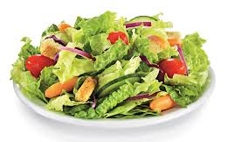
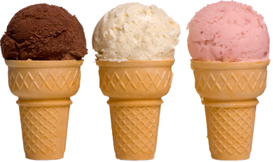
Bite Counting Accuracy
most accurate food:
salad bar (88%)
least accurate food:
ice cream cone (39%)
Accuracy increases with age (77% 18-30, 88% 50+)
Minor variations in accuracy due to utensil, container, gender, ethnicity
Currently studying this “Bite Database”

Slide 18
Outline
Motivation, existing tools, related work
Tracking wrist motion to count bites
Relating bites to calories
Detecting eating activities during the day
The “Language of Eating”
Conclusion

Slide 19
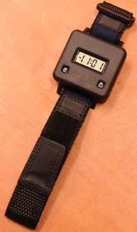

Embedded System Design
Audible alarm
On/off button
Stores time-stamped log of meals (bite count)
Lab model
Watch model

Slide 20
Bite-to-Calorie Correlation
each point = 1 meal
2 weeks data (~50 meals), 1 person

Slide 21
Correlation Test
83 subjects wore for 2 weeks, 3246 total meals
each plot = 1 person
0.4 correlation
0.7 correlation

Slide 22
Correlation Comparison
Physical activity monitors ¹
Energy expenditure
Our device
Energy intake
76% ≥ 0.4
¹ Westerterp & Plasqui, 2007, "Physical Activity Assessment with Accelerometers: An Evaluation against Doubly Labeled Water", in Obesity, vol 15, pp 2371-2379.

Slide 23
Converting Bites to Calories
kpb = kilocalories per bite
Formula based on height (h), weight (w), age (a)
kpb (male) = 0.2455 h + 0.0449 w − 0.2478 a
kpb (female) = 0.1342 h + 0.0290 w − 0.0534 a
Formula fit using 83-people 2-week data set
Tested on 276 meals cafeteria data set

Slide 24
Calories in Cafeteria Meals

Slide 25
Error: Mean and Variance

Slide 26
Outline
Motivation, existing tools, related work
Tracking wrist motion to count bites
Relating bites to calories
Detecting eating activities during the day
The “Language of Eating”
Conclusion

Slide 27
All Day Wrist Tracking
Sum of acceleration shows peaks preceding and following meals

Slide 28
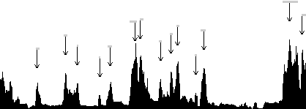
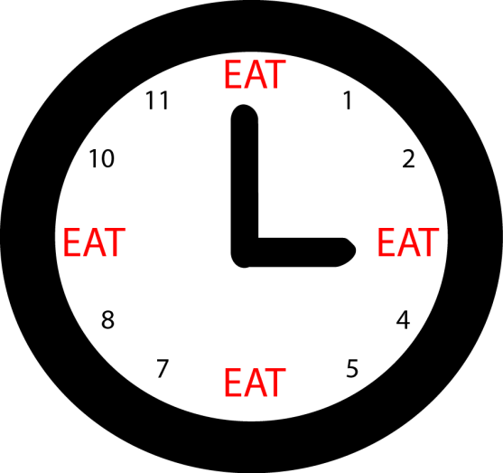
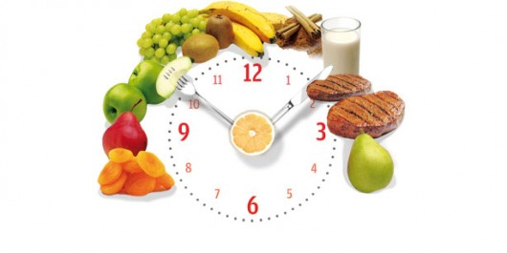
Algorithm
Segment at peaks
Calculate features of segments
Classify using Bayesian classifier
Tested on 43 subjects, 449 total hours (8-12 hours per subject), containing 116 meals/snacks
81% accuracy in detecting eating activity at 1 second resolution

Slide 29
Outline
Motivation, existing tools, related work
Tracking wrist motion to count bites
Relating bites to calories
Detecting eating activities during the day
The “Language of Eating”
Conclusion

Slide 30
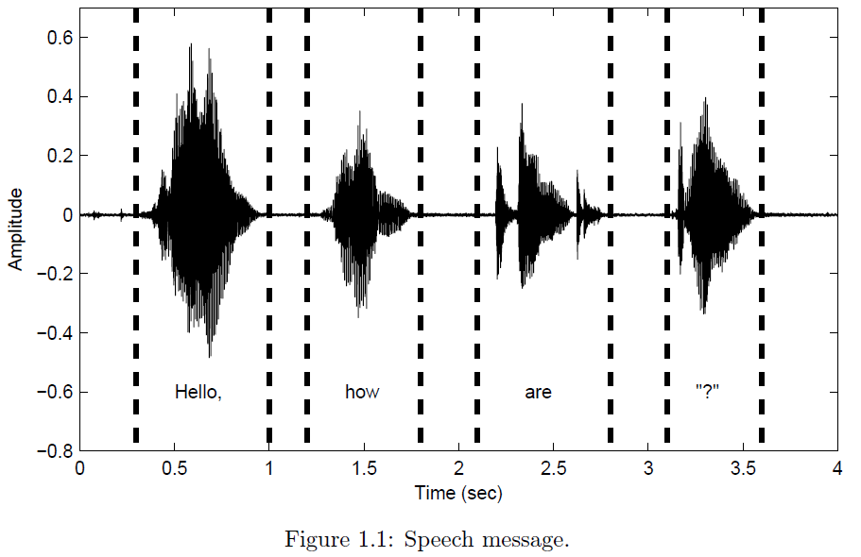
Language Recognition
Context of preceding words helps recognition of subsequent words

Slide 31
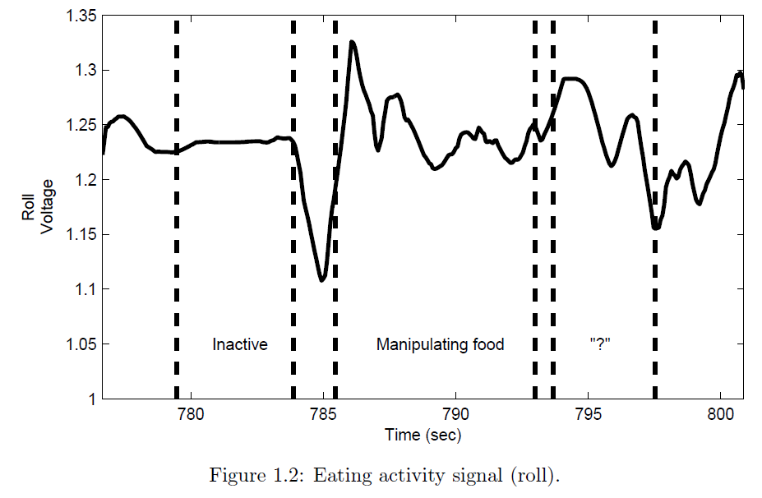
Eating Gesture Recognition
Most likely a “bite” is coming next

Slide 32
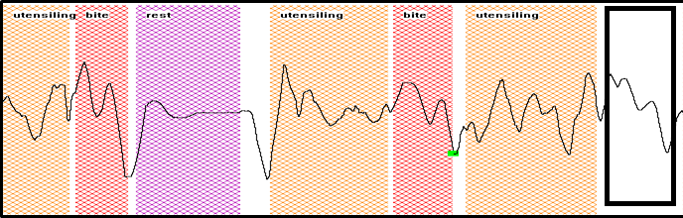

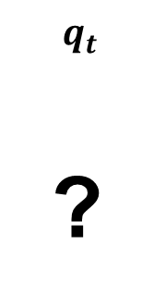







Hidden Markov Models
$$HMM4: P\left(q_{t}\right|q_{t−1}, q_{t−2}, q_{t−3}, q_{t−4})$$
$$HMM 1: P\left(q_{t}\right|q_{t−1})$$
$$q_{t−6}$$
$$q_{t−5}$$
$$q_{t−4}$$
$$q_{t−3}$$
$$q_{t−2}$$
$$q_{t−1}$$
$$q_{t}$$
?
Baseline classifiers (use no history):
HMM (recognize each gesture independently)
KNN (most similar gesture)

Slide 33
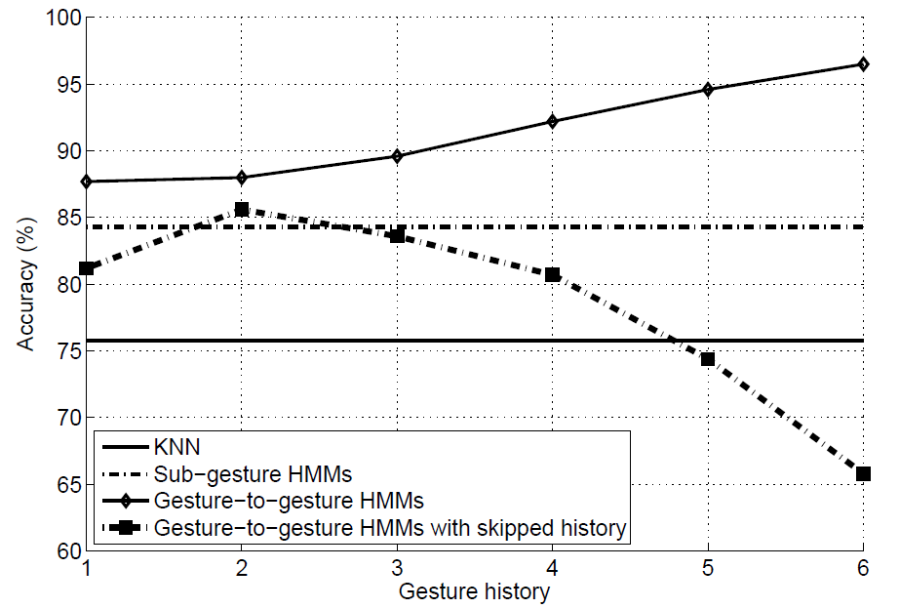
Results
More contextual history improves recognition accuracy

Slide 34
Outline
Motivation, existing tools, related work
Tracking wrist motion to count bites
Relating bites to calories
Detecting eating activities during the day
The “Language of Eating”
Conclusion

Slide 35
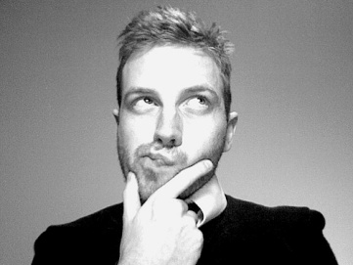
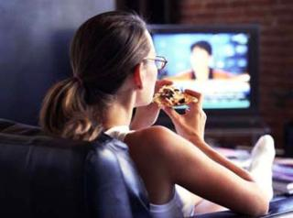
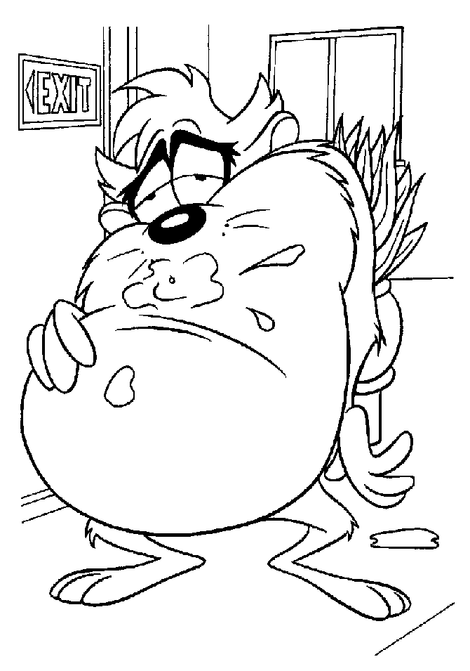
Applications
  Weight loss/maintenance
  Objective, automated monitoring
  Cognitive workload
  Offload energy intake monitoring
  Real-time feedback
  The device can give cues to stop eating

Slide 36
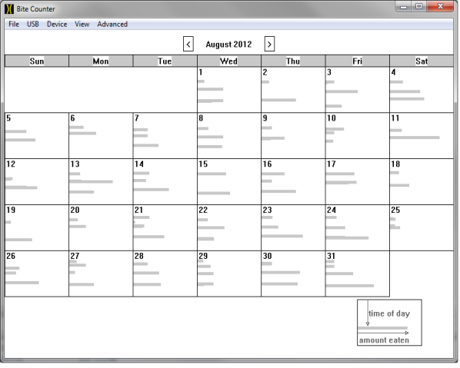
Observation Applications
time
of
day
#bites

Slide 37
Acknowledgments
Collaborators
  Adam Hoover, Electrical & Computer Engineering Department, Clemson University
  Eric Muth, Psychology Department, Clemson University
  Students: Yujie Dong, Jenna Scisco, Raul Ramos-Garcia, James Salley, Mike Wilson, Surya Sharma, Ziqing Huang, Soheila Eskandari, Yiru Shen, Phil Jasper, Amelia Kinsella, Jose Reyes, Meredith Drennan, Xueting Yu, Michael Wooten, Megan Becvarik, Ryan Mattfeld
  Pat O’Neil, Weight Management Center, Medical University of South Carolina
  Kevin Hall, Laboratory Biological Modeling, NIH
  Kathleen Melanson, Slowing Eating, University of Rhode Island
  Brie Turner-McGrievy, University of South Carolina
  Corby Martin, Pennington Biomedical Research Center, LSU
Funding
  NIH NIDDK STTR 1R41DK091141-01A1, 2R42DK091141-02
  NIH NHLBI R01 HL118181-01A1
  NIH NCI R21 CA187929-01A1
  South Carolina Launch
  South Carolina Clinical and Translational Institute

Slide 38
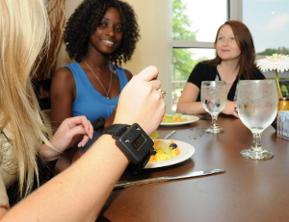
Questions?
For more info: www.ces.clemson.edu/~ahoover

