Slide 1
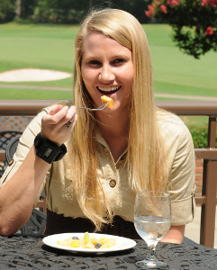

Manufacturing the Bite Counter
Adam Hoover
Electrical & Computer Engineering Department

Slide 2
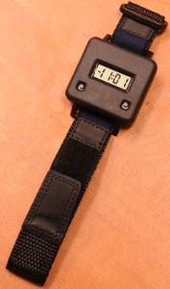
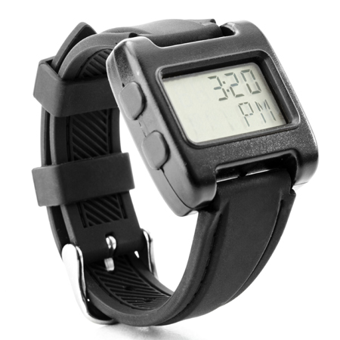
Embedded System Design
Laboratory
experiments
(2007)
2nd gen (2015)
($125k + labor)
1st gen (2011)
($35k + labor)

Slide 3
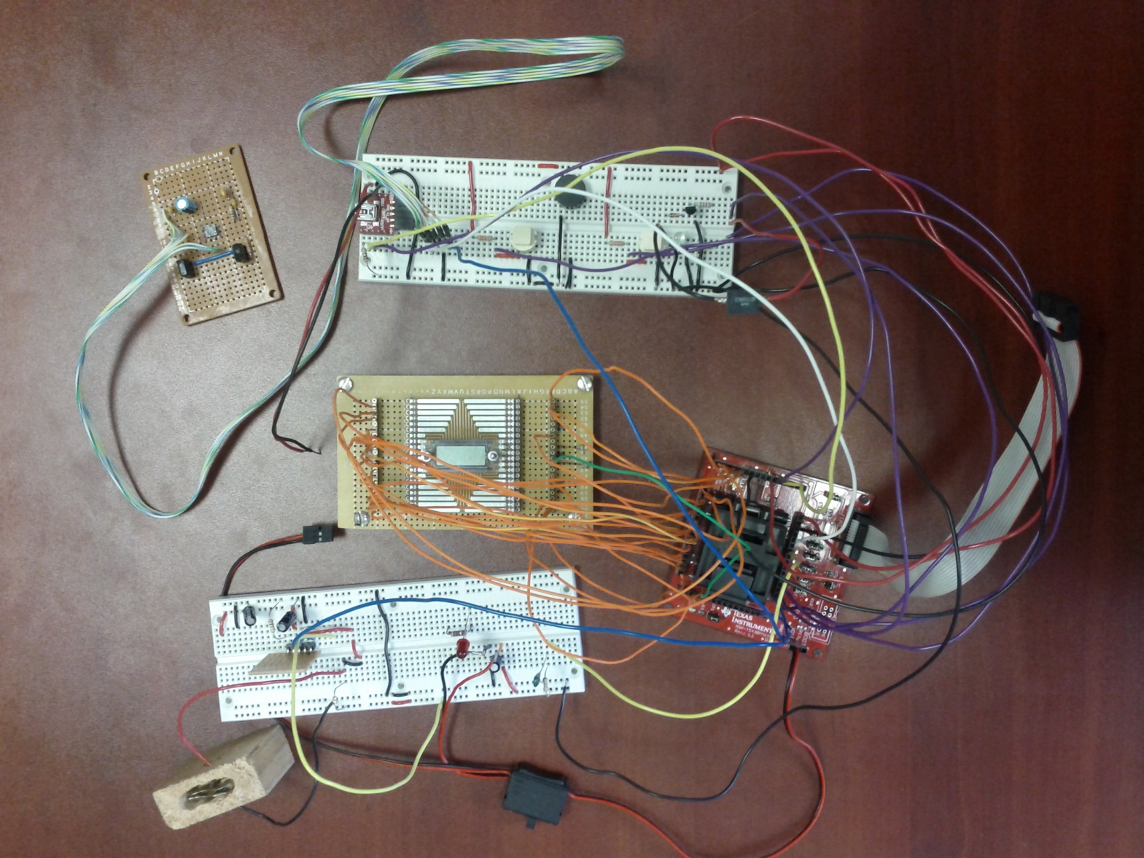
Breadboarding and Parts Selection
I/O (buttons, speaker, vibratory motor, USB port)
gyroscope
LCD
charger
processor
battery, holder

Slide 4
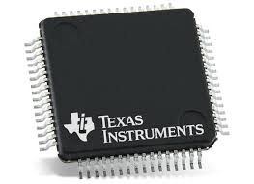
Processor
Texas Instruments MSP430 selection guide
MSP430 family chosen because:
LCD driver built-in
I2C bus (connect to sensor chip)
Low-power (nothing unusual, all microcontrollers are low power)
Small program and data (<16 KB)
Inexpensive (appx $1 per part in bulk)
Legacy (used in version 1 and version 2)

Slide 5
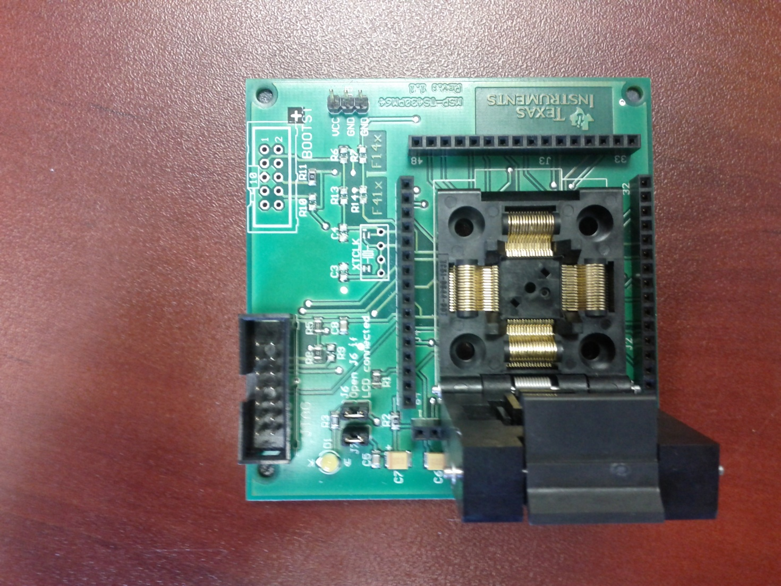
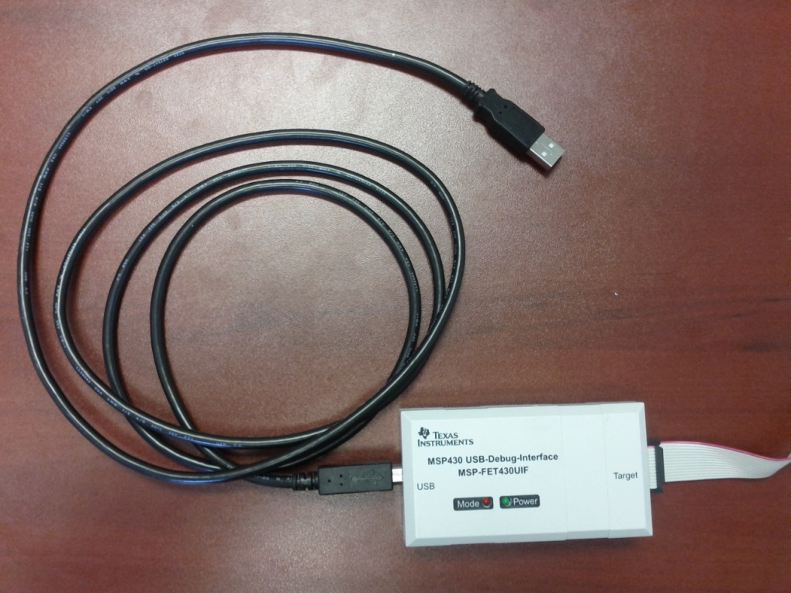
Programming Development
connects to dev board
insert chip here
USB connects to PC
dev board JTAG-USB
development board ($50-150)

Slide 6
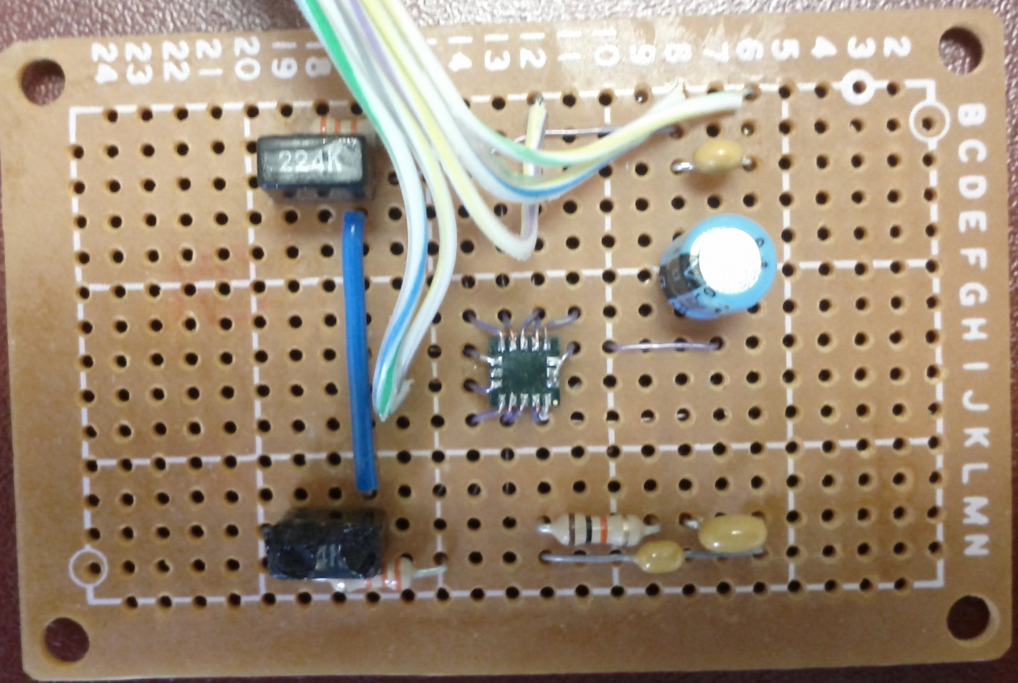
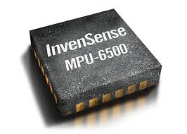
Sensors
2nd gen digital chip
1st gen analog circuits and sensor chip

Slide 7
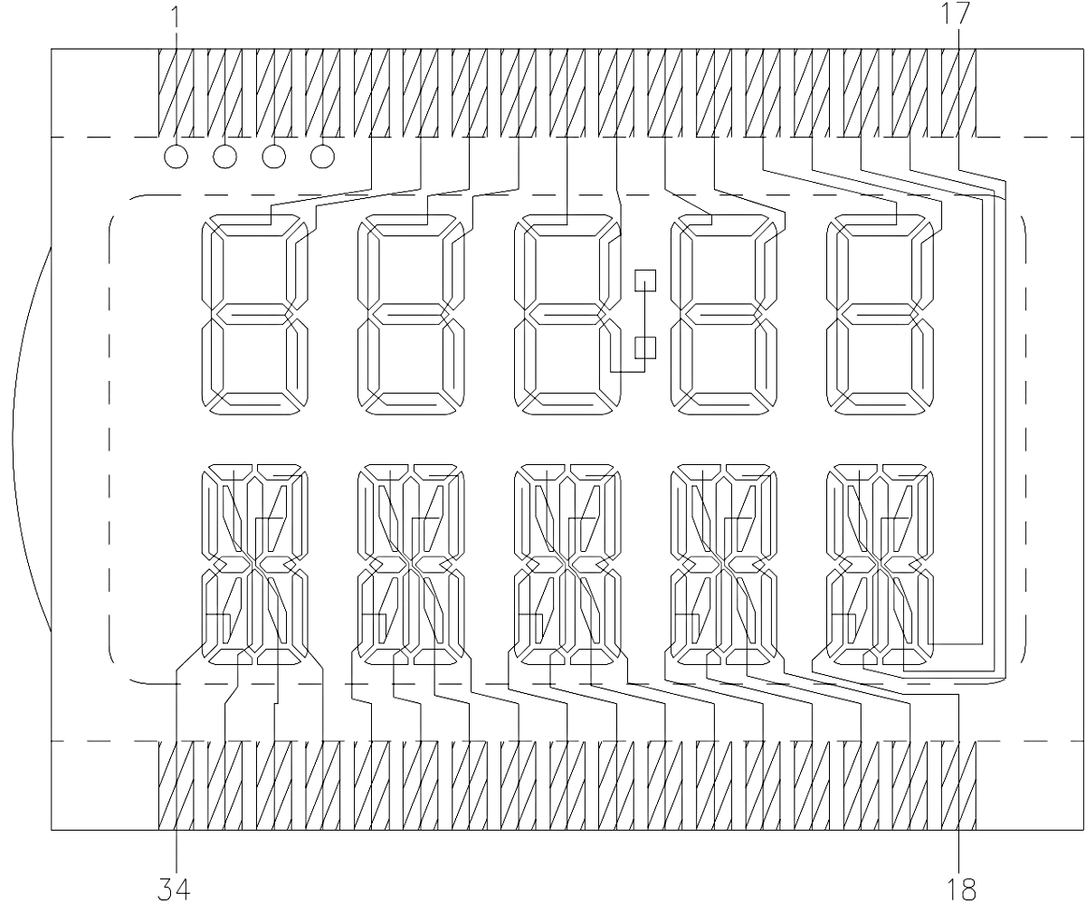
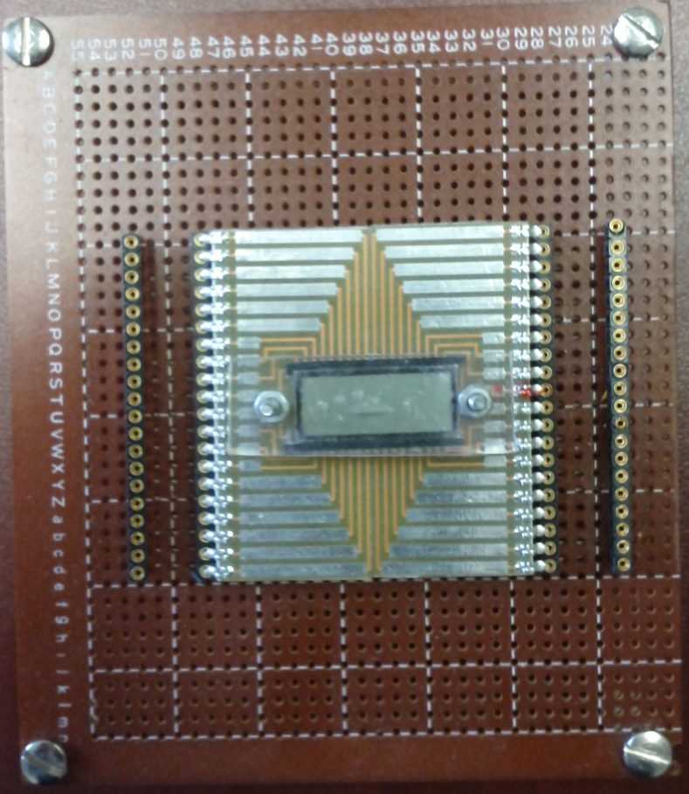
LCD
1st gen off-the-shelf LCD and dev surfboard
2nd gen custom LCD design
top row 7 seg (values), bottom row 16 seg (units)

Slide 8
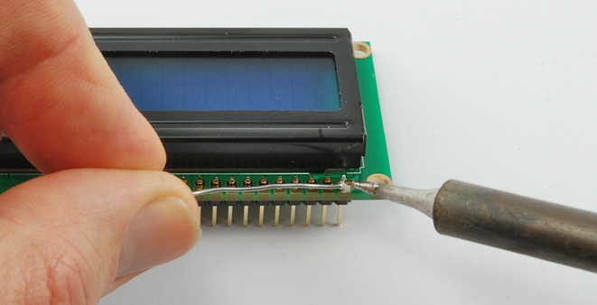
LCD connection to PCB
space needed underneath
Pins have to be individually soldered (lots of work)
Pins take up space (bad for small devices)

Slide 9
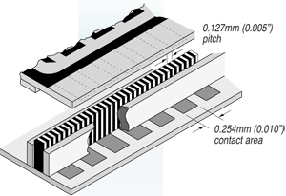
Zebra Strip (Elastomer Conductor)
LCD
zebra strip
support
conductor
insulator
PCB

Slide 10
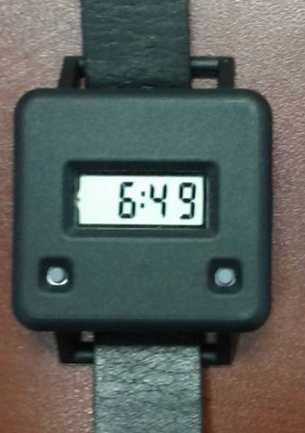
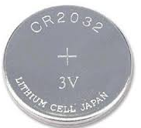
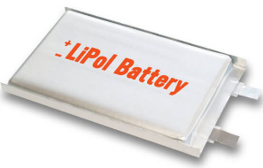
Battery
1st gen used coin package
(consumer industry)
2nd gen used square package
(wearables industry)

Slide 11
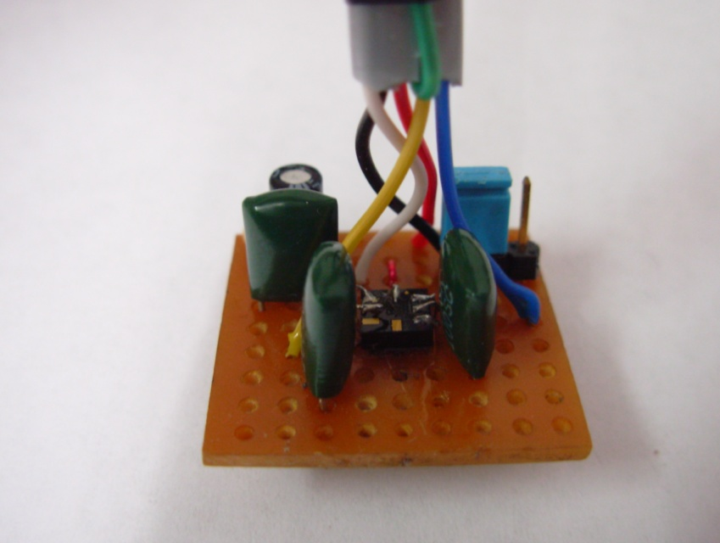
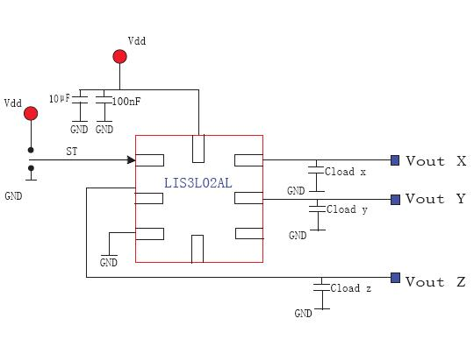


Design Team
Circuit diagrams
Prototypes

Slide 12
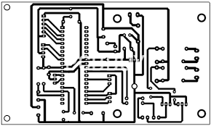

Design stages
Circuit diagrams
Printed circuit board (PCB) designs

Slide 13
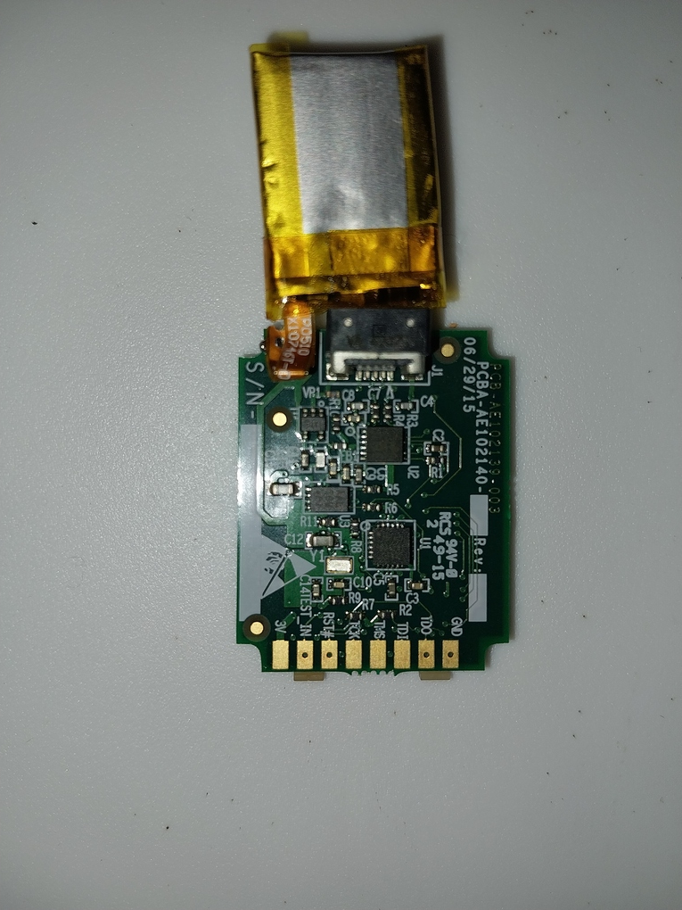
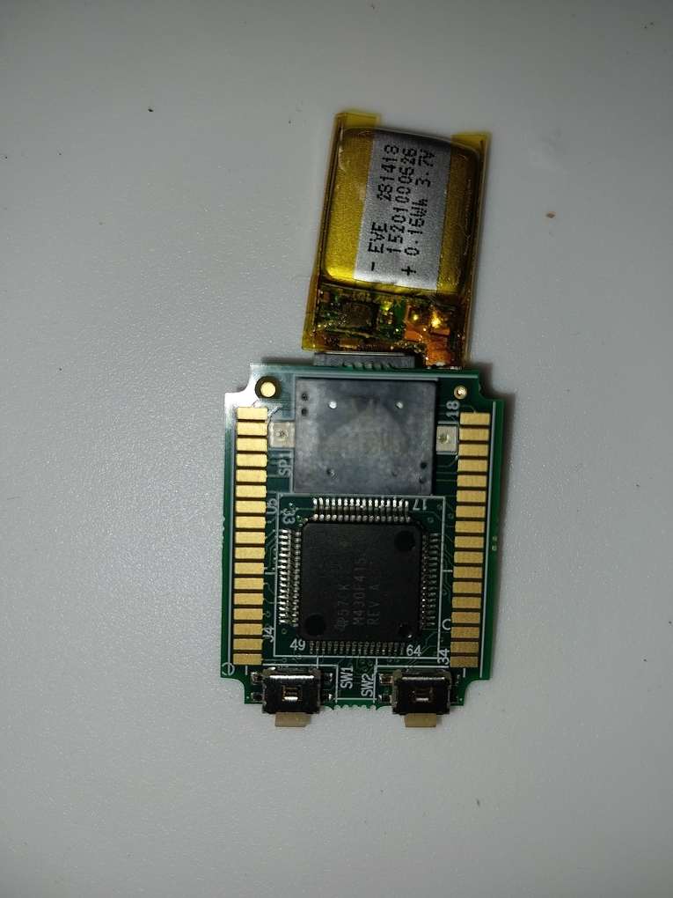

Design stages
PCB designs
PCB manufacturing

Slide 14
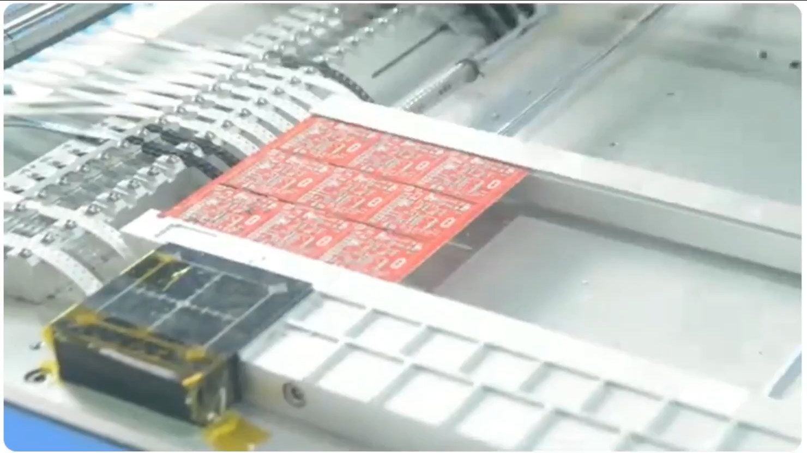
Pick-and-Place PCB Assembly Demo
part reels

Slide 15
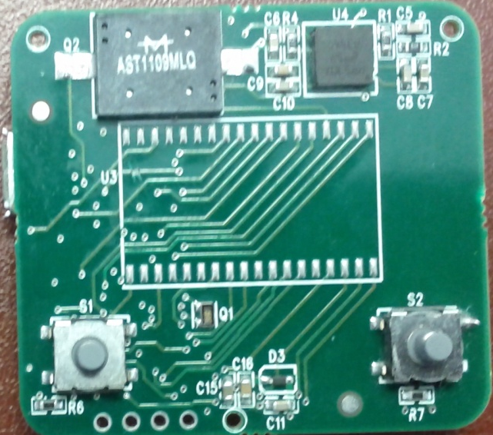
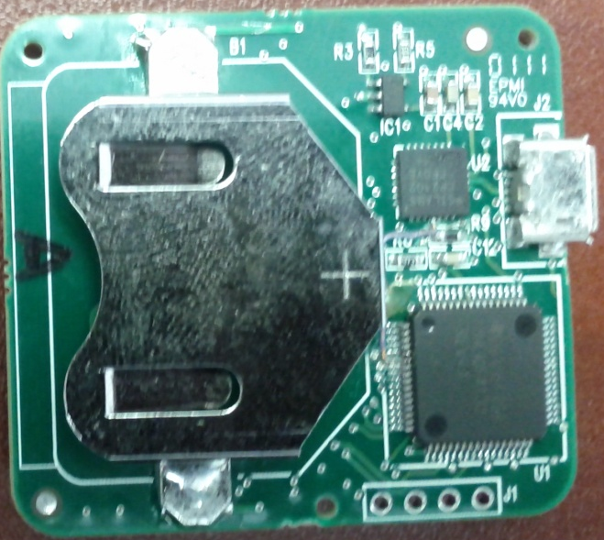
Bite counter PCB (1st gen)
gyroscope
charger
speaker
USB port
LCD
battery
processor
buttons
USB-RS232 bridge
JTAG

Slide 16
Bite Counter PCB (2nd gen)
JTAG
buttons
USB
charger
processor
LCD
sensors
speaker

Slide 17
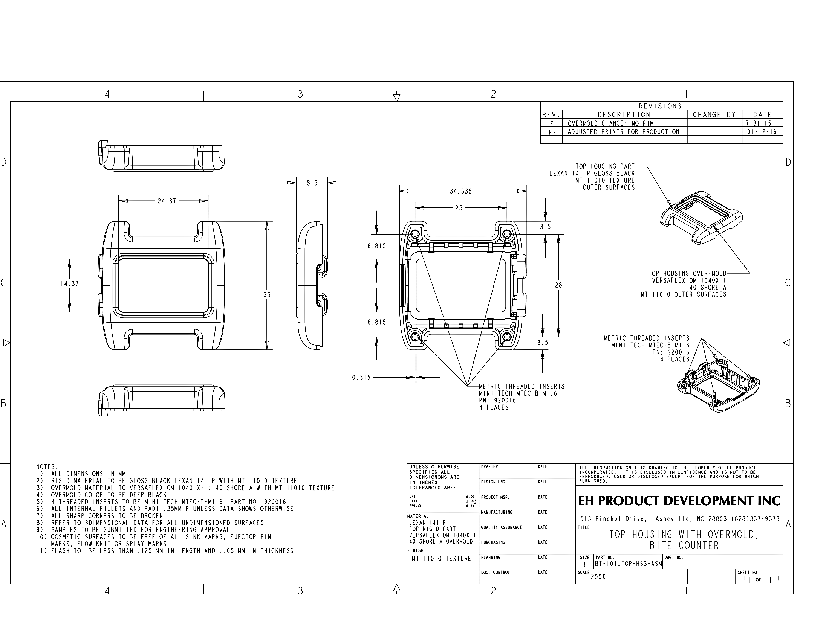

Case Design
$10k (2nd gen)
Industrial designer

Slide 18
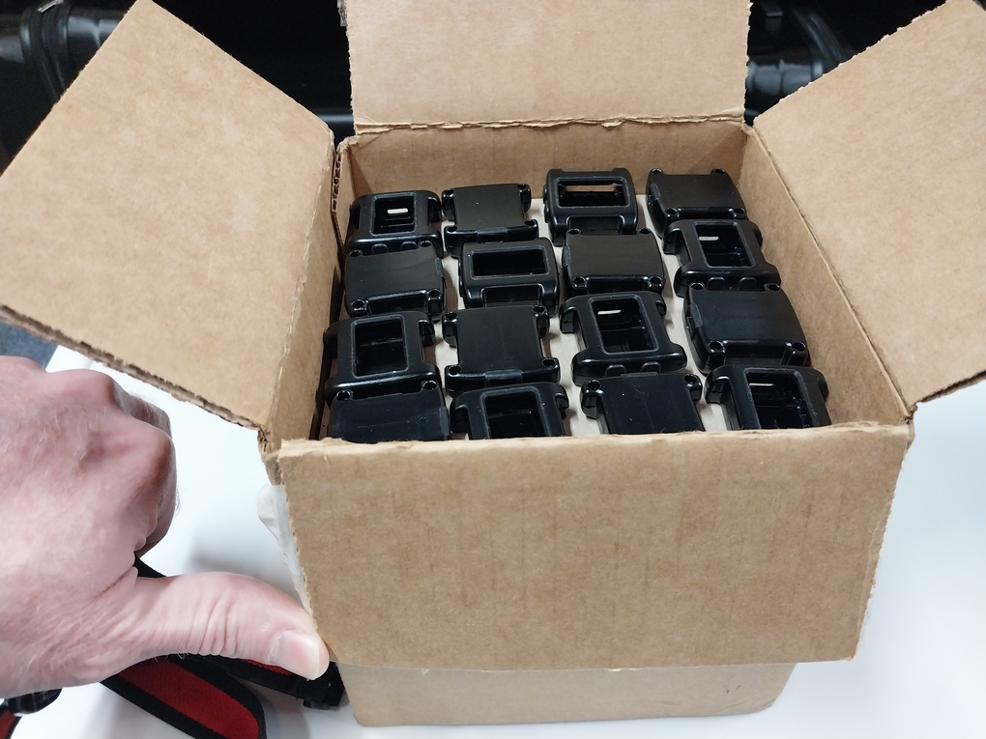
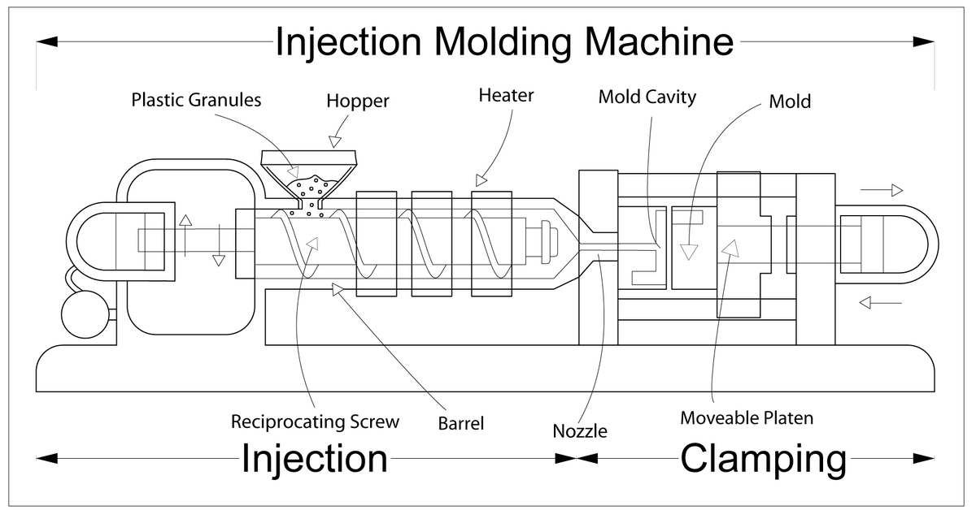

Mold and Case Manufacturing
Molds cost $10k (1st gen), $40k (2nd gen)

Slide 19
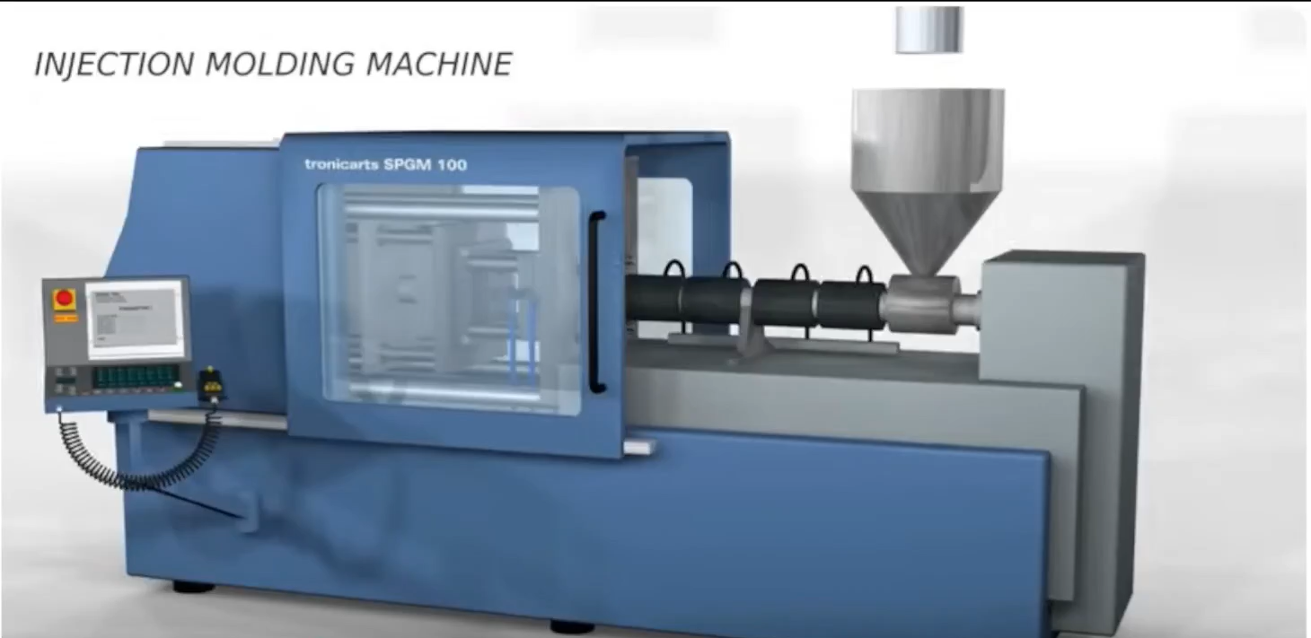
Injection Molding Demo

Slide 20
Design Team
Industrial designer
Molding and case production

Slide 21
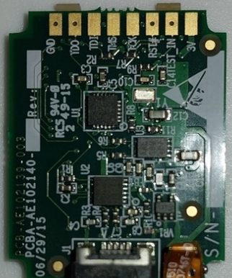
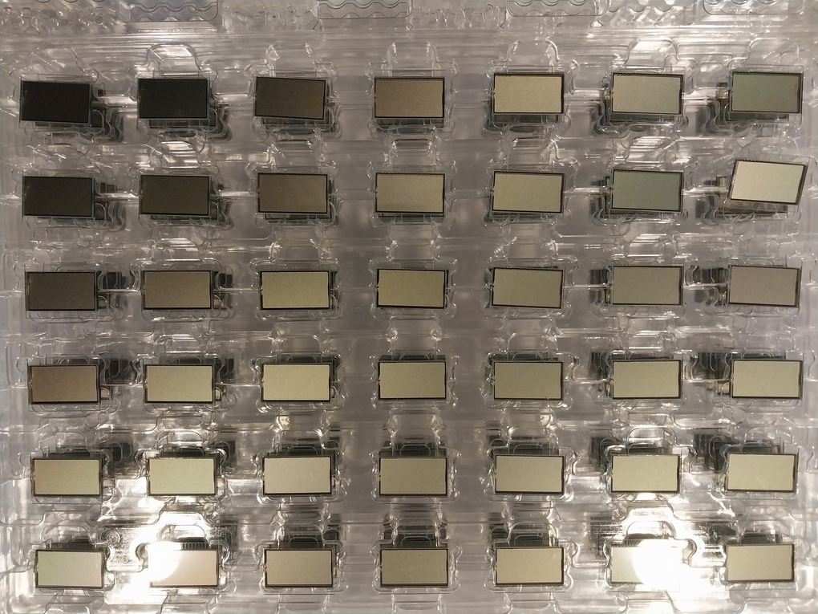

Device Assembly
PCB, case, battery, LCD, zebra strips, screws, watchband, packaging
product

Slide 22
Manufacturing Startup Costs
Part | Manufacturer | Required tooling | Cost (appx)
PCB | AAPBC | Screening, layout | $2,000
LCD | Varitronix | Design, screening | $8,500
Case | EHI | Design | $10,000
Mold, Case | Five Star Plastics | Mold design, build | $50,000
Packaging | Yebo | Design, layout | $5,000
All these are one-time costs

Slide 23
BOM (Bill of Materials)
(separate BOM, 29 parts)
Part | Manufacturer | Part# | Oder size | Cost/piece
PCB | AAPBC | AE102140-003 | 1000 | $36.00
Zebra strips (2) | Fujipoly | 2004-080 867L 146 H | 2500 | $0.30
Battery | EVE | P0510-LF(281418) | 1000 | $3.70
LCD | Varitronix | VL_7268_V01 | 5000 | $1.10
Case bottom | Five Star Plastics |  | 960 | $1.18
Case top | Five Star Plastics |  | 960 | $1.92
Screws (4) | MSCdirect.com | #78079787 | 4200 | $0.43
USB cable | Cableleader.com | U2103-1103 | 1200 | $0.85
USB charger | DHGate.gom | #215650707 | 1200 | $1.05
Watchband/pins | Voguestrap | TX1820BK | 1200 | $3.75
Packaging | Yebo |  | 10000 | $1.20
Cost per device appx $53

Slide 24
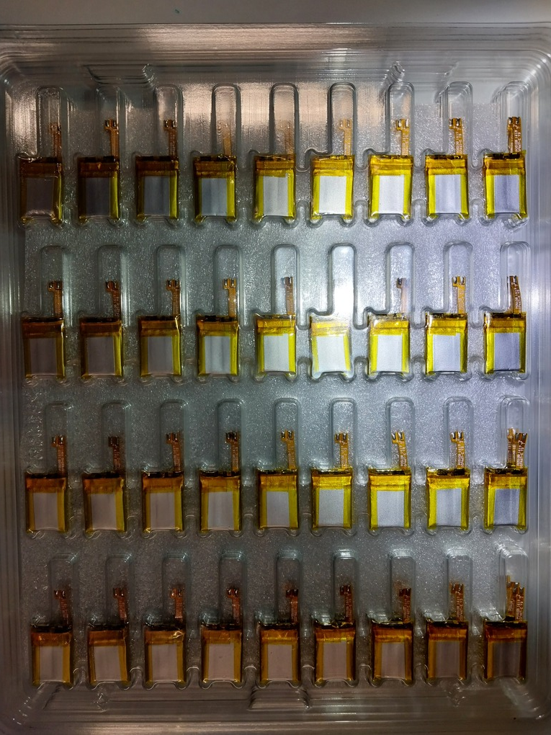
Batteries – Bulk
400-500 batteries per box

Slide 25
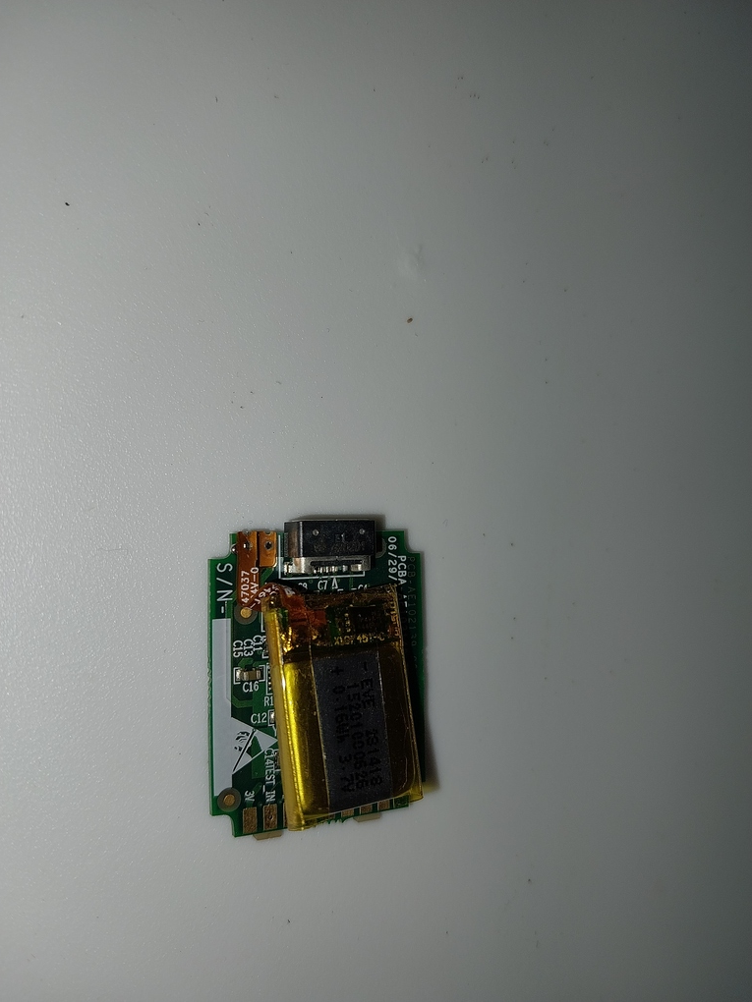
Battery Installation
solder points
after soldering, battery rests on PCB

Slide 26
Battery Tests
Function | current (mA)
accelerometer maximum | 0.450
accelerometer 30 Hz | 0.019
gyroscope maximum | 3.2
gyroscope 30 Hz | 3.0
CPU maximum | 0.220
LCD off | 0.016
LCD fully lit | 0.019
speaker | 0.2
45 mAh battery lasts 25 days in watch mode;
10 days with regular daily usage of bite counting

Slide 27
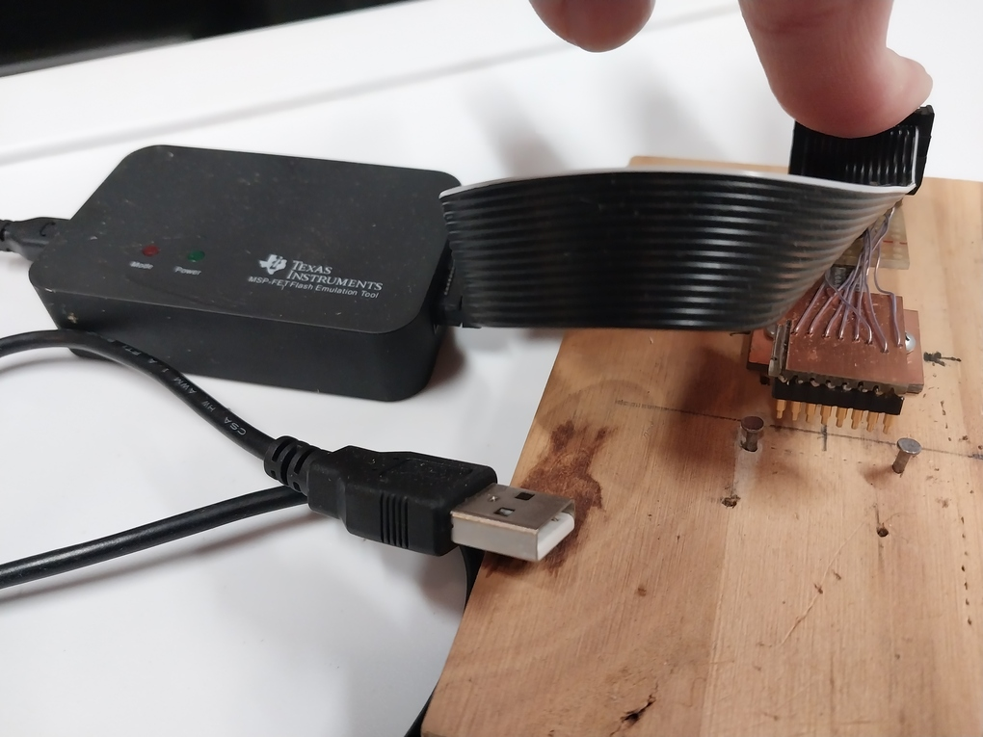
PCB Programming with Jig Tool
spring lever
JTAG pins
USB connects to PC
PCB goes here

Slide 28
PCB (Front and Back)
JTAG pads
LCD pads

Slide 29
Memory Space
Addresses | Content
C000-C3FF (1 Kb) | resident monitor
C400-F3FF (12 Kb) | application code
F400-FFE0 (3 Kb) | data records
FFE0-FFFF (32 bytes) | interrupt table
Monitor code allows device to be reprogrammed in-the-field (from PC)
Application code operates the device functions
Data records store bite count records each time device is used; can be uploaded to server if device plugged into PC
Interrupt table stores vector of addresses into application code (e.g. for button presses)

Slide 30
Cases
2 parts (front, back)
100 cases per box

Slide 31
Displays – Bulk
400-500 LCDs per box

Slide 32
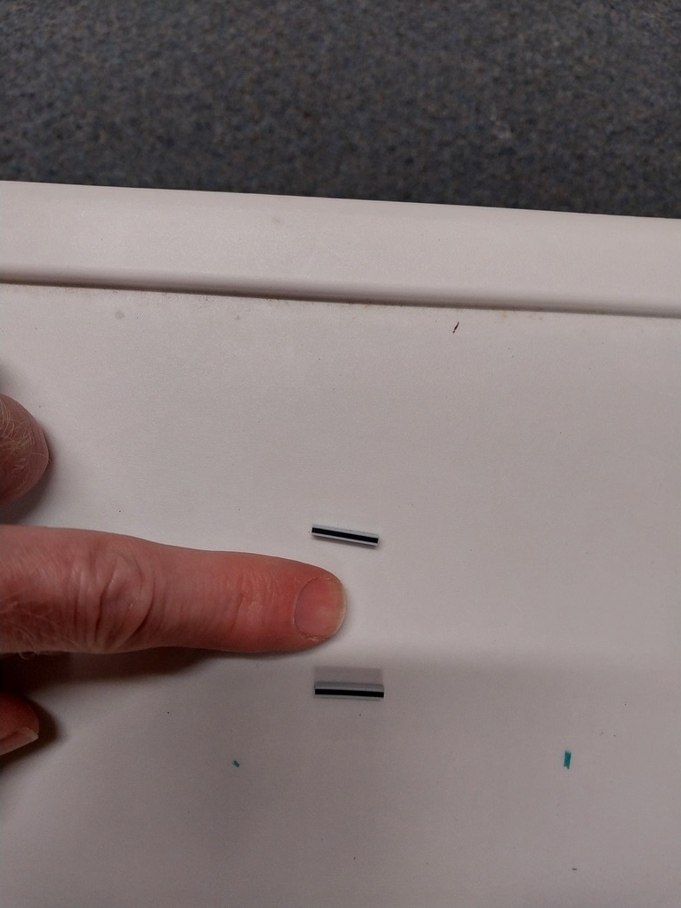
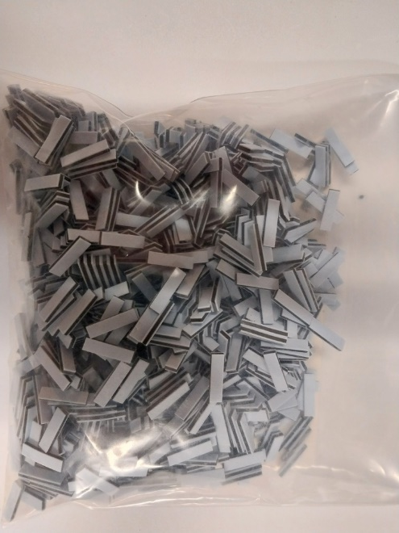
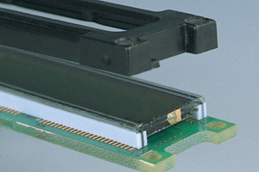
Zebra Strip (Elastomer Conductor)
bag of 1000
small
case holds everything together

Slide 33
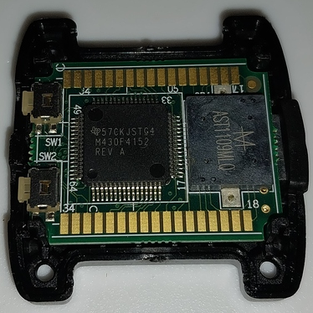
PCB in Case
LCD pads

Slide 34
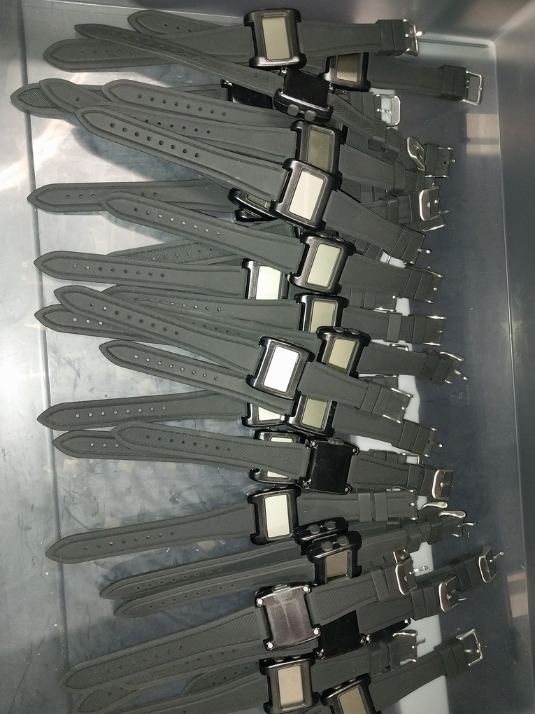
Products
ready for charging and packaging

Slide 35
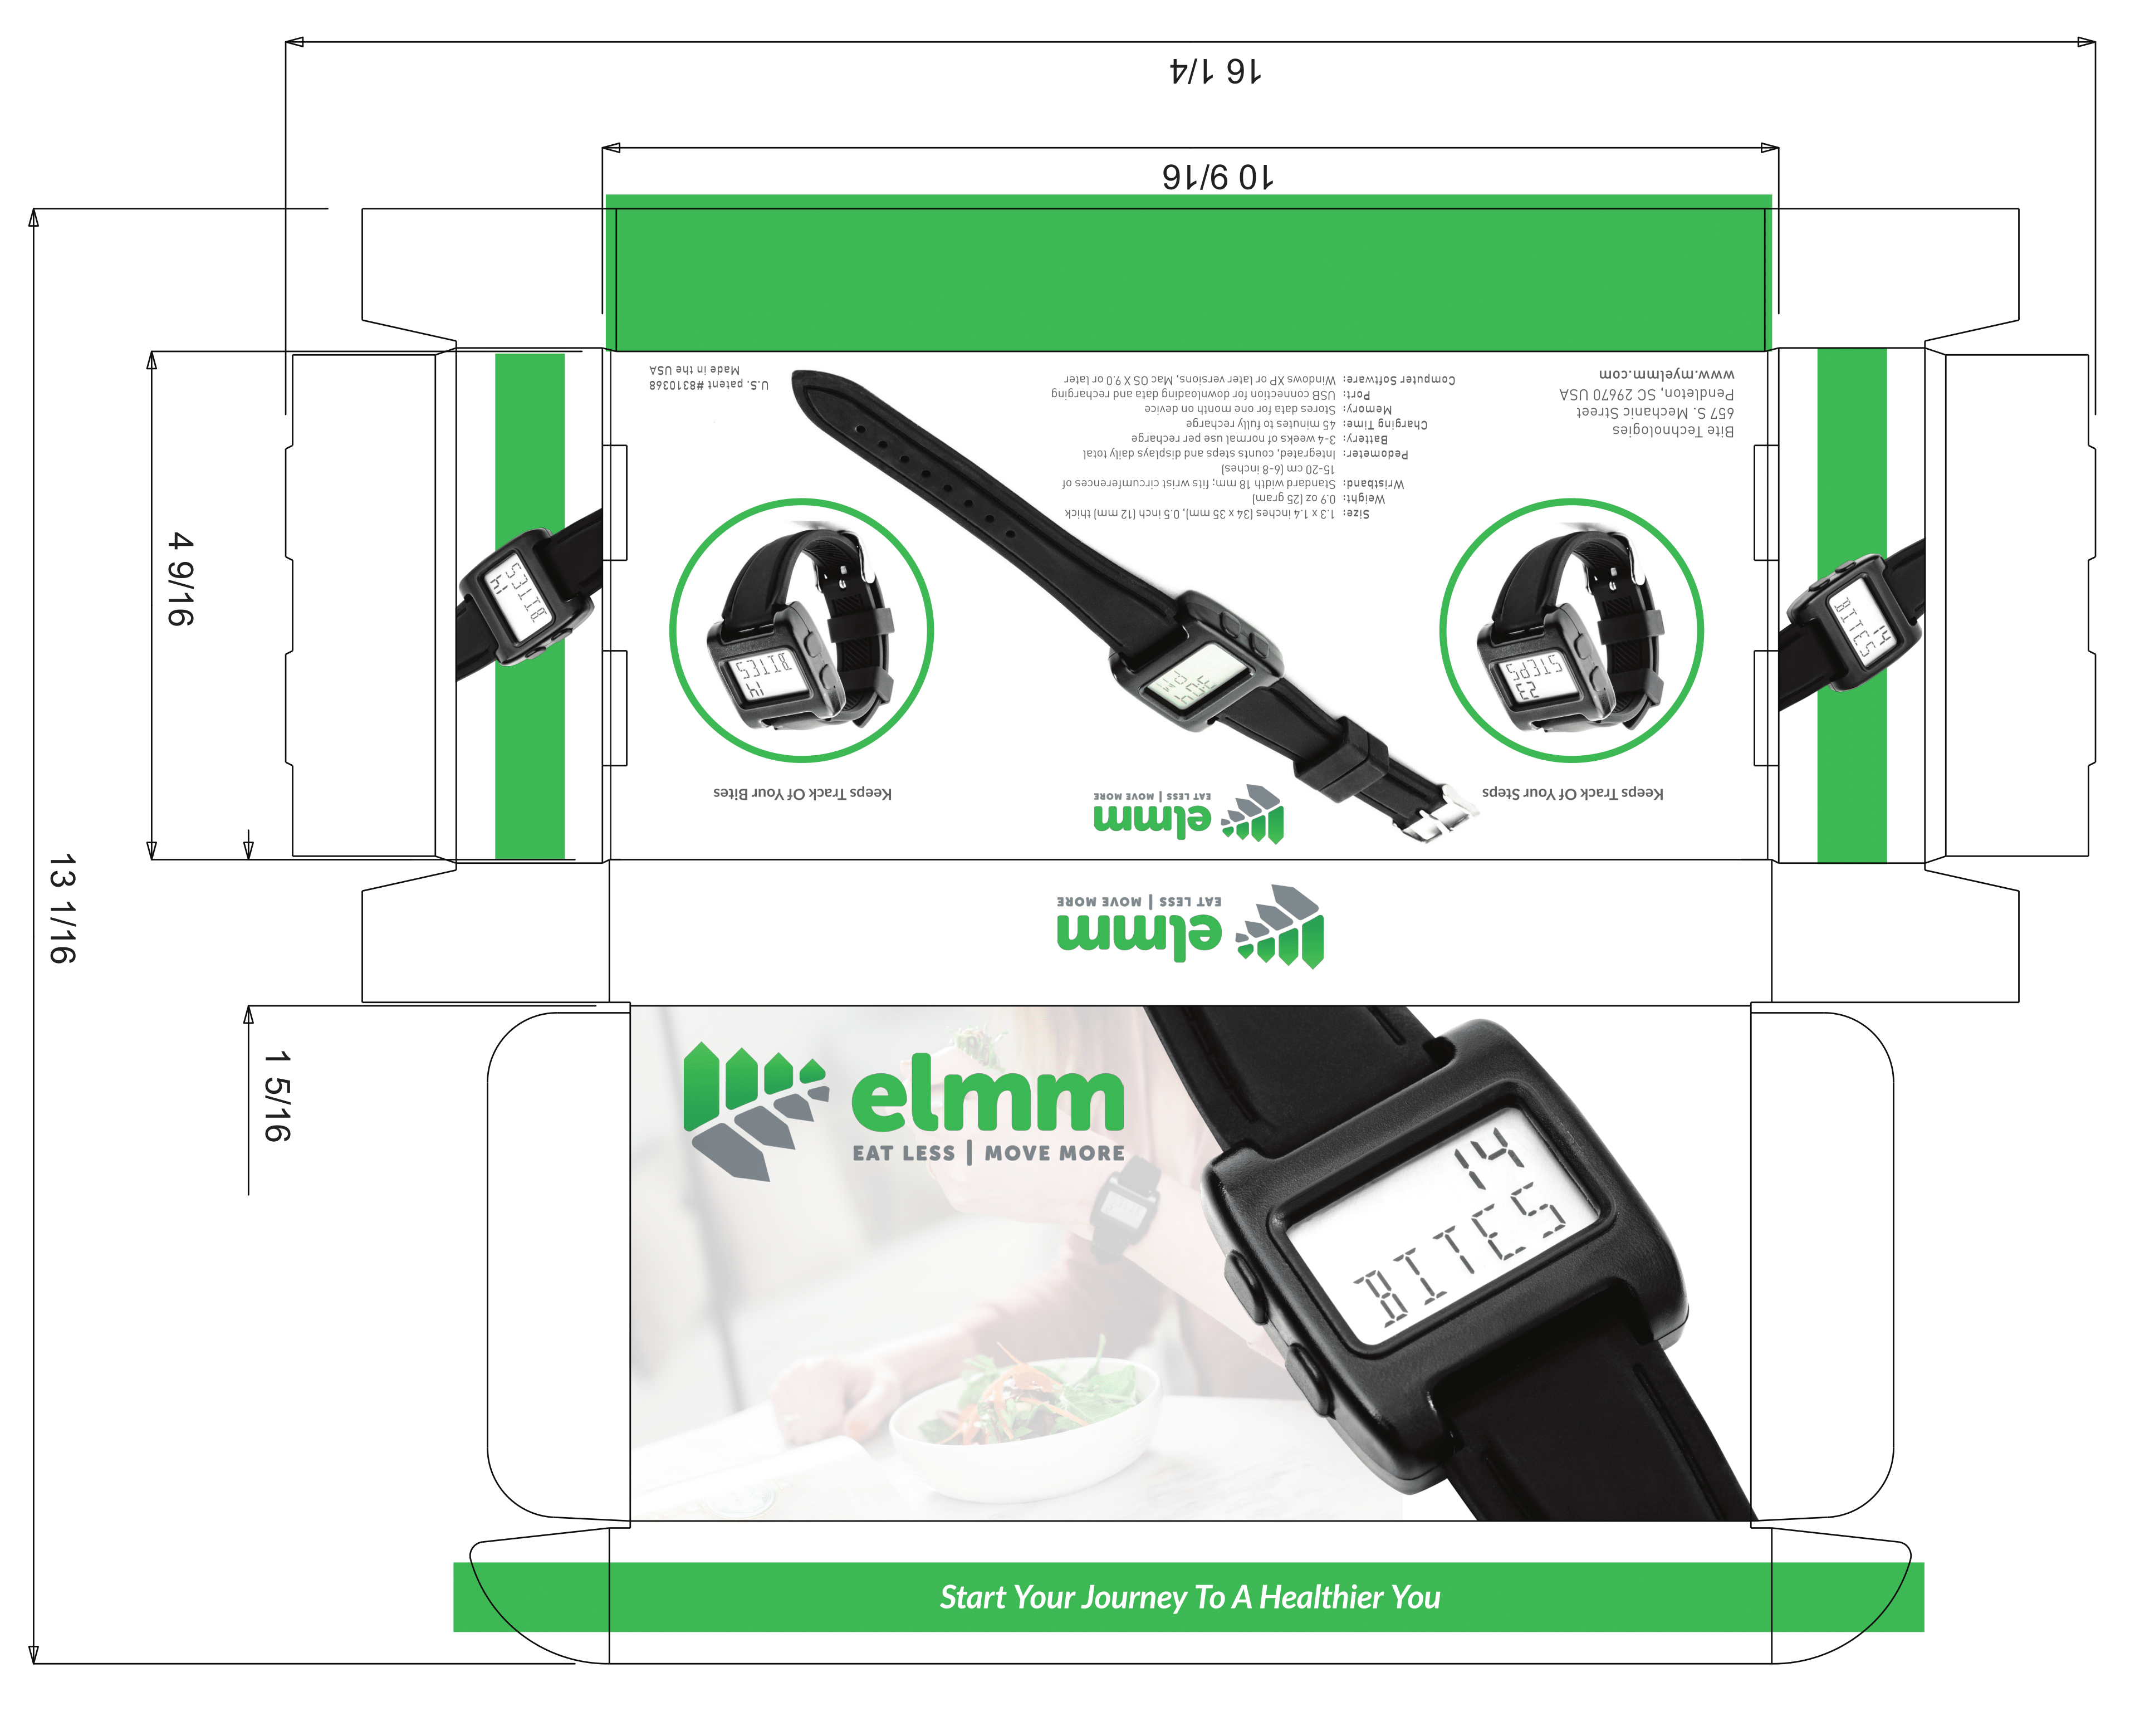

Package Design
Package design and manufacturing

Slide 36
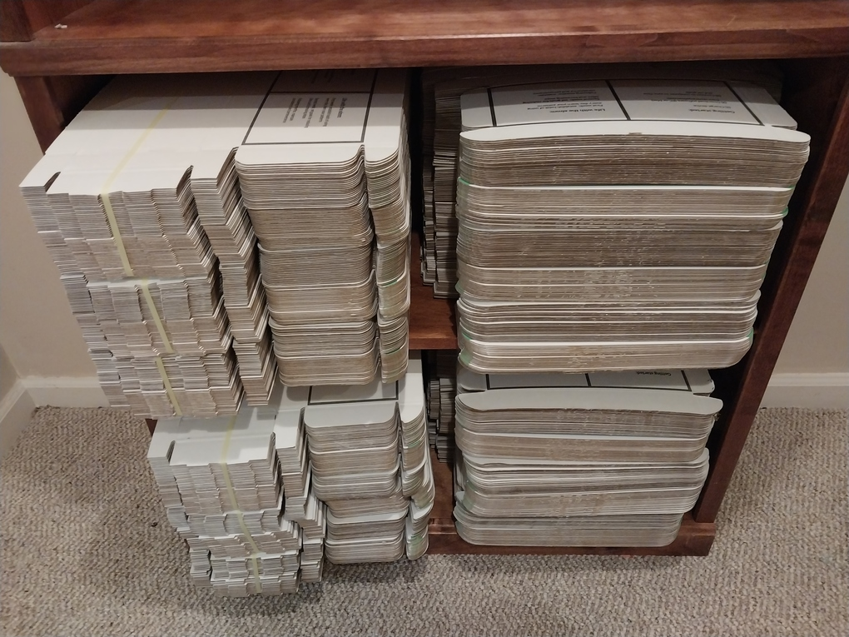
Packaging – Pre-assembly
box assembled with origami-style folding
100-200 boxes

Slide 37
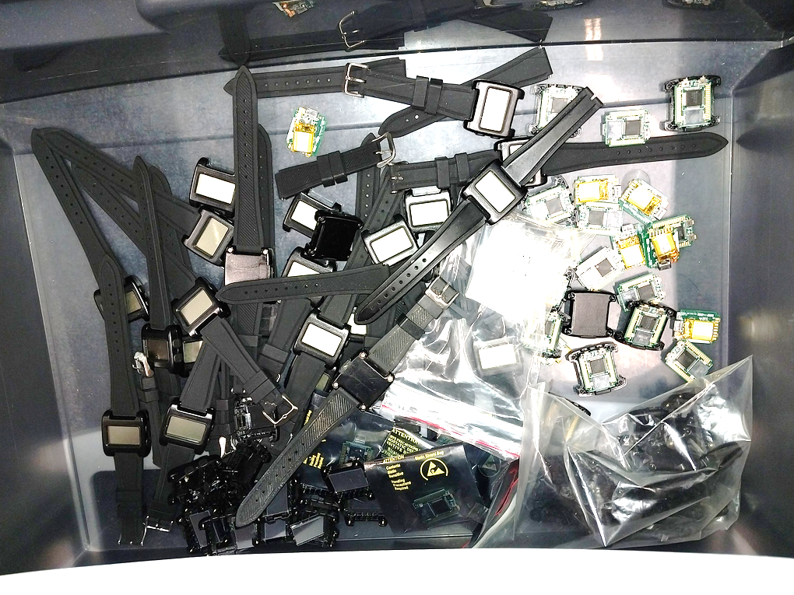
Test and Debug Parts
devices that fail during testing
parts that fail during assembly
customer returns

