Slide 1
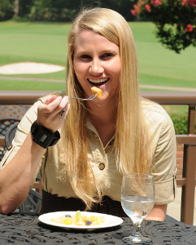

Smartwatch-based Monitoring of Daily Energy Intake
Adam Hoover
Electrical & Computer Engineering Department

Slide 2
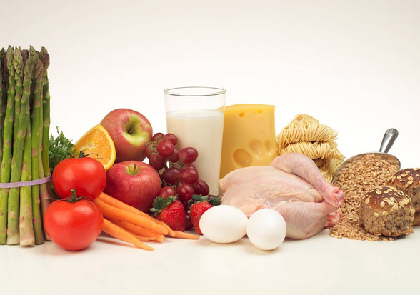
Outline
Motivation (the health part of my talk)
Tracking wrist motion to count bites (the biology part)
Relating bites to calories (a little math)
Modeling context for health signal analysis (the computing part)
Ongoing projects

Slide 3

Obesity
World prevalence: 2.5 billion adults (43%) are overweight and 880 million adults (16%) are obese (WHO 2024). Meter
Marie N, et al. "National-level and state-level prevalence of overweight and obesity…" Lancet, 2024.

Slide 4
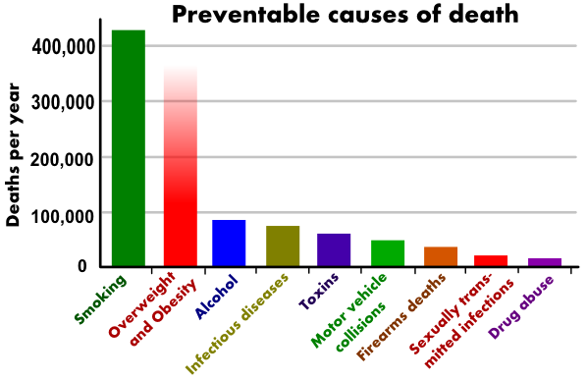
Costs
Comorbidities: Diabetes, heart disease, high blood pressure, stroke, and higher rates of certain cancers (GBD 2024)
Annual medical cost in the United States: $261 billion in 2021 (Cawley et al. 2021)
(Mokdad et al, Actual causes of death in the United States, JAMA)
GBD 2021 Risk factors Collaborators. “Global burden and strength of evidence for 88 risk factors…”, Lancet 2024.
Cawley J, et al. “Direct medical costs of obesity in the United States…”, J Manag Care Spec Pharm 2021.

Slide 5
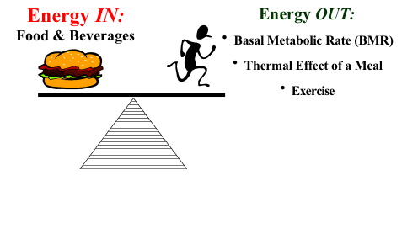
Energy Measures
Energy Intake (Calories or Joules) | Energy Expenditure (Calories or Joules)
Energy absorbed through food intake | Homeostasis (body maintenance), exercise
<- weight change ->
Self-monitoring is associated with successful weight loss/maintenance
  Wang, Deng, et al. "Exploring factors of adherence to weight loss interventions in population with overweight/obesity: an umbrella review." Obesity Reviews, 2024.

Slide 6
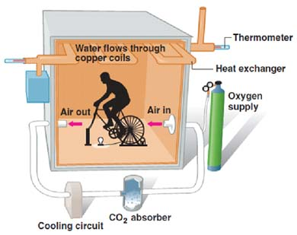
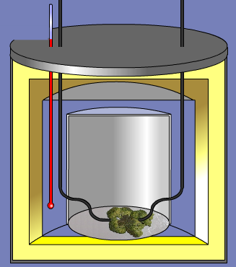
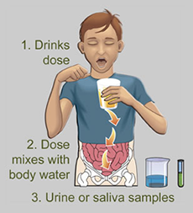
Clinical Tools
Calorimetry Chamber
(measures EE)
Bomb Calorimeter
(measures EI if exact same serving fully consumed)
Doubly Labeled Water
(measures EE directly, EI indirectly*)
*Over a week, EI – EE = weight change

Slide 7
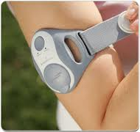
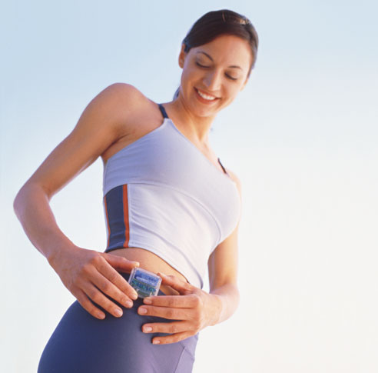
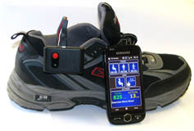
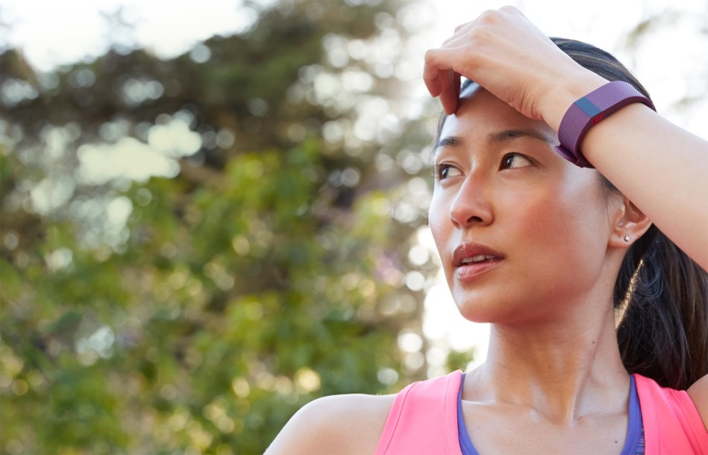
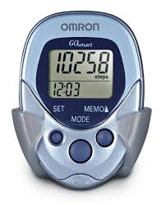
Free-Living Tools: EE
EE: physical activity monitors, pedometers

Slide 8

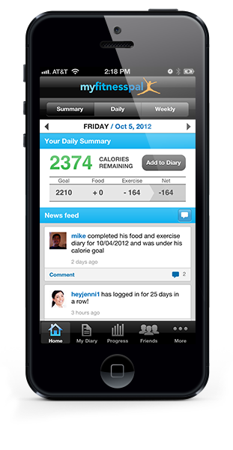
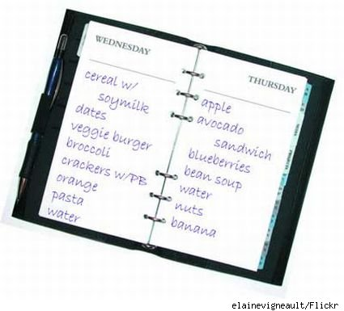
Free-Living Tools: EI
Problem #1: Compliance (not easy to use for long period of time)
Problem #2: Underestimation/underreporting bias (dozens of studies have found it ranges 10-50%)

Slide 9
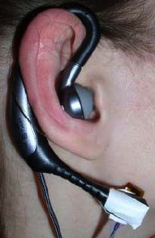
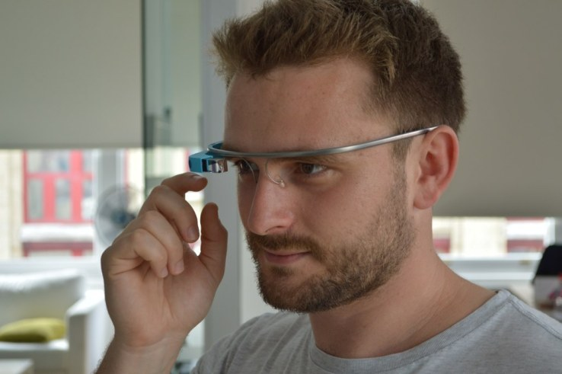
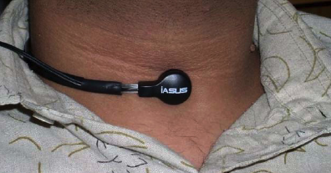
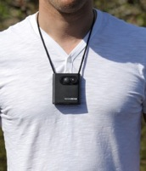
Wearable sensor-based approaches
  Throat and ear
  (e.g. Sazonov et al. 2010, Choi et al. 2022)
Detect swallows, chewing sounds
  Glasses
  (e.g. Kleinberg et al. 2015, Stankowski 2024)
Head movements
  Lanyard camera
  (e.g. Gemming et al. 2013, Alshurafa 2021)
  Video record eating activities
Free-living challenges: Accuracy, compliance (social stigma, comfort, ruggedness, battery life)

Slide 10

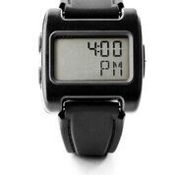
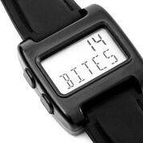
Our concept: Bite Counter
Audible alarms to queue behaviors such as slowing eating or portion control
Worn like a watch
Tracks wrist motion to detect eating episodes and count bites (hand-to-mouth gestures)

Slide 11
Outline
Motivation
Tracking wrist motion to count bites
Relating bites to calories
Modeling context for health signal analysis
Ongoing projects

Slide 12
Wrist Roll Motion
Wrist rolls to get food from table to mouth
Roll is independent of other axes of motion

Slide 13
Algorithm
The wrist undergoes a characteristic roll motion during the taking of a bite of food that can be tracked using a gyroscope
Biologically, this can be related to the necessary orientations for (1) picking food up, and (2) placing food into the mouth

Slide 14
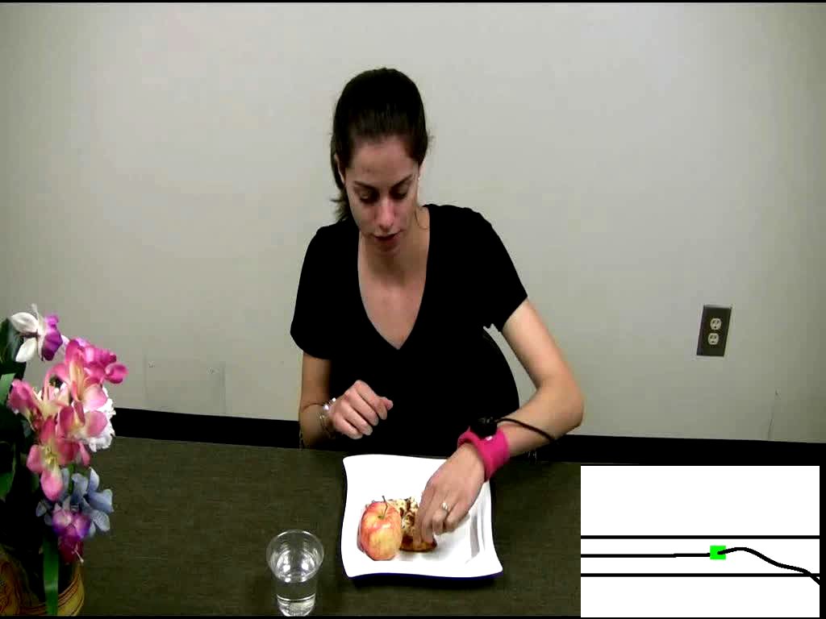
Demo of Bite Counting
Early test: 49 meals (47 participants), 1675 bites
86% bites detected, 81% positive predictive value
Talking and other actions between 67% of bites
Y. Dong, A. Hoover, J. Scisco and E. Muth, "A New Method for Measuring Meal Intake in Humans via Automated Wrist Motion Tracking", in Applied Psychophysiology and Biofeedback, vol 37, no 3, 2012, pp 205-215.

Slide 15
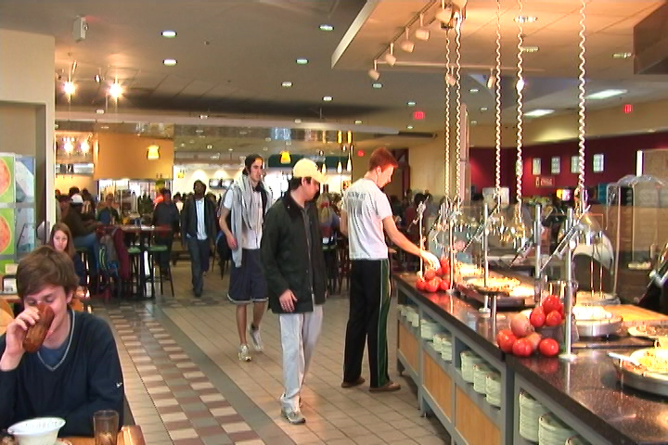
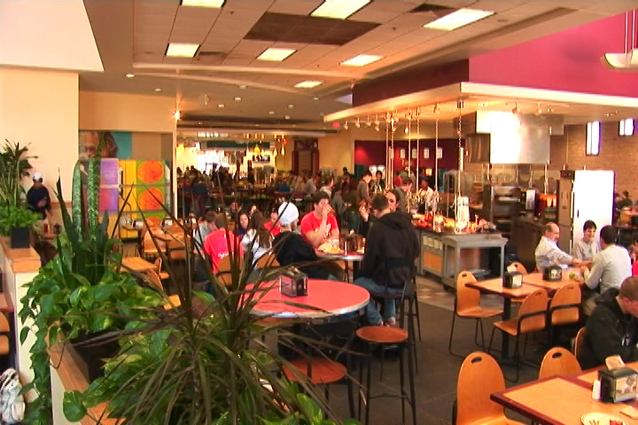
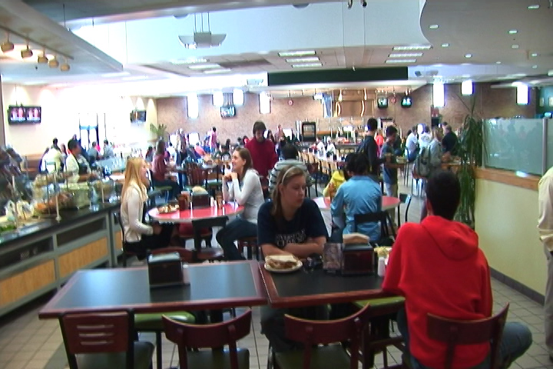
Cafeteria Experiment
Main food service for Clemson University
Seats ~800 people
Huge variety of foods and beverages
NIH R41DK091141, R42DK091141

Slide 16
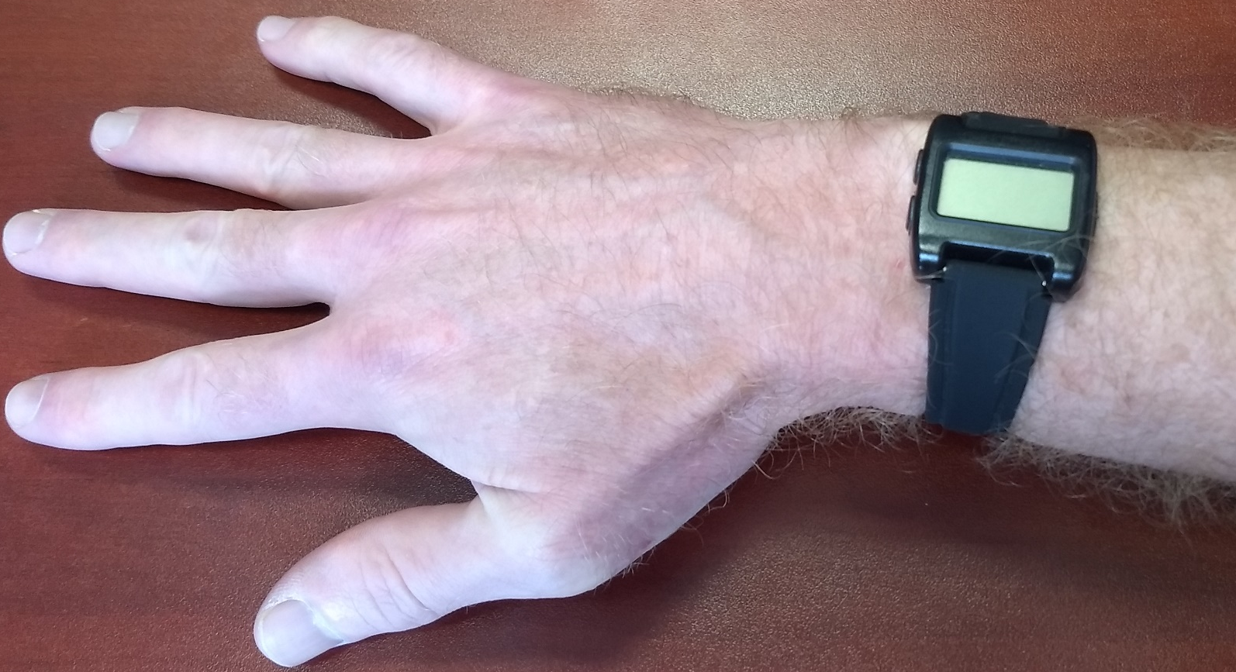
Sensors
Y
pitch
X
roll
Z
yaw
Accelerometer (X, Y, Z) and gyroscope (yaw, pitch, roll) measure wrist motion

Slide 17
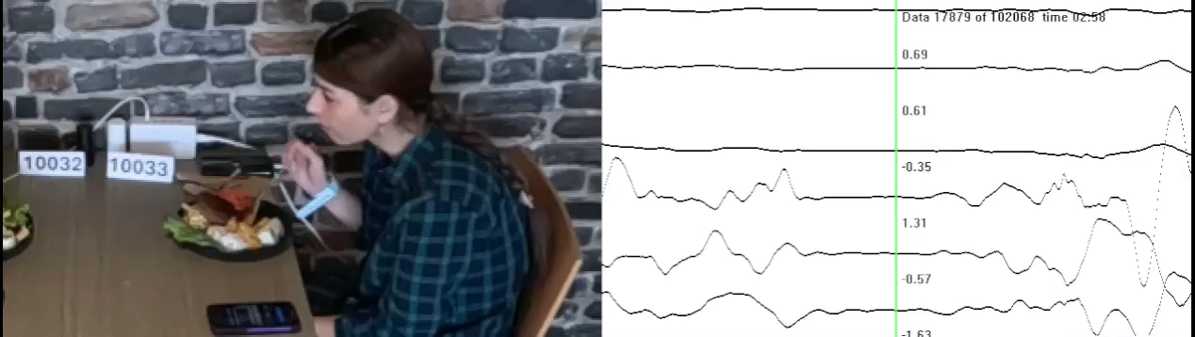
Cafeteria Demo
Z
Y
X
roll
pitch
yaw
current video frame
ground truth bite
classifier detected bite

Slide 18
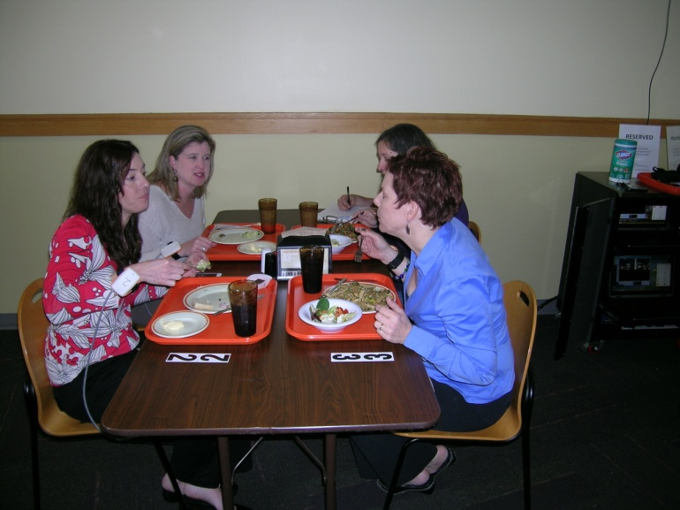
Cafeteria Experiment
276 participants (1 meal each)
374 different foods and beverages consumed
24,088 total bites
81% bites detected, 83% positive predictive value
Y. Shen, J. Salley, E. Muth and A. Hoover, "Assessing the Accuracy of a Wrist Motion Tracking Method for Counting Bites across Demographic and Food Variables", in IEEE Journal of Biomedical and Health Informatics, vol. 21 no. 3, March 2017, pp. 599-606.

Slide 19
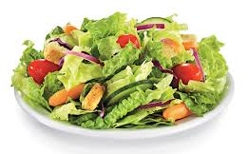
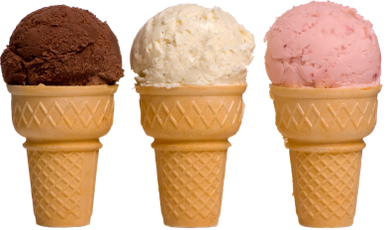
Bite Counting Accuracy
most accurate food:
salad bar (87%)
least accurate food:
ice cream cone (37%)
Accuracy increases as seconds per bite slows
(age, gender, ethnicity)
Accuracy modestly correlates with total wrist motion
(head-toward-plate vs hand-towards-mouth motion)
Y. Shen, J. Salley, E. Muth and A. Hoover, "Assessing the Accuracy of a Wrist Motion Tracking Method for Counting Bites across Demographic and Food Variables", in IEEE Journal of Biomedical and Health Informatics, vol. 21 no. 3, March 2017, pp. 599-606.

Slide 20
Outline
Motivation
Tracking wrist motion to count bites
Relating bites to calories
Modeling context for health signal analysis
Ongoing projects

Slide 21
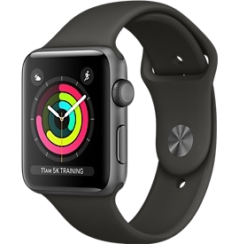


Embedded System Design
Stores time-stamped log of meals (bite count)
On/off button
Lab model
Watch model
Free app

Slide 22
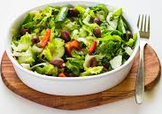
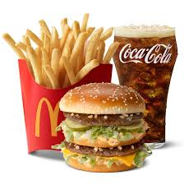
Bite-to-Calorie Correlation
each point = 1 meal
2 weeks data (~50 meals), 1 person
weekly meal variability

Slide 23
Correlation Test
83 subjects wore for 2 weeks, 3246 total meals
each plot = 1 person
0.4 correlation
ranges 0.4-0.7 for most people
0.7 correlation
J. Scisco, E. Muth and A. Hoover, "Examining the Utility of a Bite-Count Based Measure of Eating Activity in Free-Living Humans", in Journal of the Academy of Nutrition and Dietetics, vol. 114 no. 3, April 2014, pp. 464-469.
T. Chou, et al. "An explanation for the accuracy of sensor-based measures of energy intake: Amount of food consumed matters more than dietary composition." Appetite vol. 194, pp. 107176, 2024.

Slide 24
Converting Bites to Calories
kpb = kilocalories per bite
Formula based on height (h), weight (w), age (a)
kpb (male) = 0.2455 h + 0.0449 w − 0.2478 a
kpb (female) = 0.1342 h + 0.0290 w − 0.0534 a
Formula fit using 83-people 2-week data set
Tested on 276 meals cafeteria data set
J. Salley, A. Hoover, M. Wilson and E. Muth, "A Comparison Between Human and Bite-Based Methods of Estimating Caloric Intake", in Journal of the Academy of Nutrition and Dietetics, vol. 116 no. 10, pp. 1568-1577.

Slide 25
Calories in Cafeteria Meals

Slide 26
Outline
Motivation
Tracking wrist motion to count bites
Relating bites to calories
Modeling context for health signal analysis
Ongoing projects

Slide 27
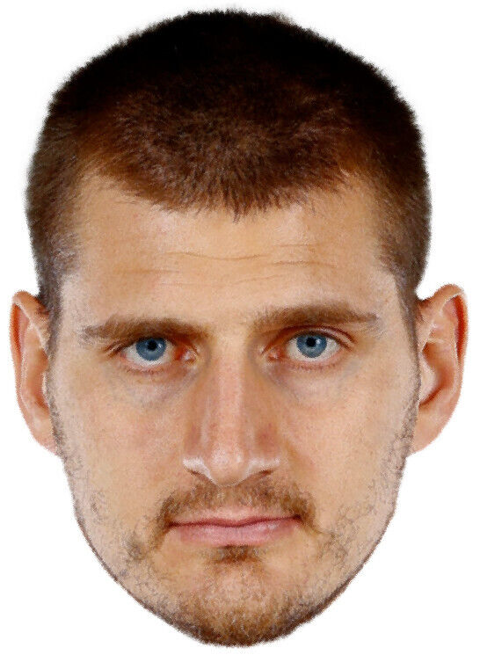
Context Helping Recognition
What is this?
Right eye
Nikola Jokic
(famous basketball player)
Many features provide context: nose, ears, chin, forehead, facial hair, etc.
An “eye classifier” can benefit from larger context.
Is it a left or right eye?
Who is it?
Hypothesis: larger context can improve health signal analysis

Slide 28
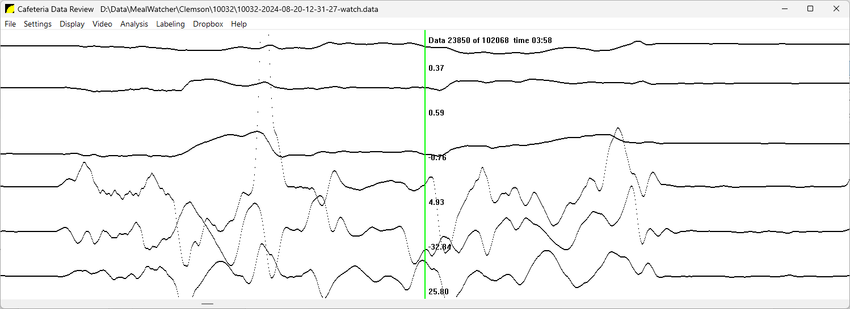
Bite Detection Using a Sliding Window
food prep
bite
rest
not used by classifier
not used by classifier
detection
There is longer-term context in eating-related gestures
R Ramos-Garcia, E Muth, J Gowdy, A Hoover, “Improving the recognition of eating gestures using inter-gesture sequential dependencies”, IEEE Journal of Biomedical and Health Informatics, 19 (3), 825-831, 2014.
S Sharma, P Jasper, E Muth, A Hoover, “The impact of walking and resting on wrist motion for automated detection of meals”, ACM Transactions on Computing for Healthcare 1 (4), 1-19, 2020.

Slide 29
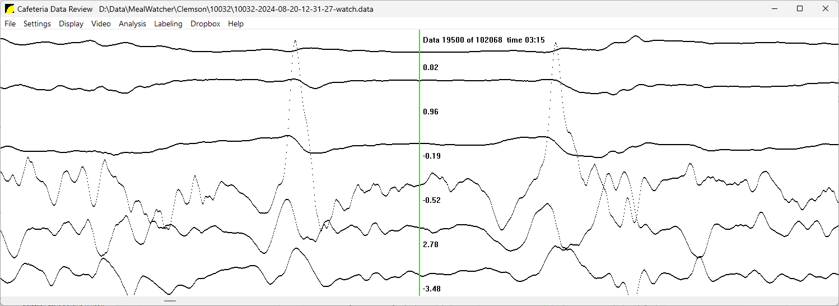
Longer Context: Window Count
2
event count in window
count of events in window = classifier target
1
0

Slide 30
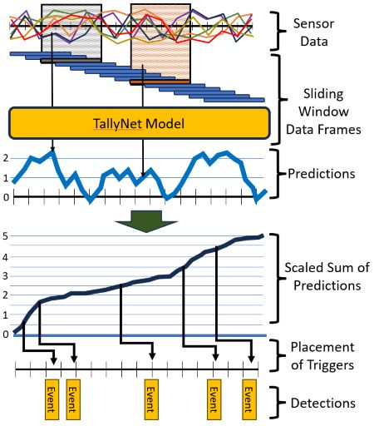
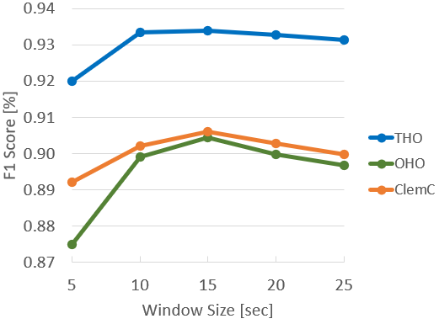
TallyNet Classifier
15 sec window works best on 3 different datasets
Riemann sum passing integer counts triggers detections

Slide 31
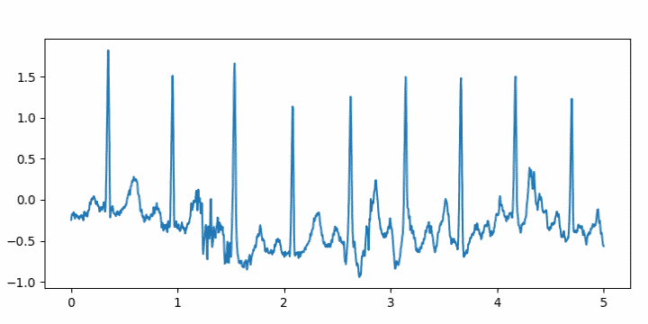
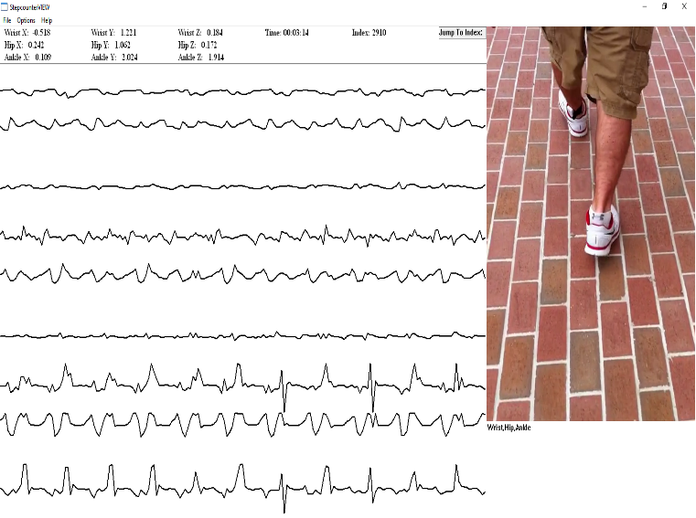
TallyNet for Other Problems
heartrate and HRV analysis
pedometer step counting

Slide 32
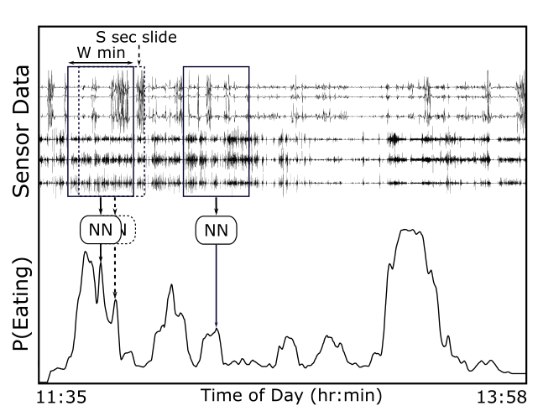
Meal Detection Using 6 min Context
NN analyzes window of data and outputs an instantaneous probability of eating
Before-meal (prep) and after-meal (cleanup) wrist motions provide extra context
meal 1
meal 2
S. Sharma and A. Hoover, "Top-Down Detection of Eating Episodes by Analyzing Large Windows of Wrist Motion Using a Convolutional Neural Network", in MDPI Bioengineering, vol 9, no 70, 2022.

Slide 33
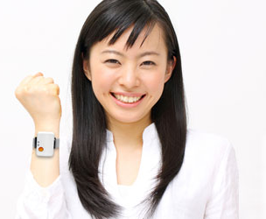

Accuracy Detecting Episodes
Shimmer device
Data recorded during everyday life
351 participants (1 day each)
4,680 total hours with 1,133 eating episodes
89% episodes detected, 1.7 FP/TP
S. Sharma and A. Hoover, "Top-Down Detection of Eating Episodes by Analyzing Large Windows of Wrist Motion Using a Convolutional Neural Network", in MDPI Bioengineering, vol 9, no 70, 2022.

Slide 34
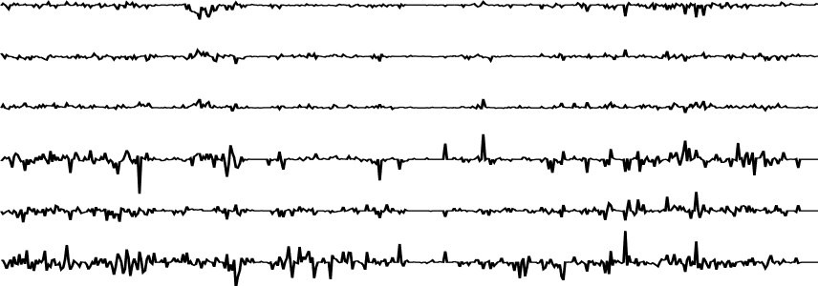
Pattern Analysis Using LONG Context
local detector
global detector
Problems:
Scarcity of full-length samples (health datasets are usually small)
Computational complexity of end-to-end training on full-length samples

Slide 35
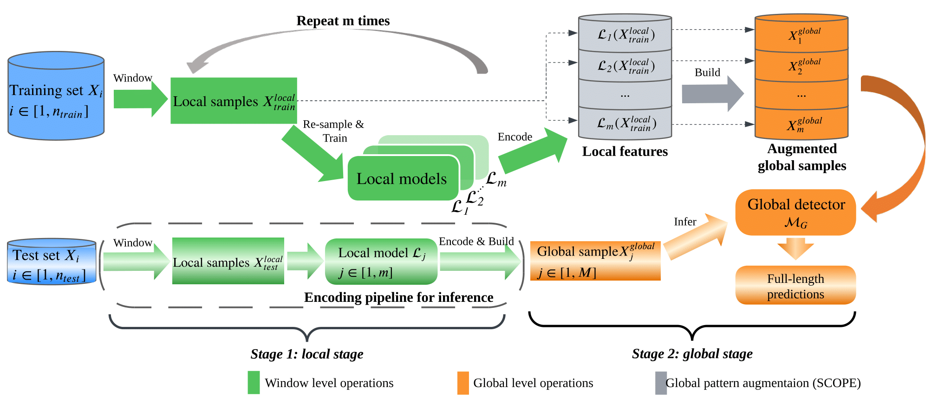
SCOPE: SynthetiC glObal Pattern augmEntation
different outputs
train on different subsets

Slide 36
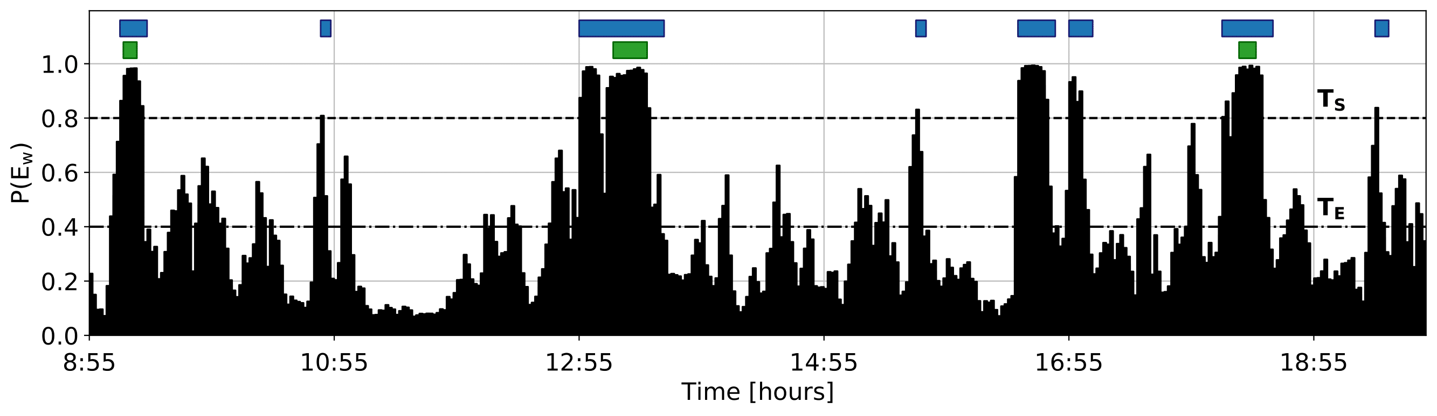
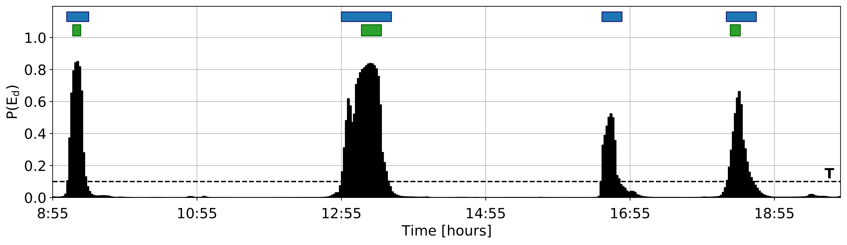
Day Length IMU Meal Detection
6 minute window classifier
detection
GT
day length classifier
fewer FP
less “background uncertainty”
Z. Tang, et al., "Detecting Eating Episodes From Wrist Motion Using Daily Pattern Analysis", IEEE J. of Biomedical and Health Informatics, 28(2), pp 1054-1065, Feb 2024.

Slide 37
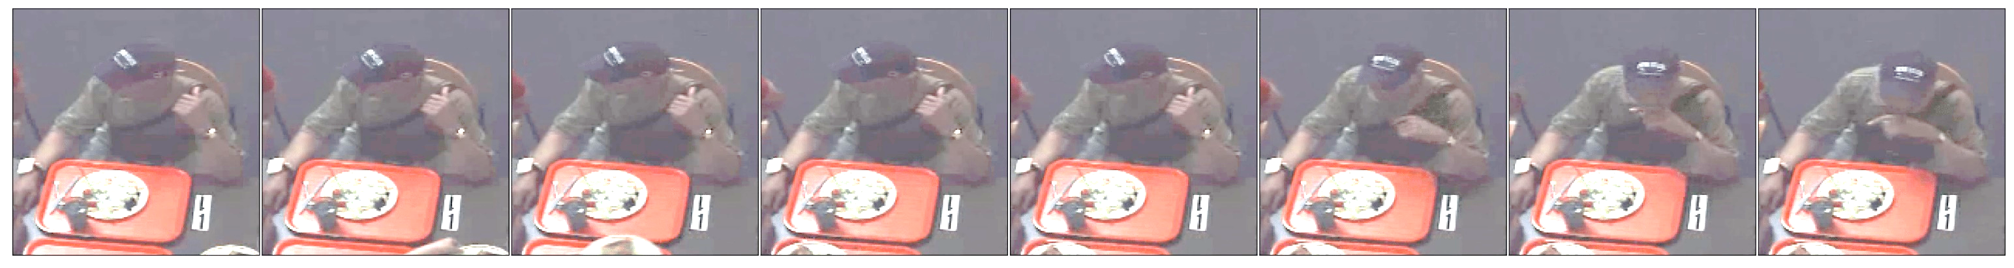
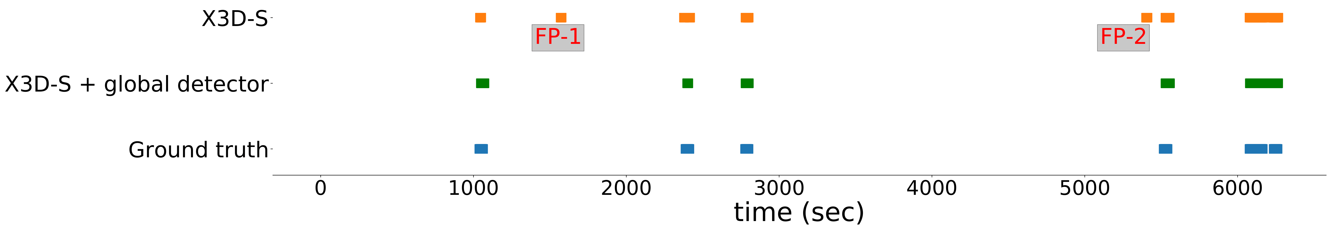
Meal Length Video Analysis
fewer FP
detected intake gestures
Model | F1 (bite drink)
X3D-L (benchmark) | 0.9 | 0.77
SlowFast (benchmark) | 0.88 | 0.78
CNN-LSTM (benchmark) | 0.89 | 0.67
Ours: CNN-LSTM + global detector | 0.94 | 0.86
Ours: X3D-S + global detector | 0.93 | 0.88
largest improvement for drink intake which is rarest class
Z Tang and A Hoover, “Video-based Intake Gesture Recognition using Meal-length Context”, ACM Transactions on Computing for Healthcare, 2025.

Slide 38
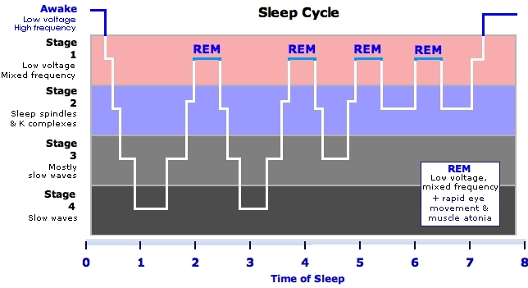
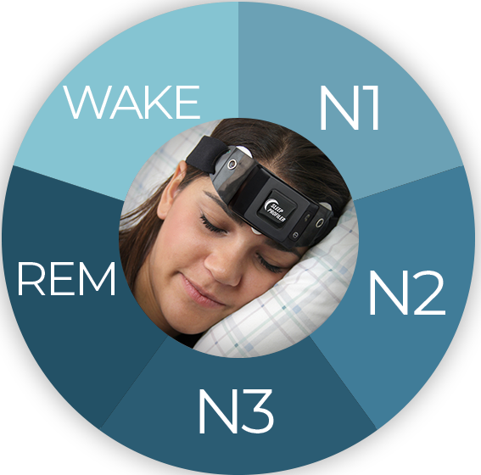
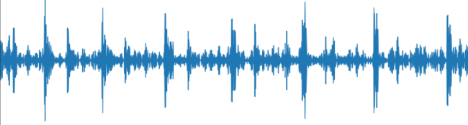


SCOPE for Other Problems
sleep stage detection in EEG
music and speech detection in audio

Slide 39
Outline
Motivation
Tracking wrist motion to count bites
Relating bites to calories
Modeling context for health signal analysis
Ongoing projects

Slide 40


Ongoing work
Ring vs. watch:
Accuracy?
Preference?
Adherence?
watch sensors
finger sensors
ring
NIH R01DK135679, “Validating Sensor-based Approaches for Monitoring Eating Behavior and Energy Intake by Accounting for Real-World Factors that Impact Accuracy and Acceptability”, $2.5M, 2023-2027.

Slide 41





Ongoing work
New app interacts with user to learn individual patterns
Original classifiers trained on group data
Pilot data on 8 subjects showed significant improvement of individual models
Current data collection testing N=30 people for 2 weeks each
NSF 2242812, EPSCoR Center on AI-Enabled Healthcare Devices, $20M, 2023-2028.

Slide 42



Ongoing work
N=275 people with overweight/obesity
SM method 1
SM method 2
smartwatch-based monitoring being tested against 3 other gold standard methods
SM method 3
SM method 4
24 week behavioral obesity treatment
microrandomized to 4 different self-monitoring approaches
NIH R01DK136216, Microrandomized Trial to Optimize Use of Burden-reducing Self-monitoring Approaches in Behavioral Obesity Treatment, $3.2M, 2024-2029.

Slide 43

Acknowledgments
Collaborators
  Adam Hoover, Electrical & Computer Engineering Department, Clemson University
  Stephanie Goldstein, Graham Thomas, The Miriam Hospital at Brown University
  Eric Muth, North Carolina A&T
  Diana Thomas, West Point Military Academy
  Brie Turner-McGrievy, University of South Carolina
  Corby Martin, Pennington Biomedical Research Center, LSU
  Pat O’Neil, Weight Management Center, Medical University of South Carolina
  Kathleen Melanson, University of Rhode Island
  Students: Brycen Havens, Faria Armin, Yu Xuan, Zeyu Tang, James Jolly, Surya Sharma, Adam Patyk, Wenkang Wei, Shaurya Gupta, Yiru Shen, Ryan Mattfeld, Basil Lin, Yujie Dong, Jenna Scisco, Raul Ramos-Garcia, James Salley, Mike Wilson, Ziqing Huang, Soheila Eskandari, Phil Jasper, Amelia Kinsella, Jose Reyes, Meredith Drennan, Xueting Yu, Michael Wooten, Megan Becvarik, John Lawler, Cameron Burroughs
Funding (smartwatch related research)
  NIH R01DK135679, R01HL118181, R01DK132210, R01HL153543, R41DK091141, R42DK091141, R21CA187929
  NSF 2242812 (part of SC-ADAPT center)
  South Carolina Clinical and Translational Institute, South Carolina Launch

Slide 44


Per-Meal Bite Counting
* Must be turned on/off for each meal
Free app
Free app

Slide 45


Day-Length Eating Monitoring
Actigraph GT9x
Shimmer3
Smartwatch
Record all-day data during everyday life
Free desktop software to do analyses (Windows)

Slide 46

Questions?
For more info: www.cecas.clemson.edu/ahoover

