Slide 1


Tracking Wrist Motion to Detect and Measure Eating Intake of Free-living Humans
Yujie Dong
Committee Members:
Dr. Adam W. Hoover, Chair
Dr. Stanley T. Birchfield
Dr. John N. Gowdy
Dr. Eric R. Muth
March 2012

Slide 2


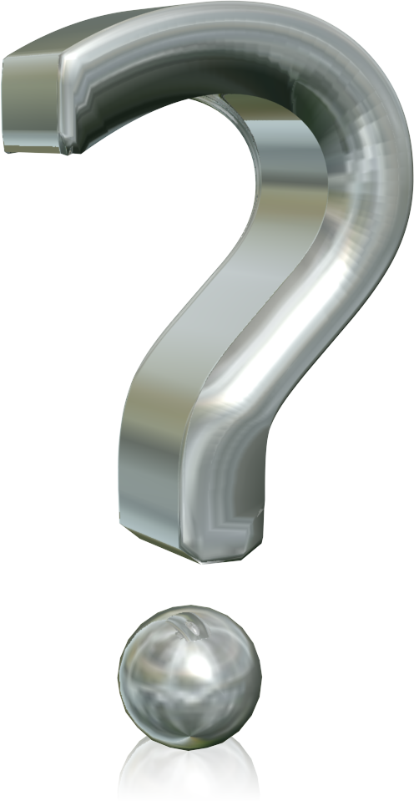
Presentation Outline
Motivation
Detecting eating
  Proc. of Int’l. Conf. on Embedded Systems and Applications
  IEEE Transactions on Biomedical Engineering (under review)
Other Work
  Measuring eating consumption via wrist motion tracking (accepted)
  Slowing bite rate reduces energy intake (published)
  An instrumented cafeteria table for recording eating activity (ongoing)
  Measuring system latency from sensing to actuation (under revision)
Summary

Slide 3

Motivation

Slide 4
Motivation
Prevalence of obesity
Statistics in 2008
  Worldwide: 1.5 billion adults were overweight and 500 million adults were obese (WHO 2011).
  USA: 34.4% of Americans were overweight and 33.9% of Americans were obese (Flegal et al. 2010).
Related diseases
  Diabetes, heart disease, high blood pressure, stroke, and higher rates of certain cancers (Wellman et al. 2002)
Annual medical cost in the United States
  $147 billion in 2008 (Finkelstein et al. 2009)
  $78.5 billion in 1998

Slide 5

New tools needed
  International Obesity Society: 10,000 researchers
  Obesity Society (U.S.): 2,500 researchers
Joint NSF/NIH Workshop
  (Ershow et al. 2007) “Engineering Approaches to Energy Balance and Obesity: Opportunitites for Novel Collaborations and Research”
Journal of the American Dietetic Association
  (Thompson et al. 2010) “Need for Technological Innovation in Dietary Assessment”
  (McCabe-Sellers et al. 2010) “Advancing the Art and Science of Dietary Assessment through Technology”

Slide 6
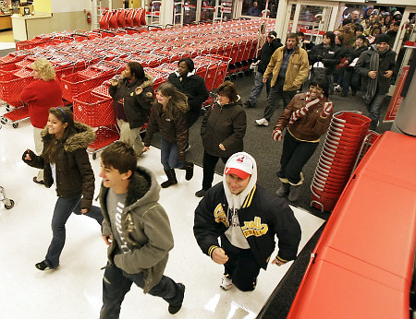
New tools needed for …
Researchers
Individuals
  Genetics
  Epidemiology
  Clinical outcomes
  Weight loss
  Fitness
  Weight maintenance

Slide 7
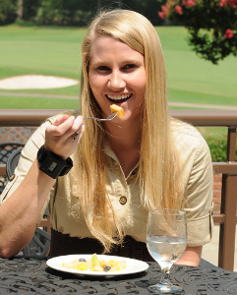
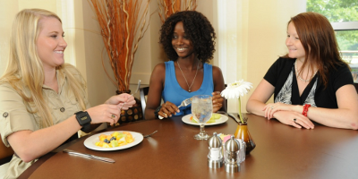
Our vision
Wrist-worn device to passively monitor eating 24/7

Slide 8
Detecting the eating activities of a free living human using wrist-worn accelerometers and gyroscopes

Slide 9

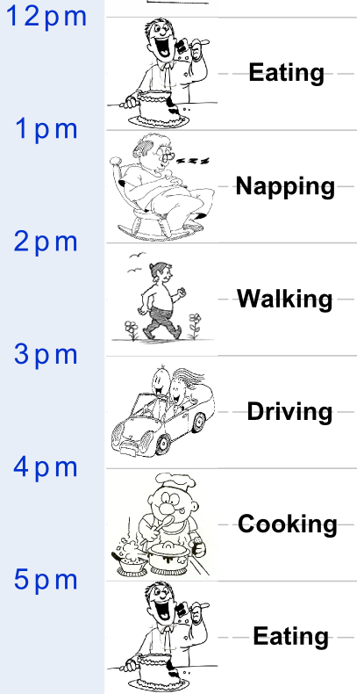
Detecting when people are eating
?
?
?

Slide 10
Related work
Activity recognition using accelerometers
  Walking, running, sitting, and resting (Atallah et al. 2009, Ermes et al. 2008, Karantonis et al. 2006, Khan et al. 2010, Pawar et al. 2007)
  Accidental falls (Yin et al. 2008)
  Sports activities (Parkka et al. 2010)
  Assembly tasks (Ward et al. 2006)
  Activity recognition using gyroscopes
    Walking, sitting, and resting (Ghasemzadeh et al. 2010)
    Tremors associated with Parkinson’s disease (Salarian et al. 2007)
Eating activity recognition? None.
10x power

Slide 11
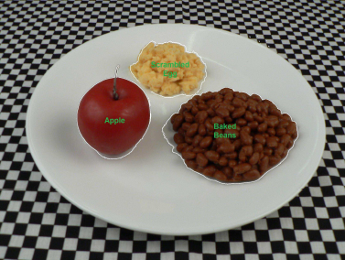
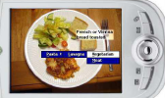
Related work
Camera-based approach
  Take pictures before and after eating (Martin et al. 2009)
  Expert compares to database (Williamson et al. 2003)
  Attempts to automate (Zhu et al. 2008)

Slide 12
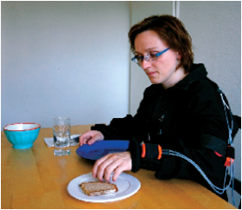
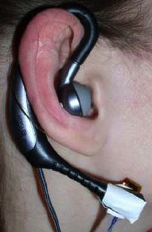
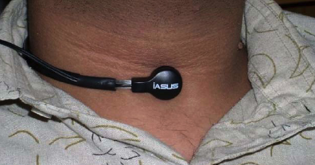
Related work
Wearable sensor-based approach
  Throat and ear (Sazonov et al. 2010)
  Arms and back (Amft et al. 2008)

Slide 13
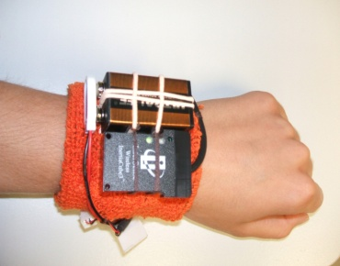
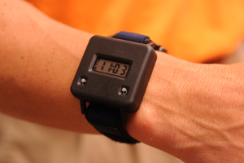
Our approach
Wrist-worn sensor
  Increased compliance and social acceptance
  Problems: pattern recognition and power consumption
lab testing …… development …….. manufacturing

Slide 14
Overview of algorithm
Preprocessing
Detect hypothesized eating
Feature extraction
Final classification

Slide 15
Overview of algorithm
Preprocessing
Detect hypothesized eating
Feature extraction
Final classification

Slide 16
Raw data
yaw
pitch
roll
x
y
z
minute

Slide 17
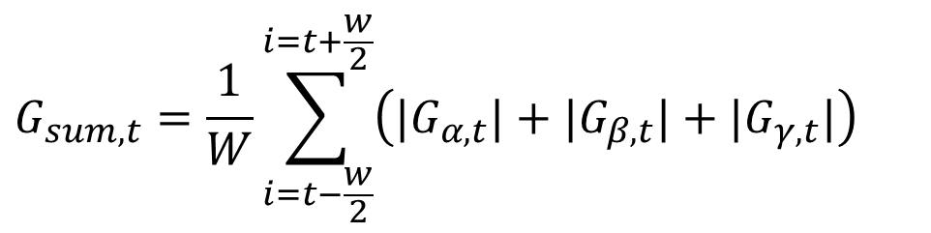
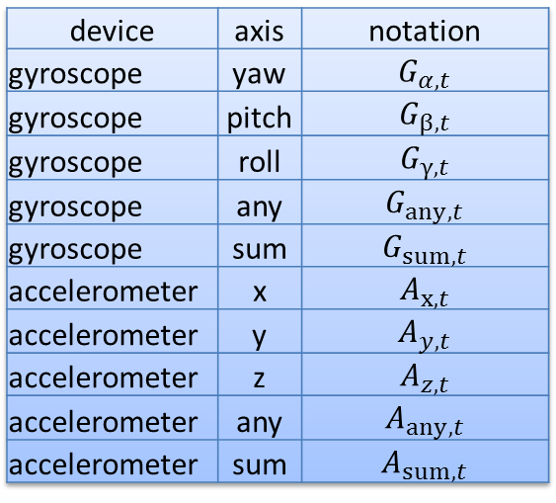
Preprocessing
device | axis | notation
gyroscope | yaw | $$G_{α,t}$$
gyroscope | pitch | $$G_{β,t}$$
gyroscope | roll | $$G_{γ,t}$$
gyroscope | any | $$G_{any,t}$$
gyroscope | sum | $$G_{sum,t}$$
accelerometer | x | $$A_{x,t}$$
accelerometer | y | $$A_{y,t}$$
accelerometer | z | $$A_{z,t}$$
accelerometer | any | $$A_{any,t}$$
accelerometer | sum | $$A_{sum,t}$$
Rotational motion
Linear motion
$$G_{sum,t}=\frac{1}{W}\sum_{i=t−\frac{w}{2}}^{i=t+\frac{w}{2}}{\left(|G_{α,t}|+|G_{β,t}|+|G_{γ,t}|\right)}$$
Notation:

Slide 18
Overview of algorithm
Preprocessing
Detect hypothesized eating
Feature extraction
Final classification

Slide 19
Motion pattern related to eating
Beginning: large wrist motion energy
During eating: reduced energy
End: large wrist motion energy
eat
eat
Example 1
Example 2

Slide 20
Criteria of first eating pattern

Slide 21
Criteria of second eating pattern

Slide 22
Evaluation
|a| < 15 minutes
|b| < 15 minutes
|a| + |b| < 20 minutes

Slide 23
Overview of algorithm
Preprocessing
Detect hypothesized eating
Feature extraction
Final classification

Slide 24

Features during hypothesized eating
Mean absolute deviation of yaw, pitch and roll
$$\frac{1}{N}\sum_{j=1}^{N}{|G_{any,j}−\frac{1}{N}\sum_{i=1}^{N}{G_{any,i}}|}$$
Regularity of motion
Eating activity
Non-eating activity

Slide 25
Features during hypothesized eating
Line fit (slope of energy over time)
Entropy
Variance
Zero crossing rate (frequency of motion)
Mean of minima (size of motion)
Mean of maxima
Percentile distribution (range of motion)
Auto correlation (repetition of motion)
Number of bites
Mean of bite interval
Variance of bite interval
Skewness of bite interval

Slide 26
Overview of algorithm
Preprocessing
Detect hypothesized eating
Feature extraction
Final classification

Slide 27

Classification: notation
Class space: V = {m, n}
  m: actual eating activity
  n: non-eating activity
Feature space: A = {$a_{1},a_{2},...,a_{N}$}
  $a_{i,j}$: the value of feature set i in hypothesized eating j

Slide 28

Classification: FLD
For each feature, calculate
  $μ_{m}=\frac{1}{M}\sum_{j=1}^{M}{a_{i,j}}$
  ${σ_{m}^{}}^{2}=\frac{1}{M}\sum_{j=1}^{M}{{(a_{i,j}−μ_{m})}^{2}}$
  $μ_{n}=\frac{1}{N}\sum_{j=1}^{N}{a_{i,j}}$
  ${σ_{n}^{}}^{2}=\frac{1}{N}\sum_{j=1}^{N}{{(a_{i,j}−μ_{n})}^{2}}$
Fisher linear discriminant (FLD): J=$\frac{|μ_{m}−μ_{n}|^{2}}{σ_{m}^{2}+σ_{n}^{2}}$
A higher FLD indicates the feature has better discriminatory power (is better for classification)
mean of feature for actual eating
variance of feature for actual eating
mean of feature for non-eating
variance of feature for non-eating

Slide 29
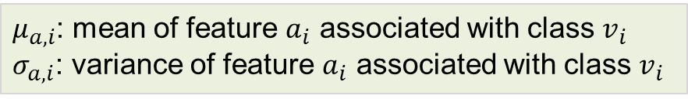
Classification: Naïve Bayes
classification
eating or other
features
Using Bayes theorem
Assume attributes are conditionally independent
$μ_{a,i}$: mean of feature $a_{i}$ associated with class $v_{i}$
$σ_{a,i}$: variance of feature $a_{i}$ associated with class $v_{i}$

Slide 30
Evaluation
Five folder cross validation scheme (Kohavi 1995)
  Four-fifths for training, one-fifth for testing
  Repeat 5 times
  Average the accuracy

Slide 31
Data Collection

Slide 32
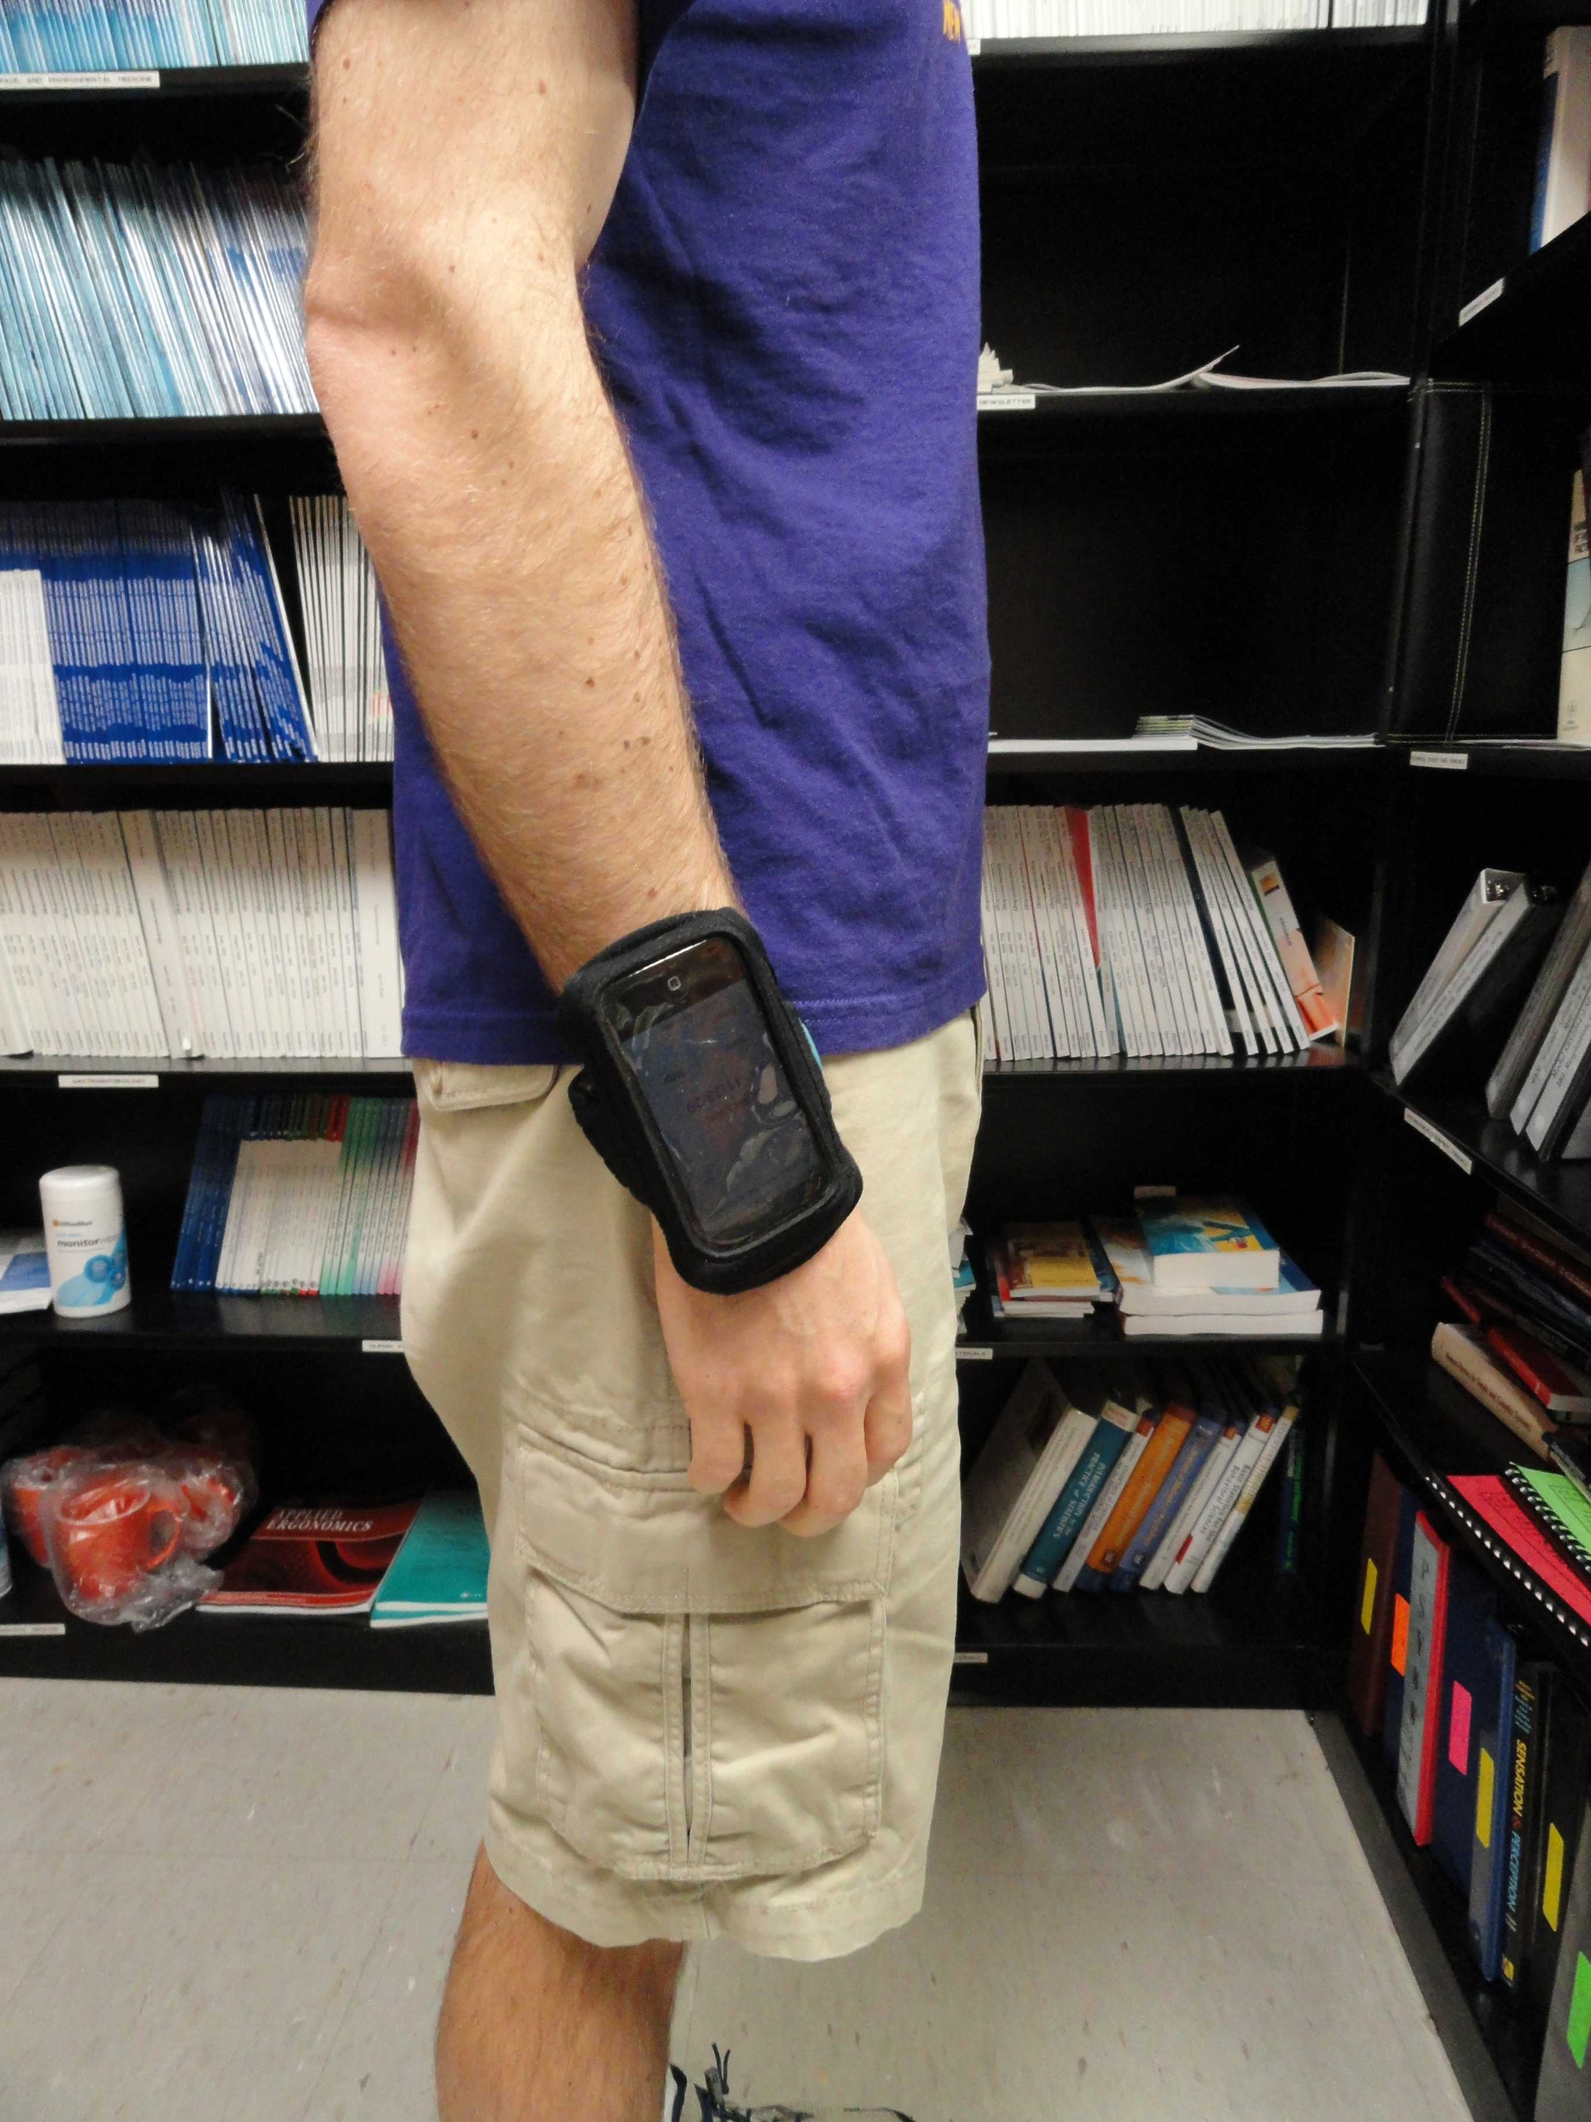
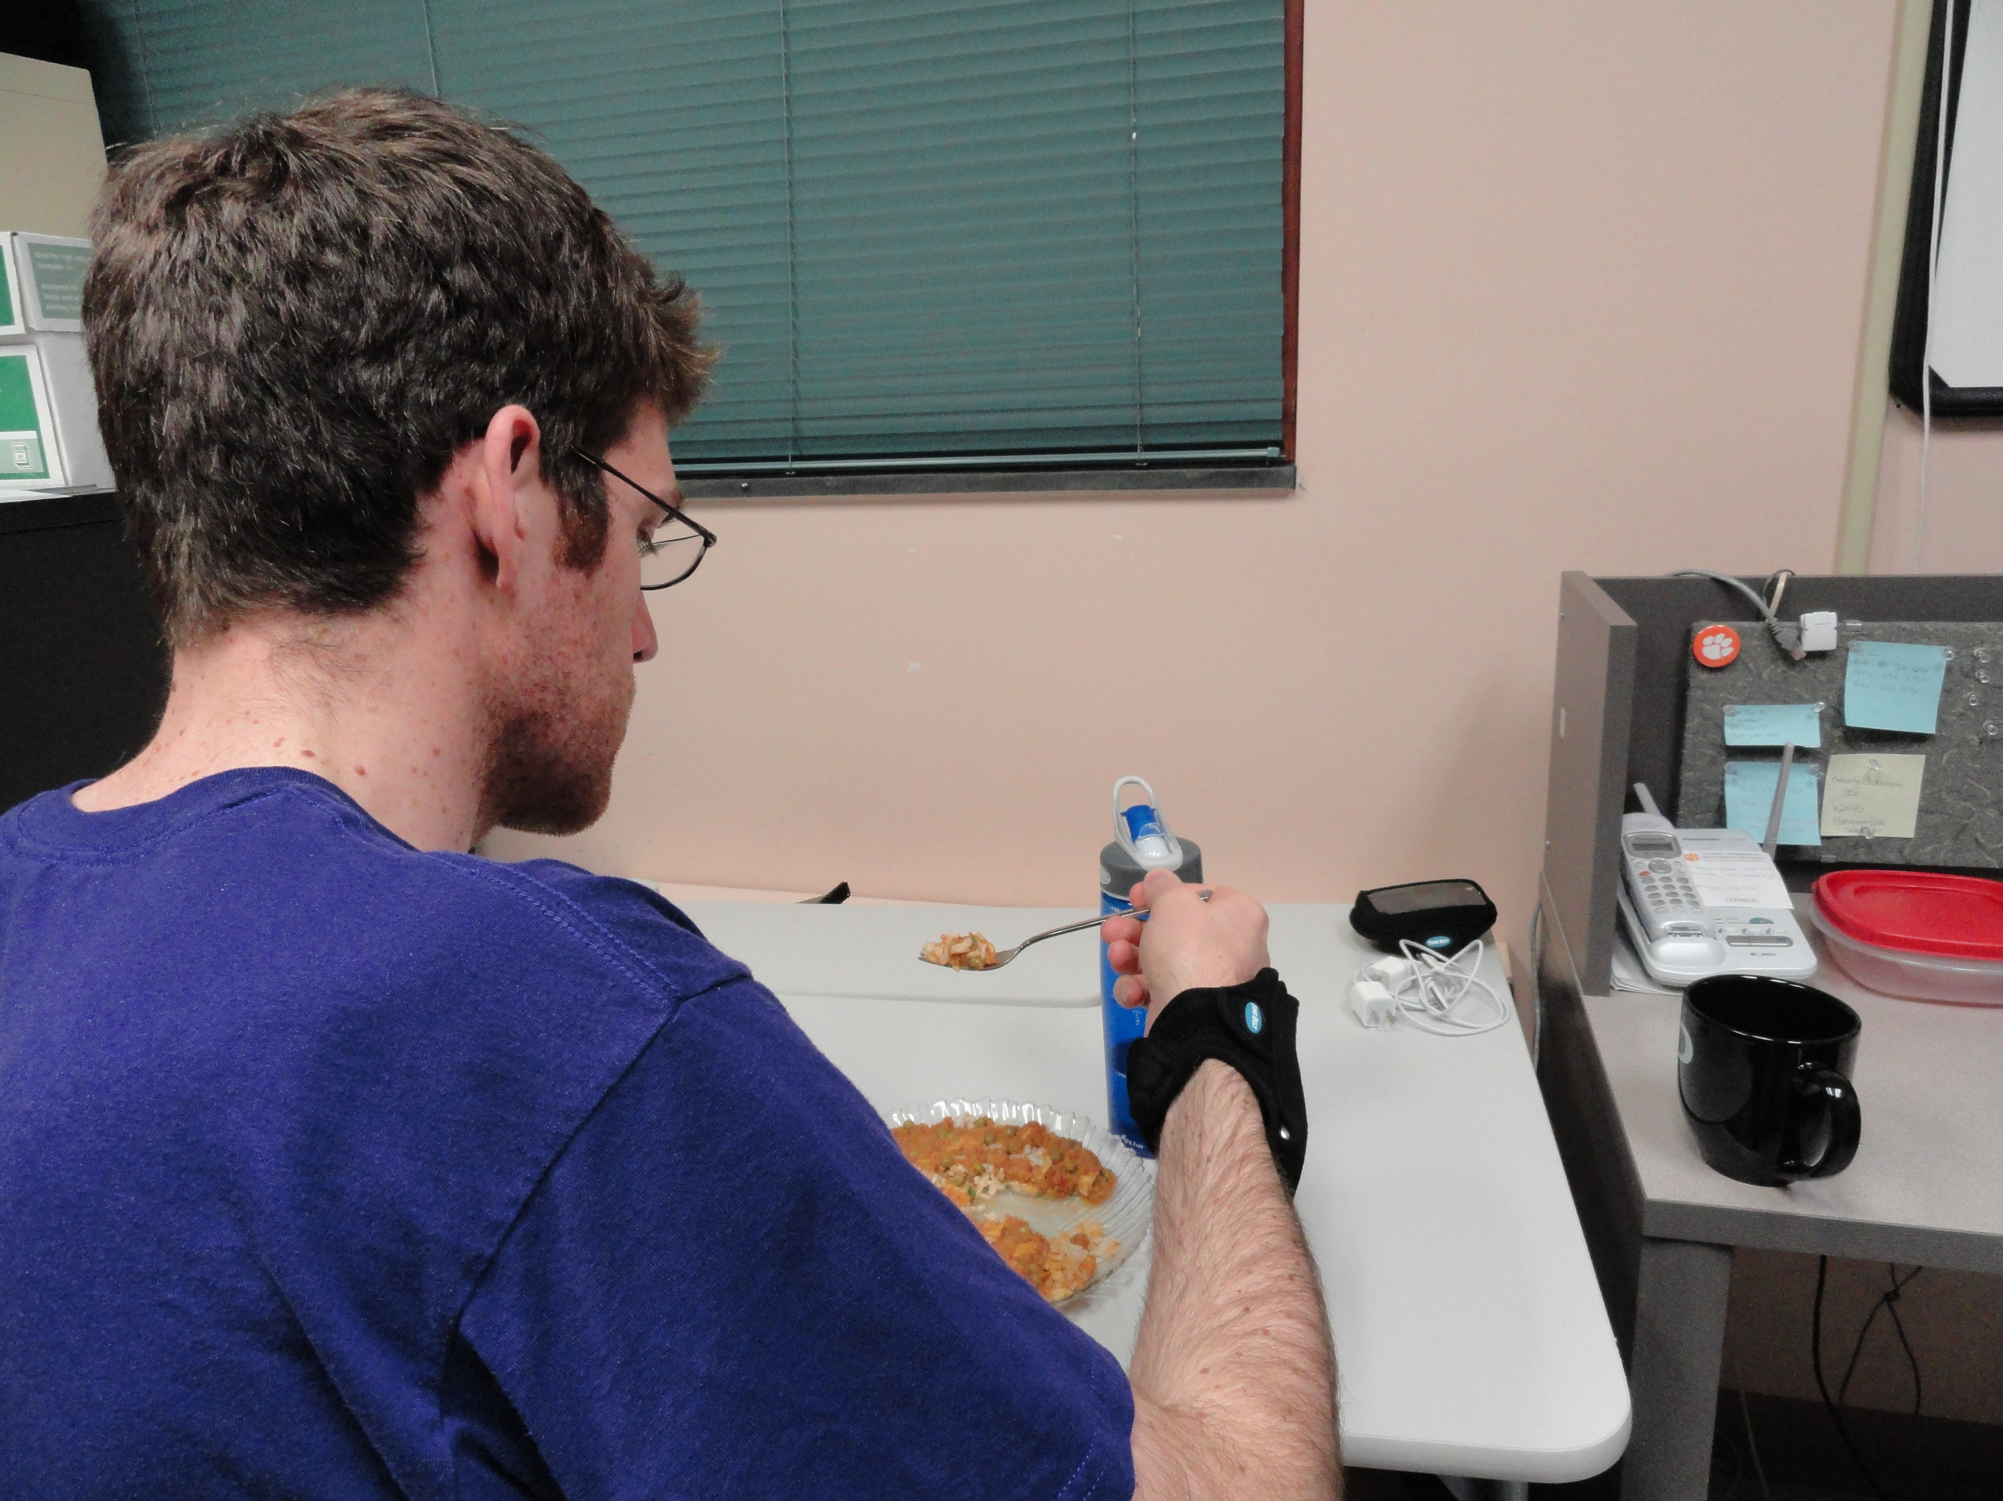
Data collection: hardware
iPhone 4
  3 axis accelerometers
  3 axis gyroscopes
  Large memory (16 GB)
  Large battery (1420 mAh)

Slide 33
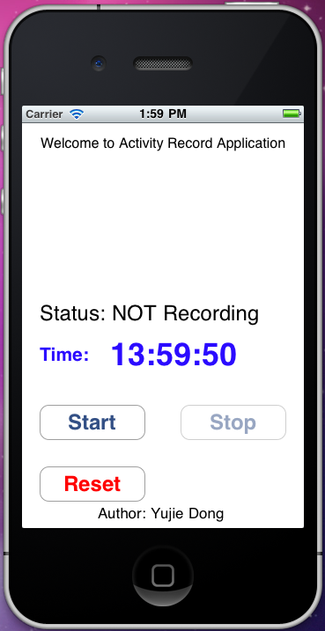
Data collection: recording program
Record 6 axes at 60 Hz
Store data on the device
Transfer to a computer through USB
Current time and status
Start, stop, and reset buttons

Slide 34
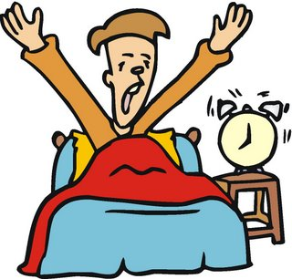




Data collection: protocol
Start recording
Remove device
Conduct activity
Keep food log
Stop recording

Slide 35
Data collection: manual log entry

Slide 36
Data collection: participants
30 participants
Approved by Clemson University Institutional Review Board
Age: 18 ~ 32
Gender
  12 male
  18 female
Ethnicity
  25 Caucasian
  2 Asian or Pacific Islander
  2 African American
  1 Hispanic

Slide 37


Usable data
meals
device on

Slide 38
Usable data
Category | Occurrences
Total manually logged eating activities | 78
Usable eating activities | 35
Subject forgot to manually log start or stop time | 4
Motion data was not recorded during manually logged entry | 8
Activity duration is too short (less than 3 minutes) | 3
Activity duration is too long (more than 30 minutes) | 9
Subject started or stopped recording less than 10 minutes before or after eating | 18
Logged eating activity is inside another logged eating activity | 1
American Time Use Survey: 1.25 hours eating and drinking per day (Bureau of Labor Statistics 2012)

Slide 39
Results

Slide 40
Result
Preprocessing
Detect hypothesized eating
Feature extraction
Final classification
Results

Slide 41
Detected hypothesized eating activities
 | True detection | False detection | Undetected
Accelerometer | 31 | 203 | 4
Gyroscope | 31 | 267 | 4
Accelerometers and gyroscopes detect the same amount of actual eating activities
Gyroscopes have more false detections

Slide 42
Result
Preprocessing
Detect hypothesized eating
Feature extraction
Final classification
Results

Slide 43
FLD of accelerometer features
Accelerometer feature | FLD | TP | FP
mean absolute deviation of x | 0.05 | 21 | 111
mean absolute deviation of y | 0.00 | 26 | 133
mean absolute deviation of z | 0.00 | 24 | 117
regularity of x motion | 0.26 | 28 | 124
regularity of y motion | 0.26 | 28 | 112
regularity of z motion | 0.28 | 27 | 109
accelerometer line fit | 0.01 | 13 | 86

Slide 44
FLD of gyroscope features
Gyroscope feature | FLD | TP | FP
mean absolute deviation of yaw | 0.44 | 22 | 63
mean absolute deviation of pitch | 0.43 | 23 | 61
mean absolute deviation of roll | 0.78 | 22 | 43
regularity of yaw motion | 1.04 | 26 | 53
regularity of pitch motion | 0.80 | 25 | 52
regularity of roll motion | 1.08 | 24 | 55
gyroscope line fit. | 0.00 | 18 | 80
bite count | 0.74 | 25 | 58
mean of bite interval | 0.16 | 23 | 74
variance of bite interval | 0.01 | 24 | 93
skewness of bite interval | 0.32 | 16 | 50

Slide 45
Result
Preprocessing
Detect hypothesized eating
Feature extraction
Final classification
Results

Slide 46
Naïve Bayes classification
Gyroscope feature | Total feature | True detection | False detection | Undetected
reg yaw, reg roll | 2 | 25 | 54 | 6
mad roll, reg roll | 2 | 26 | 46 | 5
reg yaw, reg pitch, reg roll | 3 | 27 | 54 | 4
mad roll, reg roll, bite count | 3 | 27 | 47 | 4
mad roll, reg yaw, reg pitch, reg roll | 4 | 27 | 51 | 4
mad roll, var roll, reg roll, bite count | 4 | 24 | 43 | 7
mad roll, reg yaw, reg pitch, reg roll, bite count | 5 | 27 | 49 | 4
mad roll, var roll, reg roll, line fit, bite count | 5 | 23 | 43 | 8
2 features are enough
wrist roll gives best rate

Slide 47
Conclusion
Three-part pattern
  pre-eating
  during-eating
  post-eating
Detection: accelerometers
Classification: gyroscopes
Pilot test identified 26 of 35 (74%) eating activities with 1.3 false positives per actual eating activity

Slide 48
Other Work

Slide 49
Monitoring eating consumption via wrist motion tracking

Slide 50
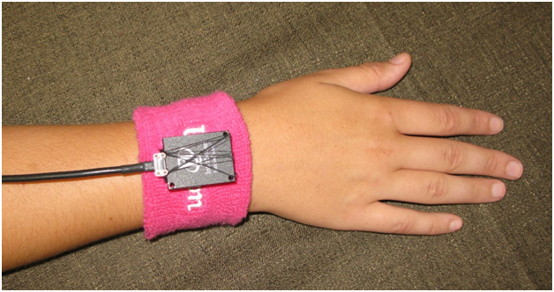
“Bite counter” device
Worn like a watch
Automatically measure bites
Used in natural environment
Feedback in real time

Slide 51
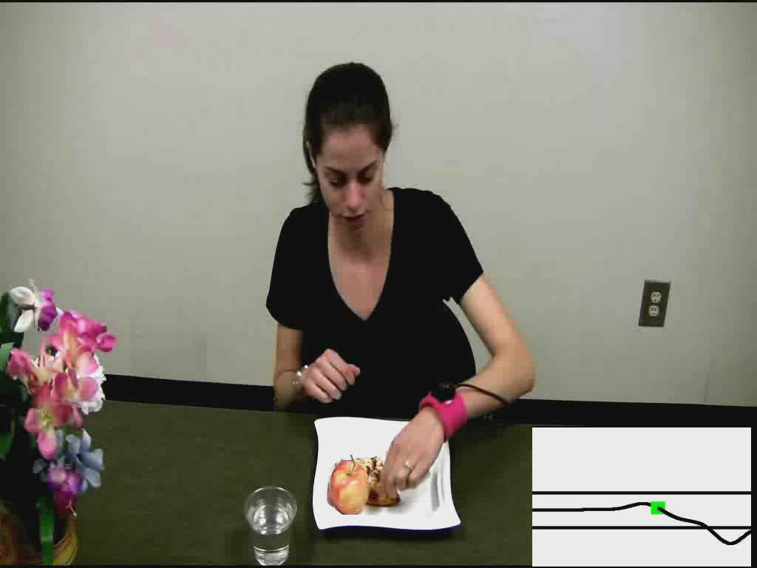
“Bite counter” device

Slide 52
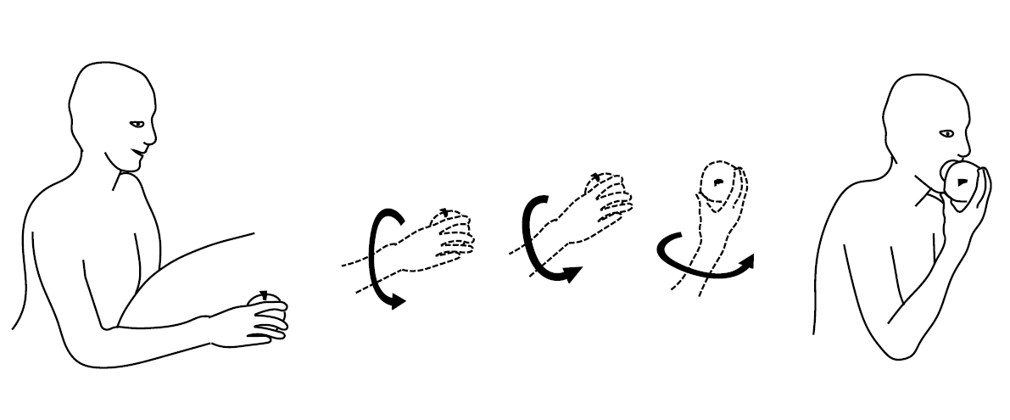
Our invention
High correlation between a simple pattern of wrist roll and the taking of a bite

Slide 53
Result
Exp 1: Test across a large number of subjects
  51 subjects
  139 meals
  Eat Kellogg’s Eggo cinnamon toast waffles
  Use fork
  94% sensitivity
  80% PPV
Exp 2: Test across a large variety of foods
  47 subjects
  49 meals
  Eat their own foods
  Use their own utensils
  86% sensitivity
  81% PPV

Slide 54
Result
Exp 3: Test relationship between bites and calories
  4 subjects
  54 meals
  Eat their own foods
  Use their own utensils
  Correlation: 0.6

Slide 55
Result
Exp 4: Test relationship between bites and calories
  83 subjects
  3246 meals
  76% have correlation > 0.4
  69% between 0.4 and 0.7
Correlation: 0.4
Correlation: 0.7

Slide 56
Slowing bite rate reduces energy intake

Slide 57
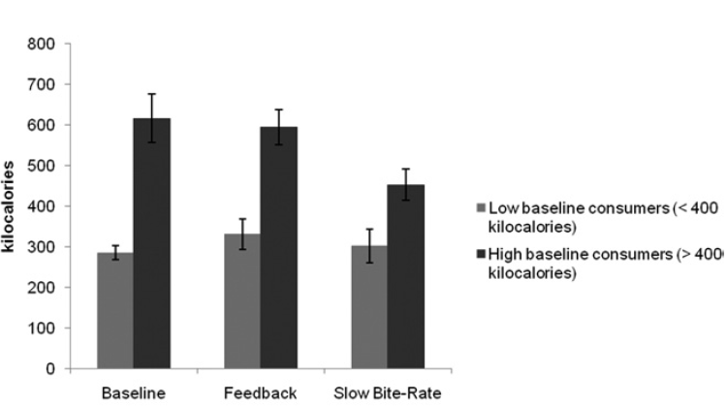
Slowing bite rate reduces intake
30 subjects, each ate three meals
  Baseline
  Bite-rate feedback
  50% Slower bite-rate target
Slower bite-rate condition significantly affect participants who ate more than 400 kcal at baseline, but not the rest.

Slide 58
An instrumented cafeteria table for recording eating activity

Slide 59
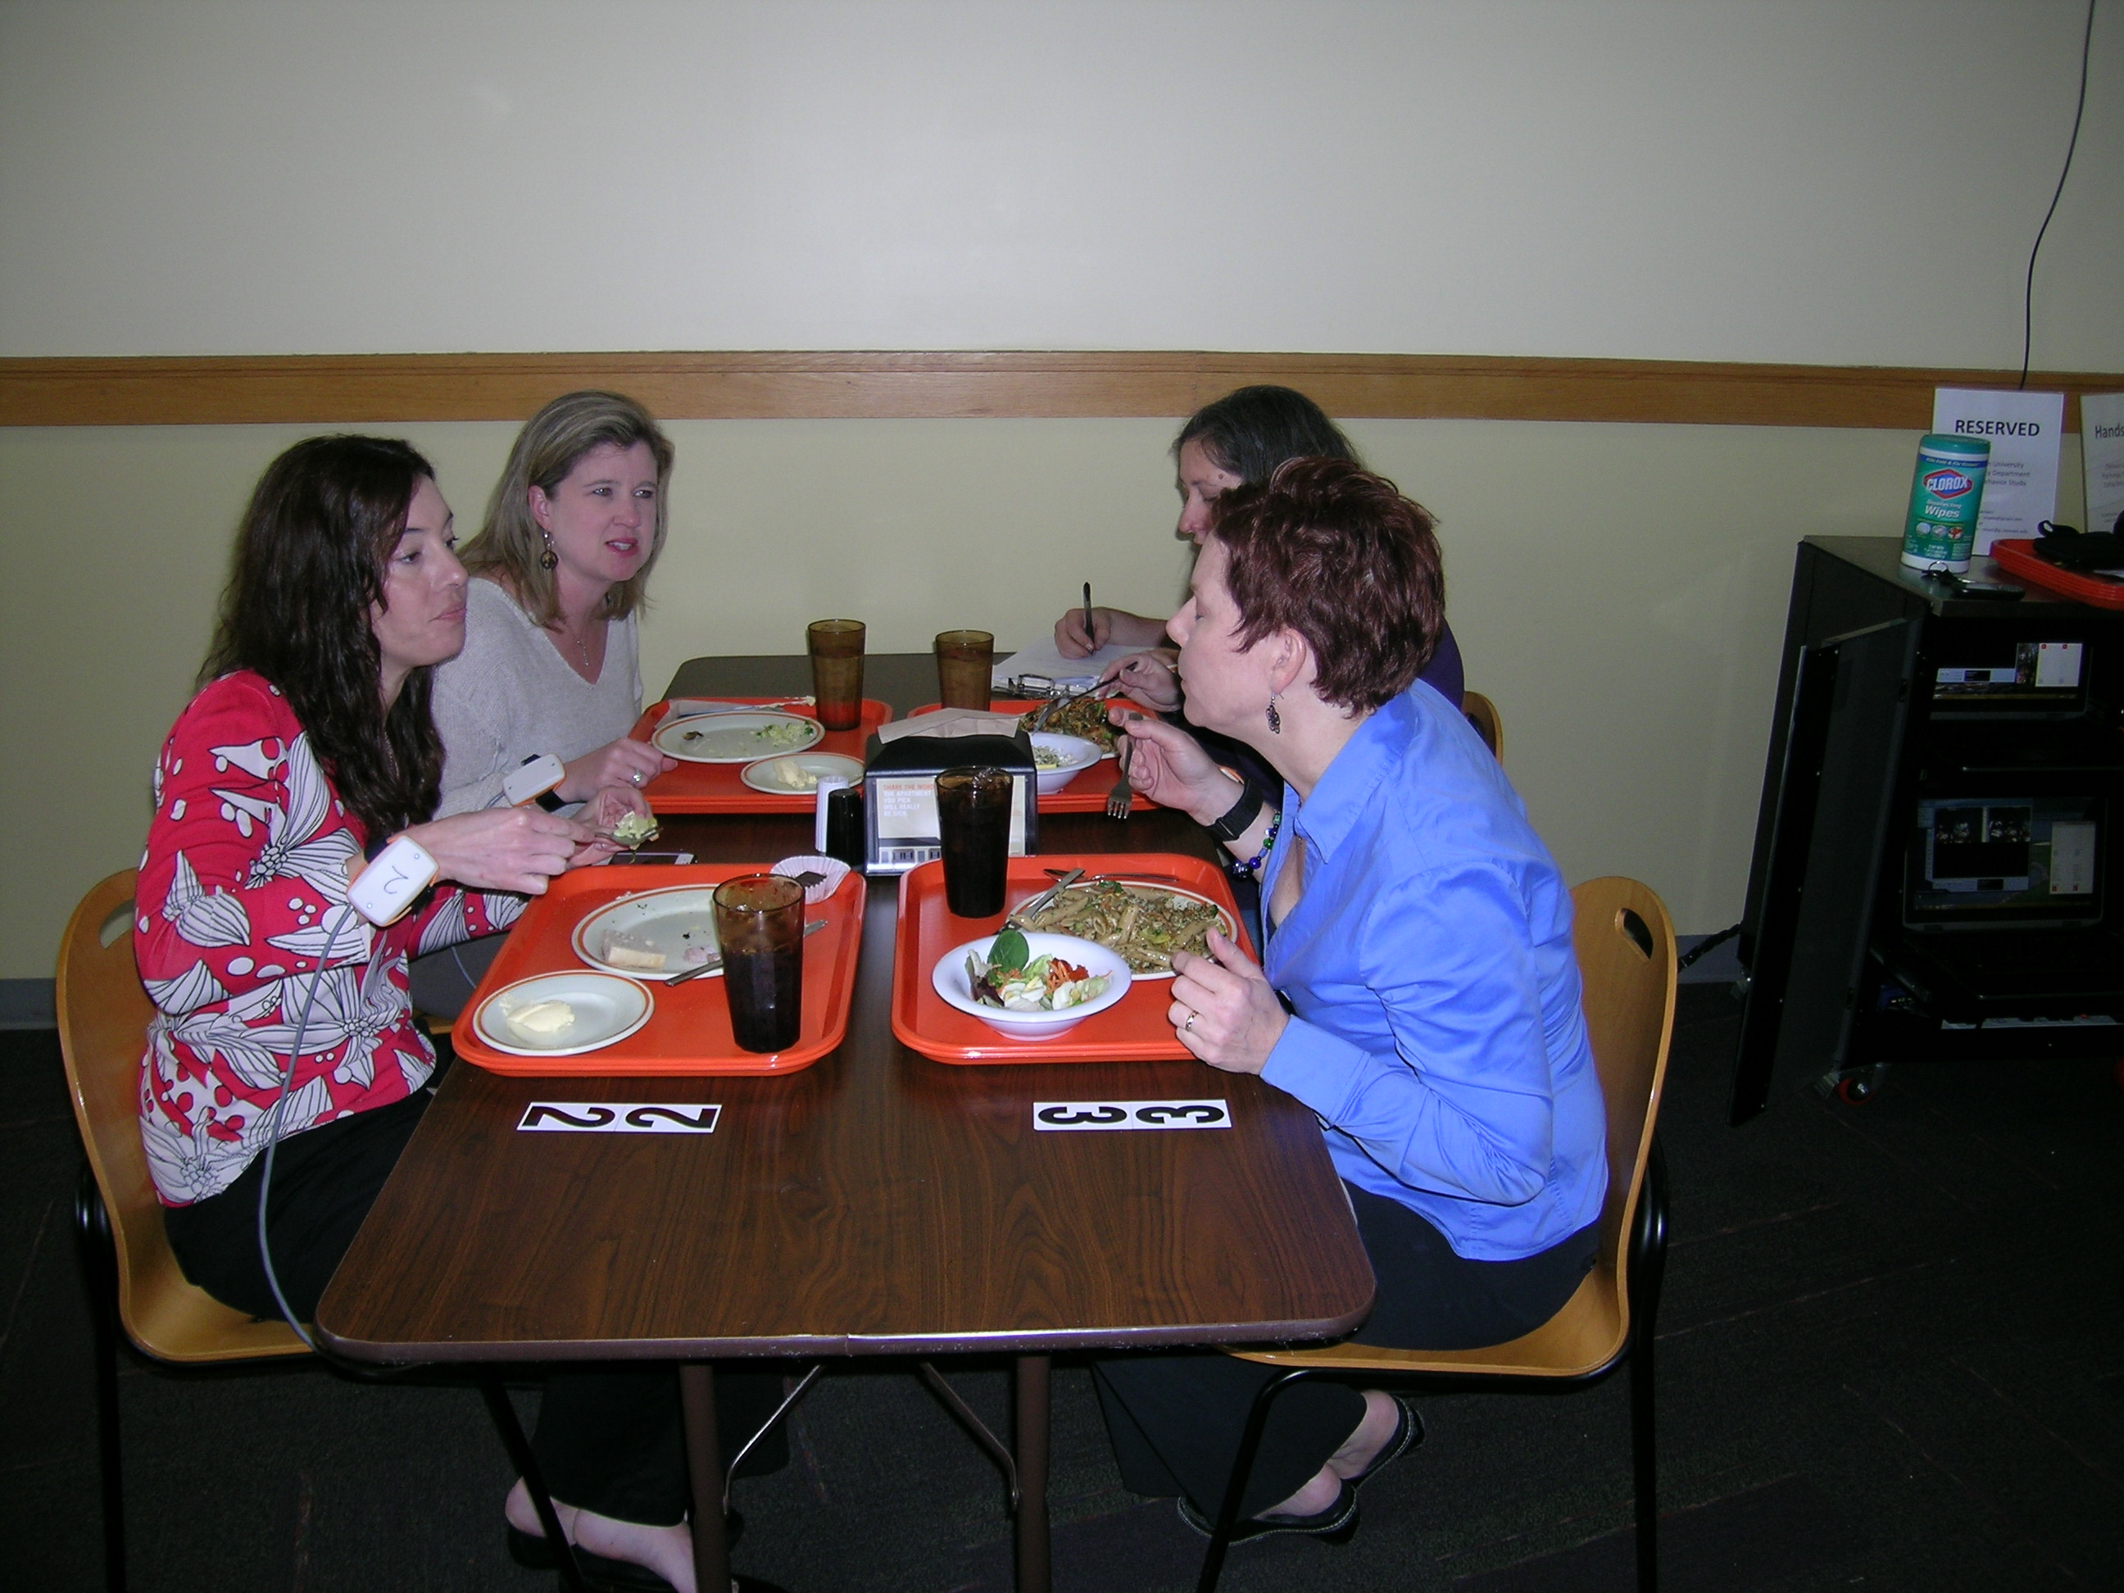
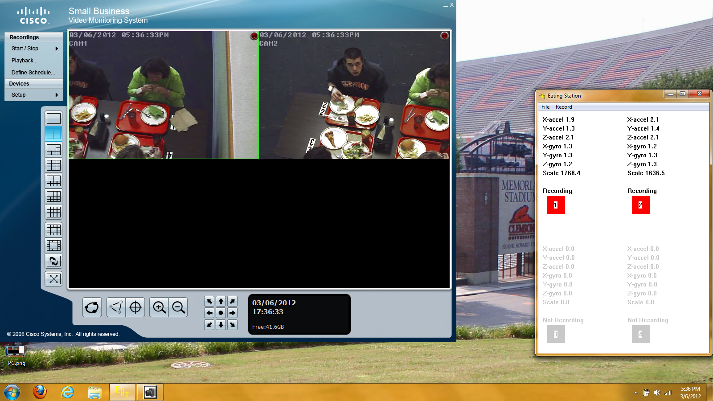
Cafeteria eating research
A dining table equipped with video recorder, scale, and wrist-worn motion sensor
Conduct food intake measurement in a cafeteria setting so calories and actual bites can be measured
Dining table
Recording program

Slide 60
Measuring system latency from sensing to actuation

Slide 61
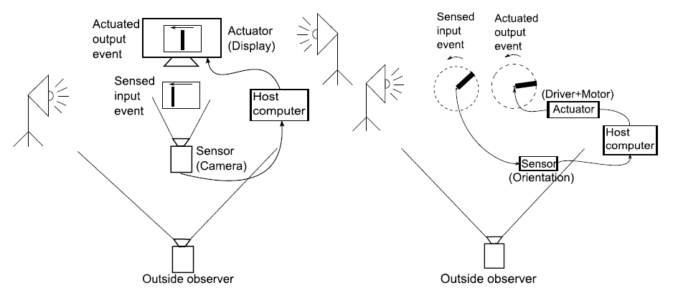
System latency measurement
Two systems
  A camera for sensing, an LCD for actuation
  An orientation sensor for sensing, a motor for actuation
Our finding
  A cyclical variation in latency
  Orientation sensor error looks like a variation in latency

Slide 62
Summary
Main contributions
  Develop an automated method to detect eating activities by tracking wrist motion throughout the day
  Develop an automated method to measure eating intake by tracking wrist motion during a meal
Other contributions
  Find slowing bite rate can reduce energy intake
  Explore the relationship between bites and calories
  Explain the variation in system latency measurement

Slide 63
Publications (Journal)
Y. Dong, A. Hoover, J. Scisco, and E. Muth, “Detecting the eating activities of a free living human using wrist-worn accelerometers and gyroscopes”, in IEEE Transaction on Biomedical Engineering, 2012 (under review).
Y. Dong, A. Hoover, J. Scisco, and E. Muth, “Monitoring eating consumption via wrist motion tracking”, in Applied Psychophysiology and Biofeedback, 2011 (accepted).
W. Wu, Y. Dong, and A. Hoover, “Measuring digital system latency from sensing to actuation at continuous 1 ms resolution”, in Presence: Teleoperators and Virtual Environments, 2011 (under revision).
J. Scisco, E. Muth, Y. Dong, A. Hoover, “Slowing bite-rate reduces caloric consumption; an application of the bite counter device”, in Journal of the American Dietetic Association, vol. 111, 2011, pp. 1231-1235.

Slide 64
Publications (Conference)
Y. Dong, A. Hoover, J. Scisco, and E. Muth, “Detecting eating using a wrist mounted device during normal daily activities”, Proceedings of the 9th International Conference on Embedded Systems and Applications, 2011.
J. Scisco, E. Muth, Y. Dong, A. Hoover, P. O'Neil, and S. Fishel-Brown, “Usability and acceptability of the bite counter device”, Proceedings of the Human Factors and Ergonomics Society Annual Meeting, 2011.
W. Wu, Y. Dong, and A. Hoover, “Measuring digital system latency from sensing to actuation at continuous 1 ms resolution” [abstract], The 3rd International Symposium on Visual Image Safety, 2011.
J. Scisco, E. Muth, A. Hoover, Y. Dong, L. Hill, M. Wiles, and S. Harris, “An environmental cue to eat slowly reduces food consumption” [abstract], Proceedings of the 55th annual meeting of the Human Factors and Ergonomics Society, 2010.
Y. Dong, A. Hoover and E. Muth “A device for detecting and counting bites of food taken by a person during eating”, Proceedings of IEEE Conference on Bioinformatics and Biomedicine, 2009, pp. 265-268.

Slide 65
Publications (Patent)
A. Hoover, E. Muth, Y. Dong and J. Scisco, “Eating Activity Detection Device”, disclosed to Clemson University for patent application in March, 2012
A. Hoover, E. Muth and Y. Dong, “Weight control device”, US Provisional Patent Application serial no. 61/144.203, filed January 13, 2009

Slide 66
