Slide 1
An Assessment of the Accuracy of an Automated Bite Counting Method in a Cafeteria Setting
MS Thesis Defense
Committee Members:
Dr. Adam Hoover (advisor)
Dr. John Gowdy
Dr. Eric Muth
Ziqing Huang
07/24/2013

Slide 2
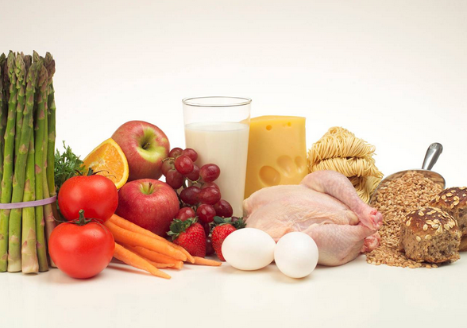
Outline
Introduction
Methods
Results
Conclusions

Slide 3
Background and motivation
Mobile health
Advances in body-worn sensors and mobile health technology (Kumar et al. , 2013)
New opportunities for managing people’s health (Kumar et al. , 2013)
Obesity Problems
Afflicts one in three adults and one in six children in the United States (Flegal et al., 2012 & Ogden et al., 2012)
Correlated to several major diseases (Wellman et al., 2002)

Slide 4
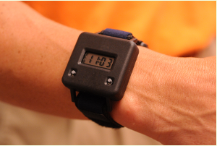
Previous work by our group
Bite Counting method(Dong et al., 2012)
Worn like a watch and uses
sensors to track wrist motion
Counts and time-stamps bites
Preliminary studies (Dong et al., 2012)
Controlled environment settings
TPR 94%, PPV 80%
Less controlled environment settings
TPR 86%, PPV 81%
http://www.icountbites.com

Slide 5
Work in this thesis
Extend the previous experiments to an even larger data set
276 subjects, 518 courses in Harcombe Dinning Hall
Build a bite-level database for this study
A total of 22,383 bites
Assessment of the bite counting method for different foods, utensils, containers and subject demographics

Slide 6
Outline
Introduction
Methods
Results
Conclusions

Slide 7
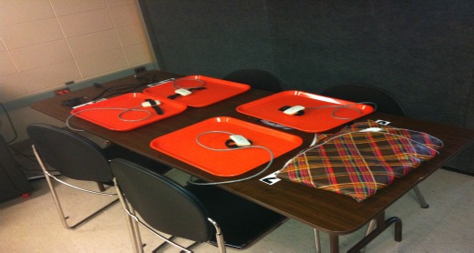
Data Collection: instrumented table
motion tracker, laptops, digital scales, cameras

Slide 8
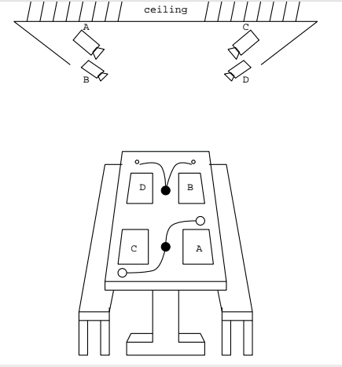
Data Collection: illustration
(Figure4.1, Y. Dong PhD dissertation, 2012)

Slide 9
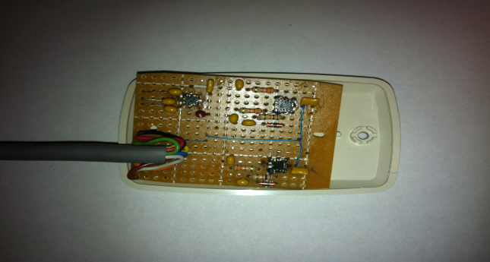
Data Collection: the wrist motion tracker
Two gyros and one accelerometer

Slide 10
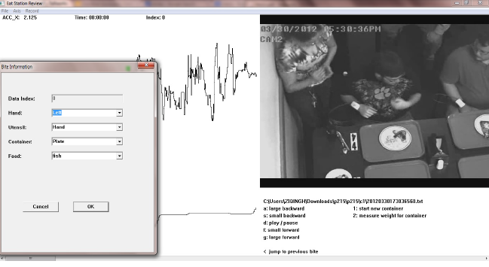
Data Collection: ground truth
(Page83-84, Y. Dong PhD dissertation, 2012)
Correlates video with wrist motion data, allows manually marking of bites

Slide 11
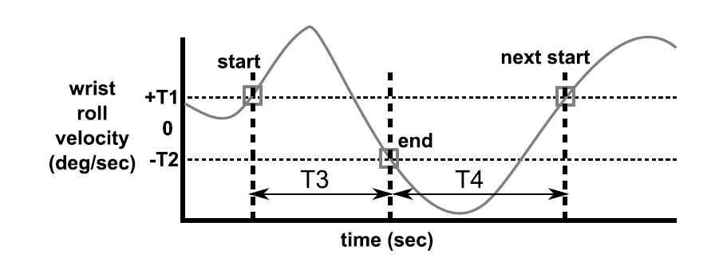
Bite detection algorithm
(Figure 2.2, Y. Dong PhD dissertation, 2012)
T1,T2: velocity thresholds, T3,T4: time thresholds

Slide 12
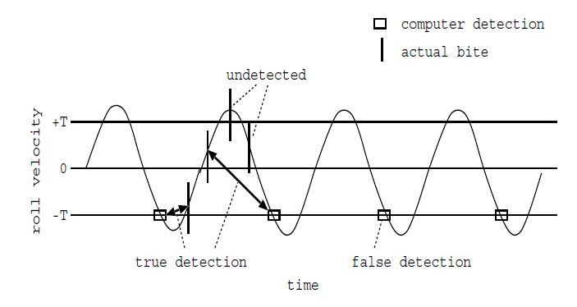
Classifications
(Fig6., Dong et al., 2012)

Slide 13
TPR and PPV

Slide 14
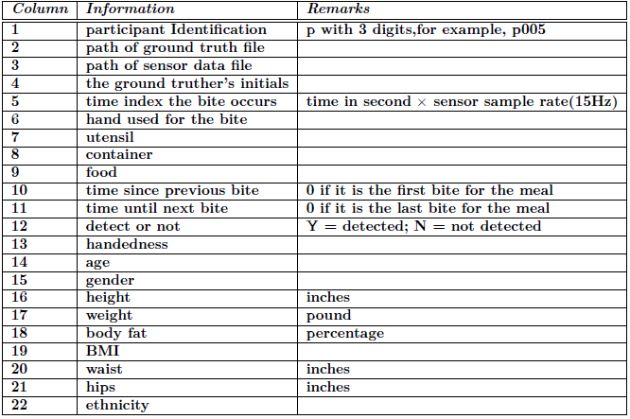
Database file
The information for each bite

Slide 15
Database file: Example of one entry
p005 c1/gt_DB.txt 20120201113500388.txt DB 525 right fork plate vegetable_stir_fry_with_black_bean_sauce 0 139 Y right 21 female 67.0 175.8 32.6 27.5 34.0 43.0 caucasian

Slide 16
Variables to be evaluated
Food
Age
Hand Patterns(hand used, handedness)
Gender
Container
Utensil
Ethnicity

Slide 17
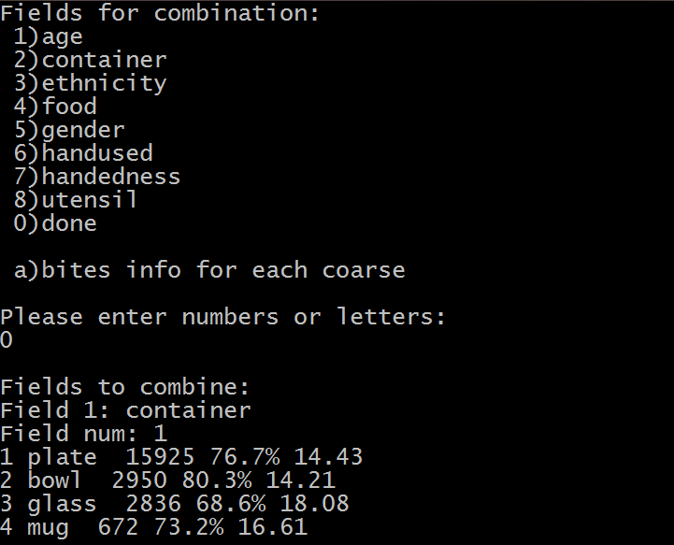
The query tool
Custom program

Slide 18
Outline
Introduction
Methods
Results
Conclusions

Slide 19
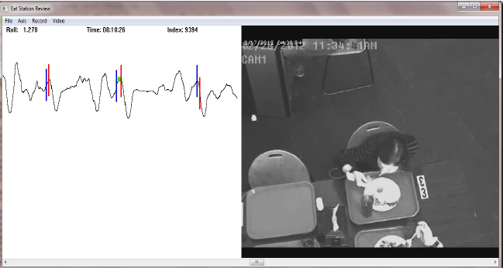
Example: true detection
Blue bar: computer detected bites Red bar: ground truth bites

Slide 20
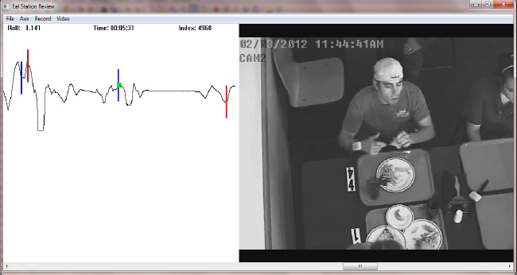
Example: false detection
Wiping the hand

Slide 21
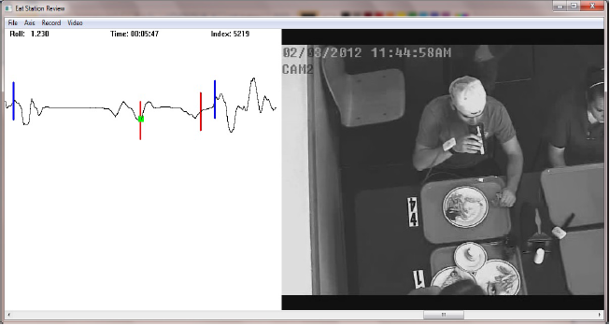
Example: undetected bites
Drinking

Slide 22
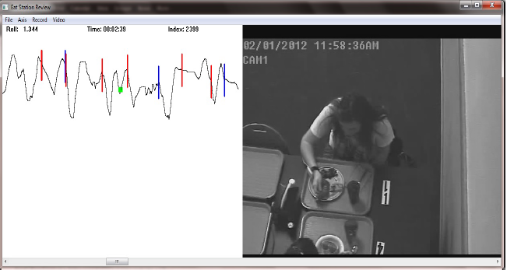
Example: fast eating rate

Slide 23
Overall accuracy
Sensitivity: 76%
Positive predictive value: 87%
with default time thresholds: T3 = 2s, T4 = 8s

Slide 24
Results: detection rate by food
Detection rate for foods

Slide 25
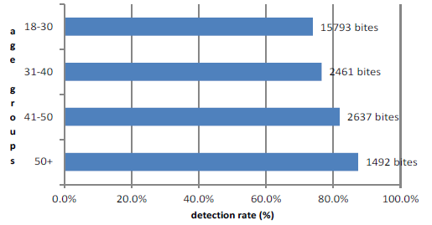
Results: detection rate by age

Slide 26
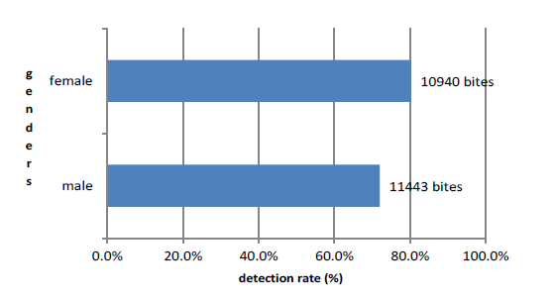
Results: detection rate by gender

Slide 27
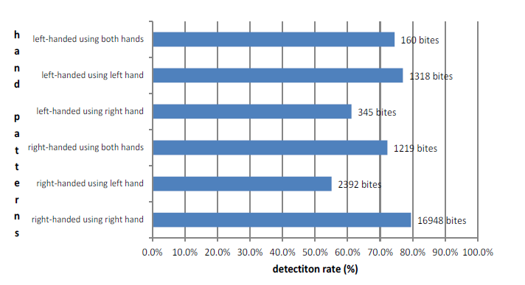
Results: detection rate by hand patterns

Slide 28
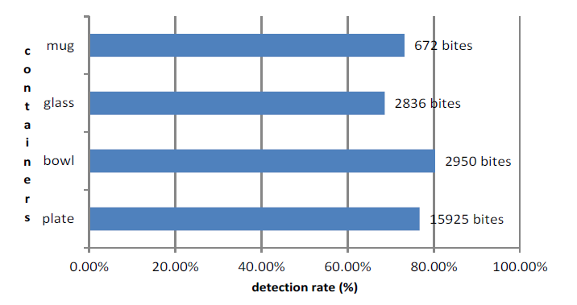
Results: detection rate by container

Slide 29
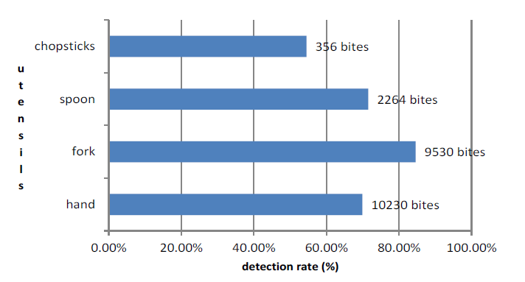
Results: detection rate by utensil

Slide 30
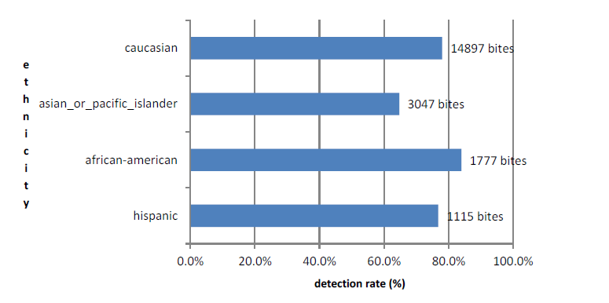
Results: detection rate by ethnicity

Slide 31
Results: bite duration by food
Bite duration for foods

Slide 32
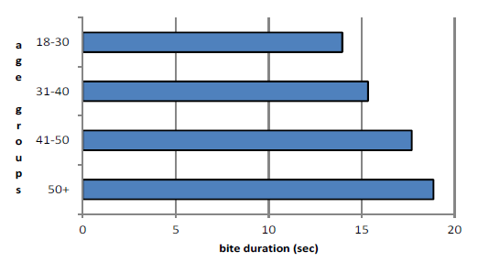
Results: bite duration by age

Slide 33
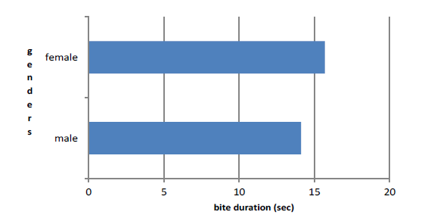
Results: bite duration by gender

Slide 34
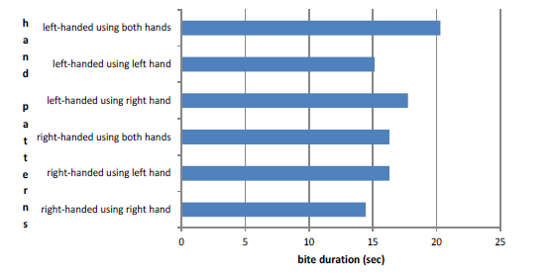
Results: eating duration by hand patterns

Slide 35
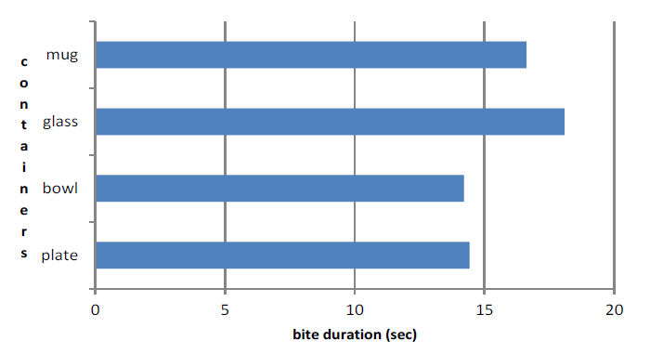
Results: bite duration by container

Slide 36
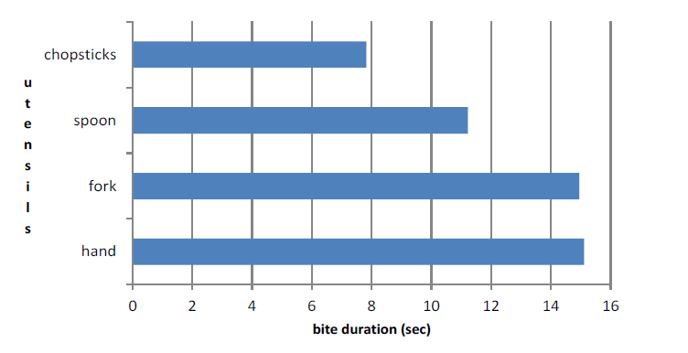
Results: bite duration by utensil

Slide 37
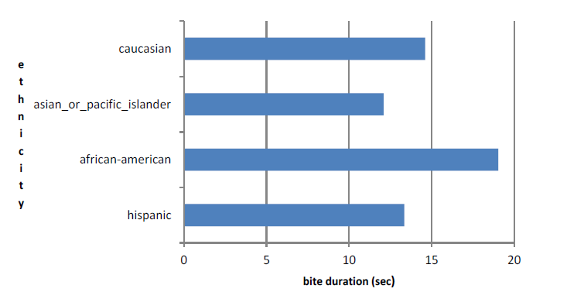
Results: bite duration by ethnicity

Slide 38
Accuracy for adjusted time thresholds
TPR: 82% ,PPV: 82%
with adjusted time thresholds: T3 = 2s, T4 = 6s
Increases the sensitivity but also increase the number of false positives

Slide 39
Outline
Introduction
Methods
Results
Conclusions

Slide 40
Conclusions
Overall TPR 76%, PPV 87%
Detection rate
Food: from 39% to 88%
Utensil: from 55% to 85%
Ethnicity: from 65% to 84%
Eating rate may be important
Shorten timing threshold T4
TPR 82%, PPV 82%

Slide 41
Acknowledgements
NIH via grant 1R41DK091141-A1
Data collection
ECE: Dr. Adam Hoover, Yujie Dong, Sanjay Patil, Kuang Yuan, Ziqing Huang, Ryan Mattfeld, John Hicks
Psychology: Dr. Eric Muth, Milk Wilson, James Salley, a group of undergraduate students

Slide 42
References
Y. Dong. Tracking Wrist Motion to Detect and Measure the Eating Intake of Free-Living Humans. PhD dissertation, Clemson University, 2012.
Y. Dong, A. Hoover, J. Scisco, and E. Muth. A new method for measuring meal intake in humans via automated wrist motion tracking. Applied Psy-chophysiology and Biofeedback, 37(3):205-215, 2012.
K. Flegal, M. Carroll, B. Kit, and C. Ogden. Prevalence of obesity and trends in the distribution of body mass index among us adults, 1999-2010. The Journal of the American Medical Association, 307(5):491–497, 2012.
C. Ogden, M. Carroll, B. Kit, and K. Flegal. Prevalence of obesity and trends in body mass index among us children and adolescents, 1999-2010. The Journal of the American Medical Association, 307(5):483–490, 2012.
N. Wellman and B. Friedberg. Causes and consequences of adult obesity: health, social and economic impacts in the united states. Asia Pacific Journal of Clinical Nutrition, 11:S705–709, 2002.
S. Kumar, W. Nilsen, M. Pavel, and M. Srivastava. Mobile health: Revolutionizing healthcare through transdisciplinary research. IEEE Computer, 46(1):28–35, 2013.

