Slide 1

TRAINING A CAMERA BASED INSPECTION SYSTEM FOR APPEARANCE VARIABILITY
MS THESIS DEFENSE
VIHANG KHARE
14th July 2020
Committee Members:
Dr. Adam Hoover
Dr. Richard Brooks
Dr. Richard Groff

Slide 2
OUTLINE
Problem of learning part appearance variability
Background
Novelty
Methods
  Overview
  Data collected
  Training for appearance variability
Results
Conclusion

Slide 3
OUTLINE
Problem of learning part appearance variability
Background
Novelty
Methods
  Overview
  Data collected
  Training for appearance variability
Results
Conclusion

Slide 4
Camera based fill level inspections
Problem of appearance variability
Compare

Slide 5

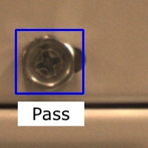
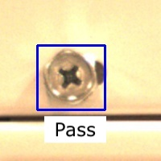
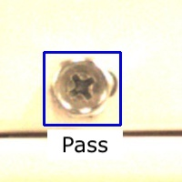

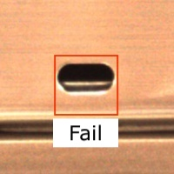

Camera based part inspections
Problem of appearance variability
Inspection templates
(ideal appearance of the part)
Inspection search windows
(portion of the machine frame where the part is expected to be present)
Compare

Slide 6
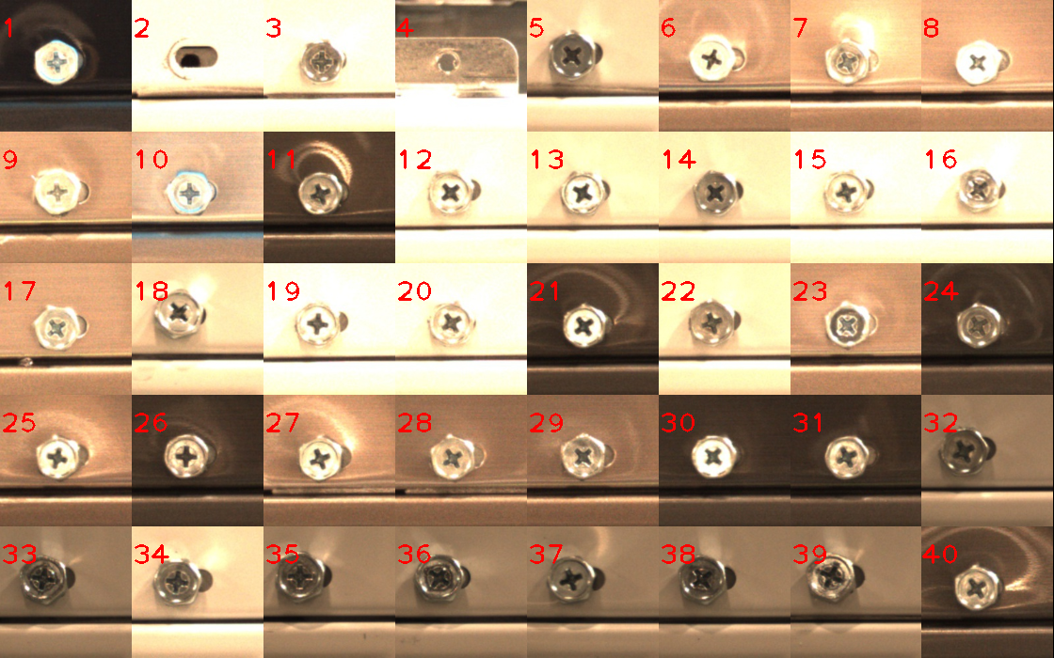
Why is this a problem?
Problem of appearance variability
40 different appearances in 3987 images of the screws

Slide 7
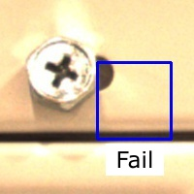
Problem of appearance variability
Why is this a problem?
Inspection templates
Inspection search windows
Compare
False alarm!

Slide 8
OUTLINE
Problem of learning part appearance variability
Background
Novelty
Methods
  Overview
  Data collected
  Training for appearance variability
Results
Conclusion

Slide 9
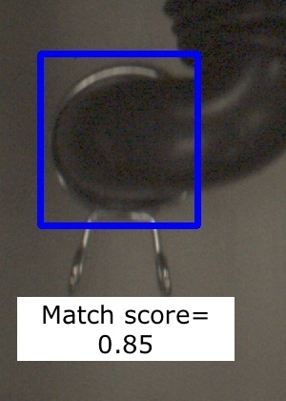
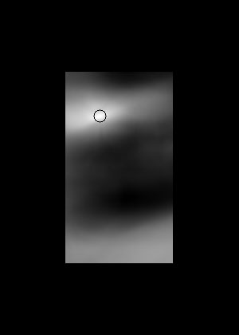
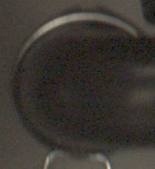
How do we compare? – Template matching
Background
Inspection search window
Template match image
Inspection template
Compare
Notes:
explain inspection window

Slide 10
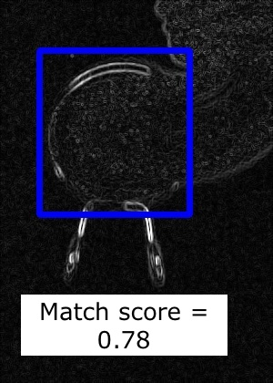
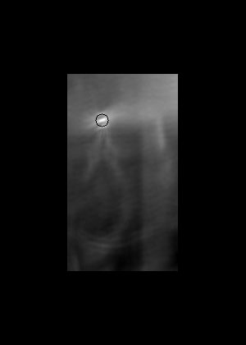
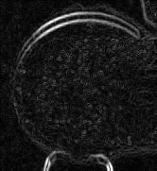
Template matching using gradient images
Background
Inspection search window
Template match image
Inspection template
Compare
Notes:
Represents directional change in intensity of colors.

Slide 11
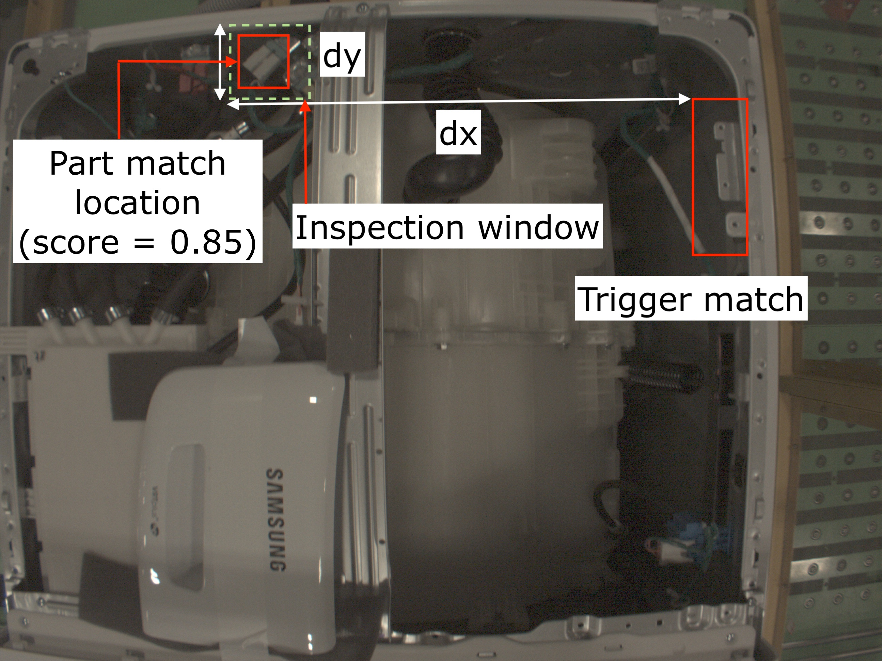
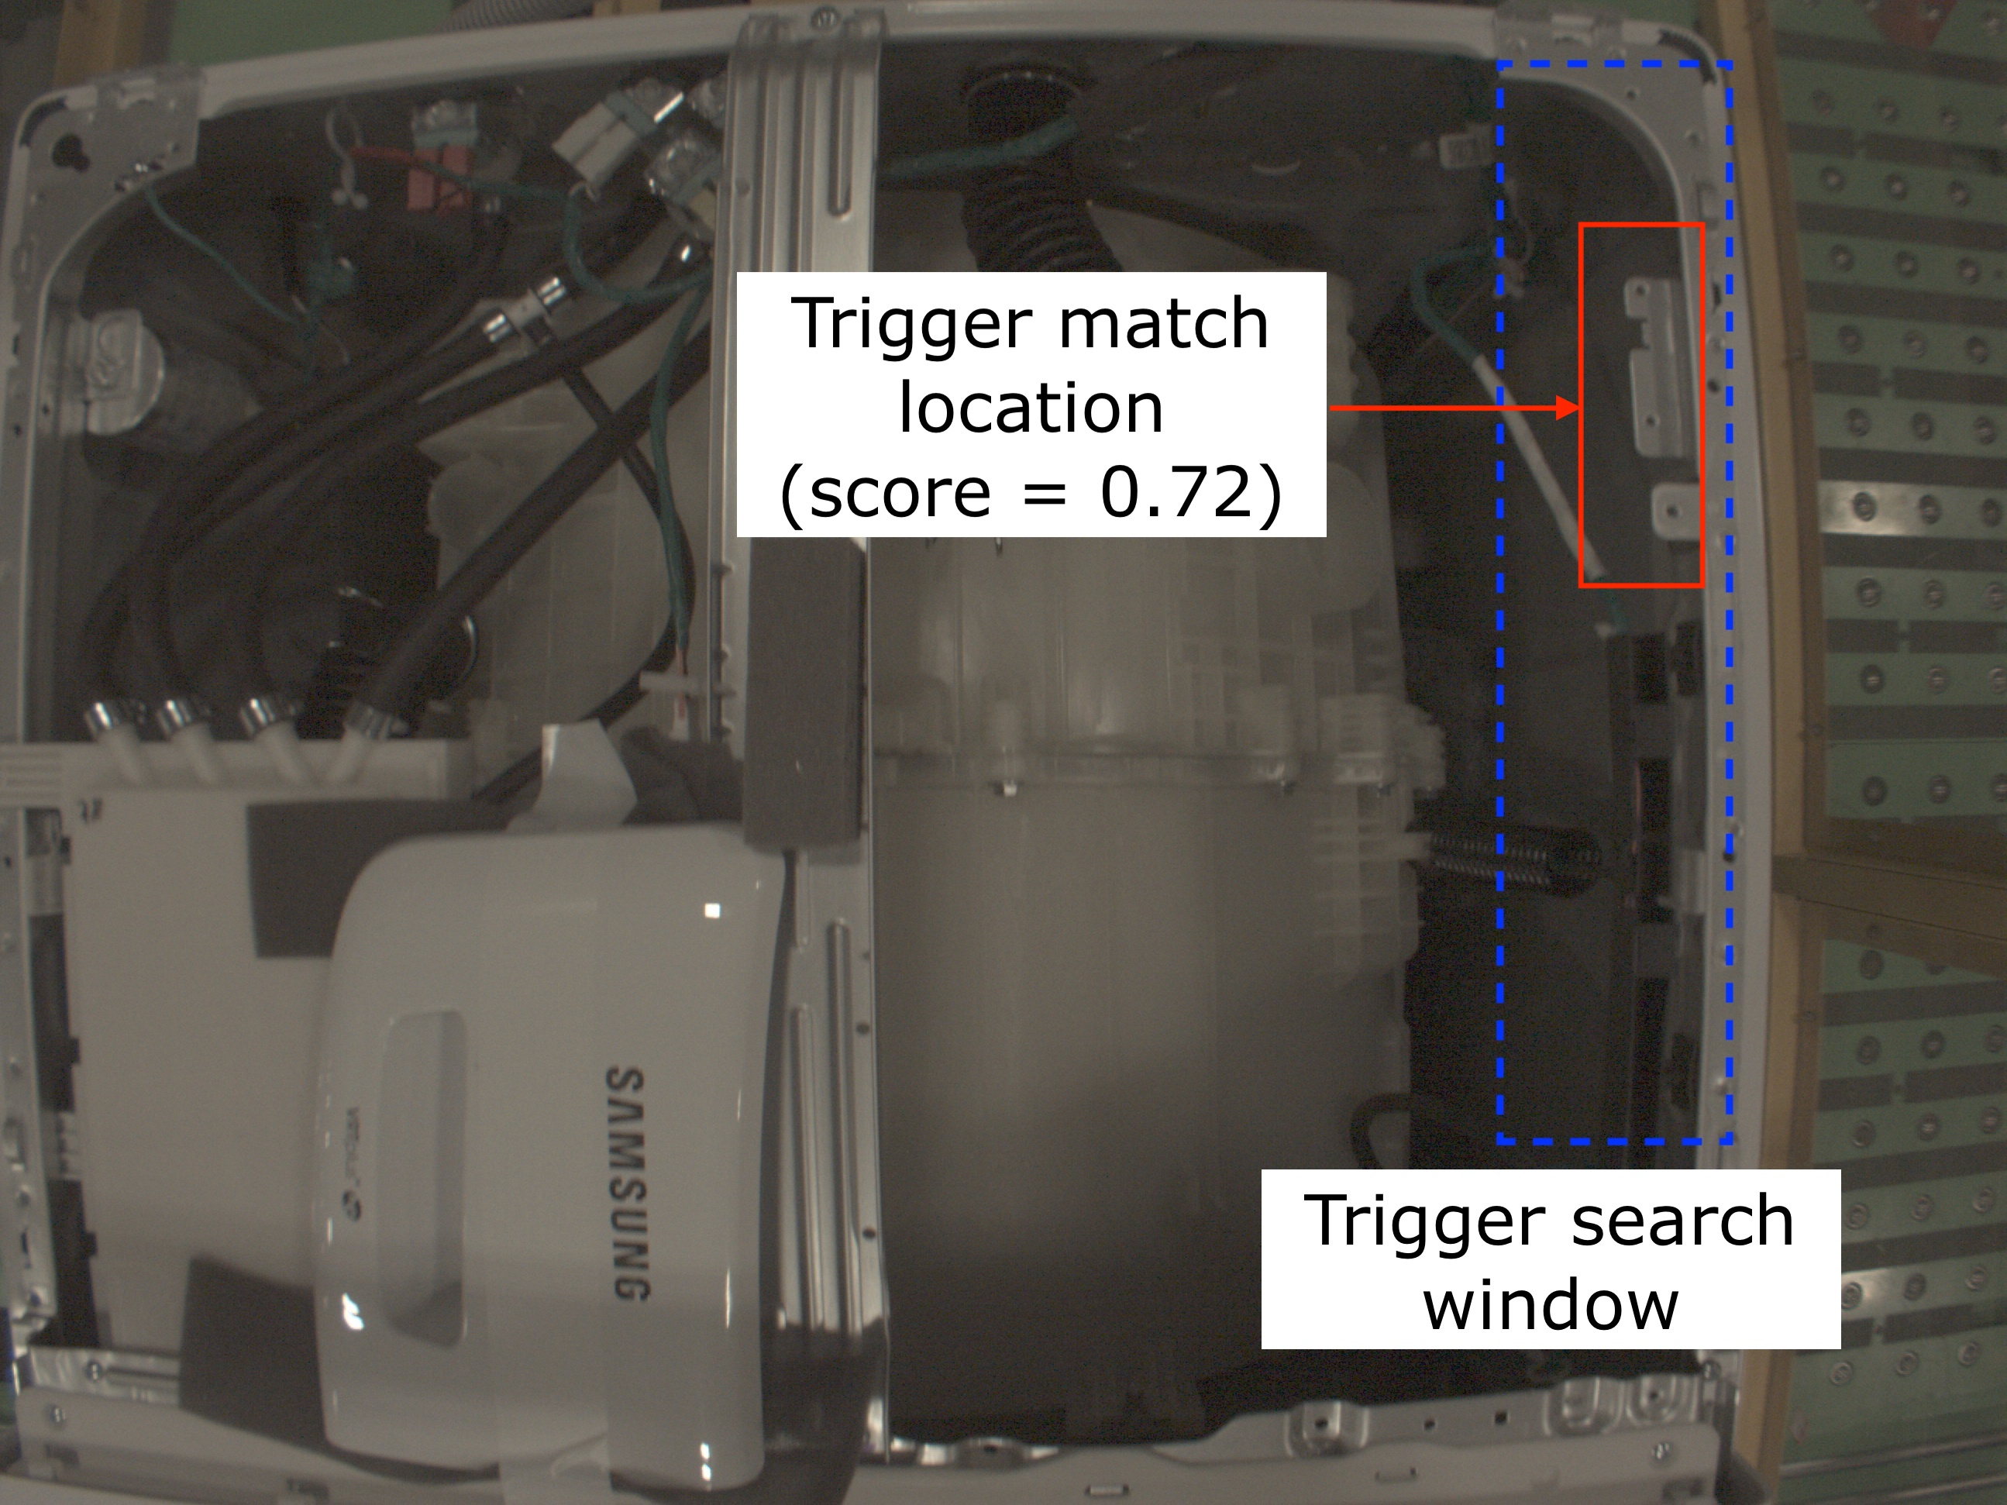
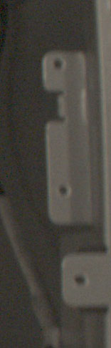
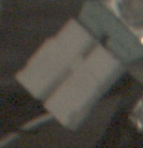
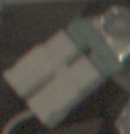
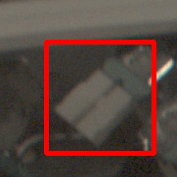
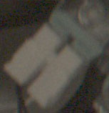
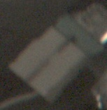
Inspection system prototype
Background
Data collection (at SEHA)
Cropping and Inspection (at Clemson)
Trigger template
Inspection templates
Inspection search window
compare
Match score =0.85

Slide 12
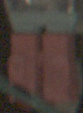
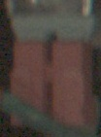
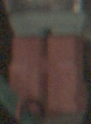
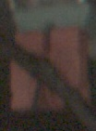
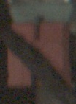
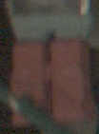
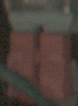
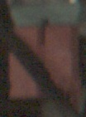
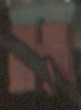
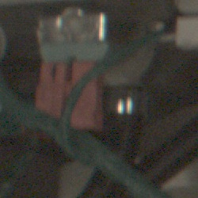
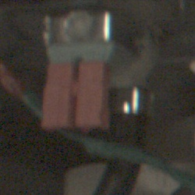
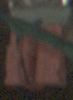
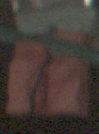
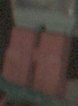
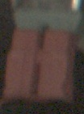
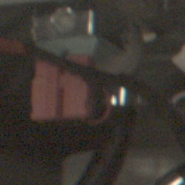
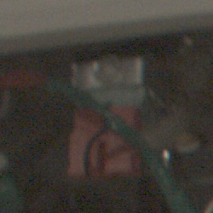
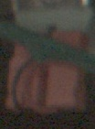
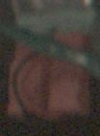
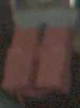
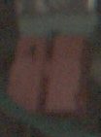
Clustering to automatically find appearance variability
Background
Input
Output
Inspection template
seed
seed
Inspection search windows
seed
seed

Slide 13
OUTLINE
Problem of learning part appearance variability
Background
Novelty
Methods
  Overview
  Data collection
  Ground truth
  Pre-processing
  Training for appearance variability
Results
Conclusion

Slide 14
Novelty
Image database
(Inspection window crops)
Clustering to find appearance variability
Training - how to use clustering output to train the system
Inspection system
Collected more data for a total of 9 inspection problems, 249,371 images
Improved in order to handle arbitrarily large datasets
Pre-processing options:
Edge/RGB matching
Inspection search window size
Inspection template size
Image pre-processing
Other parameters:
Which templates to use for inspection?
Number of templates to use
2 class (OK, NOK) vs 1 class (OK only)
How long to run clustering?
Decision tree for training future inspection problems

Slide 15
OUTLINE
Problem of learning part appearance variability
Background
Methods
  Overview
  Data collection
  Ground truth
  Pre-processing
  Training for appearance variability
Results
Conclusion

Slide 16
Methods used for our experiments
Pre-processing
Data Collection
Clustering
Training and evaluation
Ground truth

Slide 17
OUTLINE
Problem of learning part appearance variability
Background
Methods
  Overview
  Data collection
  Ground truth
  Pre-processing
  Training for appearance variability
Results
Conclusion

Slide 18
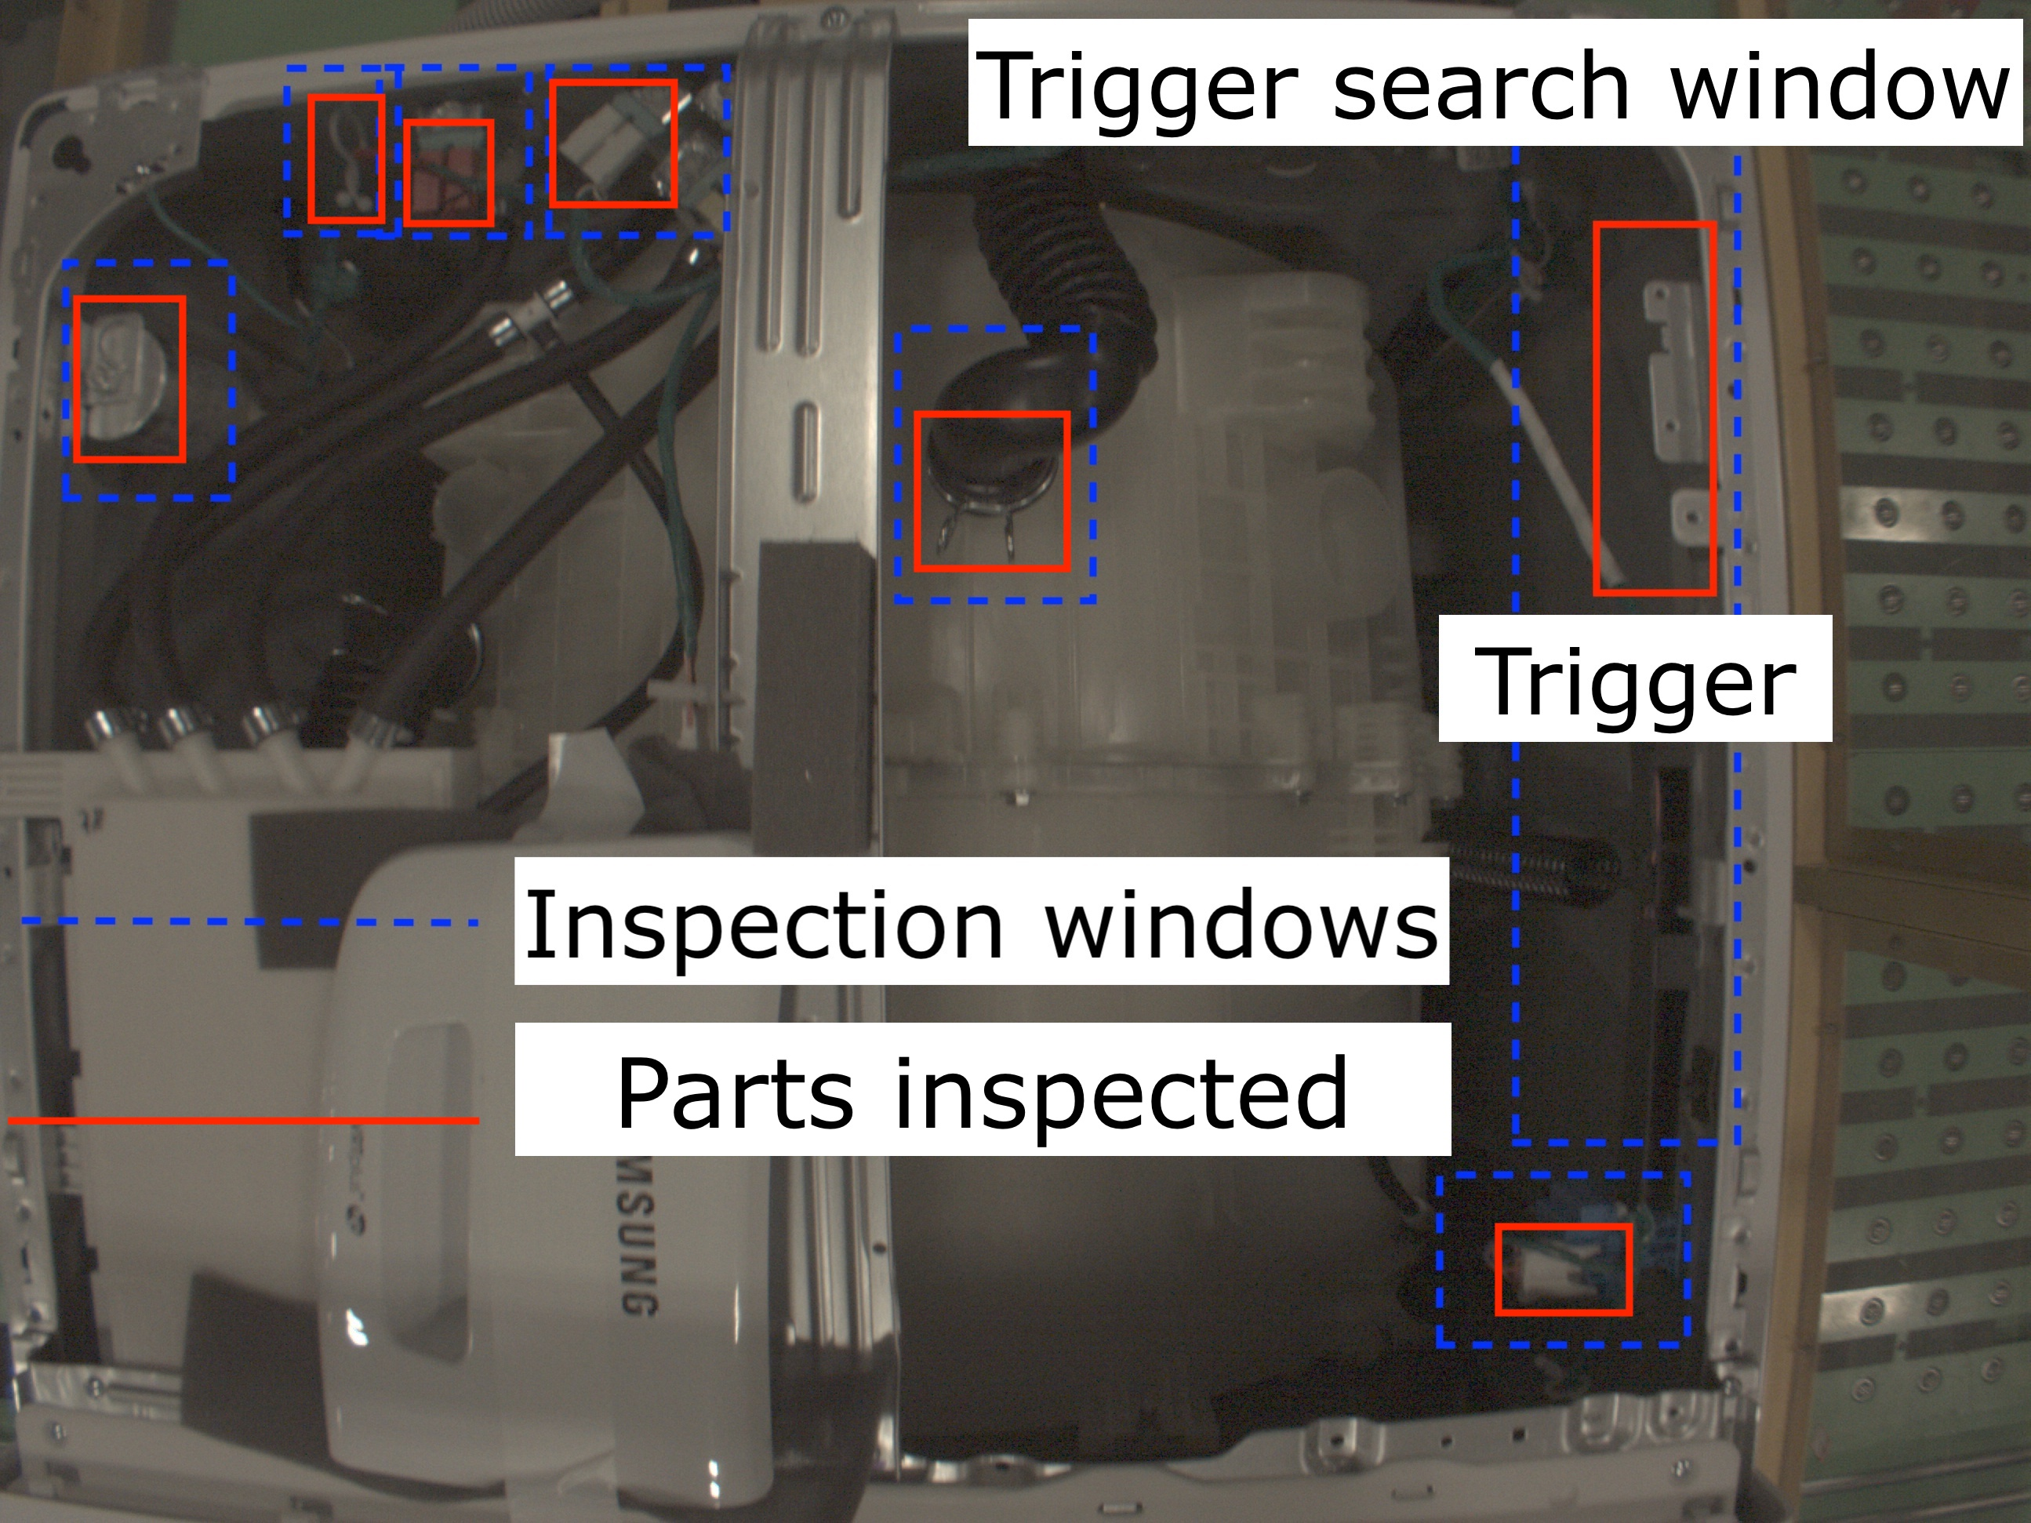
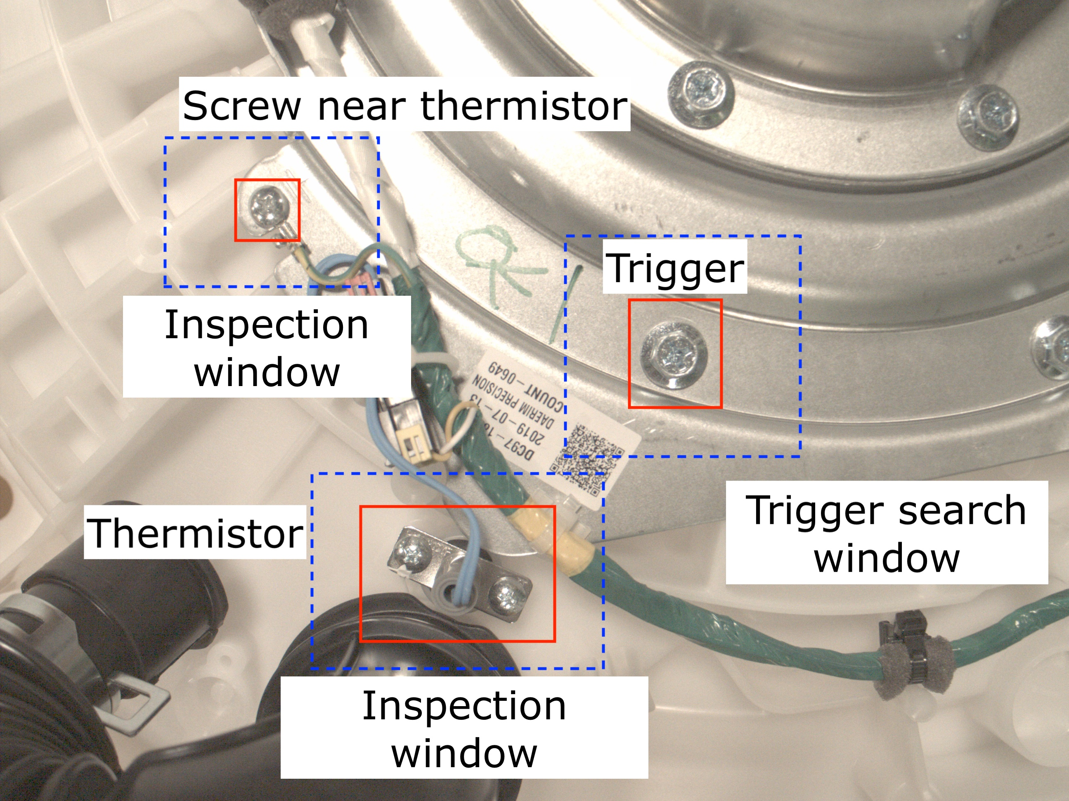
Data collected by our group
Data Collection
6 parts inspected
2 parts inspected

Slide 19
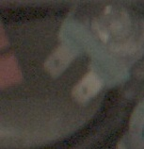
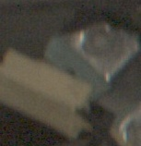
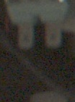
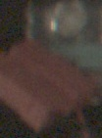
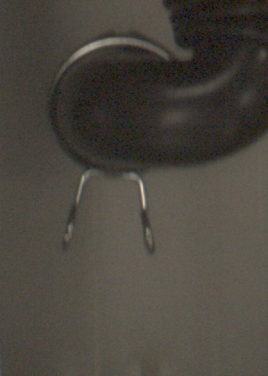
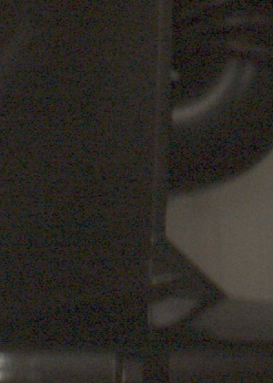
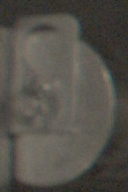

White water valve
Data Collection
Red water valve
Tub clamp hose
EMI filter

Slide 20










Data Collection
Pressure sensor
Wire holder
Thermistor screws
Screw near thermistor

Slide 21





Data provided by SEHA
Data Collection
Back screw

Slide 22
OUTLINE
Problem of learning part appearance variability
Background
Methods
  Overview
  Data collection
  Ground truth
  Pre-processing
  Training for appearance variability
Results
Conclusion

Slide 23

How do we know the actual number of defects? - Ground truth (249,371 images)
Ground truth

Slide 24
Ground truth - 249,371 images
Ground truth
Inspection problem | No. of frames | Frames analyzed | Fail to crop | Defects | Defect rate
White water valve | 39,268 | 32,242 | 1,602 | 83 | 0.26 %
Red water valve | 39,268 | 38,447 | 821 | 89 | 0.23 %
Tub clamp hose | 39,268 | 39,268 | 0 | 17 | 0.04 %
EMI filter | 39,268 | 39,268 | 0 | 31 | 0.08 %
Pressure sensor | 39,268 | 13,009 | 26,259 | 2 | 0.02 %
Wire holder | 39,268 | 36,658 | 2,610 | 180 | 0.49 %
Thermistor screws | 23,247 | 23,247 | 0 | 12 | 0.05 %
Screw near thermistor | 23,247 | 23,245 | 2 | 23 | 0.1 %
Back screws | 3,987 | 3,987 | 0 | 39 | 1.0 %

Slide 25
OUTLINE
Problem of learning part appearance variability
Background
Methods
  Overview
  Data collection
  Ground truth
  Pre-processing
  Training for appearance variability
Results
Conclusion

Slide 26
Pre-processing options
Image pre-processing
Inspection window size
Clustering
Training for appearance variability
Template match method
Inspection template size

Slide 27


Template matching revisited
Pre-processing
Edge match
Compare
RGB match
Compare
RGB match,
Edge score
Compare
Edge match,
RGB score
Compare
Variations of template matching:
1)Use RGB matching to find location and score
2)Use Edge matching to find location and score
3)Use Edge matching to find location and RGB matching to find score
4)Use RGB matching to find location and Edge matching to find score

Slide 28
Scoring
Pre-processing
RGB score
Edge score
Compare
Compare

Slide 29
Template matching revisited
Pre-processing
Edge match
Compare
RGB match
Compare
RGB match,
Edge score
Compare
Edge match,
RGB score
Compare
Variations of template matching:
1)Use RGB matching to find location and score
2)Use Edge matching to find location and score
3)Use Edge matching to find location and RGB matching to find score
4)Use RGB matching to find location and Edge matching to find score

Slide 30







Pre-processing
Matching
Inspection problem | Match method | Notes
White water valve | Either | Part has distinct color and edges
Red water valve | RGB | Occlusions
Tub clamp hose | RGB | Weak Edges
EMI filter | Either | Part has distinct color and edges
Pressure Sensor | RGB | Occlusions
Wire holder | Either | Part has distinct color and edges
Thermistor screws | RGB | Occlusions
Screw near thermistor | Edge | Circular edge
Back screw | Edge | Too much color variation, strong edges
Occlusions distort edges (RGB match)
Chance of getting latched on to something else
RGB has more information
Lot of color variation and strong distinct edges (Edge match)

Slide 31










Pre-processing
Inspection template size
Inspection template chosen
How did we decide?
Inspection windows
Inspection templates
Area of inspection
Size
Appearance of defects

Slide 32





Pre-processing
Image pre-processing to improves edges (better scoring)
Inspection search window
Inspection search window
Inspection template
Template match

Slide 33
OUTLINE
Problem of learning part appearance variability
Background
Methods
  Overview
  Data collection
  Ground truth
  Pre-processing
  Training for appearance variability
Results
Conclusion

Slide 34
Training for appearance variability
Training and Evaluation
Pre-processing
Evaluator
Clustering
Cluster viewer
Inspector
Seed viewer

Slide 35


Clustering results
Training for appearance variability
Input template
Cluster seeds - Seed viewer output
Large OK cluster seeds as training templates
All the cropped inspection search windows of the red water valve
Cluster number | Number of members
1 | 20,685
8 | 11,054
20 | 5,997
18 | 402

Slide 36
Training for appearance variability
Inspector
Compare
All cropped Inspection windows
Glimpse of inspector output
Inspector output sorted in ascending order of the match scores
Index | Name | Score | Template | Ground truth
42 | 00042.jpg | 0.71 | 2 | OK
43 | 00043.jpg | 0.77 | 0 | OK
44 | 00044.jpg | 0.70 | 1 | OK
45 | 00045.jpg | 0.72 | 1 | OK
46 | 00046.jpg | 0.82 | 1 | OK
47 | 00047.jpg | 0.77 | 0 | OK
48 | 00048.jpg | 0.73 | 1 | OK
Index | Name | Score
1 | 00195.jpg | 0.43
50 | 22250.jpg | 0.57
100 | 22246.jpg | 0.60
150 | 22988.jpg | 0.61
200 | 22081.jpg | 0.62
300 | 01210.jpg | 0.63
500 | 04082.jpg | 0.64

Slide 37


Training for appearance variability
Evaluator
N least scoring windows | Actual defects | False alarms | Defect detection rate | False alarm rate | Score of the Nth part (threshold)
50 | 40 | 10 | 0.45 | 0.1 | 0.57
100 | 80 | 20 | 0.89 | 0.22 | 0.60
150 | 84 | 66 | 0.94 | 0.74 | 0.61
200 | 86 | 114 | 0.97 | 1.28 | 0.62
300 | 88 | 212 | 0.99 | 2.38 | 0.63
Least scoring N windows compared against actual defects
All cropped inspection search windows
Compare
Defect detection rate = $\frac{No. of defects detected}{Total actual defects (89)}$
False alarm rate = $\frac{Number of false alarms}{Total actual defects (89)}$

Slide 38
OUTLINE
Problem of learning part appearance variability
Background
Methods
  Overview
  Data collection
  Ground truth
  Pre-processing
  Training for appearance variability
Results
Conclusion

Slide 39





White water valve
Results
OK seeds suggested by clustering
Tub clamp hose
OK seeds suggested by clustering

Slide 40

EMI filter
Results

Slide 41










EMI filter
Results
Class 1 (Largest OK seeds)
Class 2 (Largest NOK seeds)

Slide 42



Pressure sensor
Results
Thermistor screws

Slide 43



Screw near thermistor
Results

Slide 44

Back screw
Results
Picked the largest 31 cluster seeds

Slide 45

Wire holder
Results
Part not firm in its structure
Part has a lot of cavities or hollow spaces, thus less information
Lot of variability

Slide 46
Training summary
Results
Inspection problem | No. of classes | No. of clusters | Defect rate | Defects detected | False alarms per defect
White water valve | 1 | 20 | 0.26 % | 100 % | 0.0
Red water valve | 1 | 20 | 0.23 % | 100 % | 2.68
Tub clamp hose | 1 | 20 | 0.04 % | 100 % | 0.06
EMI filter | 2 | 40 | 0.08 % | 97 % | 2.9
Pressure sensor | 1 | 20 | 0.02 % | 100 % | 0.0
Wire holder | 1 | 60 | 0.49 % | 50 % | 5.0
Thermistor screws | 1 | 20 | 0.05 % | 83 % | 1.4
Screw near thermistor | 1 | 20 | 0.1 % | 100 % | 0.56
Back screws | 1 | 40 | 1.0 % | 100 % | 1.02

Slide 47
OUTLINE
Problem of learning part appearance variability
Background
Methods
  Overview
  Data collection
  Ground truth
  Pre-processing
  Training for appearance variability
Results
Conclusion

Slide 48

Conclusion
Conclusion and future work
Decision tree for training the system for future inspection problems
Build a software interface to encode what we learned

Slide 49
Thank you!
Questions?

