Slide 1
Ultra-wideband Position Tracking on an Assembly line
M.S Thesis Defense
Harikrishnan Ravikrishnan
Committee Members:
Dr. Adam Hoover (advisor)
Dr. Ian Walker
Dr. Richard Groff
April 22nd 2014
Department of Electrical and Computer Engineering

Slide 2

Outline
Introduction
Filtering
Method
Results
Conclusion

Slide 3
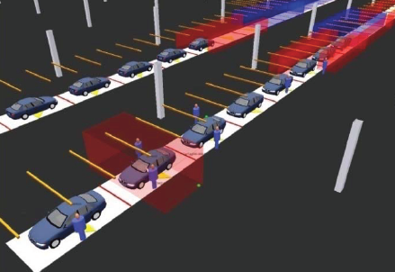
Objective
Track objects on an assembly line using an ultra-wideband (UWB) indoor tracking system.

Slide 4
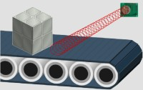
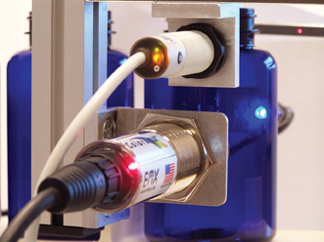
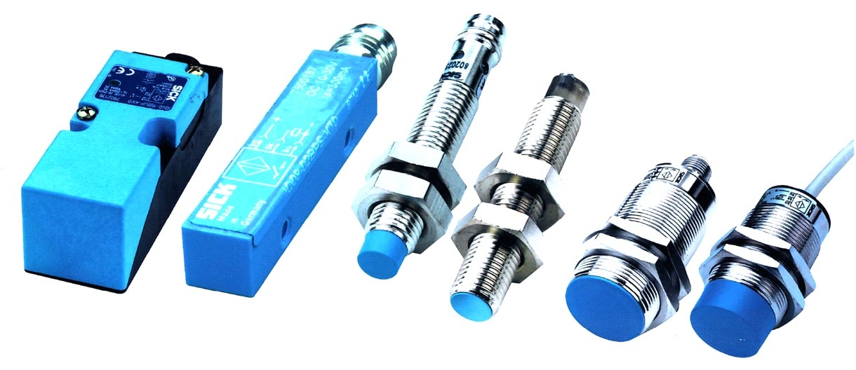
Assembly line tracking
Number of these sensors required.
Cannot distinguish between product types.
Provides reading only at sensor locations.
Ultra sound sensor
Proximity Sensors
Optical sensor
Notes:
Need to be placed at regular intervals on the assembly line.
Different models run on the same assembly line, needs configuration.

Slide 5
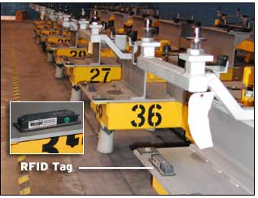
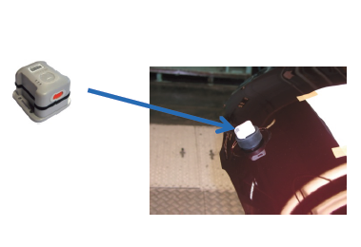
Assembly line tracking
Radio frequency identification (RFID)
Ultra-wide band (UWB)
Parts should be near RFID readers.
Provide sensor readings continuously throughout the entire tracking area.
Notes:
Readers can read the tag ID and know what model it is.
RFID product needs to come neat the RFID reader range.

Slide 6
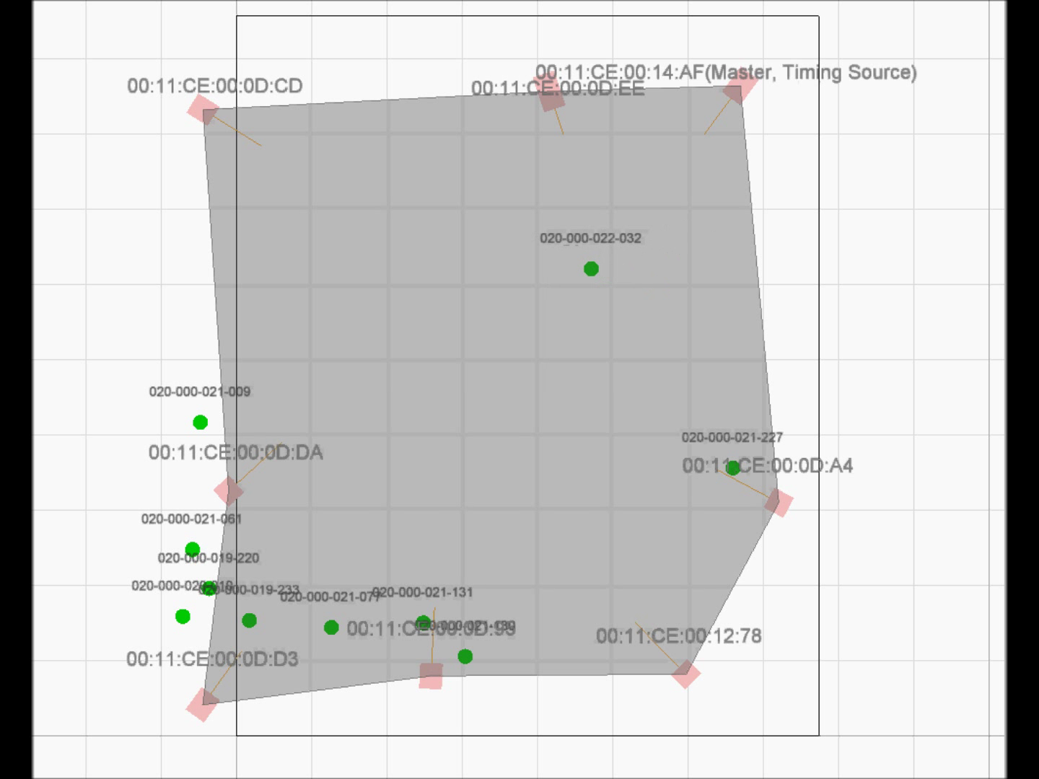
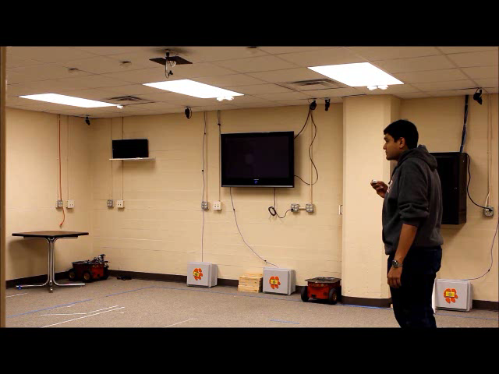
Video showing UWB indoor tracking
Notes:
This video shows an example of raw UWB indoor tracking.
As you can observe that even though the tracking takes place in a room, there is noise in the measurements
Moreover, the noise also depends on where we are in the room.

Slide 7
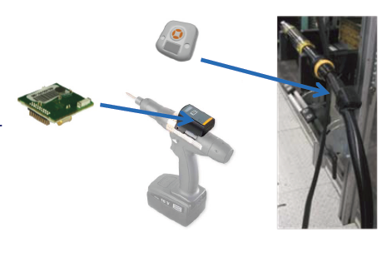
UWB tracking
Noisy !
Accuracy 30 – 100 cm in a room to building sized area.
Sufficient to monitor the current part of assembly line it is traversing.
Not accurate for precise tooling.
Notes:
Previously bar code scanners were used to scan a paper label fixed to the car.
Because multiple vehicle models are produced on the same assembly line, power tool settings must be constantly adapted for the scientific model entering a work station.

Slide 8
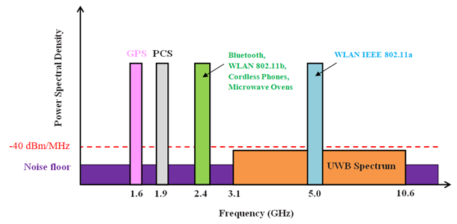
Ultra-wideband (UWB)
US FCC permitted usage in 2002.
UWB signals
  Ultra short pulses (< 1 ns)
  Low duty cycle ( < 0.5 %)
  Wide range of frequencies ( 3.1 to 10.6 GHz simultaneously)
  Large bandwidth ( > 500 MHz)
Notes:
Formerly known as pulse radio
Defense Advanced Research Projects Agency's (DARPA) in its report on the assessment of short-pulse wave technology introduced the term UWB to distinguish
it from other conventional radar technologies.
The United States Federal Communication Commission permitted the use of UWB in 2002.
Floods the entire spectrum over a wide range of frequencies

Slide 9
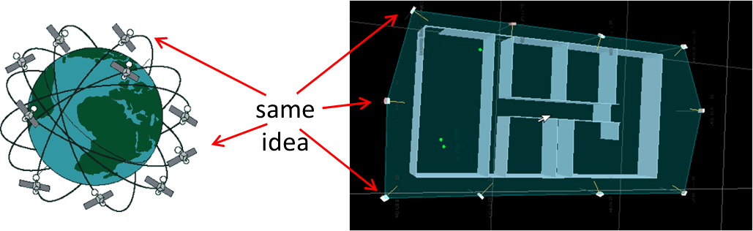
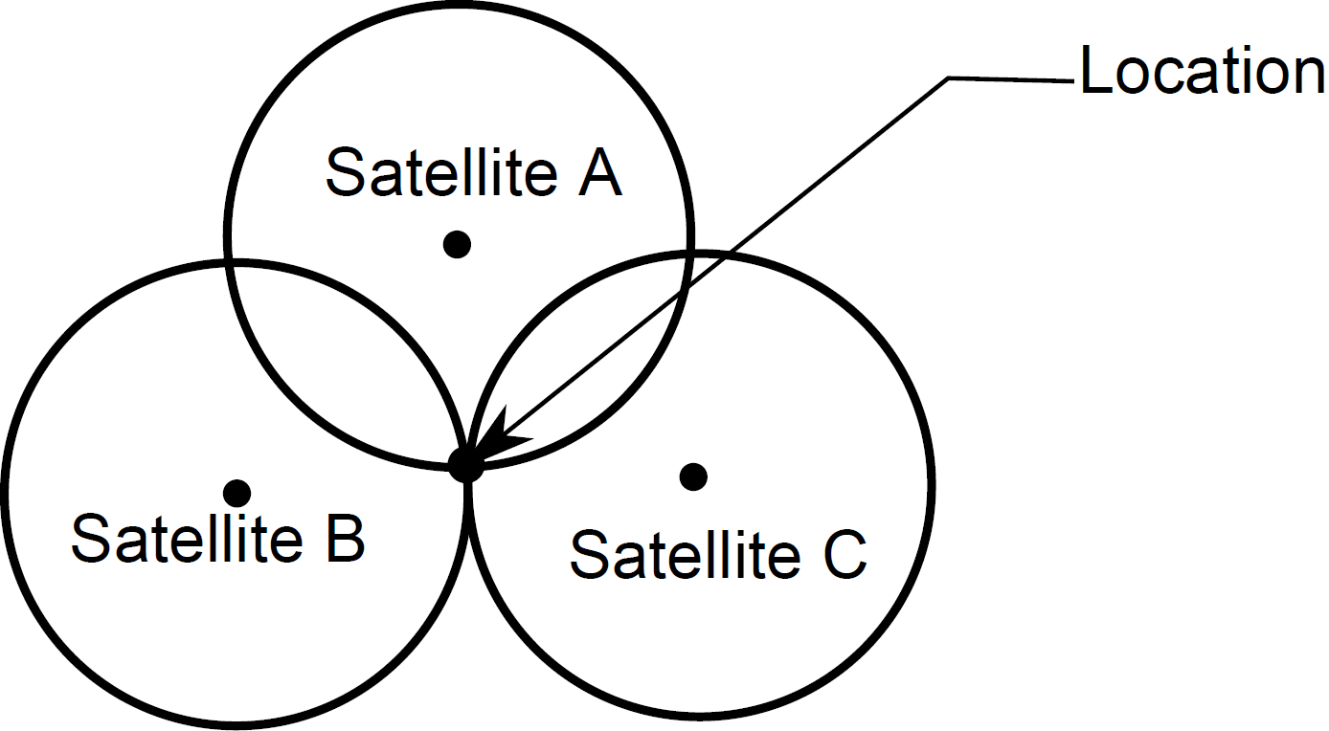
UWB indoor tracking
Except
Different scale
Transmitters/receivers switched
Trilateration
Notes:
Transmitters in GPS is satellite.
calculates the distance or range of a transmitter by computing the time taken for the radio frequency signal to propagate from the transmitter to the receiver and then multiplying that with the speed of light. Three receivers trilateration, generally multi-lateration.
Range is calculated using TOA, TDOA or AOA.

Slide 10
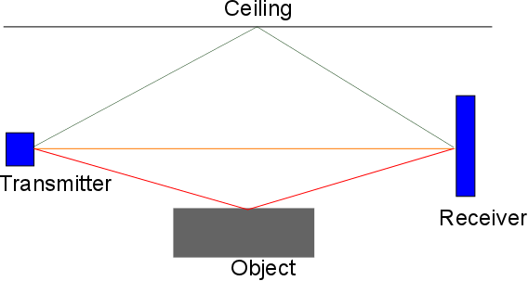
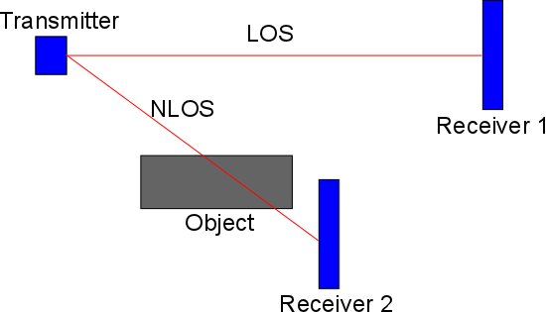
Sources of noise in UWB tracking
Non-line-of sight (NLOS)
Multipath
Synchronization
Peak detection
Sensor placement
Multipath
NLOS
Notes:
NLOS causes increased time of flight (TOF) hence directly affecting the range measurement.
Multipath can also cause increased TOF measurement, especially if the direct path is attenuated.
Since the UWB system calculates the range using TOA or TDOA, synchronization is very important as accurate clock references are needed.
Accurate peak detection also affects TOA and TDOA measurements.
Sensor placement can also affect the performance due to dilution of precision

Slide 11
Novelty
Filters have been used to improve the accuracy of UWB.
  Low et al. (2005) , Denis et al. (2010) , Banerjee (2008).
Maps have been used improve accuracy of GPS.
  Gustafsson et al. (2002),Krakiwsky et al. (1988).
Maps have been used in UWB indoor tracking.
  Map of environment noise (Improved position tracking by 15 %).
  Suski (2012)
  Floorplan maps – prevent motion tracking from traversing through walls. Meissner et al. (2010)
To our knowledge, this is the first time
Map of an assembly line is used to improve UWB position tracking.
Notes:
road map can be used to improve position tracking for an automobile using a GPS. The essence of the idea is that position measurements are constrained to locations on the path (road or assembly line).
Suski – made a map of environment noise has been shown to improve position tracking by up to 15%
Meissner - Floorplan maps have been used to constrain motion tracking from traversing through walls and other fixed objects like furniture present in the room.

Slide 12
Outline
Introduction
Filtering
Method
Results
Conclusion

Slide 13
Components of filtering
State variables – 2D tracking problem
where and are the position along x and y axes and and are the velocities.
State transition equations
where is the time interval between measurements and , are the dynamic noise.
(1)
(2)
Notes:
state variables are the quantities that describe the behavior of the thing being tracked. For a 2D tracking problem.
The state transition equations are a set of equations that describe the expected behavior of the the thing being tracked over a period of time. The state transition
equations can be written to describe any desired model. The above describe constant velocity.

Slide 14
Components of filtering
Dynamic noise
and can be obtained from the distribution .
Dynamic noise covariance
(3)
(4)
Notes:
Dynamic noise refers to the uncertainty in predictions in the state transition equation.
N(0; 2a) denotes a random, normally distributed variable with a mean of zero and a standard deviation of a. The value of a denes how large of an acceleration
can be expected during each prediction interval. The dynamic noise covariance matrix Q represents the covariance of the set of dynamic noises. In the dynamic noise
covariance matrix the zeros signify that there is no correlation between x and y axes. The discrete dynamic noise covariance matrix Qt represents the covariance for a time
interval t

Slide 15
Components of filtering
Observation
where and are obtained from the sensor.
Observation equation
where and are the measurement noise.
(5)
(6)
Notes:
The observation equations are a set of equations that describe the expected range of measurements given the current state of the thing being tracked. The observation
is obtained from the sensor. These give the position of the thing being tracked. Measurement noise is part of the observation equation and is used to describe
the potential corruption of the observations.

Slide 16
Components of filtering
Measurement noise is the uncertainty in the measurement.
Measurement noise covariance matrix
where , represent the variance represent the covariance along the X and Y axes respectively.
(7)
Notes:
The measurement noise is the uncertainty in the sensor readings.

Slide 17
Kalman filter
Linear motion models.
Noise should be Gaussian.
Predict state X_{t,t-1} = ϕX_{t-1,t-1}
Predict state covariance S_{t,t-1} = ϕS_{t-1,t-1}ϕ^{T}+Q
Innovation J = Y_{t} – M X_{t,t-1}
Calculate Kalman gain K_{t} = S_{t,t-1} M^{T} (M S_{t,t-1}M^{T} + R)⁻¹
Update state covariance S_{t,t} = [ I - K_{t}M] S_{t,t-1}
Update state X_{t,t} = X_{t,t-1 +} K_{t} J
(8)
(9)
(10)
(11)
(12)
(13)
Notes:
The algorithm works in a two-step process: in the prediction step, the Kalman fillter produces estimates of the current state variables, along with their uncertainties. Once the outcome of the next measurement is observed, these estimates are updated using a weighted average, with more weight being given to estimates with higher certainty.
innovation is calculated as the dierence between the estimated measurement and the actual measurement
where the ﬁrst subscript indicates the current time and the second subscript indicates the time of the last measurement used to calculate the quantity.
Dynamic noise and measurement noise, low Kalman weight high measurement noise, filter follows the model

Slide 18
Particle Filter
Any motion model.
Any type of noise.
Particles m = 1,2,3,…..,1000
Transition particles
Update weights
Normalize weights
Output
Resample if necessary
(14)
(15)
(16)
(17)
(18)
(19)
Notes:
A particle filter is a sequential Monte Carlo method used for estimating non-Gaussian distributions. Monte Carlo methods are a class of computational algorithms
that rely on repeated random sampling to compute their results. The samples from the Monte Carlo method in a particle lter are called particles. The particles
with corresponding weights are used to form an approximation of a probability density function. Importance sampling is performed on the probability density function.
Importance sampling is a general technique for estimating properties of a particular distribution. The basic methodology in importance sampling is to choose a distribution
which encourages the important values. The important values, in this case particles, are given higher weights and the desired output is computed from the mean.
Resampling.

Slide 19
Outline
Introduction
Filtering
Method
Results
Conclusion

Slide 20
Model
Model an assembly line as a piece wise function of linear segments.
Object takes some unknown time to travel in these segments depending on the velocity.
Object can speed up, slow down or stop while travelling from one segment to the other.

Slide 21
Filter design
State variable d represents the distance travelled along the assembly line.
State
where and represent the position and velocity at time t.
State transition equations
where represents the random change in velocity at time t.
Observations are obtained from the UWB tracking system.
(20)
(21)
(22)
Notes:
We design a particle filter because the state transition and observation equations are not linear. Dynamic noise also purely not Gaussian.
We model at using N(0; a), a zero-mean normal distribution with sigma a defning the standard deviation of the expected random change in velocity. We use the max
operator to enforce the constraint that the velocity can speed up or slow down but cannot reverse; in other words, the target being tracked may pause while moving
along a segment, but it cannot back up.
Measurements can take values anywhere in the x,y space.

Slide 22
Mapping
Filter estimate is mapped to the corresponding point on the x,y space.
Mapping done to calculate the probability distribution function in equation (17).
(23)

Slide 23
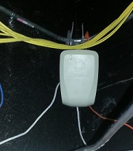
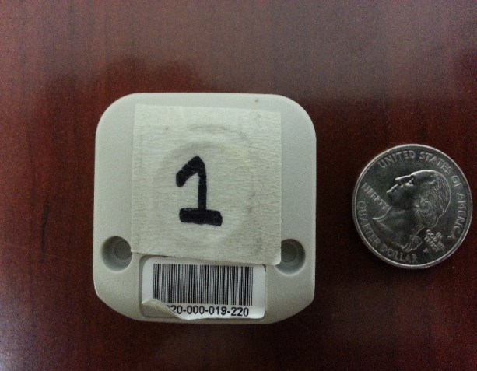
UWB positioning system
Manufacturer Ubisence Inc.
Position estimates by time difference of arrival and angle of arrival.
8 sensors are mounted in the Riggs facility
Tag
Sensor

Slide 24
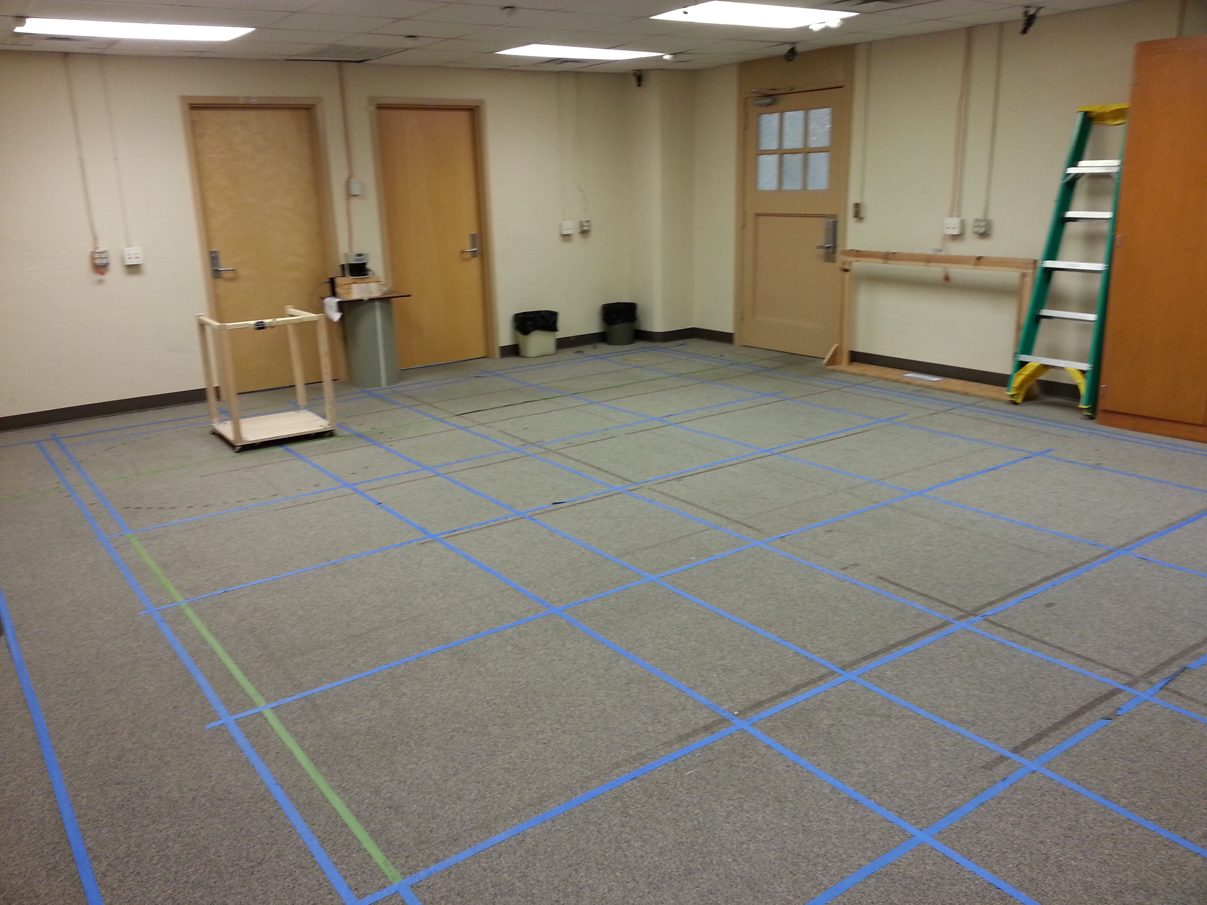
Riggs facility
Basement of Riggs.
Tracking area – 8m x 9m approx.
Covers laboratory and adjacent hallway – 20cm thick wall separates them
Walls are 5m high.
False ceiling at height of 3m made of thermocol and placed on metal railings.

Slide 25
Data collection
Height =78cm

Slide 26
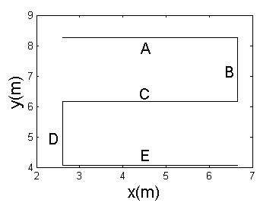
Path
Segment | x_{a} | y_{a} | x_{b} | y_{b} | d
A | 2.62 | 8.36 | 6.67 | 8.26 | 4.05
B | 6.67 | 8.26 | 6.67 | 6.15 | 6.16
C | 6.67 | 6.15 | 2.62 | 6.15 | 10.21
D | 2.62 | 6.15 | 2.62 | 4.07 | 12.29
E | 2.62 | 4.07 | 6.67 | 4.07 | 16.34
x_{a,}y_{a} – Segment start point
x_{b,}y_{b} – Segment end point
d – distance travelled on the assembly line (in m)

Slide 27
Motion
Situation 1
Constant velocity along the entire path with no halts.
Situation 2
Constant velocity with halts at segment ends.
Situation 3
Different velocities on each of the segments and no halts.

Slide 28

Situation 1
Measurements
Velocity Profile
Situation 2
Situation 3

Slide 29
Ground truth
Least square method is used to obtain time of change in dynamics.
With the time and segment end points ground truth is obtained.

Slide 30
Error metric
Root mean square error or deviation (RMSE).
- Ground truth
- Filter output
- Total number of measurements

Slide 31
Outline
Introduction
Filtering
Method
Results
Conclusion

Slide 32
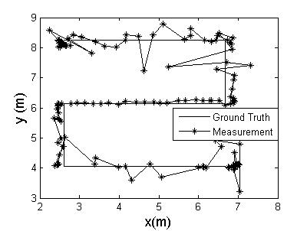
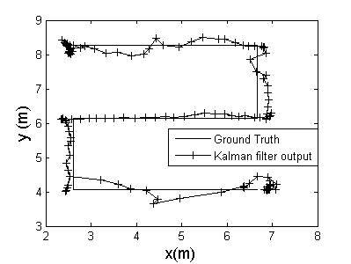
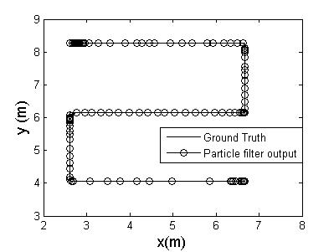
Situation 1 – Filter output

Slide 33
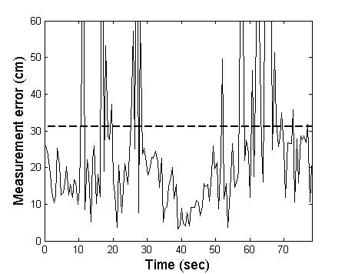
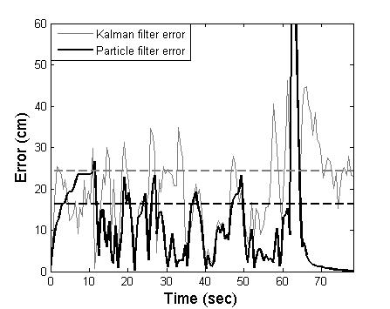
Error plots for situation 1
Average measurement error (ME) = 31.1 cm
Average Kalman filter error (KFE) = 24.4 cm
Average particle filter error = 16.3 cm
Improvement over ME = 48%
Improvement over KFE = 33%

Slide 34
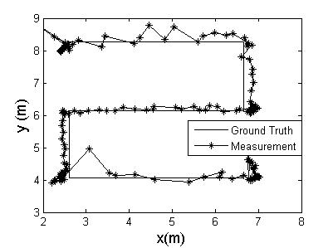
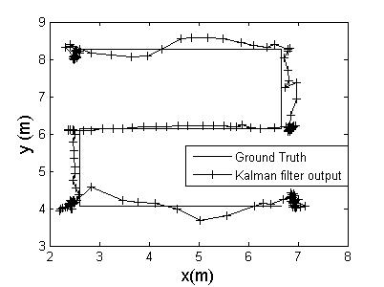

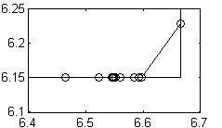
Situation 2 – Filter output
Offset from segment end

Slide 35
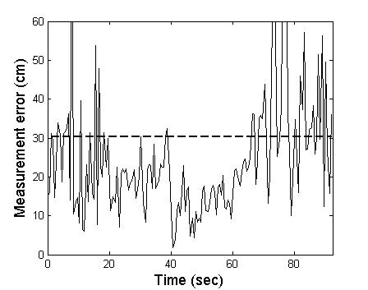
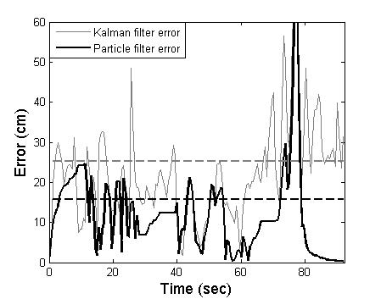
Error plots for situation 2
Average measurement error (ME) = 30.3 cm
Average Kalman filter error (KFE) = 25.2 cm
Average particle filter error = 15.7 cm
Improvement over ME = 48%
Improvement over KFE = 38%

Slide 36
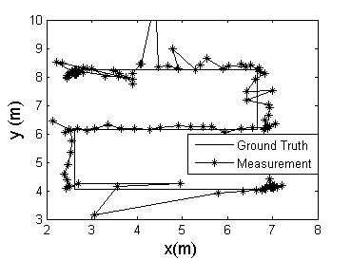
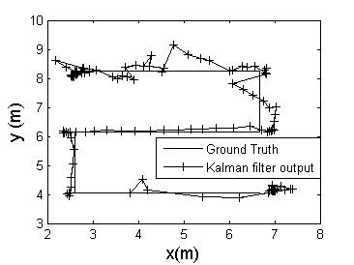
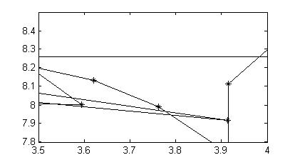
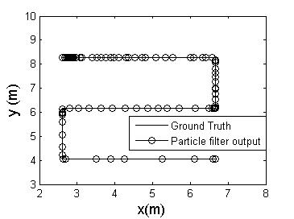
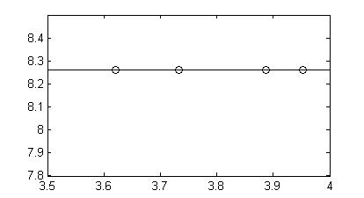
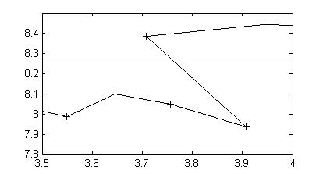
Situation 3 – Filter output
Particle filter output does not get affected.
Kalman filter output goes back.

Slide 37
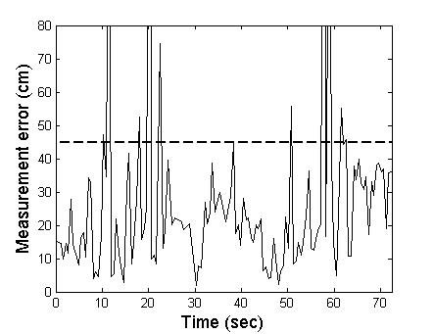
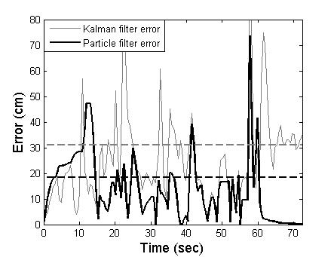
Error plots for situation 3
Average measurement error (ME) = 44.8 cm
Average Kalman filter error (KFE) = 31.1 cm
Average particle filter error = 18.5 cm
Improvement over ME = 62%
Improvement over KFE = 41%

Slide 38
Error comparison (in cm)
Situation | Data Set | Measurement | Kalman | Particle
Situation 1 | Set 1 | 31.1 | 24.4 | 16.3
 | Set 2 | 31.2 | 25.8 | 16.9
 | Set 3 | 52.8 | 31.7 | 16.1
Situation 2 | Set 1 | 30.3 | 25.2 | 15.8
 | Set 2 | 33.5 | 24.3 | 14.9
 | Set 3 | 29.4 | 24.5 | 13.7
Situation 3 | Set 1 | 38.7 | 31.2 | 20.2
 | Set 2 | 44.8 | 31.1 | 19.6
 | Set 3 | 60.8 | 33.7 | 24.8
Average error |  | 39.2 | 27.9 | 17.6
Notes:
particle lter uses a Monte Carlo approach so a single trial does not
necessarily provide a representative output. Ten iterations were done for each of the
data sets and average error was computed

Slide 39
Outline
Introduction
Filtering
Method
Results
Conclusion

Slide 40
Conclusion
Tracking error reduced by 55%.
  Raw measurement error = 39.2 cm.
  Particle filter error = 17.6 cm.
Performance better than Kalman filter by 37%.
  Kalman filter error error = 27.9 cm.
Central tracking unit in an assembly line.
Tracking can be used for tooling by using the UWB estimates in the factory control system.

Slide 41
Recommendations For Future Work
Include a segment ID as state variable.
  Would have to include in state transition and observation equations.
  Current filter overshoots before periods of rest.
  Benefit would be seen at segment joins.
Detect when tracked object leaves assembly line.
  Tracking cumulative error between a standard Kalman filter and map constrained filter, identify when they sufficiently diverge.

Slide 42
References
[1] Low, Z. N., Cheong, J. H., Law, C. L., Ng, W. T., & Lee, Y. J. (2005). Pulse detection algorithm for line-of-sight (LOS) UWB ranging applications. Antennas and Wireless Propagation Letters, IEEE, 4, 63-67.
[2] Yan, J., Tiberius, C. C., Teunissen, P. J., Bellusci, G., & Janssen, G. J. (2010). A framework for low complexity least-squares localization with high accuracy. Signal Processing, IEEE Transactions on, 58(9), 4836-4847.
[3] Denis, B., Ouvry, L., Uguen, B., & Tchoffo-Talom, F. (2005, September). Advanced Bayesian filtering techniques for UWB tracking systems in indoor environments. In Ultra-Wideband, 2005. ICU 2005. 2005 IEEE International Conference on (pp. 6-pp). IEEE.
[4] Gustafsson, F., Gunnarsson, F., Bergman, N., Forssell, U., Jansson, J., Karlsson, R., & Nordlund, P. J. (2002). Particle filters for positioning, navigation, and tracking. Signal Processing, IEEE Transactions on, 50(2), 425-437.
[5] Krakiwsky, E. J., Harris, C. B., & Wong, R. V. (1988, November). A Kalman filter for integrating dead reckoning, map matching and GPS positioning. In Position Location and Navigation Symposium, 1988. Record. Navigation into the 21st Century. IEEE PLANS'88., IEEE (pp. 39-46). IEEE.

Slide 43
References
[6] Meissner, Paul, Christoph Steiner, and Klaus Witrisal. "UWB positioning with virtual anchors and floor plan information." In Positioning Navigation and Communication (WPNC), 2010 7th Workshop on, pp. 150-156. IEEE, 2010.
[7] Suski, William, Salil Banerjee, and Adam Hoover. "System-level noise of an ultra-wideband tracking system." Information Science, Signal Processing and their Applications (ISSPA), 2012 11th International Conference on. IEEE, 2012.
[8] W. Suski, A study of environment noise in ultra-wideband indoor position tracking,” Ph.D. dissertation, Clemson University, 2012.
[9] S. Banerjee, Improving accuracy in ultra-wideband indoor position tracking through noise modeling and augmentation," Ph.D. dissertation, Clemson University, 2012.
[10] A. Hoover, Lecture notes - ece 854," 2012. [Online]. Available: http:
//www.ces.clemson.edu/ahoover/ece854/

Slide 44




Thank you!

Slide 45
Related work
Low et al. (2005) – Improve calculation of time of flight using match filtering and peak search technique.
Yan et al. (2010) – Improve accuracy by transforming a three dimensional problem into a one-dimensional problem.
Denis et al. (2005)- Bayesian filters used to track time of arrival biases.
Banerjee (2008) - Particle filter used with a model for sensor set noise.
Notes:
Low et al. – methods were explored to improve the calculation of time of light (TOF) using match filtering and a peak search technique.
Yan et al. - A least square technique was used iteratively to improve accuracy by transforming a three-dimensional localization problem into a one-dimensional problem.
Denis et al. - Bayesian filters have been used to track time of arrival (TOA) biases created by non line of sight (NLOS) conditions.
Banerjee – used a particle filter with a model of sensor set noise.

