Slide 1
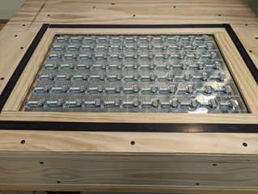

Embedding a Grid of Load Cells into a Dining Table for Automatic Monitoring and Detection of Eating Events
Mohammad Mayyan
Committee Members:
Adam Hoover (chair), Harlan Russell,
Jacob Sorber, Ian Walker

Slide 2
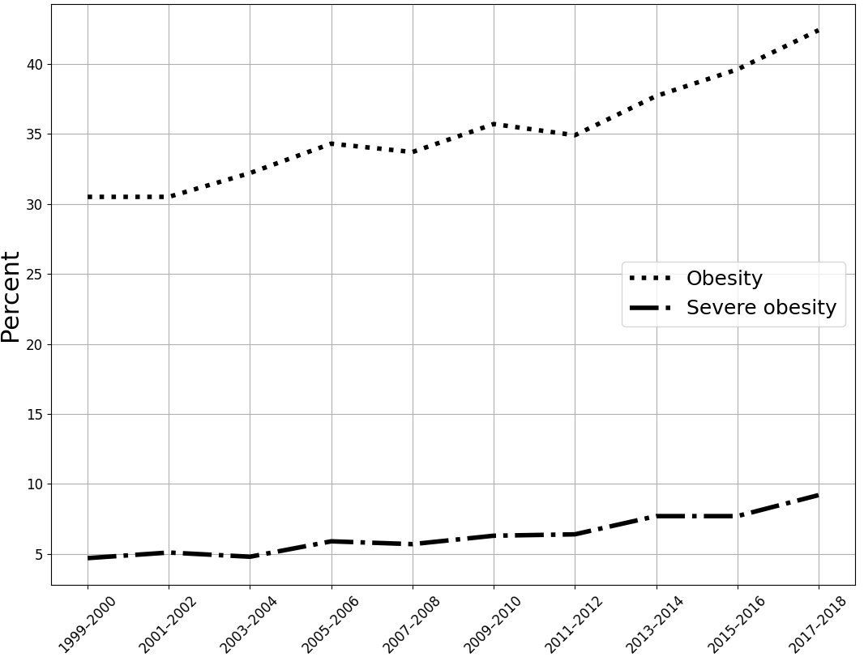

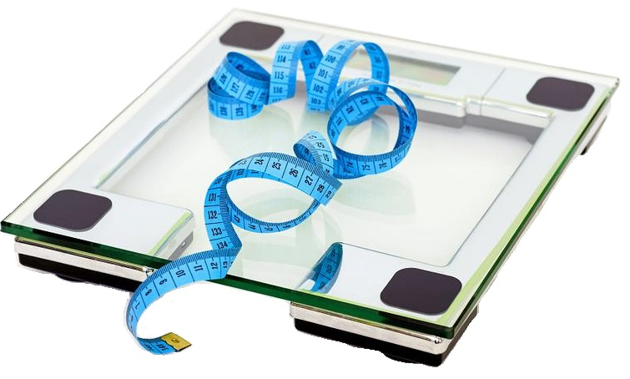
Motivation - Obesity
Classification
Overweight is a BMI ≥ 25 ¹
Obesity is a BMI ≥ 30 ¹
Severe obesity is a BMI ≥ 40 ³
Globally growing problem¹
Overweight >1.9 B, 34% obese (2016) ¹
kg/m²
[1] World Health Organization. URL www.who.int/news-room/fact-sheets/detail/obesity-and-overweight [accessed 2022-02-09]
[2] NCHS Health E-Stats, US. URL www.cdc.gov/nchs/data/hestat/obesity-adult-17-18/obesity-adult.htm [Accessed 2022-02-09]
[3] CDC, Defining Adult Overweight & Obesity. URL https://www.cdc.gov/obesity/basics/adult-defining.html [accessed 2022-06-4]
[4] NCHS Health E-Stats, US. URL www.cdc.gov/nchs/data/hestat/obesity-adult-17-18/obesity-adult.htm [Accessed 2022-02-09]
Notes:
* Overweight and obesity are defined as abnormal or excessive fat accumulation that may impair health
* 2 The National Health and Nutrition Examination Survey (NHANES) shows an age-adjusted trends of increasing obesity and severe obesity among American adults 20–74 years old from the years 1960–1962 through 2017–2018
3 WHO Regional office published on 3 May by the WHO Regional Office for Europe, reveals that overweight and obesity rates have reached epidemic proportions across the Region
Waist-to-Hip Ratio, Waist Circumference Measurement

Slide 3
Classic Assessment Tools
Tools
Dietary Records
24-H Dietary Recall
Food Frequency Questionnaire (FFQ)
Problems
Burdensome (need compliance)¹
Inaccurate
Rely on memory
[1] Brown et al. (2021), Toward more rigorous and informative nutritional epidemiology: The rational space between dismissal and defense of the status quo
Notes:
Several studies reported that dietary records underestimate energy intake in the range of 4\% to 37\% compared to energy intake measured using doubly labeled water

Slide 4
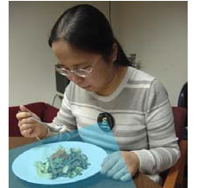
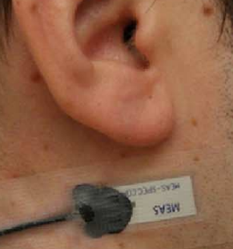
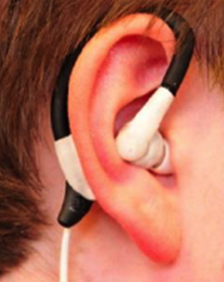
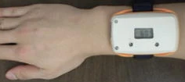
Automatic assessment tools
Acoustic-based
Motion-Based
Chewing
Gestures
Camera-Based
[Sazonov et al. (2012)]²
[Sun et al. (2014)]⁴
[Boer et al. (2018)]¹
[Dong et al. (2012)]³
[1] Boer et al. (2018), The SPLENDID eating detection sensor: Development and feasibility study
[2] Sazonov et al. (2012), A Sensor System for Automatic Detection of Food Intake Through Non-Invasive Monitoring of Chewing
[3] Dong et al. (2012), A new method for measuring meal intake in humans via automated wrist motion tracking
[4] Sun et al. (2014), eButton: a wearable computer for health monitoring and personal assistance

Slide 5
Outline
Motivation and Background
Related Work on Smart Surfaces
Novelty
Hardware
Pilot Experiment
Comparison of Eating Detection Methods On Smart Surfaces

Slide 6
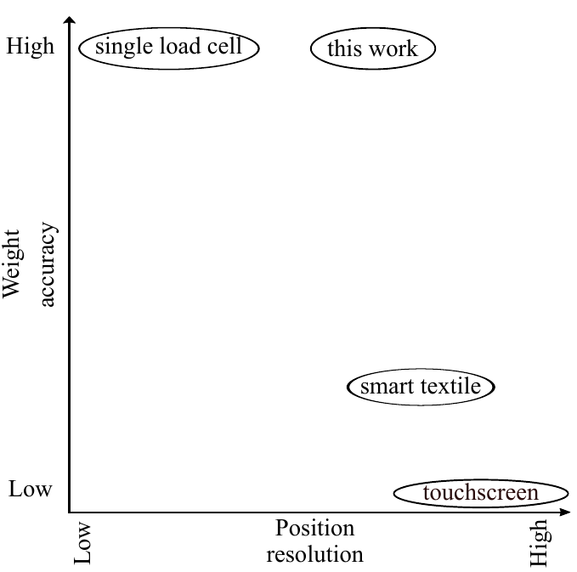
Smart Surfaces: overview
Our goal is to contribute towards higher accuracy for both position detection and weight measurements

Slide 7
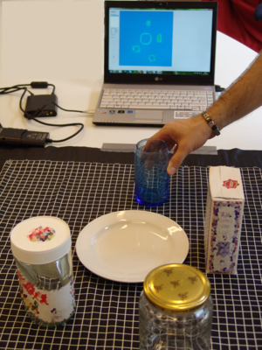
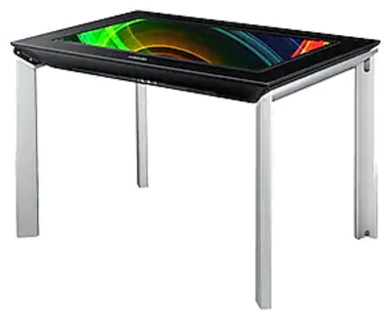
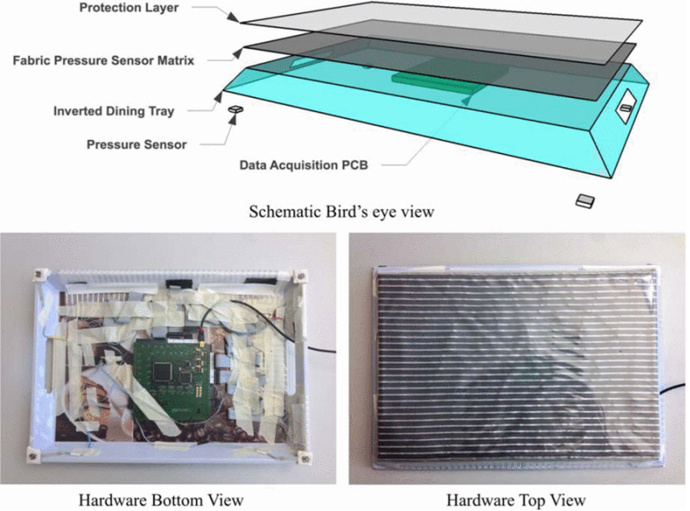
Smart Surfaces: touchscreen and smart textiles
[Manton et al. (2016)]¹
[Holzmann et al. (2010)]²
[Zhou et al. (2015)]³
[1] Manton et al. (2016), The “Smart Dining Table”: Automatic Behavioral Tracking of a Meal with a Multi-Touch-Computer
[2] Holzmann et al. (2010), Towards tabletop interaction with everyday artifacts via pressure imaging
[3] Zhou et al. (2015), Smart table surface: A novel approach to pervasive dining monitoring

Slide 8
Smart Surfaces: touchscreen and smart textiles
Ref. | Technology | Position resolution | Weight accuracy | Application
[1] | touchscreen | < 1 mm | Cannot measure weight | eating monitoring
[2] | smart textile | 1.27 cm | ±6.8 g | user interface
[3] | smart textile + force sensors | 1 cm | not reported | eating monitoring
Advantage: Good spatial resolution
Disadvantage: no or low accuracy for weight measurements
[1] Chang et al. (2006), The diet-aware dining table: Observing dietary behaviors over a tabletop surface
[2] Holzmann and Hader (2010), Towards tabletop interaction with everyday artifacts via pressure imaging
[3] Zhou et al. (2015), Smart table surface: A novel approach to pervasive dining monitoring

Slide 9
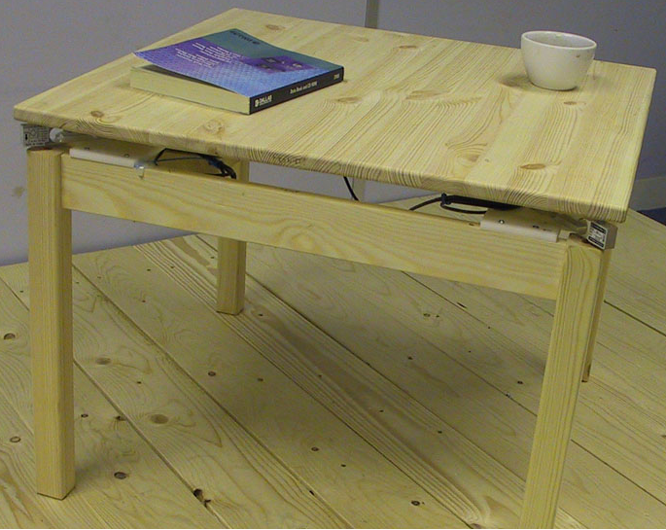
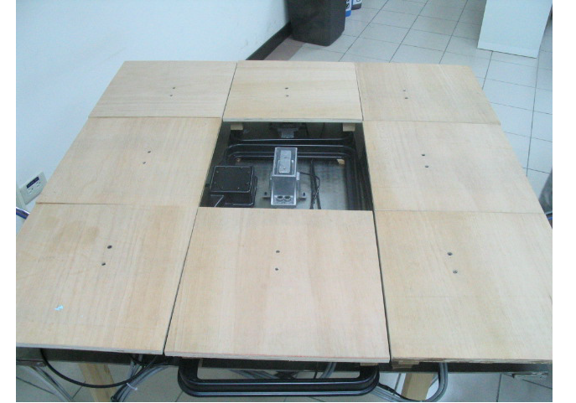
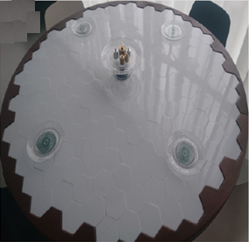
Smart Surfaces: using load cells
[Schmidt et al. (2002)]¹
[Chang et al. (2006)]²
[Haarman et al. (2020)]³
[1] Schmidt et al. (2002), Ubiquitous interaction—using surfaces in everyday environments as pointing devices
[2] Chang et al. (2006), The diet-aware dining table: Observing dietary behaviors over a tabletop surface
[3] Haarman et al. (2020), Sensory Interactive Table (SIT)—Development of a Measurement Instrument to Support Healthy Eating in a Social Dining Setting

Slide 10
Smart Surfaces: using load cells
Load cells provide high accuracy for weight measurements
A grid of load cells can provide good spatial resolution
Ref. | Technology | Position resolution | Weight accuracy | Application
[1] | load cells + RFID | 30 cm | not reported | eating monitoring
[2] | load cells | 2-4 cm (one object only) | ±100 g | user interface
[3] | load cells | 6.8 cm (one object only) | ±39 g | user interface
[4] | load cells | 9.4 cm | ±3.6 g | eating monitoring
This work | load cells | 5 cm | ±57 mg | eating monitoring
[1] Chang et al. (2006), The diet-aware dining table: Observing dietary behaviors over a tabletop surface
[2] Schmidt et al. (2002), Ubiquitous interaction—using surfaces in everyday environments as pointing devices
[3] Murao et al. (2017), Activity Recognition and User Identification based on Tabletop Activities with Load Cells. Journal of Information Processing
[4] Haarman et al. (2020), Sensory Interactive Table (SIT)—Development of a Measurement Instrument to Support Healthy Eating in a Social Dining Setting

Slide 11
Outline
Motivation and Background
Related Work on Smart Surfaces
Novelty
Hardware
Pilot Experiment
Comparison of Eating Detection Methods On Smart Surfaces

Slide 12
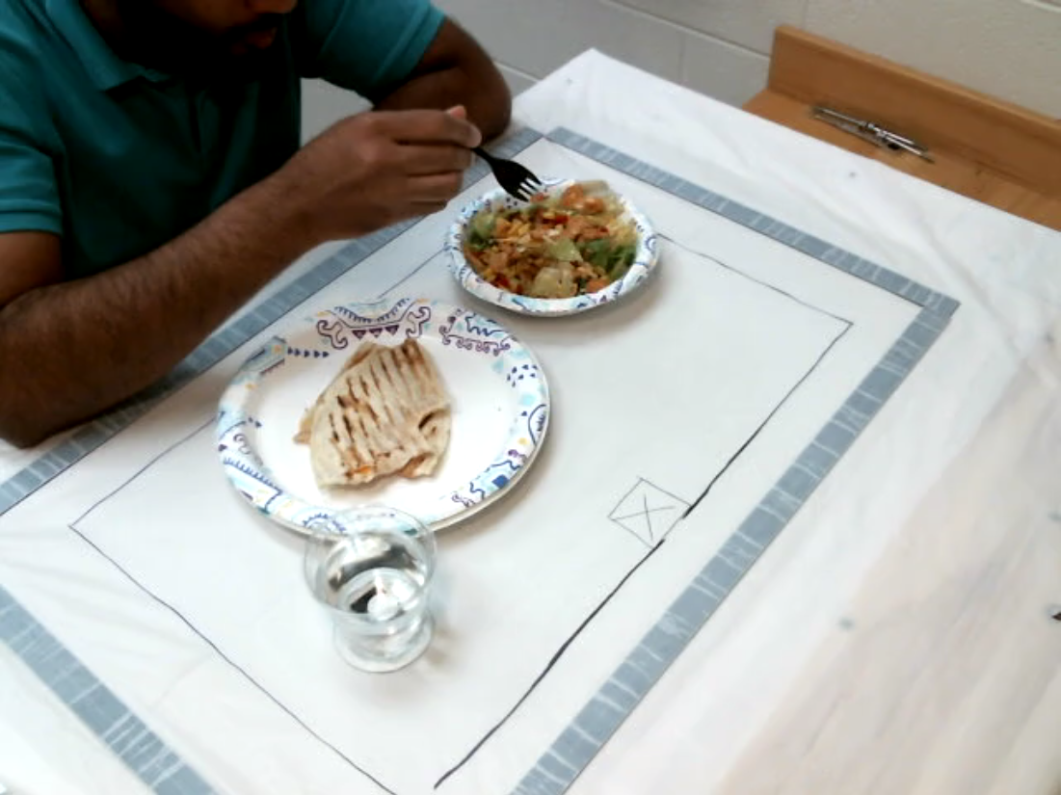
Novelty
Hardware design with 5 cm resolution of weight measurements across tabletop surface
Algorithm was developed and a pilot experiment (n=11) was conducted to demonstrate intake measurements during meals
More data (n=32) were collected for comparing our instrument to related works that use smart surfaces or scales

Slide 13
Outline
Motivation and Background
Related Work on Smart Surfaces
Novelty
Hardware
Pilot Experiment
Comparison of Eating Detection Methods On Smart Surfaces

Slide 14
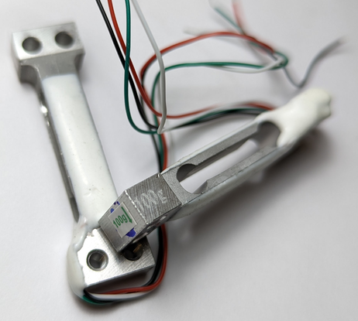
Load Cell Selection
Rated load | 100 g
Comprehensive error | 0.05%F.S
Rated output | 0.7±0.15mV/V
Error {Linearity, Hysteresis, Repeatability} | ±0.05%F.S
Creep | ±0.05%F.S/5min
Zero balance | ±0.1mV/V
Input resistance | 1130±10Ω or 1090±10Ω
Output resistance | 1000±10Ω
Temperature effect on zero | 0.1%F.S/10℃
Temperature effect on output | 0.05~0.1%/10℃
Insulation resistance | ≥2000MΩ
Dimension | 47 x 12 x 6 mm (L x H x W)
Mechanical deflection | 75.5±9.5 um
Excitation voltage | 5~10VDC
Ultimate overload | 150%F.S
QL-56 mini (Hanzhong Quanyuan Electronic Co., Ltd, China)

Slide 15
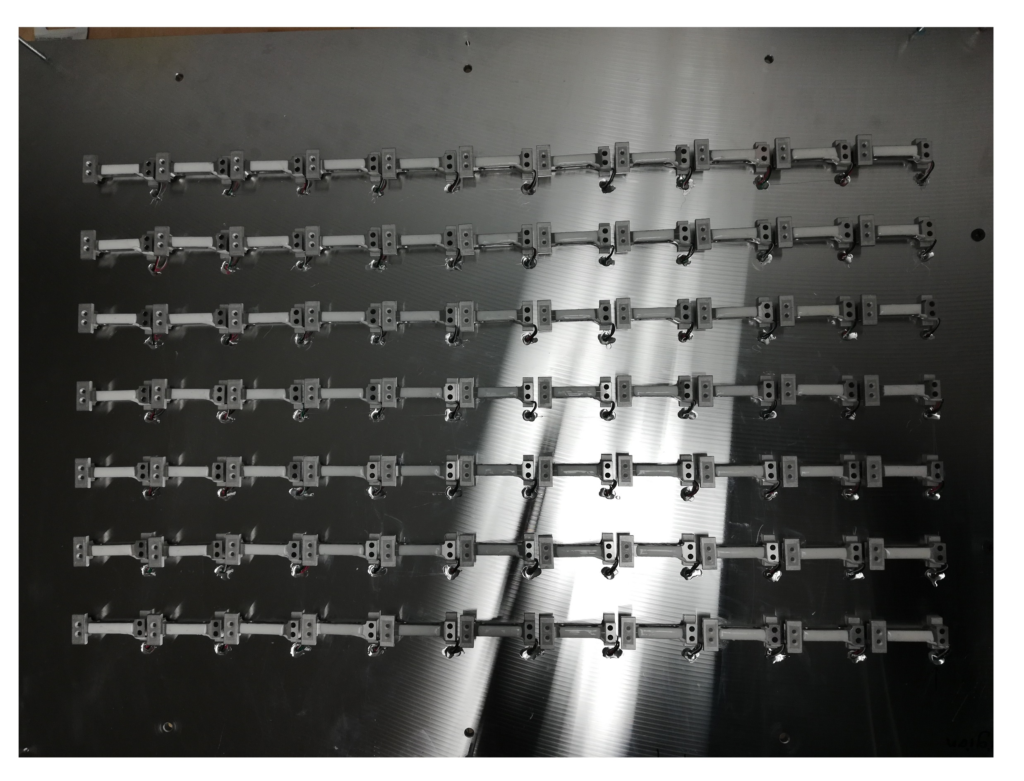
Mount Load Cells on a Metal Base
6061 Aluminum alloy
700 mm length, 500 mm width, and 6.4 mm thickness
Base and the washers were manufactured with a CNC machine

Slide 16
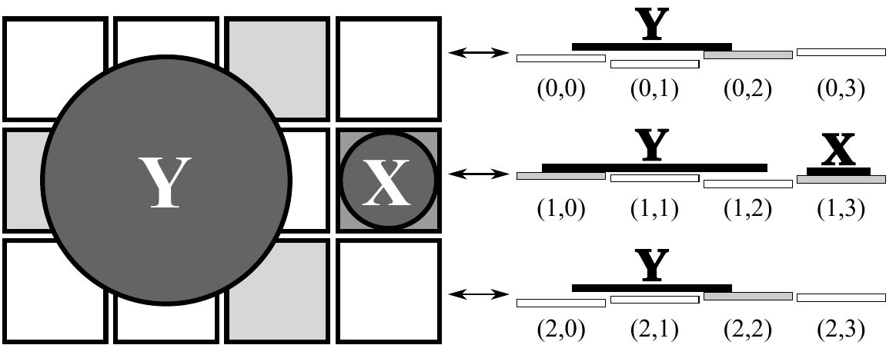
The challenge in using a grid of load cells for a force mapping surface
Vertical deviation among tops of tiles
Flatness is needed for
even weight distribution onto all load cells on which an object rests
spatial information

Slide 17
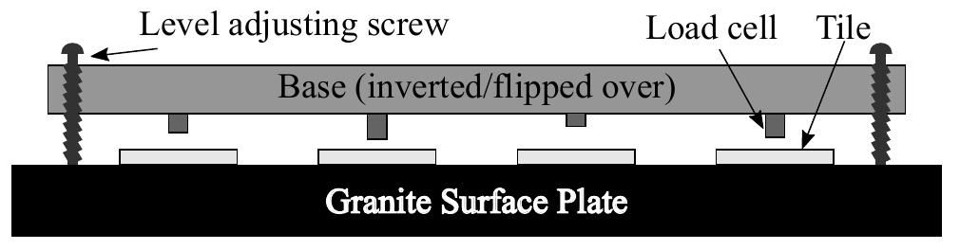
The Flatness Problem
Granite Surface Plate for flatness reference (±1 um)
Level adjusting screws

Slide 18
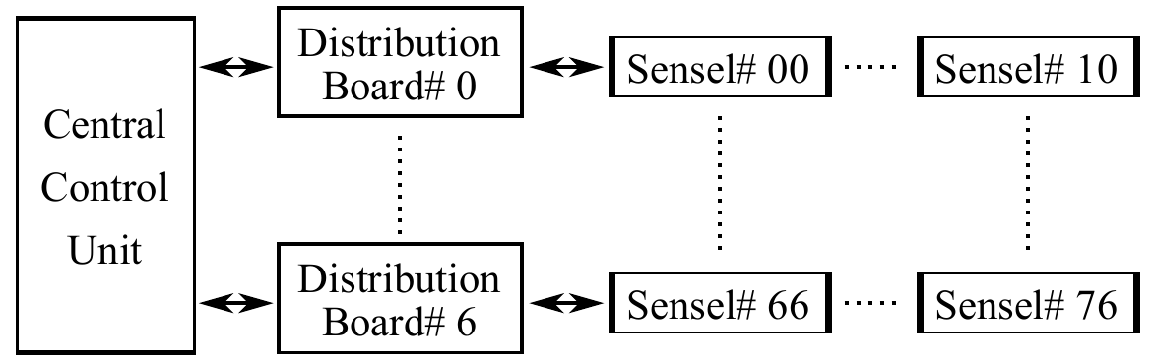
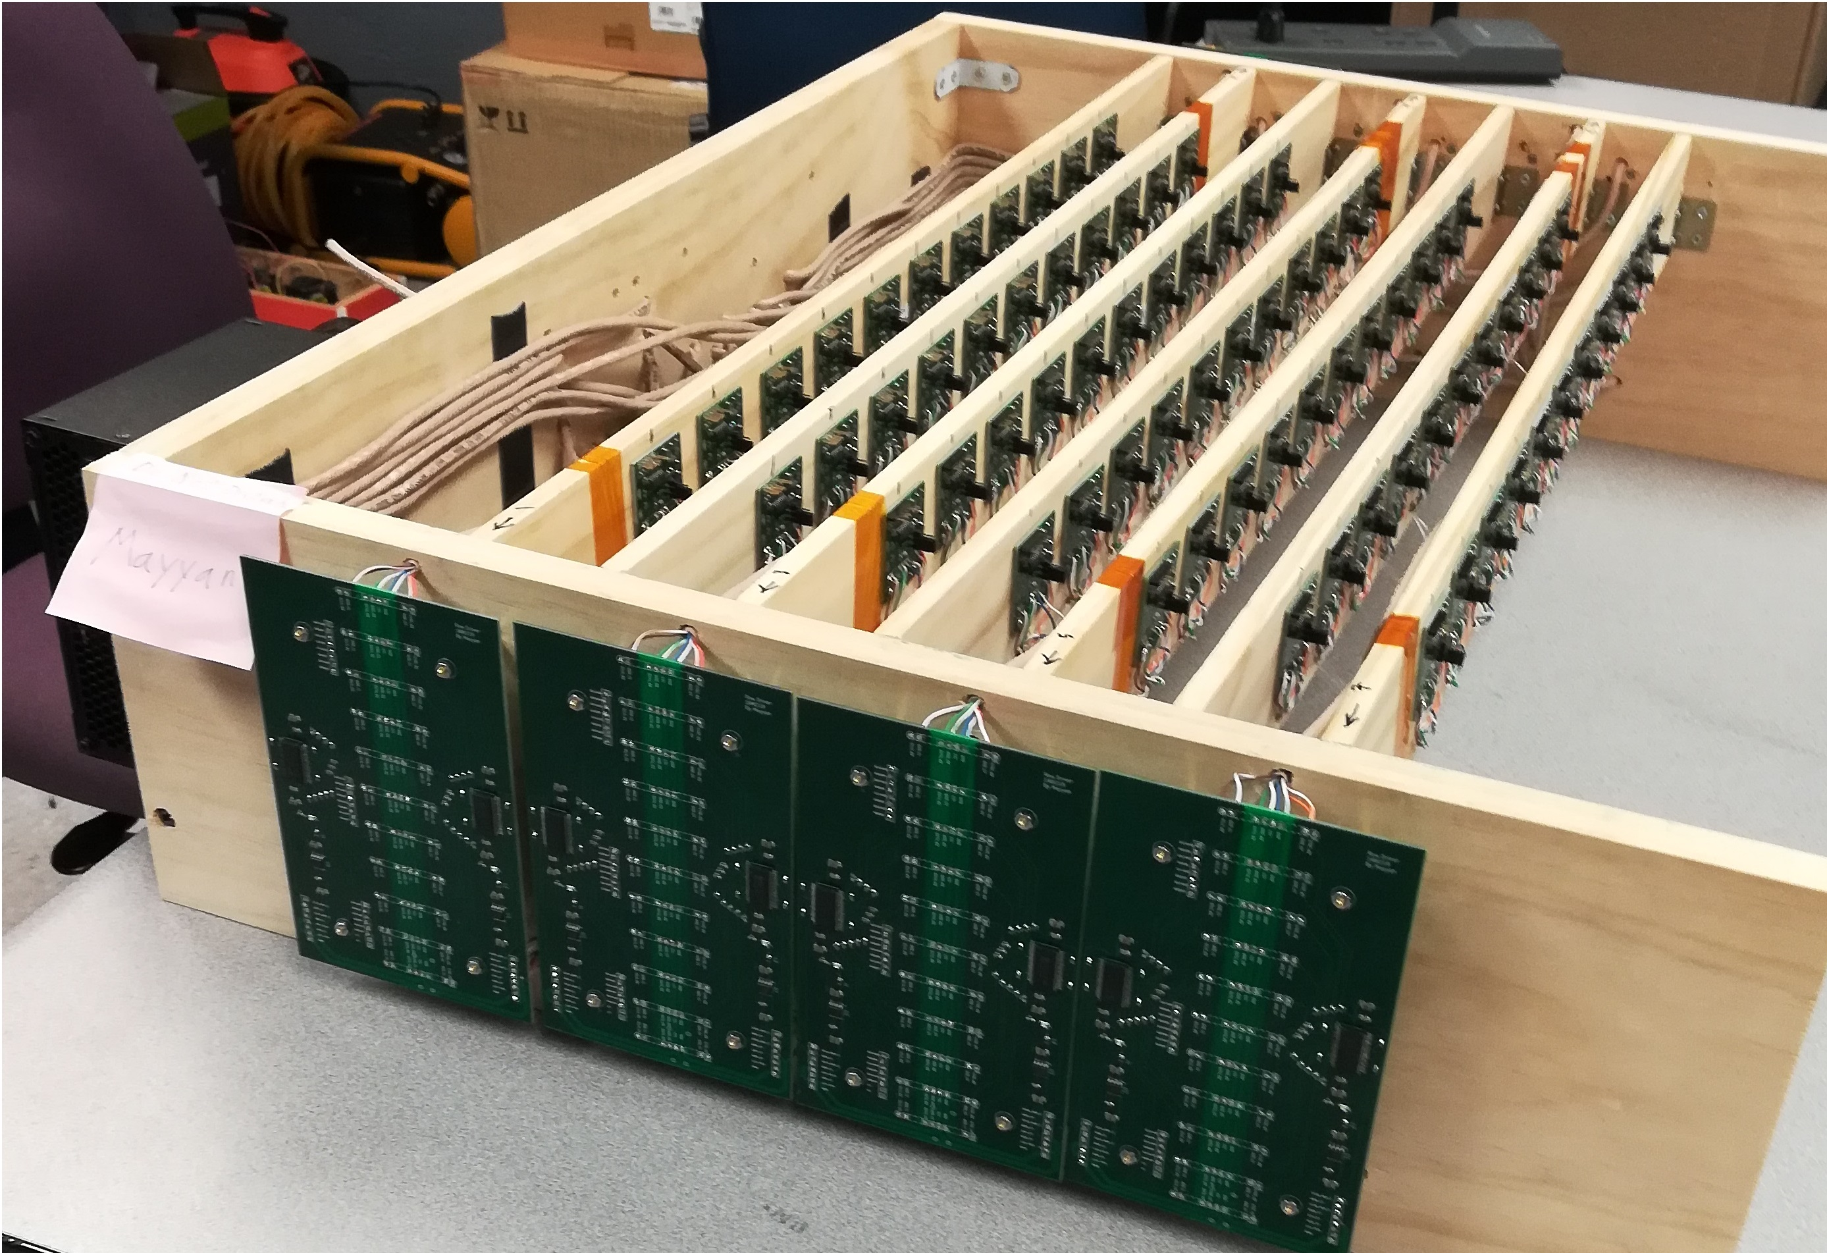
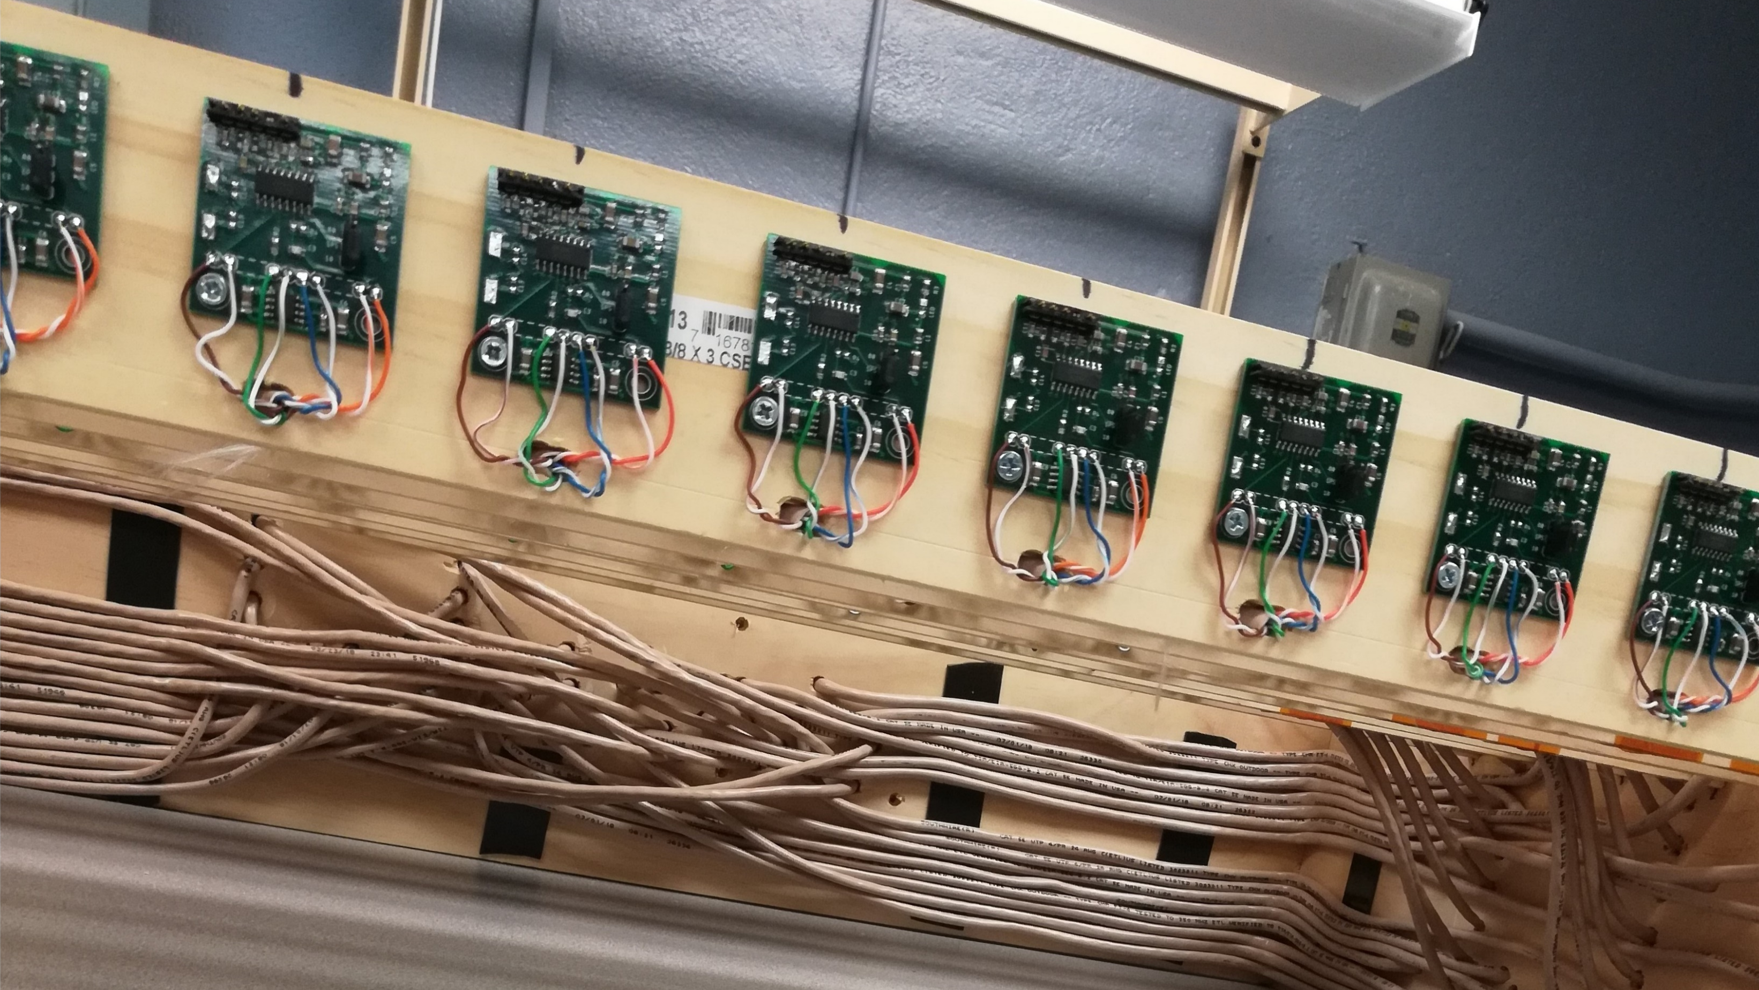
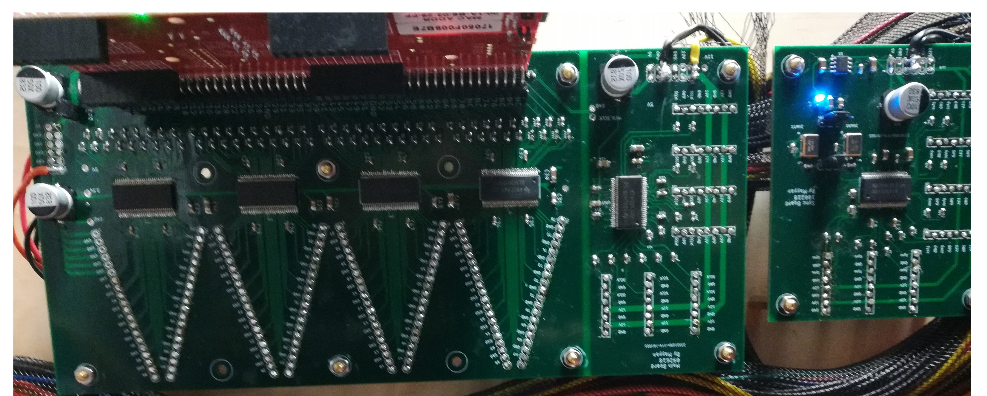
Electronics for Scanning a Grid of Load Cells
Central control unit
MCU
Data clock buffers
ADC Sync buffers
Distribution boards
Power
Sync
Data clock
Sensel boards
ADC
Power

Slide 19
Summary of Challenges
Step | Challenge | Solution
ADC | very small signal from load cells | put sensel boards as close as possible to their load cells. use parallel topology for the distribution of the sync and clock signals.
clock distribution | Ringing, cross talk (EMI), and ground loops | use four-layer PCBs + shielded Ethernet cables. match the characteristic impedance of PCB routes and cables. use terminating resistors.
load cells | overload protection | use of stopper screws and manually tune each screw using a calibration weight
surface tiles | vertical deviation among tops of tiles | the inversion method

Slide 20
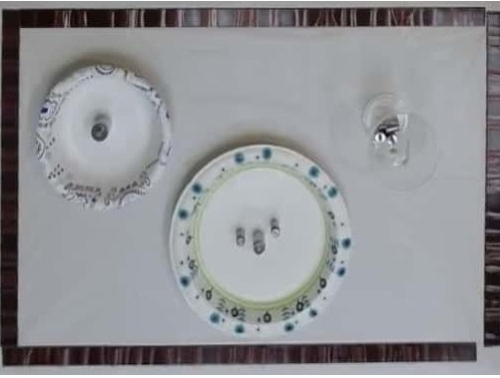
First Image of Weights

Slide 21
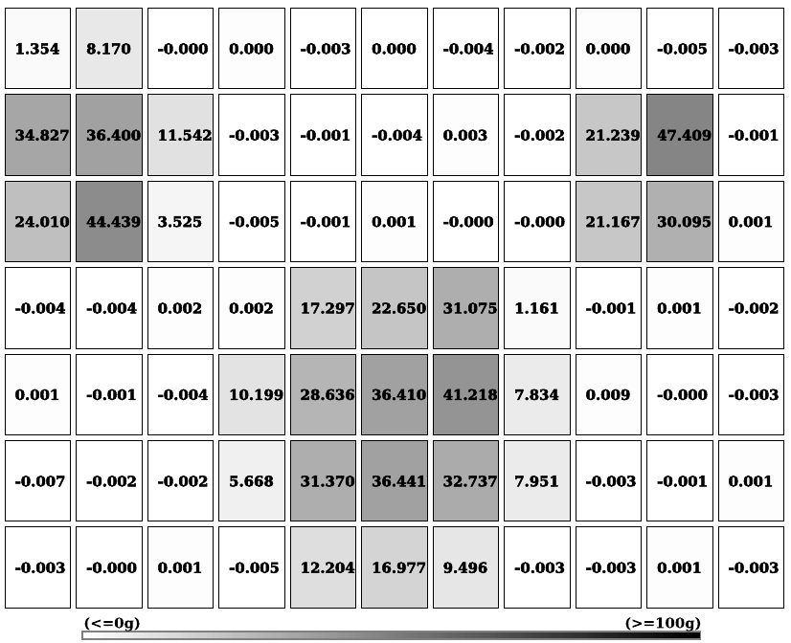
First Image of Weights
Cup rests on 4 tiles
Bowl rests on 8 tiles
Plate rests on 17 tiles

Slide 22
Hardware System Validation
Area tested | Purpose of testing | Positions | Repetitions
single cell | accuracy across different weights | 76 | 1
single cell | repeatability for detecting 50 mg while loaded with 100 g | 10 | 30
single cell | convergence to stable measurements | 10 | 2
2×2 cells | deviation among tile tops | 58 | 1
4×4 cells | accuracy in weight measurement when distributed across multiple tiles | 28 | 1
≥ 4×4 cells | ability to detect a weight change of 0.5 g on a plate containing 560 g of total weight | 6 | 25

Slide 23
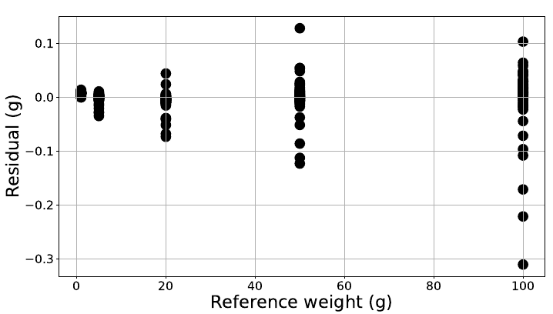
Results: Accuracy across different weights
Small effect of total weight on accuracy
Standard error increases with applied weight
Sensels have 57 mg of average standard error when loaded with a 100 g calibration weight
Notes:
1 0.002647
5 0.007452
20 0.015668
50 0.030241
100 0.057367
avrg 0.022675

Slide 24
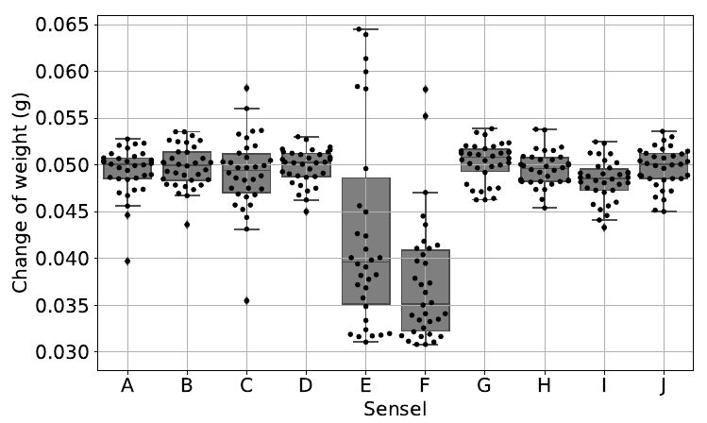
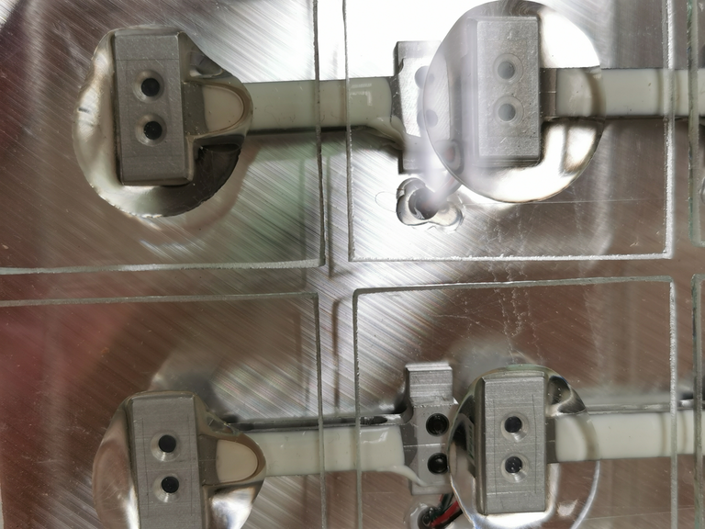
Results: Repeatability
Repeatability error was appx 3.8 mg at most locations
Notes:
0.002557 0.002246 0.004051 0.001878 0.012558 0.006626 0.002121 0.001874 0.002232 0.002164

Slide 25
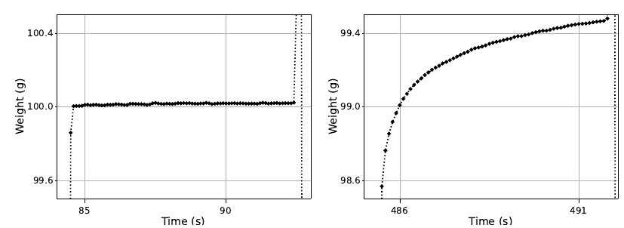
Results: Time to converge to stable weight
83% of grid cells
17% of grid cells

Slide 26
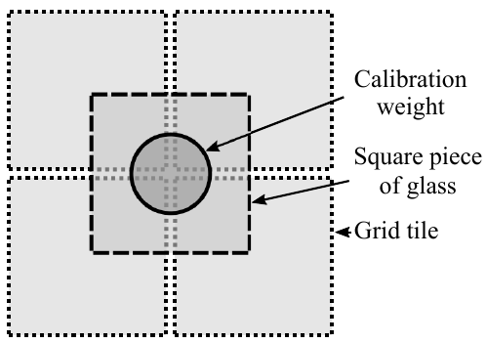
Results: 2 x 2 tiles for deviation in tile tops
A piece of glass (5X5 cm, 12.85 g) placed at the middle of a 2X2 grid area.
A calibration weight (100 g) is placed at the middle of the square piece of glass.
Notes:
The average standard deviation for all 58 positions is 5.5 g.
From the perspective of flatness of the grid surface, we found that
there is an approximately 4.2$\pm$0.5 um deviation observed in this
test assuming that 75.5$\pm$9.5 um is the average full mechanical
deflection of the QL-56 mini load cell — from no load to full load
at the rated capacity

Slide 27
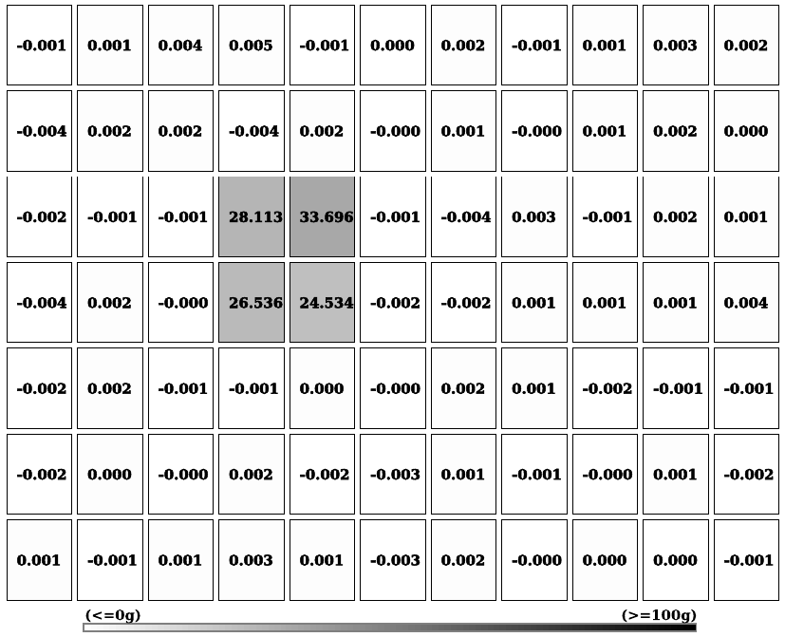
Results: 2 x 2 tiles for deviation in tile tops
The average standard deviation for all 58 positions is 5.5 g.
From the perspective of flatness, there is an approximately 4.2±0.5 um deviation
Notes:
The average standard deviation for all 58 positions is 5.5 g.
From the perspective of flatness of the grid surface, we found that
there is an approximately 4.2$\pm$0.5 um deviation observed in this
test assuming that 75.5$\pm$9.5 um is the average full mechanical
deflection of the QL-56 mini load cell — from no load to full load
at the rated capacity

Slide 28
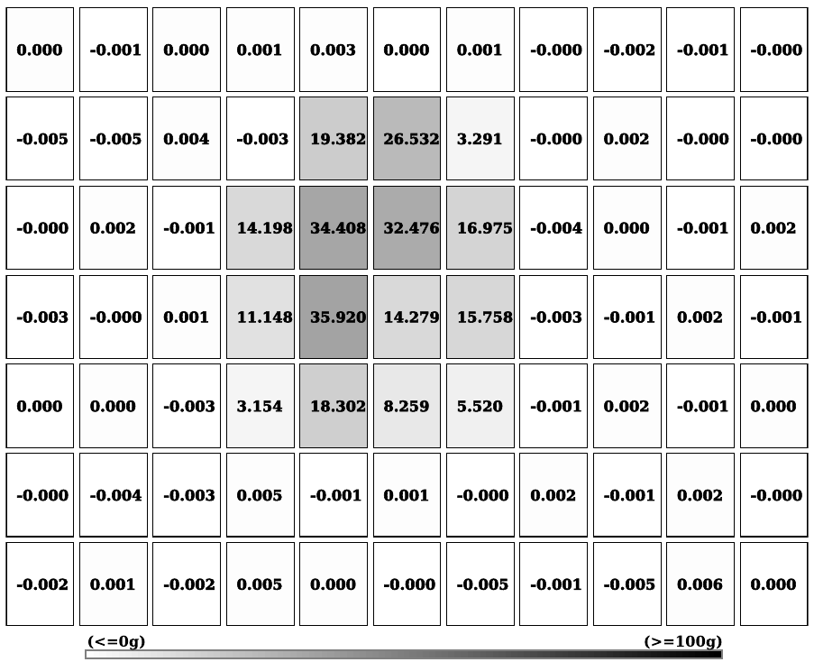
Results: accuracy in weight distributed across 4 x 4 tiles
A flat-bottomed plate weighing 260 g was tested at 28 different positions across the grid
99.97±0.1% accuracy of weight measurement was obtained
Weight distribution among tiles was ±12.44 g
Notes:
99.97±0.1% accuracy in weight estimate
(259.92/260 $\pm$ 0.22/260)

Slide 29
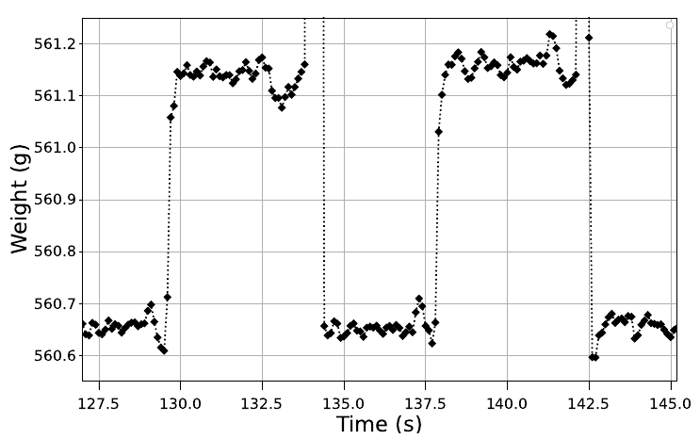
Results: Small Weight Removed from a Plate
40 SNR was obtained when a calibration weight of 0.5 g was picked up from a plate containing a total weight of 560 g

Slide 30
Outline
Motivation and Background
Related Work on Smart Surfaces
Novelty
Hardware
Pilot Experiment
Comparison of Eating Detection Methods On Smart Surfaces

Slide 31
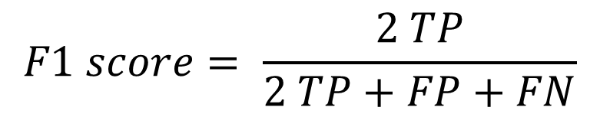
Pilot experiment
Purpose: The goal of this experiment is to determine if intake events can be reliably detected on a microgrid smart table surface
Methods:
11 Human subjects recruitment (IRB# IRB2021-0462)
Segmentation algorithm (details in document)
custom coded for 3 known containers
Intake event detection (details in document)
food
food mass
beverage
utensil (no intake)
Metrics: F1-score for bite detection
$$F1 score= \frac{2 TP}{2 TP+FP+FN}$$

Slide 32

Human Subjects
11 participants were recruited
Age: 20 to 30
Gender: 10 male, 1 female
BMI: 25 ± 5 kg/m²
Food choices:
Frozen meals and fresh salads were ordered from local grocery stores (for COVID-19 conditions)
Water

Slide 33
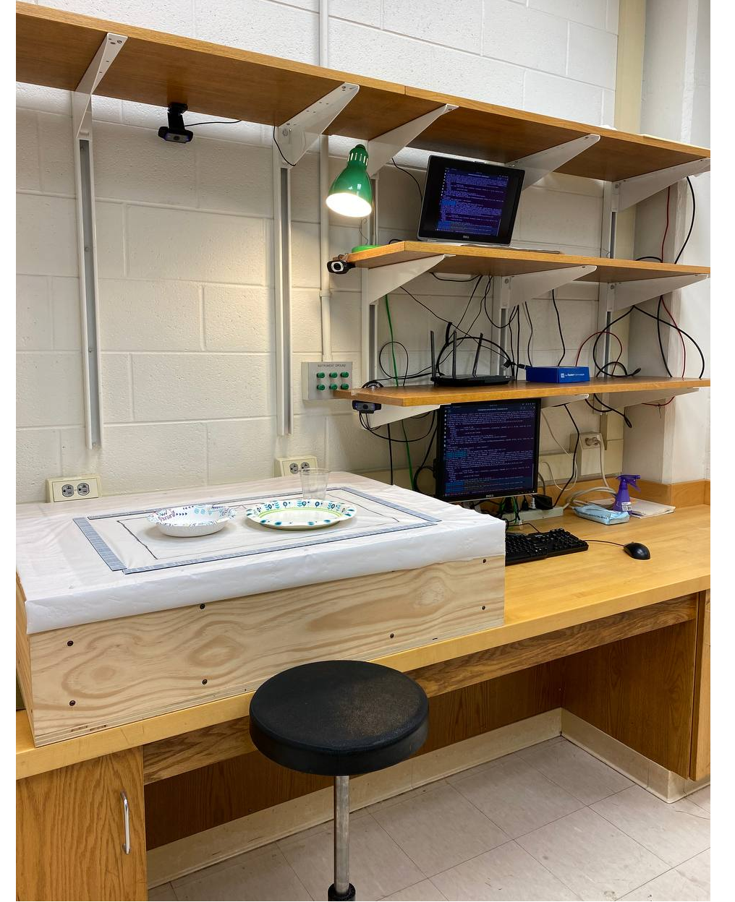
Human Subjects
Subjects signed consents
Subjects prepared food in lab
Video was recorded for ground truth
GT events = 685 total, 62 average
Meal duration = 129 minutes total, 11.77 minutes average

Slide 34
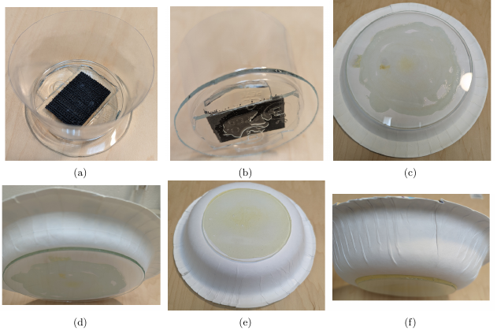
Flat-Bottomed Bases for Food Containers
Bases for food containers were attached to circle-shaped pieces of regular glass for making flat-bottomed dishes
(a) and (b) a plastic cup was cut in half
6.5 cm diameter
(c) and (d) a paper plate
19 cm diameter
(e) and (f) a paper bowl
10 cm diameter

Slide 35
Bite Detection Performance – 11 Subjects
F1-score for the 11 subjects:
Per subject
96.7% Average
100% maximum
91.2% minimum
Per container
96.5% for the plate and bowl
99.3% for the cup
Conclusion: the pilot experiment provided confidence that the tool could reliably detect intake events
Notes:
the harmonic mean of precision and recall

Slide 36
Outline
Motivation and Background
Related Work on Smart Surfaces
Novelty
Hardware
Pilot Experiment and Algorithm
Comparison of Eating Detection Methods On Smart Surfaces

Slide 37
Dataset
32 subjects
23 males
9 females
GTs = 1,836
Total meal duration = 376 minutes
 | minimum | average (±STD) | maximum
BMI (kg/m2) | 16.5 | 25.6 (±6) | 47.8
age (years) | 20 | 25.9 (±5.5) | 40
meal duration (minutes) | 5.2 | 11.7 (±4.2) | 23.6
ground truth moments | 29 | 57.4 (±19.4) | 103

Slide 38
Comparison of Methods for the Detection of Eating Events Using Smart Tables or Scales
Ref. | Algorithm | Instrument
[1] | rule-based | a dining table embedded with weighing scales
[2] | context-free grammar (CFG) | the Mandometer, version 5
[3] | random forest classifier | a three-compartment smart plate embedded with three load cells
This work | rule-based | 7 × 11 grid of load cells embedded under the surface of a custom-built dining table
[1] Mattfeld et al. (2016), Measuring the consumption of individual solid and liquid bites using a table-embedded scale during unrestricted eating
[2] Papapanagiotou et al. (2018), Automatic analysis of food intake and meal microstructure based on continuous weight measurements
[3] Mertes et al. (2019), Measuring and localizing individual bites using a sensor augmented plate during unrestricted eating for the aging population

Slide 39
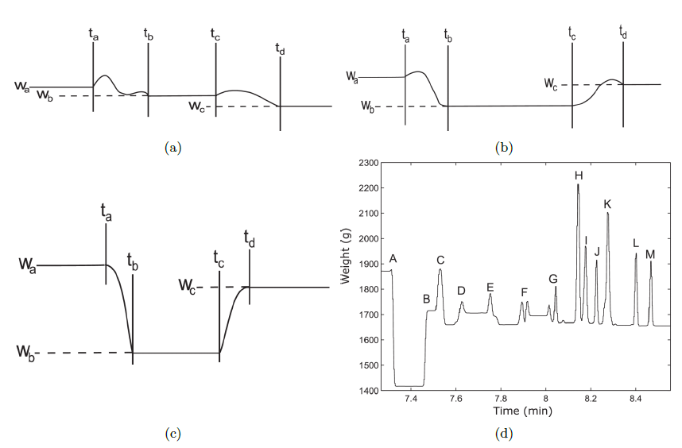
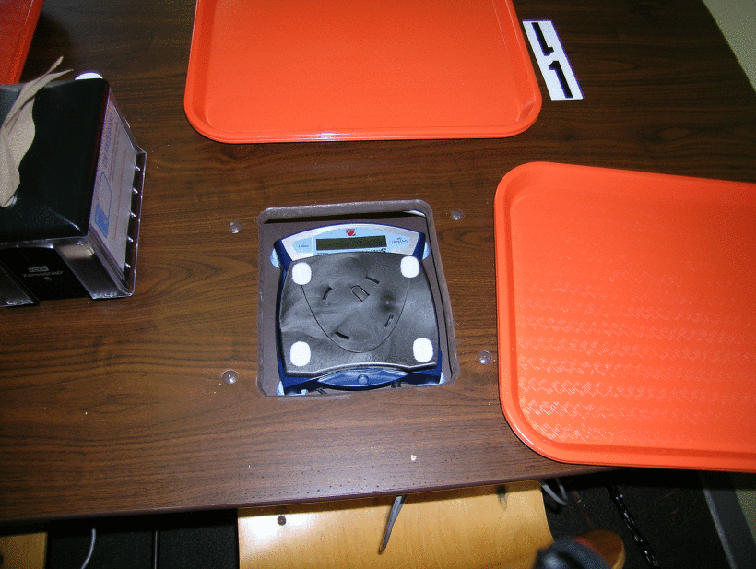
Rule-based by Mattfeld et al. (2016)
Single bite
3σ_{noise} < 30g
Mass food
100 to 300 g
3σ_{noise} < 30g
Drink bite
80 to 550 g
3σ_{noise} < 80g
[Mattfeld et al. (2016)]
Source code provided by author
[1] Mattfeld et al. (2016), Measuring the consumption of individual solid and liquid bites using a table-embedded scale during unrestricted eating

Slide 40
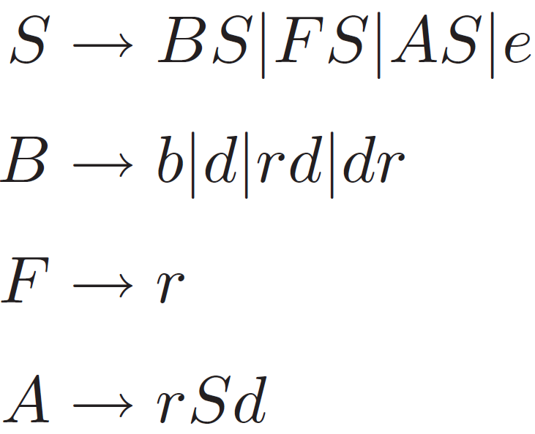
Context-Free Grammar by Papapanagiotou et al. (2018)
[Papapanagiotou et al. (2018)]
A bite occurs at:
a small ↓
a large ↓
↑ then ↓
↓ then ↑
Evaluated by the author
[1] Papapanagiotou et al. (2018), Automatic analysis of food intake and meal microstructure based on continuous weight measurements

Slide 41
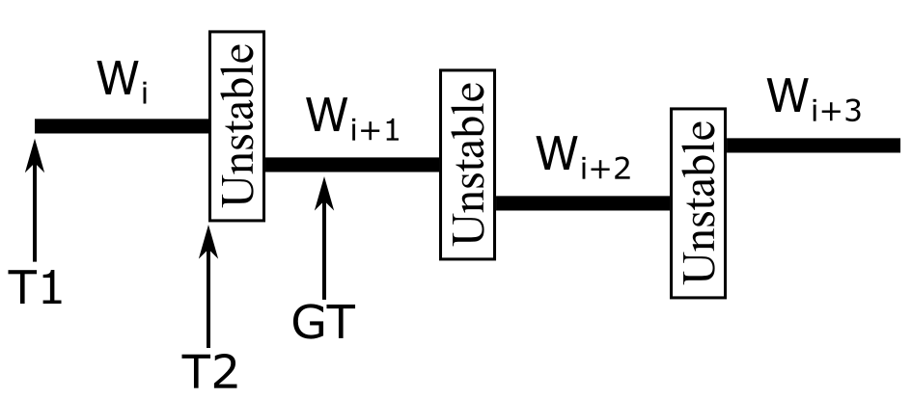
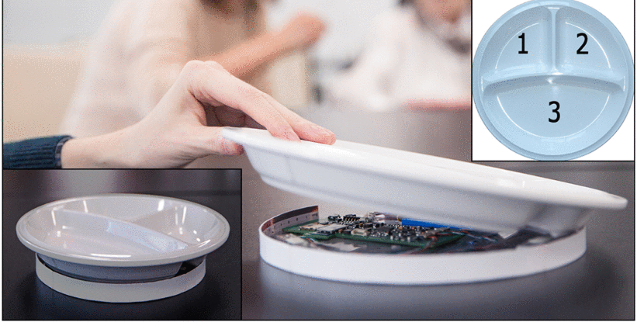
Random Forest Classifier by Mertes et al. (2019)
Feature vectors X_{i} are constructed using three consecutive stable regions
Our dataset was converted into 3,151 feature vectors
While author used MATALB, we reimplemented their method using the Python library scikit-learn. We used the same settings.
[Mertes et al. (2019)]
[1] Mertes et al. (2019), Measuring and localizing individual bites using a sensor augmented plate during unrestricted eating for the aging population

Slide 42
Metrics for Evaluating the Bite Detection
An actual bite is the moment when a subject puts food or beverage in their mouth
True positive (TP) is when a detection event occurs while an actual GT bite event was labeled in that stable window
False positive (FP) is when a detection event occurs while no actual GT bite event was labeled in that stable window
False negative (FN) is when no detection event occurs while an actual GT bite event was labeled in that stable window

Slide 43
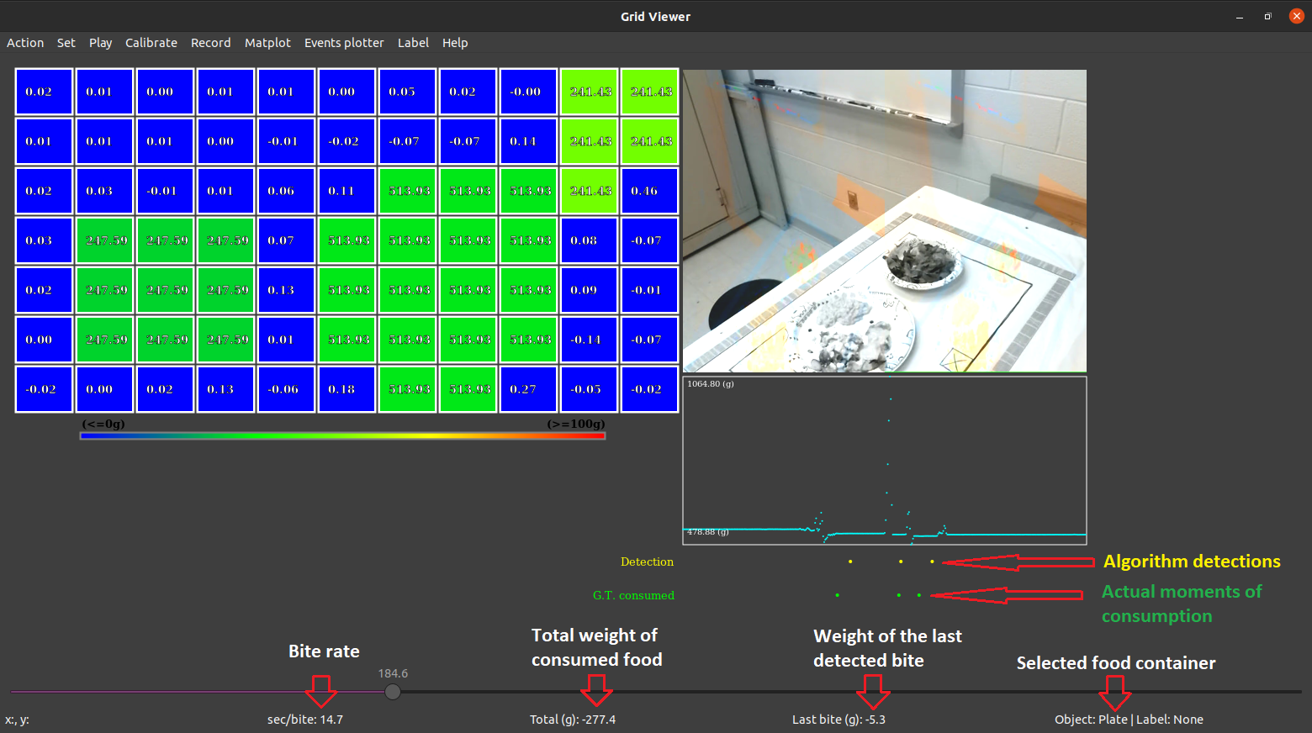

Slide 44

Metrics for Evaluating the Bite Detection
$Precision= \frac{TP}{TP+FP}$
$Recall= \frac{TP}{TP+FN}$
$Accuracy= \frac{TP}{TP+FP+FN}$
$F1 score= \frac{2 TP}{2 TP+FP+FN}$

Slide 45
Results: Comparison
Author | F1-Score | Recall | Accuracy | Precision
Mattfeld et al. 2016 | 0.86 (±0.01) | 0.78 (±0.43) | 0.77 (±0.38) | 0.98 (±0.03)
Mertes et al. 2019 | 0.84 (±0.05) | 0.84 (±0.05) | 0.84 (±0.05) | 0.84 (±0.05)
Papapanagiotou et al. 2018 | 0.78 (±0.01) | 0.76 (±0.49) | 0.64 (±0.23) | 0.83 (±0.25)
This work | 0.96 (±0.03) | 0.97 (±0.03) | 0.92 (±0.06) | 0.97 (±0.04)
Averages (±STD)
Evaluation was done per subject

Slide 46
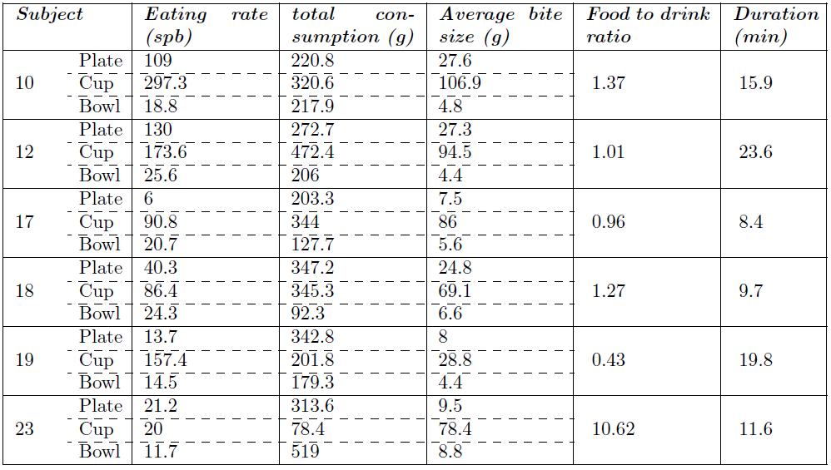




Table of Eating Behaviors
Notes:
the harmonic mean of precision and recall

Slide 47
Conclusion
Motivated by the growing problem of obesity
We built a dining table
embedded with a 7 x 11 grid of load cells (5 x 5 cm resolution)
4.2±0.5 um deviation among tops of tiles
Ability to measure 500 mg reduction of weight with 40.2 SNR
>99% Accuracy when weight of a plate is distributed among 4x4 tiles
Detection algorithm and pilot study for validation
11 subjects were recorded
F1-score of 96.7% average was obtained for the detection of eating events
A comparison against three state-of-the-art methods
A total of 32 subjects were recorded
2D data improves the bite detection accuracy
Our method scored the highest for recall (13-21% higher), accuracy (8-28% higher), and F1-score (10-18% higher)
For the assessments of eating behaviors, 2D data provides more information, e.g., for each container

Slide 48
Bite Detection Performance of our Method
32 Subjects
Evaluation was done per container
Metric | Plate | Cup | Bowl
TP | 714 | 178 | 895
FP | 66 | 2 | 22
FN | 18 | 1 | 30
Precision | 0.92 | 0.99 | 0.98
Recall | 0.98 | 0.99 | 0.97
Accuracy | 0.89 | 0.98 | 0.95
F1-score | 0.94 | 0.99 | 0.97
Notes:
the harmonic mean of precision and recall

