Slide 1
Detecting Occlusions of Automobile Parts Being Inspected By a Camera System During Manufacturing Assembly
MS Thesis Defense
Jayadevan Puthumanappilly
Committee Members:
Dr. Adam Hoover (chair)
Dr. Richard Brooks
Dr. Yongqiang Wang
August 13, 2015
Department of Electrical and Computer Engineering

Slide 2
Outline
Motivation and Background
Design and Methods
Results
Conclusion
Notes:
2

Slide 3
Outline
Motivation and Background
Design and Methods
Results
Conclusion
Notes:
3

Slide 4
Motivation
Demo of the setup program running the Spring coil use case
Existing system deployed at the BMW Spartanburg manufacturing plant
Notes:
4

Slide 5
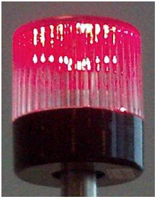
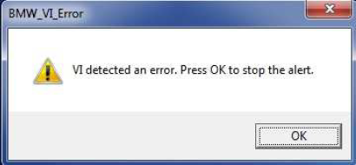
Motivation (continued)
Why is this a problem?
‘NOK’ inspection result
Audio-visual feedback
Human operator has to acknowledge the not-ok result
Notes:
5

Slide 6
Motivation (continued)
Ultimately, some way to let the operator know that an occlusion has happened
This thesis addresses the first step in achieving that objective
Notes:
6

Slide 7
Background of VI
VI operates on an assembly line, inspects each car as it passes by
“Use case” – a specific installation where VI is set up to monitor a particular part (or set of parts) of a car
Demo of the setup program running the Underbody use case
Notes:
7

Slide 8
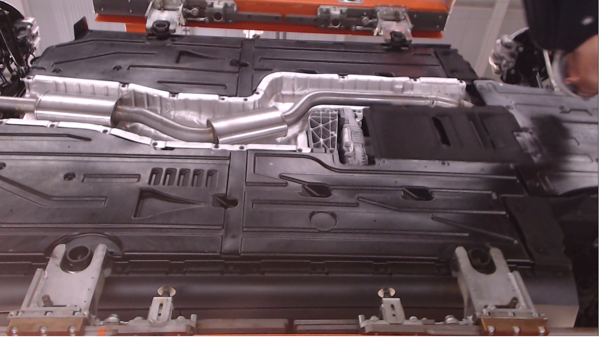
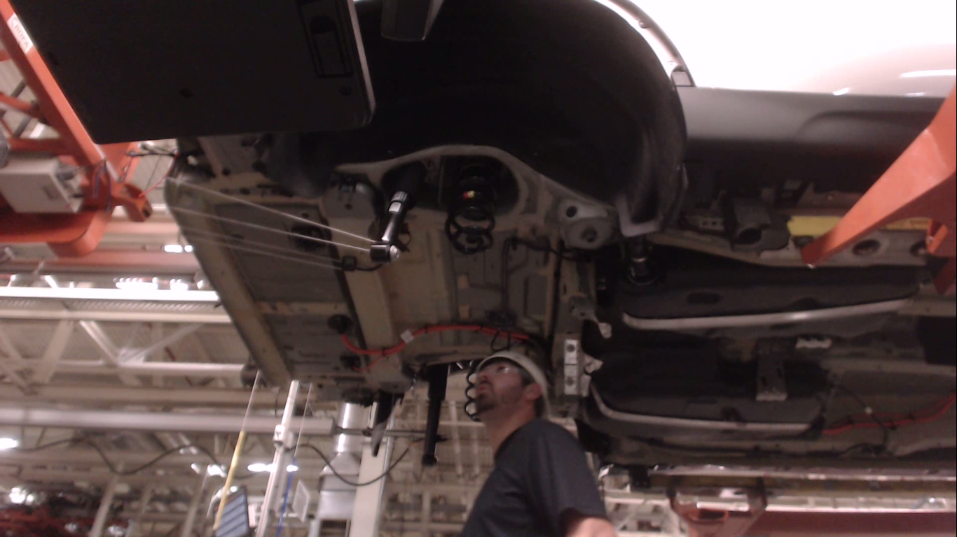
Occlusions during inspection
When do occlusions occur?
1. Line of sight blocked
2. Light blocked
Notes:
8

Slide 9
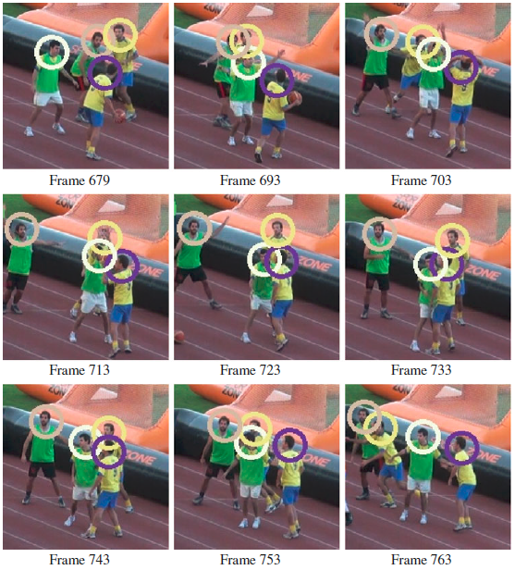
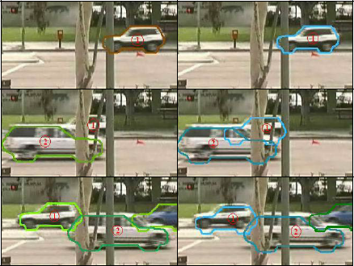
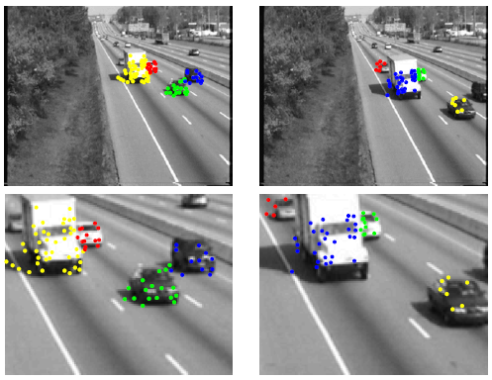
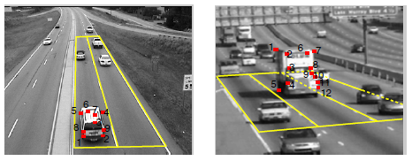
Related work
Vehicle tracking – changes in speed, direction, occluded areas, lighting
People tracking – changes in posture, trajectory, occlusion frequency, locations
Notes:
9

Slide 10
Novelty
Goal of this work is simpler – detect occlusions within the easier constraints of:
1. An assembly line (movement in one direction, predictable trajectory, consistent distance between part and camera, controllable lighting conditions)
2. Limited set of parts to be tracked (all parts known beforehand)
3. Occlusion to be detected in a consistent spot (point of interest is a small window being inspected)
A simpler system works best within such constraints – easier to setup, more accurate and robust, works with low-cost equipment
Notes:
10

Slide 11
Outline
Motivation and Background
Design and Methods
Results
Conclusion
Notes:
11

Slide 12
Overview of Design and Methods
Simulation testbed created, scenarios simulated
Simulation results analyzed
New algorithm proposed, based on analysis
New algorithm verified
Notes:
12

Slide 13
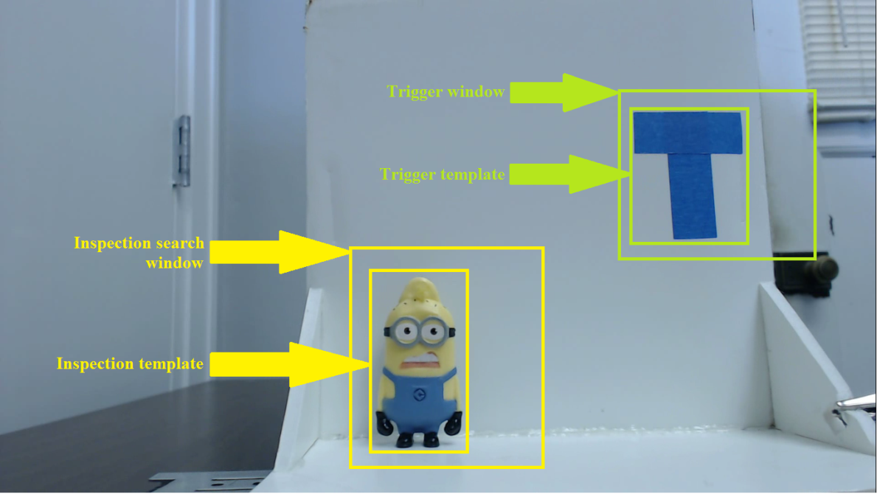
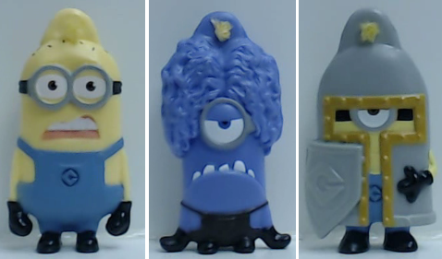
Simulation testbed
Testbed constructed to simulate movement of cars in assembly line
3 classes
1 inspection area
Notes:
13

Slide 14
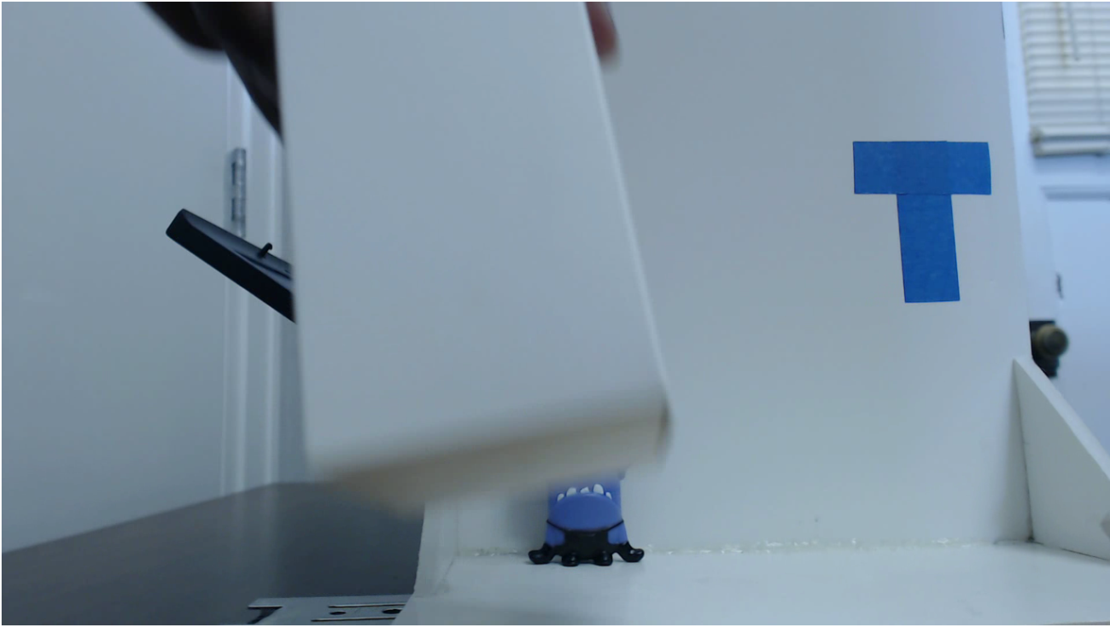
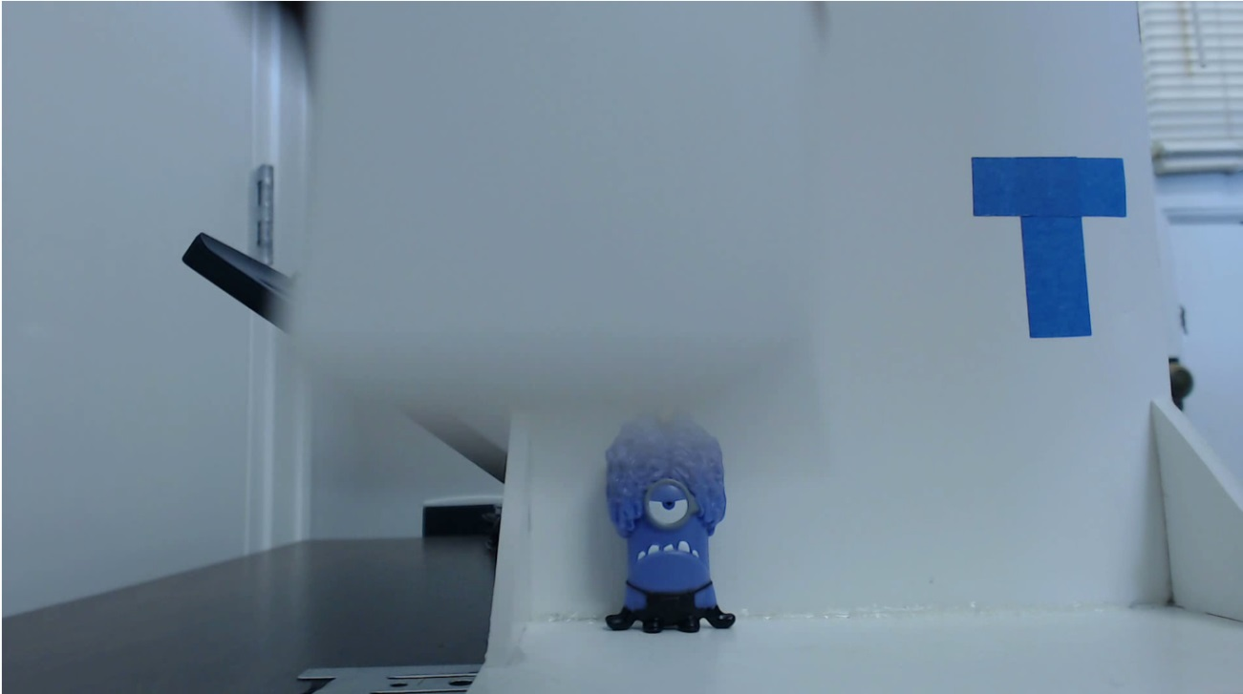
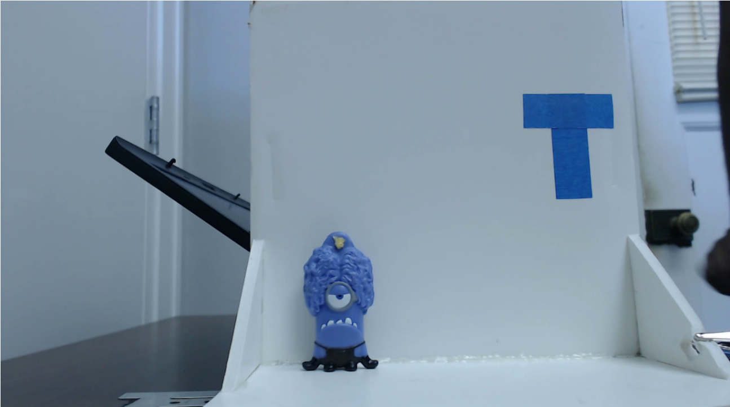
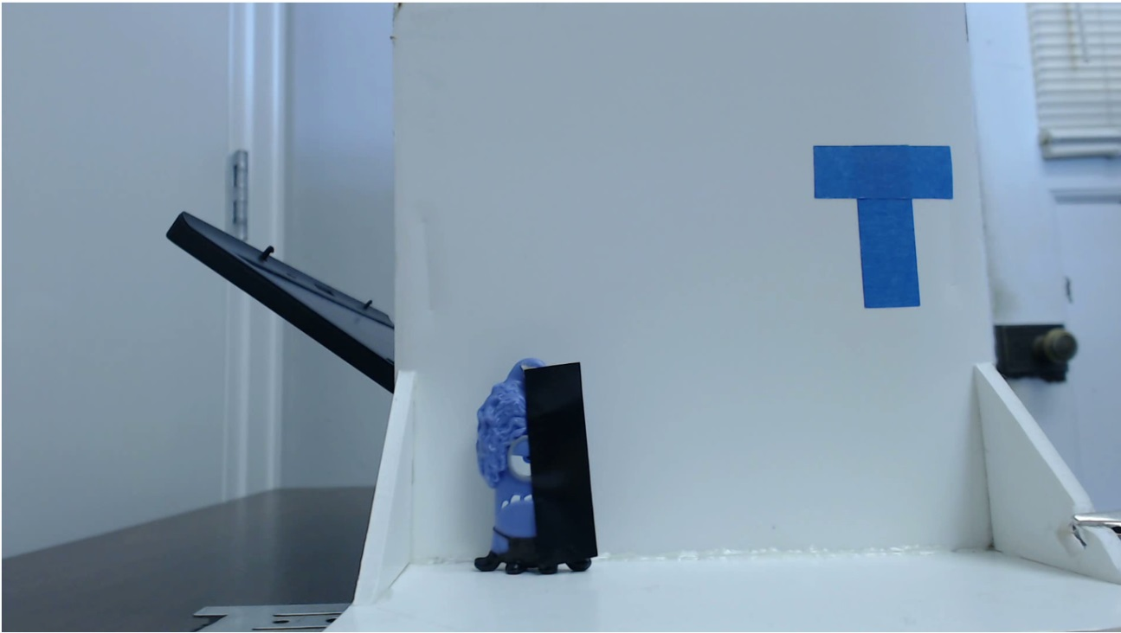
Scenarios simulated
Four types of cases:
No occlusion
Brief occlusion
Partial occlusion
Intermittent occlusion
Notes:
14

Slide 15
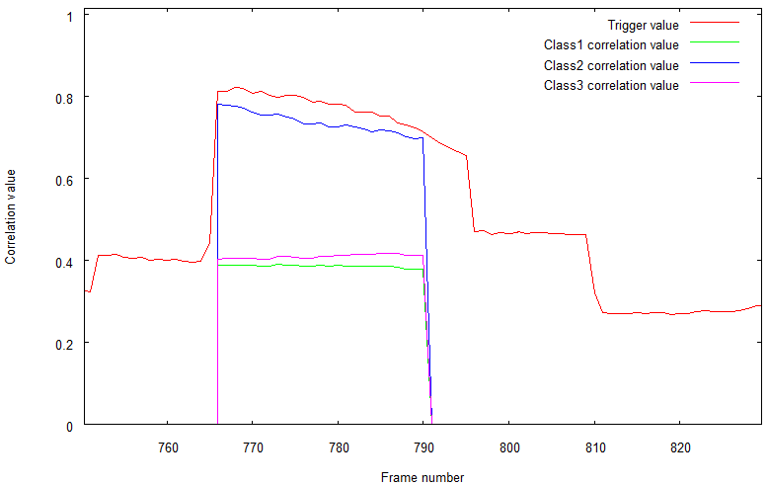
Analysis of simulation results
No occlusion (output correlation values for each image frame)
Notes:
15

Slide 16
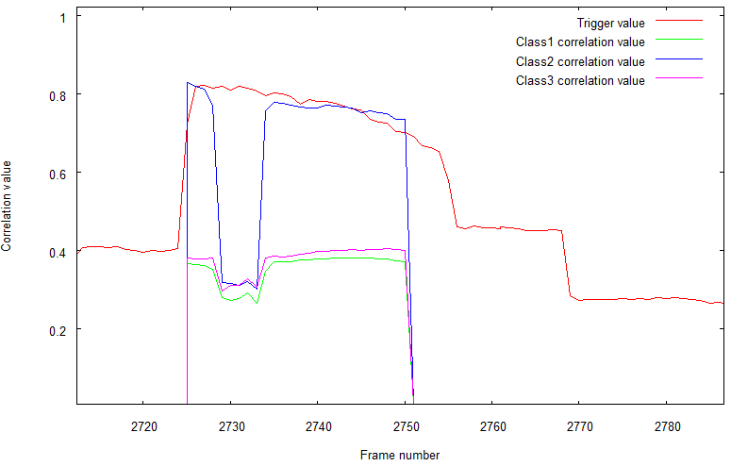
Analysis of simulation results (cont.)
Brief occlusion (output correlation values for each image frame)
Notes:
16

Slide 17
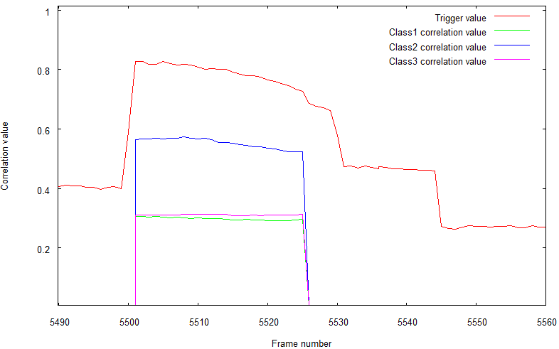
Analysis of simulation results (cont.)
Partial occlusion (output correlation values for each image frame)
Notes:
17

Slide 18
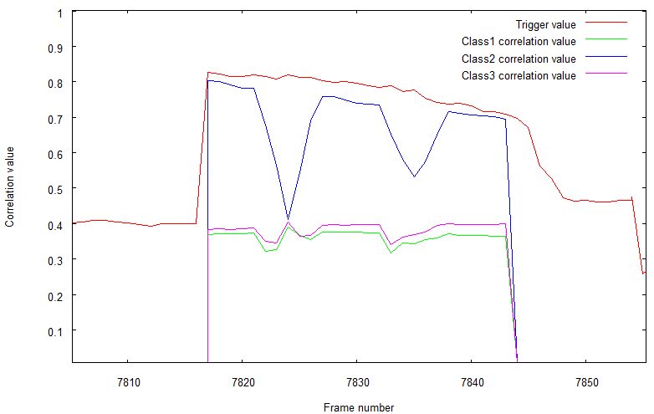
Analysis of simulation results (cont.)
Intermittent occlusion (output correlation values for each frame)
Notes:
18

Slide 19
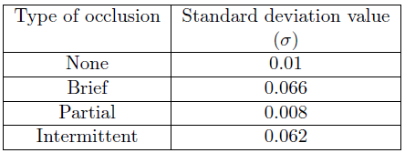
Analysis of simulation results (cont.)
Average standard deviation of correlation values is a good indicator of brief, intermittent, and no occlusions
Cannot detect partial occlusions
Notes:
19

Slide 20
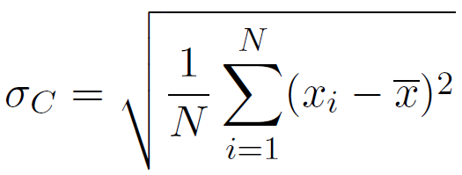
Statistics used in new algorithm
Set of class correlation values for each class within an inspection area defined as:
where N is the number of frames that have been triggered,
and M is the number of classes in this inspection area
For each class C, standard deviation of correlation values X_{C} computed as:
Notes:
20

Slide 21
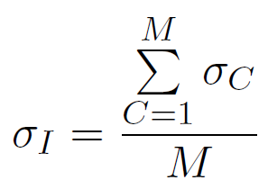
Statistics used in new algorithm (cont.)
Average value of standard deviation across all classes computed as:
Occlusion detected, if σ_{I} > pre-defined threshold for this use case
Notes:
21

Slide 22
Where does the new algorithm fit in?
Currently a stand-alone application
Ultimately integrate with VI during the classification process
Help VI make the OK/ not OK decision
Notes:
22

Slide 23
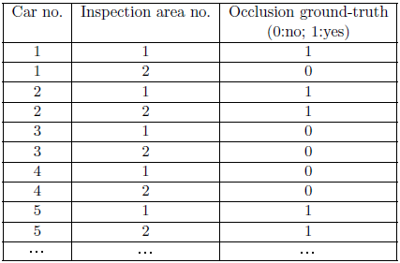
Verification of the new algorithm
First step – record ground-truth data for all six use cases
Demo of the ground truth generation process using the setup program, for the Spring coil use case
Notes:
23

Slide 24
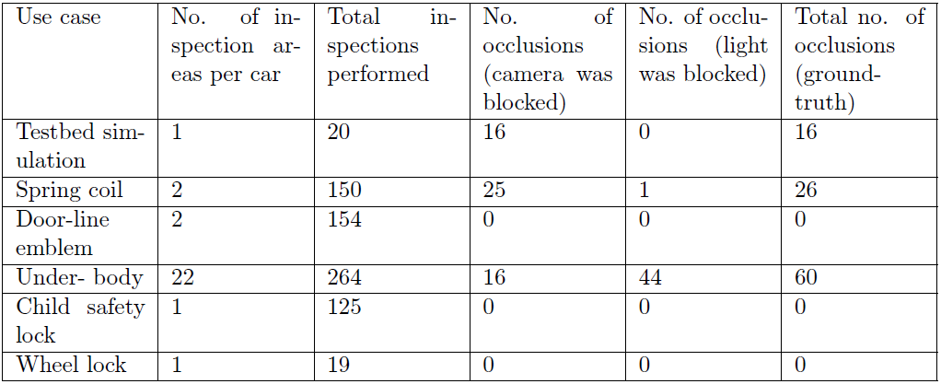
Verification of the new algorithm (cont.)
Net occlusions ground-truth information collected:
Notes:
24

Slide 25
Verification of the new algorithm (cont.)
Second step – select the threshold standard deviation value for each use case.
Find a threshold such that any value above threshold – occlusion; any value equal or below – no occlusion
1. Inspect live data for each use case
2. Compute average standard deviation values
3. Match the standard deviation values with ground truth information
4. Generate histogram of standard deviation values
5. Figure out where to draw the threshold
Notes:
25

Slide 26
Verification of the new algorithm (cont.)
Third (and final) step – run the live data through the new algorithm, with the new threshold standard deviation values obtained from the 2nd step.
Examine the results of occlusion detection, compare with the ground-truth information
Notes:
26

Slide 27
Outline
Motivation and Background
Design and Methods
Results
Conclusion
Notes:
27

Slide 28
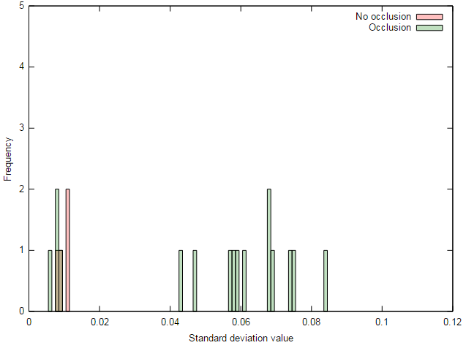
Selection of threshold for the Testbed simulation
16 inspections with occlusion, 4 inspections with no occlusion
Threshold of 0.04 chosen – good separation between TPs and TNs
Notes:
28

Slide 29
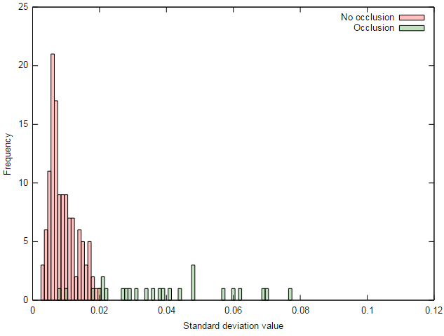
Selection of threshold for Spring Coil
124 inspections with no occlusion, 26 inspections with occlusion
Threshold of 0.02 chosen – captures all TNs, all TPs (except 4 partials)
Notes:
29

Slide 30
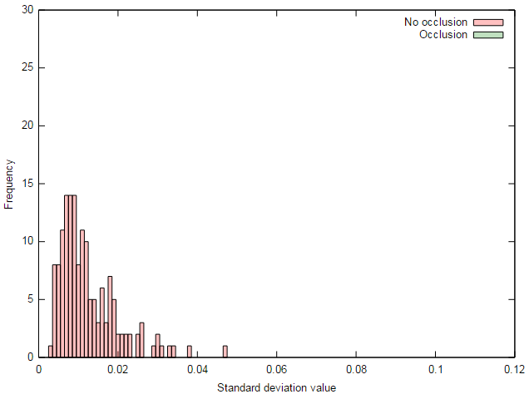
Selection of threshold for Door-line emblem
154 inspections, all with no occlusion
Threshold of 0.050 chosen – captures all TNs
Notes:
30

Slide 31
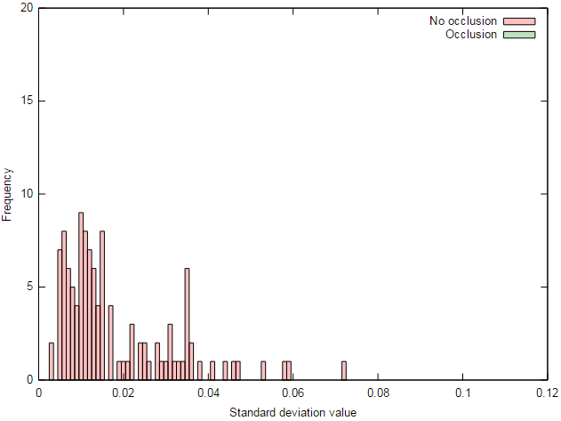
Selection of threshold for Child safety lock
125 inspections, all with no occlusion
Threshold of 0.075 chosen – captures all TNs
Notes:
31

Slide 32
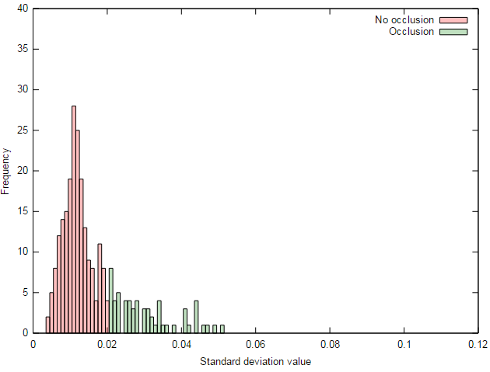
Selection of threshold for Underbody
204 inspections with no occlusion, 60 with occlusions
Threshold of 0.02 chosen – hard separation
Notes:
32

Slide 33
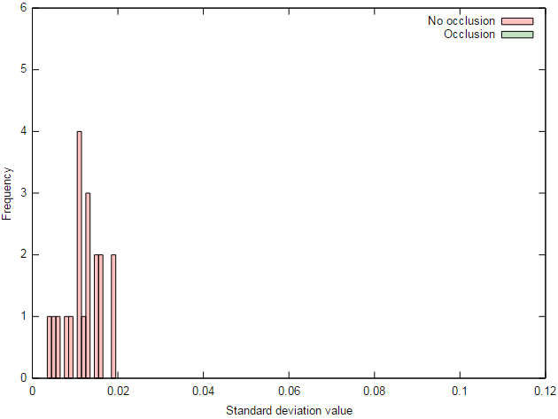
Selection of threshold for Wheel lock
19 inspections, no occlusions
Threshold value of 0.040 chosen to capture all TNs
Notes:
33

Slide 34
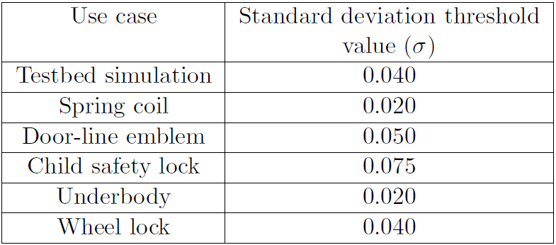
Summary of threshold values chosen
Varies from use case to use case:
Dependent on: lighting conditions (shadows), level of zoom of camera, amount of movement or jitter in the assembly
Threshold has to be adjusted individually for each use case
Notes:
34

Slide 35
Partial occlusions during inspection
3 partial occlusions from the Spring Coil use case
Notes:
35

Slide 36
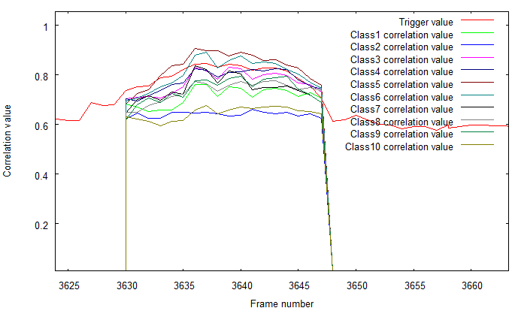
Assembly movement during inspection
Case in Door-line emblem with excessive shaking of assembly during inspection; no occlusion, but high std. deviation
Notes:
36

Slide 37
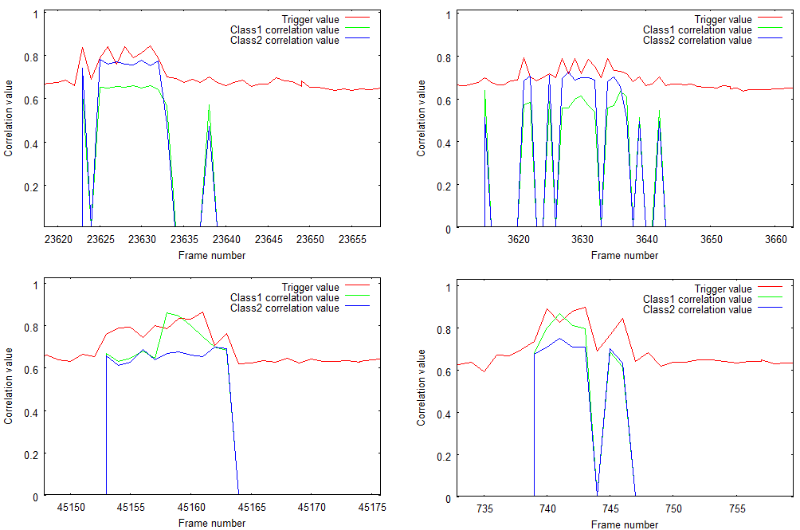
Assembly movement during inspection (cont.)
4 cases in Child safety lock with excessive shaking of assembly during inspection; no occlusion, but high std. deviation
Notes:
37

Slide 38
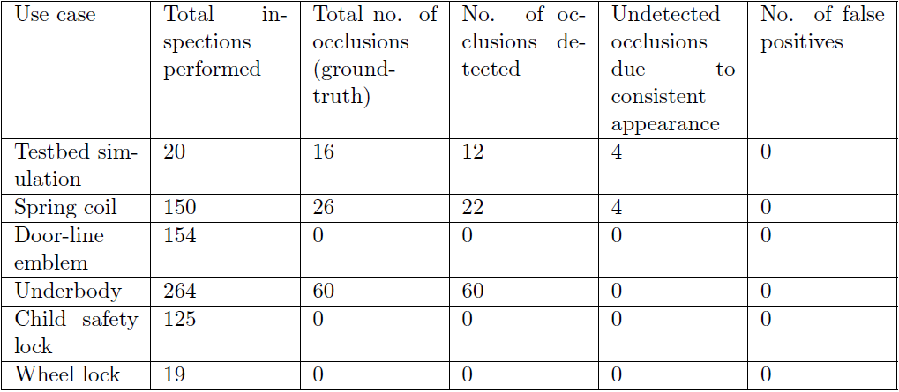
Net occlusions detected
740 inspections in total; 102 occlusions, 94 detected
No false positives
Overall occlusion detection accuracy of 98.9% (732/740)
Notes:
38

Slide 39
Conclusion
Developed a fast and simple method by which occlusions can be detected
Analyze standard deviation of correlation values output from template matching process to detect occlusions
Achieved an occlusion detection accuracy of 98.9%
Works well to detect brief and intermittent occlusions – the most common type of occlusions within our context
Does not detect partial occlusions, and cases where the trigger itself is also occluded
Algorithm is sensitive to level of light on the inspection window, shaking of the assembly during inspection, camera zoom level (distance from the part being inspected)
Notes:
39

Slide 40
Thank you!
Questions?
Notes:
40

