Slide 1


A Training Assistant Tool for the
Automated Visual Inspection System
Mohan Karthik Ramaraj
M.S. Thesis Defense
Electrical and Computer Engineering Department
Clemson University
Committee Members:
Dr. Adam Hoover
Dr. Richard Groff
Dr. Yongqiang Wang
Notes:
Thank everyone for coming

Slide 2
Outline
  Visual Inspector (VI)
  Problem Definition
  Related Work
  Method
    Image Similarity Metrics
    Localization Viewer
    Image Similarity Viewer
  Results
  Conclusion
Notes:
VI – intro to how VI works
PD – What is the problem VI is facing
RW – Different problem domains
M – similarity metrics and two tools
R – Output of tool
C

Slide 3
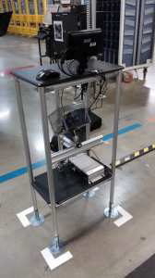
Visual Inspector (VI)
Installation of the VI system in the plant.
Display
Stand
Computer
Notes:
Tell what VI is and what it does( camera based system to monitor correct installation)
Explain installation

Slide 4
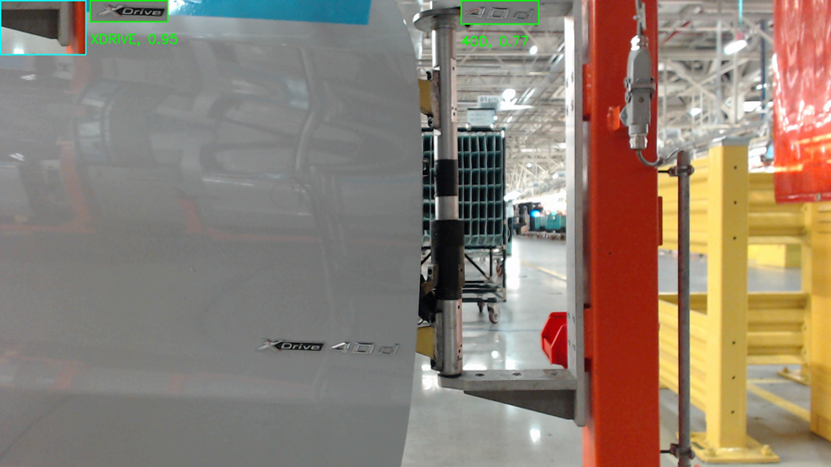
Visual Inspector (VI)
Inspection
Notes:
VI meant for spotting problems.

Slide 5
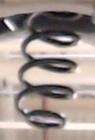
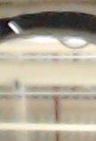
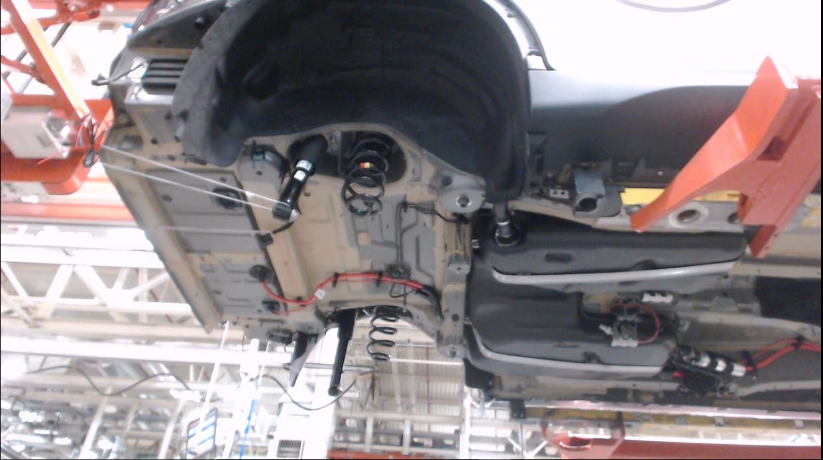
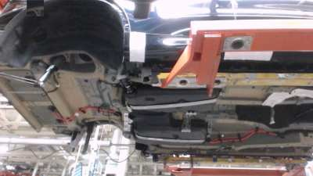
Visual Inspector (VI)
Detection
Present
Absent

Slide 6








Visual Inspector (VI)
Classification
Door Emblem
Door Badge

Slide 7
Visual Inspector (VI)
Outline
  Visual Inspector (VI)
  Problem Definition
  Related Work
  Method
    Image Similarity Metrics
    Localization Viewer
    Image Similarity Viewer
  Results
  Conclusion

Slide 8
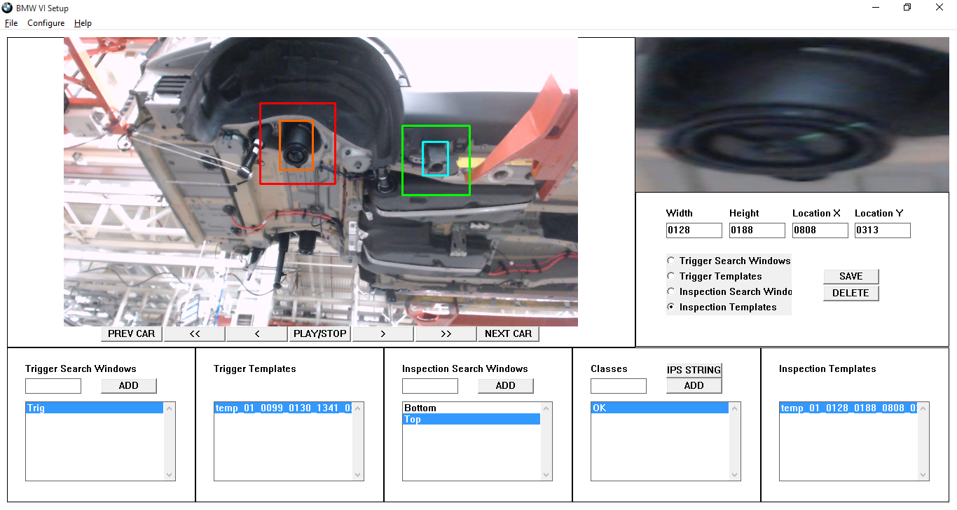
Problem Definition
Setup Program
Notes:
Setup used to train data
User should have pre recorded video(30 mins; 90-120secs; 15-20 cars)
Outlines the windows and templates

Slide 9
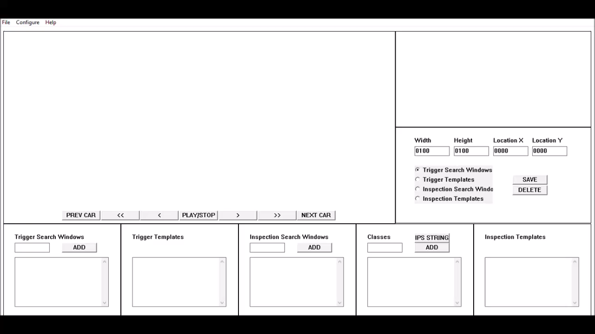
Problem Definition
Video of setup

Slide 10
Problem Definition
Inspection Window
Inspection Window
Inspection Template
a) Typical window size
b) Small window size
c) Large window size

Slide 11
Problem Definition
Class 1
Class 2
Inspection Template
a) Including similar background area
b) Excluding similar background area
c) Small template size matching with background artifacts
Notes:
Rectangle area so similar bg appears
Small size matches with bg

Slide 12
Problem Definition
a)Template outlined around entire
minion
b)Template outlined around the
varying parts

Slide 13
Problem Definition
a) Global Dissimilarity
Small inspection templates are sufficient.
b) Local Dissimilarity
Requires part to be completely outlined.
The challenge in outlining the window and template is in optimizing the size while considering all the above the problems.
Notes:
Depends on appearance of part
Small template affects ability to localize
User does not understand how any of template matching works so needs assistant.

Slide 14
Outline
  Visual Inspector (VI)
  Problem Definition
  Related Work
  Method
    Image Similarity Metrics
    Localization Viewer
    Image Similarity Viewer
  Results
  Conclusion

Slide 15
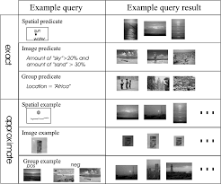
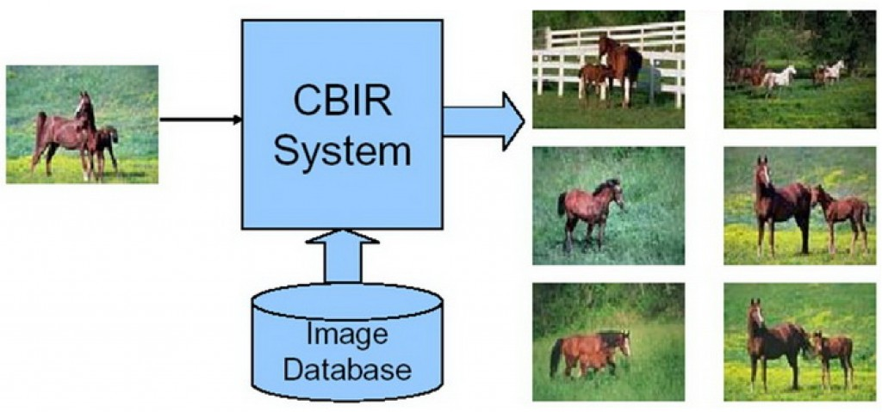
Related Work
Content-Based Image Retrieval (CBIR)
The problem of searching for digital images in large databases based on the image content.
General representation of working of CBIR.
Image borrowed from [1].
Example query images and results.
Image borrowed from [2].

Slide 16
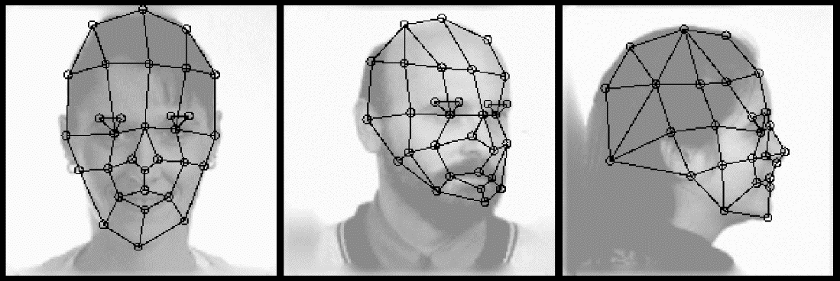
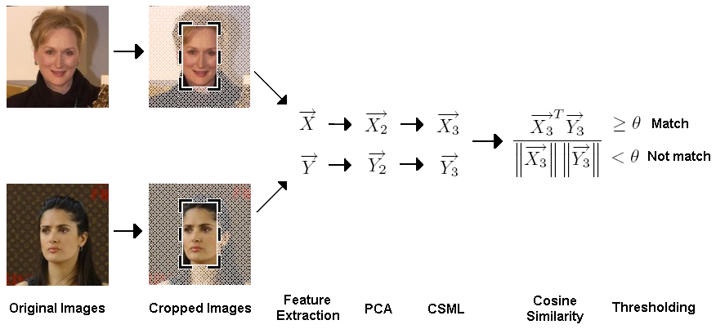
Related Work
Face Recognition
The process of identifying a person from a digital image.
(a) Grids for different faces.
Image borrowed from [3].
(b) Face verification.
Image borrowed from [4].

Slide 17
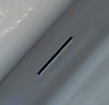




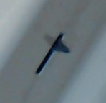
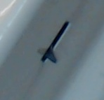
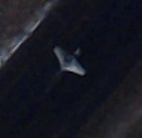
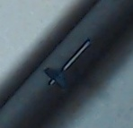
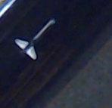
Novelty
Problem domain: automobile assembly inspection.
Seek to assist user during problem setup to try to maximize classification accuracy.
Example of safety lock data
Class 1 - Absent
Class 2 - Present
Notes:
Unconstrained data (related work)
Constrained data where we can modify window and template sizes.

Slide 18
Outline
  Visual Inspector (VI)
  Problem Definition
  Related Work
  Method
    Image Similarity Metrics
    Localization Viewer
    Image Similarity Viewer
  Results
  Conclusion

Slide 19
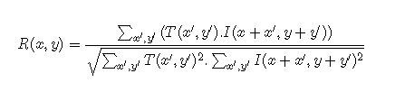
Image Similarity Metrics
Normalized Cross-correlation (NCC)
Cross-correlation: image to template similarity.
Normalized cross-correlation is defined as,
I=image; T=template; (x,y)=image location; (x’,y’)=template coordinates
Normalized cross-correlation: illumination independent
Notes:
Cross-correlation is used for matching a template to an image.
The score is highest where the template matches the image the best.
Drawback is that high intensity areas produce high cross-correlation irrespective of the similarity.
Solution is to use normalized cross-correlation

Slide 20
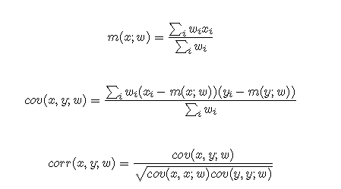
Image Similarity Metrics
Weighted Normalized Cross-correlation (WNCC)
Background artifacts adversely affect cross-correlation score.
Weight image (w): specifies important pixels.
x, y, w = 1-D vectors with length n.
Notes:
The template is always rectangular shaped which might include background artifacts adversely affecting the cross-correlation score.
In NCC, it is not possible to specify which pixels are important.
To overcome this problem, a weight image is used to specify which pixels needs to be given more importance.

Slide 21
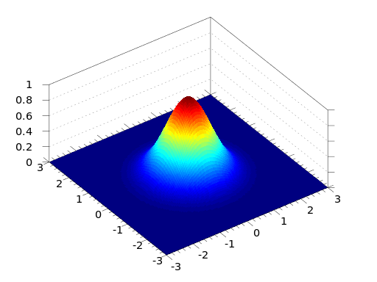
Image Similarity Metrics
Gaussian Weighted Normalized Cross-correlation
Weight image = Gaussian image.
Object centered hence center weighed more.
Notes:
Gaussian image is nothing but a Gaussian kernel which is the same size as the template.
Object is centered in the template so center is weighed more.
Standard deviation chosen based on dimension of image.

Slide 22

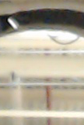

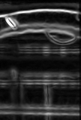
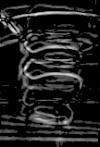
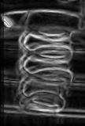
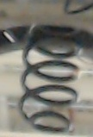
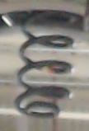
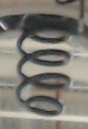
Image Similarity Metrics
Average Difference Weighted Normalized Cross-correlation
Weight image = Average difference image.
Average image is average of class templates.
Applicable to only 2-class cases.
Average
Difference
Image
Example of spring coil use case
Average
Image
Class 1 - Absent
Class 2 - Present
Notes:
Average image of a class is calculated by taking the first two images in the class and aligning them and averaging the pixel intensities of the overlapping area to create a new image which is the average of the first two images.
This new image is then coupled with the third image to create the average of the first three images and this continues till a single average image of all the images in the class is obtained.
The difference between the two average images is calculated to create a difference image.

Slide 23
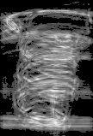
Cumulative Difference Weighted Normalized Cross-correlation
Weight image = Cumulative difference image.
Covers more area.
Cumulative Difference Image
Notes:
While average difference image would give a precise shape of the object, this method would result in a image giving importance to the area where the object would occur.
Sum of all difference images

Slide 24
Outline
  Visual Inspector (VI)
  Problem Definition
  Related Work
  Method
    Image Similarity Metrics
    Localization Viewer
    Image Similarity Viewer
  Results
  Conclusion

Slide 25
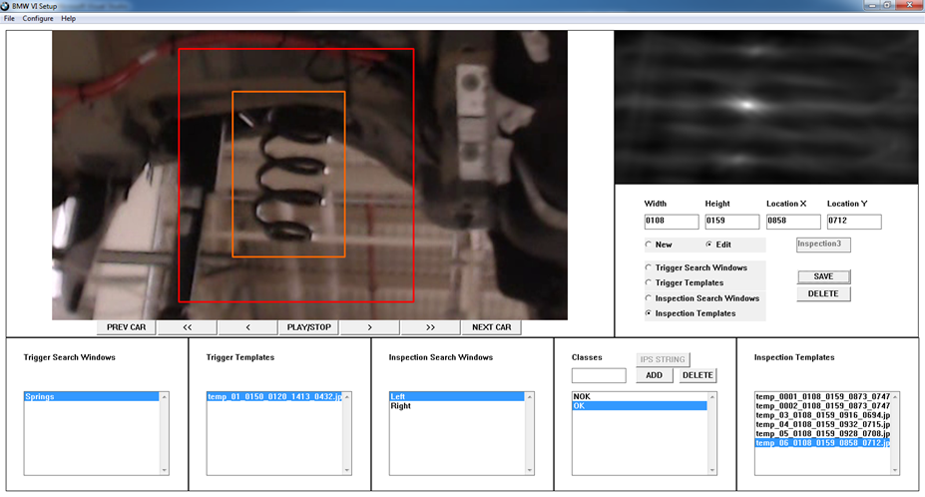
Localization Viewer
Assists the user in outlining the trigger search window, trigger template, inspection search window and inspection template.
Guides the user in best practices to delineate training data.

Slide 26
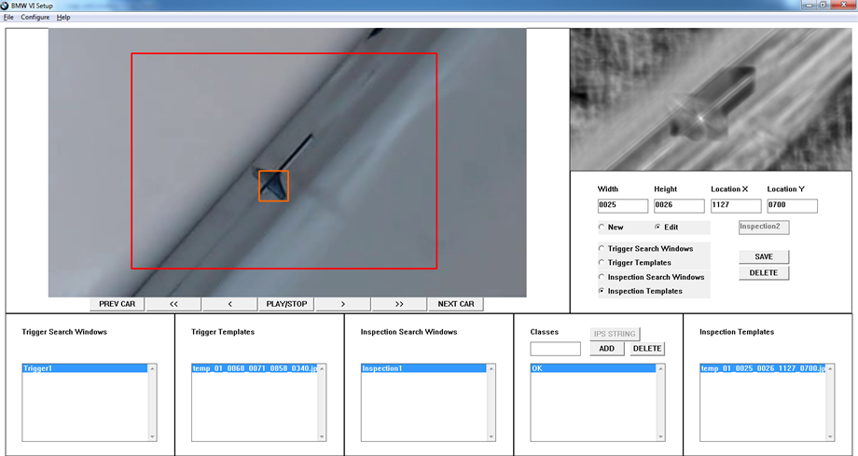
Localization Viewer
Example of bad localization because of small template size.

Slide 27
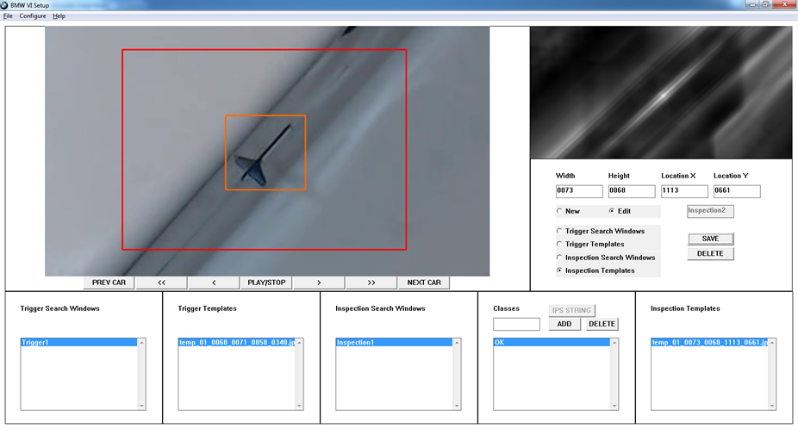
Localization Viewer
Increasing template size improves localization but still has partial matches.

Slide 28
Outline
  Visual Inspector (VI)
  Problem Definition
  Related Work
  Method
    Image Similarity Metrics
    Localization Viewer
    Image Similarity Viewer
  Results
  Conclusion

Slide 29
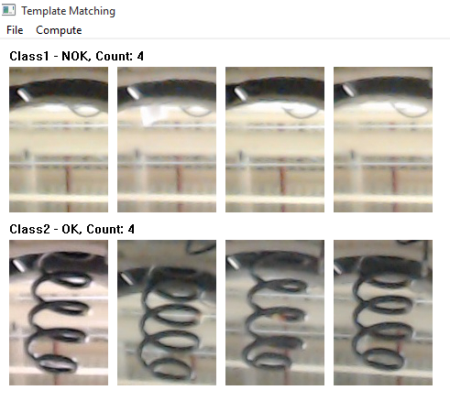
Image Similarity Viewer
Used to ascertain if the training data that has been developed is suitable for the inspection problem.
If the data was found to be not suitable, the results can be observed to find the problem and redraw the templates.
The steps to operate the tool are as follows.
Step 1: Load the inspection folder containing the classes.

Slide 30
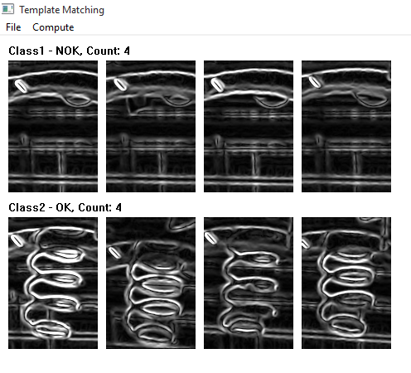
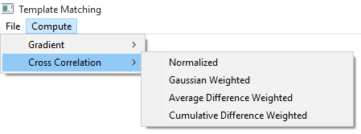
Image Similarity Viewer
Step 2: Compute the gradient of all the images loaded.
Step 3: Choose one of the 4 similarity metrics to be used for calculations.

Slide 31
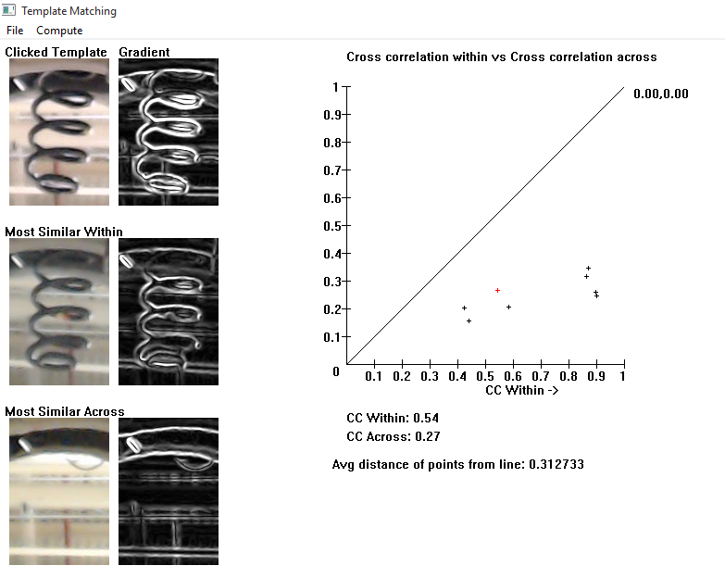
Image Similarity Viewer
Plot similarity within vs across for templates
Notes:
Will be explained on upcoming slides

Slide 32
Image Similarity Viewer
Cross-correlation within vs cross-correlation across plot
Cross-correlation (CC) within
Intra-class comparisons.
Sliding window implemented by zero padding reference image.
Maximum CC score(CC-within) recorded.
Cross-correlation across
Inter-class comparisons.
Maximum CC score(CC-across) recorded.
Notes:
For a template, the highest cross-correlation score among all the comparisons is saved.
Hence each template has one cross-correlation score corresponding to it called the CC-within score.

Slide 33
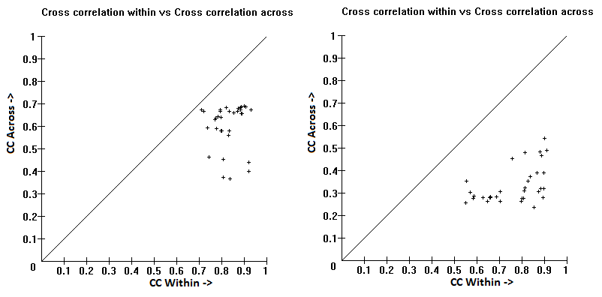
Image Similarity Viewer
Image Metric Selection
Good discrimination = High ratio of CC-within/CC-across.
Best metric if points towards bottom right.
Example of NCC (left) vs Gaussian WNCC (right) for wheel lock use case
Notes:
Since the maximum CC scores were found to vary between 0 to 1 the X and Y axes are set to that range.

Slide 34


Image Similarity Viewer
Evaluation Metric
Plot insufficient in some cases.
Average perpendicular distance of points to the line are calculated.
(Cx,Cy) = template point; (x,y) = perpendicular point on line; d=distance between points
If Cx < x, d is negative.
Best metric selected based on plot and quantified data.
Notes:
In some cases the user may not be able to select a metric by looking at the plots as the points may have moved just slightly or just few points might have moved.

Slide 35
Outline
  Visual Inspector (VI)
  Problem Definition
  Related Work
  Method
    Image Similarity Metrics
    Localization Viewer
    Image Similarity Viewer
  Results
  Conclusion

Slide 36
Results
Spring Coil
Class 1 - Absent
Average Difference Image
Class 2 - Present
Cumulative Difference Image

Slide 37
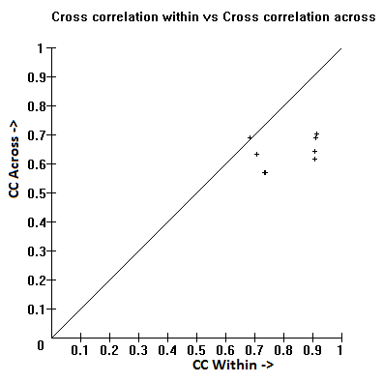
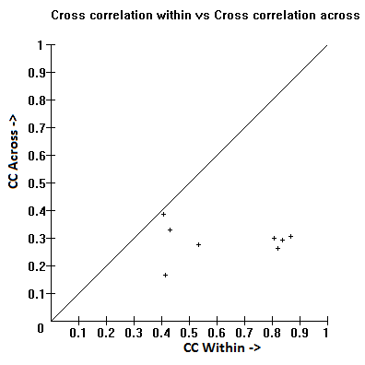

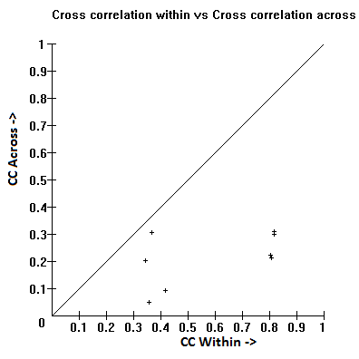
Results
Average
Difference
WNCC
0.2487
NCC
0.1242
Gaussian
WNCC
0.3127
Cumulative
Difference
WNCC
0.2692
Notes:
Thin edges
Springs angled and not aligned

Slide 38














Results
Wheel Lock
Average
Difference
Image
Class 1 - Absent
Cumulative
Difference
Image
Class 2 - Present

Slide 39
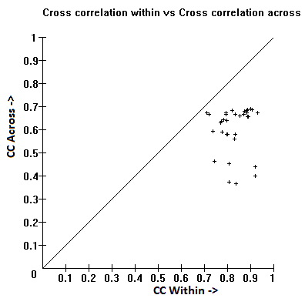
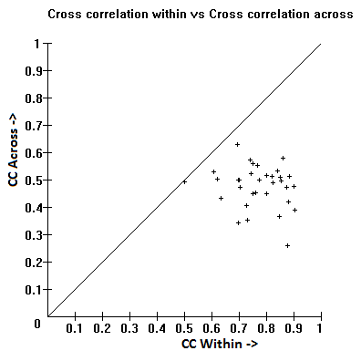
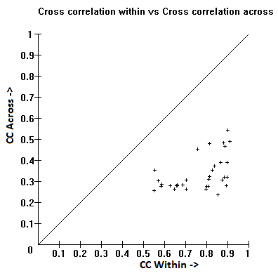
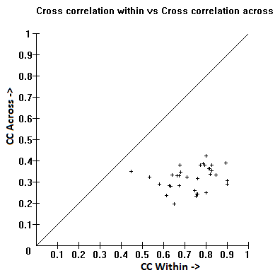
Results
Average
Difference
WNCC
0.2089
NCC
0.1606
Cumulative
Difference
WNCC
0.2947
Gaussian
WNCC
0.3052
Notes:
Good case.
Solid object covering most of template area

Slide 40
Results
Under Body Bolts
Average
Difference
Image
Class 1 - Absent
Cumulative
Difference
Image
Class 2 - Present

Slide 41

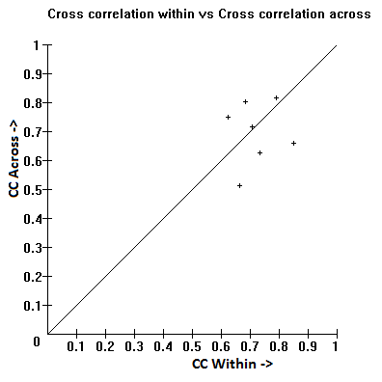


Results
Average
Difference
WNCC
0.0192
NCC
0.0223
Cumulative
Difference
WNCC
0.0396
Gaussian
WNCC
0.0287
Notes:
Very small object with no strong edges

Slide 42


Results
Safety Lock Cam0
Average
Difference
Image
Class 1 - Absent
Cumulative
Difference
Image
Class 2 - Present

Slide 43
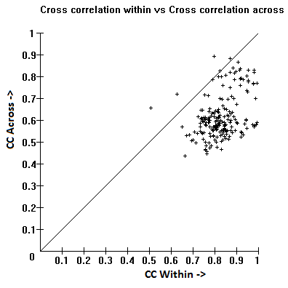
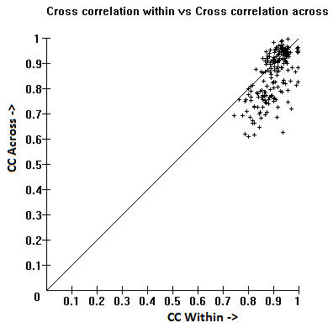
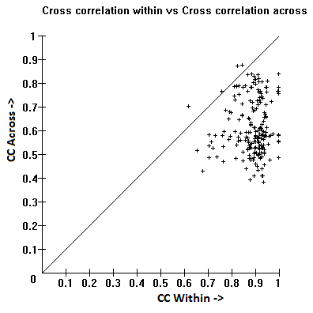
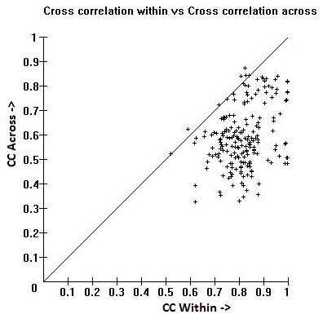
Results
Average
Difference
WNCC
0.0322
NCC
0.1526
Cumulative
Difference
WNCC
0.1619
Gaussian
WNCC
0.1936
Notes:
Images not clear
Lock position varies
Angle varies
Reflection causes match

Slide 44




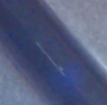







Results
Safety Lock Cam1
Average
Difference
Image
Class 1 - Absent
Cumulative
Difference
Image
Class 2 - Present

Slide 45




Results
Average
Difference
WNCC
0.1091
NCC
0.1457
Cumulative
Difference
WNCC
0.194
Gaussian
WNCC
0.2219
Notes:
Images not clear
Lock position varies
Angle varies
Reflection causes match

Slide 46







Results
Door Badge Cam0
Class 1 - SDrive
Cumulative
Difference
Image
Class 2 - XDrive
Class 3 - Tape

Slide 47



Results
NCC
0.0364
Cumulative
Difference
WNCC
0.0155
Gaussian
WNCC
0.0322
Notes:
Lots of similar area so high cc across
Small difference between s and x
Edges not clear in white bg

Slide 48










Results
Door Badge Cam1
Class 1 - SDrive
Cumulative
Difference
Image
Class 2 - XDrive
Class 3 - Tape

Slide 49



Results
NCC
-0.0098
Gaussian
WNCC
-0.0486
Cumulative
Difference
WNCC
-0.0733
Notes:
Lots of similar area so high cc across
Small difference between s and x
Edges not clear in white bg

Slide 50

















Results
Door Emblem Cam0
Class 1 - 25d
Class 2 - 30d
Class 3 - 35d
Class 4 - 35i

Slide 51












Results
Class 5 - 40d
Class 6 - 50i
Class 7 - Tape
Cumulative Difference Image

Slide 52



Results
NCC
0.0064
Cumulative
Difference
WNCC
0.0023
Gaussian
WNCC
-0.0041
Notes:
Small difference between classes.

Slide 53




















Results
Door Emblem Cam1
Class 1 - 25d
Class 2 - 30d
Class 3 - 35d
Class 4 - 35i

Slide 54















Results
Class 5 - 40d
Class 6 - 50i
Class 7 - Tape
Cumulative Difference Image

Slide 55



Results
NCC
0.0122
Cumulative
Difference
WNCC
0.0168
Gaussian
WNCC
0.0118
Notes:
Small difference between classes.

Slide 56
Results
Summary
Use case | # of Classes | NCC | Average Diff WNCC | Gaussian WNCC | Cumulative Diff WNCC
Spring Coil | 2 | 0.1242 | 0.2487 | 0.3127 | 0.2692
Wheel Lock | 2 | 0.1606 | 0.2089 | 0.3052 | 0.2947
Underbody | 2 | 0.0223 | 0.0192 | 0.0287 | 0.0396
Safety Lock(Cam0) | 2 | 0.1526 | 0.0322 | 0.1936 | 0.1619
Safety Lock(Cam1) | 2 | 0.1457 | 0.1091 | 0.2219 | 0.194
X/S Drive(Cam0) | 3 | 0.0364 | n.a | 0.0322 | 0.0155
X/S Drive(Cam1) | 3 | -0.0098 | n.a | -0.0486 | -0.0733
Door Model(Cam0) | 7 | 0.0064 | n.a | -0.0041 | 0.0023
Door Model(Cam1) | 7 | 0.0122 | n.a | 0.0118 | 0.0168

Slide 57
Outline
  Visual Inspector (VI)
  Problem Definition
  Related Work
  Method
    Image Similarity Metrics
    Localization Viewer
    Image Similarity Viewer
  Results
  Conclusion

Slide 58
Conclusion
Image Similarity Viewer tested on 9 use cases.
Difficult to narrow down a single metric.
Possible to conclude a metric failed by looking at the plots and templates.
Promising results in the lab; needs further testing and development.
Future work :
  Preprocessing steps to isolate the object and eliminate background details.
  Metrics with use of wavelets to detect variations in rotation, scaling and translation.
Notes:
It was observed that it was difficult to narrow down a single metric that would work for all the cases as each use case comprised of different parts varying in shape and size.
It was possible to conclude why an inspection problem would not work with a metric by looking at the plots and templates.

Slide 59
References
[1] http://hubpages.com/technology/Global-and-Local-Color-Histogram#
[2] A. Smeulders, M. Worring, S. Santini, A. Gupta, and R. Jain, Content-based
image retrieval at the end of the early years," Pattern Analysis and Machine
Intelligence, IEEE Transactions on, vol. 22, no. 12, pp. 1349-1380, 2000.
[3] Wiskott, Laurenz, et al. "Face recognition by elastic bunch graph
matching."Pattern Analysis and Machine Intelligence, IEEE Transactions
on 19.7 (1997): 775-779.
[4] Nguyen, Hieu V., and Li Bai. "Cosine similarity metric learning for face
verification." Computer Vision–ACCV 2010. Springer Berlin Heidelberg,
2011. 709-720.

Slide 60
Thank
You!

