Slide 1
A device to record natural daily wrist motion
MS Thesis Defense
Surya Prakash Sharma
Committee Members:
Dr. Adam Hoover (Chair)
Dr. Ian Walker
Dr. Jason Hallstrom
November 24, 2014
Notes:
Hello and welcome
Titled “A device to record natural daily wrist motion”
Grab some snacks

Slide 2
Outline
Motivation and Background
Methods
Results
Conclusion
Notes:
We’re going to discuss
Why
How
What were the results
What did we learn

Slide 3
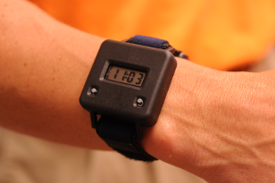
Motivation
Our vision: Wrist-worn eating activity monitor
Previous work: 81% accuracy detecting periods of eating (44 subjects, 1 day) 86% accuracy counting bites during eating (49 subjects, 1 meal)
Need: device to record large number of people for long period of time
The bite counter
Notes:
Create wrist worn eating activity monitor
Work done by our group previously attained 81% accuracy when trying to detect periods of eating
Further they could count the number of bites during these meals with 86% accuracy
Our group now needs more data to improve these algorithms, for which we plan to create a device to record wrist movement across a large number of subjects for a long period of time.

Slide 4
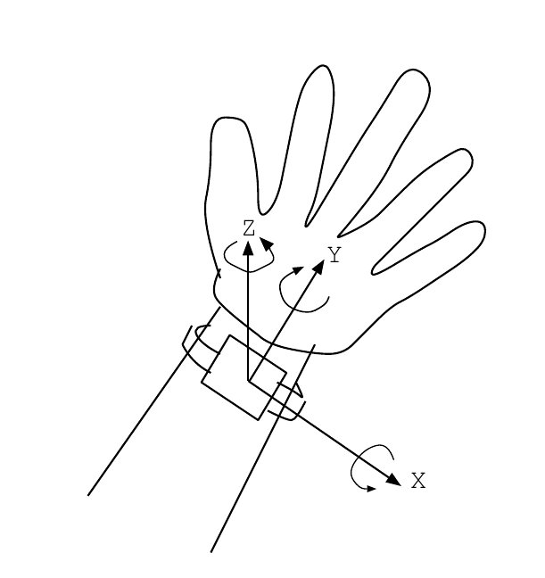
Background (cont)
Recording wrist movement data requires three basic components
Accelerometer – Translational motion
Gyroscope – Rotational Motion
Memory – Store Data

Slide 5
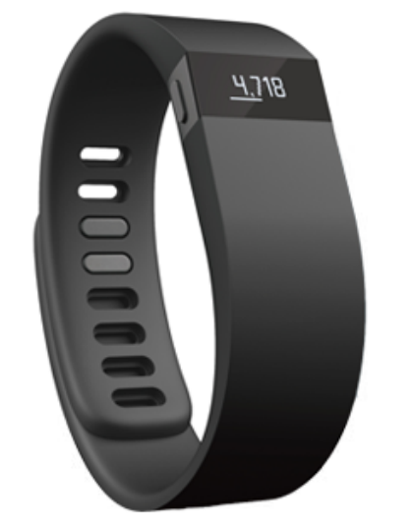
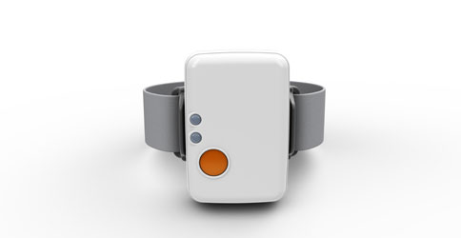
Background
Multiple wrist worn devices available.
None has addressed the need of recording translational and rotational wrist movement data.
Many devices do not contain all the required sensors
Others have unneeded features increasing cost, weight and discomfort, while reducing battery life.
Notes:
Multiple devices already exist.
They process movement data and record some other quantity (steps)
Most devices missing gyroscope.
Unneeded features.

Slide 6
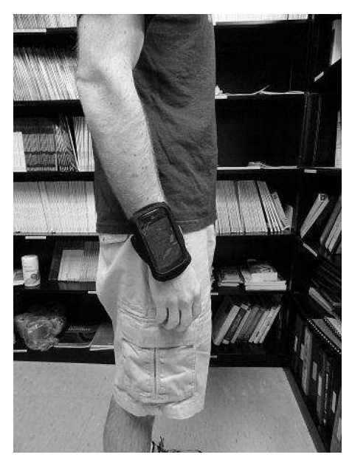
Previous Work
iPhone Based Data Logger
Long Battery Life
High resolution data
High customizability
Big Size
Low comfort
http://www.ces.clemson.edu/~ahoover/theses/dong-diss.pdf

Slide 7
Other Devices
Activity Trackers
Long Battery Life
Small Size
High Comfort
Economical Cost
Low resolution data
No customizability
No gyroscope
The Fitbit Flex
https://www.flickr.com/photos/uscpsc/13104103473

Slide 8
Other Devices (cont)
Research Devices
Average Battery Life
High resolution Data
High customizability
Medium Comfort
High cost
Development Kit: $2000
Unit : $249
Promotional photo of the SHIMMER
www.shimmersensing.com/shop/shimmer3

Slide 9
Other Devices (cont)
Smartwatches
Average Battery Life
Average customizability
OK Comfort
Some have all sensors
High cost
Unit : $249
Low resolution data
Samsung Gear 2
https://www.flickr.com/photos/ridble/12794729274/in/photostream/

Slide 10
Summary
Name | Market Segments | Both Sensors | Size | Weight (g) | Active Battery Life (hours) | Extra components
iPhone | Mobile Phone | Y | Large | 149 | 40 | Display, GSM Module
MetaWatch | SmartWatch | N | Small | 81 | 80 | Display, Bluetooth Module
Samsung Gear 2 | SmartWatch | Y | Small | 68 | 48 | Display, Bluetooth Module, Media Player
Fitbit Zip | Fitness Tracker | N | Small | 8 | 6 mo
Fitbit Flex | Fitness Tracker | N | Small | N/A | 120
Jawbone Up Move | Fitness Tracker | N | Small | 6.8 | 168
Jawbone Up 3 | Fitness Tracker | N | Small | 29 | 168
Fitbit One | Fitness Tracker | N | Small | 8 | 240
Nike FuelBand | Fitness Tracker | N | Small | 30 | 96
SHIMMER | Research | Y | Medium | 23.6 | 24 | SD Card, Bluetooth Module
Thalmic Labs Myo | Research | Y | Medium | 93 | 48 | EMG Sensors
Note: Sizes are as follows:
Small : Wrist watch or similar
Medium: Larger than wrist watch, smaller than a smartphone.
Large: Smartphone

Slide 11
Novelty
New Wrist mounted device to log motion data
Good Battery Life
High customizability
Economical Cost
High Comfort
Smaller size leads to more comfort, and the user can wear it longer

Slide 12
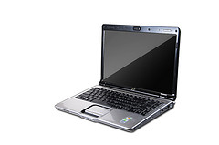
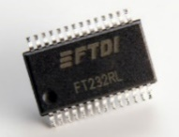
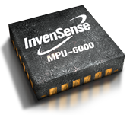
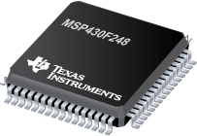
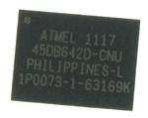
Methods
Computer
USB to UART
Sensors
Memory
Microcontroller
http://www.ti.com/graphics/folders/partimages/MSP430F248.jpg https://www.flickr.com/photos/40875537@N04/5659910644
http://www.snowcap.fi/uploads//2011/12/mpu6000.png http://electronics-diy.com/img/FT232RL_chip.jpg
http://www.mouser.com/images/adestotechnologies/images/cason8.jpg

Slide 13
Components
Sensor
Memory chip
Microcontroller
USB to UART bridge
Battery
Battery charger
LED
Button
Case

Slide 14
Procedure
Part selection
Circuit design / Prototype / Programming
PCB design
Soldering

Slide 15
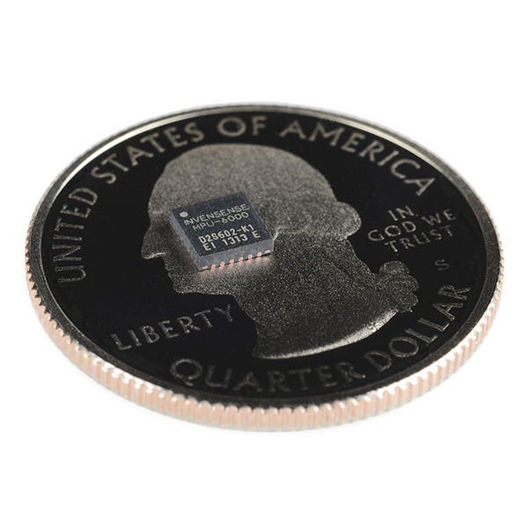
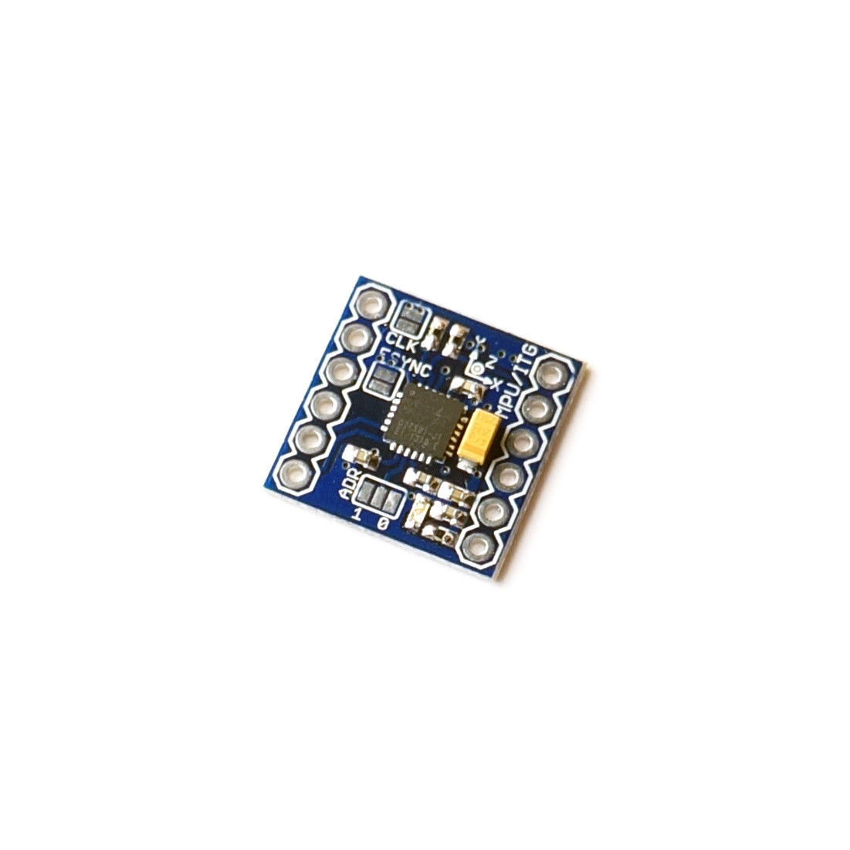
Sensor
MPU-6000: MEMS 6 axis sensor
2.375 – 3.46 V supply
Current Consumption:
Accelerometer : 200 uA
Gyro + Acc: 3.8 mA
Digital Communication over SPI / I²C
8 KHz internal clock
Measurement Range:
Accelerometer: ±2, ±4,±8,±16 g
Gyro: ±250/±500/±1000/±2000 °/sec
Breakout Board
Current Consumption for STMicro LSM330: 6.1 mA
InvenSense MPU-6000
https://www.sparkfun.com/products/11234
http://www.ebay.com/itm/261417344740
Notes:
Prev work: 3 components, 1 acc, 2 gyro.
Each gyro 6.1 mA
Gyro + Acc 3.8 mA
St Micro 6.1 mA
33% power savings just by using the right component
Breakout Board
Not meant to be used in prototypes. Meant for small handheld devices like phones.
Smaller and smaller.
Hard to connect to these.
Breakout boards breaks the pads on the chips to bigger holes to connect to.
BB was imported from Germany b/c none available here.
BB for sister component was available, but that chip lacks SPI.

Slide 16
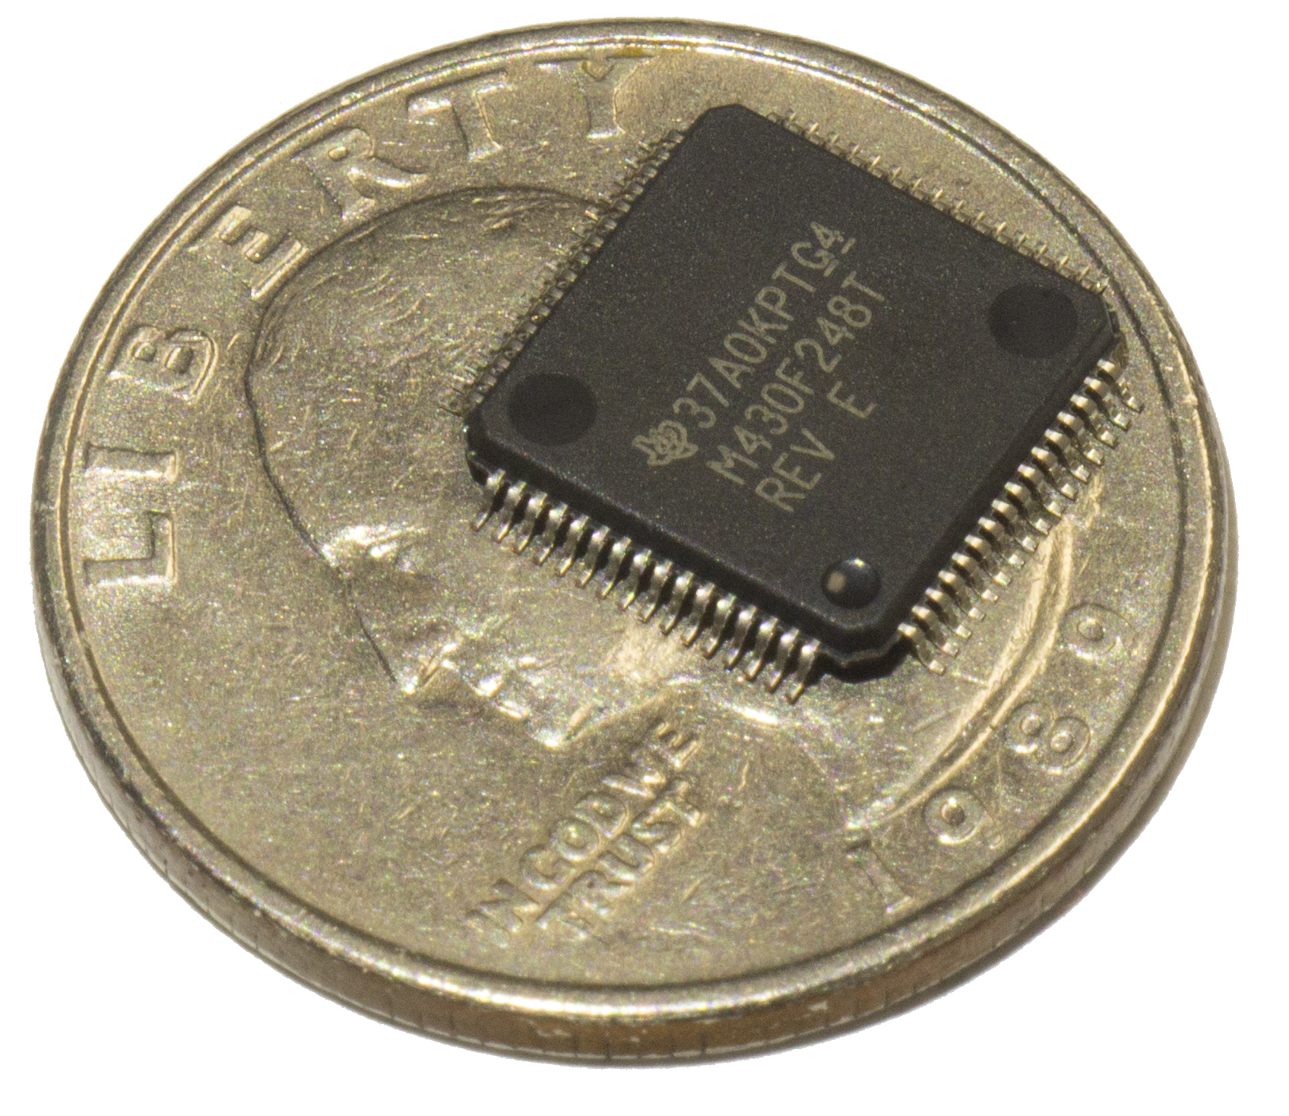
Microcontroller
MSP430F248
1.8 – 3.46 V supply
Current Consumption : 270 uA @ 1 MHz
SPI and UART modules
Two 16 bit timers
4 KB RAM
The MSP430F248 microcontroller
Notes:
Looked at previous work / competitors and selected the MSP430 fam.
400 devices.
We knew it would need to support the memory and the sensor.
SPI
Timer

Slide 17
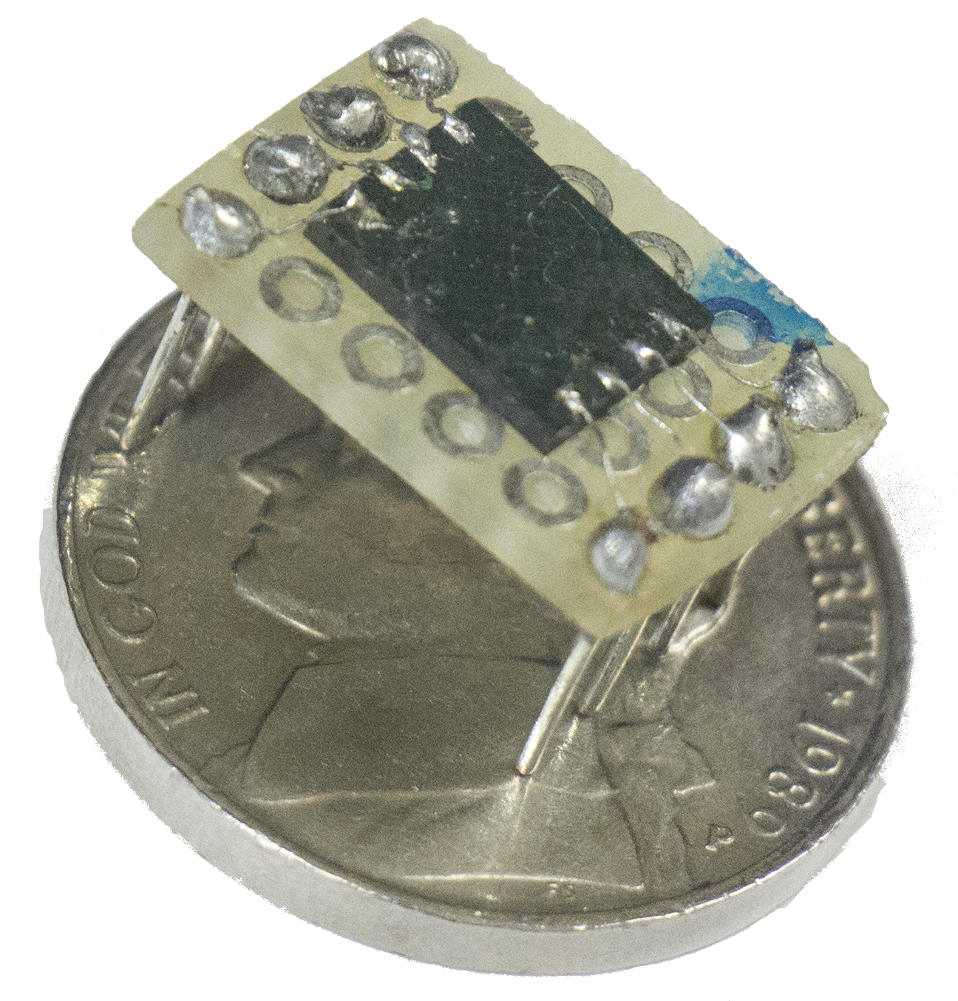
Memory
AT45DB642D
2.7 – 3.6 V supply
Current Consumption
Read : 15 mA
Write / Erase : 25 mA
Standby : 25 uA
SPI communication
Package : CASON
Write duty cycle: 0.56%
Average current: 140 μA
Memory chip
Notes:
High write current
Writes once every 11 seconds, takes about 64 milli
SPI

Slide 18
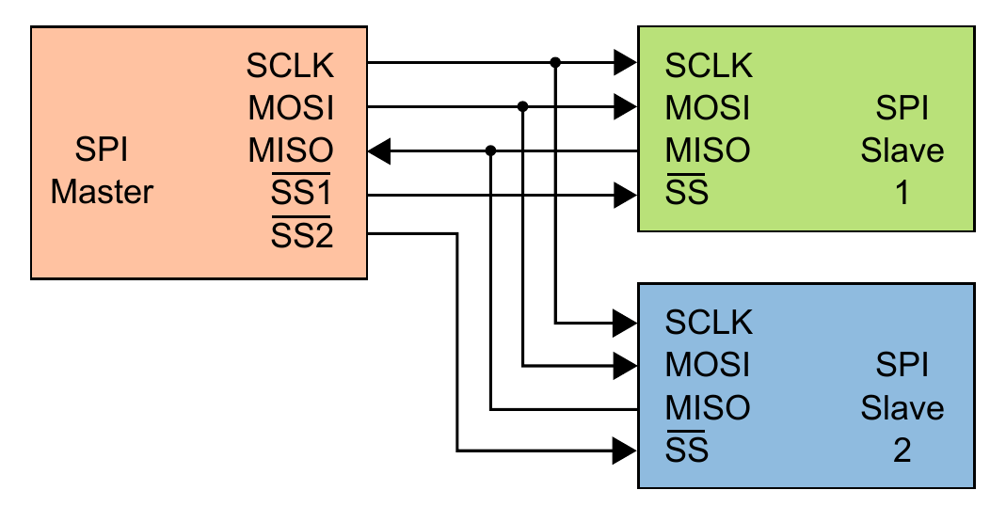
SPI
Sensor
Memory
SPI master with two slaves on the same bus
http://en.wikipedia.org/wiki/Serial_Peripheral_Interface_Bus

Slide 19
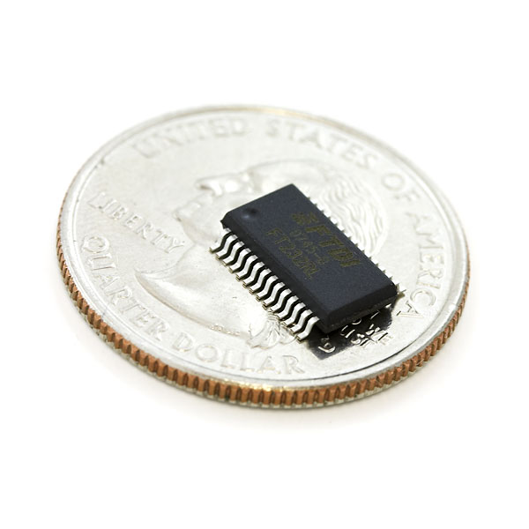
Data Transfer
FT232RL USB to UART bridge
5 V supply
Integrated 3.3 V level converter
Data transfer technology would require 18 mA of current over 30 minutes
Using a wired connection allows this power to be sourced from the host
Battery can be charged with the same connector
Allows us to get data off the device
FT232RL
https://www.sparkfun.com/products/650
Notes:
Once data is recorded the entire day, has to be transferred to a computer.
Computers lack serial ports, replaced by the newer USB standard.
FT232 creates a virtual serial port on the computer through the USB connection.
Why not wireless.
18 mA wireless, 30 minutes time, need battery power.
Wired lets us source this from host.

Slide 20
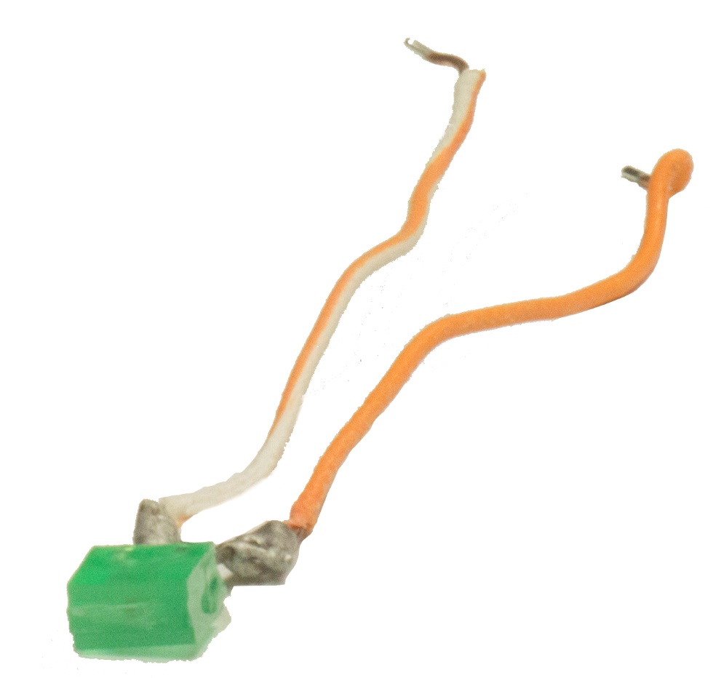
LED
Typical current draw of 20 mA
Duty cycle: 0.56%
Average current: 110 μA
Off the shelf LED
Photo of a LED

Slide 21
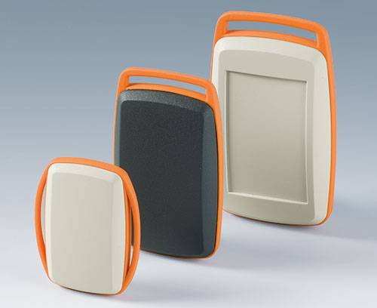
Case
Ergo Minitec Series
Largest case used for previous work
Smallest case measures 52 mm x 32 mm x 15 mm
Intermediate ring allows a strap to pass through
Lightweight
Ergo Minitec Series Cases
http://www.okw.com/en/Plastic-enclosures/Minitec.htm

Slide 22
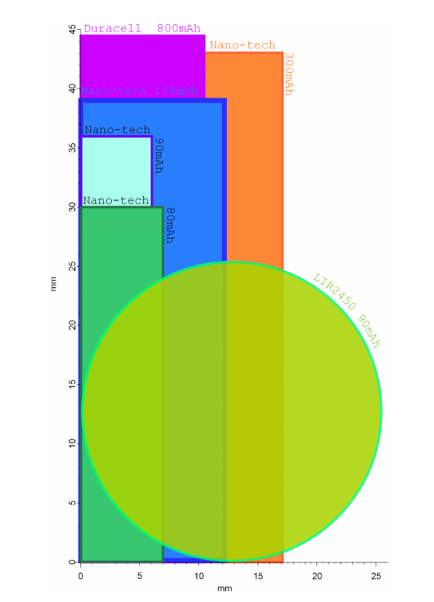
Battery
Turnigy Nano-tech 160 mAh
Most batteries would fit in 52 mm x 32 mm
Case is limiting factor
Case is curved so the Duracell AAA 800 mAh, Nano-tech 300 mAh and LIR2450 90 mAh batteries wouldn’t fit
Nano-tech 160 mAh provides the highest battery capacity
Top view profiles of different batteries considered

Slide 23
Prototype

Slide 24
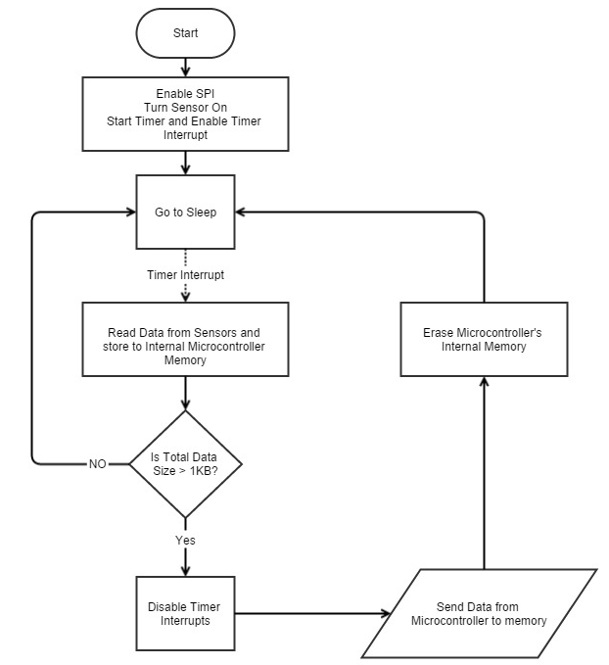
Programming
Simplified algorithm for the device

Slide 25
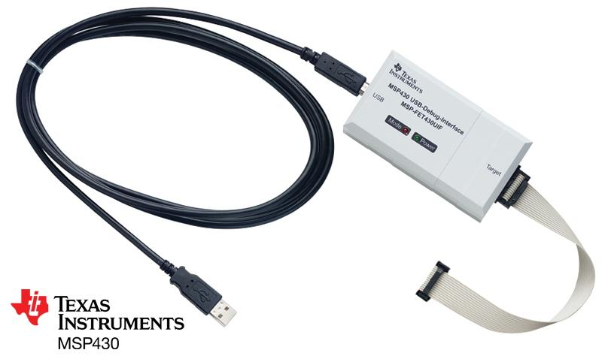
Programming (cont)
MSP430 JTAG Tool
Photo: Texas Instruments

Slide 26
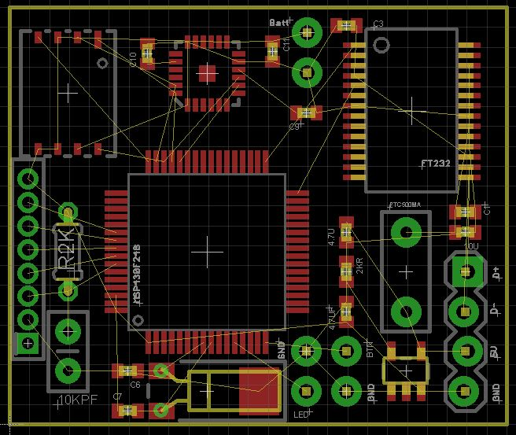
PCB Layout
Parts placed before routing

Slide 27
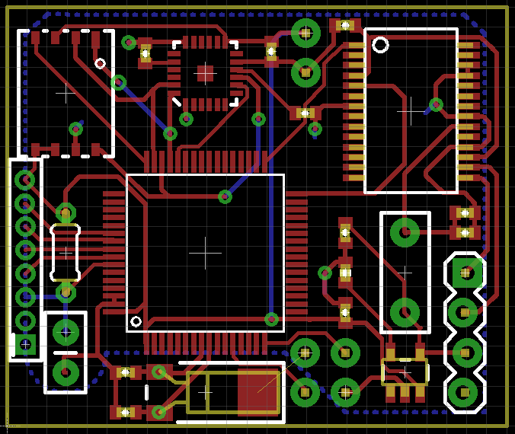
PCB Layout (cont)
PCB layout after routing

Slide 28
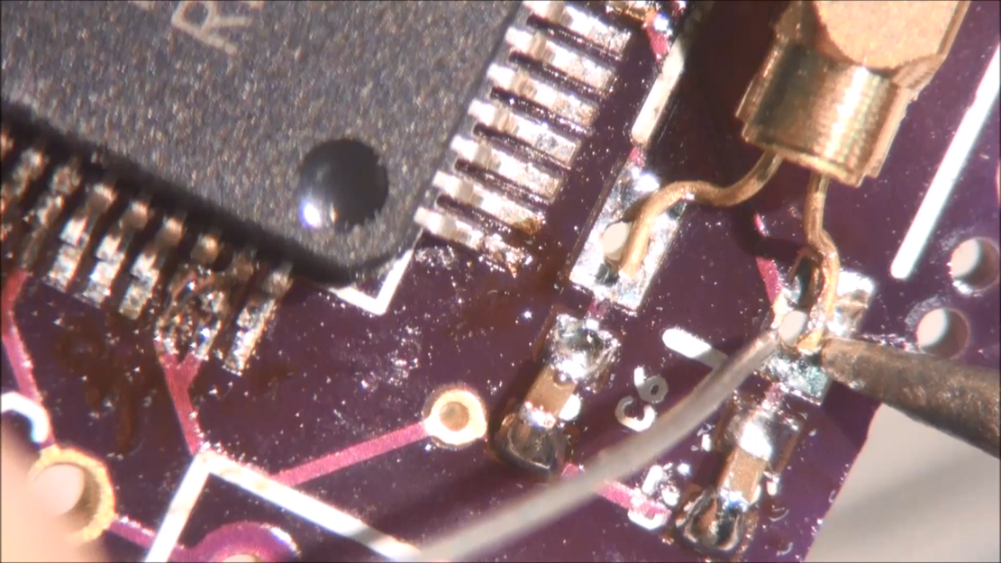
Soldering (Mounting Parts)
Video : Soldering Crystal (41 seconds)

Slide 29
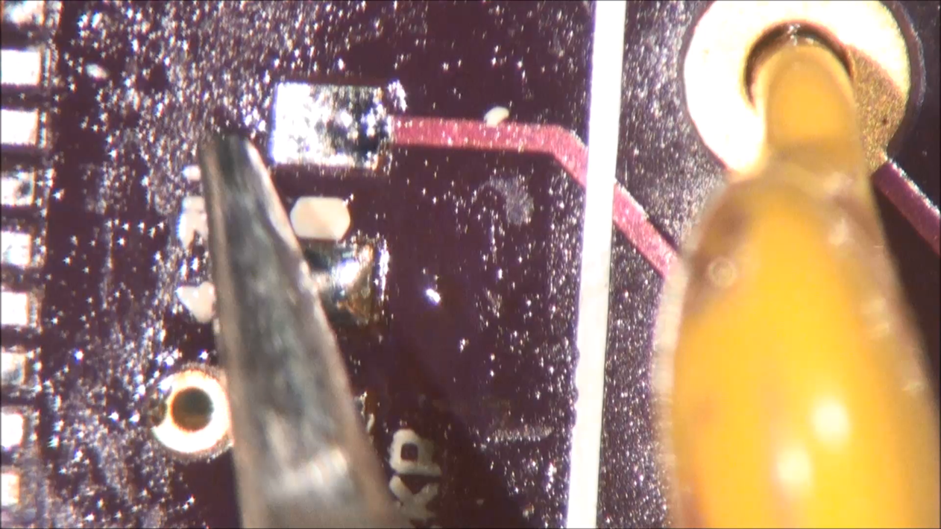
Soldering (cont)
Video : Soldering SMD Resistor (44 seconds)

Slide 30
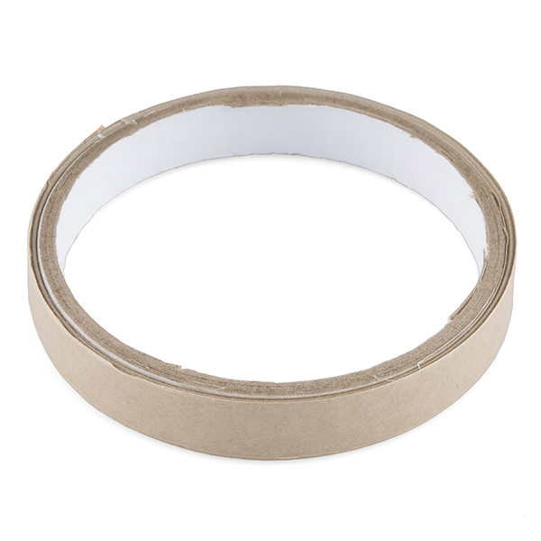
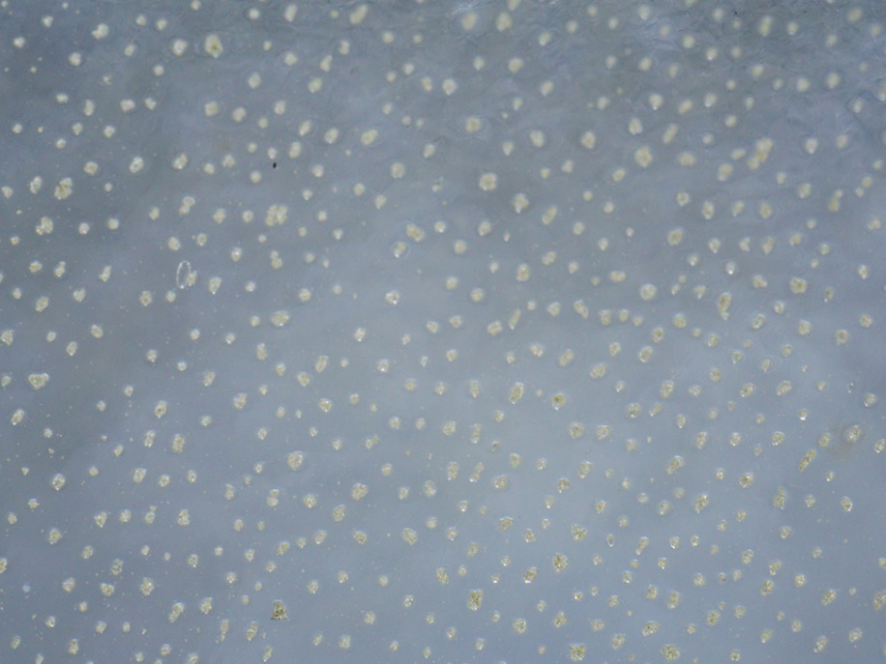
Z – axis tape
Z – axis tape reel
Z – axis tape under a microscope
http://www.adafruit.com/product/1656
https://www.sparkfun.com/products/12042

Slide 31
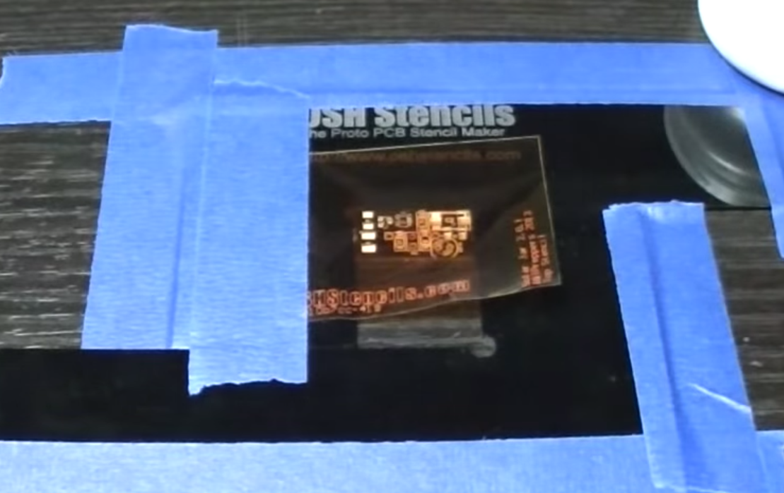
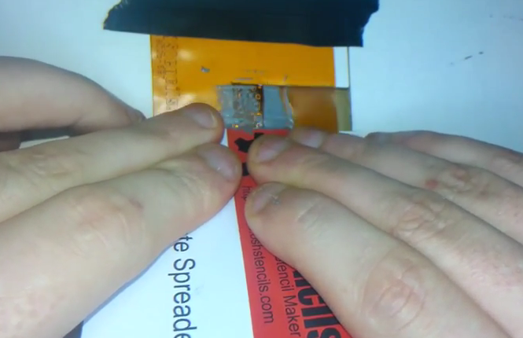
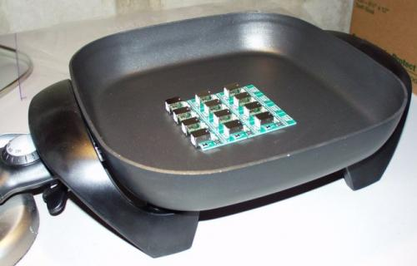
Soldering (cont)
Stencil placement
Solder paste application
Hot plate reflow soldering
https://www.sparkfun.com/tutorials/59
https://www.youtube.com/watch?v=P7Fa-WZHxbI
https://www.youtube.com/watch?v=1RMtOAHbfvU

Slide 32
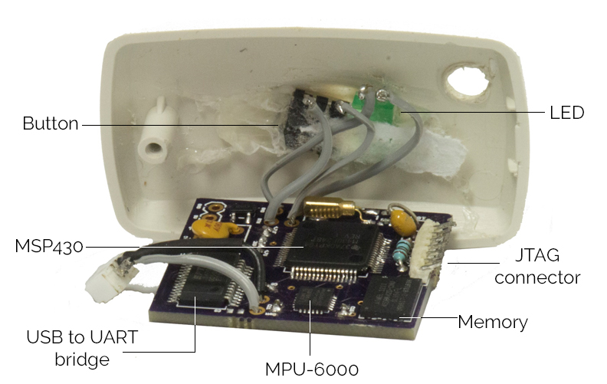
Final Device
Final PCB with top case cover

Slide 33
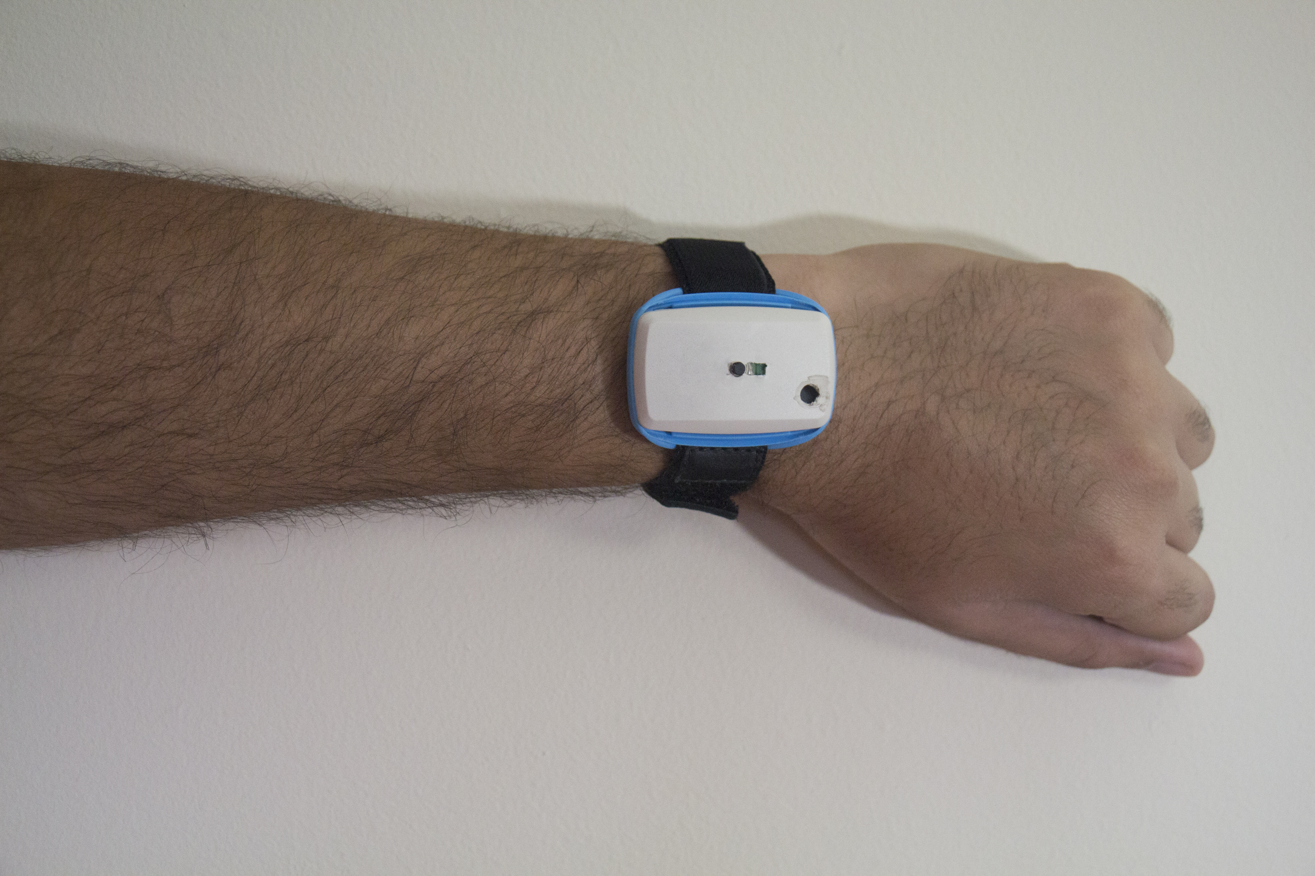
Results
Final device mounted on wrist

Slide 34
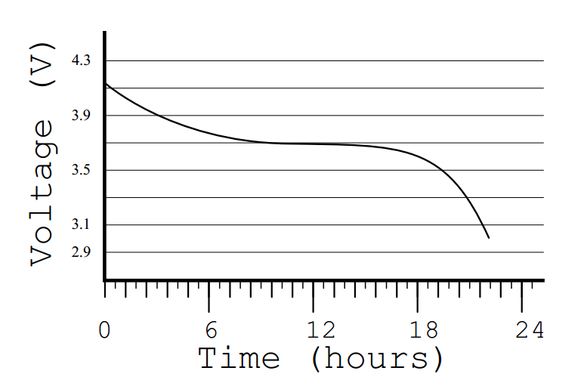
Results (cont)
Battery life of active device

Slide 35
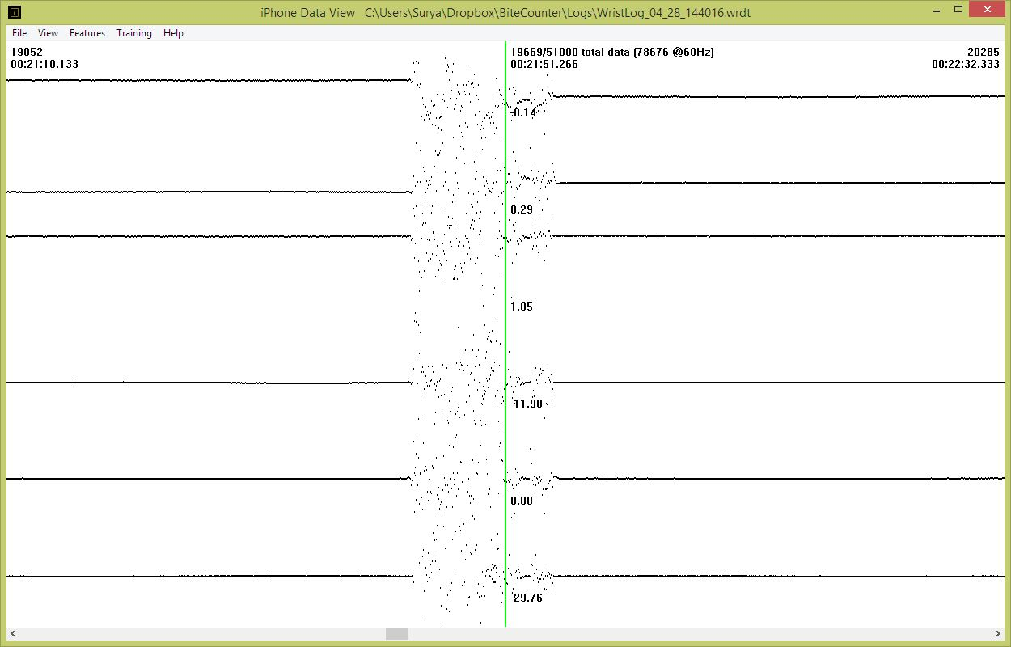
Results (cont)
WristView showing recorded data

Slide 36
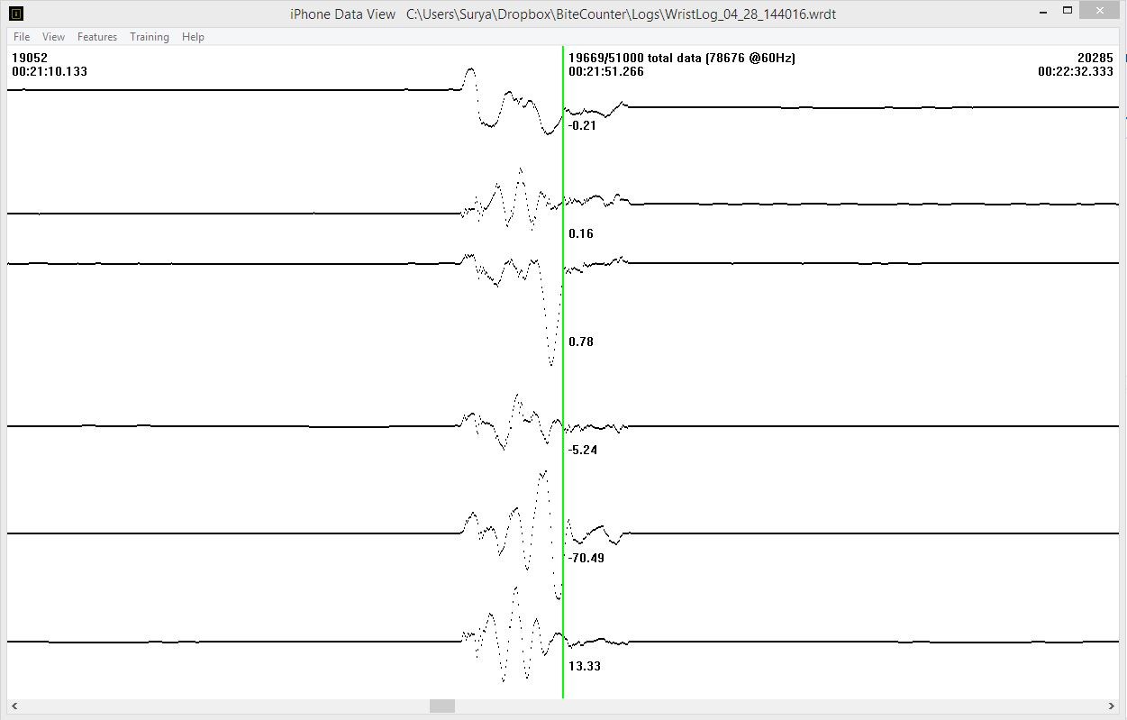
Results (cont)
WristView showing smoothed data

Slide 37
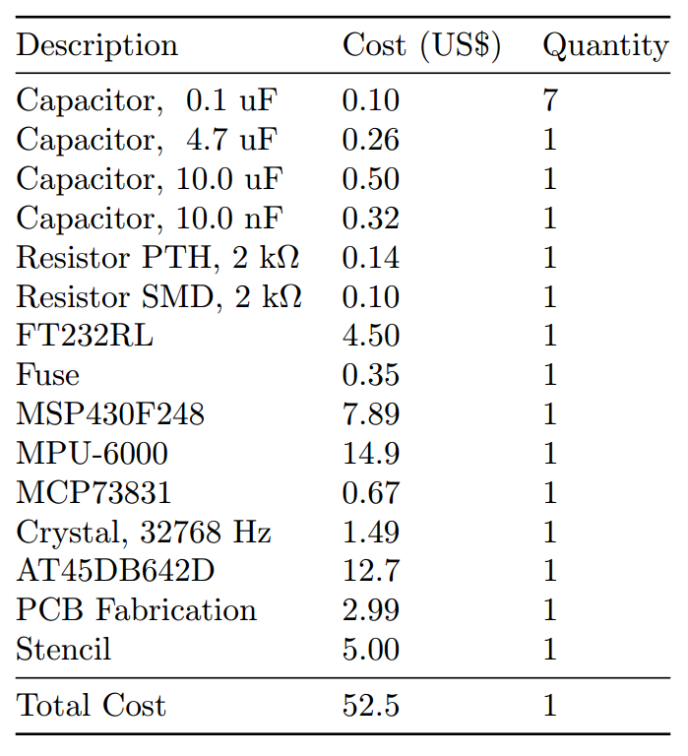
Results (cont)
Device production cost

Slide 38
Results (cont)
Name of Device | Market Segments | Both Sensors | Size | Weight | Active Battery Life (hours) | Extra components
iPhone | Mobile Phone | Y | Large | 149 | 40 | Display, GSM Module
MetaWatch | SmartWatch | N | Small | 81 | 80 | Display, Bluetooth Module
Samsung Gear 2 | SmartWatch | Y | Small | 68 | 48 | Display, Bluetooth Module, Media Player
Fitbit Zip | Fitness Tracker | N | Small | 8 | 6 mo
Fitbit Flex | Fitness Tracker | N | Small | N/A | 120
Jawbone Up Move | Fitness Tracker | N | Small | 6.8 | 168
Jawbone Up 3 | Fitness Tracker | N | Small | 29 | 168
Fitbit One | Fitness Tracker | N | Small | 8 | 240
Nike FuelBand | Fitness Tracker | N | Small | 30 | 96
SHIMMER | Research | Y | Medium | 23.6 | 24 | SD Card, Bluetooth Module
Thalmic Labs Myo | Research | Y | Medium | 93 | 48 | EMG Sensors
This Work | Research | Y | Small | 26.6 | 24
Good Battery Life
High customizability
Economical Cost
High Comfort

Slide 39
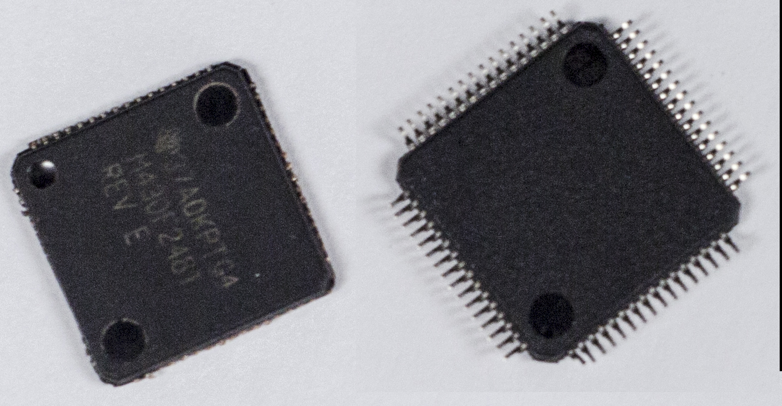
Challenges
Microcontroller after cutting pins to desolder

Slide 40
Future Work
Dataset of wrist motion movement needs to be created
100 – 200 subjects wearing this device for up to 2 weeks each
20 – 25 devices needed

Slide 41
Future Work (cont)
Add a local time feature to the watch
Consider using EMG sensors to pursue new algorithms
Try a different profile with custom molded case

Slide 42
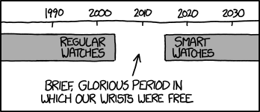
Questions ?
Old people used to write obnoxious thinkpieces about how people these days always wear watches and are slaves to the clock, but now they've switched to writing thinkpieces about how kids these days don't appreciate the benefits of an old-fashioned watch. My position is: The word 'thinkpiece' sounds like a word made up by someone who didn't know about the word 'brain'.
http://xkcd.com/1420/

