Slide 1
Detecting Periods of Eating in Everyday Life by Tracking Wrist Motion – What is a meal?
Surya Sharma
Committee Members:
Adam Hoover (chair), Brian Dean,
Yingjie Lao, Yongqiang Wang

Slide 2
Outline
Motivation
Related Work
Data Collection
Replication Experiment
Sharma, S., Jasper, P., Muth, E., & Hoover, A. (2016, June). Automatic detection of periods of eating using wrist motion tracking. In 2016 IEEE First International Conference on Connected Health: Applications, Systems and Engineering Technologies (CHASE) (pp. 362-363). IEEE.
Filtering Linear Acceleration
Sharma, S., & Hoover, A. (2019, November). A Study on Linear Acceleration of the Wrist During Free-Living. In 2019 IEEE International Conference on Bioinformatics and Biomedicine (BIBM) (pp. 1624-1628). IEEE.
The Impact of Secondary Activities
S. Sharma, P. Jasper, E. Muth, and A. Hoover, “The impact of walking and resting on wrist motion for automated detection of meals,” ACM HEALTH, vol. 1, no. 1, pp. 1–18, 2020
Top-down Detection of Eating Episodes Using a CNN
S. Sharma, and A. Hoover, “Top-down Detection of Eating Episodes in Free-living by Analyzing Large Windows of Wrist Motion Using a Convolutional Neural Network”, submitted to IEEE Journal of Biomedical and Health Informatics for review.
Conclusions and Future Work

Slide 3
Outline
Motivation
Related Work
Data Collection
Replication Experiment
Filtering Linear Acceleration
The Impact of Secondary Activities
Top-down Detection of Eating Episodes Using a CNN
Conclusions and Future Work

Slide 4
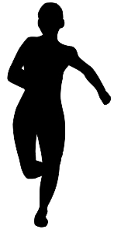
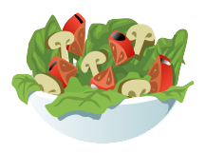
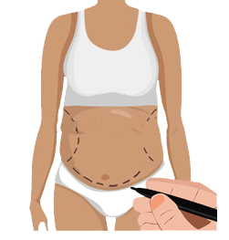
Motivation - Obesity
Affects 42.4% of US adults (>95 Million)¹
Can lead to premature preventable death¹
Being overweight is linked to more deaths than being underweight²
Surgeries are an option to reduce weight³
Lifestyle change through increased energy expenditure or reduced energy intake is preferred^{2,4}
[1] https://www.cdc.gov/obesity/data/adult.html
[2] https://www.who.int/features/factfiles/obesity/en/
[3] Angrisani, L., Santonicola, A., Iovino, P., Formisano, G., Buchwald, H., & Scopinaro, N. (2015). Bariatric surgery worldwide 2013. Obesity Surgery, 25(10), 1822-1832.
[4] M. K. Serdula, A. H. Mokdad, D. F. Williamson, D. A. Galuska, J. M. Mendlein, and G. W. Heath, “Prevalence of attempting weight loss and strategies for controlling weight,” JAMA, vol. 282, no. 14, pp. 1353?1358, 1999.

Slide 5
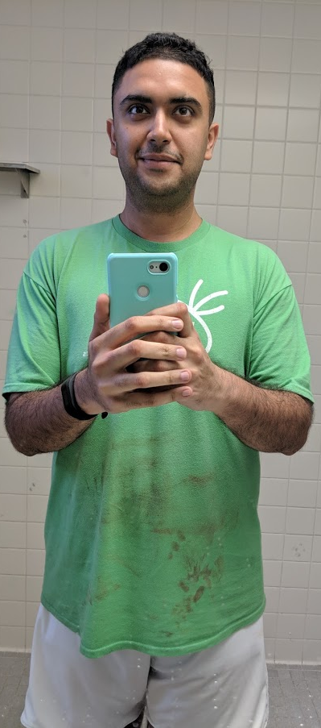
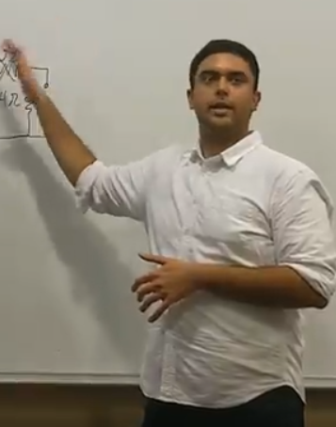
Motivation - Personal
2010
2014
2016
2019
2020
105 kgs / 231 lbs
110 kgs / 243 lbs
120 kgs / 265 lbs
101 kgs / 222 lbs
110 kgs / 243 lbs

Slide 6
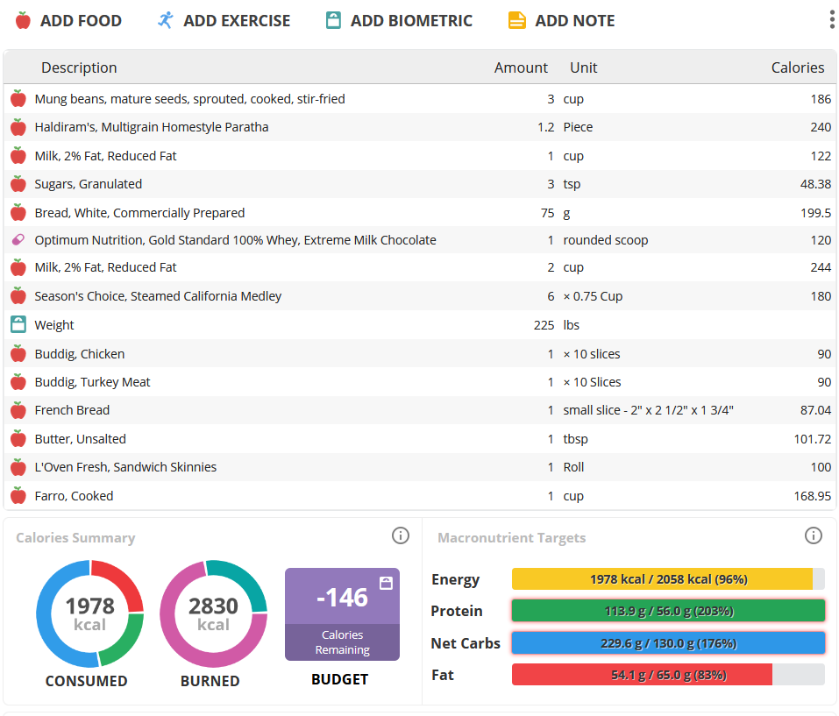
Motivation – Food Diaries
Self-monitoring is a vital component for successful weight loss¹
Food diaries are the most commonly used tool to track dietary intake
[1] K. N. Boutelle and D. S. Kirschenbaum, “Further support for consistent self-monitoring as a vital component of successful weight control,” Obesity Research, vol. 6, no. 3, pp. 219-224, 1998.

Slide 7
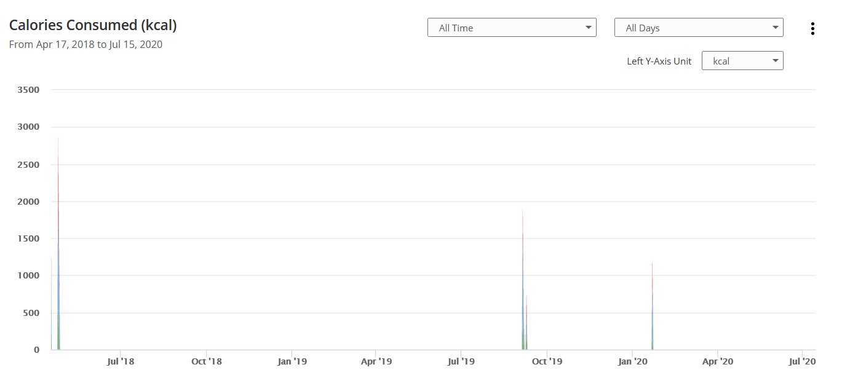
Motivation - Compliance
Compliance is hard
Less than 3% of ~200K Eatery app users continued using the app more than one week¹
[1] Helander, E., Kaipainen, K., Korhonen, I., & Wansink, B. (2014). Factors related to sustained use of a free mobile app for dietary self-monitoring with photography and peer feedback: retrospective cohort study. Journal of Medical Internet Research, 16(4), e109.

Slide 8
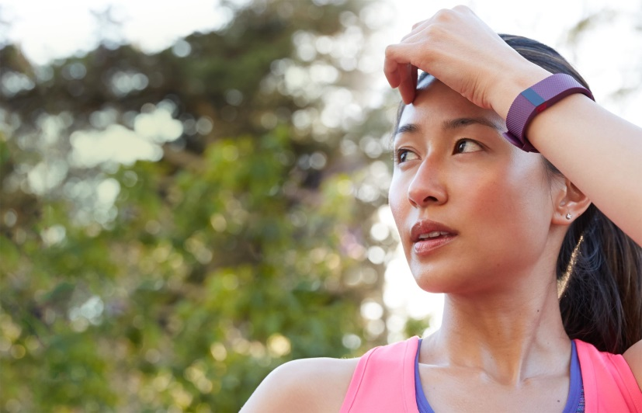
Challenge: Wearable Device for Eating
Something like the FitBit

Slide 9
Outline
Motivation
Related Work
Data Collection
Replication Experiment
Filtering Linear Acceleration
The Impact of Secondary Activities
Top-down Detection of Eating Episodes Using a CNN
Conclusions and Future Work

Slide 10
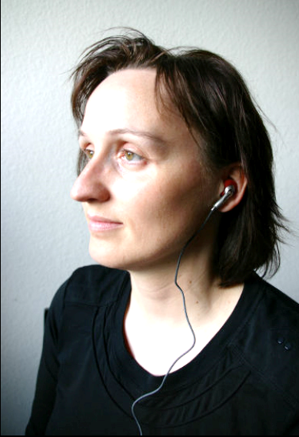
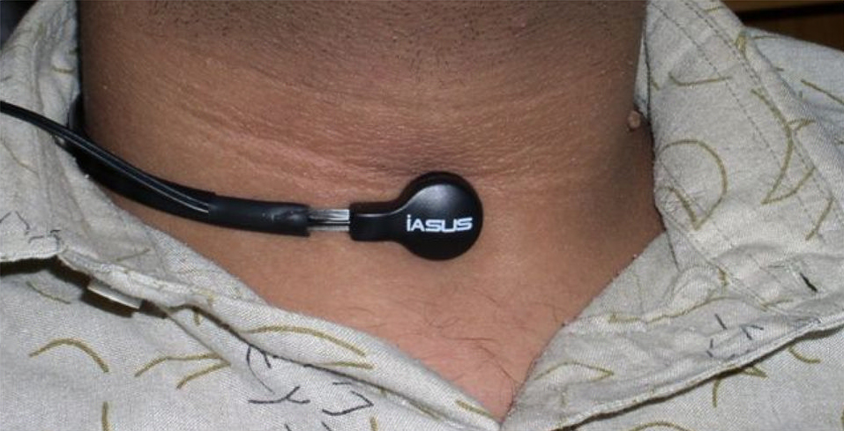
Related Work – Earphones and Microphones
[Sazonov2010]
[Amft2010]
Use microphones to detect sounds of swallowing or chewing
Tested on < 25 participants
[Bi2018]
Amft2010: Amft, O. (2010, November). A wearable earpad sensor for chewing monitoring. In SENSORS, 2010 IEEE (pp. 222-227). IEEE.
Sazonov2010: Sazonov, E., Schuckers, S., Lopez-Meyer, P., Makeyev, O., Sazonova, N., Melanson, E. L., & Neuman, M. (2008). Non-invasive monitoring of chewing and swallowing for objective quantification of ingestive behavior. Physiological Measurement, 29(5), 525.
Bi 2018: Bi, S., Wang, T., Tobias, N., Nordrum, J., Wang, S., Halvorsen, G., ... & Halter, R. (2018). Auracle: Detecting eating episodes with an ear-mounted sensor. Proceedings of the ACM on Interactive, Mobile, Wearable and Ubiquitous Technologies, 2(3), 1-27.

Slide 11
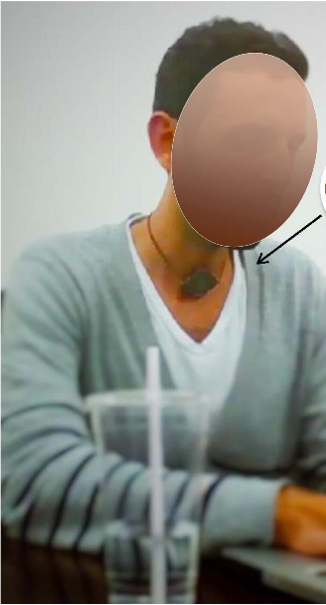
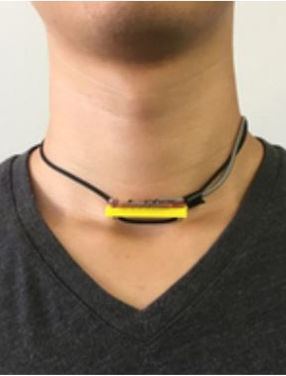
Related Work – Necklaces
[Alshurafa2015]
[Chun2018]
Detect movements of the throat or jaws to detect chewing
Tested on < 25 participants
[Chun2020]
Alshurafa2015: Alshurafa, N., Kalantarian, H., Pourhomayoun, M., Liu, J. J., Sarin, S., Shahbazi, B., & Sarrafzadeh, M. (2015). Recognition of nutrition intake using time-frequency decomposition in a wearable necklace using a piezoelectric sensor. IEEE sensors journal, 15(7), 3909-3916.
Chun2018: Chun, K. S., Bhattacharya, S., & Thomaz, E. (2018). Detecting eating episodes by tracking jawbone movements with a non-contact wearable sensor. Proceedings of the ACM on Interactive, Mobile, Wearable and Ubiquitous Technologies, 2(1), 1-21.
Chun2020: San Chun, K., Jeong, H., Adaimi, R., & Thomaz, E. Eating Episode Detection with Jawbone-Mounted Inertial Sensing, 42nd Engineering in Medicine and Biology Conference (EMBC 2020)

Slide 12
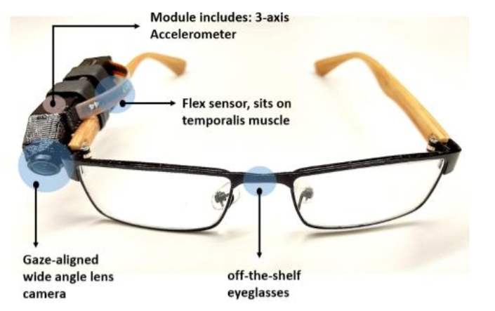
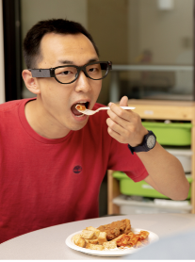
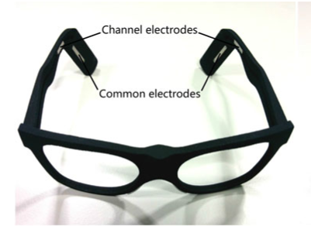
Related Work – Glasses
[Doulah2020]
[Bedri2020]
Multisensor arrays containing cameras, IMUs, EMGs
Tested on < 25 participants
[Zhang2017]
Zhang, R., & Amft, O. (2017). Monitoring chewing and eating in free-living using smart eyeglasses. IEEE Journal of Biomedical and Health Informatics, 22(1), 23-32.
Doulah, A. B. M. S. U., Ghosh, T., Hossain, D., Imtiaz, M. H., & Sazonov, E. (2020). “Automatic Ingestion Monitor Version 2”—A Novel Wearable Device for Automatic Food Intake Detection and Passive Capture of Food Images. IEEE Journal of Biomedical and Health Informatics.
Bedri2020: Bedri, A., Li, D., Khurana, R., Bhuwalka, K., & Goel, M. (2020, April). FitByte: Automatic Diet Monitoring in Unconstrained Situations Using Multimodal Sensing on Eyeglasses. In Proceedings of the 2020 CHI Conference on Human Factors in Computing Systems (pp. 1-12).

Slide 13
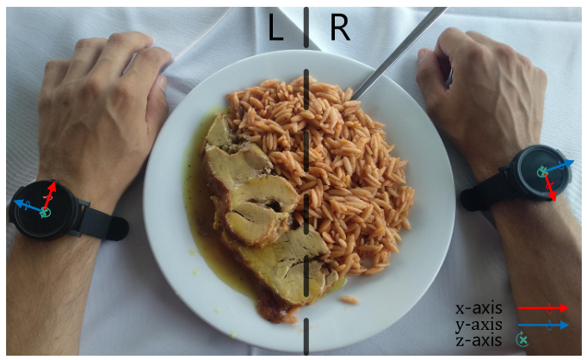
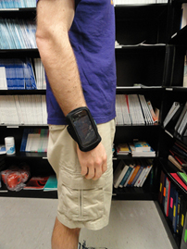
Related Work – Wrist Watch
[Dong2013]
Wrist motion tracking using IMU sensors
Tested on < 45 participants
Multiple surveys have reported wrist watches are preferred compared to others
[Kyritsis2020]
Dong, Y., Scisco, J., Wilson, M., Muth, E., & Hoover, A. (2013). Detecting periods of eating during free-living by tracking wrist motion. IEEE Journal of Biomedical and Health Informatics, 18(4), 1253-1260.
Kalantarian, H., & Sarrafzadeh, M. (2015). Audio-based detection and evaluation of eating behavior using the smartwatch platform. Computers in Biology and Medicine, 65, 1-9.
Kalantarian, H., Alshurafa, N., & Sarrafzadeh, M. (2017). A survey of diet monitoring technology. IEEE Pervasive Computing, 16(1), 57-65.
Kyritsis, K., Diou, C., & Delopoulos, A. (2020). A Data Driven End-to-end Approach for In-the-wild Monitoring of Eating Behavior Using Smartwatches. IEEE Journal of Biomedical and Health Informatics.

Slide 14
Wrist Motion (cont…)
Our group has been working with wrist data since 2011 – bite detection, eating in cafeteria, everyday eating, walking detection

Slide 15
Outline
Motivation
Related Work
Data Collection
Replication Experiment
Filtering Linear Acceleration
The Impact of Secondary Activities
Top-down Detection of Eating Episodes Using a CNN
Conclusions and Future Work

Slide 16
Large, Everyday Life Data Collection
Track wrist motion all day using a Shimmer3
Collect a large amount of data from participants in free-living, without the burden of being monitored
Cameras cannot be easily implemented in free-living, participants are concerned about privacy¹
Participants have expressed discomfort during the use of ego-centric wearable cameras with first-person view²
Participants self-reported meal start and end times using a button press
[1] Thomaz, E., Parnami, A., Bidwell, J., Essa, I., & Abowd, G. D. (2013, September). Technological approaches for addressing privacy concerns when recognizing eating behaviors with wearable cameras. In Proceedings of the 2013 ACM International Joint Conference on Pervasive and Ubiquitous Computing (pp. 739-748).
[2] Alharbi, R., Stump, T., Vafaie, N., Pfammatter, A., Spring, B., & Alshurafa, N. (2018). I can't be myself: effects of wearable cameras on the capture of authentic behavior in the wild. Proceedings of the ACM on Interactive, Mobile, Wearable and Ubiquitous Technologies, 2(3), 1-40.

Slide 17
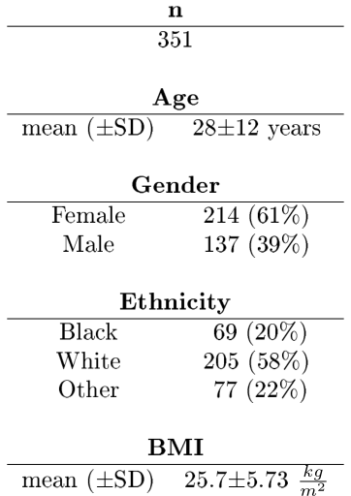
Data Collection
Pilot Data Collection – 2 months
Full Data Collection – 1 year
408 participants total
351 participants (354 days) usable data
4,680 hours data (265 eating)
Weekday | Monday | Tuesday | Wedneday | Thursday | Friday
 | 132 | 390 | 284 | 161 | 51
(52%)*
(27%)*
Weekend | Sunday | Saturday
 | 84 | 30
(64%)*
* Distribution in the state of South Carolina

Slide 18
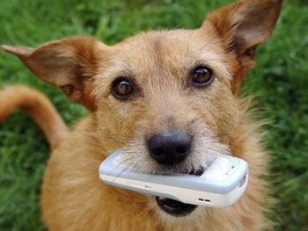
Results
1 year to collect data – 354 days
1 year to clean data, check annotations
89 GB of data
86% of the data was usable (351/408 participants):
9.3% lost due to Human Behavior
4 participants did not turn device on (or inadvertently turned it off)
2 carried the device in their pockets
2 devices lost (Dog, Gymnasium)
13 failed to follow instructions
4.6% lost due to Hardware Issues (19 device failures)
Dog ate my homework is a valid excuse in any scenario

Slide 19
Results
Collected 10x – 100x more data than previous work
Work | Dataset | Meals | Hours | Hours Eating | Participants
Thomaz 2015 | Wild-7 | - | 31.5 | 2 | 7
Thomaz 2015 | Wild-Long | - | 422 | 16 | 1
Kyritsis 2020 | FreeFIC held-out | 6 | 35 | 2 | 6
Kyritsis 2020 | FreeFIC | 17 | 77 | 5 | 6
Mirtchouk 2017 | ACE-E | 55 | 144 | 12 | 6
Dong 2014 | iPhone | 116 | 449 | 22 | 43
This Work | New Dataset | 1,133 | 4,680 | 250 | 351

Slide 20
Outline
Motivation
Related Work
Data Collection
Replication Experiment
Filtering Linear Acceleration
The Impact of Secondary Activities
Top-down Detection of Eating Episodes Using a CNN
Conclusions and Future Work
Sharma, S., Jasper, P., Muth, E., & Hoover, A. (2016, June). Automatic detection of periods of eating using wrist motion tracking. In 2016 IEEE First International Conference on Connected Health: Applications, Systems and Engineering Technologies (CHASE) (pp. 362-363). IEEE.

Slide 21
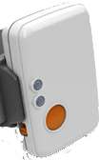
Replication Experiment
Replicate previous work by Dong et al. on the New data set
The Shimmer3 weighs 5x less than an iPhone 4, and less than most smart watches

Slide 22
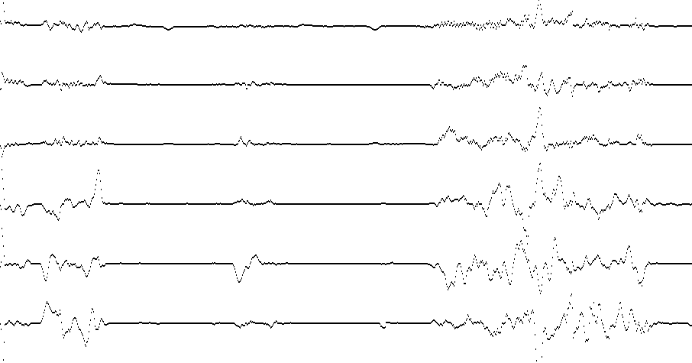
Replicating Previous Work: Representing Data
2 minutes
x
y
z
yaw
pitch
roll
x + y + z

Slide 23
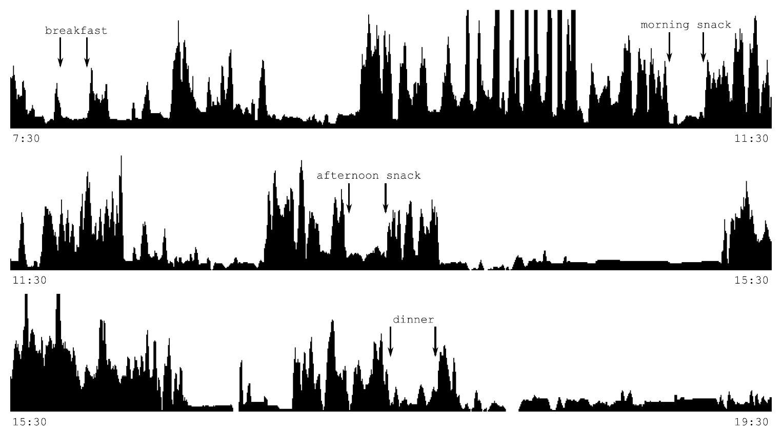
Representing Data

Slide 24
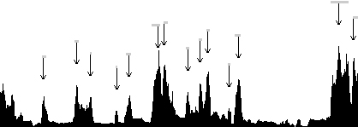
Method
Manipulation
Peak Detection
Segmentation
Sum of Acceleration
Wrist Roll
Roll Regularity
Feature Values
Features
Classification
Dong, Y., Scisco, J., Wilson, M., Muth, E., & Hoover, A. (2013). Detecting periods of eating during free-living by tracking wrist motion. IEEE journal of biomedical and health informatics, 18(4), 1253-1260.

Slide 25
Example Whole Day
Classifier Output
Participant reported ground truth (green lines)
other
5.5 hours (11 hours total)

Slide 26
Results
Eating activities were more complex than previously captured
Work | WACC | TPR | TNR
Dong et al. | 81 (-6) | 82 (-11) | 81 (-9)
New Dataset | 75 (-6) | 71 (-11) | 73 (-9)
There was much more time difference between self-reports and start / end of detections
Work | Start Time Difference (min) | End Time Difference (min)
Dong et al. | -0.6 | 1.5
New Dataset | -4.5 | 7

Slide 27
Why did replication not work?

Slide 28
Outline
Motivation
Related Work
Data Collection
Replication Experiment
Filtering Linear Acceleration
The Impact of Secondary Activities
Top-down Detection of Eating Episodes Using a CNN
Conclusions and Future Work
Sharma, S., & Hoover, A. (2019, November). A Study on Linear Acceleration of the Wrist During Free-Living. In 2019 IEEE International Conference on Bioinformatics and Biomedicine (BIBM) (pp. 1624-1628). IEEE.

Slide 29
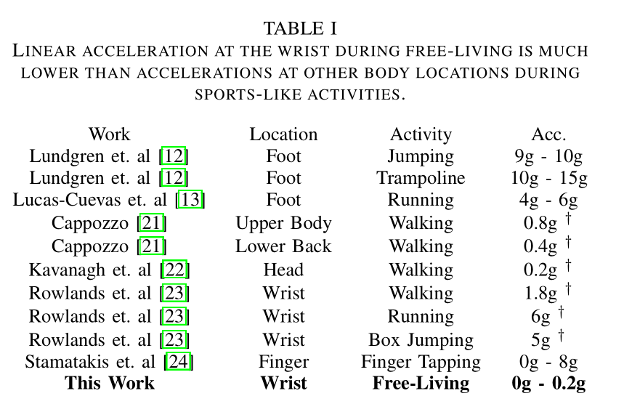

Slide 30
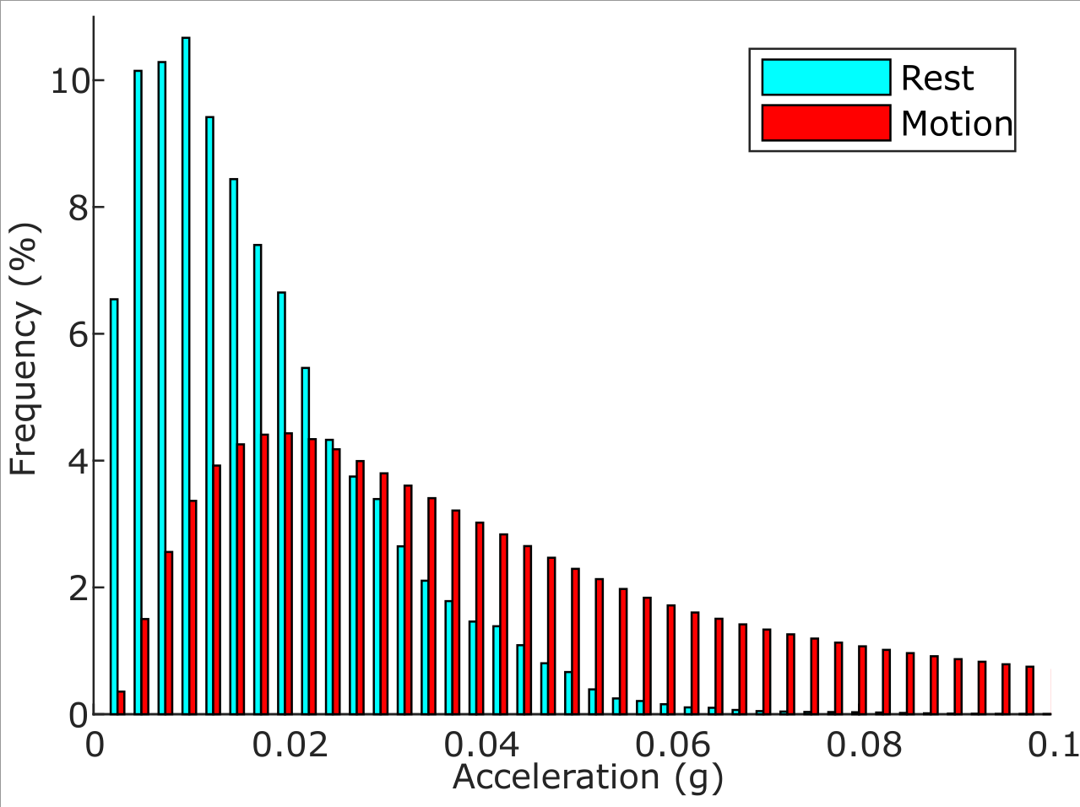
Noise in Linear Acceleration
70% of wrist motion overlaps with the noise range of commercial accelerometers
Spread of noise(blue) vs rest (red)
Sharma, S., & Hoover, A. (2019, November). A Study on Linear Acceleration of the Wrist During Free-Living. In 2019 IEEE International Conference on Bioinformatics and Biomedicine (BIBM) (pp. 1624-1628). IEEE.

Slide 31
Noise in Linear Acceleration
Work | WACC | TPR | TNR
Without Filter | 75 | 71 (11) | 73 (-9)
With Filter | 75 | 73 (+2) | 74 (+1)
Before Filter
Filtering improves the detection of peaks
After Filter
Sharma, S., & Hoover, A. (2019, November). A Study on Linear Acceleration of the Wrist During Free-Living. In 2019 IEEE International Conference on Bioinformatics and Biomedicine (BIBM) (pp. 1624-1628). IEEE.

Slide 32
Outline
Motivation
Related Work
Data Collection
Replication Experiment
Filtering Linear Acceleration
The Impact of Secondary Activities
Top-down Detection of Eating Episodes Using a CNN
Conclusions and Future Work
S. Sharma, P. Jasper, E. Muth, and A. Hoover, “The impact of walking and resting on wrist motion for automated detection of meals,” ACM Transactions on Computing for Healthcare, vol. 1, no. 1, pp. 1–18, 2020.

Slide 33
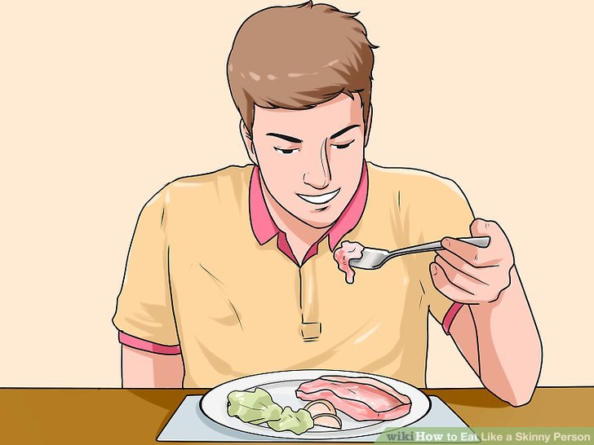
Lab vs Everyday Life
 | Controlled |  | Unconstrained
 | Precision | Recall | Precision | Recall
Thomaz (2015) | 67 | 89 | 65 (-2) | 79 (-10)
Mirtchouk (2017) | 88 | 87 | 45 (-43) | 85 (-2)
Chun (2018) | 95 | 82 | 78 (-17) | 73 (-9)
Zhang (2018) | 94 | 90 | 79 (-15) | 77 (-13)
Doulah (2018) – Meal durations (min) and pauses between ingestive bouts (sec) were significantly longer in field-like setting compared to lab
Alex (2019) -- Eating rate (bites/min) appx twice as slow in free-living compared to cafeteria

Slide 34
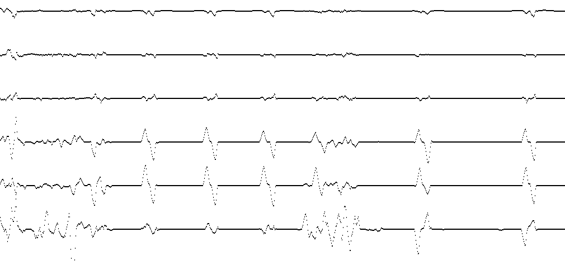
Eating a banana
2 minutes
Food preparation
Intake events (“bites”)

Slide 35
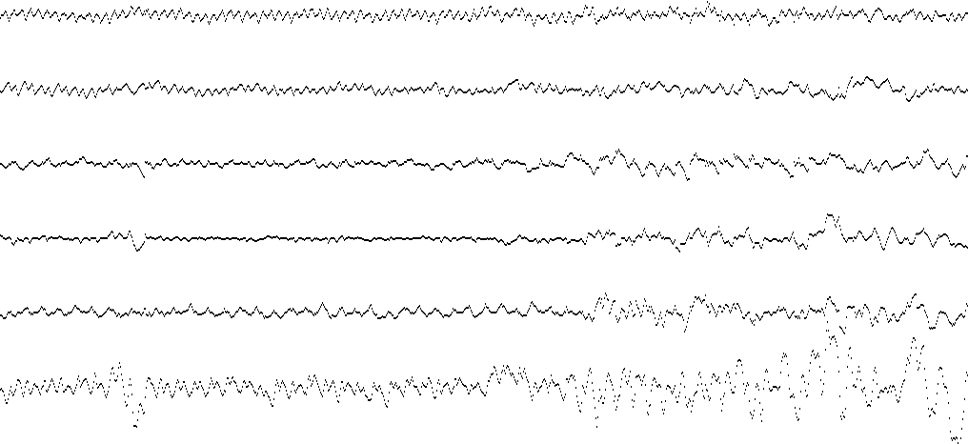
Walking
1 minute
Oscillations are steps
(Click here for video walking demo)

Slide 36
Singular activity classification
Can be classified using features based on frequency, magnitude, rotation vs acceleration, motion to rest ratio, etc.

Slide 37
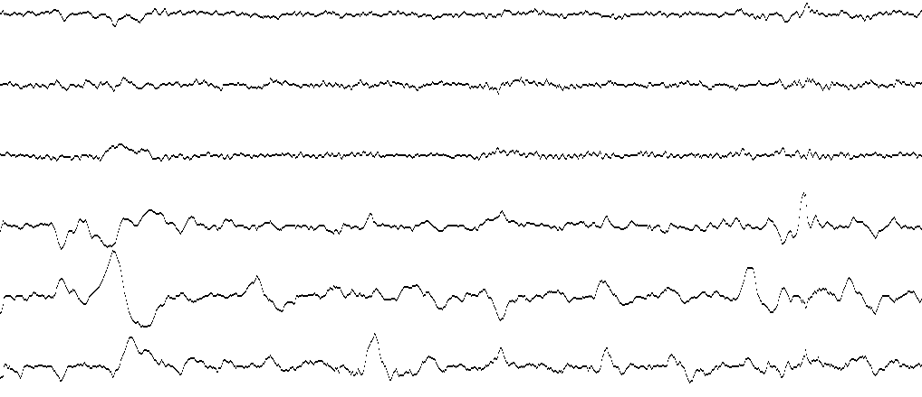
Two Simultaneous Activities
1 minute
Walking and eating a banana at the same time

Slide 38
Self-reported Secondary Activities
Secondary activity | Number of meals | % of meals in data set
None | 317 | 28%
Talking | 281 | 25%
Something | 535 | 47%
Selection of reported secondary activities
Putting away groceries | Playing with niece | Walking dog
Watching media on computer | Sitting in meeting | House chores
Checking email and internet | Working on papers | Reading book
Talking and playing pool | Sitting in car | Talking in car
Talking to team in class | Getting ready | Doing work
Talking to friend in a fair | Playing trivia | Working
Talking and texting | Watching TV | Reading

Slide 39
Rest Detector
Detected by looking for low variance in accelerometer and gyroscope signals
Walking Detector
Detected by looking for a high number of zero crossings
S. Sharma, P. Jasper, E. Muth, and A. Hoover, “The impact of walking and resting on wrist motion for automated detection of meals,” ACM Transactions on Computing for Healthcare, vol. 1, no. 1, pp. 1–18, 2020.

Slide 40
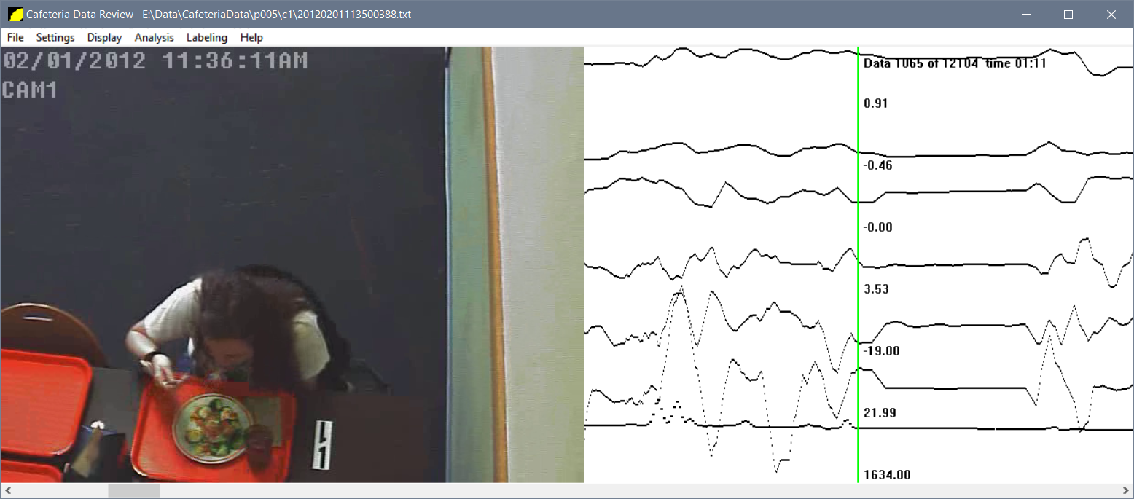
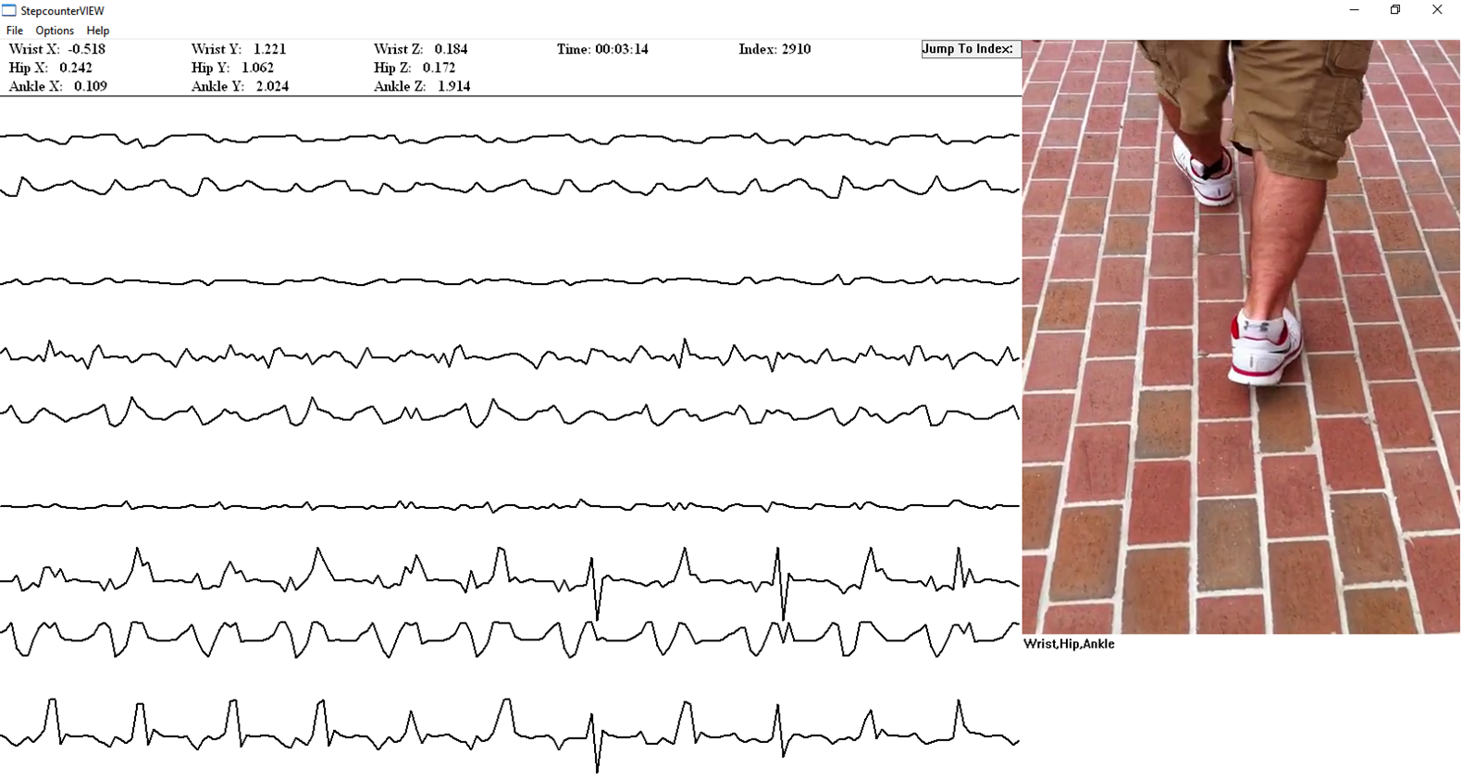
Detecting Resting and Walking
Train and Test Walking and Resting Classifier on Pedometer and Cafeteria Datasets
Evaluate on new data set

Slide 41
Results
Data set | Data Evaluated | Total data (hrs) | Eating (hrs) | % duration detected resting | % duration detected walking
Pedometer | Periods of Walking | 5 | 0 | 0% | 100%
Cafeteria | Meals | 96 | 96 | 7%* | 0.3%
Free living | Meals | 4,680 | 229 | 12.8% (1.8x) | 5.5%
* Ground truth rest in cafeteria measured as 6.8% using video.
21/1,133 meals walking, 38/1,133 meals resting
1,063 “valid” meals : Clemson all-day dataset (CAD)
Overall classifier accuracy improved from 74% to 77% by excluding resting and walking
91% of meals with no secondary activity detected compared to 87% of meals with

Slide 42
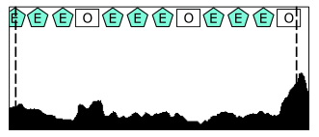
Results - Example Meals
Participant reported ground truth (dashed lines)
10 min
Eating
only
11 min
Mostly eating
Classifier Output

Slide 43
Results - Example Meals
Participant reported ground truth (dashed lines)
19 min
Eating is <50% of self-reported meal duration
Classifier Output

Slide 44
Results - Example Meals
Participant reported ground truth (dashed lines)
30 min
9 min of rest, 2 min of walking, several min of other possibly due to mixture of activities (eating + secondary activity confusing classifier)
Classifier Output

Slide 45
Results - Example Meals
Participant reported ground truth (dashed lines)
34 min
12 min of walking, possibly grazing while doing secondary activity (cleaning up, preparing to leave location, other)
Classifier Output

Slide 46
Lessons Learned
Secondary activities happen during the majority of meals in free living.
Lab meals without secondary activities are not representative.
Motion patterns due to secondary activities impact the motion patterns related to eating.
Secondary activities are overlapping and intermittent with actual consumption, and therefore difficult to model.

Slide 47
Outline
Motivation
Related Work
Data Collection
Replication Experiment
Filtering Linear Acceleration
The Impact of Secondary Activities
Top-down Detection of Eating Episodes Using a CNN
Conclusions and Future Work
S. Sharma, and A. Hoover, “Top-down Detection of Eating Episodes in Free-living by Analyzing Large Windows of Wrist Motion Using a Convolutional Neural Network”, submitted to IEEE Journal of Biomedical and Health Informatics for review.

Slide 48
Previous Work (Bottom Up/Gesture Spotting)
[Junker2008]
[Kyritsis2020]
Detect physiological events indicative of eating (bites / swallows / chews) using 0.5 – 5 sec windows
Combine regions with a high concentration of these events to detect eating
Junker, H., Amft, O., Lukowicz, P., & Tröster, G. (2008). Gesture spotting with body-worn inertial sensors to detect user activities. Pattern Recognition, 41(6), 2010-2024.
Kyritsis, K., Diou, C., & Delopoulos, A. (2020). A Data Driven End-to-end Approach for In-the-wild Monitoring of Eating Behavior Using Smartwatches. IEEE Journal of Biomedical and Health Informatics.

Slide 49
Novelty: Top Down Detection
Look at large windows (6 – 15 min) of wrist motion data using a CNN to detect periods of eating
Meal preparation and cleanup helps detect start and end of meals¹
Consumption, stirring, cutting, and resting between ingestion events can help improve the detection of eating activities²
[1] Dong, Y., Scisco, J., Wilson, M., Muth, E., & Hoover, A. (2013). Detecting periods of eating during free-living by tracking wrist motion. IEEE Journal of Biomedical and Health Informatics, 18(4), 1253-1260.
[2] Shen, Y., Salley, J., Muth, E., & Hoover, A. (2016). Assessing the accuracy of a wrist motion tracking method for counting bites across demographic and food variables. IEEE Journal of Biomedical and Health Informatics, 21(3), 599-606.

Slide 50
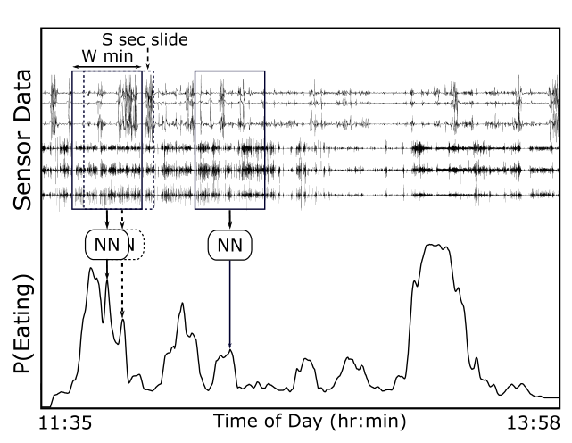
Top-down Detection of Eating Episodes Using a CNN
Use a sliding window of W minutes with a slide of S seconds
Use a CNN to look at window of data and generate an instantaneous probability of eating

Slide 51
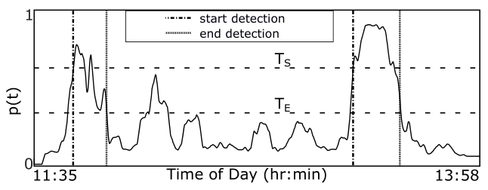
Segmentation of Eating Activities
Use a hysteresis based segmenter to segment periods of eating
Use two thresholds- start threshold T_{S} and end threshold T_{E}
High start threshold reduces false positives
Low end threshold helps improve boundary detection in the presence of resting and other secondary activities
In total we have three parameters – W, T_{S} and T_{E}

Slide 52
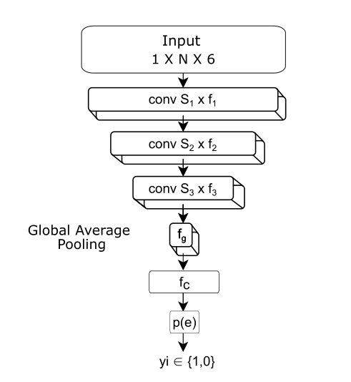
CNN Architecture
N = 15 * 60 * W
S₁ = 44 units (3 sec) X 10 filters
S₂ = 20 units X 10 filters
S₃ = 4 units X 10 filters
f_{g} = 10 weights
f_{c} = 200 weights

Slide 53
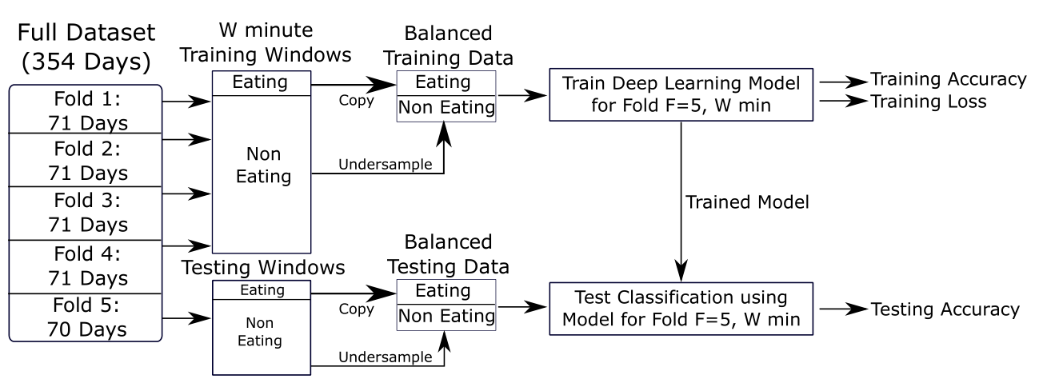
Training the Neural Network
Models for for W = {7.5sec - 15 min}
5-fold cross-validation
5 folds X 15 windows = 75 models
Label window as eating if 50% of window falls within self-reported period of eating
Under sample the non-eating class

Slide 54
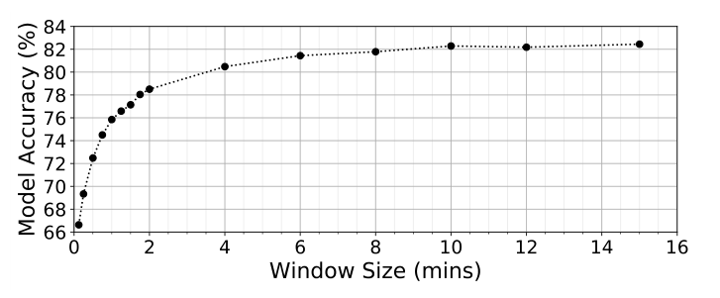
Results – Classification Accuracy v/s Window Size
Longer windows perform slightly better, but the increase in training and prediction time is much longer
Classification accuracy plateaus after 6 mins

Slide 55
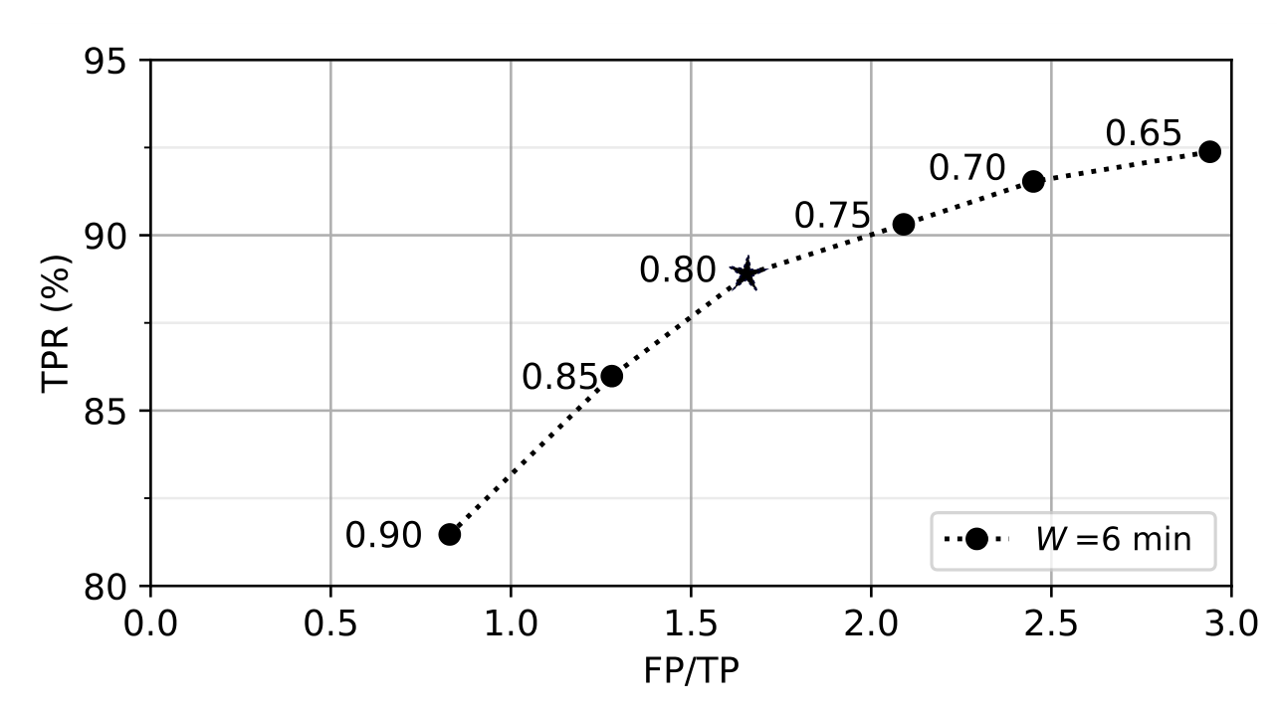
Results – Effect of Start Threshold T_{S}
Knee at T_{S} = 0.8 balances TPR vs FP/TP

Slide 56
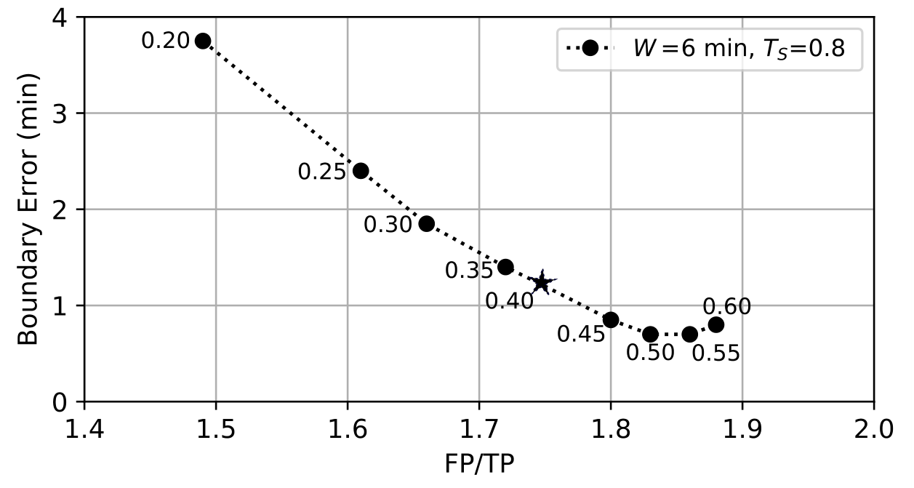
Results – Effect of End Threshold T_{E}
Knee at T_{E} = 0.40 balances Boundary Error vs FP/TP

Slide 57
Results – Episode Metrics
Work | Dataset | EA | Participants | TPR | FP/TP
Thomaz 2015 | Wild-7 | - | 7 | - | -
Thomaz 2015 | Wild-Long | - | 1 | - | -
Kyritsis 2020 | FreeFIC held-out | 6 | 6 | - | -
Kyritsis 2020 | FreeFIC | 17 | 6 | - | -
Mirtchouk 2017 | ACE-E/FL | 31 | 5 | 94 | -
Mirtchouk 2017 | ACE-E | 55 | 6 | 87 | -
Kyritsis 2020 | ACE-E+FL | 86 | 11 | - | -
Dong 2014 | iPhone | 116 | 43 | 86 | 3.8
Bayesian Classifier [This Work] | CAD | 1063 | 351 | 89 | 5.2
CNN [This Work] | CAD | 1063 | 351 | 89 | 1.7
Compared to Bayesian on CAD, CNN provides a 67% reduction in false detections (FP/TP) and FP/hr (1.06 -> 0.35)
Compared to Dong 2014, CNN provides 3% better detection and reduces FP by half.
Some work has not reported FP or TPR. It is possible all meals were detected.

Slide 58
Results – Time Metrics
CNN performs better than Bayesian Classifier (+25% F₁-score, +6% ACC_{W})
Other work reported for completeness

Slide 59
Conclusion
Evidence that non-eating actions during meals can be indicative of eating
15% increase in window based classification accuracy when using large windows (10 mins) vs short windows (7.5sec – 2 min)
100% time recall in self-reported meals may be ambitious
Top down approaches to detect eating should be explored
Comparisons between different works and different data sizes must be made cautiously

Slide 60
Thank You!
&
Q&A
This work was supported by the National Institutes of Health (NIH) grant #1R01HL118181-01A1.

Slide 61
Extra Slides for Discussion

Slide 62
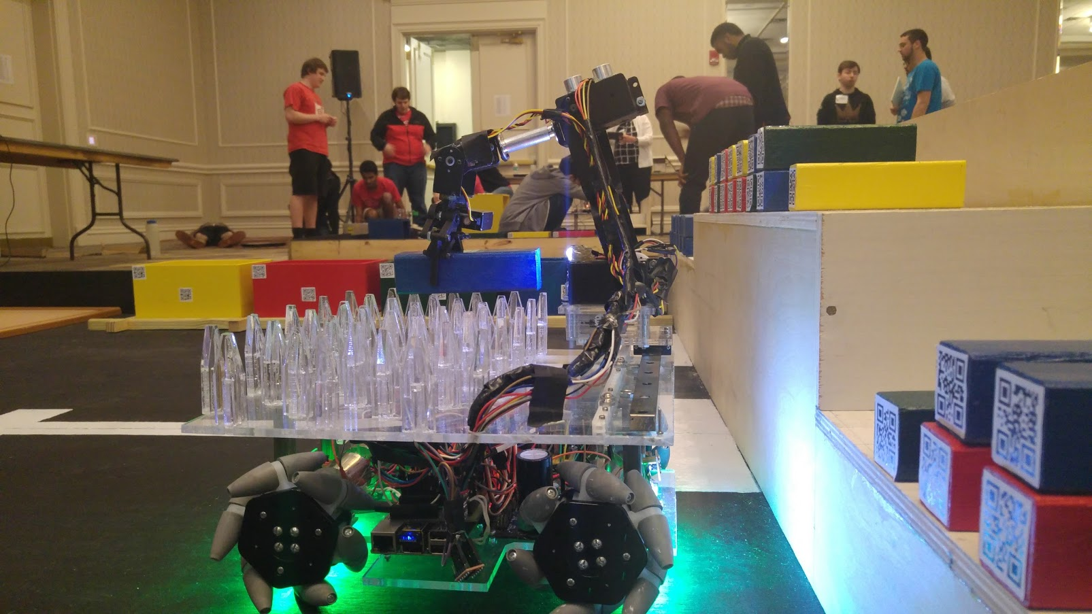
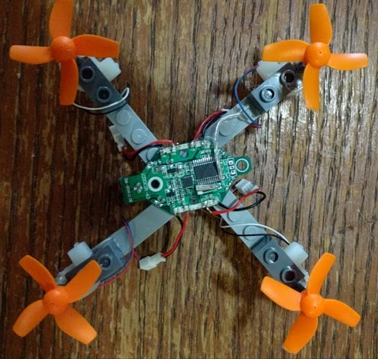
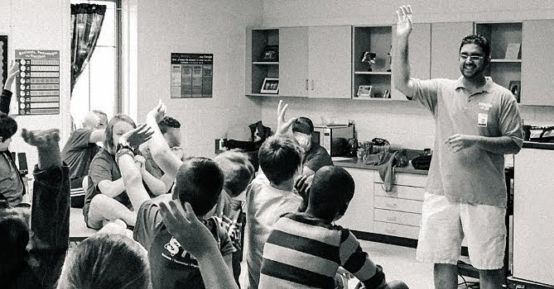
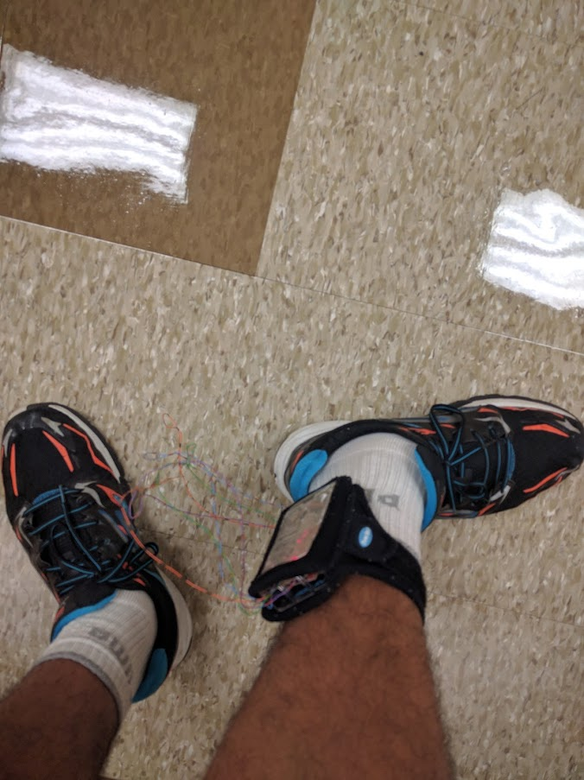
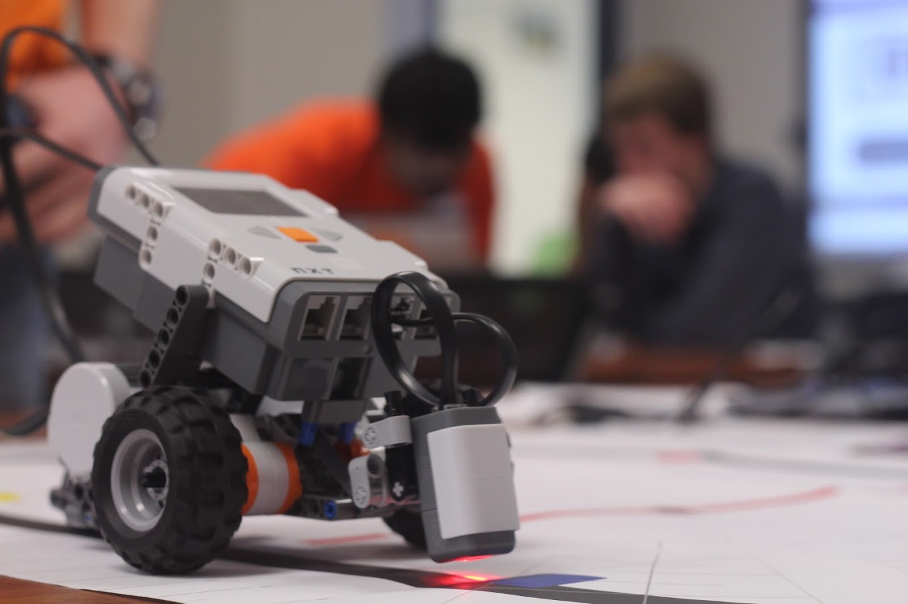
Thank You!
Questions?

Slide 63
Outline
Motivation
Related Work
Data Collection
Replication Experiment
Filtering Linear Acceleration
The Impact of Secondary Activities
Top-down Detection of Eating Episodes Using a CNN
A Discussion on Metrics
Conclusions and Future Work

Slide 64
Time Recall is affected by secondary activities
If a classifier correctly detects walking as walking and resting as resting, it will never achieve 100% TPR on self-reported meals

Slide 65
Results – Change in Feature Values
$$FLD=\frac{{\left(μ_{1}−μ_{2}\right)}^{2}}{{\left(σ_{1}^{2}−σ_{2}^{2}\right)}^{2}}$$
Fisher’s Linear Discriminant
 | Manipulation |  |  | Sum of Acc |  |  | Roll |  |  | Roll-Reg
 | Mean | Variance | FLD | Mean | Variance | FLD | Mean | Variance | FLD | Mean | Variance | FLD
Eating | 791 | 45785 | 1.5˅ | 0.039 | 0.0002 | 0.05 | 9.1 | 18.2 | 0.09 | 0.58 | 0.02 | 0.49
Non-Eating | 395 | 57284 |  | 0.054 | 0.0043 |  | 6.8 | 39.2 |  | 0.37 | 0.07
Dong et al.
 | Manipulation |  |  | Sum of Acc |  |  | Roll |  |  | Roll-Reg
 | Mean | Variance | FLD | Mean | Variance | FLD | Mean | Variance | FLD | Mean | Variance | FLD
Eating | 608˅ | 45808˅ | 0.84˅ | 0.057˄ | 0.0006˄ | 0.02˅ | 13.6˄ | 23.1˄ | 0.09 | 0.66˄ | 0.02 | 0.46˅
Non-Eating | 337˅ | 41652˅ |  | 0.068˄ | 0.0043˄ |  | 9.5˄ | 65.4˄ |  | 0.45˄ | 0.08
Replication Experiment

Slide 66
Selected Metrics
(Informed by our exploration of 354 days of data)
Eating Time
Eating Episodes
Eating Boundaries
Bell, Brooke M., et al. "Automatic, wearable-based, in-field eating detection approaches for public health research: a scoping review." NPJ digital medicine 3.1 (2020): 1-14.

Slide 67
Eating Time Metrics
Label each datum/second/minute as TP, FP, TN, FN
Calculate Weighted Accuracy
09:00
12:00

Slide 68
Episode Metrics
Label self-reported meals as TP or Miss
Label FPs in detected segments
Cannot count TN
Report TPR and FP/TP
09:00
12:00

Slide 69
Boundary Error
Boundary errors are signed

Slide 70
Most Time Metrics are Affected by Imbalance

Slide 71
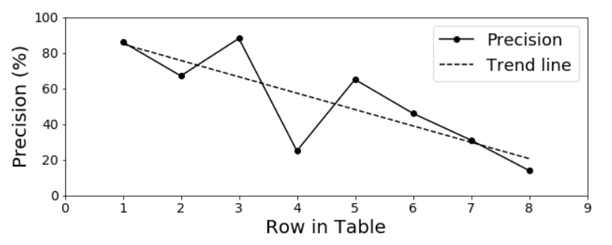
Affected by size of data set

Slide 72
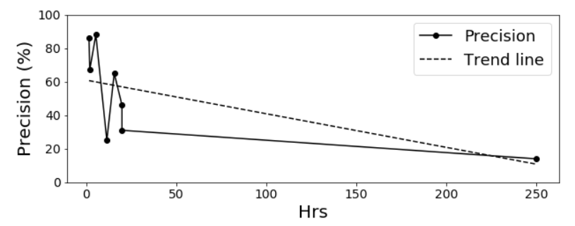
Affected by size of data set
We used row # on the X axis because Hrs does not scale well

Slide 73
Comparing Time and Episode Metrics
A v/s B Episode Metrics tell a better story
C v/s D Episode Metrics tell a better story

Slide 74
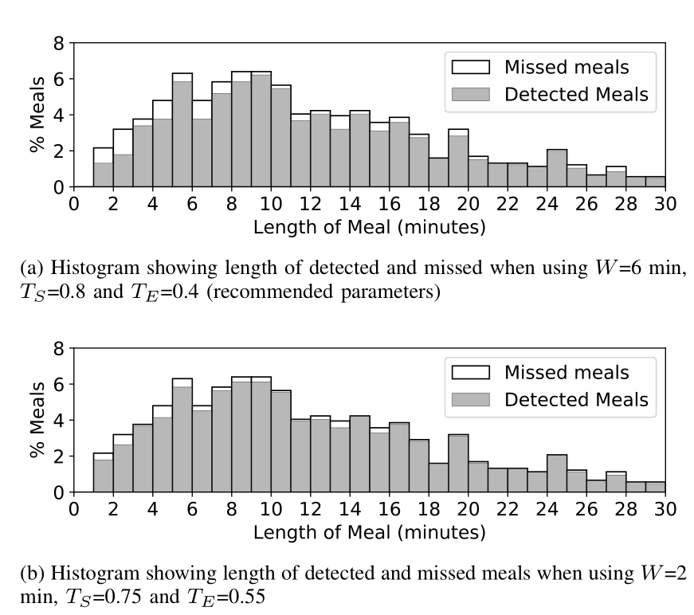
Results - Snacks
W = 6 min (89% TPR) misses many snacks
Using a shorter window of W=2 minutes detects 95% meals (TPR), but increases FP/TP 6.1
Other work reported 67% FPs were snacks¹
[1] Mirtchouk, M., Lustig, D., Smith, A., Ching, I., Zheng, M., & Kleinberg, S. (2017). Recognizing eating from body-worn sensors: Combining free-living and laboratory data. Proceedings of the ACM on Interactive, Mobile, Wearable and Ubiquitous Technologies, 1(3), 1-20.

