Slide 1


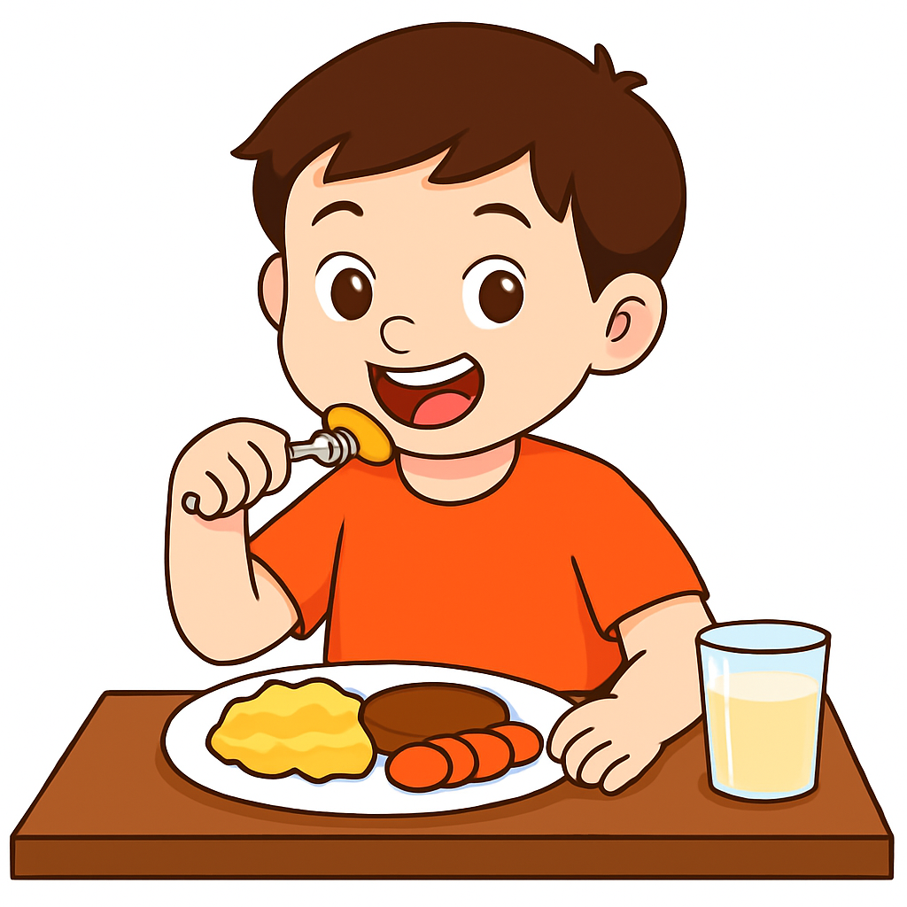
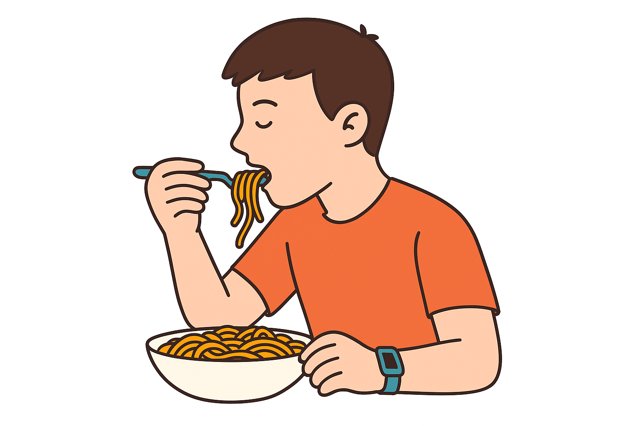
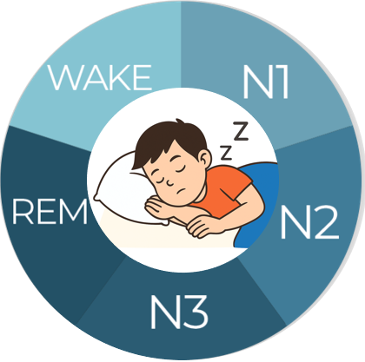
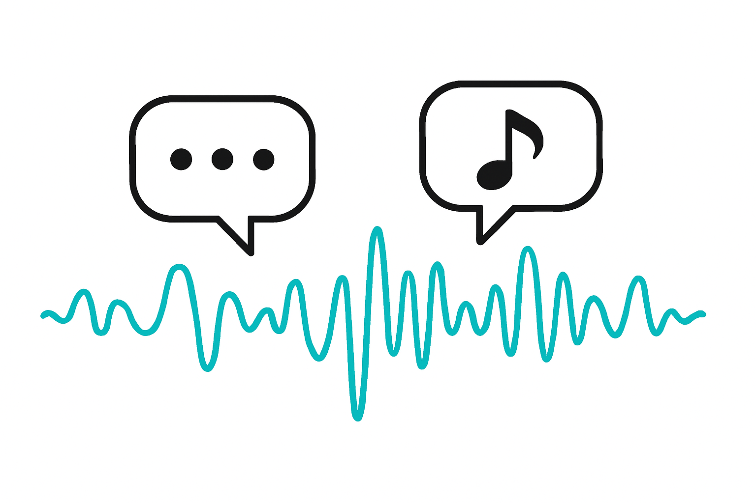
Learning Global Context for Sparse Activity Recognition in Lengthy Recordings
Zeyu Tang
Committee Members
Dr. Jon Calhoun
Dr. Adam Hoover (Chair)
Dr. Feng Luo
Dr. Lan Zhang
Funding
NIH: R01DK135679, R01DK132210, R01HL153543
NSF: 2242812
DARPA: Arcadia program
Samsung Electronics
South Carolina Department of Commerce

Slide 2
Outline
Motivation
Detecting eating episodes from wrist motion using daily pattern analysis¹
Detecting intake gestures from videos using meal-length context^{2,3}
A generalized framework for sparse activity recognition
Conclusion
[1] Zeyu Tang, Adam Patyk, James Jolly, Stephanie P Goldstein, J Graham Thomas, and Adam Hoover. Detecting eating episodes from wrist motion using daily pattern analysis. IEEE Journal of Biomedical and Health Informatics, 28(2):1054–1065, 2023.
[2] Zeyu Tang and Adam Hoover. Video-based intake gesture recognition using meal-length con-text. ACM Transactions on Computing for Healthcare, 6(2):1–24, 2025.
[3] Zeyu Tang and Adam Hoover. A new video dataset for recognizing intake gestures in a cafeteria setting. In 2022 26th International Conference on Pattern Recognition (ICPR), pages 4399–4405. IEEE, 2022.

Slide 3
Motivation

Slide 4
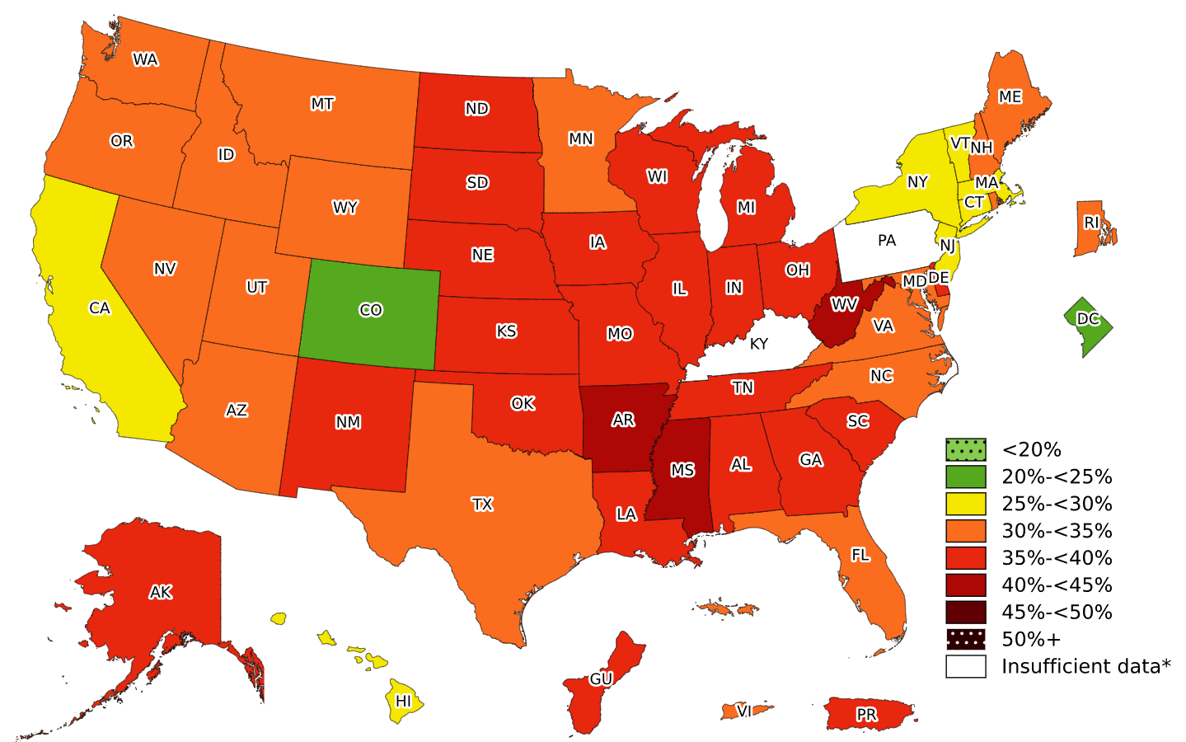
Motivating Health Problem - Prevalence of Obesity
In 2023, all U.S. states and territories had an obesity prevalence higher than 20% (more than 1 in 5 adults)¹
Obesity contributes to various diseases, including type 2 diabetes, heart disease, stroke, sleep apnea, and certain cancers²
[1] Centers for Disease Control and Prevention. Adult Obesity Prevalence Maps.
https://www.cdc.gov/obesity/data-and-statistics/adult-obesity-prevalence-maps.html, Online: Accessed 2025
[2] National Institutes of Health, Health Risks of Overweight & Obesity,
https://www.niddk.nih.gov/health-information/weight-management/adult-overweight-obesity/health-risks, Online: Accessed 2025

Slide 5
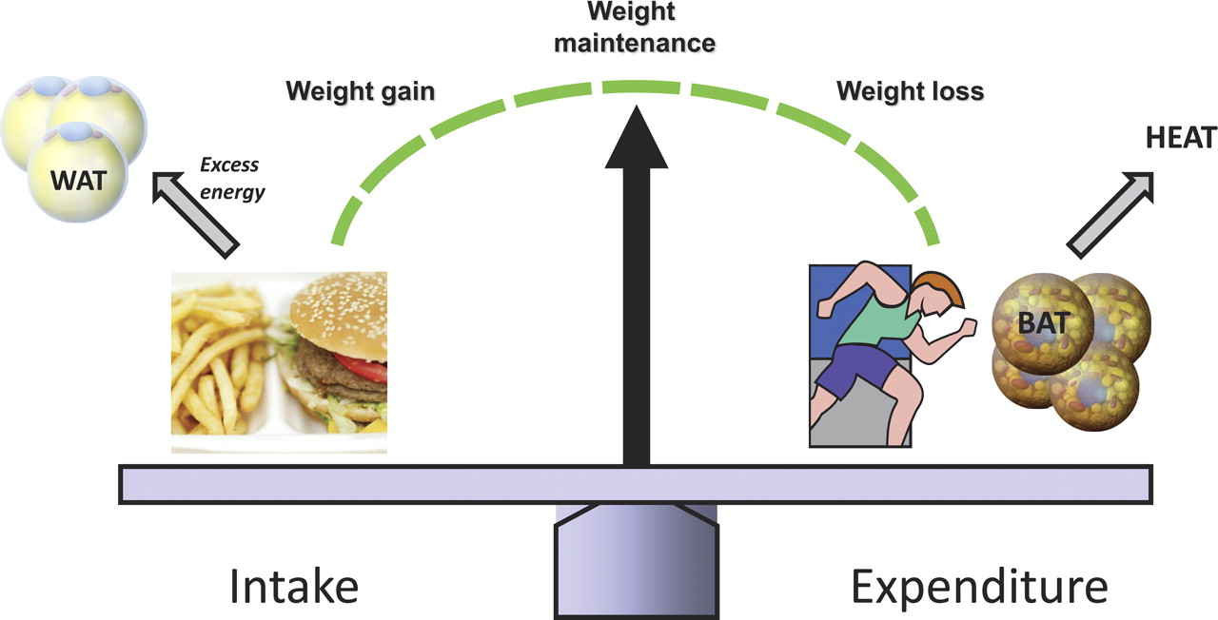
Energy Measures
Energy Intake (EI)¹: absorbed through food intake (kilocalories or joules)
Energy Expenditure (EE)²: needed to carry out a physical function such as breathing, digesting food, or physical movement (kilocalories or joules)
Image source: Seale P, et al., Brown fat in humans: turning up the heat on obesity.
[1] F. Thompson and A. Subar. Dietary assessment methodology. Nutrition in the Prevention and Treatment of Disease, 1(4):5–48, 2017.
[2] Westerterp, Klaas R. Control of energy expenditure in humans. European Journal of Clinical Nutrition 71, no. 3 (2017): 340-344.

Slide 6
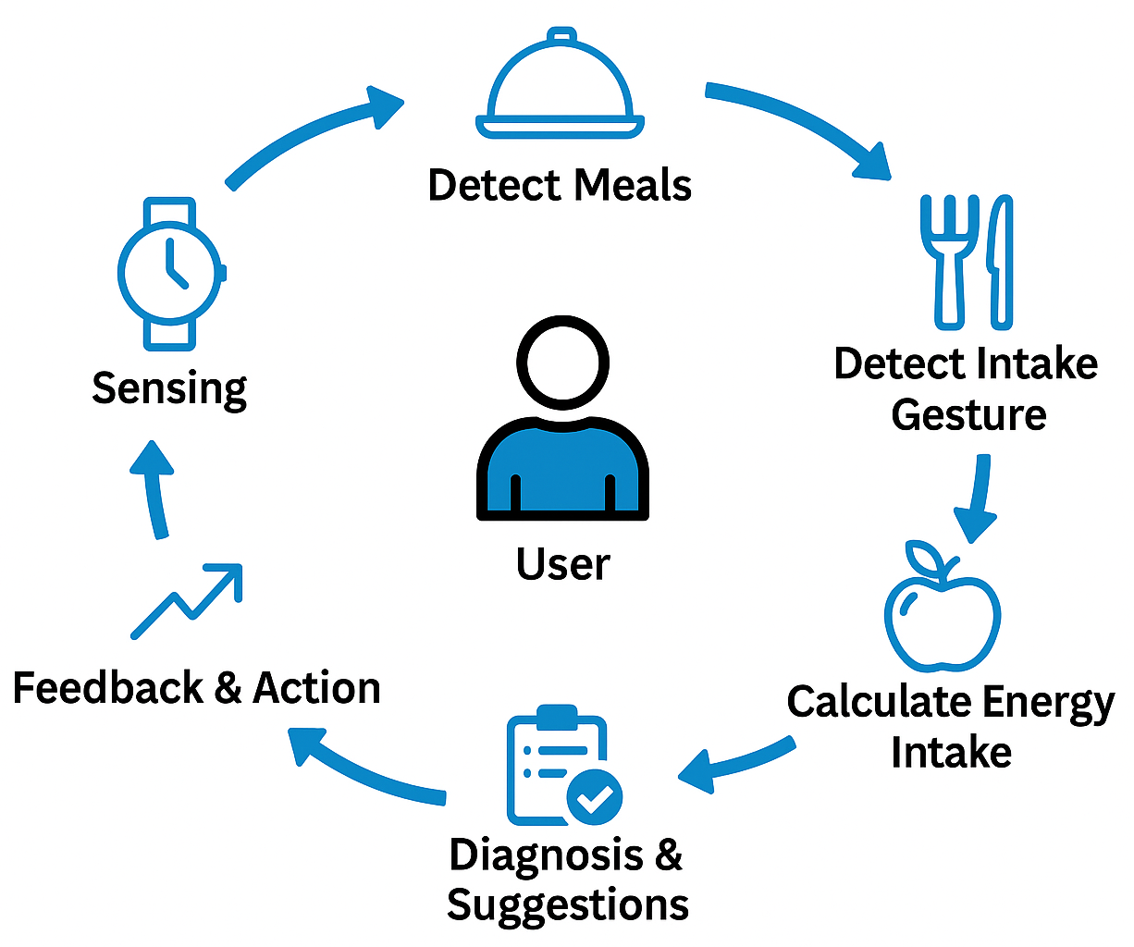
Measure EI – Dietary Monitoring
Easiest way to track energy intake is self-monitoring, but it requires both patience and objectivity from the user¹
Automated Dietary Monitoring (ADM) offers a more convenient and objective alternative
Our group has been working on measuring eating activities since 2011
[1] Burke LE, Wang J, Sevick MA. Self-monitoring in weight loss: a systematic review of the literature. Journal of the American Dietetic Association. 2011 Jan 1;111(1):92-102.

Slide 7
Detecting Eating Episodes From Wrist Motion
Zeyu Tang, Adam Patyk, James Jolly, Stephanie P Goldstein, J Graham Thomas, and Adam Hoover. Detecting eating episodes from wrist motion using daily pattern analysis. IEEE Journal of Biomedical and Health Informatics, 28(2):1054–1065, 2023.

Slide 8
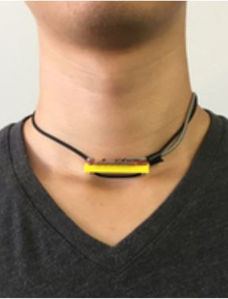
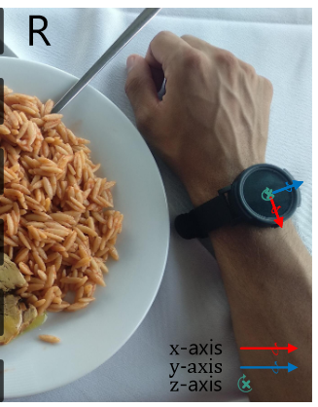
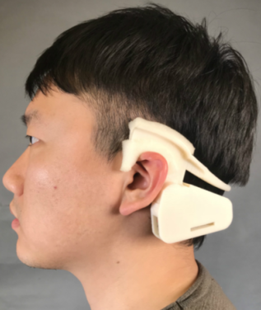
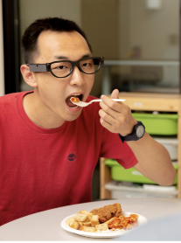
Wearable Tools for Meal Detection
Wearable devices are ideal for continuous, all-day measurement
Optical sensor:
necklaces with range sensing to capture throat or jaw movements
Motion sensor:
watches to track wrist motion using IMU sensors
[Chun 2018]
[Kyritsis 2021]
Multi-modality:
smart glasses with sensor arrays (cameras, IMUs, EMGs)
Microphone:
detect sounds of chewing or swallowing
[Bi 2018]
[Bedri 2020]

Slide 9
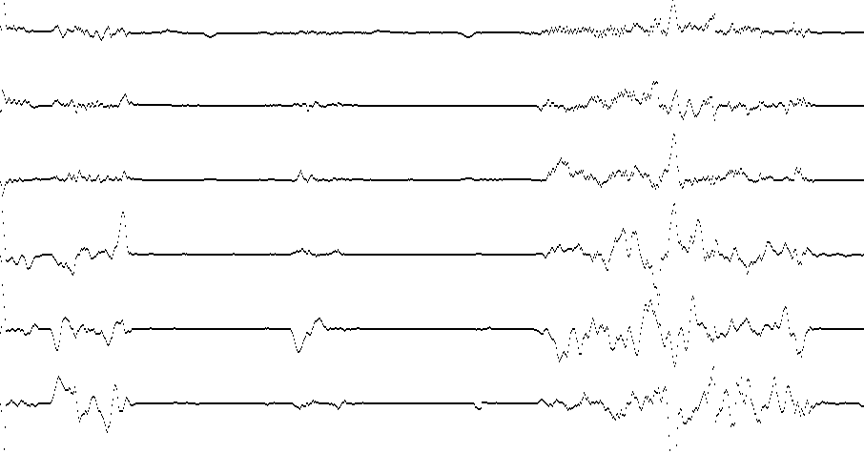
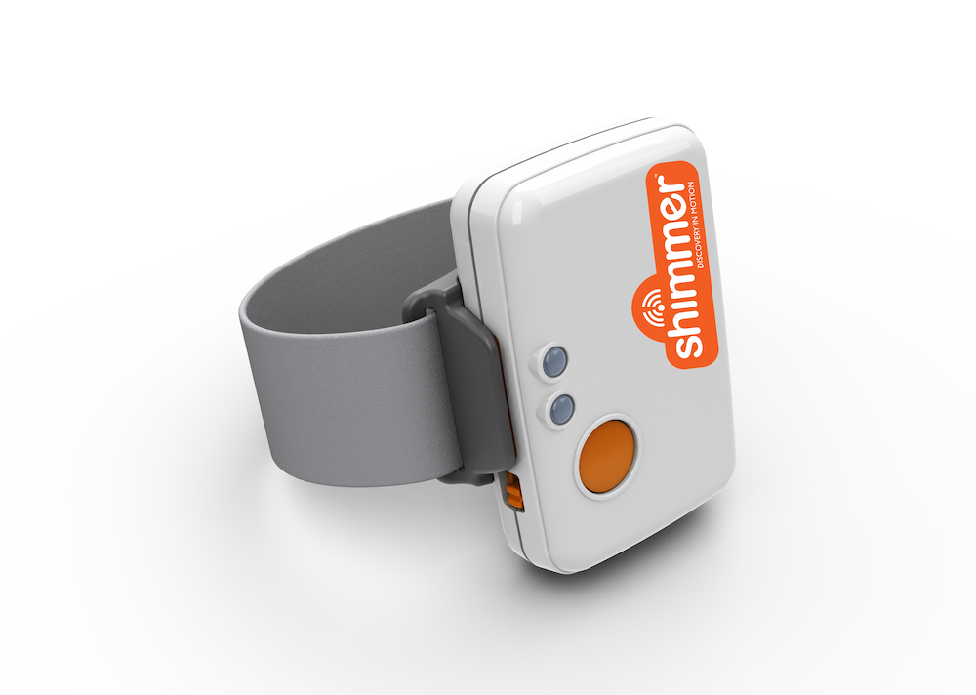
Our Tool: Wrist Motion Sensors
Wrist motion tracking using IMU sensors
Suitable for free-living, all-day monitoring with minimal user burden
Comfortable, and socially acceptable compared to others
x
y
z
yaw
Device: Shimmer 3
pitch
roll
Segment of raw sensor data¹
Surya Sharma, Phillip Jasper, Eric Muth, and Adam Hoover. The impact of walking and resting on wrist motion for automated detection of meals. ACM Transactions on Computing for Healthcare, 1(4):1–19, 2020.

Slide 10
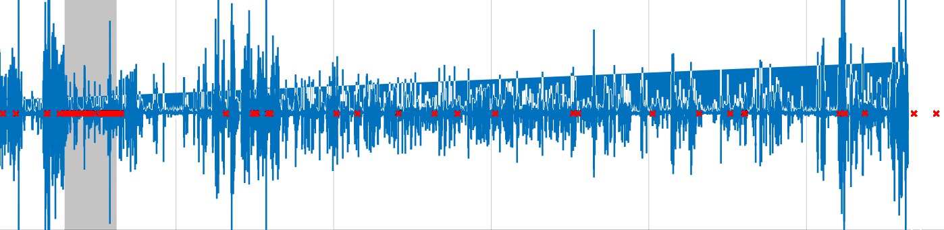
Related Works - Bottom-up Approach
Detect physiological events indicative of eating (bites / swallows / chews) using 0.5 – 5 sec windows
Combine regions with a high concentration of these events to detect eating
GT meal
EM
X-acceleration
detected bites
Example of estimating meal regions (EM) from bite detection¹.
Kyritsis K, Diou C, Delopoulos A. A data driven end-to-end approach for in-the-wild monitoring of eating behavior using smartwatches. IEEE Journal of Biomedical and Health Informatics. 2020 Apr 3;25(1):22-34.

Slide 11
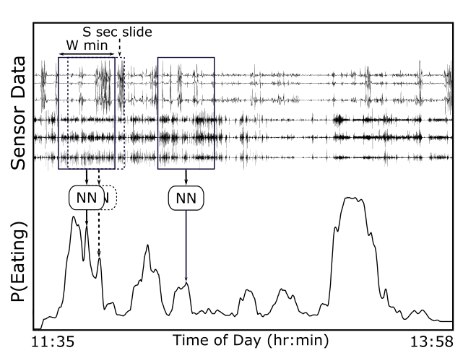
Previous Work from Our Lab: Top-Down Approach
Look at large windows (6 – 15 min) of wrist motion data, and use a CNN to generate an instantaneous probability of eating
meal 1
meal 2
Top-down approach¹
[1] S. Sharma and A. Hoover. Top-down detection of eating episodes by analyzing large windows of wrist motion using a convolutional neural network. MDPI Bioengineering, 1(4), 2022.

Slide 12
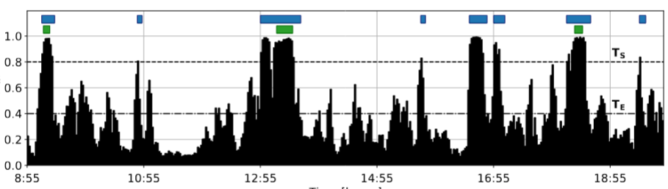
Limitations of Previous Works
Meals are infrequent events in a day-long recording (usually 2-4 times), which make models prone to false positives
Contextual information are limited with windows, and secondary activities like walking or talking during meals often confuse models¹
Predicted meal episodes GT meal episodes
P(eating)
Time
Prediction examples from a previous model²
[1] Surya Sharma, Phillip Jasper, Eric Muth, and Adam Hoover. The impact of walking and resting on wrist motion for automated detection of meals. ACM Transactions on Computing for Healthcare, 1(4):1–19, 2020.
[2] S. Sharma and A. Hoover. Top-down detection of eating episodes by analyzing large windows of wrist motion using a convolutional neural network. MDPI Bioengineering, 1(4), 2022.

Slide 13
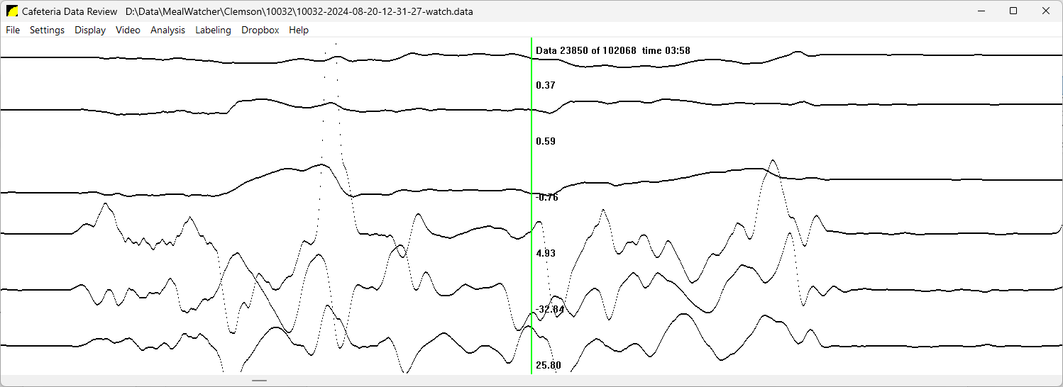
Revisit: Why Top-Down is Better Than Bottom-Up
Meal preparation and cleanup helps detect start and end of meals¹
Consumption, stirring, cutting, and resting between ingestion events can help improve the detection of individual intake gestures²
Window for bottom-up approach
food prep
bite
resting
Window for top-down approach
[1] Y. Dong et al. Detecting periods of eating during free-living by tracking wrist motion. IEEE Journal of Biomedical and Health Informatics, 18(4):1253–1260, 2013.
[2] Yiru Shen, James Salley, Eric Muth, and Adam Hoover. Assessing the accuracy of a wrist motion tracking method for counting bites across demographic and food variables. IEEE Journal of Biomedical and Health Informatics, 21(3):599–606, 2016.

Slide 14
Our Novelty – Extend Top-Down Approach to Entire Day
Use a model to analyze a day-long recording simultaneously
Utilize temporal correlations between eating and non-eating activities
Utilize the global context of when eating episodes (meals, snacks) are more likely to occur within a day
Local window approach
Global approach (ours)

Slide 15
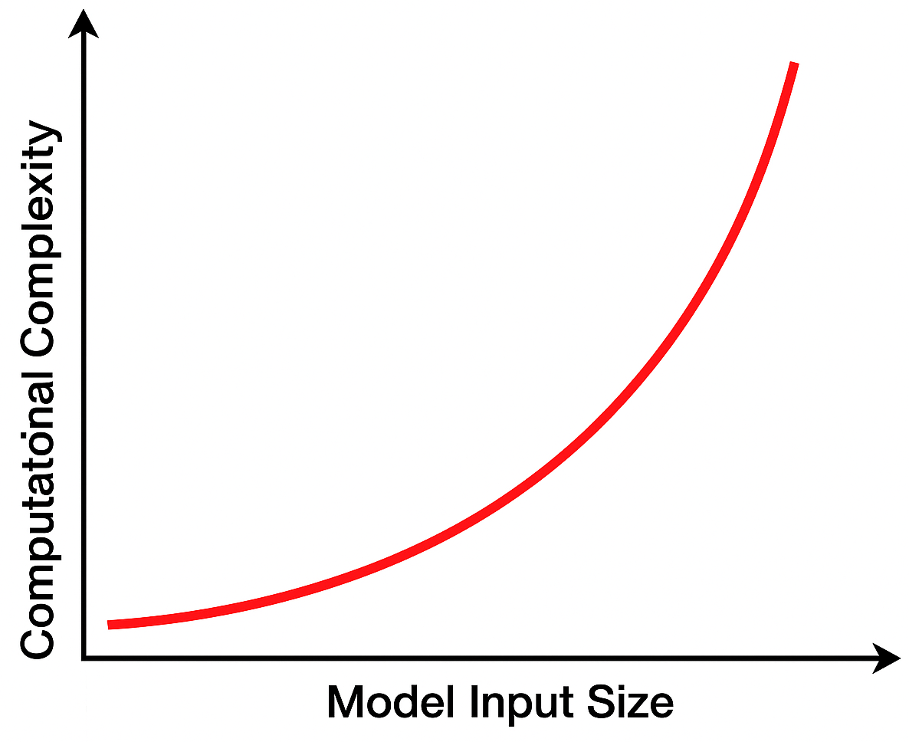
Challenges of Training Models on Global Level
Scarcity of full-length samples (health datasets are usually small)
Computational complexity of end-to-end training on full-length samples
Dataset | Recordings | Meals | Participants
FreeFIC held-out¹ | 22 | 6 | 6
FreeFIC¹ | 22 | 17 | 6
ACE-E² | 15 | 55 | 6
[Dong 2013]³ | 43 | 116 | 43
CAD⁴ | 354 | 1,133 | 351
[1] Kyritsis K, Diou C, Delopoulos A. A data driven end-to-end approach for in-the-wild monitoring of eating behavior using smartwatches. IEEE Journal of Biomedical and Health Informatics. 2020 Apr 3;25(1):22-34.
[2] Mark Mirtchouk, Drew Lustig, Alexandra Smith, Ivan Ching, Min Zheng, and Samantha Kleinberg. Recognizing eating from body-worn sensors: Combining free-living and laboratory data. Proceedings of the ACM on Interactive, Mobile, Wearable and Ubiquitous Technologies, 1(3):1–20, 2017.
[3] Y. Dong et al. Detecting periods of eating during free-living by tracking wrist motion. IEEE Journal of Biomedical and Health Informatics, 18(4):1253–1260, 2013.
[4] Surya Sharma, Phillip Jasper, Eric Muth, and Adam Hoover. The impact of walking and resting on wrist motion for automated detection of meals. ACM Transactions on Computing for Healthcare, 1(4):1–19, 2020.

Slide 16
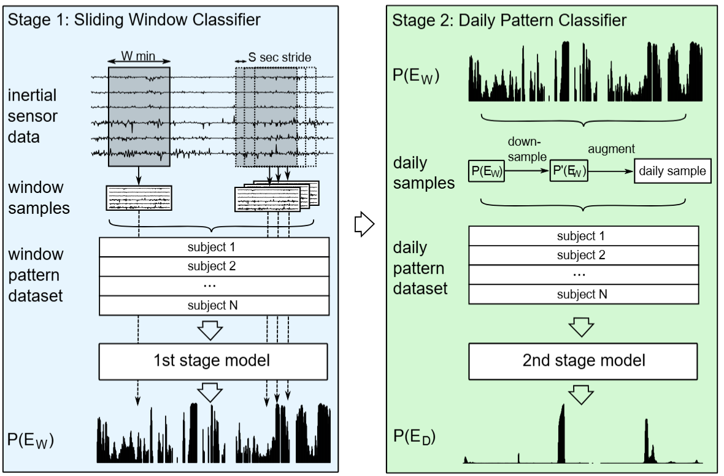
Method – Framework Overview
Two - stage: a small model calculate local predictions, and a separate model analyze global patterns built from local prediction logits
Daily sample augmentation: generate synthetic daily samples

Slide 17
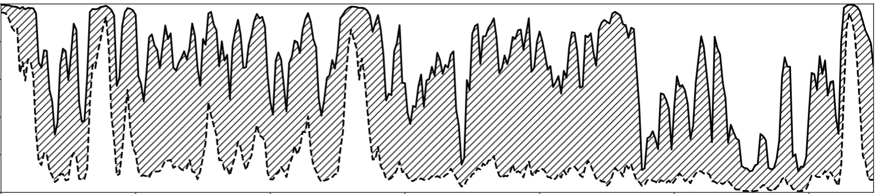
Method - Generate Synthetic Daily Samples
Repeat training windowed eating classifier. Each time can generate a different interpretation for meal detection task
Use all trained variants for generating diverse daily samples
354 recordings (CAD dataset) × 565 iterations = 200,010 daily samples
P(eating)
Time
Difference (shading) between the min and max estimated probabilities from 565 retrainings of a sliding window model ¹
[1] Zeyu Tang, Adam Patyk, James Jolly, Stephanie P Goldstein, J Graham Thomas, and Adam Hoover. Detecting eating episodes from wrist motion using daily pattern analysis. IEEE Journal of Biomedical and Health Informatics, 28(2):1054–1065, 2023.

Slide 18
Method - Wrap SOTA Models in Stage 1
Bottom-up: a pre-trained bite detector¹ + a trainable NN head for meal detection
Top-down: a CNN model for eating detection²
6 min
6 min
2 sec
…
…
List of P(bite)
…
P(eating)
P(eating)
Bottom-up model
Top-down model
[1] H. Heydarian, et al. Deep learning for intake gesture detection from wrist-worn inertial sensors: The effects of data preprocessing, sensor modalities, and sensor positions. IEEE Access, 8:164936– 164949, 2020.
[2] S. Sharma and A. Hoover. Top-down detection of eating episodes by analyzing large windows of wrist motion using a convolutional neural network. MDPI Bioengineering, 1(4), 2022.

Slide 19
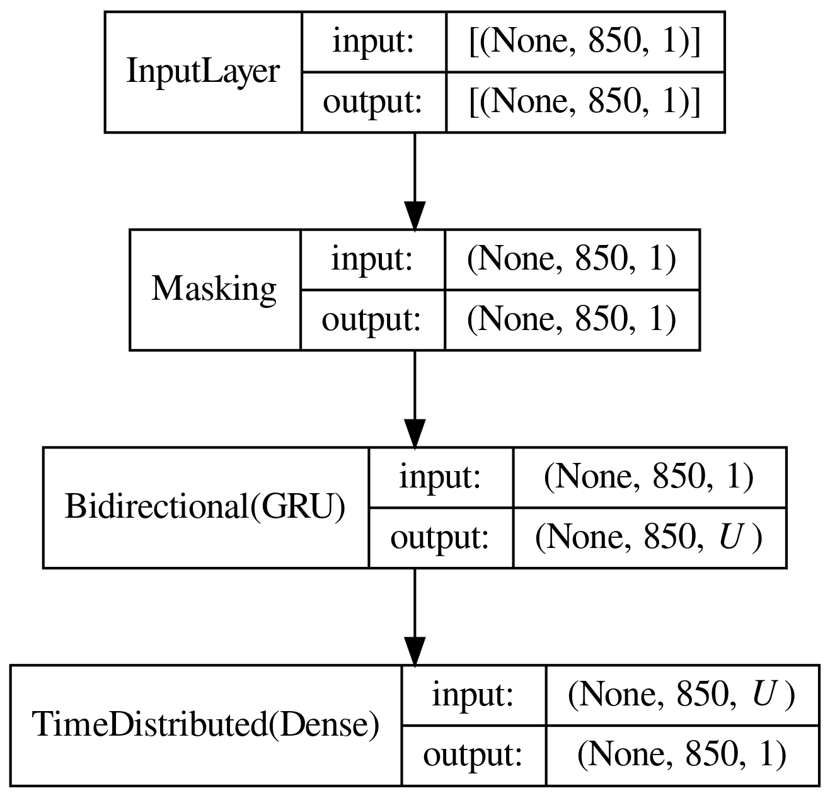
Method – Model for Learning Daily Patterns
Daily samples are zero-padded to a length of 850 (i.e. 23.6 hours)
Use GRU to learn temporal context
1

Slide 20
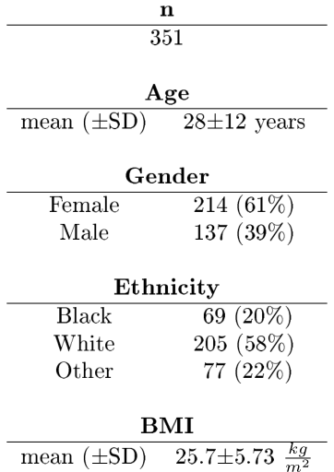
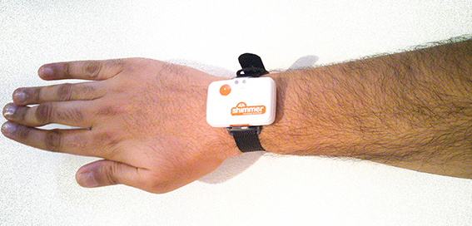
Evaluation Dataset - Clemson All-Day (CAD) Dataset
Largest dataset in the field:
4,680 hours, 249 hours of eating
1,133 meals, 354 recordings
Sampling rate: 15 Hz
6-axis data: accelerations and rotations along X, Y, and Z axes
Participants self-reported ground truth
Dataset source: Sharma S, Jasper P, Muth E, Hoover A. Automatic detection of periods of eating using wrist motion tracking. In 2016 IEEE First International Conference on Connected Health: Applications, Systems and Engineering Technologies (CHASE) 2016 Jun 27 (pp. 362-363). IEEE.

Slide 21
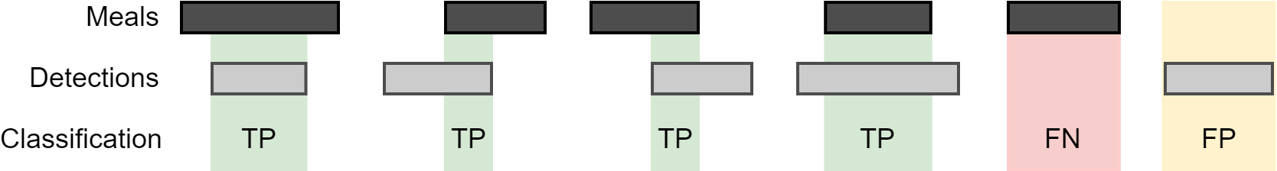
Evaluation Scheme
Time metrics: compare the prediction to the ground truth for each timestep. We focus on F1 and weighted accuracy
Episode metrics: compare the predicted eating episodes and ground truth. We focus on episode TPR and FP/TP
5-fold cross validation
GT
Time
Pred.
Episode
Criteria for episode metrics¹
Surya Sharma and Adam Hoover. The challenge of metrics in automated dietary monitoring as analysis transitions from small data to big data. In 2020 IEEE International Conference on Bioinformatics and Biomedicine (BIBM), pages 2647–2653. IEEE, 2020.

Slide 22
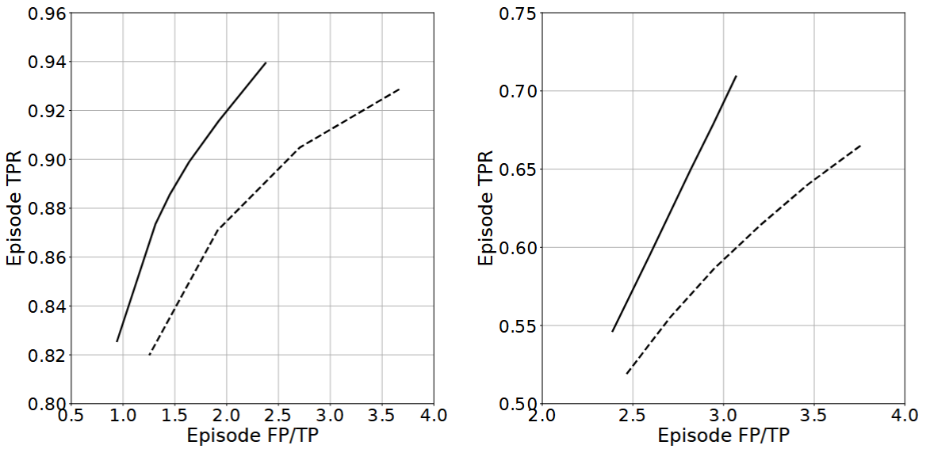
Results – Episode Metrics, Window vs. Global
Daily pattern classifier consistently detects more true positives with fewer false positives
Window model
Our framework
TPR
FP/TP
Left: top-down model as backbone. Right: bottom-up model as backbone
Source: Zeyu Tang, Adam Patyk, James Jolly, Stephanie P Goldstein, J Graham Thomas, and Adam Hoover. Detecting eating episodes from wrist motion using daily pattern analysis. IEEE Journal of Biomedical and Health Informatics, 28(2):1054–1065, 2023.

Slide 23
Results – Benchmark Existing Works
Method | Time F1 (%) | Time AccW (%) | Episode TPR (%) | Episode FP/TP | Authors
NN bite detector + heuristic meal detector (2 sec window) | 14 | 56 | 59 | 19.5 | Heydarian 2020 Kyritsis 2021
NN bite detector + NN meal detector (6 min window) | 14 | 60 | 59 | 3 | Heydarian 2020
heuristic meal detector (1-min~30-min window) | 23 | 77 | 86 | 3.8 | Dong 2013
NN meal detector (6 min window) | 35 | 81 | 87 | 1.9 | Sharma 2022
Our framework + NN meal detector (all day) | 38 | 84 | 89 | 1.4 | Ours
Longer
context,
Larger
gain!

Slide 24
Conclusion
Diurnal eating habits can be learned by a neural network and eating detection can benefit from day-length analysis
Long context helps reduce prediction noise
Fine-grained detail is not always necessary for capture daily patterns
Does this approach work only for day-long IMU data, or is there something more general here?

Slide 25
Detecting Intake Gestures from Videos
Zeyu Tang and Adam Hoover. A new video dataset for recognizing intake gestures in a cafeteria setting. In 2022 26th International Conference on Pattern Recognition (ICPR), pages 4399– 4405. IEEE, 2022.
Zeyu Tang and Adam Hoover. Video-based intake gesture recognition using meal-length context. ACM Transactions on Computing for Healthcare, 6(2):1–24, 2025.

Slide 26
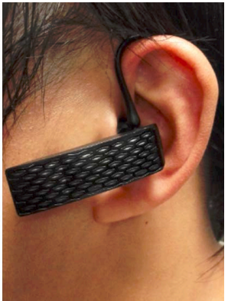

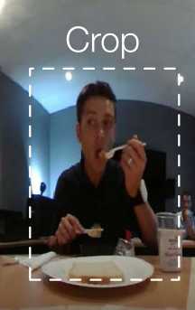
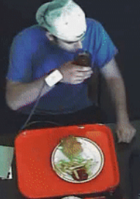
Common Sensors
EMG sensor in a pairs of glasses
[Zhang 2018]
Acoustic sensor in an earphone
[Gao 2017]
Camera
[Rouast 2020]
Motion sensor worn on the wrist
[Luktuke 2020]

Slide 27
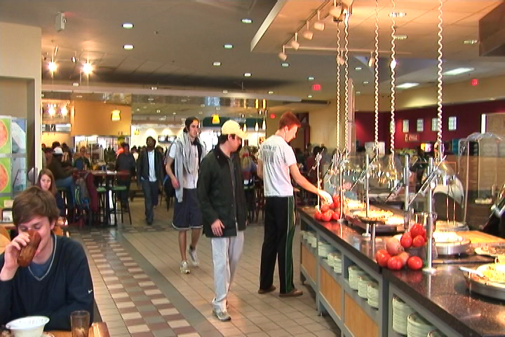
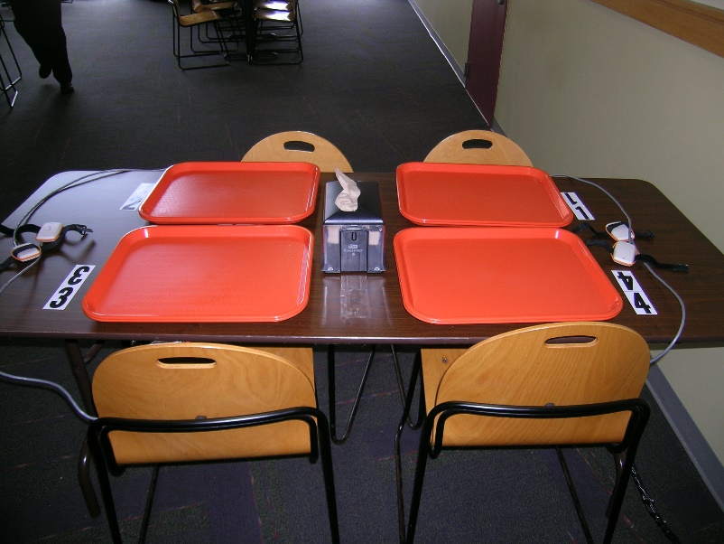
Our tool: Ceiling-mounted Camera
Captures fine-grained information, including hand and body motion, the types of foods and beverages being consumed
Requires no further effort from the user initial installation
Placed away from participants to minimize impact on their behaviors
The site of data collection: Harcombe Dining Hall at Clemson University

Slide 28
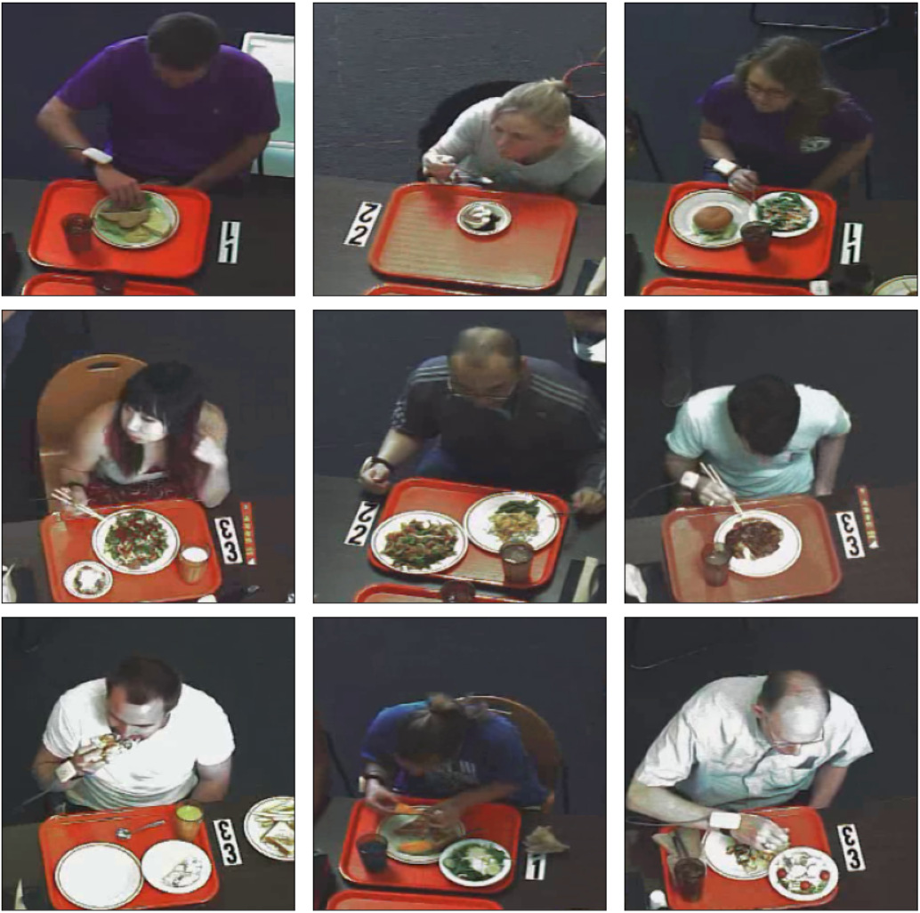
Our Video Dataset - Clemson Cafeteria Dataset
The largest video dataset collected in free-living environment for intake gesture detection¹
264 participants, 486 meal videos. 374 food and beverage types
Annotated activities include:
19,632 bite gestures (food intake), totaling 12 hours and 28 minutes
3,510 drink gestures (liquid intake ), totaling 5 hours and 13 minutes
Non-intake (background), totaling 89 hours and 21 minutes
Videos were recorded in 480 x 640 spatial resolution at 30 Hz
Cropped frame samples
[1] Zeyu Tang and Adam Hoover. A new video dataset for recognizing intake gestures in a cafeteria setting. In 2022 26th International Conference on Pattern Recognition (ICPR), pages 4399– 4405. IEEE, 2022.

Slide 29
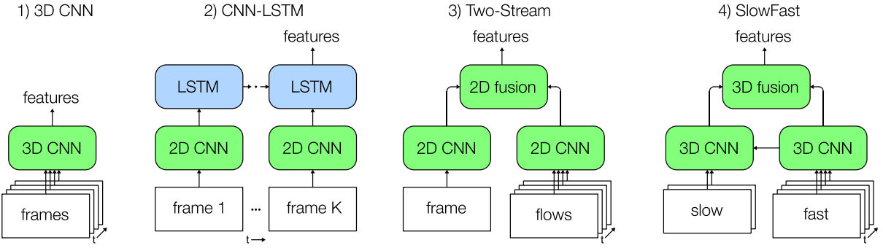
Related Works on Video-based Intake Gesture Detection - Window-based Method
Most existing works inherit from generic video-based activity classification and focus on window-based methods
Sliding Window
[Feichtenhofer
2020]
[Rouast 2019]
[Simonyan 2014]
[Feichtenhofer 2019]

Slide 30
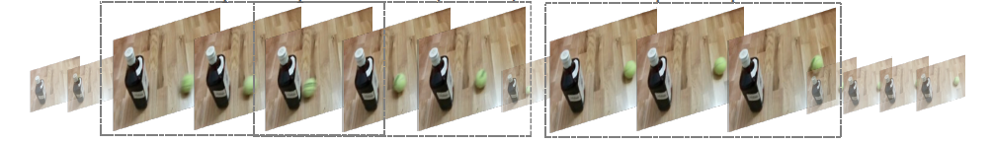
Related Works on Generic Activity Recognition - Long Context
A few studies in generic video-based activity recognition have tried injecting long-context cues into window models
Inter-window learning
e.g. collaborative memory¹, global attention²
Backbone
Backbone
Backbone
Sampled Clip
Sampled Clip
Sampled Clip
[1] Xitong Yang, Haoqi Fan, Lorenzo Torresani, Larry S Davis, and Heng Wang. Beyond short clips: End-to-end video-level learning with collaborative memories. In Proceedings of the IEEE/CVF Conference on Computer Vision and Pattern Recognition, pages 7567–7576, 2021.
[2] Yiping Tang, Yang Zheng, Chen Wei, Kaitai Guo, Haihong Hu, and Jimin Liang. Video representation learning for temporal action detection using global-local attention. Pattern Recognition, 134:109135, 2023.

Slide 31
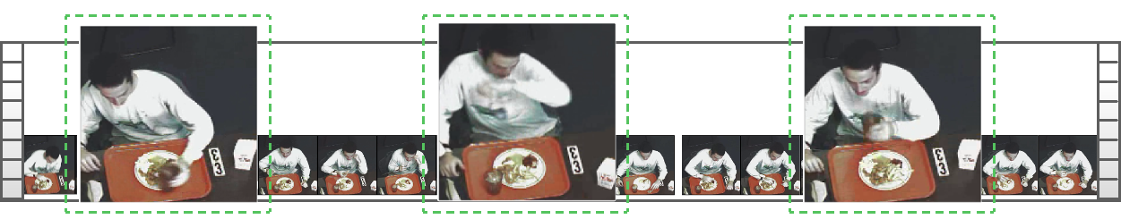
Limitations of Previous Works
Aggregating a limited number of windows equals to a larger window
Computational cost limits the size of windows
Face data scarcity when segmenting a longer clip into one sample
Meal recordings average ~30 minutes, but typical video windows last only 2 seconds. Window-level analysis cannot see true long context
Pick up a cup but not drink
Wipe the mouth,
Like a bite
A true drink gesture
Misleading activities can confuse window models

Slide 32
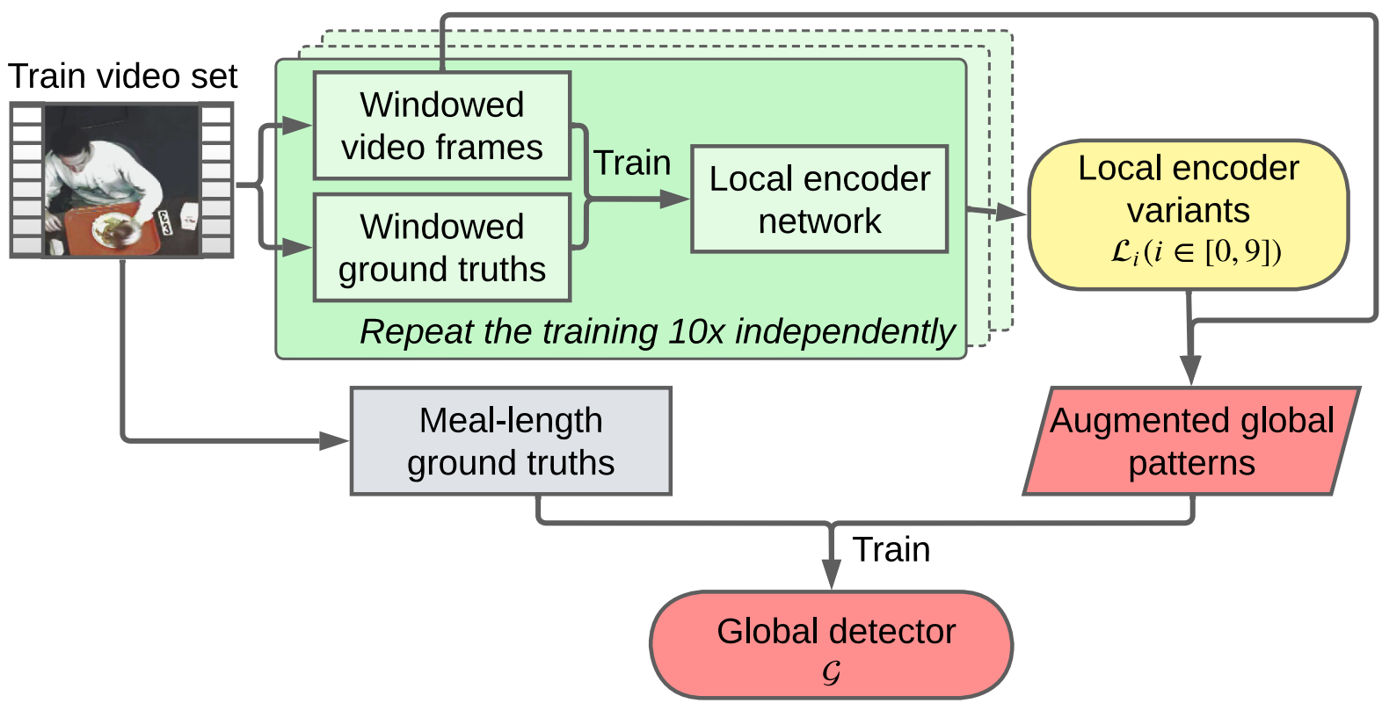
Method (Inspired by Daily Patterns) - Global Level Analysis
A local-global framework for reducing computation
Augment global samples to battle data shortage
Proposed framework ¹
[1] Zeyu Tang and Adam Hoover. Video-based intake gesture recognition using meal-length context. ACM Transactions on Computing for Healthcare, 6(2):1–24, 2025.

Slide 33
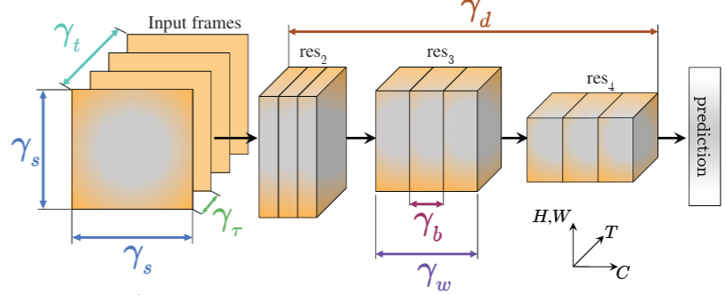
Method - Models for Local Encoder
X3D¹ – SOTA model (during my study) in generic activity recognition
CNN-LSTM² - SOTA model (during my study) in intake gesture detection
X3D optimizes a 3D-CNN network on various axes as specified by γ_{i}
CNN-LSTM applies 2D-CNN for spatial features and LSTM for temporal context
[1] Christoph Feichtenhofer. X3d: Expanding architectures for efficient video recognition. In Proceedings of the IEEE/CVF Conference on Computer Vision and Pattern Recognition, pages 203–213, 2020.
[2] Philipp V Rouast and Marc TP Adam. Learning deep representations for video-based intake gesture detection. IEEE Journal of Biomedical and Health Informatics, 24(6):1727–1737, 2019.

Slide 34
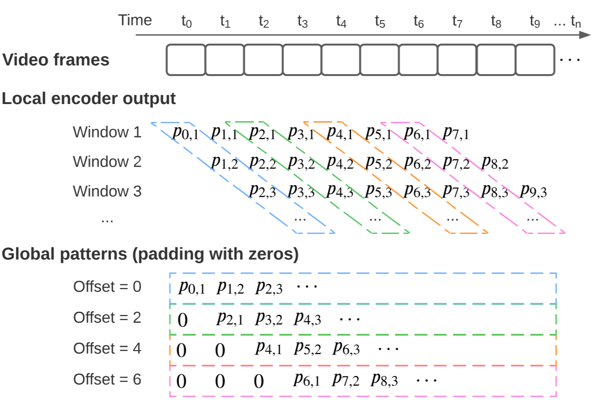
Method - Global Pattern Augmentation
Train local models only 10 times due to high cost (>1 day per run)
Use seq-to-seq prediction with varied window offsets
Use different position offsets for generating global patterns

Slide 35
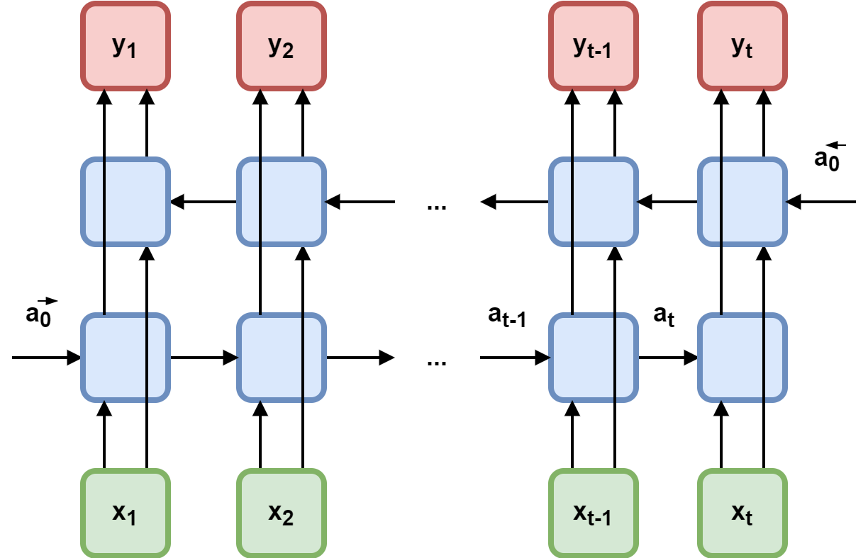
Method - Global Detectors
Pad global samples to a length of 41 minutes
Downsample global samples to 2 Hz
Model: Bi-directional LSTM layers + time distributed dense layers
LSTM layer

Slide 36
Results – Window Level vs. Global Level
Global detectors provide better performance than window-based models.
Global detectors are good at reducing false positives
Performance gain is larger on ‘drink’, which is sparsest class and shows a more consistent global pattern between individuals
Method | F1 (bite) | F1 (drink) | Precision (bite) | Precision (drink) | Recall (bite) | Recall (drink)
CNN-LSTM¹ | 0.89 | 0.75 | 0.90 | 0.73 | 0.88 | 0.78
CNN-LSTM¹ + global detector | 0.91 | 0.84 | 0.91 | 0.89 | 0.91 | 0.80
X3D² | 0.91 | 0.73 | 0.88 | 0.68 | 0.93 | 0.80
X3D² + global detector | 0.94 | 0.85 | 0.95 | 0.91 | 0.92 | 0.80
Source: Zeyu Tang and Adam Hoover. Video-based intake gesture recognition using meal-length context. ACM Transactions on Computing for Healthcare, 6(2):1–24, 2025.
[1] Philipp V Rouast and Marc TP Adam. Learning deep representations for video-based intake gesture detection. IEEE Journal of Biomedical and Health Informatics, 24(6):1727–1737, 2019.
[2] Christoph Feichtenhofer. X3d: Expanding architectures for efficient video recognition. In Proceedings of the IEEE/CVF Conference on Computer Vision and Pattern Recognition, pages 203–213, 2020.

Slide 37
Conclusion
Global context improves gesture detection beyond window-based models
Global context helps more when window-based models struggle, such as low visual cues, highly sparse events
Performance gains are consistent across architectures and demographics
Two studies, different sensors, different timescales — but the same principle works. Is this a coincidence?

Slide 38
A Shared Pattern Emerges
Both studies confirmed the same insight:
Sparse events in long recordings
benefit from full-recording context
This pattern generalizes beyond dietary monitoring to any domain with rare events in long signals
Based on these studies, we realized a meta approach is possible to all similar problems

Slide 39
A Generalized Framework for Sparse Activity Recognition

Slide 40
What Are Sparse Events?
An event in a temporal recording is sparse if it occurs or :
briefly: short duration relative to recording
Infrequently: low frequency of event instances
Brief event, e.g. bite gestures over a meal course
Infrequent event, e.g. meal episodes over a day

Slide 41
Sparse Events Across Human Activity Domains
The same problem structure appears beyond dietary monitoring:
In lengthy recordings, target events may be infrequent or brief
Most prior approaches use local window-based analysis
Domain | Target Event | Recording | Total Event Duration Ratio | Modality
Daily routines¹ | Eating | ~13 hr/day | 1:18.8 | IMU
Intake gestures² | Drink | ~30 min/meal | 1:20.6 | Video
Sleep stages³ | N3 stage | ~9 hr/night | 1:15.1 | EEG
TV show (audio)⁴ | Music | ~40 min/show | 1:1.6 | Audio
[1] Surya Sharma, Phillip Jasper, Eric Muth, and Adam Hoover. The impact of walking and resting on wrist motion for automated detection of meals. ACM Transactions on Computing for Healthcare, 1(4):1–19, 2020.
[2] Zeyu Tang and Adam Hoover. A new video dataset for recognizing intake gestures in a cafeteria setting. In 2022 26th International Conference on Pattern Recognition (ICPR), pages 4399– 4405. IEEE, 2022.
[3] B. Kemp, A. Zwinderman, B. Tuk, H. Kamphuisen, and J. Oberye, Analysis of a sleep-dependent neuronal feedback loop: the slowwave microcontinuity of the eeg. IEEE Transactions on Biomedical Engineering, vol. 47, no. 9, pp. 1185–1194, 2000.
[4] Y.-N. Hung, C.-W. Wu, I. Orife, A. Hipple, W. Wolcott, and A. Lerch, A large tv dataset for speech and music activity detection. EURASIP Journal on Audio, Speech, and Music Processing, vol. 2022, no. 1, p. 21, 2022.

Slide 42
Global Patterns in Human Activities
Many human activities carry sequential context across the recording:
Domain | Global Pattern / Rhythm | Implication
Daily routines | Breakfast, lunch, dinner timing | Time-of-day constrains meal likelihood
Intake gestures | Prep → eating → satiation | Gesture frequency varies with meal phase
Sleep stages | Repeat ~90-min NREM/REM cycles | Stage transitions follow cyclic structure
TV show (audio) | Genre-specific rhythms | Show format predicts segment distribution
These patterns span the full recording, consistent across individuals
→ Cannot be captured by isolated sliding windows

Slide 43
Related work: Context Modeling
Approach | Method | Context Scope | Limitation
Intra-window | Classify each window independently¹⁻⁴ | Single window (2-360 sec) | No cross-window info
Inter-window | LSTM across adjacent epochs⁵ | ~10 consecutive windows | Diminishing returns; data scarcity
Semi global-level | Collaborative memory⁶ Global attention⁷ | Short video (windows as tokens) | Input-length, global context, and compute limits
Our method holistically models global context while retaining raw temporal resolution,
And handles data scarcity and computation budget.
[1] Sharma, S., Jasper, P., Muth, E. and Hoover, A.. The impact of walking and resting on wrist motion for automated detection of meals. ACM Transactions on Computing for Healthcare, 1(4), pp.1–19, 2020.
[2] Feichtenhofer, C., Fan, H., Malik, J. and He, K.. SlowFast networks for video recognition. Proceedings of the IEEE/CVF International Conference on Computer Vision (ICCV), pp.6202–6211, 2019.
[3] Eldele, E., Chen, Z., Liu, C., Wu, M., Kwoh, C.K., Li, X. and Guan, C.. An attention-based deep learning approach for sleep stage classification with single-channel EEG. IEEE Transactions on Neural Systems and Rehabilitation Engineering, 29, pp.809–818, 2021.
[4] Hung, Y.N., Won, M. and Yang, Y.H.. Modeling music audio with rhythmic and harmonic structure. EURASIP Journal on Audio, Speech, and Music Processing, 2022(1), pp.1–15, 2022.
[5] Seo, H., Back, S., Seong, S. and Park, J.. Intra-subject and inter-subject transfer learning for sleep stage classification using convolutional neural network. Biomedical Signal Processing and Control, 61, p.102037, 2020.
[6] Yang, X., Xue, K., Fu, K., Sun, X., Zha, J. and Guo, J.. RefinedDet++: Single-shot refinement detector for object detection in high-spatial-resolution remote sensing images. Proceedings of the IEEE/CVF Conference on Computer Vision and Pattern Recognition (CVPR), pp.16469–16479, 2021.
[7] Tang, Y., Feng, D., Xu, L., Zhang, Z. and Lu, H.. Deep reinforcement learning for automated mobile health intervention: A review of theory and applications. Pattern Recognition, 134, p.109135, 2023.

Slide 44
Challenges in Modeling Global Patterns
Challenge 1: Computational cost for high-dimensional data
e.g. end-to-end on a 30-min video: ~720 GB memory
Our two-stage approach: same recording, practical training time
Challenge 2: Data scarcity at the recording level
Window approach: each recording → hundreds of training samples
Global approach: each recording = ONE training sample

Slide 45
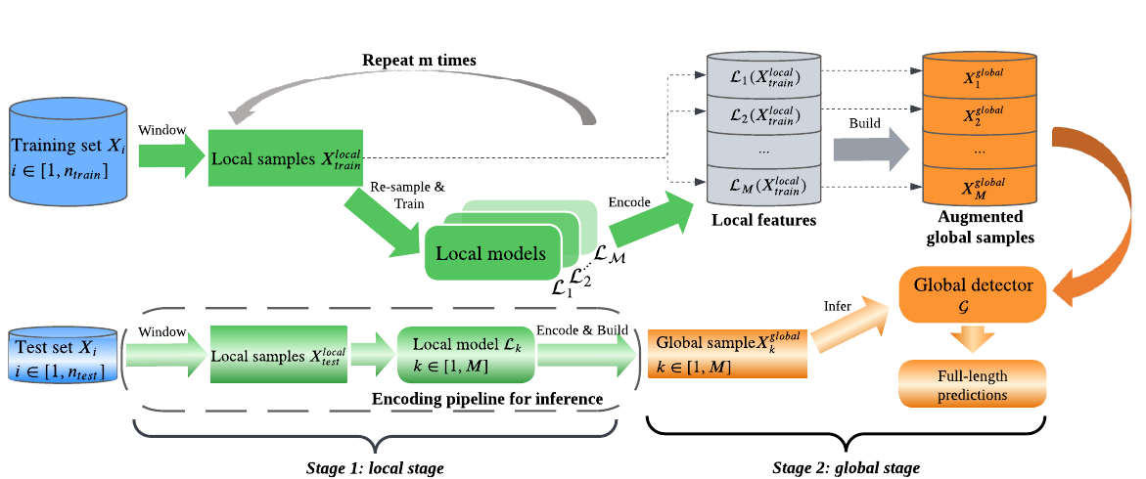
Solution to Challenge 1 - The Unified Two-Stage Pipeline
Stage 1 (Local): wrap any window-based model extracts local probabilities from sliding windows
Stage 2 (Global): train a global detector that learns recording-level temporal patterns

Slide 46
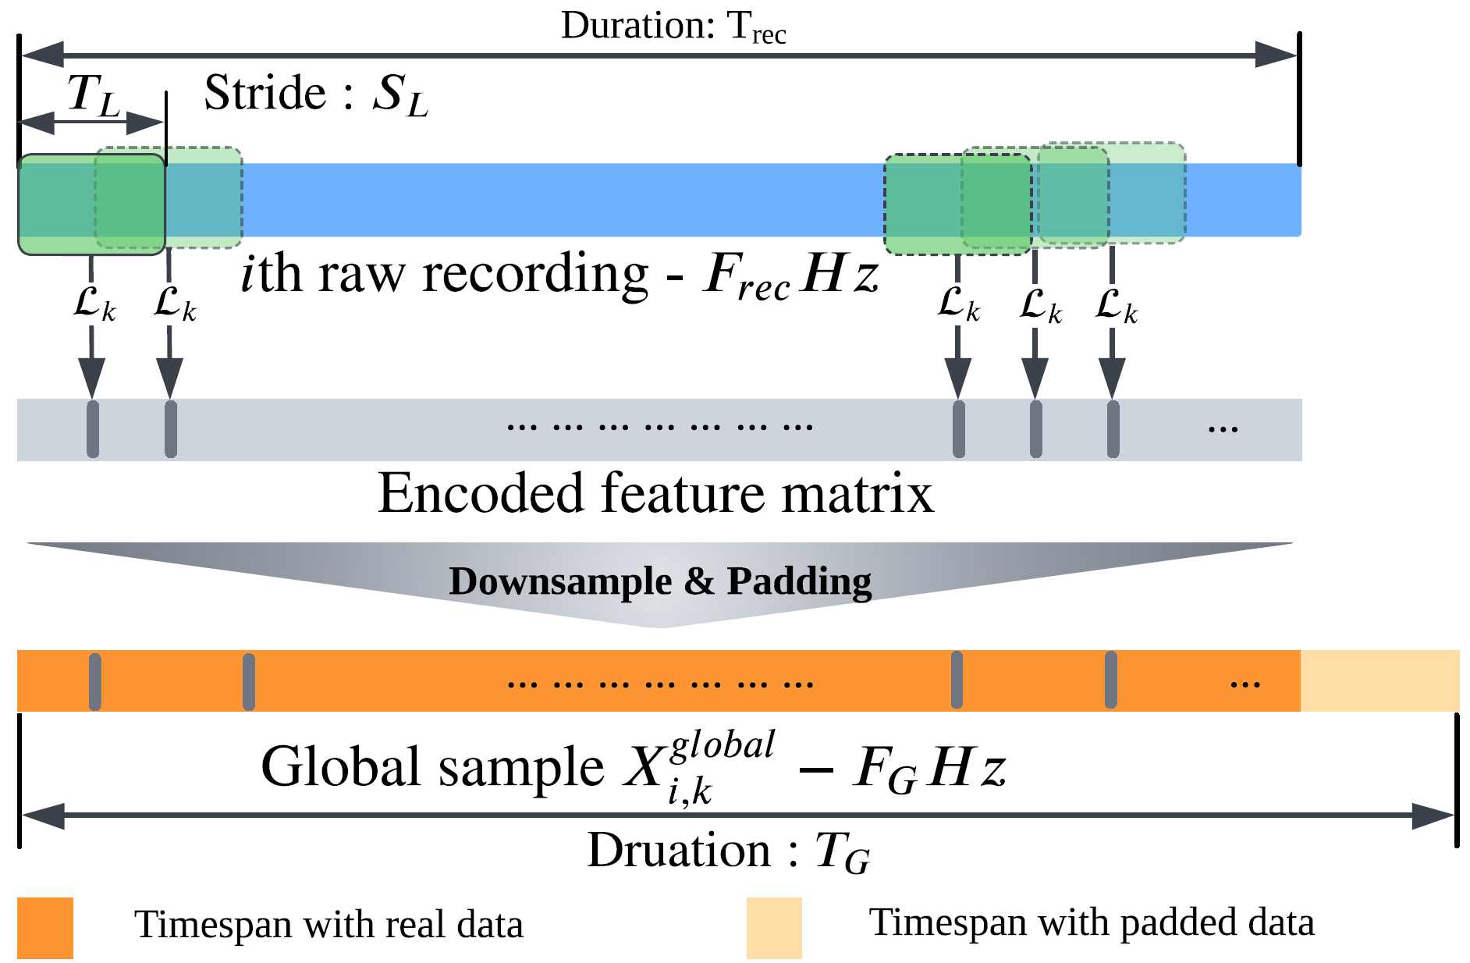
Solution to Challenge 2 – SCOPE (SynthetiC glObal Pattern augmEntation)
SCOPE procedure:
1. Train local model M times with random sampling and seeds.
2. Each encodes recordings with various R window offsets.
4. Expand N recordings to M×N×R global samples
Key insight:
same local model architecture, different random seeds/samples
→ Different model instances
→ different feature embeddings

Slide 47
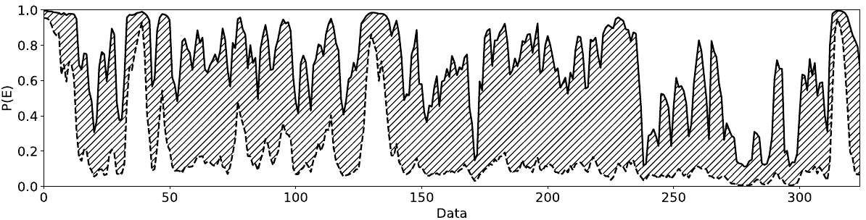
Why SCOPE Works: Model Volatility
Example from meal episode detection from wrist motion recording:
565 training runs with same architecture but different random seeds
Large variance in local predictions → diverse but semantically valid global samples
Range of predicted eating probabilities across model instances (Shaded area)

Slide 48
Experiments - Four Test Cases Across Domains
All cases share: sparse events, lengthy recordings, limited labeled data
All formulated using the same two-stage pipeline with SCOPE
Cases 1–2: dietary monitoring; Cases 3–4: new domains
Domain | Detection Task | Modality | Rec Length | Dataset | # Rec
Daily routines | Meal Episodes | IMU | ~13 hr | CAD | 354
Intake gestures | Intake gestures | Video | ~30 min | Cafeteria | 486
Sleep stages | Sleep stages | EEG | ~9 hr | Sleep-EDF (v2013/ v2018)¹ | 39/153
TV show (audio) | Speech/music | Audio | ~40 min | TVSM² | 2,293
[1] Kemp, B., Zwinderman, A.H., Tuk, B., Kamphuisen, H.A. and Oberyé, J.J.. Analysis of a sleep-dependent neuronal feedback loop: the slow-wave microcontinuity of the EEG. IEEE Transactions on Biomedical Engineering, 47(9), pp.1185–1194, 2000.
[2] Hung, Y.N., Won, M. and Yang, Y.H.. Modeling music audio with rhythmic and harmonic structure. EURASIP Journal on Audio, Speech, and Music Processing, pp.1–15. (Article number: 21), 2022.

Slide 49
Recap: Cases 1 & 2 Under the Framework
Both dietary monitoring cases show consistent improvements:
Global context is especially effective for sparse minority classes
Case | Model | Metric | Local | + global
Meal detection¹ | Sharma | Ep. TPR | 0.87 | 0.89
 | Sharma | Ep. FP/TP | 1.90 | 1.40
Gesture detection² | CNN-LSTM | Drink F1 | 0.67 | 0.86
 | X3D-S | Drink F1 | 0.73 | 0.88
[1] Zeyu Tang, Adam Patyk, James Jolly, Stephanie P Goldstein, J Graham Thomas, and Adam Hoover. Detecting eating episodes from wrist motion using daily pattern analysis. IEEE Journal of Biomedical and Health Informatics, 28(2):1054–1065, 2023.
[2] Zeyu Tang and Adam Hoover. Video-based intake gesture recognition using meal-length context. ACM Transactions on Computing for Healthcare, 6(2):1–24, 2025.

Slide 50
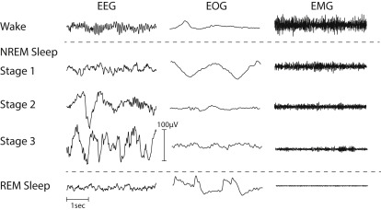
Case 3: Sleep Stage Detection
5 sleep stages: W, N1, N2, N3, REM
Modality: electrophysiological signal
Datasets: Sleep-EDF v2013 (39 rec.) and v2018 (153 rec.) ¹
Local model: AttnSleep²; global model: Bi-LSTM
Sparse classes (coverage ratio): N3 (1 : 15.1), N1 (1 : 9.1), REM(1 : 7.6)
[1] Kemp, B., Zwinderman, A.H., Tuk, B., Kamphuisen, H.A. and Oberyé, J.J.. Analysis of a sleep-dependent neuronal feedback loop: the slow-wave microcontinuity of the EEG. IEEE Transactions on Biomedical Engineering, 47(9), pp.1185–1194, 2000.
[2]. Eldele, E., Chen, Z., Liu, C., Wu, M., Kwoh, C.K., Li, X. and Guan, C.. An attention-based deep learning architecture for sleep stage classification with single-channel EEG. IEEE Transactions on Neural Systems and Rehabilitation Engineering, 29, pp.809–818, 2021.

Slide 51
Case 3 - Results
MF1 improved by +0.05 on both datasets
Largest gains on N1 (+0.11) and REM (+0.10/+0.13)
Limited gain on N3: too few raw samples
Consistent on both v2013 (N=39) and v2018 (N=153)
Dataset | Method | F1
 |  | W | N1 | N2 | N3 | REM | Macro
v2013 | Local | 0.85 | 0.39 | 0.87 | 0.88 | 0.75 | 0.75
v2013 | + Global | 0.88 | 0.50 | 0.88 | 0.88 | 0.85 | 0.80
v2018 | Local | 0.91 | 0.41 | 0.82 | 0.80 | 0.69 | 0.73
v2018 | + Global | 0.92 | 0.52 | 0.85 | 0.79 | 0.82 | 0.78

Slide 52
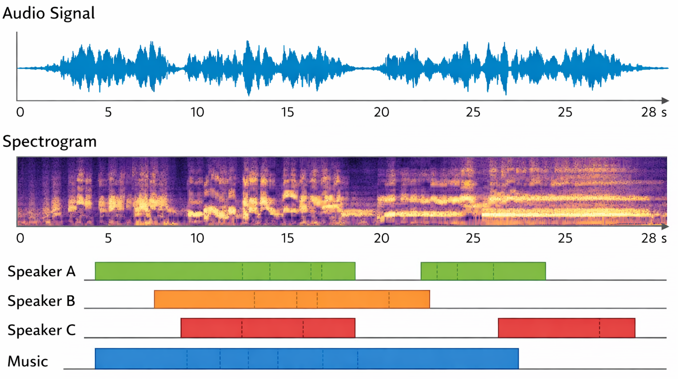
Case 4: Speech & Music from TV Audio
Task: Segment speech and music from broadcast Netflix show audio
Dataset: TVSM¹ — 2,293 training rec. (~40 min avg), 20 test rec
Local model: TCN and CRNN¹; global model: Bi-LSTM
Sparse classes (coverage ratio): speech (1 : 1.6), music (1 : 1.6)
[1] Hung, Y.N., Won, M. and Yang, Y.H.. Modeling music audio with rhythmic and harmonic structure. EURASIP Journal on Audio, Speech, and Music Processing, pp.1–15. (Article number: 21), 2022.

Slide 53
Case 4 - Results
Music (concentrated, regular) benefits more than speech (frequent, random)
CRNN + framework: music F1 0.905 → 0.926 (+0.021)
Method | F1 |  | Precision |  | Recall
 | Music | Speech | Music | Speech | Music | Speech
TCN | 0.913 | 0.910 | 0.900 | 0.871 | 0.926 | 0.953
+ global | 0.923 | 0.913 | 0.913 | 0.873 | 0.934 | 0.955
CRNN | 0.905 | 0.913 | 0.905 | 0.870 | 0.905 | 0.960
+ global | 0.926 | 0.914 | 0.914 | 0.875 | 0.938 | 0.956

Slide 54
Summary - Cross-Domain Validation
Global modeling helps when structured temporal patterns exist
Gains are strongest for sparse minority classes
Lightweight global models suffice for Stage 2
Task | Modality | # Rec | Metric | Local | + Global
Meal Episodes | IMU | 354 | Ep. TPR | 0.87 | 0.89
Intake gestures | Video | 486 | Drink F1 | 0.67 | 0.86
Sleep stages | EEG | 153 | MF1 | 0.73 | 0.78
Speech/music | Audio | 2,293 | Music F1 | 0.913 | 0.923

Slide 55
SCOPE - Ablation Study
Compare SCOPE vs. no augmentation vs. Gaussian noise
Each setting: 10 training runs, report mean ± std
Case | N | Metric | None | Gaussian | SCOPE
Meal | 354 | Ep. TPR | 0.41±0.24 | 0.48±0.19 | 0.87±0.00
Gesture | 486 | Drink F1 | 0.07±0.20 | 0.18±0.26 | 0.85±0.00
Sleep | 39 | MF1 | 0.66±0.02 | 0.67±0.02 | 0.78±0.01
Audio | 2293 | Mus F1 | 0.93±0.00 | 0.92±0.01 | 0.93±0.00

Slide 56
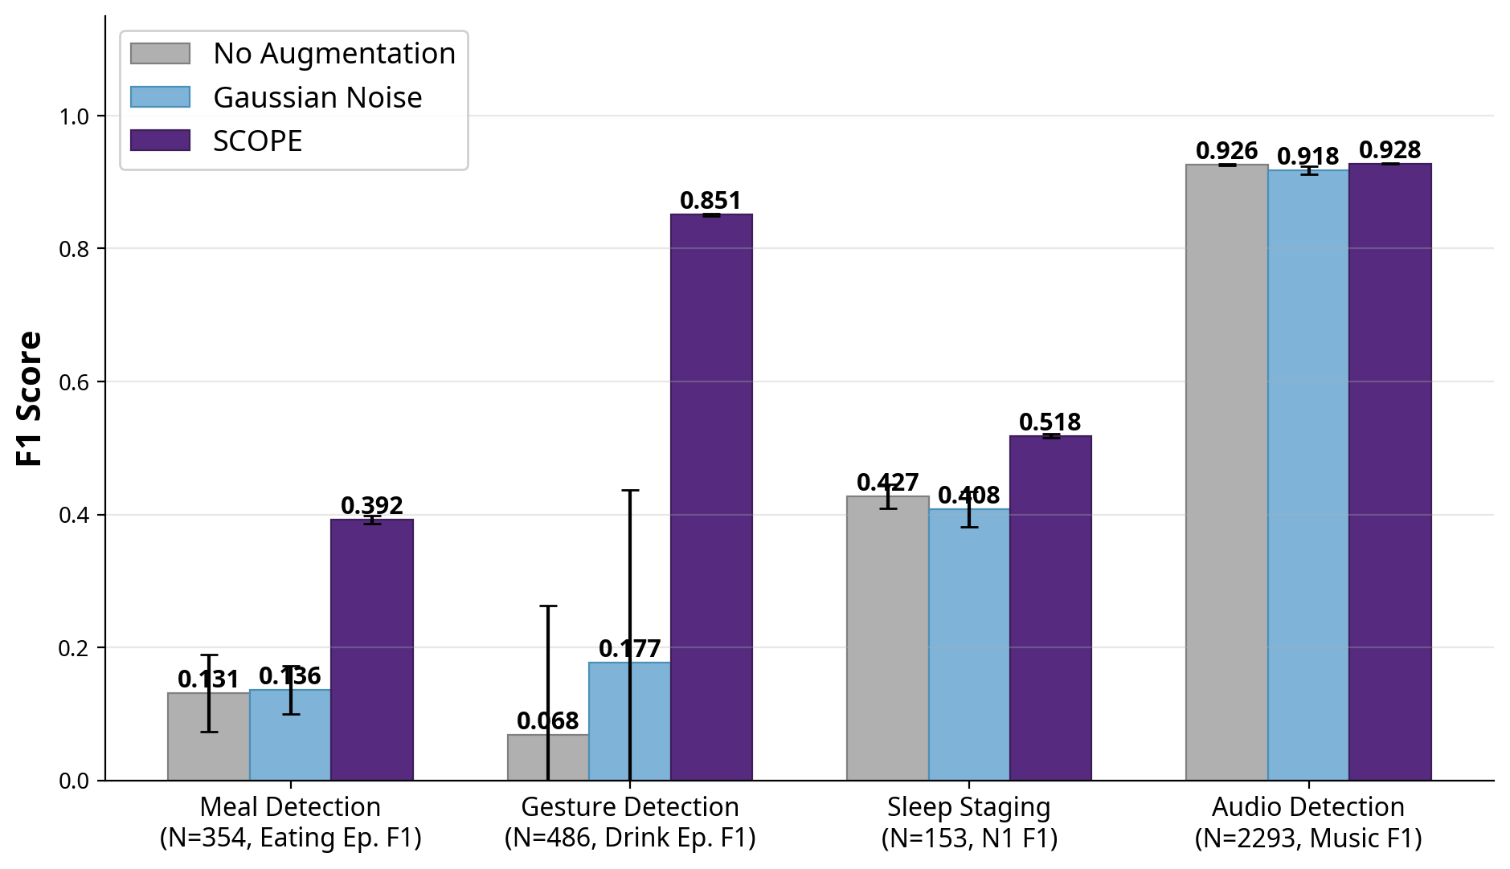
SCOPE – Ablation Study
Compare SCOPE vs. no augmentation vs. Gaussian noise
Each setting: 10 training runs, report mean ± std
Meal (N=354):
Eating Ep. F1: 0.131 → 0.392
Gesture (N=486):
Drink Ep. F1: 0.068 → 0.851
Sleep (N=153):
N1 F1: 0.427 → 0.518
Audio (N=2,293):
Music F1: 0.926 → 0.928
SCOPE most effective when data scarcity is prominent

Slide 57
Conclusion and Future Work

Slide 58
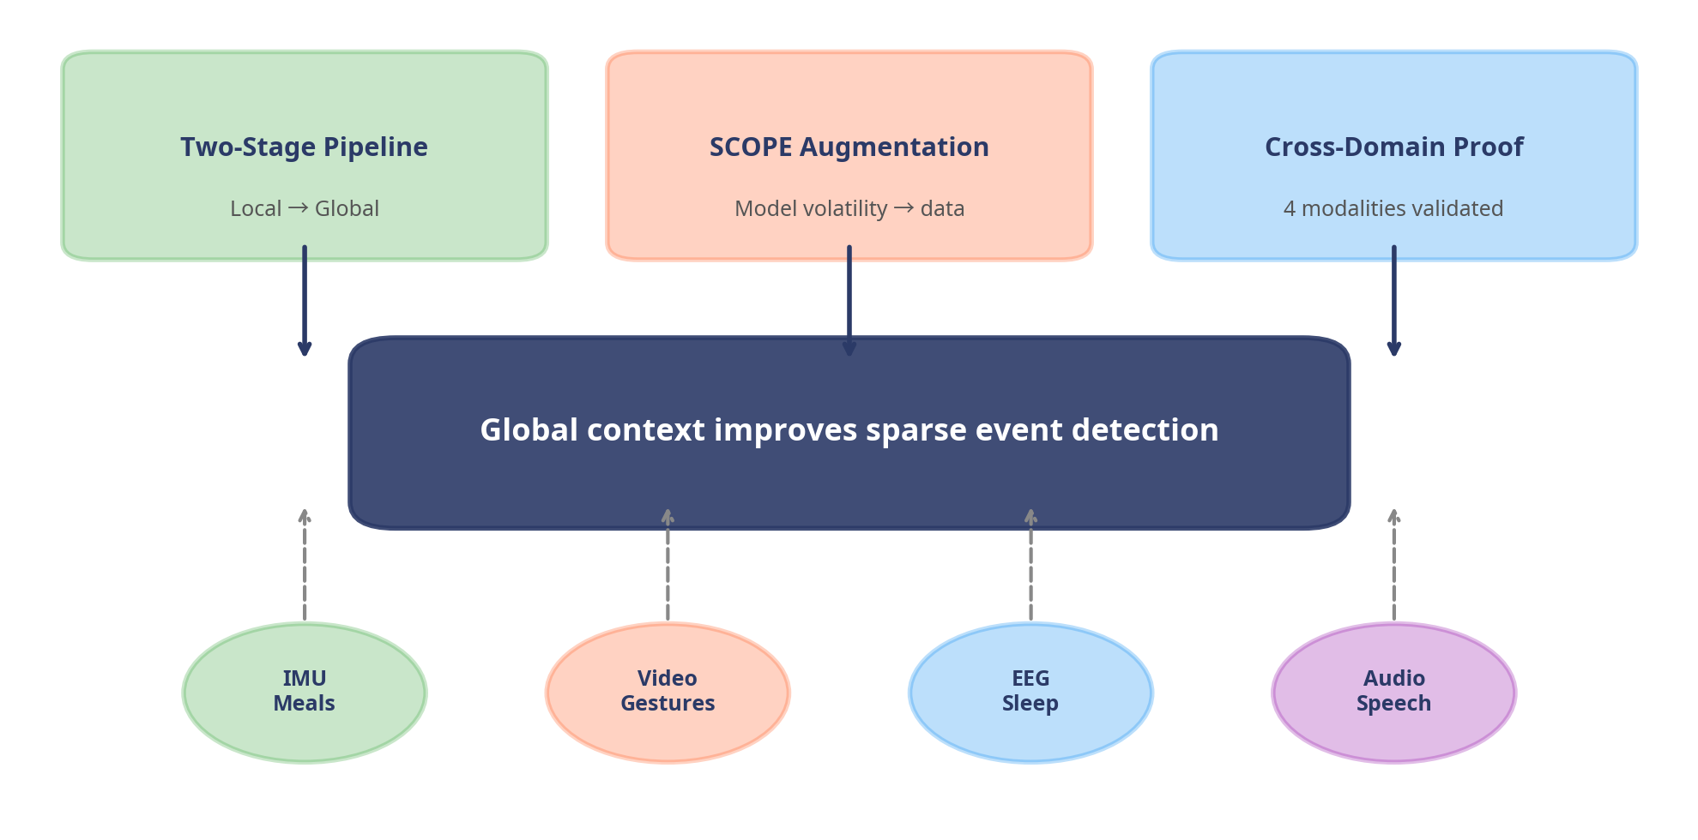
Contributions
Defined sparse event recognition
Unified two-stage framework
SCOPE augmentation via volatility
Validated across 4 domains

Slide 59
Future Work
Joint training of local and global stages
Stage-two performance is bounded by stage-one representations
Joint optimization could improve both stages simultaneously
Online deployment
Current framework requires the full recording before inference
Real-time deployment needs streaming-capable adaptations
SCOPE augments in raw signal space
Current method cannot generate synthetic raw recordings
Future work: generative raw data following guidance from SCOPE signals.

Slide 60
Acknowledgments
Committee Members:
Dr. Adam Hoover (Chair), Dr. Jon Calhoun, Dr. Feng Luo, Dr. Lan Zhang
My family
My research group
Clemson ECE staff

Slide 61
Thank you!
Question?

Slide 62
Appendix
Extra Slides for Q&A

Slide 63
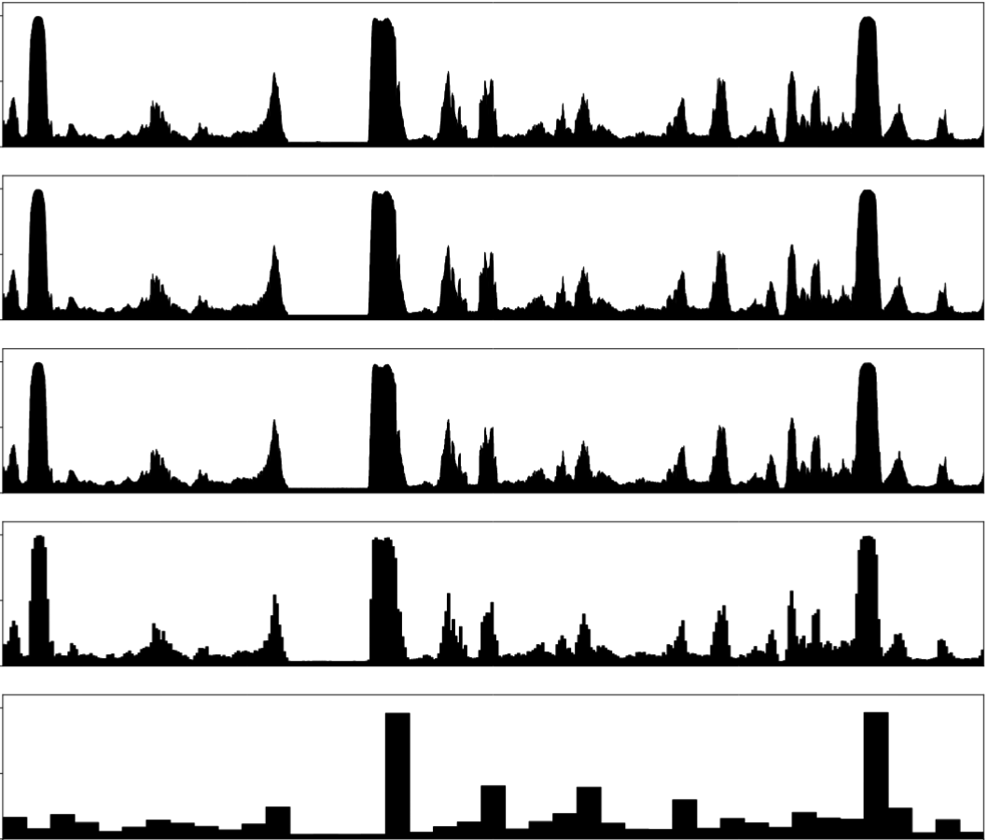
Method – Downsample (Daily Patterns)
Reduce the sampling rate of daily samples to 100-sec stride
Large sampling rate is unnecessary for providing long context
Stride: 115 sec
Stride: 1 sec
1
Stride: 10 sec
Stride: 100 sec
Stride: 1,000 sec
Results of downsampling a daily sample ¹.
[1] Zeyu Tang, Adam Patyk, James Jolly, Stephanie P Goldstein, J Graham Thomas, and Adam Hoover. Detecting eating episodes from wrist motion using daily pattern analysis. IEEE Journal of Biomedical and Health Informatics, 28(2):1054–1065, 2023.

Slide 64
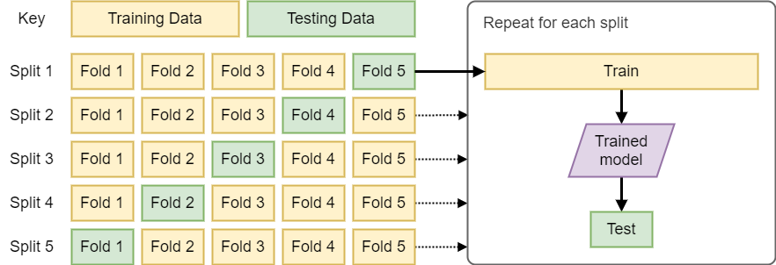
Evaluation Settings (Daily Pattern)
5-fold cross validation
Split by original recording in CAD dataset
Training:
50 epochs; maximum steps per epoch: 1,000
Binary cross entropy loss
Under-sample non-eating data to balance against eating data in stage 1
Input size for stage 1: 6-min with 6 axis, at 15 Hz
Input size for stage 2: 23.6 hours at 0.01 Hz

Slide 65
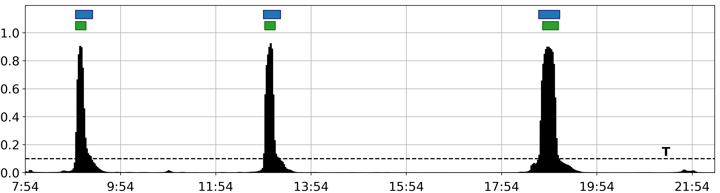
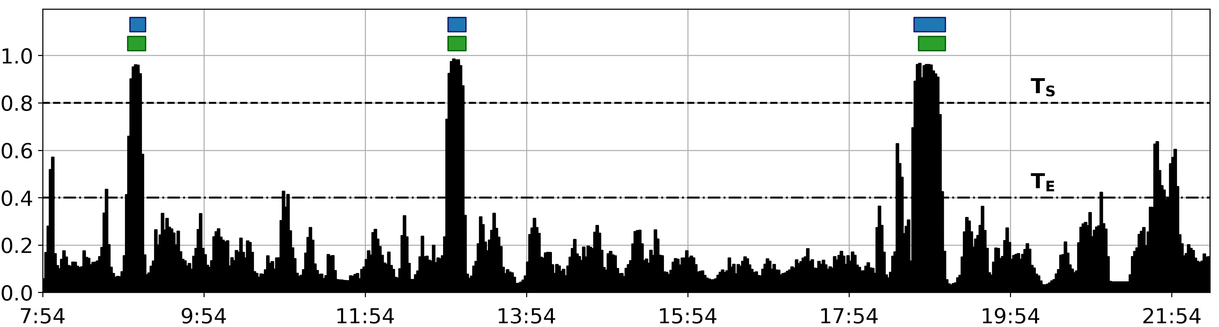
Results - Prediction Signal-to-Noise Ratio (SNR) (Daily Pattern)
Sliding window approach has a consistent background noise (appx 0.2), while daily pattern approach is much cleaner
P(eating)
Time
Ground truth episodes
Predicted episodes
Predictions from daily pattern classifier (upper) and a window model (lower)
Source: Zeyu Tang, Adam Patyk, James Jolly, Stephanie P Goldstein, J Graham Thomas, and Adam Hoover. Detecting eating episodes from wrist motion using daily pattern analysis. IEEE Journal of Biomedical and Health Informatics, 28(2):1054–1065, 2023..

Slide 66
Video Dataset – Ours vs. Existing Datasets (Video Gesture)
Dataset | Participants (Videos) | Gestures (Types) | Food choices | Camera position | Avail.
OREBA¹ | 102 (102) | 4,279 (Bite, drink) | lasagna, bread, yogurt, water | On the dining table; front view | Public
[Hossain2020]² | 28 (84) | 2,101 (Bite) | Not reported | 3-feet from participants; side view | Private
[Qiu2020]³ | 12 (52) | 2,039 (Bite) | 66 (food, beverage) | On the shoulder of the participant; over-shoulder view | Private
Clemson Cafeteria (ours) | 264 (486) | 23,142 (Bite, drink) | 374 (food, beverage) | On the ceiling of 5 meters height; over-head view | Public
[1] Philipp V Rouast, Hamid Heydarian, Marc TP Adam, and Megan E Rollo. Oreba: A dataset for objectively recognizing eating behavior and associated intake. IEEE Access, 8:181955– 181963, 2020.
[2] Delwar Hossain, Tonmoy Ghosh, and Edward Sazonov. Automatic count of bites and chews from videos of eating episodes. IEEE Access, 8:101934–101945, 2020.
[3] Jianing Qiu, Frank P-W Lo, Shuo Jiang, Ya-Yen Tsai, Yingnan Sun, and Benny Lo. Counting bites and recognizing consumed food from videos for passive dietary monitoring. IEEE Journal of Biomedical and Health Informatics, 25(5):1471–1482, 2020.

Slide 67
Evaluation Settings (Video Gesture)
Training, validation, testing sets
Split by original participants with a ratio of 70: 15: 15
Training:
50; maximum steps per epoch: 10,000
Cross entropy loss
Class weights: Inverse square root of class sizes
Pre-trained datasets: CNN-LSTM: ImageNet; X3D: Kinetics
Augmentation for raw frames: brightness jittering, random horizontal flipping
Input size for local encoders:
X3D : 13 frames with 160x160 resolution at 5 Hz
CNN-LSTM 16 frames with 224x224 resolution at 8 Hz
Input size for global detector 2: 41 minutes at 2 Hz

Slide 68
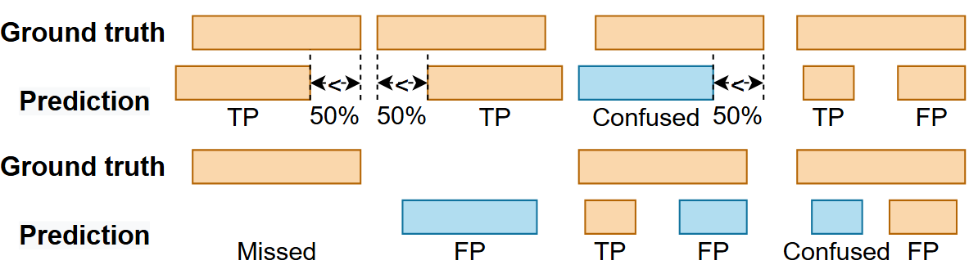
Episode-based Evaluation Scheme (Video Gesture)
Frame-level predictions are processed first to remove small gaps and jitters
Continuous frames with the same prediction labels are considered as one bounded gesture events
Detected event boundaries are compared with ground truth
Evaluation criteria^{1, 2}
[1] Yadnyesh Y Luktuke and Adam Hoover. Segmentation and recognition of eating gestures from wrist motion using deep learning. In 2020 IEEE International Conference on Big Data (Big Data), pages 1368–1373. IEEE, 2020.
[2] Zeyu Tang and Adam Hoover. Video-based intake gesture recognition using meal-length context. ACM Transactions on Computing for Healthcare, 6(2):1–24, 2025.

Slide 69

Results - F1 Improvement Across Demographics (Video Gesture)
Better performance in drink detection for younger individuals: the global patterns are more consistent
Higher gains for people with darker skins: global patterns help when local visual cues are weak
Source: Zeyu Tang and Adam Hoover. Video-based intake gesture recognition using meal-length context. ACM Transactions on Computing for Healthcare, 6(2):1–24, 2025.

Slide 70

Example on Reducing False Positives ( Video Gesture)
Left: X3D
Right: X3D + global detector
Under low light condition, similar clothing/background colors reduced tool and hand visibility, and challenged local models
The global detector eliminated these false positives by combining global context with frame-level probabilities

Slide 71

Example on Reducing False Positives ( Video Gesture)
Left: X3D
Right: X3D + global detector
When the video is over-exposed, bright clothes and skin also challenged local models
The global detector is still able to remove these false positives

Slide 72
Challenge 2 - Data Scarcity at the Recording Level
Window-based: each recording → hundreds of training windows
Global-level: each recording = ONE training sample
Need: diverse global samples without additional annotation
Dataset | N (rec.) | Windows | Ratio
CAD (Meal) | 354 | ~283,000 | 1:800
Cafeteria (Gest.) | 486 | ~97,000 | 1:200
Sleep-EDF | 39 | ~30,000 | 1:770
TVSM (Spc/Mus) | 2,293 | ~275,000 | 1:120

Slide 73
Summary - When Does Global Context Help Most?
Condition 1: Events must be sparse
Drink gestures (+0.15–0.19 F1), N1 sleep (+0.11 F1)
Global cues become more valuable for rare events when local cues are far from saturated
Condition 2: Structured temporal patterns exist
Sleep cycles (~90 min) and meal patterns provide strong structure
Speech events occur more randomly → less context to exploit

Slide 74
Framework Design Choices
Why BiLSTM for Stage 2?
Bidirectional: captures both past and future context
Low parameter count: avoids overfitting with small N
Sufficient capacity: probability sequences are low-dimensional
Why not end-to-end training?
Modularity: any local model can be wrapped without retraining
Practicality: Stage 1 training is the computational bottleneck
Consistent gains across four domains and eight local models

Slide 75
SCOPE - Ablation Study
Compare SCOPE vs. no augmentation vs. Gaussian noise
Each setting: 10 training runs, report mean ± std
Case | N | Metric | None | Gaussian | SCOPE
Meal | 354 | Ep. TPR | 0.41±0.24 | 0.48±0.19 | 0.87±0.00
Gesture | 486 | Drink F1 | 0.07±0.20 | 0.18±0.26 | 0.85±0.00
Sleep | 39 | MF1 | 0.66±0.02 | 0.67±0.02 | 0.78±0.01
Audio | 2293 | Mus F1 | 0.93±0.00 | 0.92±0.01 | 0.93±0.00

