Slide 1
Individualized Wrist Motion Models for Detecting Eating Episodes using Deep Learning
Presented By
Wenkang Wei
Committee:
Dr. Adam Hoover (Chair)
Dr. Richard Groff
Dr. Yongqiang Wang

Slide 2
Outline
Background and Motivation
Motivation
Related Work
Novelty
Methods
Results
Conclusion

Slide 3
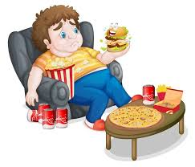
Motivation - Obesity
Prevalence of Obesity
Reported by CDC in 2017, obesity was prevalent in 39.8 % of the population and affected about 93.3 million US adults in 2015 ~ 2016
China has about 46 % of adults and 15 % of children being obese or overweight
Effect from Obesity
Risk of diseases like heart disease, stroke, and kidney problems increases
People who are overweight or obese are up to twice as likely as normal-weight people to develop liver cancer, reported by National Cancer Institution
Causes
Genetics
Lack of physical activity
Poor diet and imbalance energy intake

Slide 4
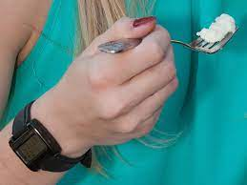
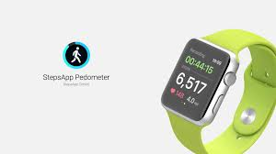
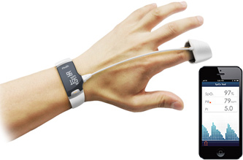
Motivation - mHealth
mHealth
A term used for the practice of medicine and public health supported by mobile devices
Self-monitoring software for mHealth helps monitor user's health, diet and fight against obesity
Example of mHealth devices
Pedometer
Blood pressure monitor
Bite counter
…
Bite Counter
Pedometer
Blood pressure monitor

Slide 5
Related Work
Gesture Recognition
A study improving gesture recognition using HMMs to encode context like utensil, gender, age (Shen 2018)
U-Net, deep learning method, to segment and classify multiple gesture patterns (Luktuke 2020)
Eating detection
A rule-based algorithm to track the wrist motion and segment the data (Dong et. al 2012)
A threshold-based algorithm to segment eating during freeliving based on wrist energy data (Dong et. al 2013)
Convolution neural network with large window to detect eating episodes on a large freeliving eating activity data set of a group of people (Sharma 2020)

Slide 6
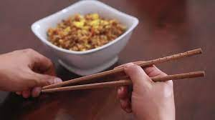
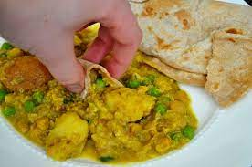
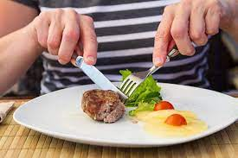
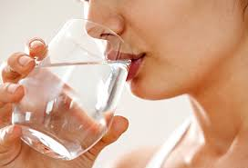
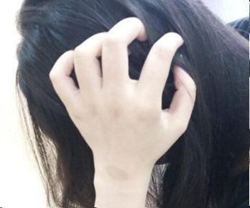
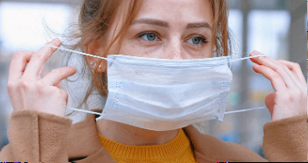
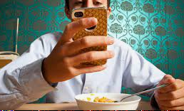
This Work – Individual Differences
This work considers
Eating behaviors may vary between individuals
Utensils used (chopsticks, fork, etc.)
Food choices
Eating pace
Non-eating behaviors with wrist motions that can be confused with eating may also vary between individuals
Facial grooming habits
Daily tasks that resemble eating
Secondary activities during eating
Eating behaviors from a group vary
More …
Non-eating behaviors vary among people

Slide 7
Novelty
Investigate and compare eating detection performance between a group model and individual models
We also answer these questions:
Do individual models perform better than the group model, when testing them on the same individual data?
How much improvement do individual models get, compared with group model? Do they vary, depending on each individual?
Does changing individual hyper-parameters help improve performance of individual models?

Slide 8
Outline
Background and Motivation
Methods
Data Collection
Data Processing
CNN Model and Hysteresis Threshold
Metrics
Training and Evaluation
Hyper-Parameter Tuning
Results
Conclusion

Slide 9
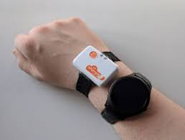
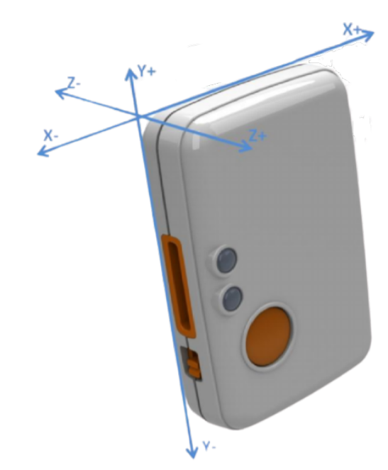
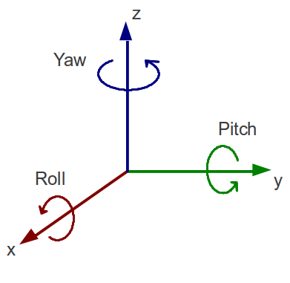
Method – Data Collection
Shimmer3 wearable device was used to collect wrist motion time series data
6-axis data:
Accelerometer: x, y z
Gyroscope: roll, pitch, yaw
Data was collected from 8 participants
At least 10 days of data for each one

Slide 10
Method – Data Collection
Individual data set of 8 participants from this work
Dataset | Days | Total Hours | Meal Cnt | Avg Meal Cnt per Day | Avg Hour per Meal | Eating Hours | Non-Eating Hours | Ratio: Non-eat/eat
1 | 17.0 | 129.2 | 32.0 | 1.9 | 0.2 | 7.7 | 121.5 | 15.8
2 | 14.0 | 125.6 | 26.0 | 1.9 | 0.1 | 3.3 | 122.3 | 37.1
3 | 23.0 | 167.2 | 60.0 | 2.6 | 0.1 | 7.6 | 159.6 | 21.0
4 | 13.0 | 134.0 | 38.0 | 2.9 | 0.2 | 9.3 | 124.7 | 13.4
5 | 14.0 | 127.8 | 20.0 | 1.4 | 0.3 | 5.9 | 121.9 | 20.7
6 | 12.0 | 144.8 | 26.0 | 2.2 | 0.3 | 7.0 | 137.8 | 19.7
7 | 10.0 | 120.4 | 22.0 | 2.2 | 0.3 | 5.9 | 114.5 | 19.4
8 | 12.0 | 115.5 | 22.0 | 1.8 | 0.5 | 10.8 | 104.7 | 9.7
Total | 115.0 | 1064.5 | 246.0 | - | - | 57.5 | 1,007.0 | 17.5
Average | 14.4 | 133.1 | 30.8 | 2.1 | 0.2 | 7.2 | 125.9 | 17.5

Slide 11
Method – Data Collection
Summary of data sets
Clemson All-day Data set (CAD), a group data set, from previous work (Sharma 2020)
Individual data set from this work
Dataset | Participants | Days | Total Hours | Eating Hours | Non-Eating Hours | Meal Counts
CAD | 351 | 354 | 4,680 | 229 | 4,451 | 1,133
Individual data set | 8 | 115 | 1,064.5 | 57.5 | 1,007 | 246

Slide 12
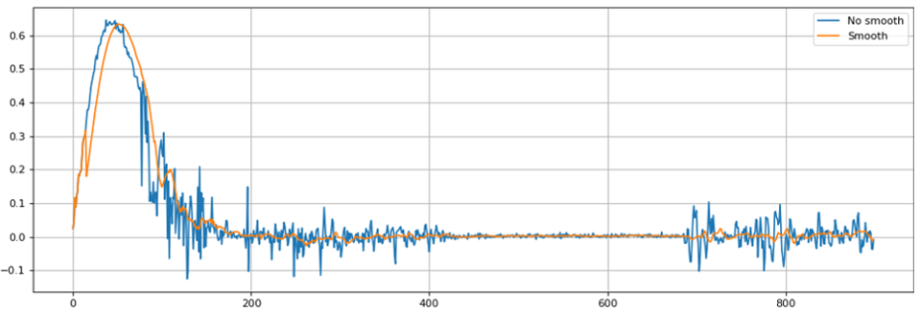
Data Processing - Smoothing
Data Processing step is as same as previous work (Sharma 2020)
Accelerometer data is affected by noise (blue curve)
Smoothing using a Gaussian filter on accelerometer data
Smoothed signal better captures the trend/pattern of signal (orange curve)
Signal
Index of data point
Index of data point

Slide 13
Data Processing – Z-Normalization
Unscaled input variables can result in a slow or unstable learning process in deep learning
Z-normalization: $x_{normalized}=\frac{x−\overline{x}}{σ}$, $\overline{x}$ (or $μ$) is mean of time series data, $σ$ is variance of data
Re-scale feature to have zero-mean and unit variance and avoid effect of different scales in data

Slide 14
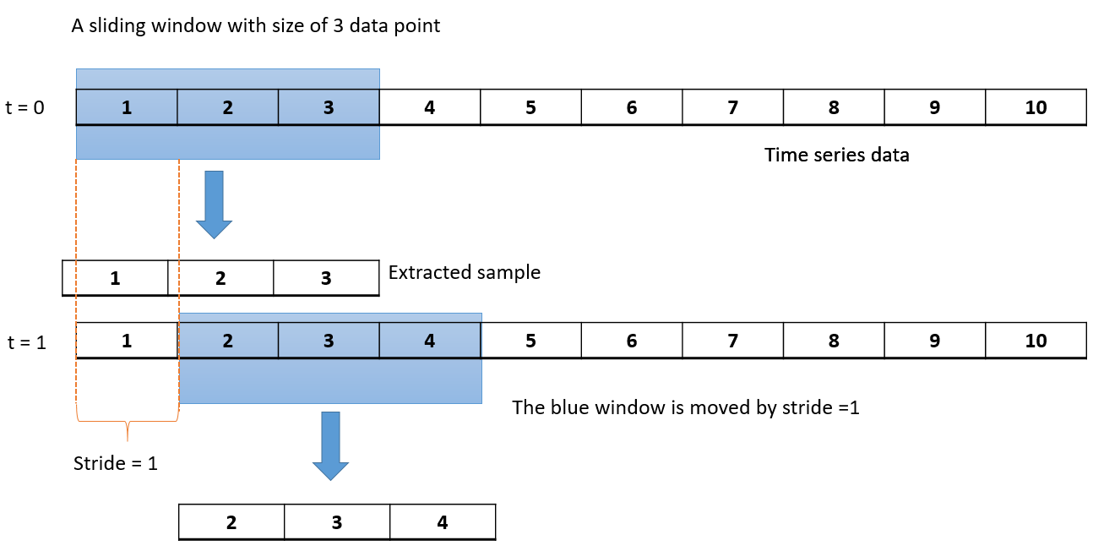
Data Processing – Sliding window
Window with size = W and stride to extract a sample with size of W
In this work
W = 6 min x 60 sec/min x 15Hz = 5400
For the group model, stride = 15 sec x 15Hz = 225
For individual models, stride = 5 sec x 15Hz = 75
Label a sample as “1” eating if 50% of window falls within self-reported eating period, otherwise “0”
Notes:
In this work
W = 6 min x 60 sec/min x 15Hz = 5400
For the group model, stride = 15 sec x 15hz = 225
For individual model, stride = 5 sec x 15Hz =75 to create more samples and avoid model under-fitting
Label the sample as “1” eating if 50% of window fall within repoted eating period, otherwise “0”

Slide 15
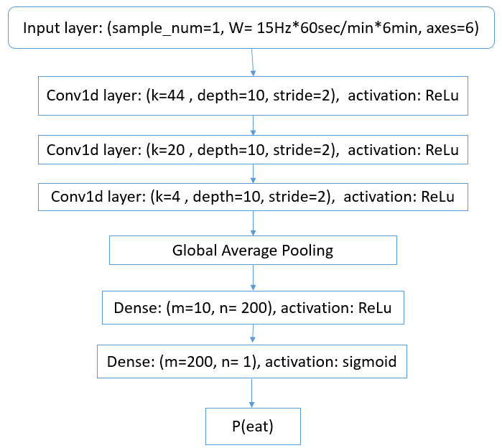
CNN Model
3 different layers used
1D Convolution
K: kernel (also called filter) size
Depth: the number of filters
Global Average Pooling
Dense
m: size of input vector
n: size of output vector
P(eat) : probability of eating
Predict “1” eating if P(eat) >=0.5, otherwise, “0” non eating for the sample

Slide 16
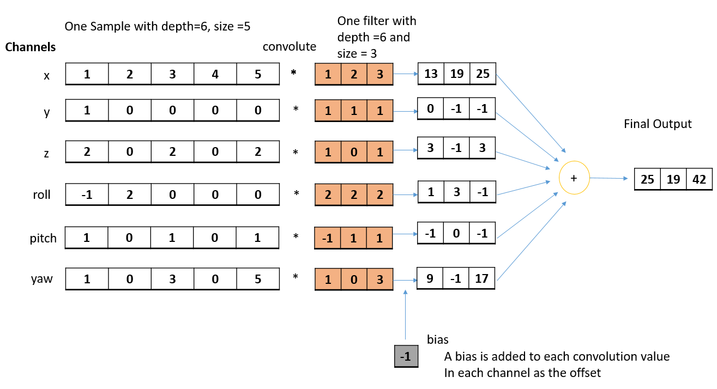
CNN Model
Example:
1D- Convolution Layer
Depth of filter = the depth of input
# of filters = depth of output
Tuple in “Output Shape” shows:
(None, size of output, depth of output)

Slide 17
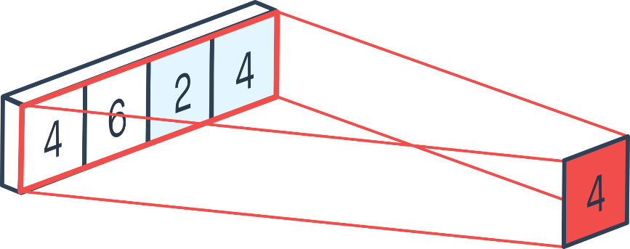
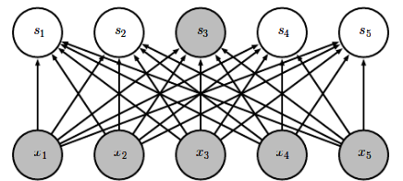
Global Average Pooling
CNN Model
Global Average Pooling
Reduce dimension by replacing one channel with its mean value
Dense Layer
Each neuron from previous layer is connected to every neuron in the next layer
Then activation function is applied
Dense layer
Output
Input

Slide 18
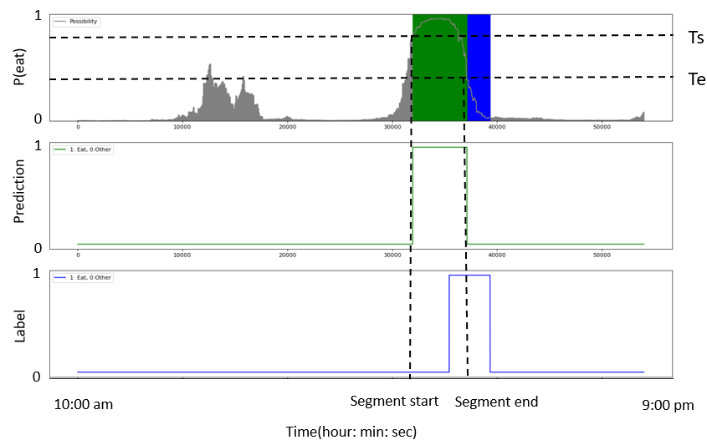
Post-Processing - Hysteresis Threshold
First generate continuous probability sequence of eating, P(eat) on one day of data
Threshold Ts detects start of eating
Threshold Te detects start of non-eating (resting, etc.)
When P(eat) > Ts, segment starts. When P(eat) < Te, segment ends

Slide 19
Metrics – Time Metric: Weighted Accuracy
Time Metric
Test on samples extracted by a sliding window
Confusion matrix
Weighted Accuracy (WAcc)
$$WAcc=\frac{W×TP +TN}{W×(TP+ FN) +(TN+FP)}$$
$W$ is balance ratio $\frac{non−eating hours}{eating hours}$ for each individual. For CAD data, $W=20$ from previous work (Sharma 2020)

Slide 20
Metrics – Episode Metrics: TPR, FP/TP
Episode Metrics
Label detected self-reported meal as TP, missing meal as a FN, extract segment as FP
Don’t consider TN
Episode Metrics:
True positive rate: $TPR=\frac{TP}{TP +FN}$ $FP/TP=\frac{FP}{TP }$

Slide 21
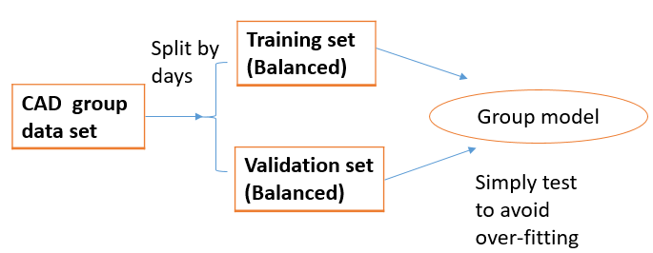
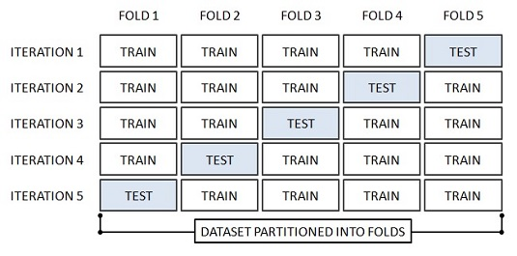
Model Training
For the group model
Training the group model
Training set 80% days ($≈$283 days), 20% days ($≈$ 71 days) as validation set
Under sample non-eating class to balance data
5-fold cross validation for individual models
Split data of one individual by days into 5 folds
Each iteration select 1 fold ($≈$2 days) for testing, 4 folds ($≈8$ days) for training
Under sample non-eating class to balance training data
For individual models of one person

Slide 22
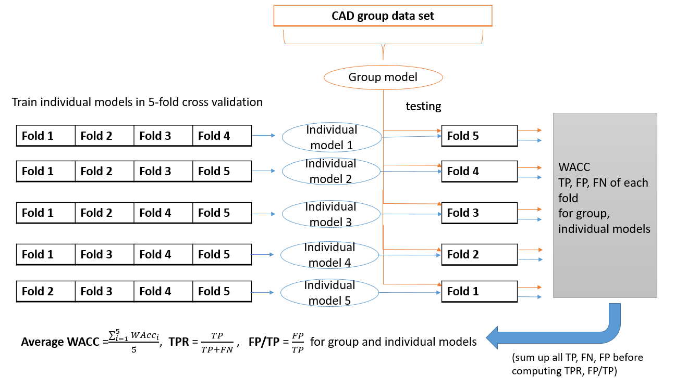
Performance Comparison
For one person, use 5-fold cross validation to get individual models
Test both group and individual models consistently
Group thresholds: Ts = 0.8, Te = 0.4 from previous work (Sharma 2020)

Slide 23
Hyper-Parameter Tuning: Ts, Te
First find performance of all Ts, Te combinations from sets
Ts = [0.85, 0.8, 0.75, 0.7, 0.65, 0.6, 0.55, 0.5]
Te = [0.1, 0.15, 0.2, 0.25, 0.3, 0.35, 0.4, 0.45]
Method 1: TPR method
First consider Ts, Te pair with minimum FP/TP when TPR >= 0.8
If not found, consider Ts, Te pair with maximum TPR
Method 2: FP/TP method
First consider Ts, Te pair with maximum TPR when FP/TP <= 1
If not found, consider Ts, Te pair with minimum FP/TP
Method 3: Balance method
Find Ts and Te that maximize TP ratio, $TP ratio=\frac{TP}{TP+FN+FP}$
It considers both TPR and FP/TP performance

Slide 24
Outline
Background and Motivation
Methods
Results
Distributions of Model Output
Time Metrics
Episode Metrics
Tuning Hyper-Parameters Ts and Te
Conclusion

Slide 25
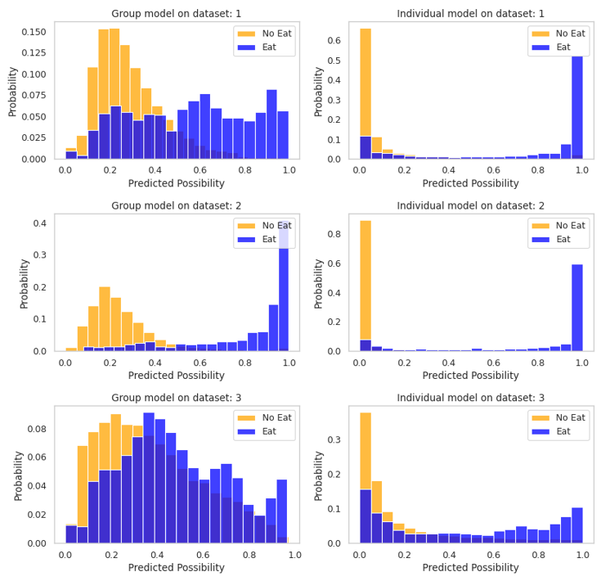
Results - Distributions of Model Output
Distributions of P(eat) on eating and non-eating data for individuals 1, 2, 3
Histograms:
Blue: distributions of P(eat) on eating data
Yellow: distributions of P(eat) on non eating data
Columns
Left : distributions from the group model
Right : distributions from individual models
Individual models can better separate two distributions than the group model

Slide 26
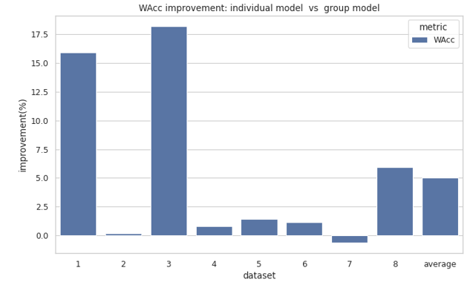
Time Metric – Weighted Accuracy
Dataset | WAcc
 | Group Model | Individual Models
1 | 0.774 | 0.897
2 | 0.956 | 0.958
3 | 0.611 | 0.722
4 | 0.757 | 0.763
5 | 0.825 | 0.837
6 | 0.786 | 0.795
7 | 0.688 | 0.684
8 | 0.843 | 0.893
Average | 0.780 | 0.819
WAcc Improvement $=\frac{WAcc_{individual } −WAcc_{group }}{WAcc_{group }}×100 (\%)$

Slide 27
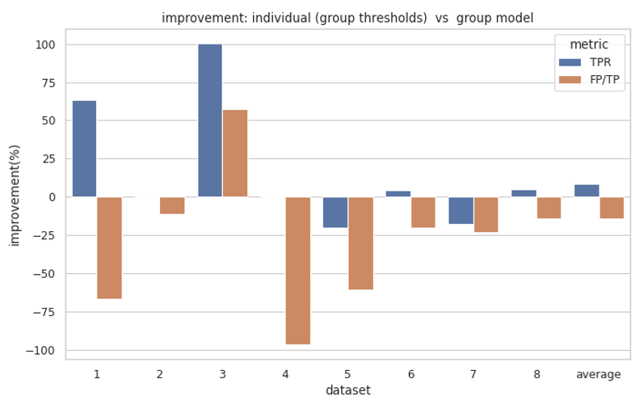
Episode Metrics With Group Thresholds
$$=\frac{TPR_{individual} −TPR_{group }}{TPR_{group }}×100 (\%)$$
Dataset | TPR |  | FP/TP
 | Group Model | Individual Models | Group Model | Individual Models
1 | 0.594 | 0.969 | 0.368 | 0.613
2 | 0.923 | 0.923 | 0.375 | 0.417
3 | 0.333 | 0.667 | 2.8 | 1.2
4 | 0.763 | 0.763 | 0.897 | 1.759
5 | 0.75 | 0.6 | 1.4 | 2.25
6 | 0.885 | 0.923 | 1.739 | 2.083
7 | 0.773 | 0.636 | 3.882 | 4.786
8 | 0.864 | 0.909 | 0.789 | 0.9
Average | 0.736 | 0.799 | 1.531 | 1.751
$$=− \frac{FP/TP_{individual } −FP/TP_{group }}{FP/TP_{group }}×100 (\%)$$

Slide 28
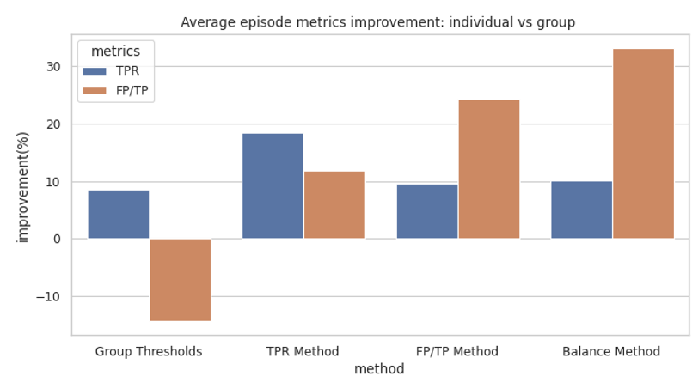
Episode Metrics After Tuning Ts, Te
Improvement on average performance shows balance method provides the best overall improvement
Choose balance method as final method
Method | TPR: improvement(%) | FP/TP : improvement(%)
Group Thresholds | 8.6 | -14.4
TPR Method | 18.5 | 12.0
FP/TP Method | 9.6 | 24.4
Balance Method | 10.1 | 33.2

Slide 29
Tuned Thresholds from Balance Method
Most individuals have tuned thresholds Ts = 0.85 > group Ts=0.8, Te = 0.1 < group Te = 0.4
Higher Ts helps reduce FP in episode metrics.
Lower Te helps better detect start of resting and other behavior with very low P(eat)
Dataset | Ts | Te
1 | 0.85 | 0.10
2 | 0.85 | 0.10
3 | 0.80 | 0.10
4 | 0.85 | 0.10
5 | 0.85 | 0.10
6 | 0.85 | 0.10
7 | 0.85 | 0.10
8 | 0.85 | 0.25
Te
Ts
lower Te
Higher Ts

Slide 30
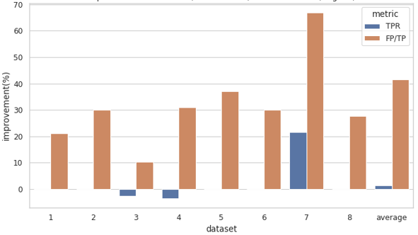
Episode Metrics using Balance Method
Individual models (balance method) VS Individual models (group thresholds)
$$=\frac{TPR_{CTH} −TPR_{GTH }}{TPR_{GTH }}×100 (\%)$$
$$=− \frac{FP/TP_{CTH } −FP/TP_{GTH }}{FP/TP_{GTH }}×100 (\%)$$
CTH: customized thresholds from balance method
GTH: group thresholds

Slide 31
Outline
Background and Motivation
Methods
Results
Conclusion
Discussion
Limitation and Future Work

Slide 32
Conclusion
Question 1: Do individual models perform better than the group model, when testing them on the same individual data?
Yes. On average, compared with the group model, the individual models improve 5% in time metric and about 10% in TPR and 33% in FP/TP when using balance method.
Question 2: How much improvement do individual models get, compared with group model? Do they vary depending on each individual?
Yes. The improvement of individual models can vary per individual. Some could have obvious improvement in WAcc, TPR, FP/TP, while the others can improve WAcc, FP/TP only or even drop TPR
Question 3: Does changing individual hyper-parameters help improve performance of individual models?
Yes. Using balance method, individual models have the average improvement of 10.1% on TPR and 33.2 % on FP/TP, compared with the group model.

Slide 33
Conclusion
Limitation
Limited data per individual - Need more days of data for each individual
Only 8 participants - Investigate more participants to make results more convincing
No window size test - Need to Investigate effect of window size for each person with large computational time and need
Topics for Future work
Minimum days of data required to get good individual models
Transfer learning to borrow the group model knowledge to improve individual models
Testing time = # individuals $×$ # windows $×$ 5-fold cross validation $×$ Time of training one model

Slide 34
Thank you! & QA

