Slide 1
Using Transfer Learning to Train Individualized Models to Detect Eating Episodes from Daily Wrist Motion
AUGUST 16th, 2021
Thesis Defense
Cole Younginer
Thesis Committee:
Dr. Adam Hoover (Committee Chair)
Dr. Melissa Smith
Dr. Jon Calhoun

Slide 2
Outline
Introduction
Methods
Results
Conclusion

Slide 3
Outline
Introduction
Motivation
Related Work
Background
Novelty
Methods
Results
Conclusion

Slide 4
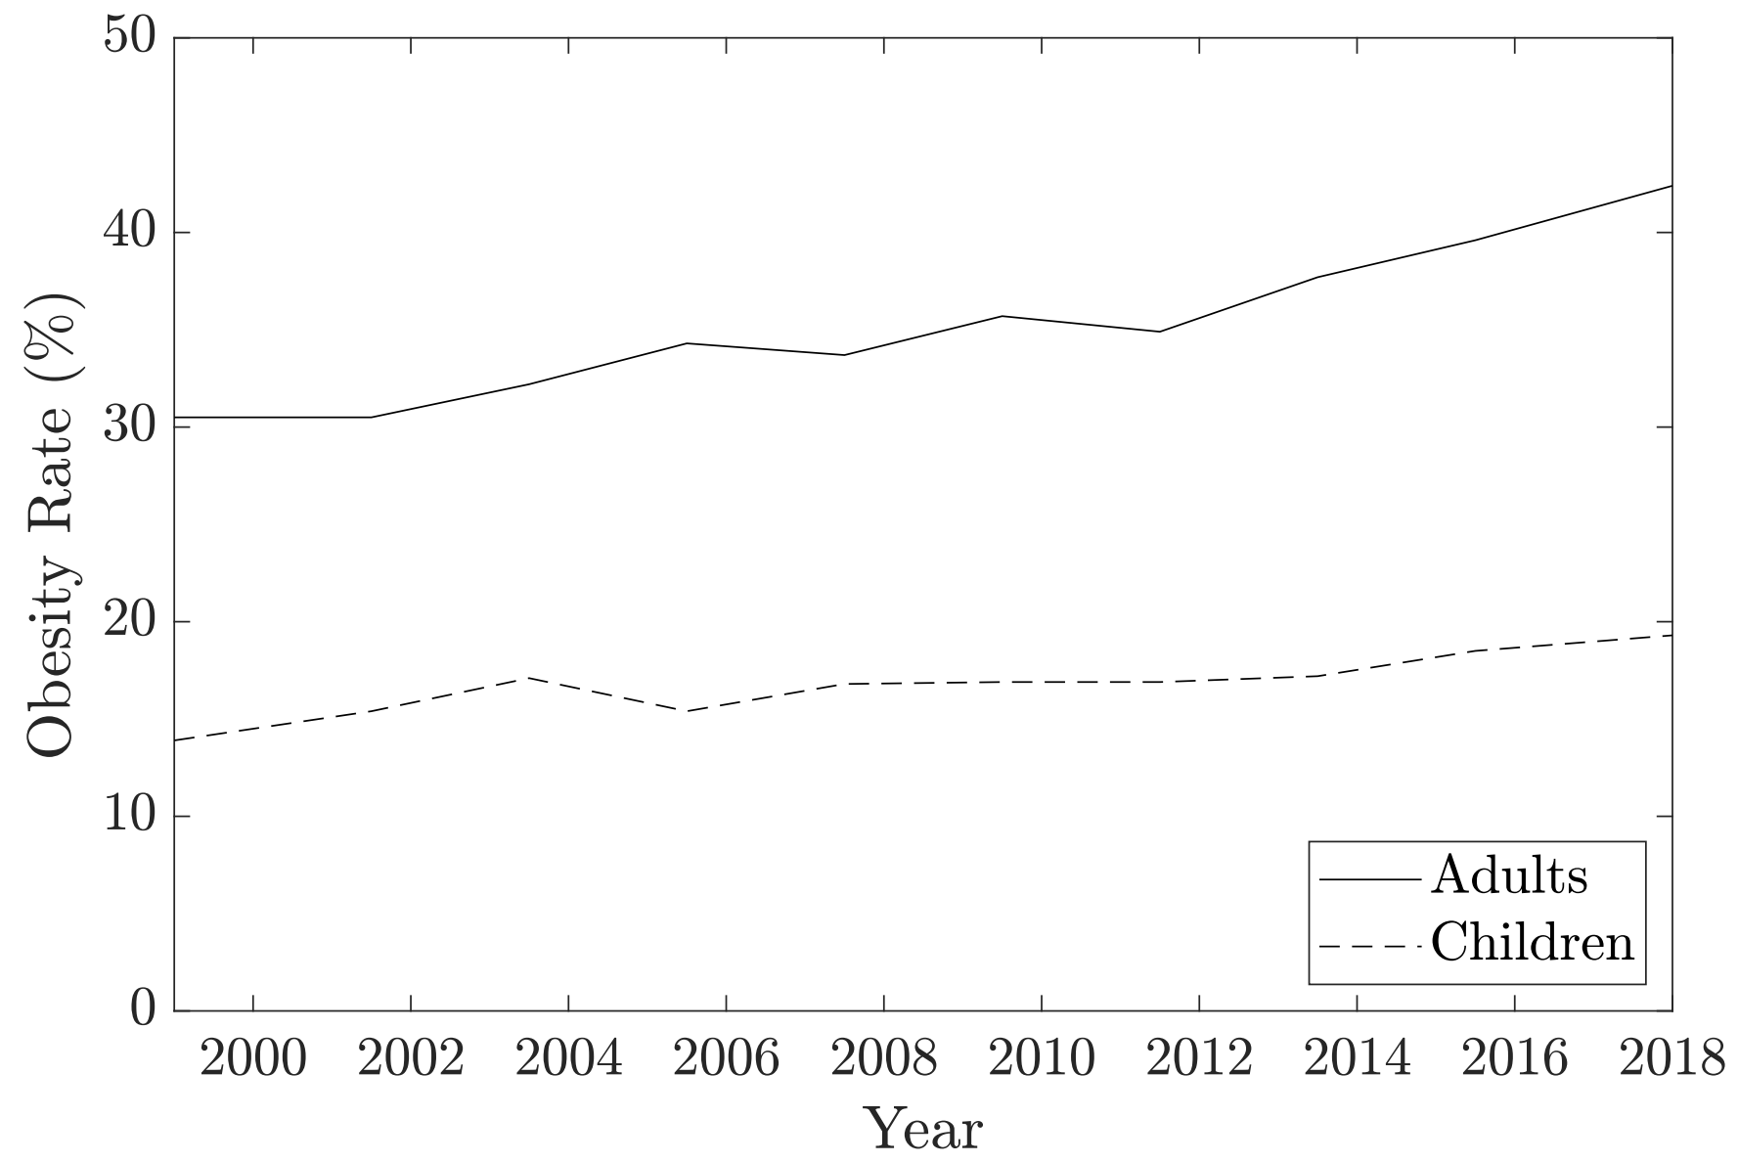
INTRODUCTION
Motivation: Obesity
Global health epidemic
42.4% of U.S. adults affected in 2018 (CDC)
Predicted to reach 50% by 2030 (Wang et. al)
Increased risk of other health problems
Heart disease, diabetes, cancer
Primary factors
Overconsumption
Unhealthy diets high in sugars and fats
Increased sedentarism
Recent COVID-19 pandemic has amplified several factors
Obesity Rates in the U.S. from 1999-2018.

Slide 5
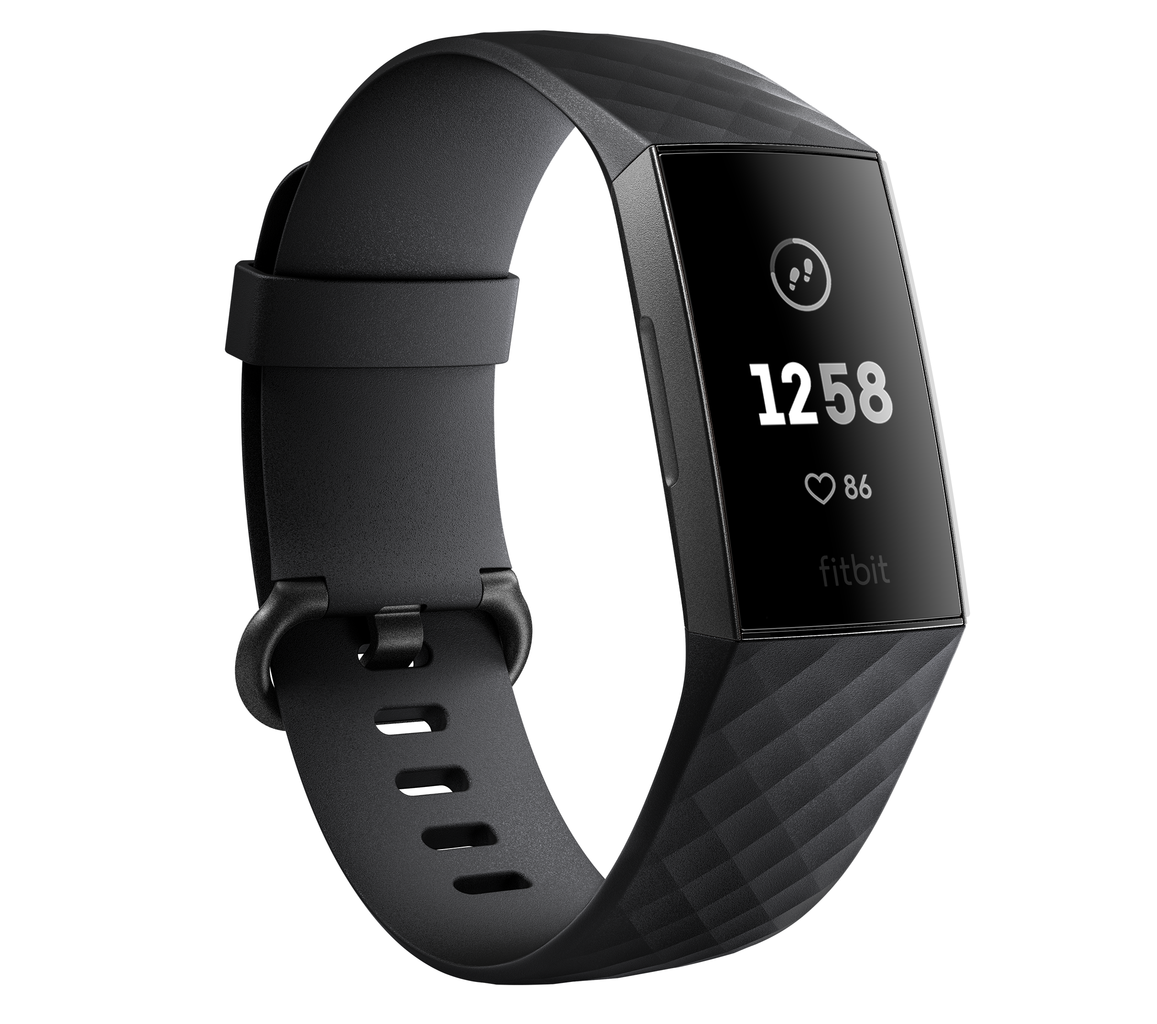
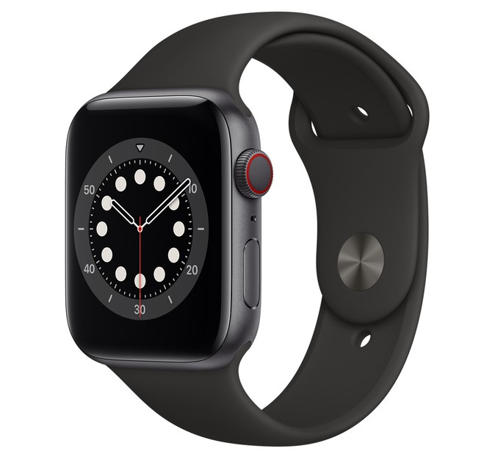
INTRODUCTION
Motivation: mHealth
Noncommunicable diseases (NCDs) most common cause of death in 2020 according to WHO
71% of all deaths worldwide
Obesity increases risk for many NCDs
Need to be more proactive with healthcare
Mobile health (mHealth) tools can monitor health
Smartphones
Smartwatches
Commonly used to monitor energy expenditure, but cannot monitor energy intake
Fitbit
Apple Watch

Slide 6
INTRODUCTION
Motivation: Automated Dietary Monitoring (ADM)
Only way of measuring energy intake is through self-reporting
Food journals
Fitness applications
Problems:
Tediousness
Self-reporting bias
ADM: Create a wearable device that can automatically track energy intake

Slide 7
INTRODUCTION
Related Work
Use wrist motion and a rule-based algorithm to track individual bites (Dong et. al 2009)
Use deep learning with wrist motion to track individual bites and combine them into meals (Kyritsis et. al 2019)
Use deep learning with large detection window to detect entire eating episodes (Sharma 2020)
351 participants
Group model
Create personalized deep learning models for improvements in eating episode detection (Wei 2021)
Multiple days of data collected from 8 participants
Improved eating episode detection but more false positives

Slide 8
INTRODUCTION
Background: Transfer Learning
Transfer learning: Technique where knowledge acquired from one task is applied to another, related task.
Example: Programming languages
Many languages share basic concepts
Loops
Conditionals
Variables
Once concepts are learned in one language, learning another language is easier

Slide 9
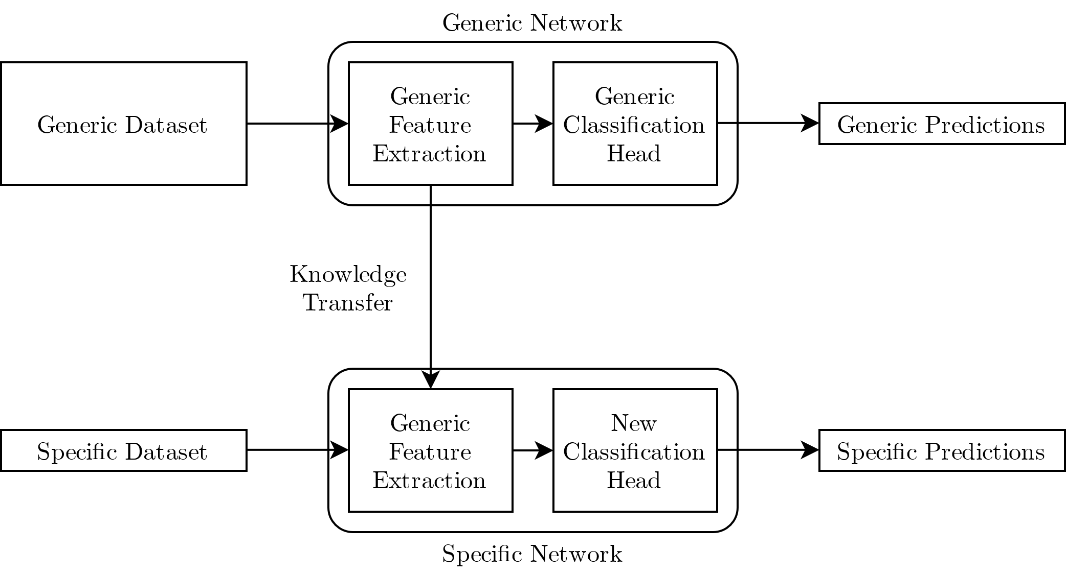
INTRODUCTION
Background: Transfer Learning
Same idea can be applied to neural networks
Networks split between feature extraction layers and classification layers
Steps:
Train a general or generic model
Transfer and freeze feature extraction layers
Train a new classification head
Fine-tune feature extraction layers

Slide 10
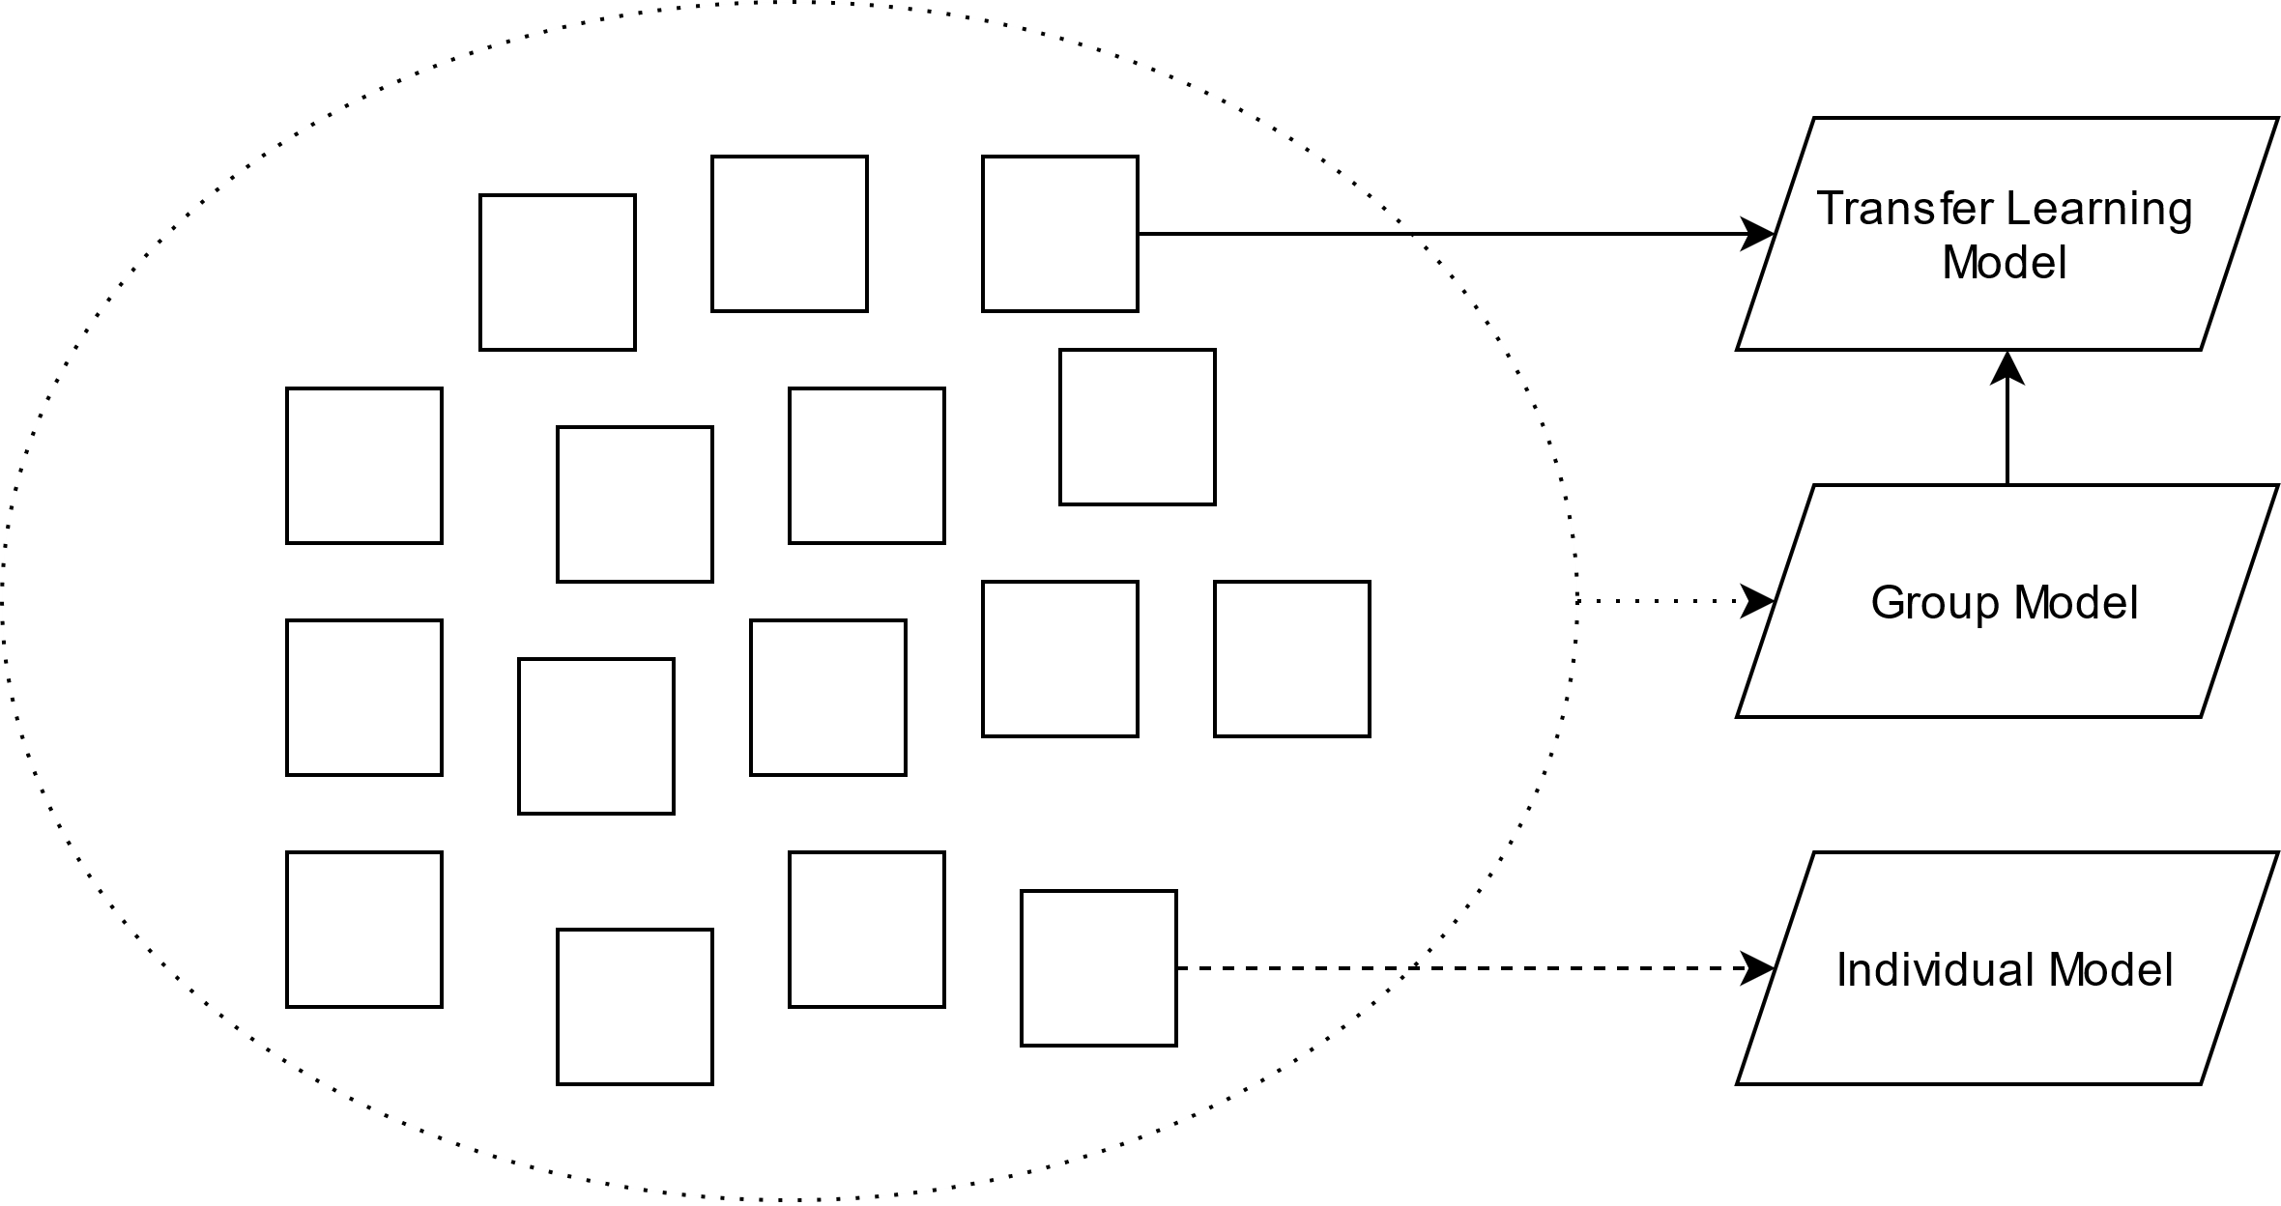
INTRODUCTION
Novelty
Use transfer learning to leverage features learned from a group eating detection model to improve the performance of personalized eating detection models

Slide 11
INTRODUCTION
Novelty: Main Questions
Can transfer learning be employed to increase the performance of individualized eating detection models by utilizing features learned from a group model?
How much performance can be gained? Does this gain vary depending on the individual?
Can transfer learning speed up the training process of individualized models?

Slide 12
Outline
Introduction
Methods
Datasets
Data Pre-Processing
Neural Network Architecture
Network Training
Post-Processing
Evaluation Metrics
Results
Conclusion

Slide 13
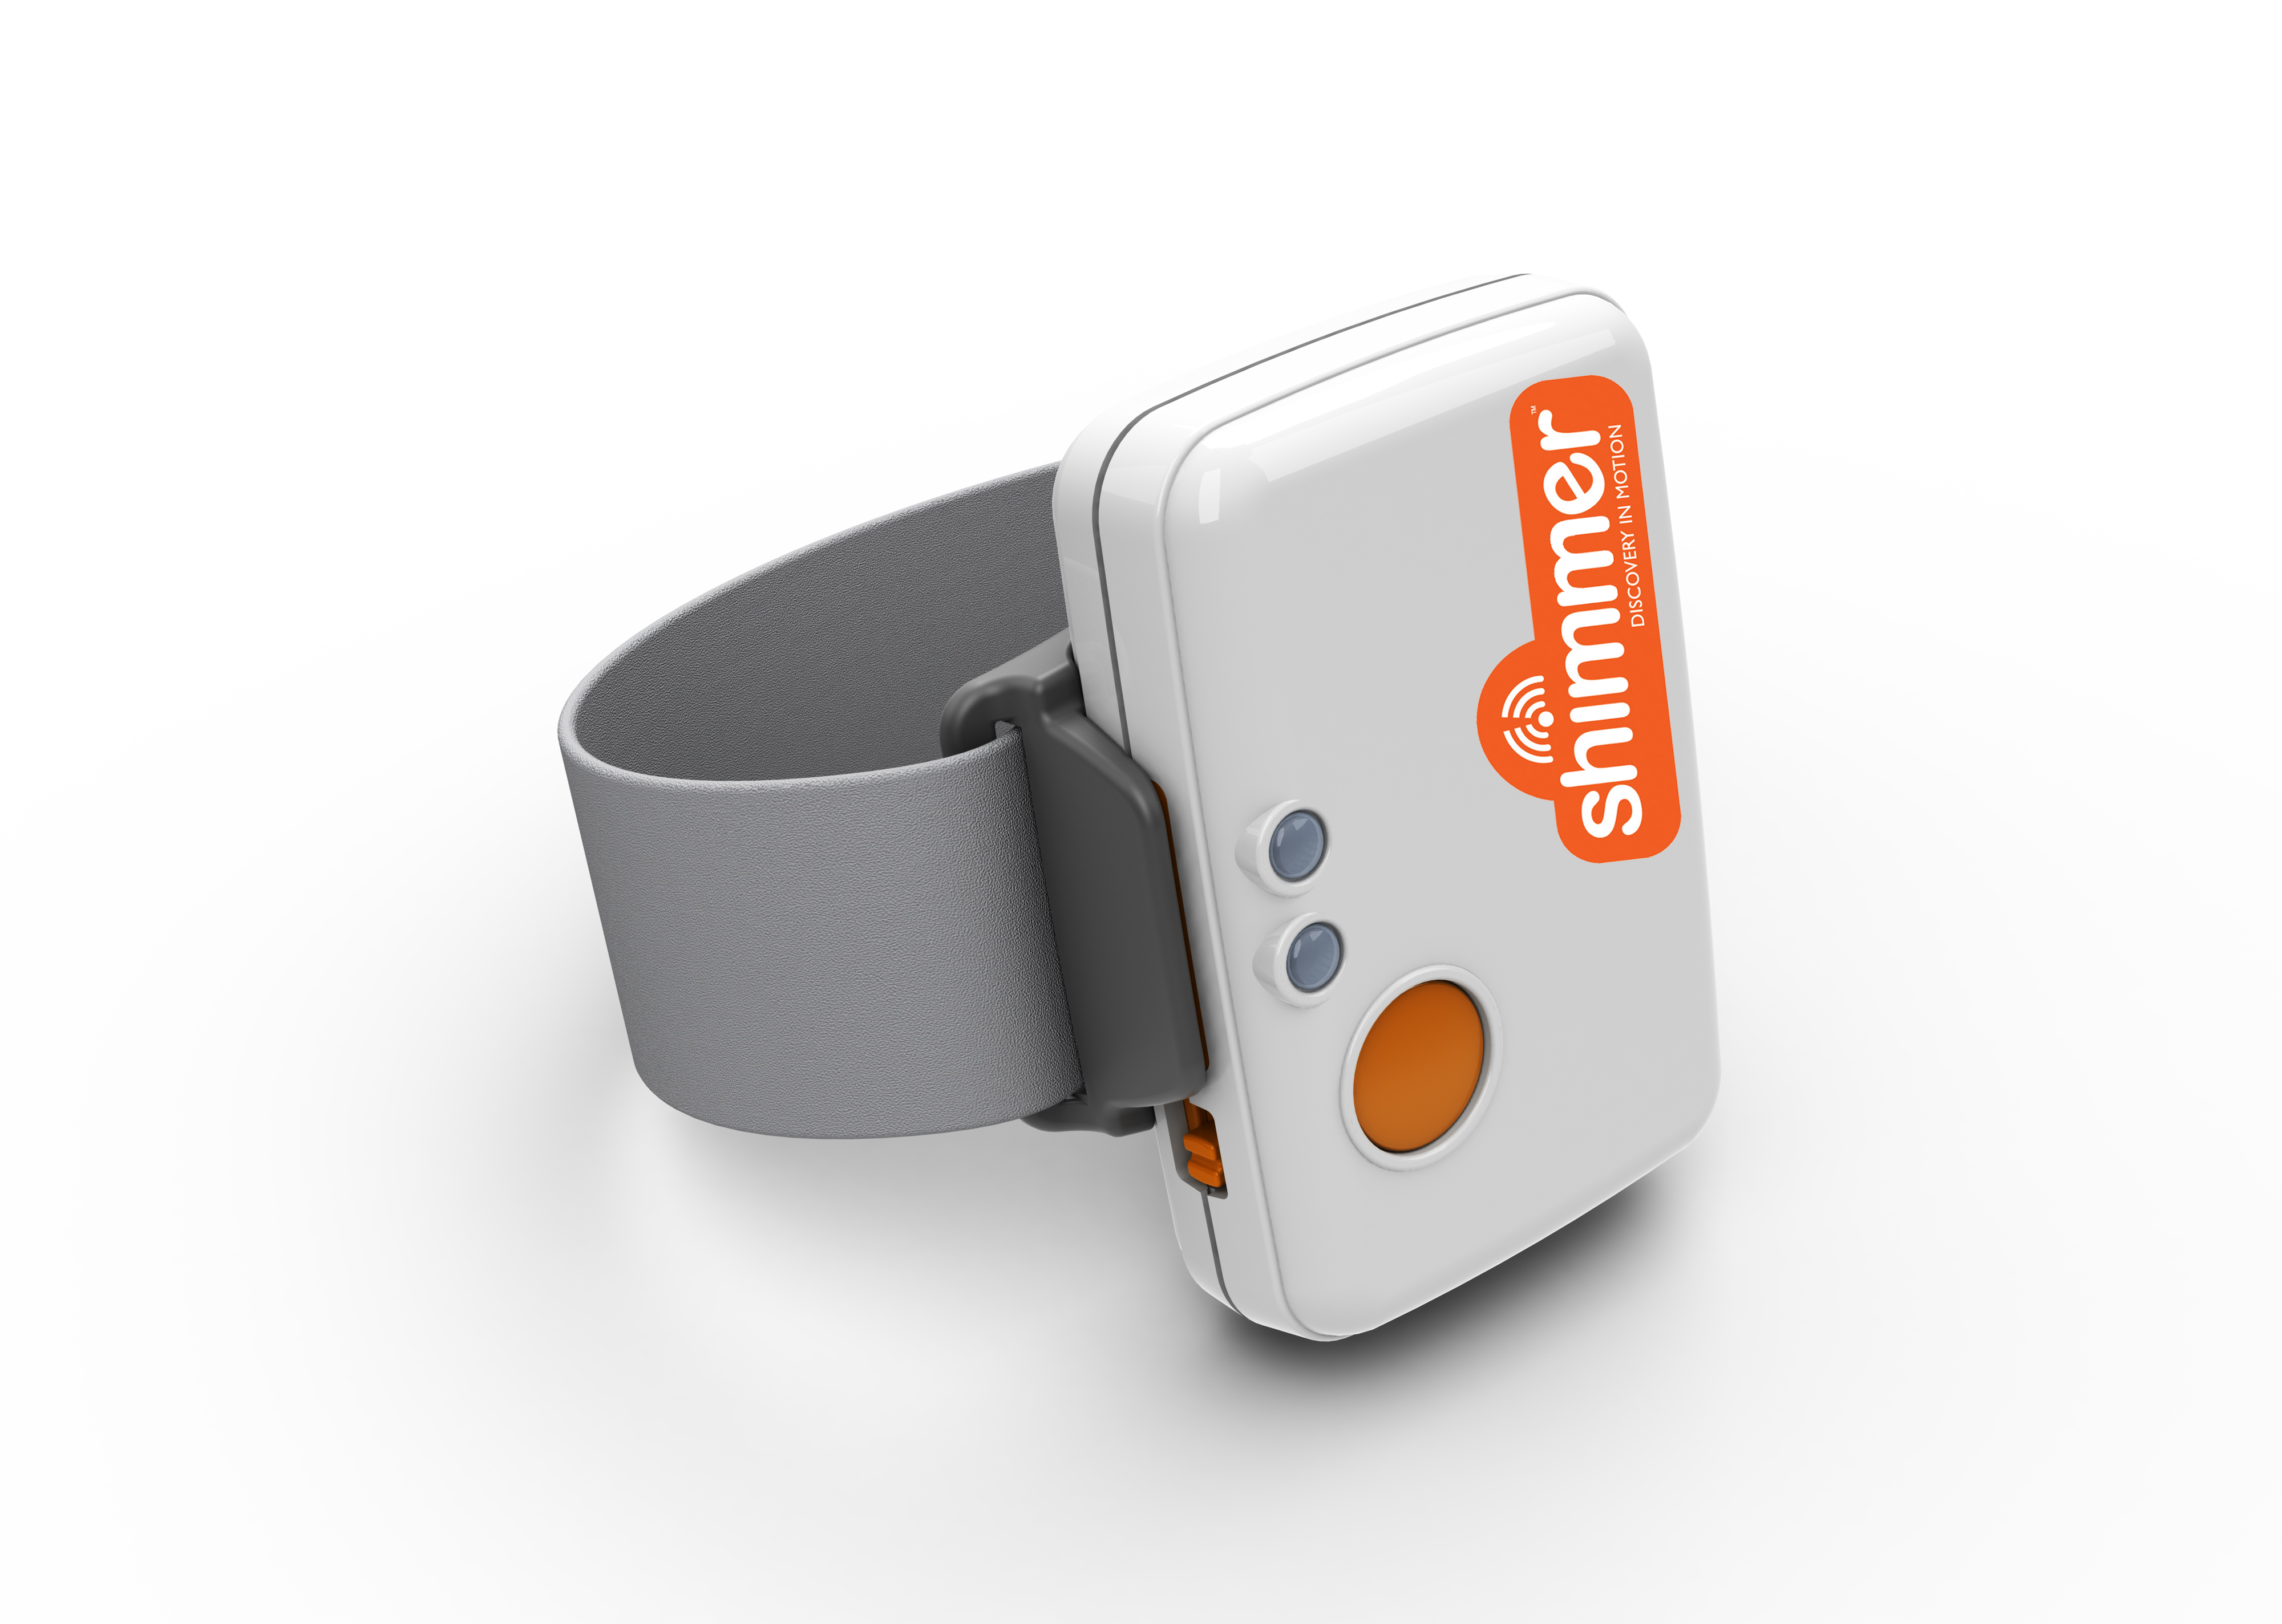
METHODS
Datasets
Clemson All Day (CAD) dataset
354 days of free-living wrist motion data collected from 351 different people (approximately one day per person)
Multiday dataset
Approximately 10-14 days of wrist motion data collected from eight subjects
Both datasets collected using Shimmer3 IMU device
Six total axes of data recorded at 15 Hz
Accelerometer, gyroscope
Ground truth recorded manually using button presses on Shimmer3

Slide 14
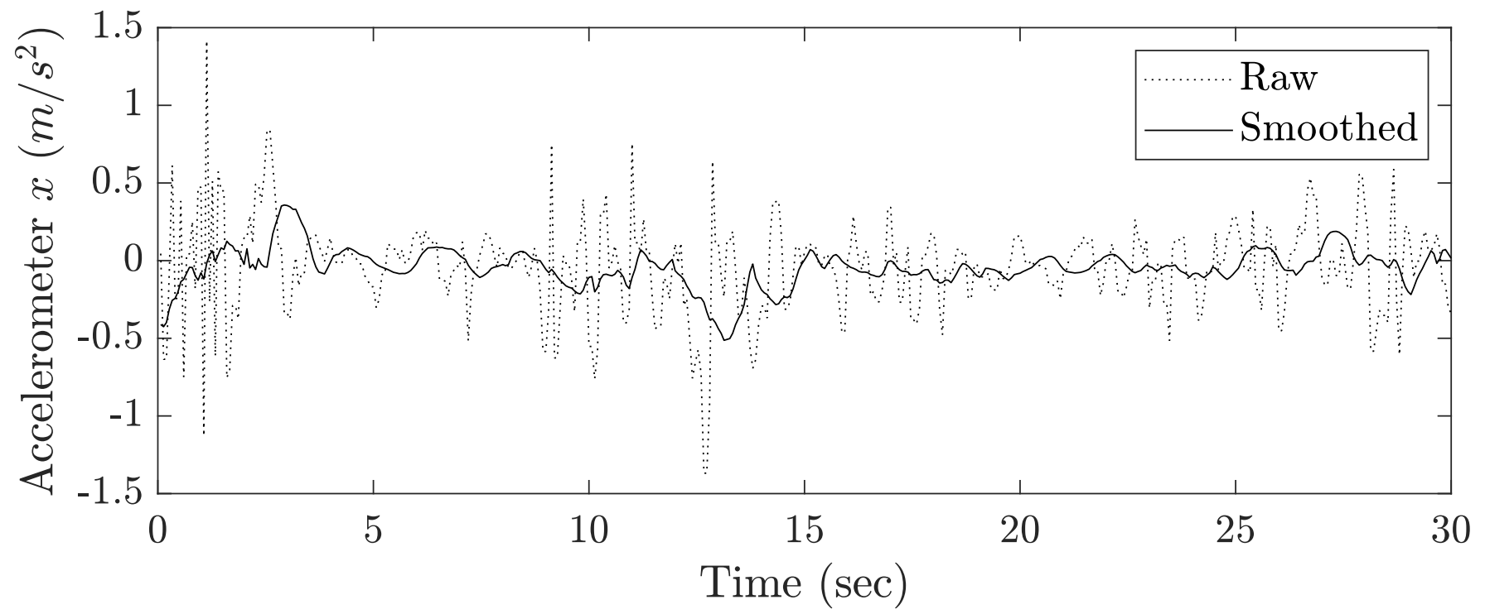
METHODS
Data Pre-Processing: Smoothing
IMU data prone to noise
Smooth using Gaussian filter
Smooth each axis independently
Gaussian window of 15 points (corresponds to one second)

Slide 15
METHODS
Data Pre-Processing: Normalization
Accelerometer and gyroscope readings have different ranges of values
Accelerometer measured in m/s²
Gyroscope measured in deg/sec
Use Z-score normalization
Rescales each axis to have zero mean and unit variance
$$z=\frac{x−µ}{σ}$$

Slide 16
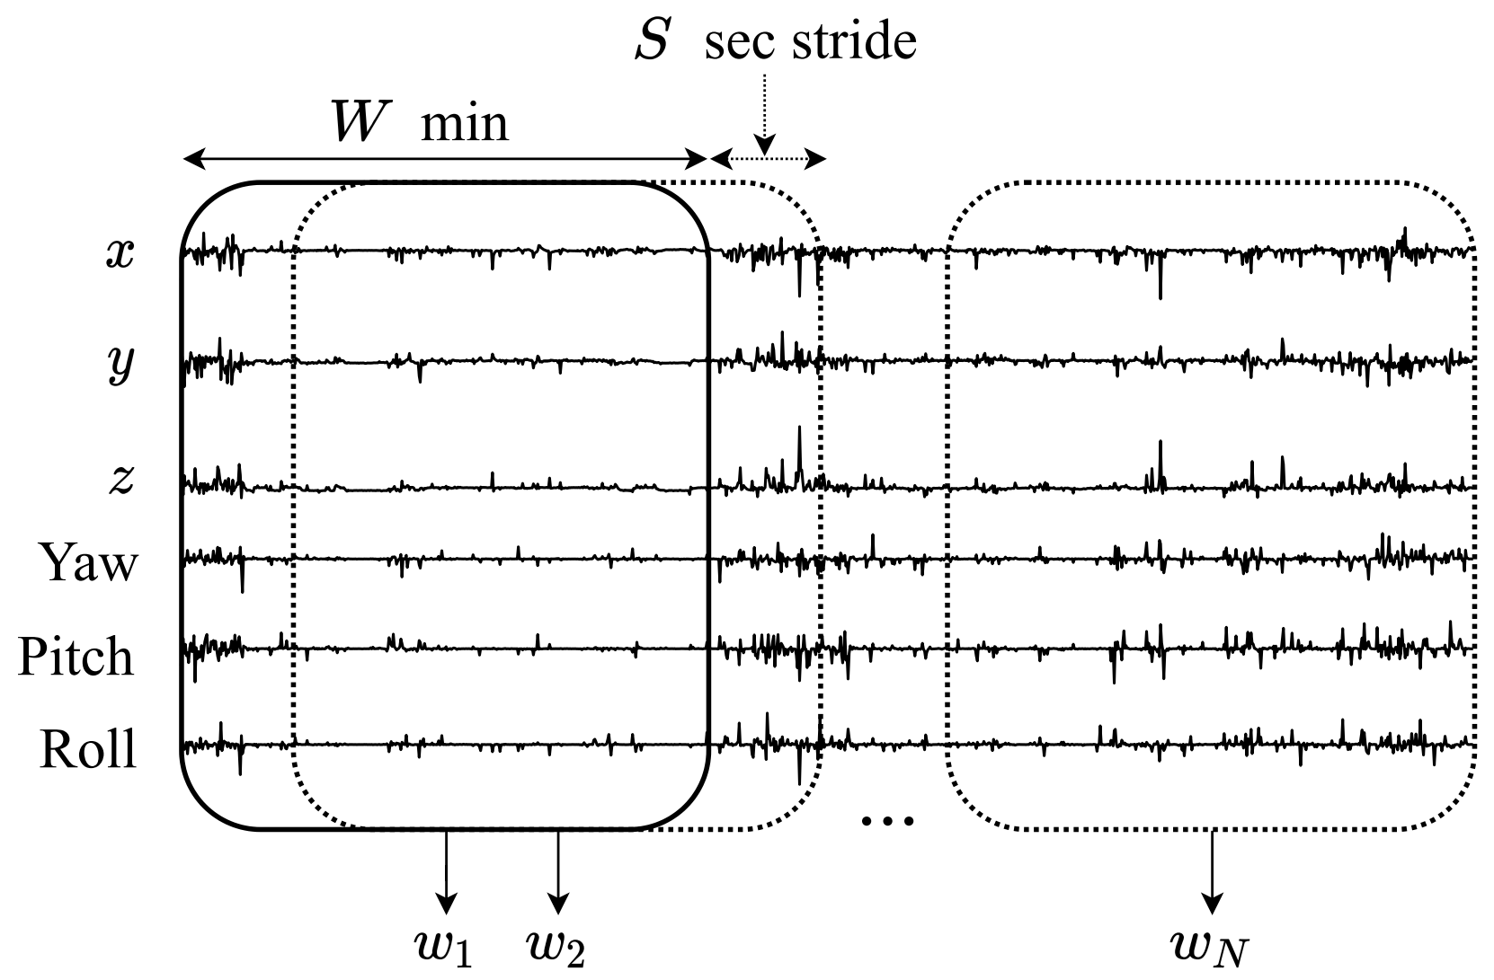
METHODS
Data Pre-Processing: Sliding Window & Data Imbalance
Generate samples using sliding window
W = 6 minutes
Stride S = 15 seconds
Label entire window using majority label for all points within window
1 = eating
0 = non-eating
Undersample non-eating samples to balance labels for training

Slide 17
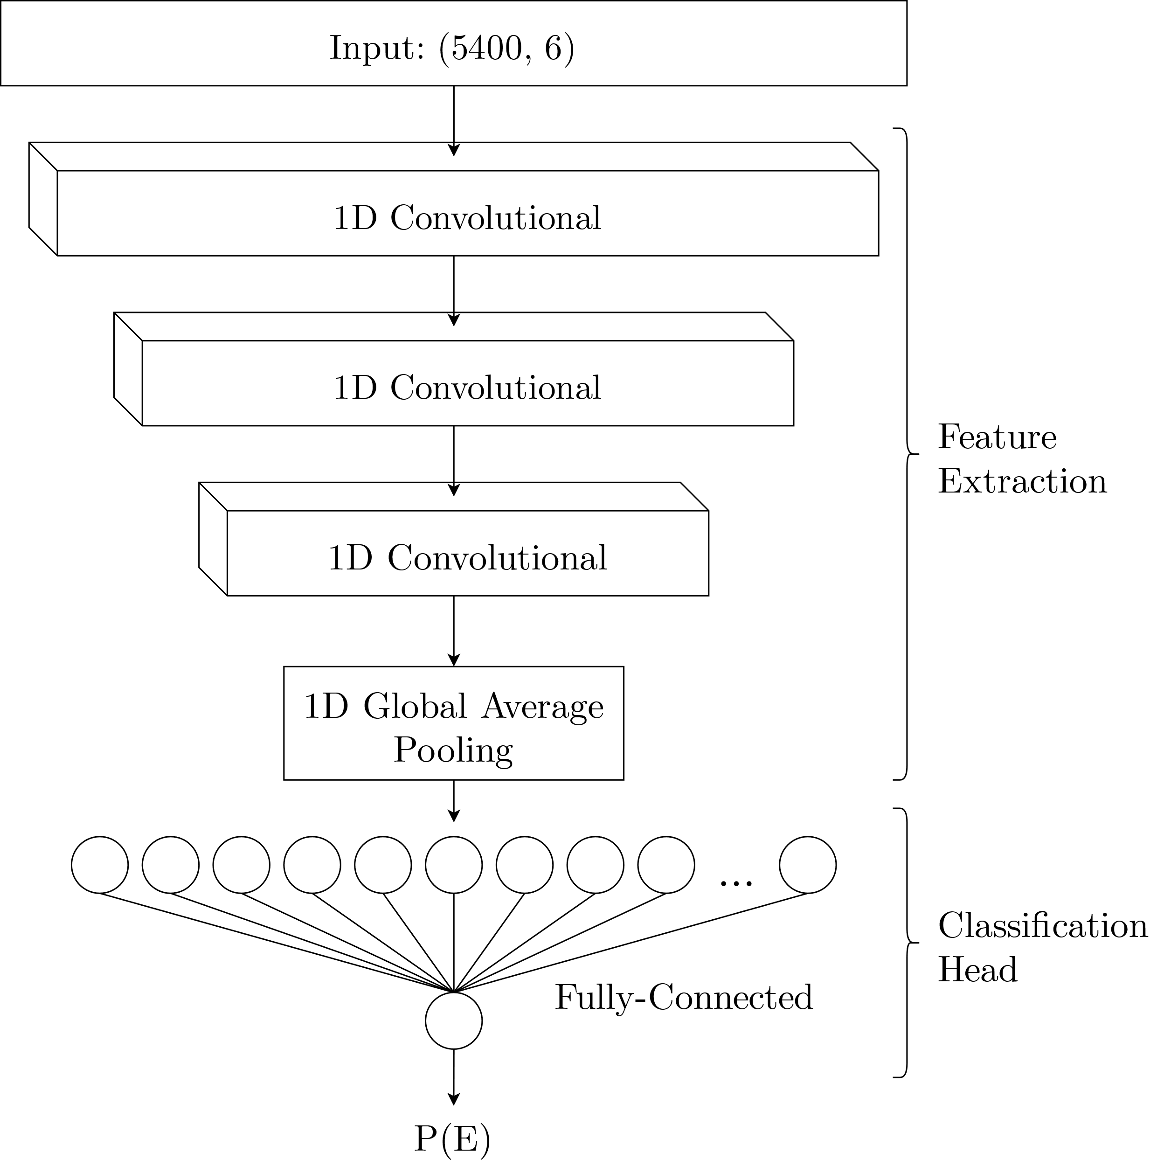
METHODS
Network Architecture
Three 1D convolutional layers
Each subsequent convolutional layer learns more specific features
1D Global average pooling
2 Fully-connected layers
Final output: probability of eating P(E) for input window

Slide 18
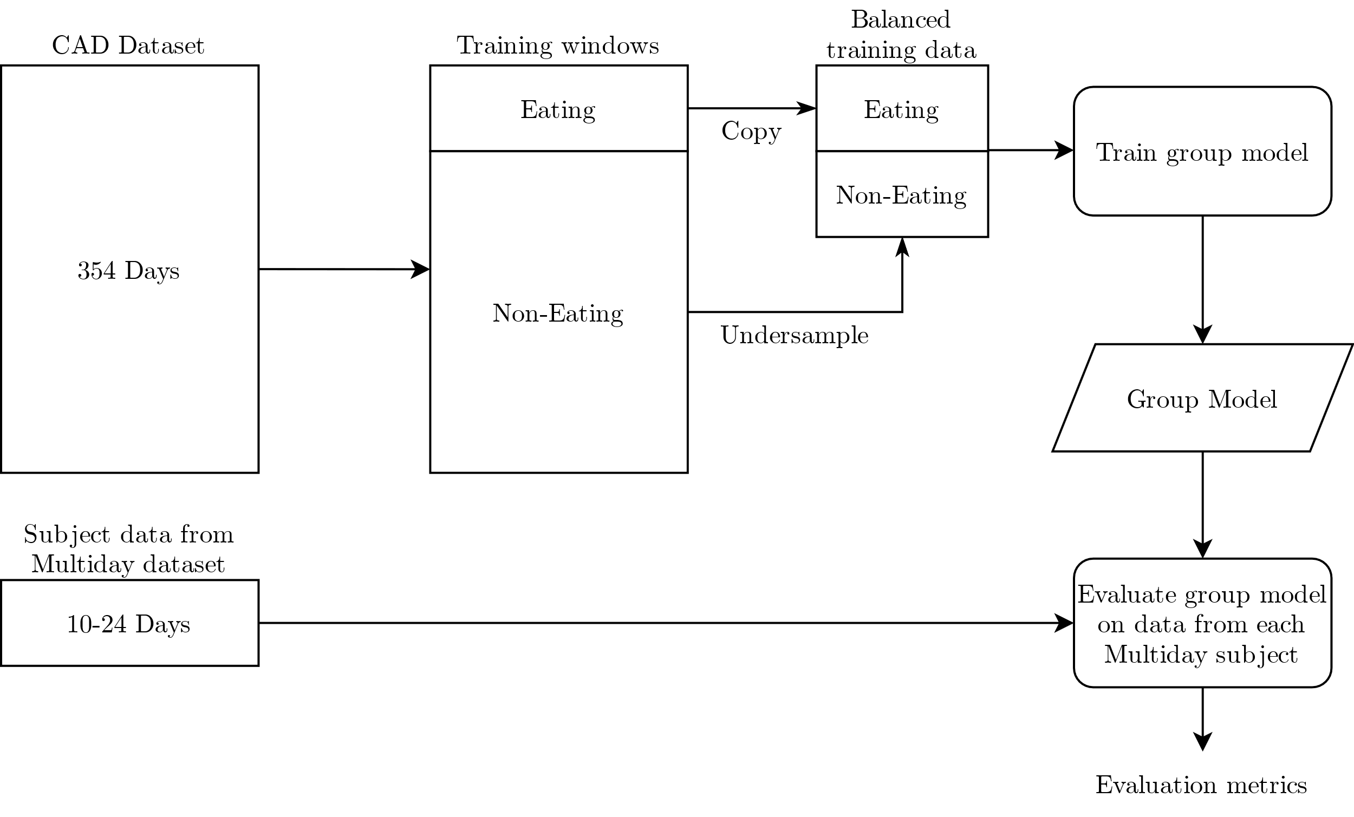
METHODS
Network Training: Group Model

Slide 19
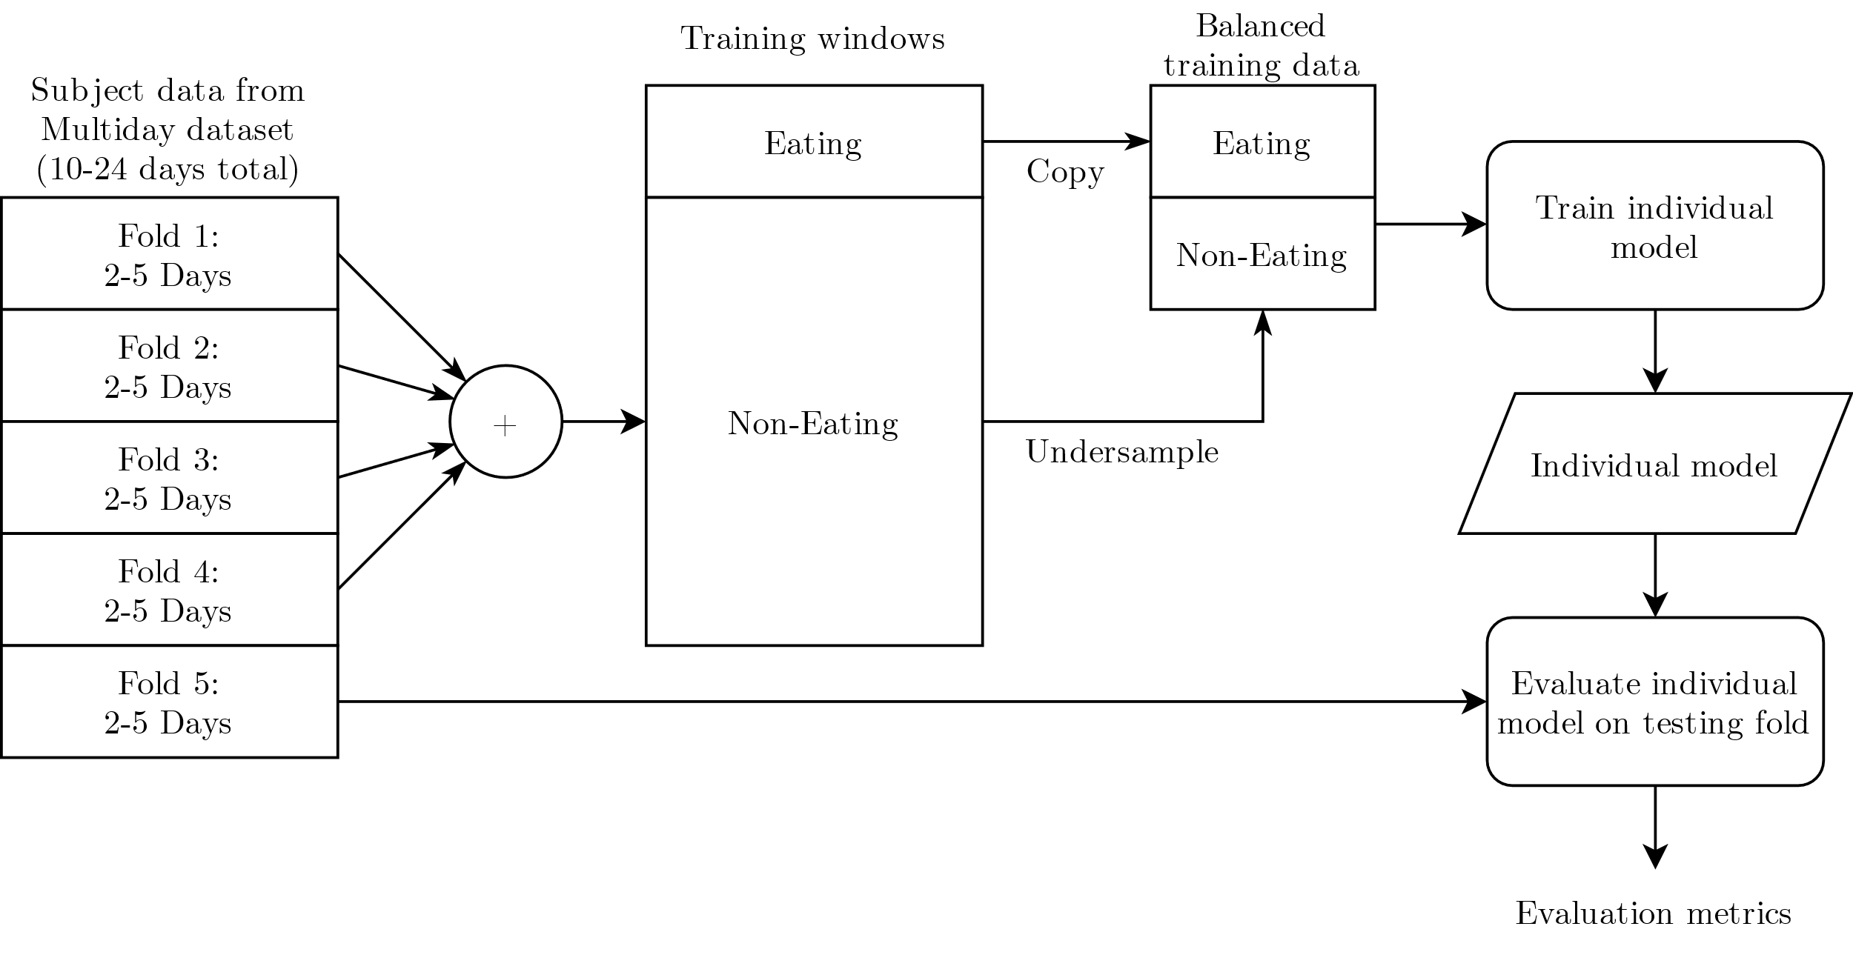
METHODS
Network Training: Individual Models

Slide 20
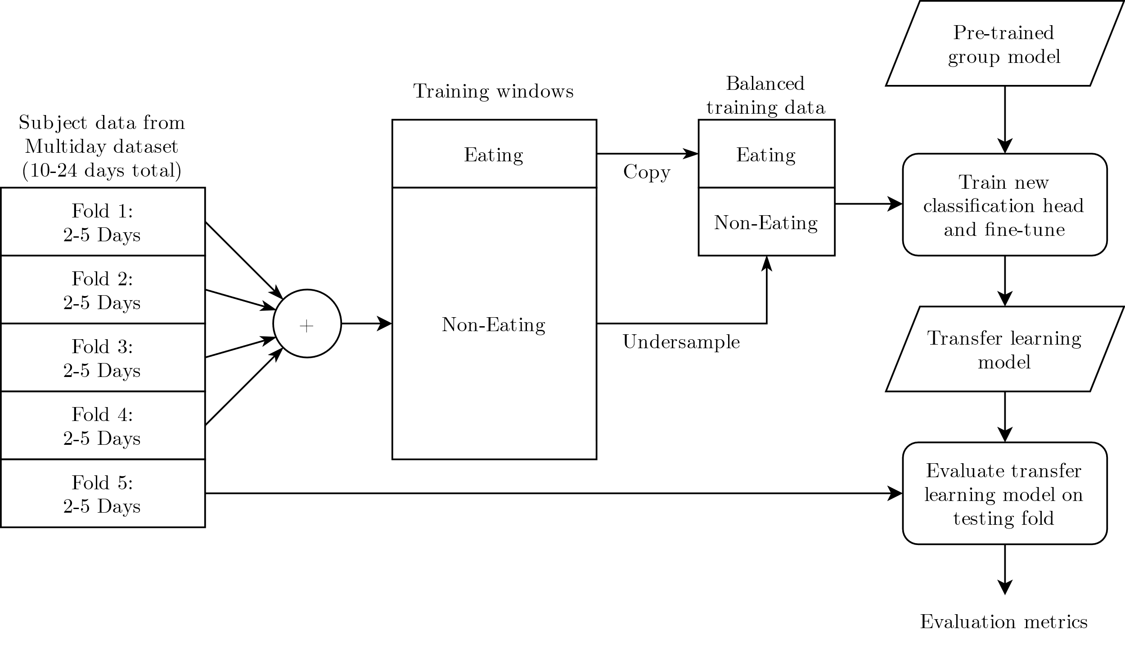
METHODS
Network Training: Transfer Learning Models

Slide 21
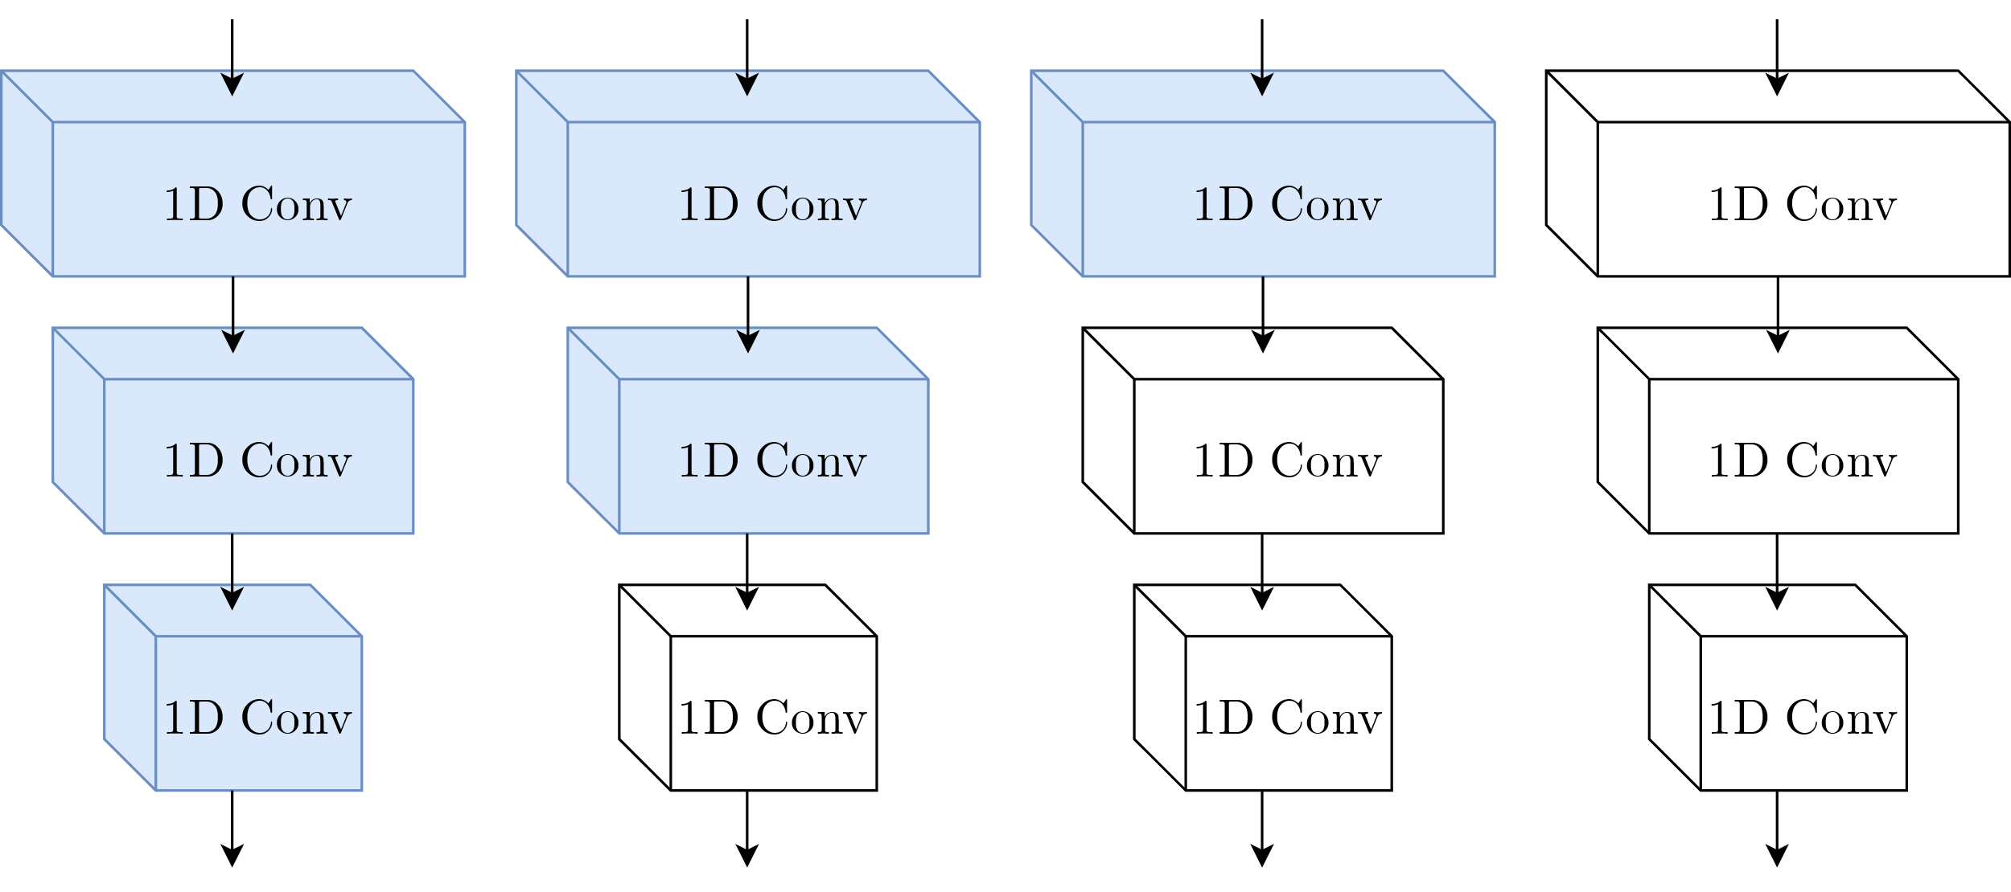
METHODS
Network Training: Transfer Learning Models
Fine-Tune 0
Layers
Fine-Tune 1
Layer
Fine-Tune 2
Layers
Fine-Tune 3
Layers

Slide 22
METHODS
Post-Processing
Evaluate on full days of data
Use sliding window to produce sequence of P(E) values throughout the day
Use two thresholds T_{S} and T_{E} to detect meals

Slide 23
METHODS
Evaluation Metrics: Time Metrics
Weighted Accuracy:
$${\text{Acc}}_{\text{W}}=\frac{W×\text{TP}+\text{TN}}{W×\text{(}\text{TP}\text{+}\text{FN}\text{)}+\text{(}\text{TN}\text{+}\text{FP}\text{)}}$$

Slide 24
METHODS
Evaluation Metrics: Episode Metrics
True Positive Rate (TPR):
False Positive per True Positive (FP/TP)
$$\text{TPR}=\frac{\text{TP}}{\text{TP}+\text{FN}}$$
$$\text{FP}\text{/}\text{TP}=\frac{\text{F}\text{P}}{\text{TP}}$$

Slide 25
METHODS
Evaluation Metrics: Model Volatility
Results can vary between runs for the same model
Choice of non-eating samples
Choice of folds during cross validation
Recent replications of the group experiment showed multiple runs are needed to estimate average performance
Run each model 30 times for more accurate results

Slide 26
Outline
Introduction
Methods
Results
Fine-Tuning Transfer Learning Model Layers
Group vs. Individual vs. Transfer Learning
Per Subject Variability
Model Volatility
Conclusion

Slide 27
RESULTS
Fine-Tuning Transfer Learning Model Layers
Weighted accuracy and TPR both increase as more layers are fine-tuned
Biggest increasing when fine-tuning the second layer
FP/TP increases only slightly when using any amount of fine-tuning
Training the classification head takes up the majority of training time
Overall training times were low, therefore fine-tuning all layers was optimal
Fine-Tuned Layers | Acc_{W} (%) | TPR (%) | FP/TP
0 | 73 | 63 | 1.20
1 | 75 | 69 | 1.42
2 | 80 | 80 | 1.43
3 | 80 | 81 | 1.40
Fine-Tuned Layers | Training Time (s)
0 | 53.4
1 | 70.9
2 | 72.4
3 | 86.6

Slide 28
RESULTS
Group vs. Individual vs. Transfer Learning
Individual model was able to beat the group model in both weighted accuracy and TPR, but showed a much higher FP/TP
Overall results of transfer learning model relative to individual model:
1% decrease in weighted accuracy
6% decrease in TPR
43% improvement in FP/TP
Individual model trained in 98.9 s
12% decrease in training times when using transfer learning
Model | Acc_{W} (%) | TPR (%) | FP/TP
Group | 73 | 64 | 1.39
Individual | 81 | 87 | 2.45
Transfer | 80 | 81 | 1.40

Slide 29
RESULTS
Group Model
Individual Model
Transfer Learning Model

Slide 30
RESULTS
Group Model
Individual Model
Transfer Learning Model

Slide 31
RESULTS
Per Subject Variability: Time Metrics
Transfer learning model performed better than individual model in weighted accuracy for most subjects
Only subject 003 and 004 did not achieve a higher weighted accuracy with transfer learning model
Examined subject 003’s data manually
Short recordings
Quick, infrequent meals
Errors with ground truth
Subject | Acc_{W} (%)
 | Group | Individual | Transfer
001 | 82 | 90 | 90
002 | 90 | 93 | 94
003 | 54 | 71 | 62
004 | 60 | 75 | 74
005 | 83 | 82 | 83
006 | 63 | 82 | 83
007 | 73 | 67 | 69
008 | 77 | 89 | 89

Slide 32
RESULTS
Per Subject Variability: Episode Metrics
Subject | TPR (%) |  |  | FP/TP
 | Group | Individual | Transfer | Group | Individual | Transfer
001 | 80 | 98 | 94 | 1.73 | 0.95 | 0.40
002 | 87 | 89 | 93 | 0.14 | 0.88 | 0.29
003 | 12 | 76 | 42 | 0.67 | 2.38 | 1.81
004 | 38 | 85 | 72 | 0.17 | 2.72 | 1.45
005 | 75 | 78 | 77 | 2.10 | 3.66 | 1.82
006 | 48 | 97 | 96 | 0.44 | 2.99 | 2.01
007 | 89 | 80 | 76 | 4.16 | 4.70 | 2.15
008 | 81 | 92 | 96 | 0.67 | 1.30 | 1.30

Slide 33
RESULTS
Per Subject Variability
Model | Acc_{W} (%) | TPR (%) | FP/TP
Group | 73 | 64 | 1.39
Individual | 81 | 87 | 2.45
Transfer | 80 | 81 | 1.40
Removed outlier in subject 003 and recalculated averages
Transfer learning model now shows highest weighted accuracy of 83% and ties for the lowest FP/TP with group model
Overall results relative to individual model:
1% improvement in weighted accuracy
3% decrease in TPR
46% improvement in FP/TP
Model | Acc_{W} (%) | TPR (%) | FP/TP
Group | 75 | 71 | 1.34
Individual | 82 | 89 | 2.46
Transfer | 83 | 86 | 1.34

Slide 34
RESULTS
Model Volatility
Determine model volatility using standard deviations over 30 runs
Group model shows highest volatility in all metrics
Using fine-tuning, transfer learning model is able to reduce volatility compared to group model
Model | Acc_{W} (%) | TPR (%) | FP/TP
Group | ±3 | ±6 | ±0.66
Individual | ±1 | ±3 | ±0.33
Transfer | ±1 | ±4 | ±0.28

Slide 35
RESULTS
Model Volatility: Comparison to Previous Work
Compare averages to previous work (Wei 2021)
Results of previous work within a few standard deviations, but not close to averages
Important to train multiple times
 | Acc_{W} (%) |  | TPR (%) | FP/TP | FP/TP
 | Group | Individual | Group | Individual | Group | Individual
Previous Work | 78 | 82 | 74 | 80 | 1.53 | 1.75
30 Trial Results | 73 ± 3 | 81 ± 1 | 64 ± 6 | 87 ± 3 | 1.39 ± 0.66 | 2.45 ± 0.33

Slide 36
Outline
Introduction
Methods
Results
Conclusion
Limitations
Future Work

Slide 37
CONCLUSION
Conclusion
Can transfer learning be employed to increase the performance of individualized eating detection models by utilizing features learned from a group model?
On average, the transfer learning model showed a slightly lower weighted accuracy and TPR compared to the individual model, however, it achieved a 43% improvement in FP/TP
How much performance can be gained? Does this gain vary depending on the individual?
For most subjects in the Multiday dataset, the transfer learning model showed the highest overall weighted accuracy; however, there was an outlier in subject 003.
After removing outlier, the transfer learning model showed the highest weighted accuracy (83%) and tied for the lowest FP/TP of 1.34, which was a 46% improvement compared to the individual model.
Can transfer learning speed up the training process of individualized models?
Yes. On average the transfer learning model was able to train 12% faster. More speedup could be gained by fine-tuning less layers.

Slide 38
CONCLUSION
Limitations
Requires a group dataset
Time-consuming and expensive to collect
Transfer learning better for established datasets
Data limitations
Only one group dataset collected from 351 people
Multiday dataset was collected from eight individuals

Slide 39
CONCLUSION
Future Work
Test to see how many individual days are needed to train an accurate transfer learning model
Find ways to limit model volatility
Examine tuning hyperparameters (window size, hysteresis thresholds) to improve individualized models even further
Examine different network architectures such as RNNs

Slide 40
Questions

Slide 41
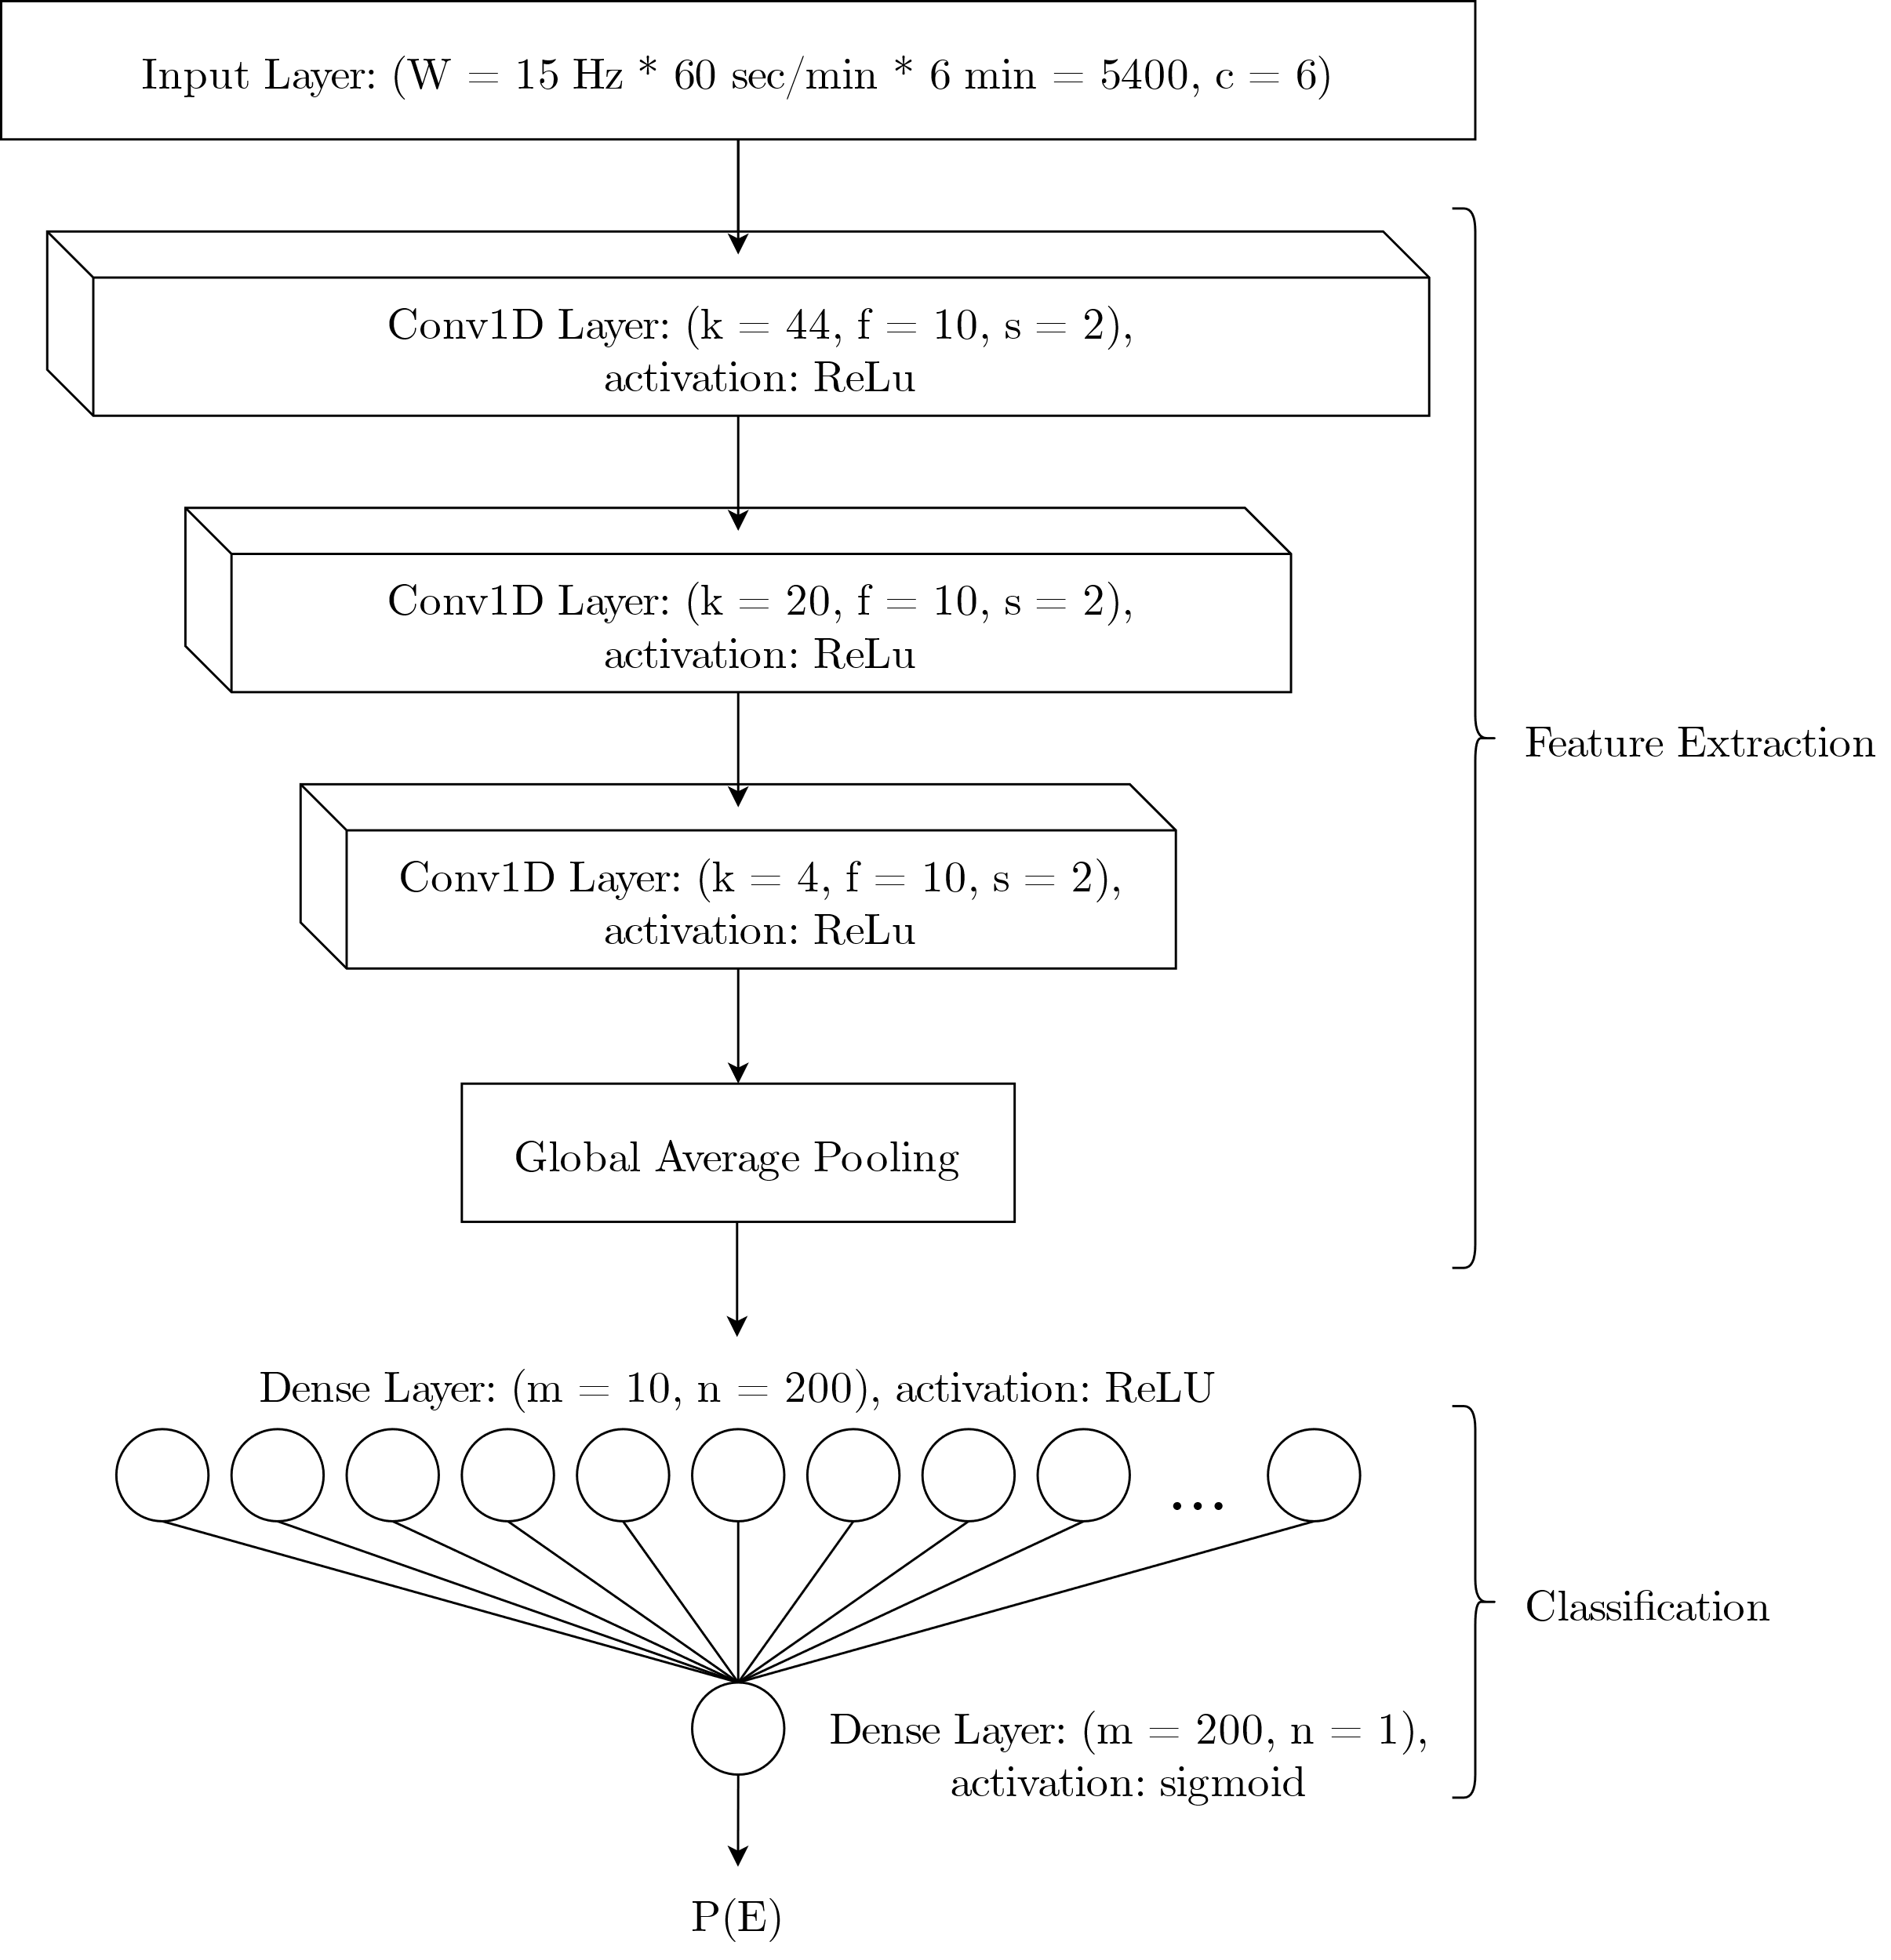
METHODS
Network Architecture

Slide 42
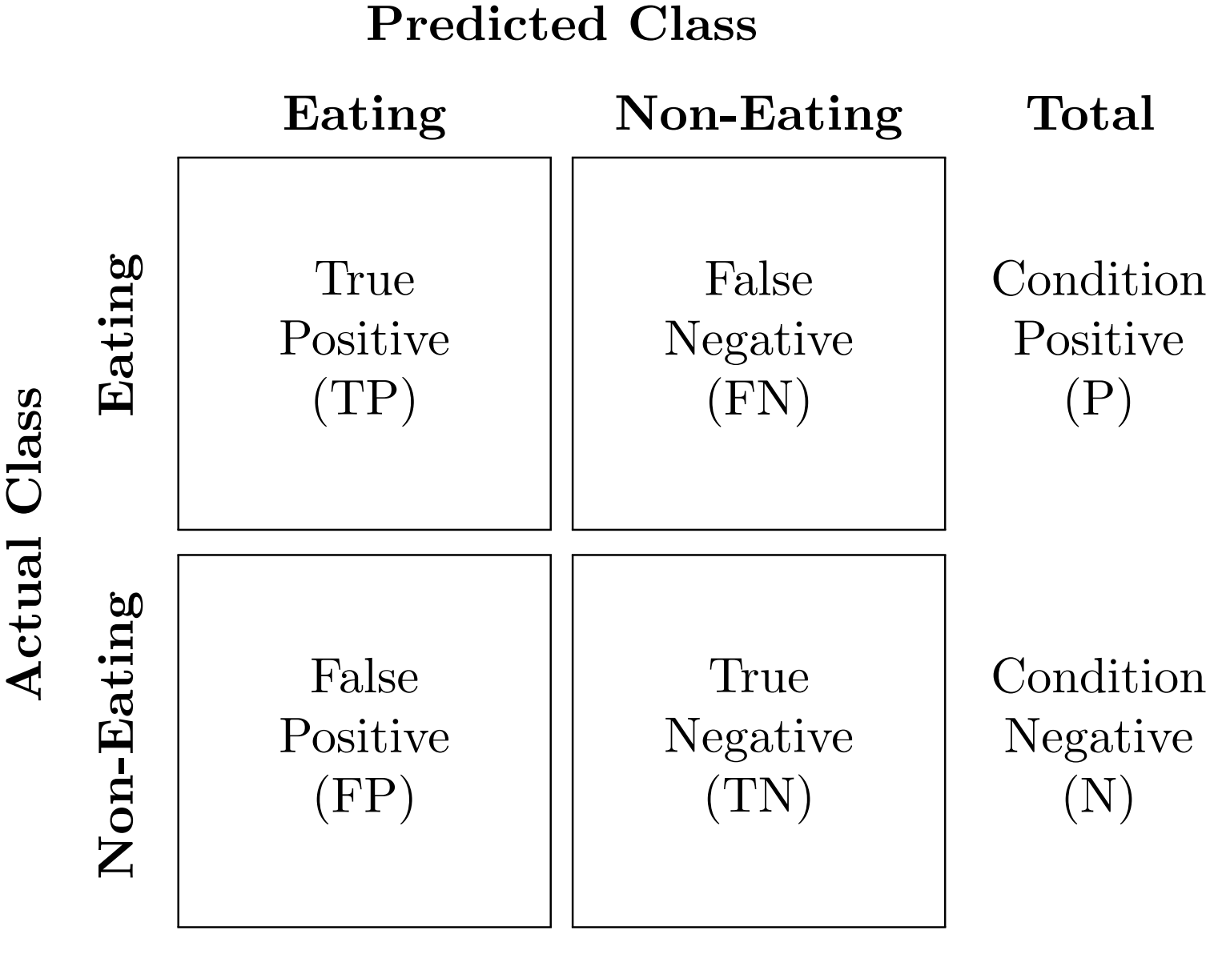
METHODS
Evaluation Metrics
Evaluate using both time metrics and episode metrics
Time metrics compare ground truth to detections at every time point
Episode metrics compare full detection segments to ground truth segments
Both metrics use standard confusion matrix outcomes
Episode metrics don’t use TN

Slide 43
RESULTS
Per Subject Variability: Time Metrics
Subject | Acc_{W} (%)
 | Group | Individual | Transfer
001 | 82 | 89.9 | 90.3
002 | 90 | 93 | 94
003 | 54 | 71 | 62
004 | 60 | 75 | 74
005 | 82.7 | 82 | 83.0
006 | 63 | 82 | 83
007 | 73 | 67 | 69
008 | 77 | 88.8 | 89.1

