Slide 1
A study of
the regularity of autocorrelation of manipulation
of wrist motion during eating
Xueting Yu
Dr. Adam Hoover (chair)
Dr. Richard Groff
Dr. Eric Muth
December 2, 2014

Slide 2
Obesity
[common]
34.9% of U.S population is obese
[serious]
A leading preventable cause of death
[costly]
$147 billion annual medical cost

Slide 3
Obesity
[common]
34.9% of U.S population is obese
[serious]
A leading preventable cause of death
[costly]
$147 billion annual medical cost
Energy intake > Energy expenditure

Slide 4
3 Most common tools
Diary record
19%-41% error per day
24 hour recall
20%-50% food consumption
underreporting
Food frequency
questionnaire
NOT designed to produce measures of energy intake

Slide 5
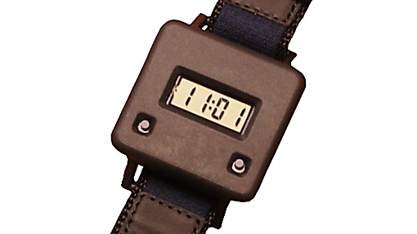
Bite counter
Watch-like device
Track wrist motion
Accelerometers and gyroscopes

Slide 6
Objective
Classification of eating activity (EA)
and non-eating activity (NonEA)
Based on features computed from
accelerometers and gyroscopes readings

Slide 7
Overview of algorithm
Data collection
New feature
Methods
Current work
New algorithm
Software tool
Evaluation metrics

Slide 8
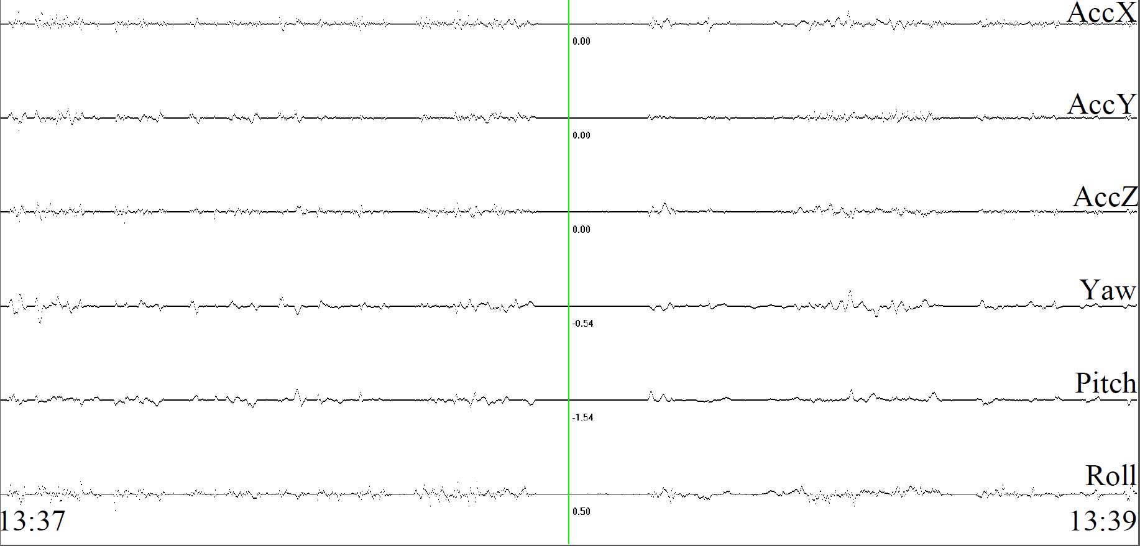
Raw data
Gaussian-weighted window
Notes:
Here is the raw sensor data over a period of 2 minutes
The raw sensor data is noisy
R sub t
S sub t
N
R

Slide 9
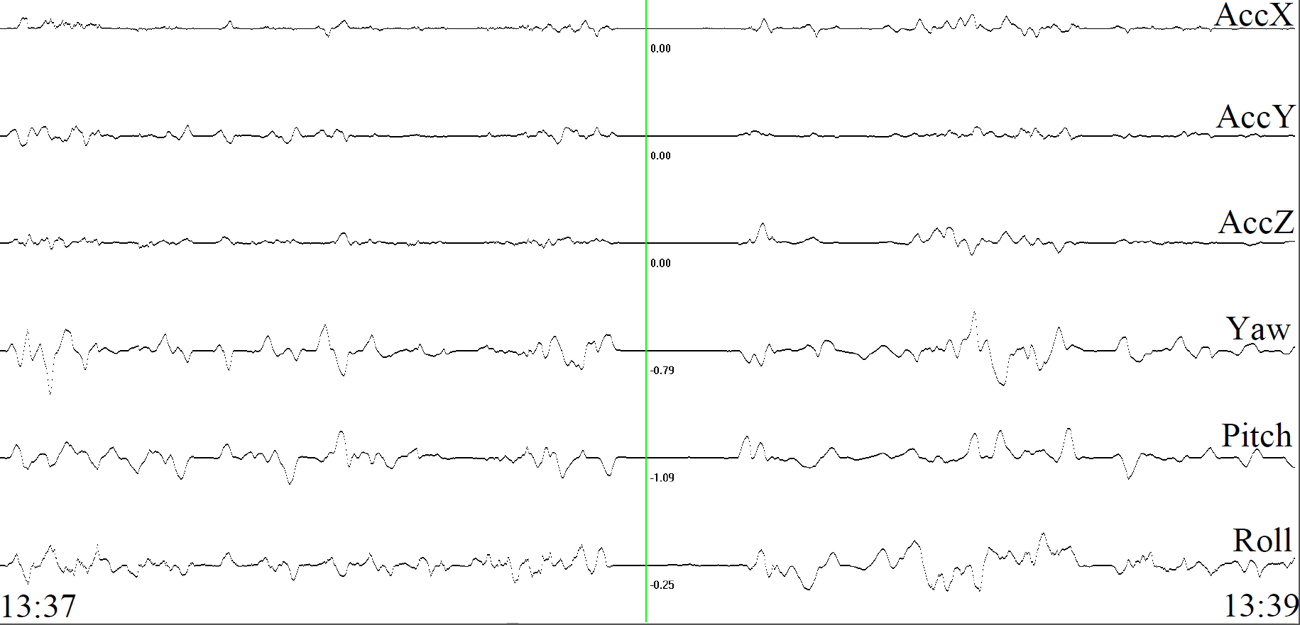
Smoothed data
Gaussian-weighted window

Slide 10
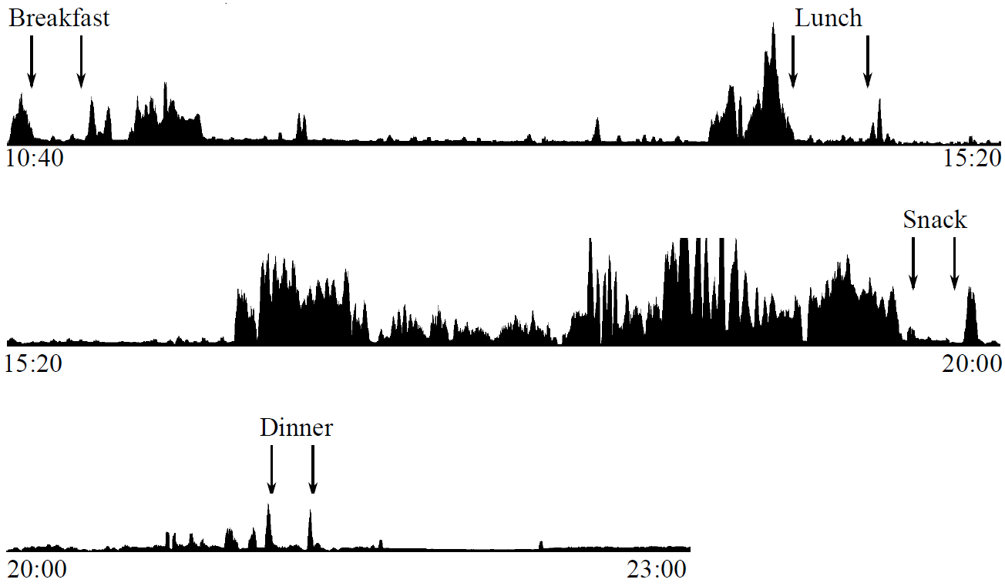
Segmenting data
Sum of acceleration
Notes:
Our group found that it tends to have a period of higher wrist motion energy
Prior to an meal and after the meal.
Here is an example of the wrist motion energy of a person for an entire day.
Meals are indicated as arrows, start and end time are manully logged by user.
S sub x
W

Slide 11
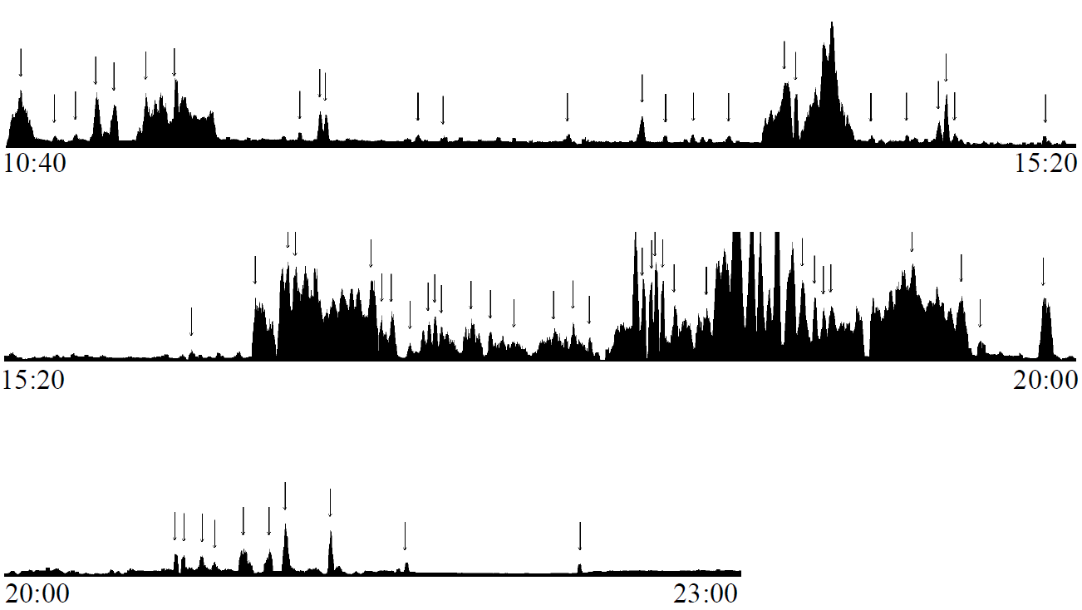
Segmenting data
Sum of acceleration
Peak-based segmentation

Slide 12
Segment features
Manipulation
Linear acceleration
Wrist roll motion
Regularity of wrist roll motion

Slide 13
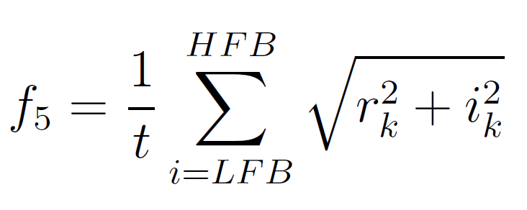
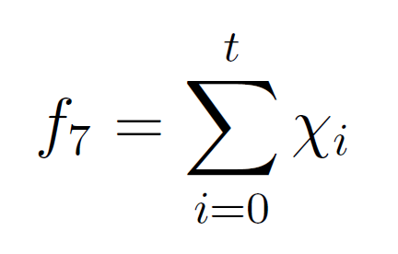
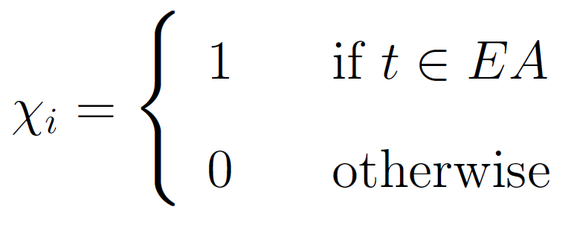
Segment features
Regularity of manipulation
Time since last EA
time-based
Cumulative eating time
,
time-based

Slide 14
Classifier
Naive Bayesian classifier
= EA
= NonEA
The probability of each feature given each class

Slide 15
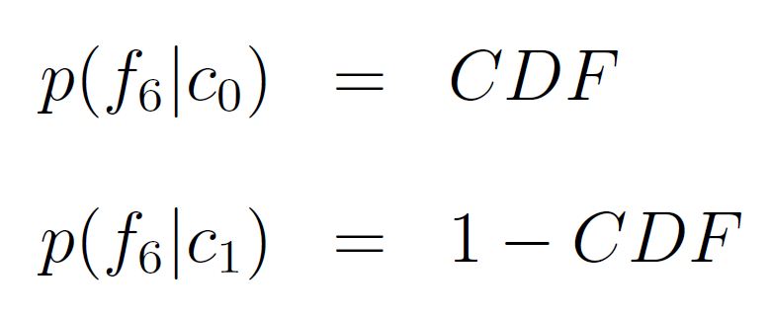
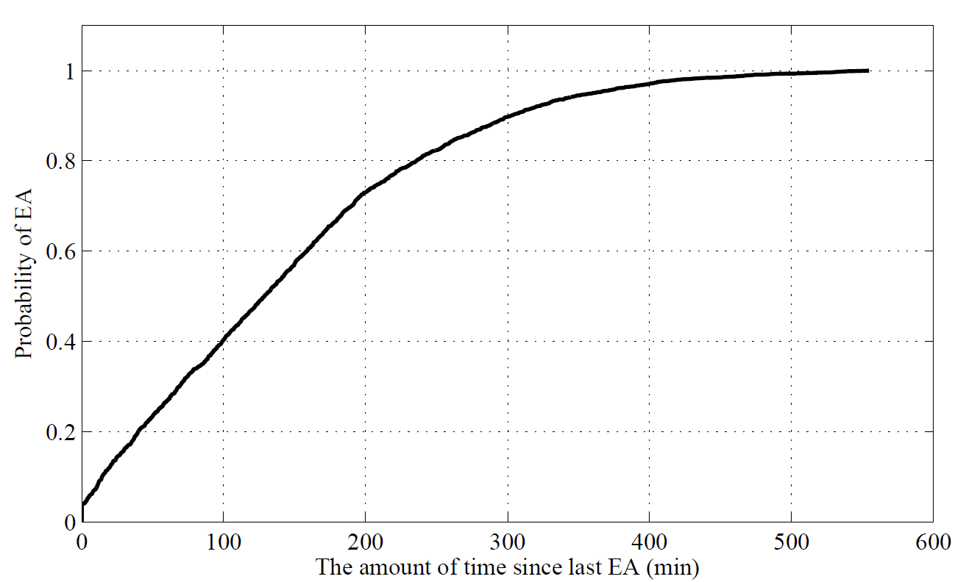
Segment features
= 0.9
= 1 – 0.9 = 0.1
0.9
CDF of time since last EA

Slide 16
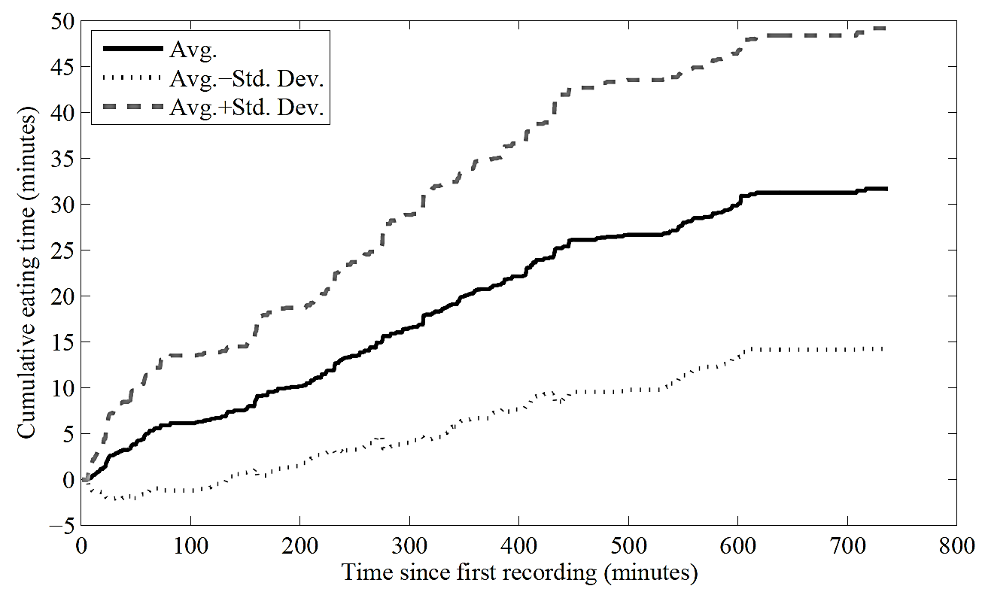
Segment features
≈ 17

Slide 17
Data collection
programmable
large memory and battery
accelerometer and gyroscope
Collect using iPhone 4
Record data at 15 Hz
Total 43 recordings
Total 449 hours data
Set 1 20 recordings
Set 2 23 recordings
Training data
EA whole period
NonEA 5 minutes segment

Slide 18
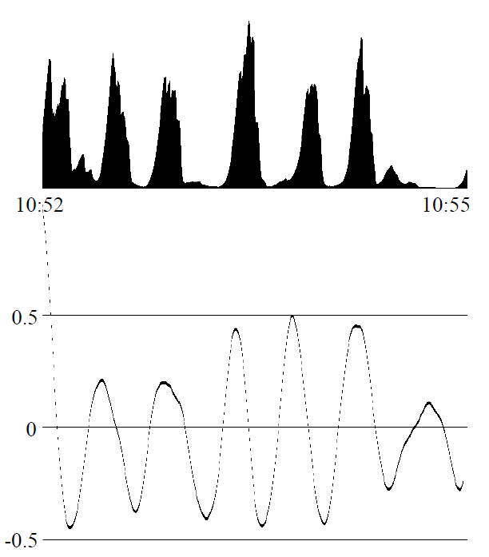
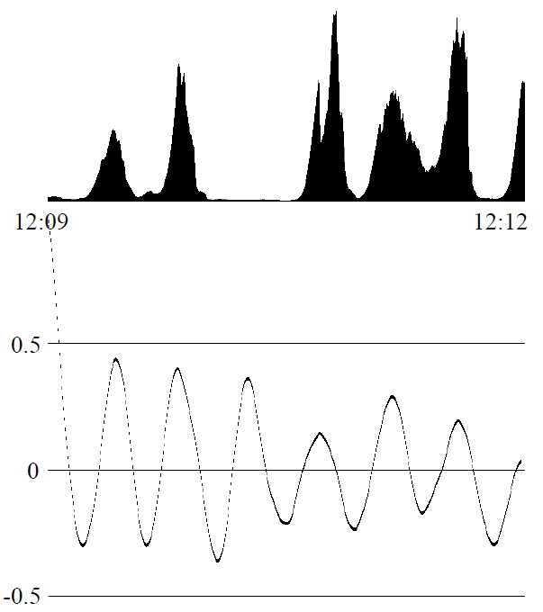
New feature
Regularity of autocorrelation of manipulation
manipulation
manipulation
autocorrelation
autocorrelation
Notes:
Regularity of manipulation, perform FFT on manipulation.
If input signal is purely combined by sinuosoidal signals, then FFT will perform really well.
However, manipulation is only regular (left), or even not regular(right)
After taking autocorrelation, the signal is much more suitable for frequency anylasis.

Slide 19
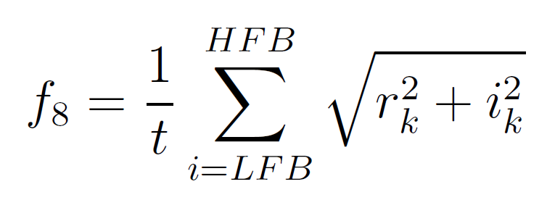
New feature
Regularity of autocorrelation of manipulation
Notes:
The autocorrelation is the correlation of signal with itself.
Acl sub k
N
W0
After perfom FFT

Slide 20
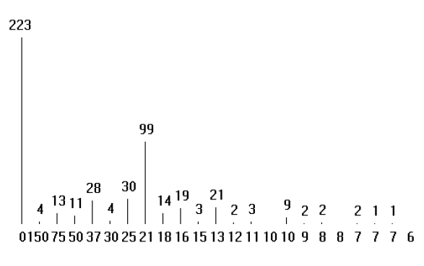
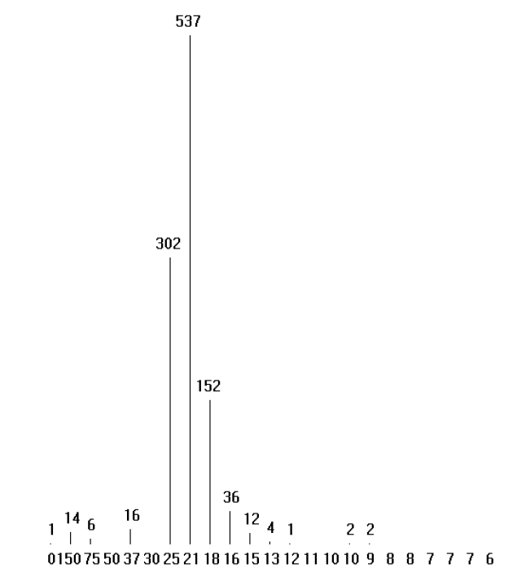
New feature
Regularity of autocorrelation of manipulation
FFT on manipulation
manipulation
FFT on autocorrelation
autocorrelation

Slide 21
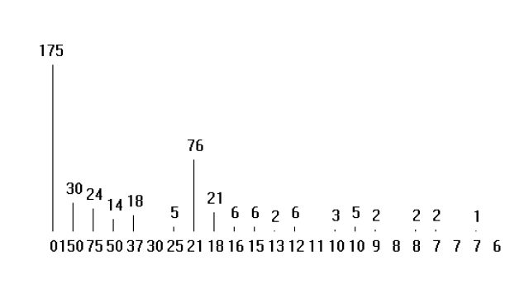
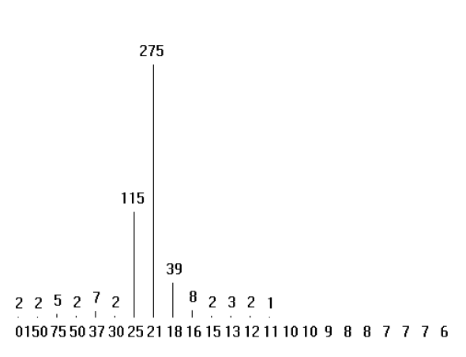
New feature
Regularity of autocorrelation of manipulation
FFT on manipulation
manipulation
FFT on autocorrelation
autocorrelation
Notes:
FFT of autocorrelation still has a well performance
Autocorrelation makes the frequency anylasis much more robust

Slide 22
New algorithm
Try every possible combination
Time since last EA
Real-time
NonEA
NonEA
EA
(EA)
= 0
Notes:
Ground truth EA

Slide 23
Segment features
CDF of time since last EA

Slide 24
New algorithm
Try every possible combination
Time since last EA
Real-time
Off-line
NonEA
NonEA
EA
NonEA
(EA)

Slide 25
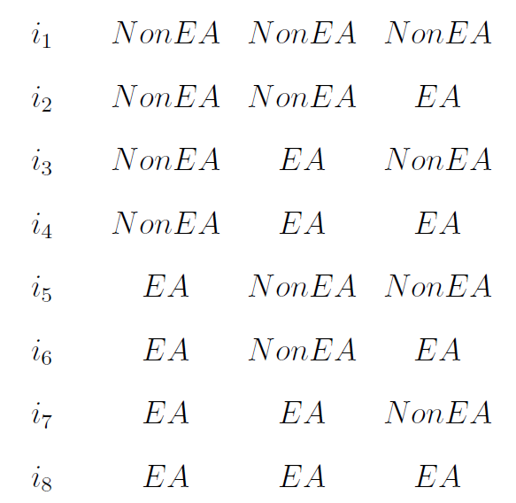
New algorithm
Try every possible combination
Assume segment number = 3

Slide 26
New algorithm
Try every possible combination
Average segment number is 67
Total possible combinations are $2^{67}≈1.5×{10}^{20}$

Slide 27
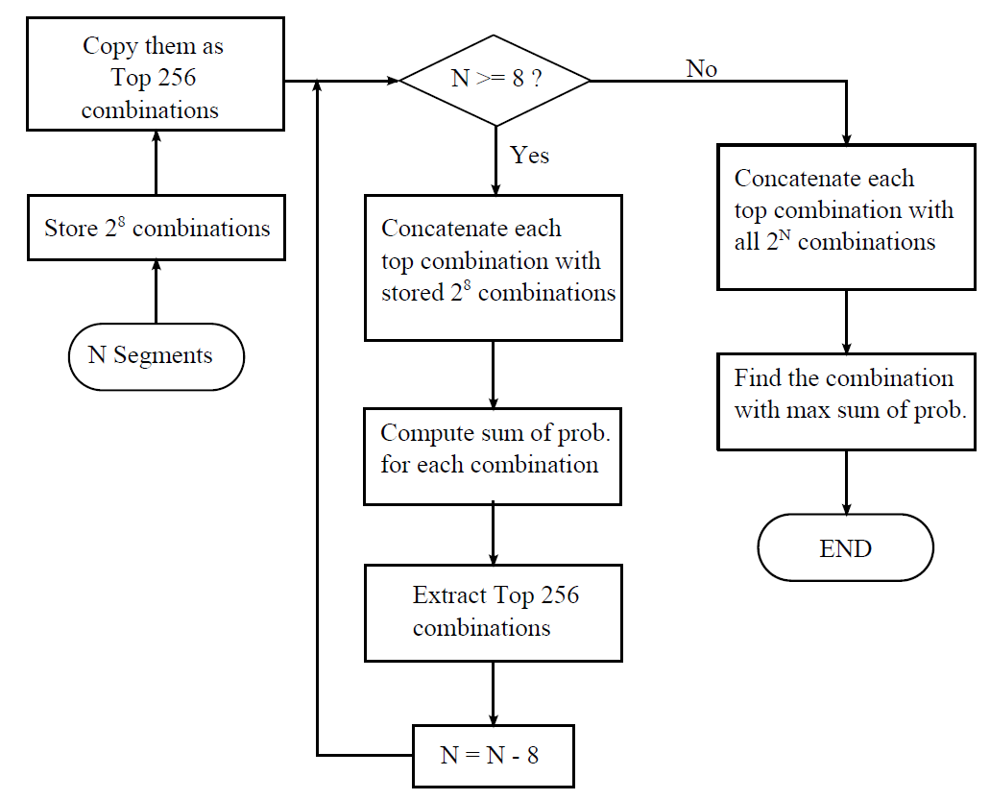
New algorithm
Try every possible combination
Total 256
Total 65536

Slide 28
Software tool
Demo

Slide 29
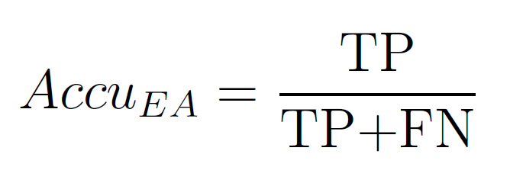
Evaluation metrics
Overall accuracy
Accuracy of EA
Accuracy of NonEA
TP: ground truth is EA, detected as EA
TN: ground truth is NonEA, detected as NonEA

Slide 30
Results
Original 4 features
Current work
New feature
New algorithm

Slide 31
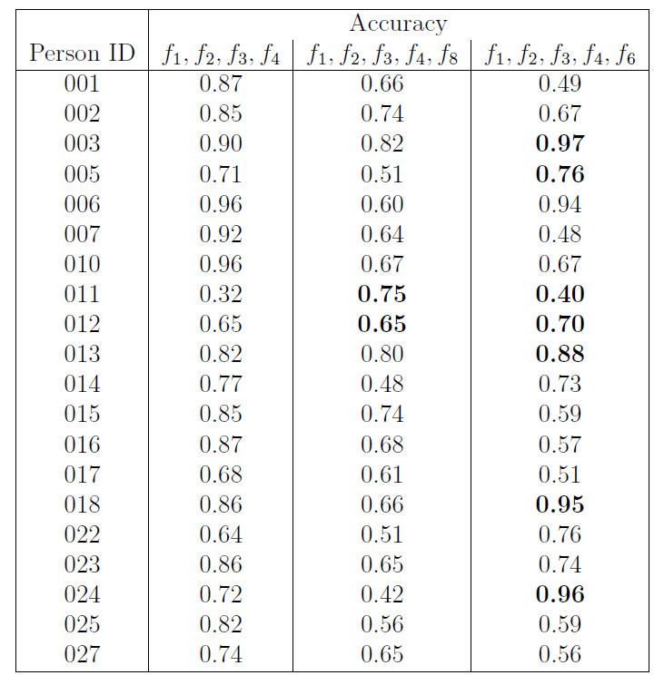
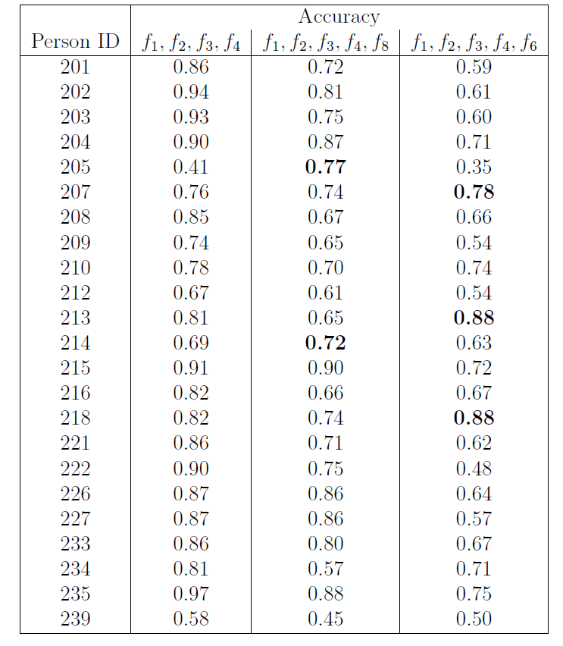
Results
New feature
New algorithm
New feature
New algorithm

Slide 32
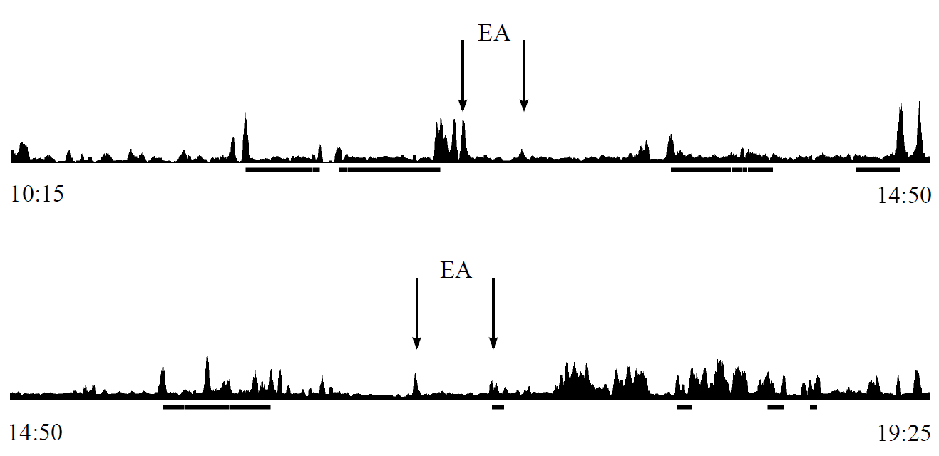
Results – New feature
Original 4 features
Accuracy 32%

Slide 33
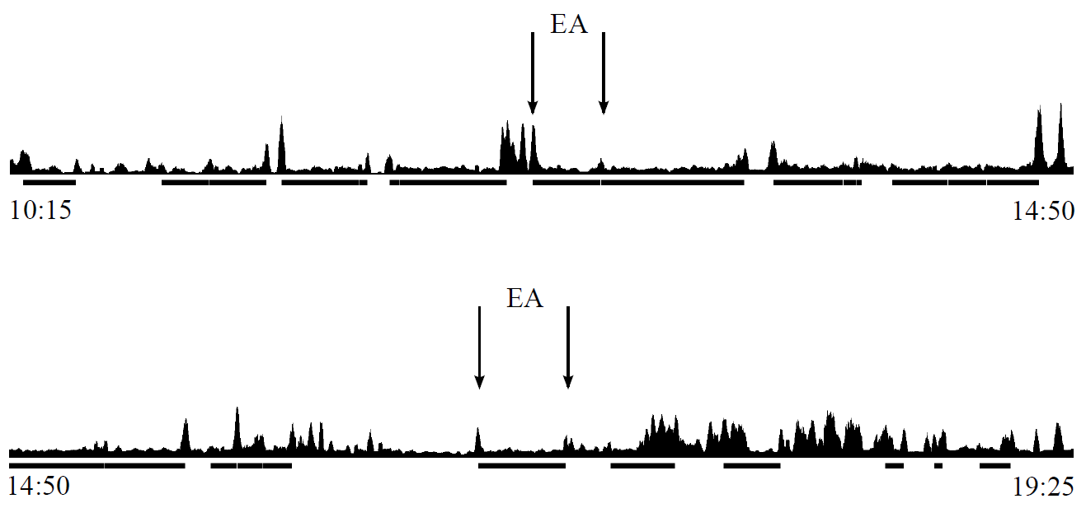
Results – New feature
Add new feature
Accuracy 75%

Slide 34
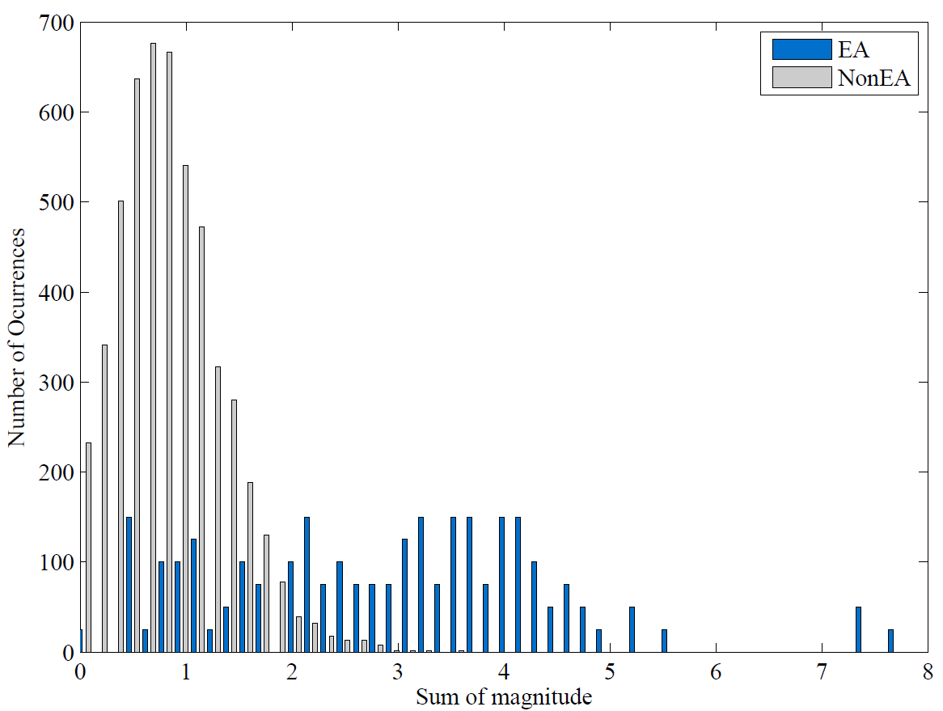
Results – New feature
EA and NonEA distribution
The probability of each feature

Slide 35
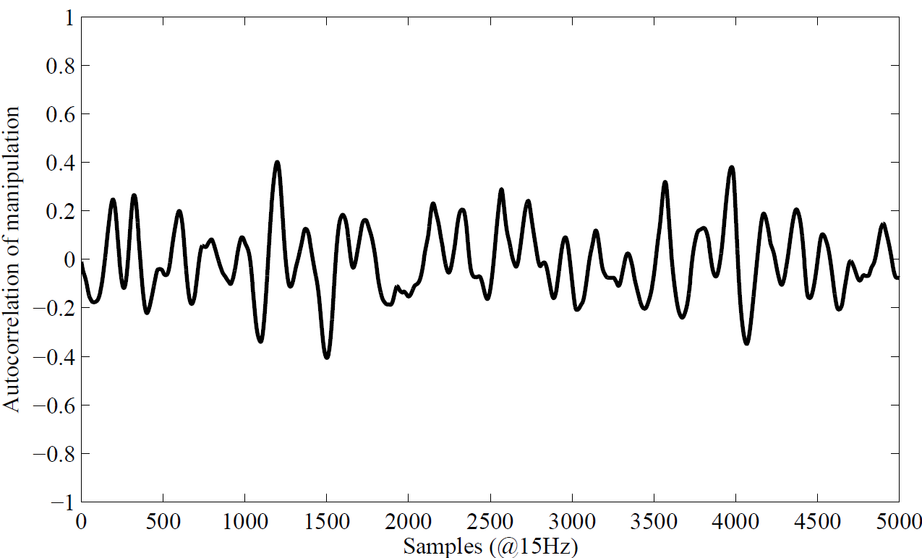
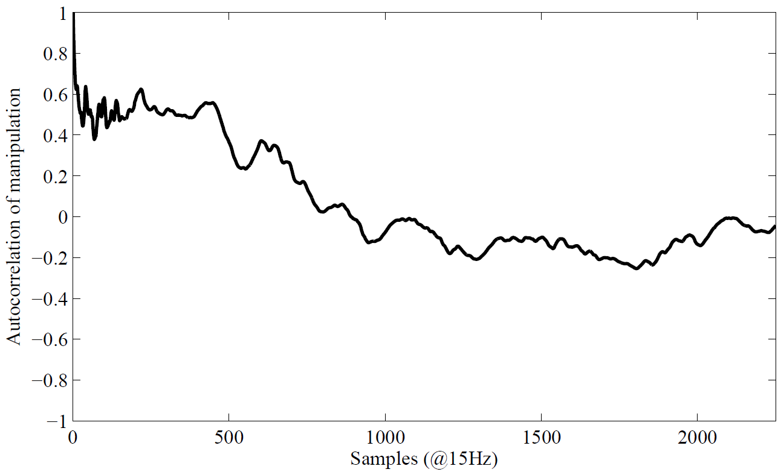
Results – New feature
EA
NonEA
Pick from region where EA distribution
does not overlap with NonEA distribution

Slide 36
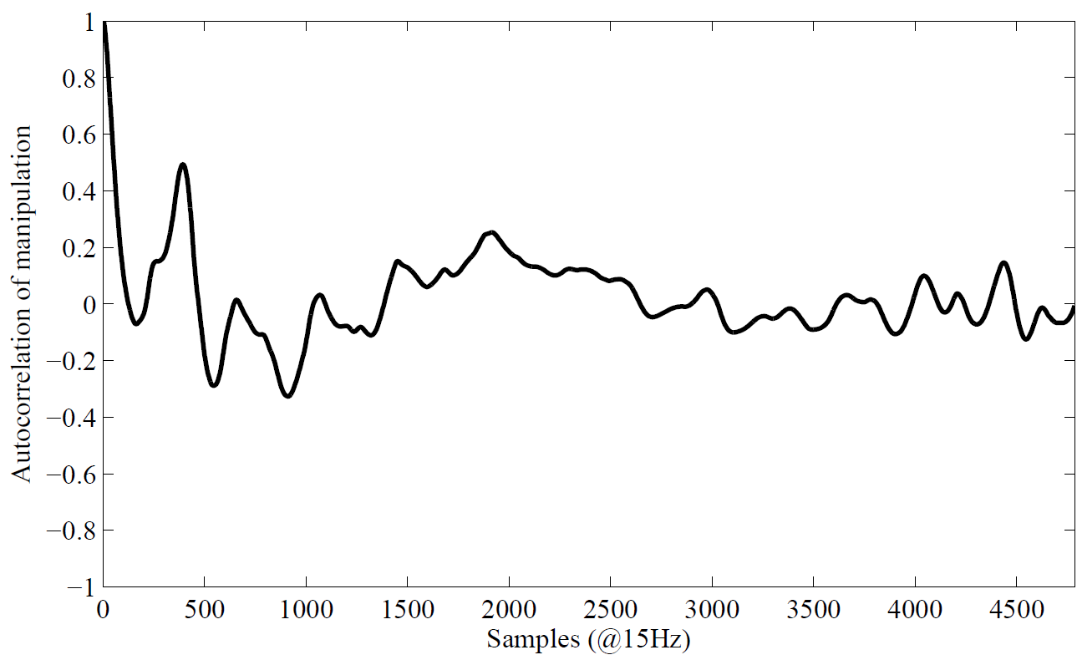
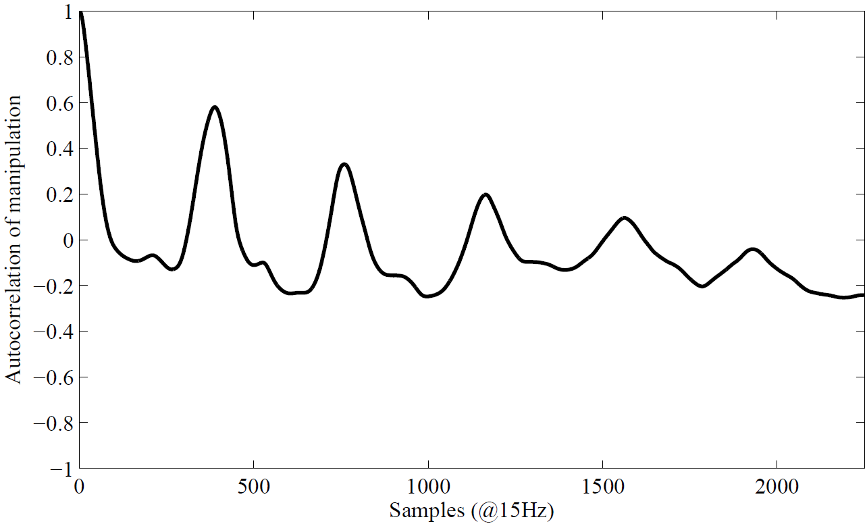
Results – New feature
EA
NonEA
Pick from region where EA distribution
overlaps with NonEA distribution

Slide 37
Results – New feature
EA - autocorrelation
EA - manipulation

Slide 38
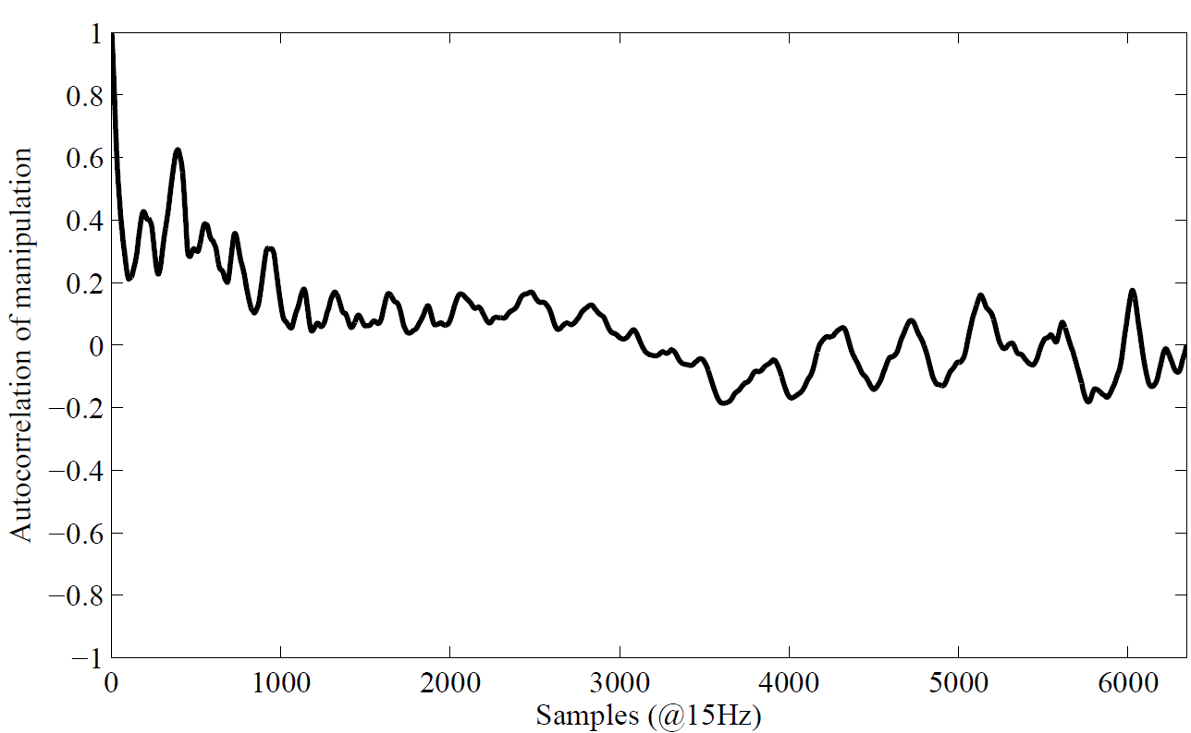
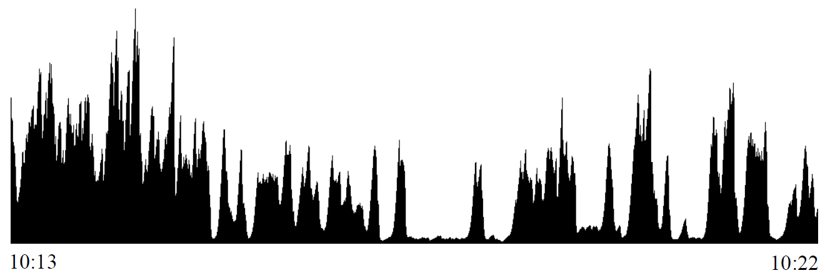
Results – New feature
EA - autocorrelation
EA - manipulation
Notes:
Here is another example shows periodicity of actual manipulation problem.

Slide 39
Results
New feature
New algorithm
New feature
New algorithm
Notes:
The new algorithm improve the classifier performance most for person ID 0 2 4

Slide 40
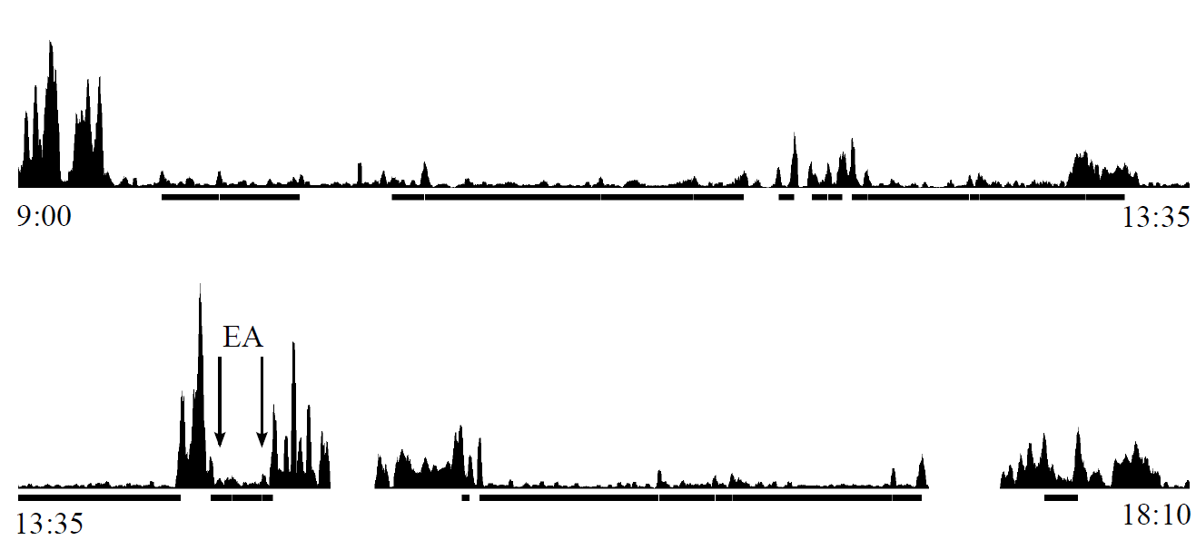
Results – New algorithm
Original 4 features
Accuracy 72%

Slide 41
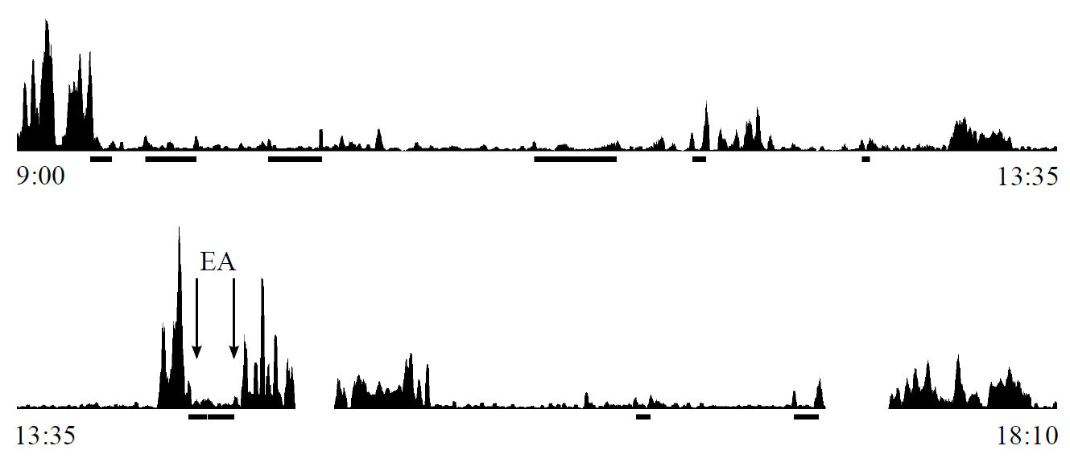
Results – New algorithm
Apply new algorithm
Accuracy 96%
Eliminated 15 FP
Notes:
Classifier still capture EA segment, decrease the number of FP a lot, detected EA tend to separate with each other.

Slide 42
Results
New feature
New algorithm
New feature
New algorithm

Slide 43
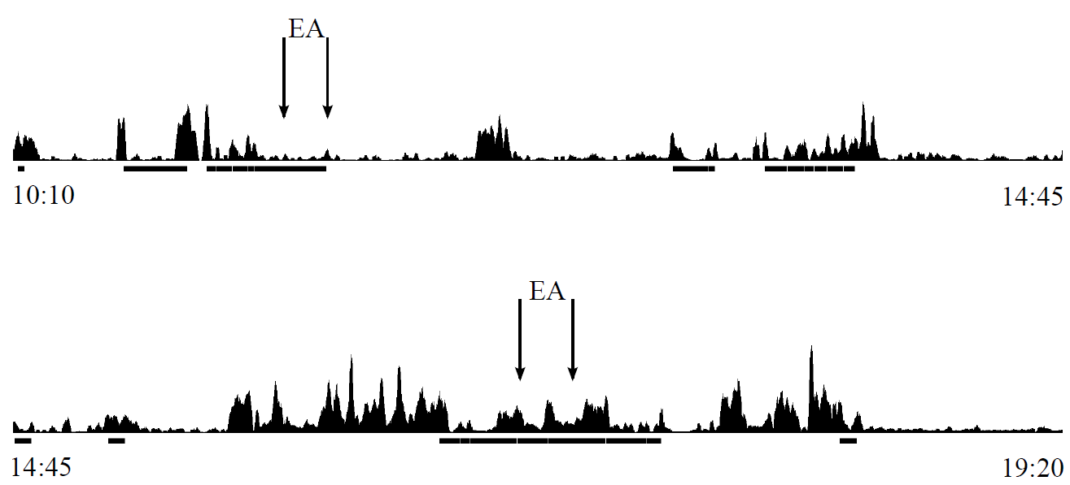
Results – New algorithm
Original 4 features
Accuracy 87%

Slide 44
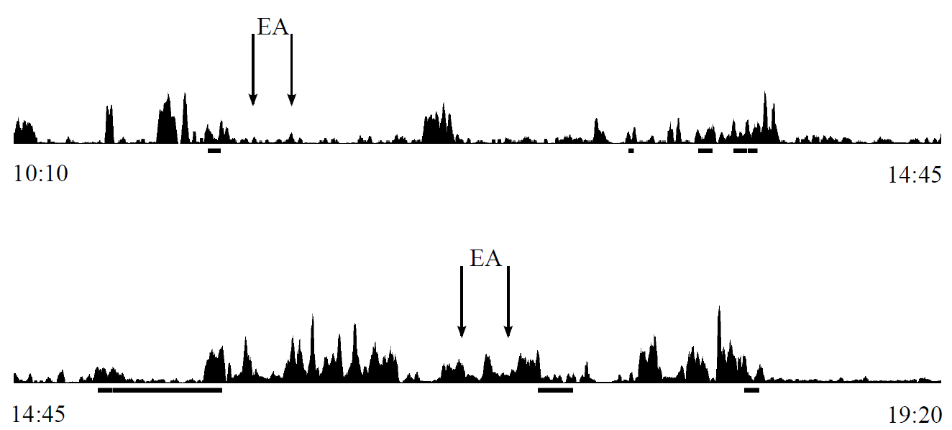
Results – New algorithm
Apply new algorithm
Accuracy 49%
Notes:
The detected EA are, again, separated with each other, but they locate on the wrong place.

Slide 45
Discussion
Regularity of autocorrelation of manipulation
Not capture regularity completely
Training on all data
Try every possible combination
Not truly try every possible combination
Notes:
This study considers 1 new feature and 1 new algorithm.
New feature: it was intented to capture the regularity of manipulation better.
Different people eat in different way

Slide 46
Future work
Explore new features that focus on NonEAs
Collect free-living data from individual over a longer duration
Genetic algorithm
Trying the subset of combinations most likely to produce the highest overall probability

Slide 47
Thank you !

