Slide 1
A Study of Environment Noise in
Ultra-Wideband Indoor Position Tracking
Ph.D. Dissertation Defense
Committee Members:
Dr. Adam Hoover (advisor)
Dr. Richard Brooks
Dr. John Gowdy
Dr. Eric Muth
William Suski
04/13/2012

Slide 2
How does UWB Tracking Work?
Rx
Rx
Tx
Rx
Rx

Slide 3
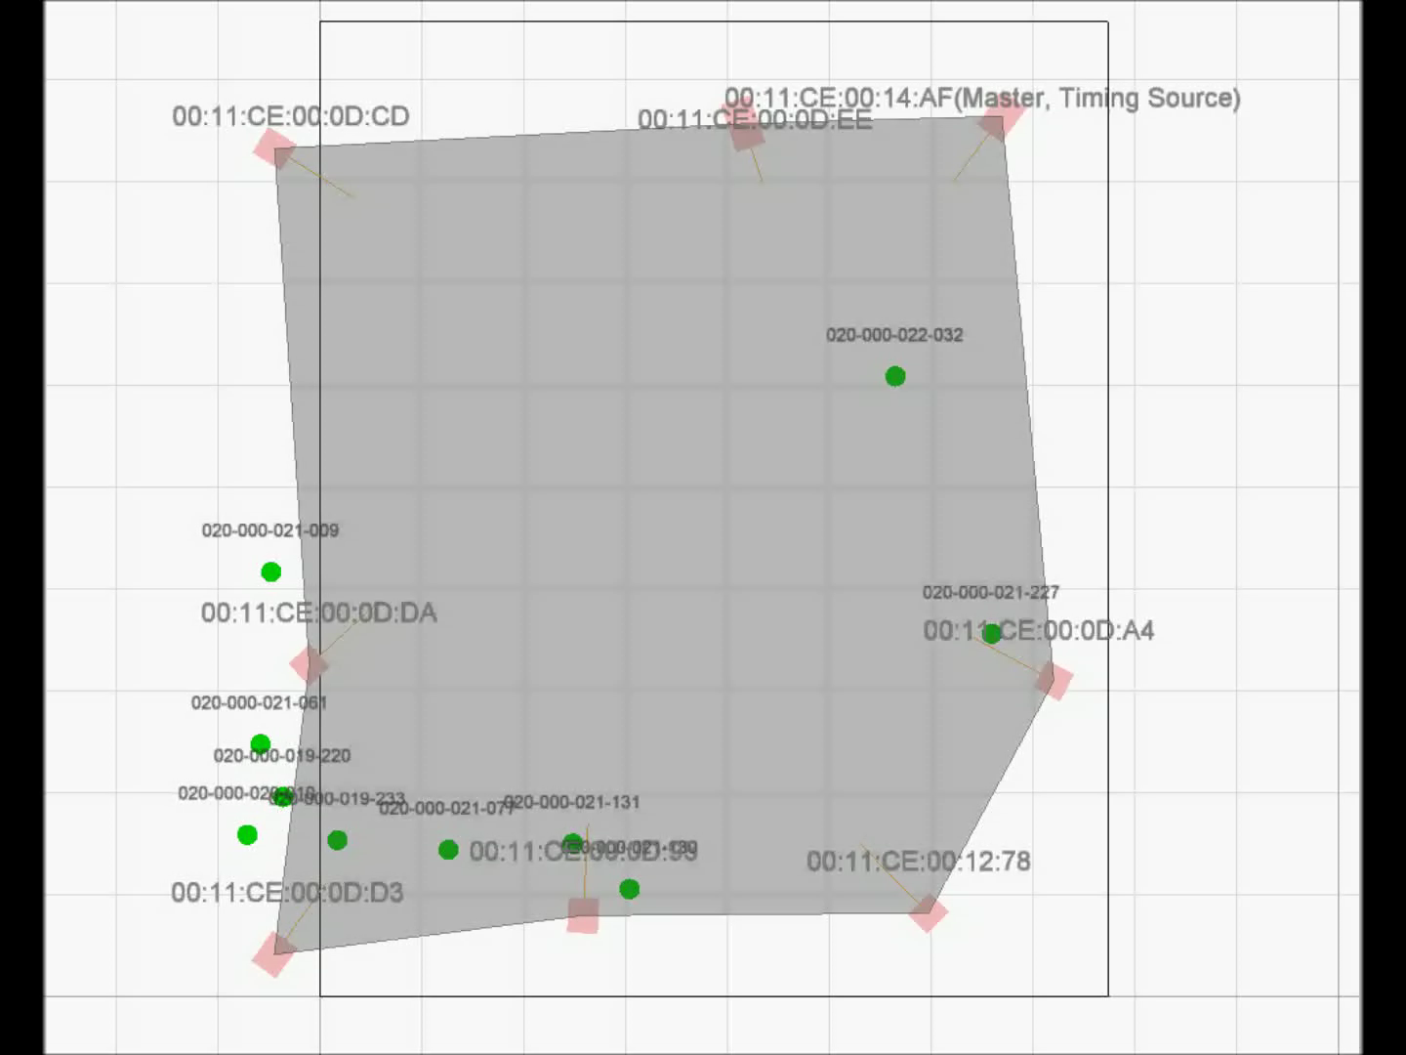
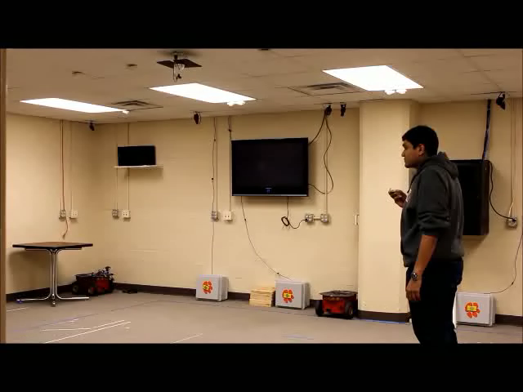
UWB Tracking Example

Slide 4
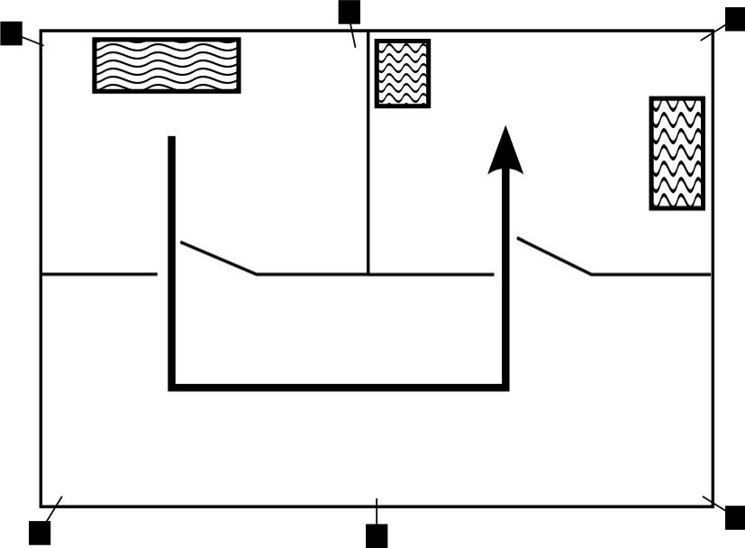
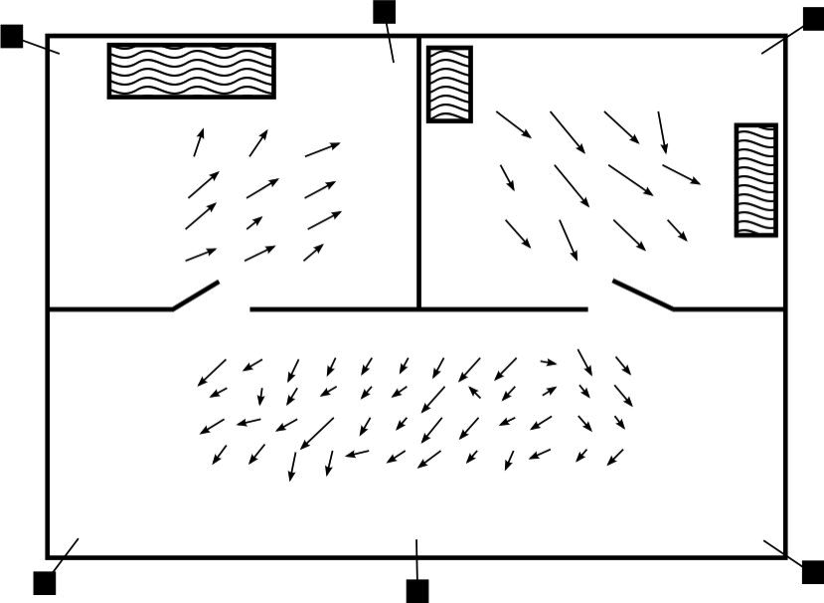
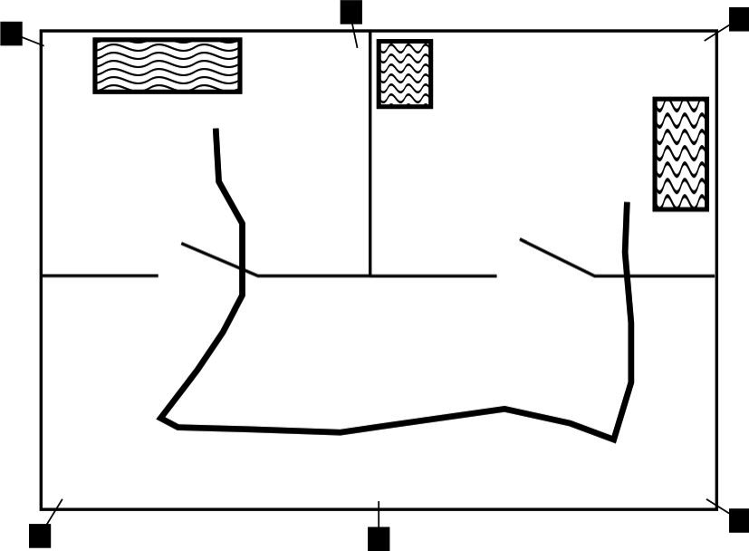
What Is Environment Noise?
Actual Motion
Environment Noise
Raw Measurements

Slide 5

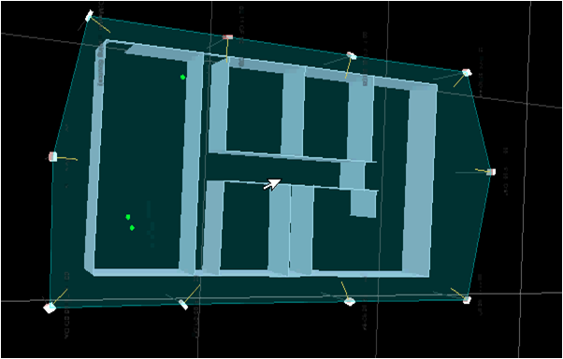
Outline
Related Work
  GPS
  UWB Error Sources
  Systems
  Error Isolation
  Simulations
Measure & Model
Filter
Optimize Configuration
Conclusions
Future Work
same idea

Slide 6
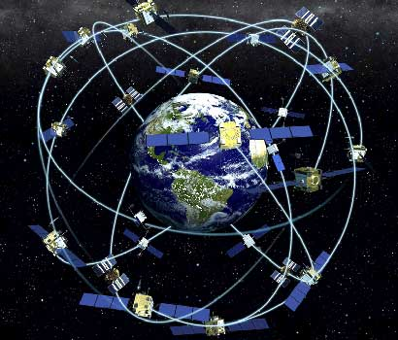
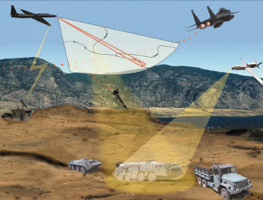
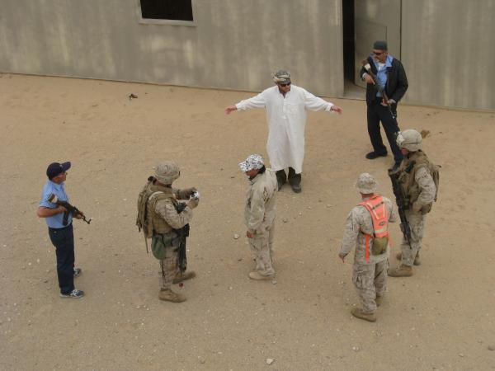
Motivation
Accurate Indoor Tracking
GPS has improved 20x since 1994 due to:
  Atmospheric filtering
  Street maps
  Land and satellite-based augmentation
UWB positioning is a new technology
Similar to GPS
Achieve < 1 cm accuracy indoors
How accurate?
Move these guys a little
And the entire context
changes

Slide 7
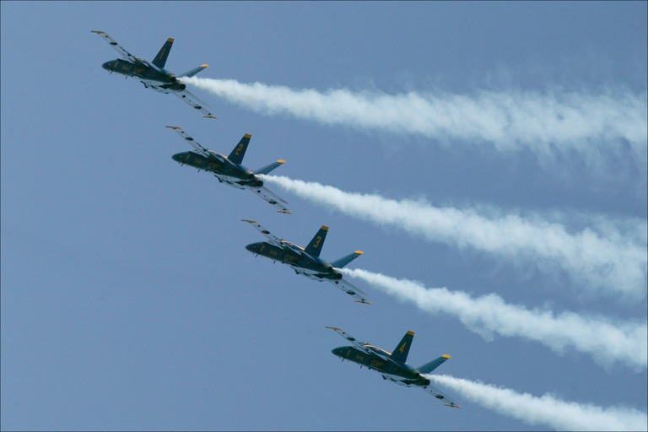

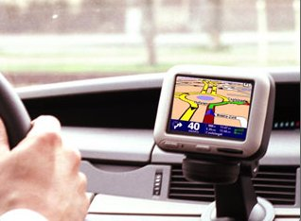
Global Positioning System
First deployed in 1970s, basic accuracy is ~100 m
  Developed for air and water vehicle navigation, battlespace awareness
Accuracy improved to 1 - 10 m
  Used for vehicle and pedestrian navigation
Uses trilateration for positioning

Slide 8
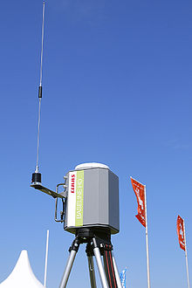
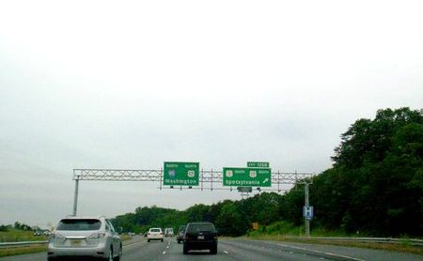
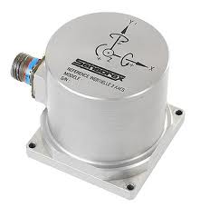
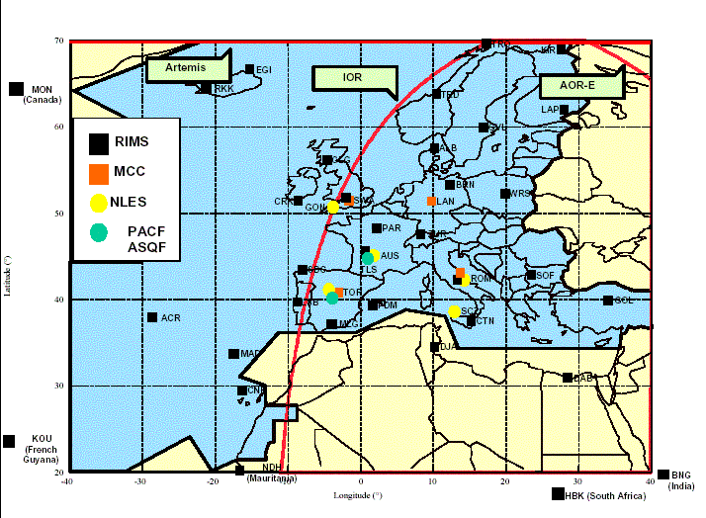
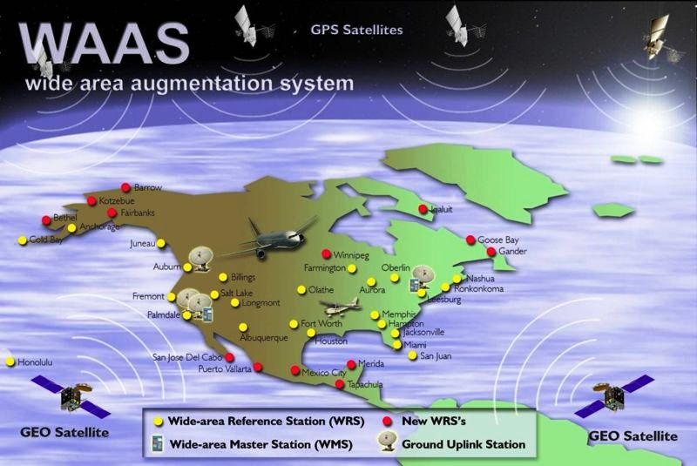
GPS Augmentation
Calculated
Position
After
Augmentation
DGPS (Differential GPS)
Maps
Sensor Fusion
WAAS (Wide Area Augmentation System)
EGNOS (European Geostationary
Navigation Overlay Service)

Slide 9
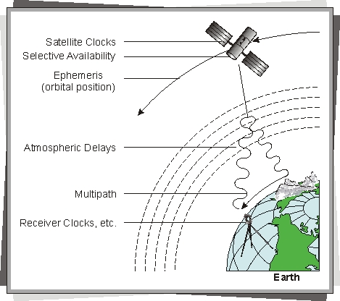
GPS Error Modeling
Errors occur due to…
  Timing
  Ephemeris
  Atmospheric delay
  Multipath
Improved via
  Kalman filtering

Slide 10
UWB Positioning Error Sources
Multipath
Non-Line-Of-Sight (NLOS)
Wall
TX
RX
TX
RX
Wall
Timing
Antenna effects
Peak detection
Sensor set
Others?

Slide 11
Related Work: Systems
Proof-of-concept systems
  Fontana, et al. (2003) – Met FCC power requirements
  Guoping and Rao (2005) – Meets FCC regs, low-cost
  Zetik, et al. (2004) – Spread spectrum UWB
  Waldmann, et al. (2008 & 2009) – Pulsed frequency modulated continuous wave (FMCW)
  Oh, et al. (2009) – Communications and positioning (IEEE 802.15.2a, u-Home)
  MacGougan, et al. (2010) – UWB+GPS

Slide 12
Related Work: Error Isolation
Error Isolation
  Mahfouz, et al. (2008) - sampling rate, peak detection, timing, antenna phase-center and base station configuration
  Low, et al. (2005) - match filtering and peak search technique
  Yang, et al. (2010) – selective correlation

Slide 13
Related Work: Simulation
Simulation
  Steiner and Wittneben (2012) – Energy detection fingerprinting
  Denis, et al. (2005) – Track NLOS conditions
  Jing, et al. (2012) – UWB distortion through building materials
  Chung, et al. (2003) - pulse trains for TOA
  Shen, et al. (2010) - LOS and NLOS detection
  Yu and Oppermann (2004) – Decrease TDOA positioning calculation time

Slide 14
Outline
Related Work
Measure & Model
Filter
Optimize Configuration
Conclusions
Future Work
Measure & Model

Slide 15
Test Facilities
Shoothouse Facility
Riggs Facility
Approximately 13 x 10 m
Approximately 8 x 10 m

Slide 16
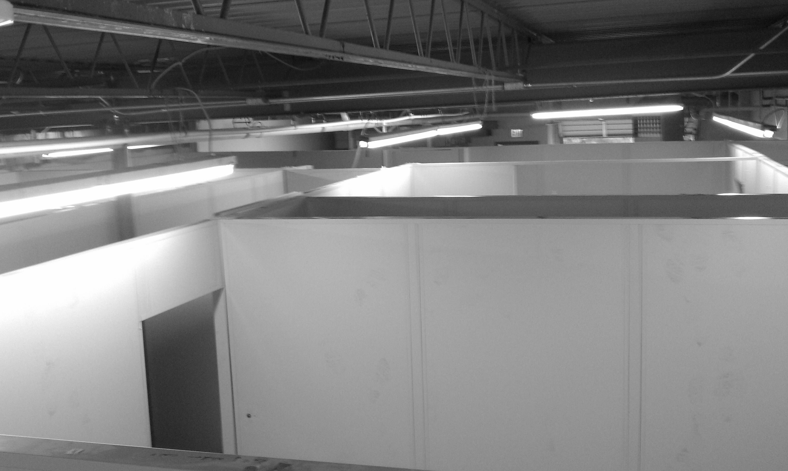
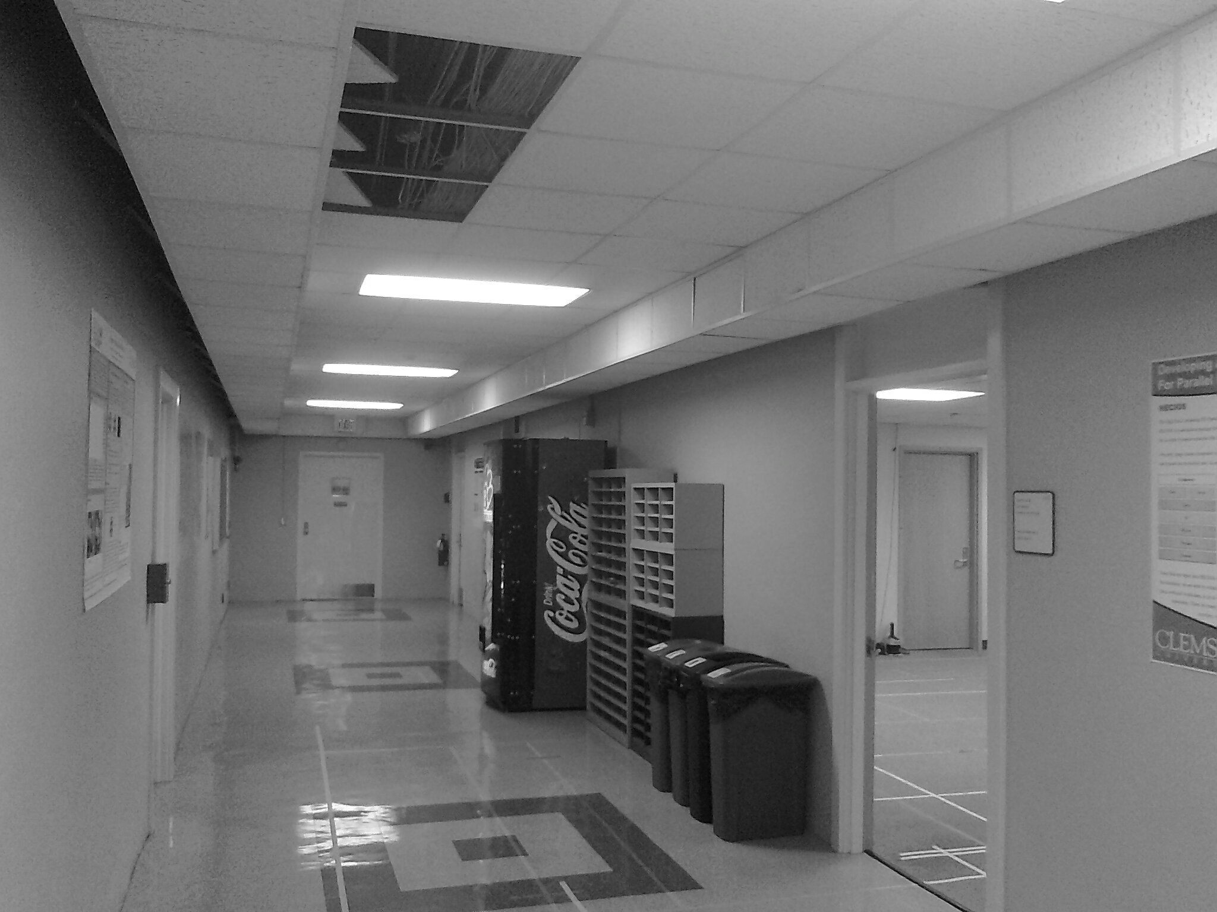
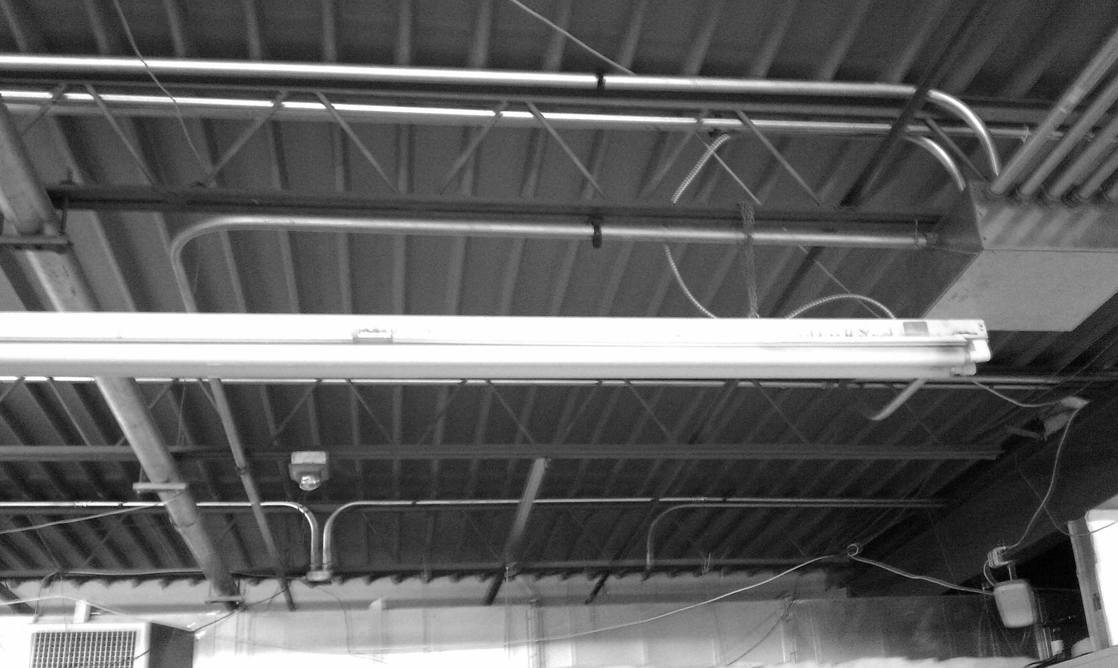
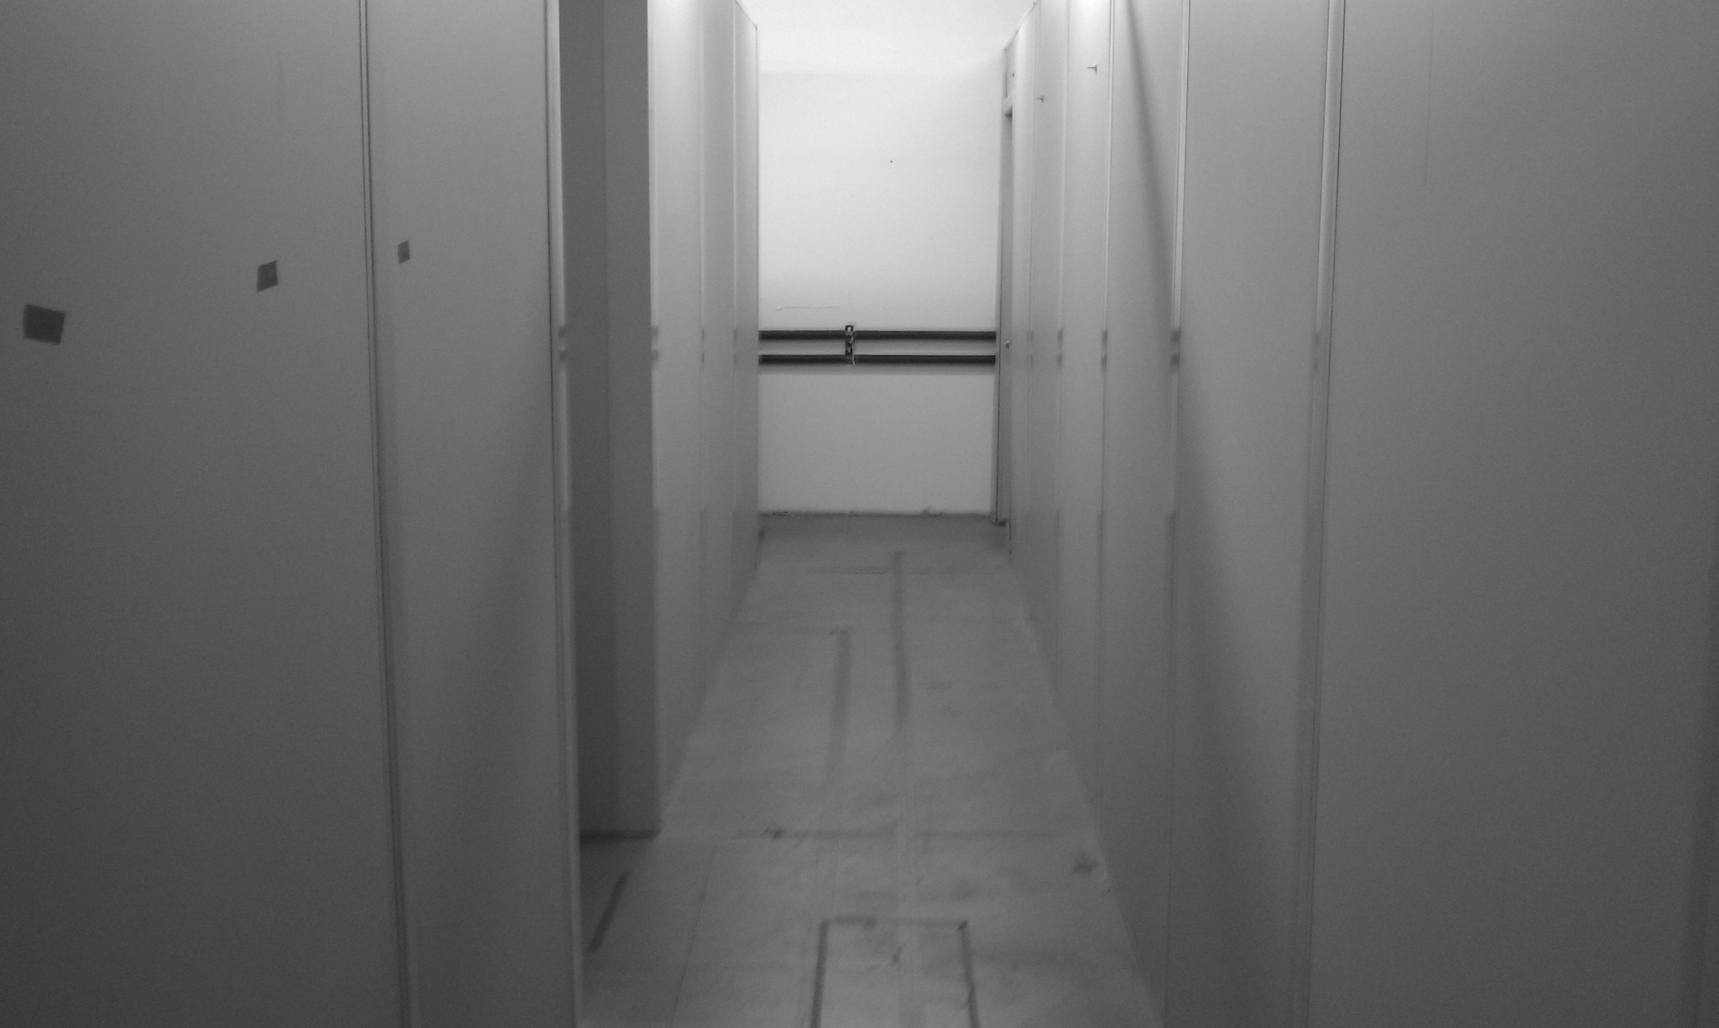
Facility Photos

Slide 17
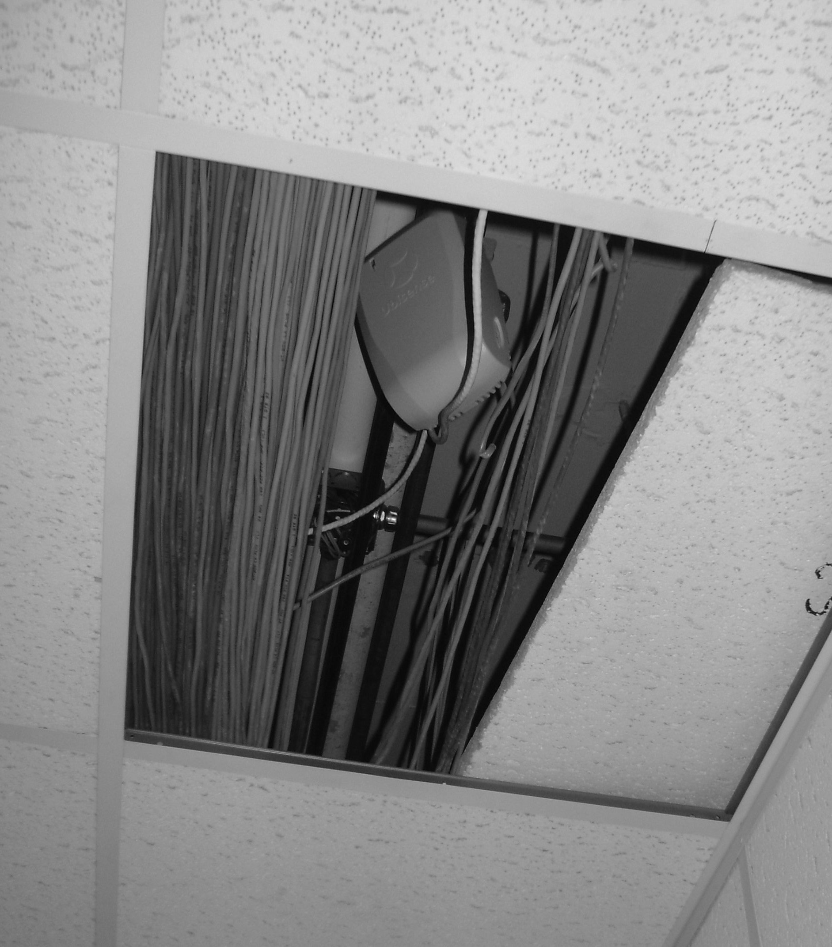
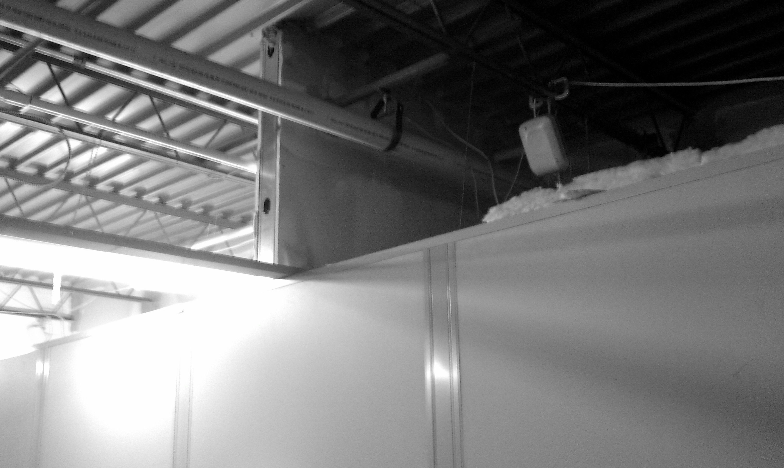
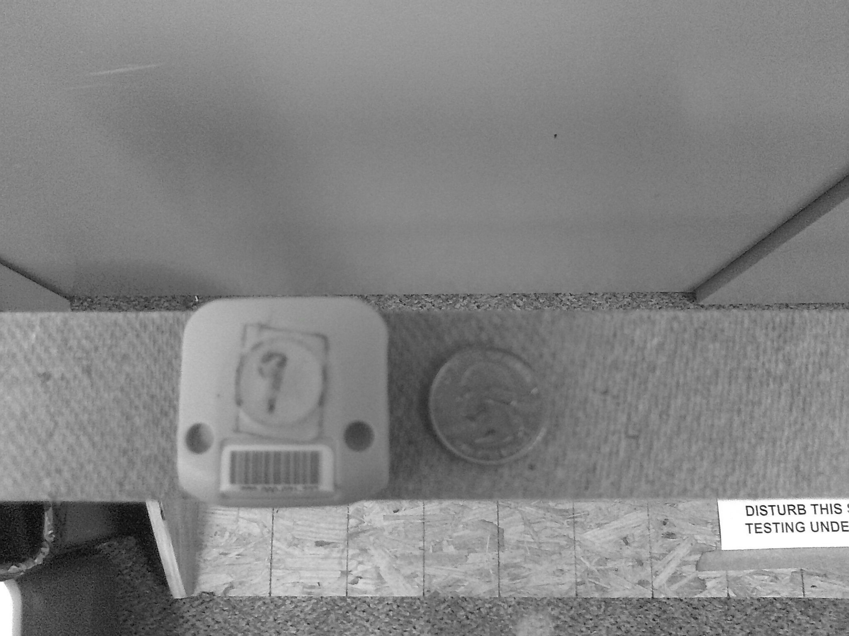
UWB System Photos

Slide 18
Facility Installations
Shoothouse Facility
Riggs Facility
Sensors indicated by black squares

Slide 19
Measurement Collection
Shoothouse Facility
Riggs Facility
Collection locations indicated by unfilled squares

Slide 20
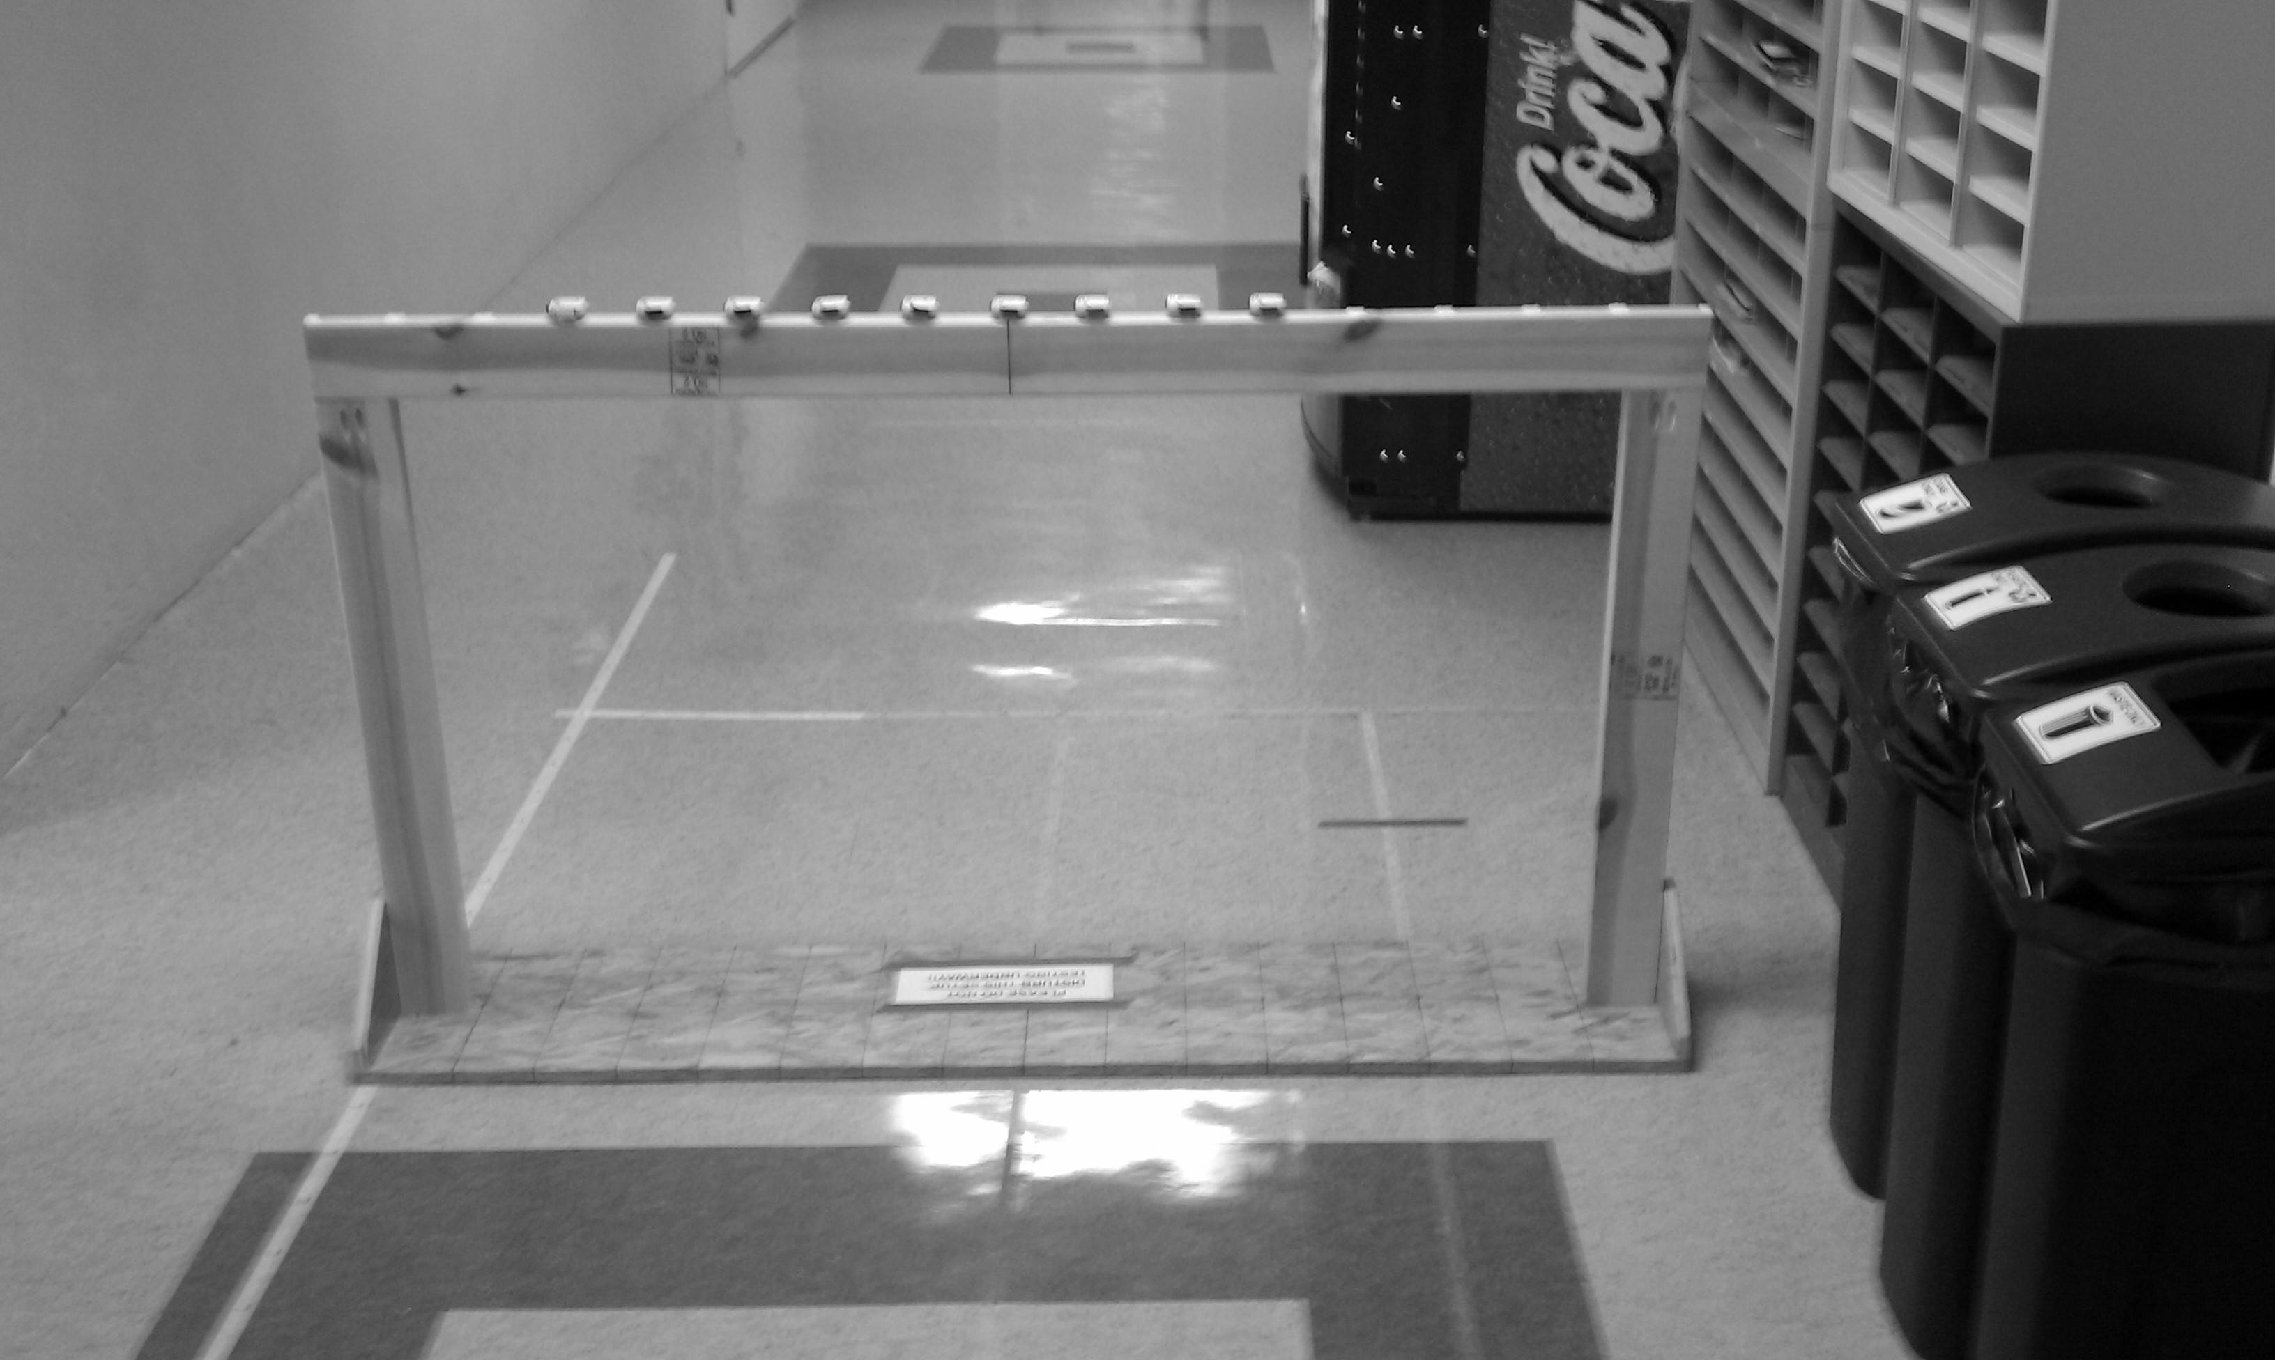
Collection Summary
Shoothouse Facility
Riggs Facility
499 measurements per location
7931 locations
4M measurements
500 measurements per location
3272 locations
1.6M measurements

Slide 21
Observed Noise
500 measurements shown in each figure
Data forms clusters
(480, 540) cm
Ground Truth
(620, 430) cm
Measurements

Slide 22
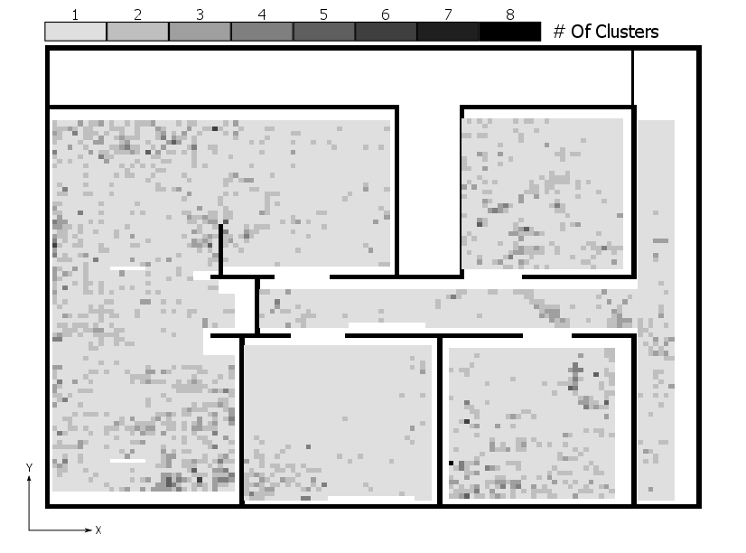
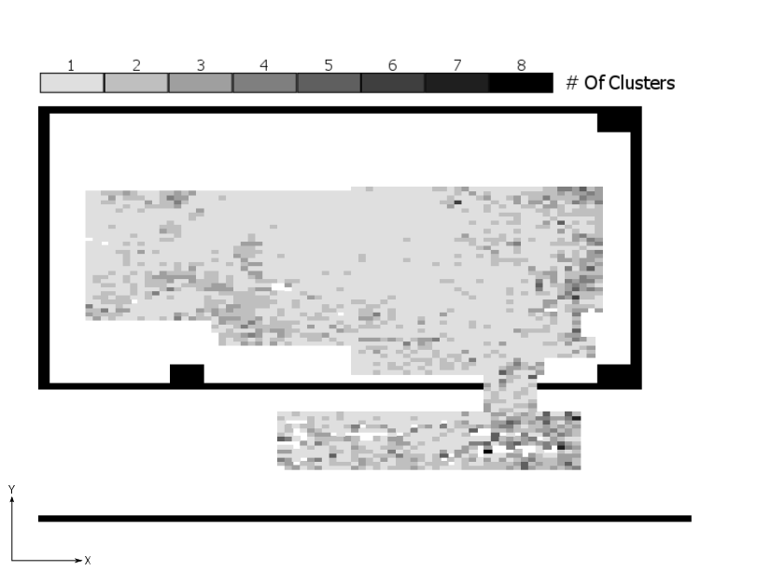
Overall Clustering
Shoothouse Facility
Riggs Facility
Overall number of clusters plots
ε = 30, K = 10

Slide 23
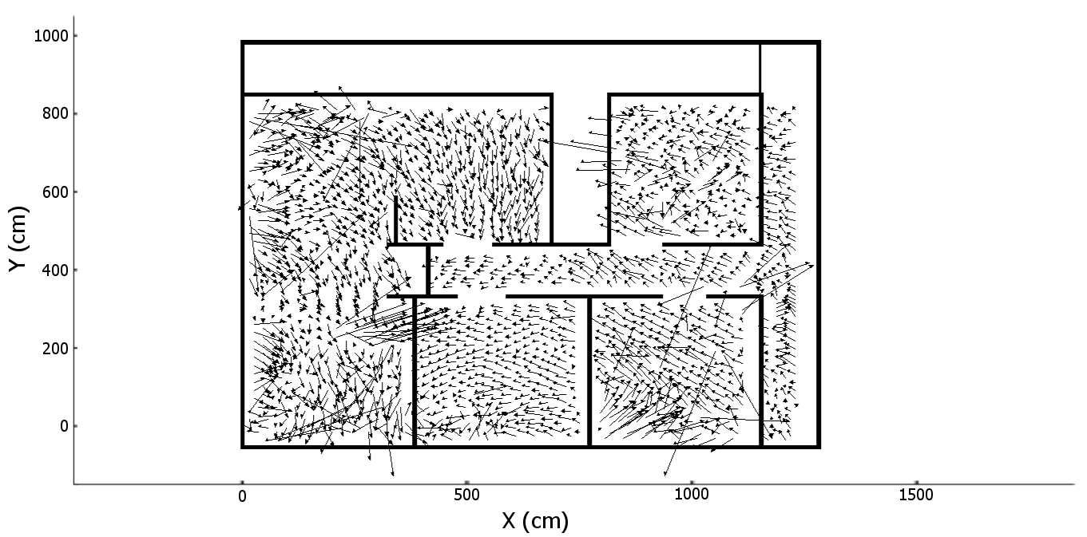
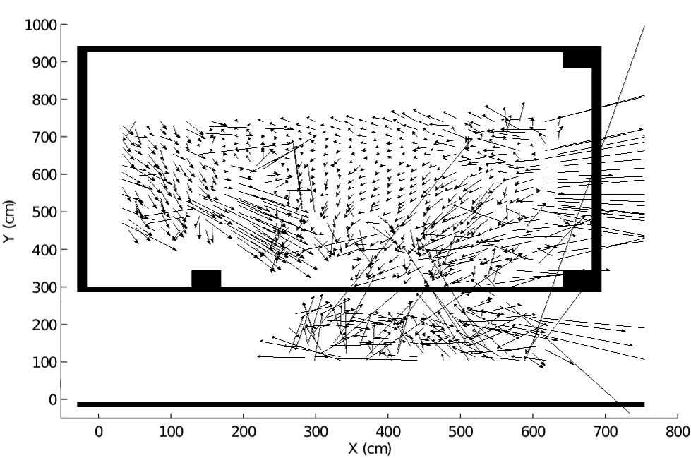
Error Vectors
Shoothouse Facility
Riggs Facility

Slide 24
Stability Over Time
Collected over two months time
Average cluster mean change: 3.7 cm, σ = 3.1 cm
Small compared to 20 cm average error

Slide 25
Local Similarity
Measurements taken at 1 cm intervals
Comparison of measured vs. interpolated model

Slide 26
Environment Noise Conclusions
Evidence is shown that the noise present in an UWB indoor position tracking system is
  Stable over time
  Locally similar
Single and Multi-modal noise found throughout two facilities
Noise can be modeled using two-dimensional weighted sum of Gaussian random variable

Slide 27
Outline
Related Work
Measure & Model
Filter
Optimize Configuration
Conclusions
Future Work
Filter

Slide 28
Measurement Noise Map Augmented Particle Filter (MNMAPF)
Set of M=1000 particles
Transition particle states
Update weights
Probability of the measurement given the state
Normalize weights
Compute output
Resample if necessary

Slide 29
Dynamic Track Collection
Trial | Range | Velocity
1 | (480, 570) – (480, 710) cm | 20 cm/s
2 | (460, 630) – (320, 630) cm | 16 cm/s
3 | (600, 390) – (390, 630) cm | 76 cm/s
4 | (390, 600) – (630, 390) cm | 70 cm/s

Slide 30
Raw Track Measurements

Slide 31
Effect Of Dynamic Noise On Filter Output
Raw

Slide 32
Filtering Results

Slide 33
Performance Summary
Average over all tracks for 300 iterations of the BPF and ENPF
3 cm improvement over raw measurements

Slide 34
Augmented Particle Filter Conclusions
A map of environment noise can be used to improve particle filter tracking performance
17 cm average MNMAPF error vs. 20 cm raw measurement error
15% reduction in tracking error
Significant time commitment required to generate map

Slide 35
Outline
Related Work
Measure & Model
Filter
Optimize Configuration
  Related Work
  Current Facility-wide Error
  Sensor Set Selection
  RF Range Metric
  Through-Wall Distance Metric
  PDOP Metric
  Yaw Metric
  Pitch Metric
  Metric Combination
  Parameter Optimization
  Verification
  Optimization Conclusions
Conclusions
Future Work
Optimize Configuration

Slide 36
Configuration Optimization
Reduce the facility-wide average error by changing sensor location and/or orientation

Slide 37
Related Work
Sensor placement in simulation only
  Hegazy and Vachtsevanos (2003) – condition number
  Sinha, et al. (2004) – Newton-Raphson/Genetic Algorithm
  Jourdan, et al. (2006) – performance error bound (PEB)
  Jourdan and Roy (2008) – optimal sensor placement using PEB
None of this work has considered sensor orientation

Slide 38
Current Facility-wide Error
4 cm
100 cm
Sensor ID
Normalized average error, capped at 100 cm

Slide 39
Visual Segmentation
Segment | 1 | 2 | 3 | 4 | 5 | 6 | 7 | 8 | 9 | 10
Good |  | X
Average | X |  |  |  | X |  |  | X
Poor |  |  | X | X |  | X | X |  | X | X

Slide 40
Overview
Create a simulation to match as closely as possible the actual noise measured
Calculate metrics based on sensor location, orientation and facility floorplan
  RF range
  Through-wall distance
  PDOP
  Yaw
  Pitch
Metrics calculated for each position in the Riggs facility for the set of 5 best sensors, S_{b}

Slide 41
Sensor Set Selection
Given a set of sensors S, select 5 best based on lowest
Wall

Slide 42
RF Range Metric
The RF range metric is the sum of the RF range values for all five sensors in S_{b}
Selected as a metric because the variance of range estimates increases with distance (Gezici 2004).
Factors in NLOS conditions

Slide 43
RF Range Per Sensor

Slide 44
RF Range Combined
RF Range metric for best five sensors at each location
Has low values in areas corresponding to segments 2 and 5
2
5

Slide 45
Through-Wall Distance Per Sensor
The through-wall distance metric is the sum of the through-wall distance values for all five sensors in S_{b}
Through-wall distance is the distance a UWB signal would travel within a wall(s)
Selected as a metric due to biases created by NLOS conditions (Yousseff 2008)
NLOS biases are always positive

Slide 46
Through-Wall Distance Metric

Slide 47
Through-Wall Distance Combined
Through-wall distance metric for best five sensors at each location
Has high values in area corresponding to segment 7
7

Slide 48
PDOP Metric
Position dilution of precision (PDOP) is a measure of observation geometry often used in GPS systems
Lower values indicate better sensor geometry
Calculation based solely on sensor placement

Slide 49
PDOP Metric (cont.)
PDOP for the best five sensors at each location
4

Slide 50
Yaw Metric
The yaw metric is the sum of the difference between the yaw angle of sensor i and the line between the sensor and transmitter.
Angle rotates about the vertical z axis

Slide 51
Yaw Metric Combined
Yaw metric for the best five sensors at each location
2
5
9

Slide 52
Pitch Metric
The pitch metric is the sum of the difference between the yaw angle of sensor i and the line between the sensor and transmitter.
Angle rotates up and down

Slide 53
Pitch Metric Combined
Pitch metric for the best five sensors at each location
6
8
9
10

Slide 54
Metric Combination
Each of the five metric shown helps explain some segment(s)
No metric specifically explains segment 1; however, it is of average quality
Segment 4 found to have been caused by a calibration error
A combination of these metrics should be used
Metric | Affected Segment
RF Range | 2, 5
Through-Wall Distance | 7
PDOP | 4
Yaw Angle | 2, 5, 9
Pitch Angle | 6, 8, 9, 10

Slide 55
Metric Combination (cont.)
Metrics are combined using a weighted sum:
The optimal weight values {k₁, k₂, k₃, k₄, k₅} selected by
Brute force search of space: in increments of 0.05
Values found for k_{i} = {0.40, 0.85, 0.70, 0.05, 0.20}

Slide 56
Metric Combination (cont.)
Actual Facility Error
Combined Metric
Normalized average error plot after correction of calibration error

Slide 57
Parameter Optimization
Combined metric can be used to determine optimal system installation parameters: sensor location and orientation
Sensor locations fixed due to physical constraints of Riggs facility
Optimize sensor yaw and pitch angles for minimum total combined metric value for all locations
Search space of X¹⁶, (8 sensors, 2 angles each)
  X depends on resolution of search
Computationally prohibitive space to search by brute force
Genetic algorithm implementation chosen to search space

Slide 58
Genetic Algorithm
Method for solving problems that takes cues from evolution (Forrest 1993)
Uses selection, crossover and mutation to generate new individuals
More “fit” individuals selected more likely to reproduce
Combined metric used as fitness score

Slide 59
Genetic Algorithm (cont.)
Generation 1
Fitness Score
First generation formed randomly
New generations formed by selecting individuals for reproduction
Fitness proportionate selection
Crossover and mutation occurs
Each new generation will be more “fit” than the previous
After 200 generations, individual with lowest fitness score selected as optimal
4005
Crossover & Mutation
Generation 2
3967
Generation 3
3500
Generation G
1501

Slide 60
Genetic Algorithm (cont.)
10k chromosomes, randomly initialized
200 generations

Slide 61
Genetic Algorithm (cont.)
Current
Optimized
Combined metric reduced from 2250 to 1519 using genetic algorithm (30% reduction)
Takes approximately 250 minutes to execute
C implementation run on Fedora Core 14

Slide 62
Metric Comparison
Current
Combined Metric
Yaw
Pitch
After Optimization

Slide 63
Verification
Sensor orientation angles modified to closely match the optimized angles
Could not be matched exactly due to physical limitations
System re-calibrated after orientation adjustment
All angles within 8 degrees
Sensor | 1 | 2 | 3 | 4 | 5 | 6 | 7 | 8
Optimized Yaw | -46.6 | -87.1 | -123.0 | 146.8 | 101.1 | 49.9 | 14.3 | 39.5
New Yaw | -44.6 | -86.8 | -123.6 | 138.9 | 94.3 | 53.9 | 21.2 | 42.1
Optimized Pitch | -22.6 | -30.9 | -26.8 | -28.0 | -29.0 | -25.9 | -21.8 | -25.0
New Pitch | -18.1 | -29.5 | -30.7 | -23.2 | -23.2 | -28.2 | -20.7 | -21.0

Slide 64
Verification (cont.)
Re-collection Locations
Data re-collected at 90 locations throughout Riggs facility
Average error reduced from 47 cm to 21 cm (55%)
75 locations found to have reduced average error
60 locations have error reduced between 0 and 50 cm

Slide 65
Optimization Conclusions
Combined metric developed based on sensor location, orientation and facility floorplan
Optimal sensor orientation angles found by minimizing the combined metric using a genetic algorithm
30% reduction in combined metric after optimization
55% reduction in average measurement error after physical orientation adjustment
Could be used to determine optimum sensor placement
Could focus minimization in certain areas of a facility

Slide 66
Outline
Related Work
Measure & Model
Filter
Optimize Configuration
Conclusions
Conclusions

Slide 67
Conclusions
Measure and Model
Filter
Optimize Installation

Slide 68
Questions?

Slide 69
UWB Radio Technology
20 MHz
UWB
Narrow Band
500 MHz
Short duration pulse gives…
Fine time resolution
Wide bandwidth
Lower power in all frequencies
This leads to…
More precise range estimates
Robustness to multipath
More probable detection through obstacles
Minimal interference

Slide 70
UWB System Components

Slide 71
Filtering
State space approach
  Estimate variables of interest and covariances
  Covariances give an estimate of uncertainty
  Example: two-dimensional position and velocity
X position
X velocity
State vector
Y position
Y velocity
All @ time t

Slide 72
Filtering
State transition
  Set of equations governing system dynamics
  Matrix notation
Dynamic Noise

Slide 73
Filtering
Observation model
  Describes the observable portion of the system
  Matrix notation
Observation Noise

Slide 74
Filter Comparison
Four commonly used filtering techniques
Kalman Filter
  Requires:
    Linear measurement and observation equations
    Gaussian noise distributions
  Analytic solution, low computational complexity
Extended Kalman Filter and Unscented Transform
  Requires:
    Gaussian noise distributions
  Analytic solution, low computational complexity
Particle Filter
  No requirements on equations or distributions
  Monte Carlo solution, high computational complexity

Slide 75
Kalman Filter Equations
Provide an analytic solution
Simple to implement
Iterate through the five equations below:
Kalman gain update
State update
Predictor covariance update
Predicted state update
Predictor covariance update

Slide 76
Recursive Bayesian Estimation
Applicable for any distribution
Requires all previous states and measurements
Defaults to Kalman filter for Gaussian distributions
Non-Gaussian distributions are often intractable
These cases require an approximate method

Slide 77
Basic Particle Filter
Set of M=1000 particles
Transition particle states
Update weights
Probability of the
measurement given the state
Normalize weights
Compute output
Resample if necessary

Slide 78
Environment Noise Model
Bivariate, multi-modal Gaussian environment noise model
Shown as a weighted sum of bivariate, unimodal Gaussians
Bivariate, multimodal Gaussian PDF
Bivariate, unimodal Gaussian PDF

Slide 79
Automatic Clustering
Number of clusters, , unknown
Density-based spatial clustering for applications with noise (DBSCAN)
  Ester 1996
  Determines number of clusters
  Two input parameters: ε and K
  ε is the neighborhood size
  K is the required number of points in a cluster

Slide 80
Clustered Data
(480, 540) cm
(620, 430) cm
Cluster Means
Single cluster identified in left figure
Three clusters in right figure
ε=30, K=10

Slide 81
Calculating The Noise Model
Four parameters for each cluster:
  Number of clusters,
  2 x 1 cluster mean vector,
  2 x 2 covariance matrix,
  Cluster weight,

Slide 82
Generated Model
(480, 540) cm
(620, 430) cm
Ellipses indicate one, two and three standard deviations from the mean

Slide 83
Method Overview
Basic
Particle
Filter
Ground
Truth
Identification
Dynamic
Recording
Error Calculation
MNMA
Particle
Filter
Cluster
Means
Number
Of
Clusters
Cluster
Covariance
Measurement
Collection
Cluster
Weights
Environment Noise Model Generation

Slide 84
Recorded Tracks
Moving
Stationary

Slide 85
Error Metric
Ground truth
Raw
Measurements

Slide 86
Conclusions
Measurement noise in UWB indoor position tracking system was studied through two measurement campaigns
Noise location dependent and multi-modal
Evidence that noise is stable over time and locally similar
Map of measurement noise used to improve UWB indoor position tracking in particle filter framework (15% less)
Developed a metric for estimating measurement quality based on sensor position, orientation and facility floorplan
Found optimal sensor orientation parameters using genetic algorithm
Reduced measurement error by 55% in a small measurement campaign after orientation optimization

Slide 87
Recommendations For Future Work
Augmentation methods show promise for improving tracking error in UWB indoor positioning systems
  LADAR for differential LPS
Measurement noise map takes a significant amount of time to generate
  Reduction of this time through automated methods
Expand genetic algorithm to search for optimal sensor locations
Further work into modeling the effects of building materials on UWB signals to mitigate NLOS bias

