Slide 1
Reverse-Projection Method for Measuring Camera MTF
Stan Birchfield

Slide 2
MTF measures camera sharpness
Optical transfer function (OTF) Fourier transform of impulse response
Modulation transfer function (MTF) Magnitude of OTF
Spatial frequency response (SFR) MTF for digital imaging systems
Slanted edge Simplest target for computing SFR
High MTF Low MTF → Sharp camera → Blurry camera
SFR ≈ MTF

Slide 3
What affects MTF?
MTF affected by
Lens
Sensor
Electronics
Target
Pose
Lighting intensity and color
Color channel
ROI
Orientation
Algorithm
✓
Slanted edge
✗

Slide 4
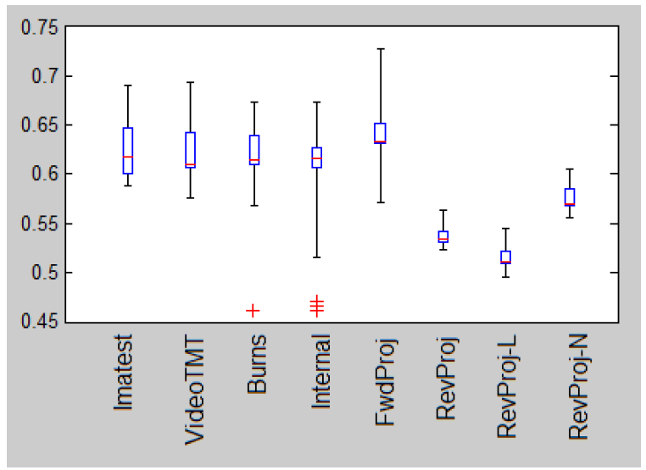
Variability of results
Same:
Sensor
Target
Lighting conditions
Pose
Different:
Crops from 25 to 50 pixels wide
Angles between 5 and 20 degrees
MTF30
Set of ~20 total cropped images

Slide 5
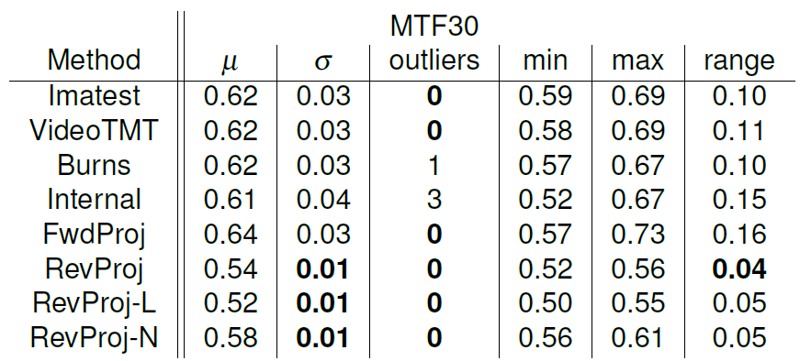
Variability of results
Same:
Sensor
Target
Lighting conditions
Pose
Different:
Crops from 25 to 50 pixels wide
Angles between 5 and 20 degrees
Set of ~20 total cropped images

Slide 6
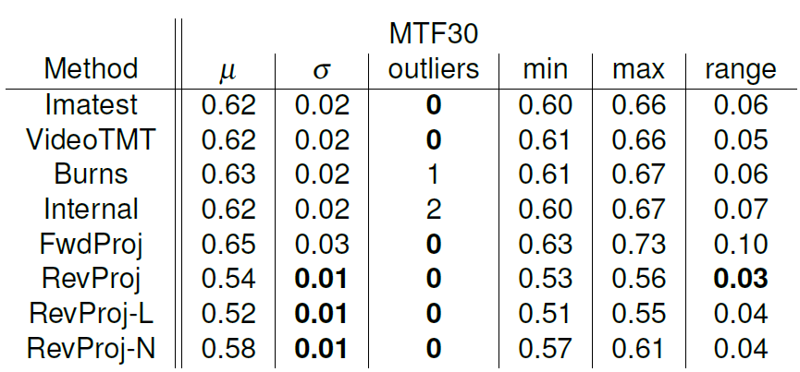
Variability of results
Same:
Sensor
Target
Lighting conditions
Pose
Angle
Different:
Crops from 25 to 50 pixels wide
These are all crops of the same image!

Slide 7
ISO 12233: The standard way to estimate MTF
[2000, 2014]
Slanted edge approach
Define ROI (region of interest) either manual or automatic
Gamma expansion undo OECF (opto-electronic conversion function)
Luminance from RGB
Find points along edge
Fit line to points
Project 2D array onto 1D array
Differentiate
Apply Hamming window
Compute DFT (discrete Fourier transform)
Magnitude of DFT yields estimate of MTF

Slide 8
ISO 12233: The standard way to estimate MTF
[2000, 2014]
Slanted edge approach
Define ROI (region of interest) either manual or automatic
Gamma expansion undo OECF (opto-electronic conversion function)
Luminance from RGB
Find points along edge
Fit line to points
Project 2D array onto 1D array
Differentiate
Apply Hamming window
Compute DFT (discrete Fourier transform)
Magnitude of DFT yields estimate of MTF

Slide 9
Comparison
Standard approach
Proposed approach
Centroid of derivative along rows
Ordinary least squares
Forward projection
Ridler-Calvard segmentation
Total least squares
Reverse projection
Step 4: Find points along edge
vs.
Step 5: Fit line to points
vs.
Step 6: Project from 2D to 1D
vs.

Slide 10
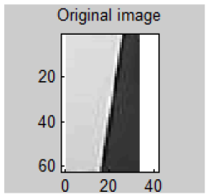
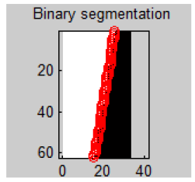
Step 4: Find points along edge
Standard approach
Proposed approach
Derivative along rows
For each row:
Compute 1D derivative using FIR filter
Compute centroid
Local
Assumes near-vertical orientation
Ridler-Calvard segmentation
Repeat:
μ₁ ← graylevel mean below τ
μ₂ ← graylevel mean above τ
τ ← (μ₁ + μ₂) /2
Global
Any orientation
T. W. Ridler, S. Calvard, Picture thresholding using an iterative selection method, IEEE Trans. System, Man and Cybernetics, SMC-8:630-632, 1978.

Slide 11
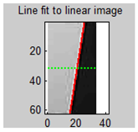
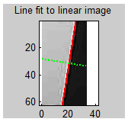
Step 5: Fit line to points
Standard approach
Proposed approach
Ordinary least squares
y = mx + b (slope-intercept form)
Minimizes vertical error
Affected by orientation
Total least squares
ax + by + c = 0 (standard form)
Minimizes perpendicular error
Any orientation

Slide 12
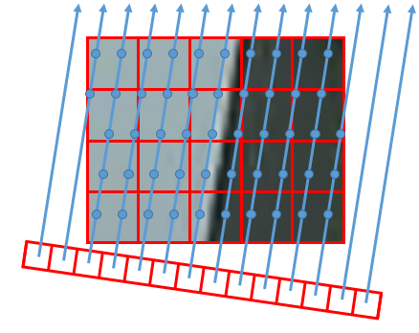
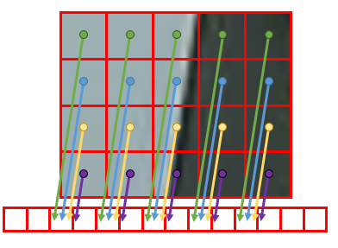
Step 6: Project from 2D to 1D
Standard approach
Proposed approach
Forward projection
For each 2D pixel:
Project to nearest 1D bin
Then average
Reverse projection
For each 1D bin:
Project average of 2D pixels (maybe interpolated)
some
bins
may be
empty
all
bins
have
values!

Slide 13
Forward vs. reverse projection
Forward projection
bump
Reverse projection
(All other steps identical)

Slide 14
What causes the bump?
Forward projection
period of noise = amount of oversampling
Reverse projection

Slide 15
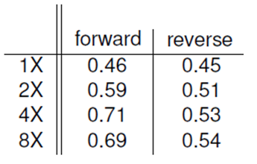
Stability across subsamplings
more stable

Slide 16
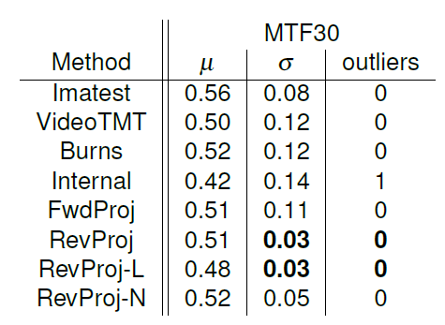
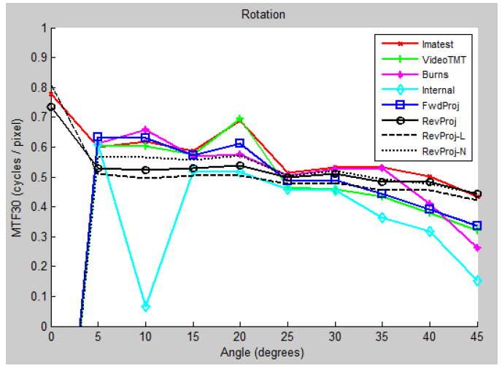
Experiment 1: Different orientations
gap
0º to 45º, increments of 5º (50x50 crops)
Details: 4:1 contrast ratio, 580 lux, 5540 K, AGC off, JPEG

Slide 17
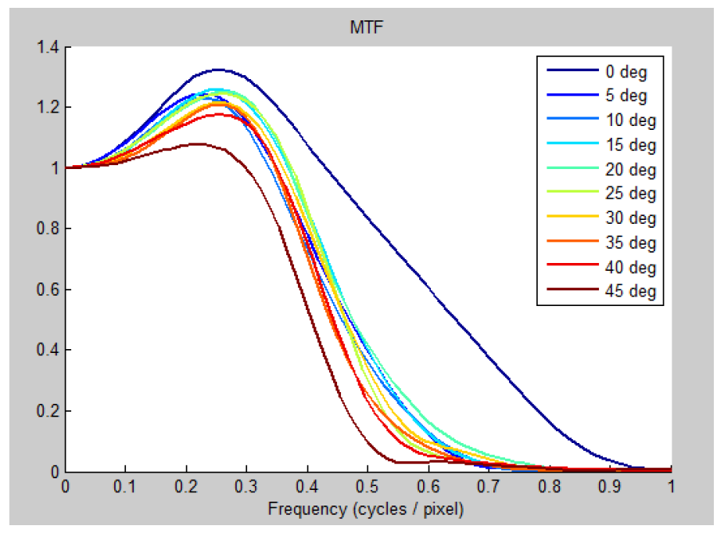
MTF curves of reverse projection
consistency
across
orientation

Slide 18
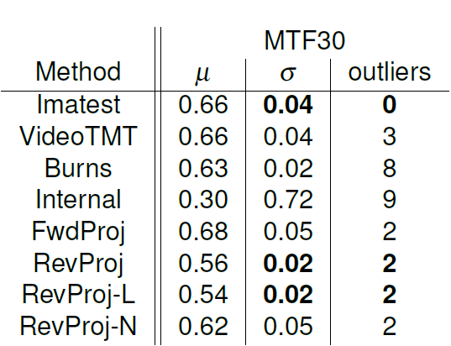
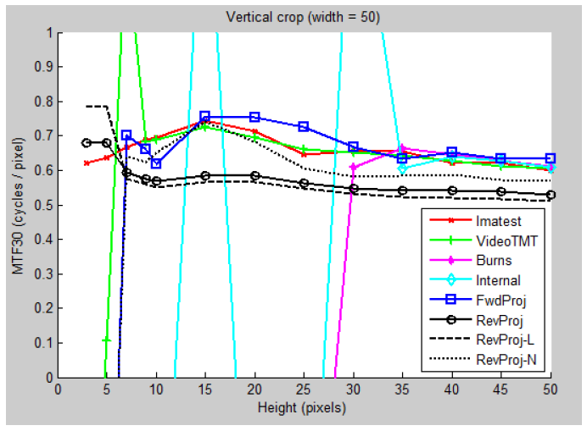
Experiment 2: Vertical crop
Number of rows: 3 to 50

Slide 19
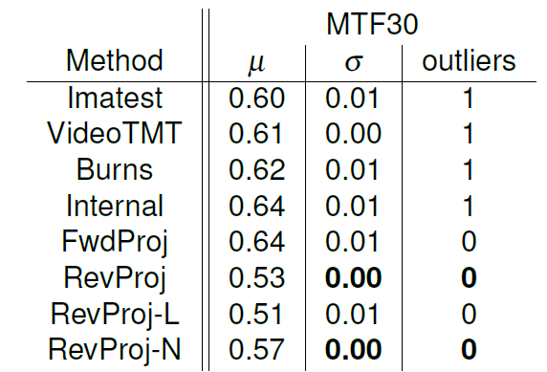
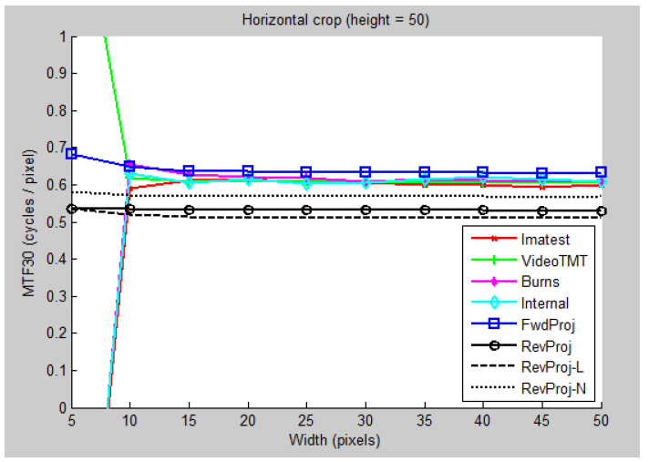
Experiment 3: Horizontal crop
Number of columns: 5 to 50

Slide 20
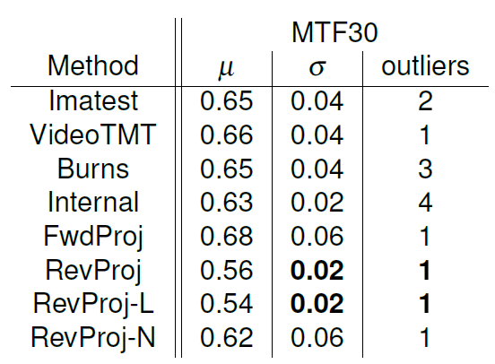
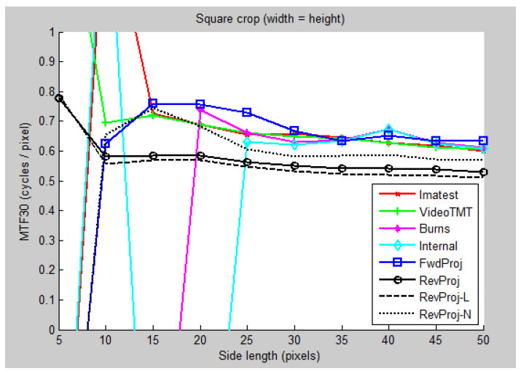
Experiment 4: Square crop
Side length: 5 to 50

Slide 21
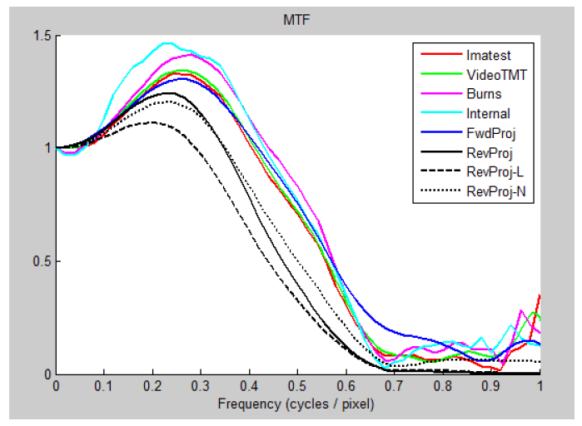
MTF curve comparison
50 x 50 crop
5º orientation
Bilinear interpolation
Bicubic interpolation
No interpolation
→ interpolation alone does
not explain discrepancy

Slide 22
Conclusion
Existing implementations of ISO 12233 exhibit variability
± 0.07 in MTF30 due to crop alone
significant digits
Proposed solution:
Ridler-Calvard to find points
total least squares to fit line
reverse projection
Advantages:
stability
invariance to orientation
Remaining questions:
Is high-frequency bump caused by forward projection?
Is reverse projection more or less accurate?
More experiments?

Slide 23
Thanks!
Special thanks to
Andrew Juenger
Erik Garcia
Kanzah Qasim

