Slide 1
Extracting Minimalistic Corridor Geometry from Low-Resolution Images
Yinxiao Li, Vidya, N. Murali, and Stanley T. Birchfield
Department of Electrical and Computer Engineering
Clemson University
{ yinxial, vmurali, stb }@clemson.edu

Slide 2
What can you see from this image?
16 x 12
Notes:
2

Slide 3
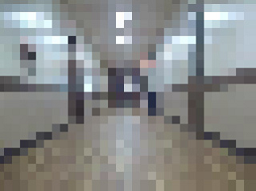
What can you see from this image?
32 x 24
Notes:
3

Slide 4
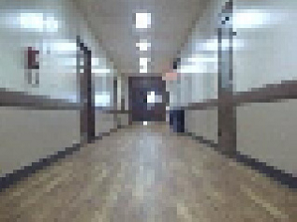
What can you see from this image?
64 x 48
Notes:
4

Slide 5
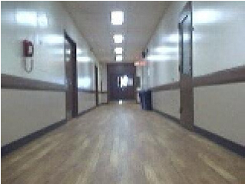
What can you see from this image?
160 x 120
Notes:
5

Slide 6
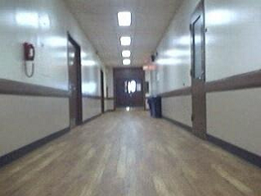
What can you see from this image?
320 x 240
Notes:
6

Slide 7
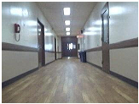
Motivation
Goal: Investigate the impact of image resolution upon the
accuracy of extracting geometry for indoor robot navigation
320 x 240
32 x 24
Why?
reduce computation, free the CPU for other tasks
limit the algorithm search space
autonomous exploration and navigation

Slide 8
Outline
Previous Work
Orientation Line Estimation
Wall-Floor Boundary
Experimental Results
Conclusion

Slide 9
Outline
Previous Work
Orientation Line Estimation
Wall-Floor Boundary
Experimental Results
Conclusion

Slide 10
Previous Work
Related Approaches:
Selective Degradation Hypothesis (Leibowitz et al. 1979)
Scene Classification Using Tiny Images (Torralba 2008, Torralba et al. 2009)
Minimalistic Sensing (Tovar et al. 2004, O’Kane and LaValle 2007)
Autonomous Exploration Using Low-resolution Images (Murali and Birchfield 2008, 2012)
Automatic Floor Segmentation of Indoor Corridors (Li and Birchfield 2010)
Our contributions:
Provide a simple geometric representation for the corridor structure
orientation line and wall-floor boundary
Investigate the minimum resolution needed for basic robot exploration
(320 x 240 → 32 x 24)

Slide 11
Low-resolution exploration (Murali and Birchfield 2008, 2012)

Slide 12
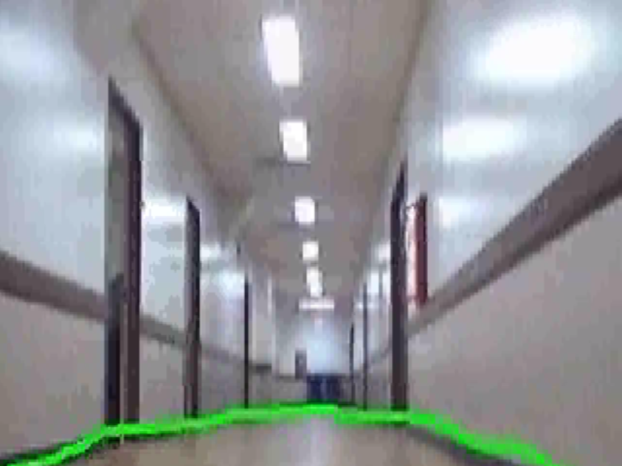
Floor segmentation (Li and Birchfield 2010)

Slide 13
Outline
Previous Work
Orientation Line Estimation
Wall-Floor Boundary
Experimental Results
Conclusion

Slide 14
Orientation Line Estimation
Orientation Line Estimated by combining:
Median of Bright Pixels
Maximum Entropy
Symmetry by Mutual Information

Slide 15
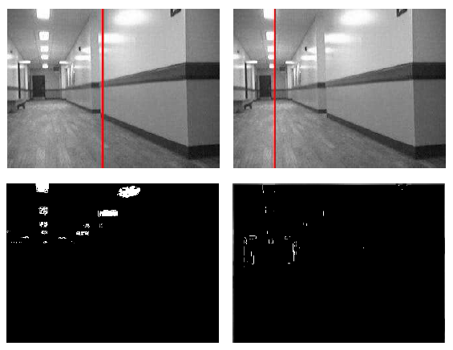
Median of Bright Pixels
Ceiling lights along the main corridor axis
If lights are not in the center → k-means
Ullman’s formula for local contrast to reduce influence of specular reflections
regular
Ullman
Autonomous Exploration Using Rapid Perception of Low-Resolution Image Information, V. N. Murali and S. T. Birchfield, Autonomous Robots, 32(2):115-128, February 2012.

Slide 16
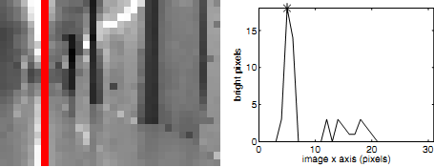
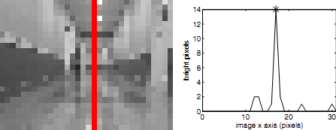
Median of Bright Pixels
Ceiling lights along the main corridor axis

Slide 17
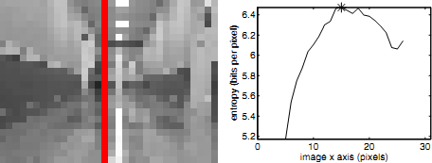
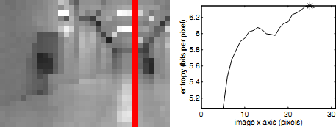
Maximum Entropy
Max entropy occurs when camera is pointing down the corridor
Variety of depths can be seen
More image information
Autonomous Exploration Using Rapid Perception of Low-Resolution Image Information, V. N. Murali and S. T. Birchfield, Autonomous Robots, 32(2):115-128, February 2012.

Slide 18
Symmetry by Mutual Information
Mutual Information
Divide image into vertical slices by horizontal coordinate
Compute probability mass function (PMF)
Joint PMF of intensities
PMFs computed of two sides
Autonomous Exploration Using Rapid Perception of Low-Resolution Image Information, V. N. Murali and S. T. Birchfield, Autonomous Robots, 32(2):115-128, February 2012.

Slide 19
Orientation Line Estimation
Maximum Entropy
Median of Bright Pixels
Symmetry by Mutual Information
Weights
Result largely unaffected by image resolution!

Slide 20
Outline
Previous Work
Orientation Line Estimation
Wall-Floor Boundary
Experimental Results
Conclusion

Slide 21
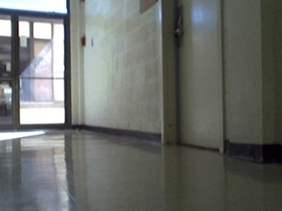
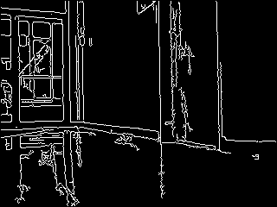
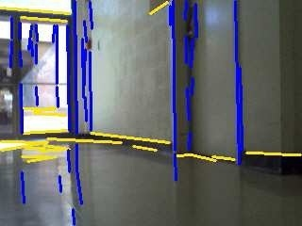
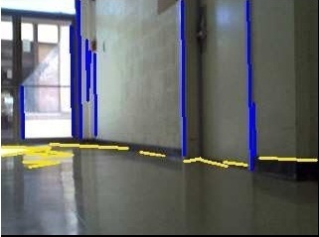
Detecting Line Segments (LS)
Canny
classify as
horiz or vert
prune

Slide 22
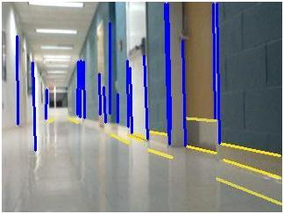
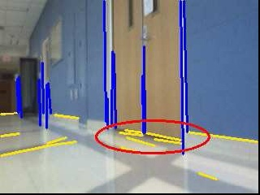
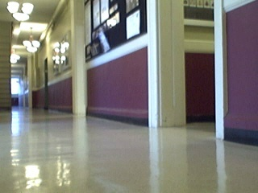
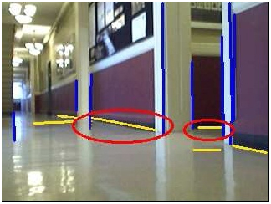
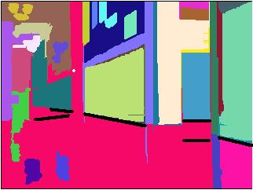
Wall-Floor Boundary – Score Model
horizontal line
Structure Score
Bottom Score
Homogeneous Score
(threshold, then
distance to regions)
(distance to bottom
of vertical lines)
(size of segmented
region just below)
Image-Based Segmentation of Indoor Corridor Floors for a Mobile Robot , Y. Li and S. Birchfield, IROS 2010

Slide 23
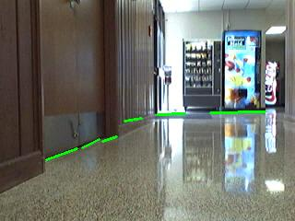
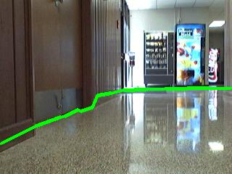
Wall-Floor Boundary
horizontal line
Weights
Structure Score
Bottom Score
Homogeneous Score
connect
Image-Based Segmentation of Indoor Corridor Floors for a Mobile Robot , Y. Li and S. Birchfield, IROS 2010

Slide 24
Wall-Floor Boundary
horizontal line
Weights
Structure Score
Bottom Score
Homogeneous Score
Result largely unaffected by image resolution!
Image-Based Segmentation of Indoor Corridor Floors for a Mobile Robot , Y. Li and S. Birchfield, IROS 2010

Slide 25
Outline
Previous Work
Orientation Line Estimation
Wall-Floor Boundary
Experimental Results
Conclusion

Slide 26
Results
How to combine results?
Orientation Line

Slide 27
Results
How to combine results?
Wall-floor Boundary

Slide 28
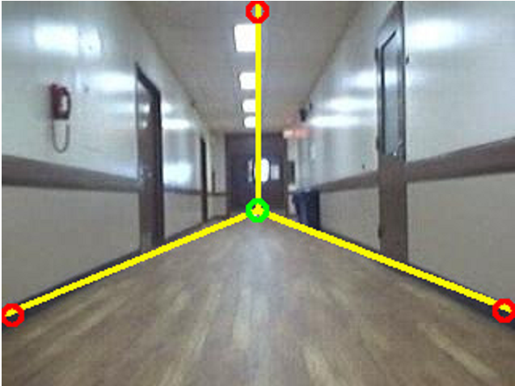
Results
How to combine results?
Proposed Geometry

Slide 29
Results
Results in multi-resolution images

Slide 30
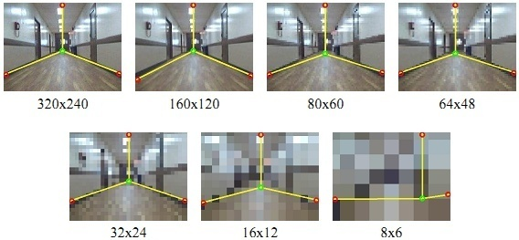
Results

Slide 31
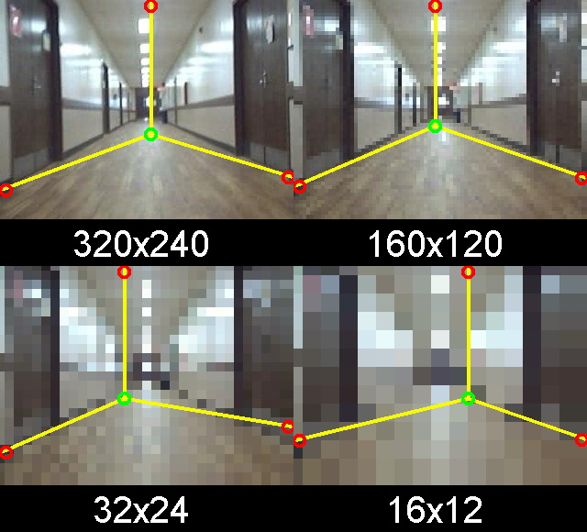
Results
Video

Slide 32
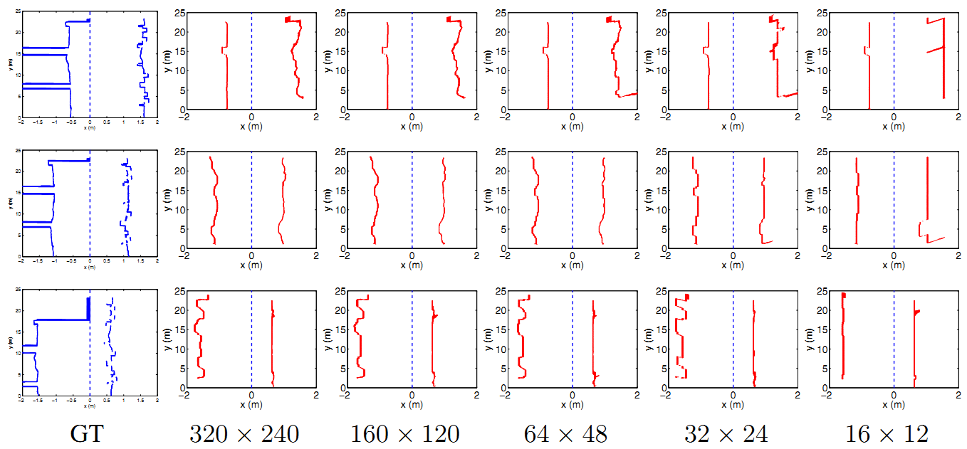
Results
Corridor Reconstruction
Drove robot three times (middle, left, right)
Compared with laser ground truth (in blue)

Slide 33
Outline
Previous Work
Orientation Line Estimation
Wall-Floor Boundary
Experimental Results
Conclusion

Slide 34
Conclusion
Summary
Minimalistic geometric representation of indoor corridor in low-resolution images
Discard 99.8% of image pixels, runs at 1000 fps, which frees CPU for other tasks
Future work
Investigate more complex environments
Integrate geometric representation into closed-loop system
Use geometric representation for mapping

Slide 35
Thanks! Questions?
Partially sponsored by NSF grant IIS-1017007

