Slide 1
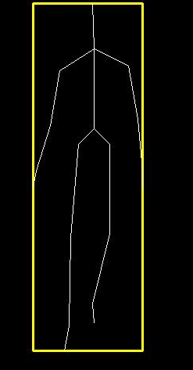
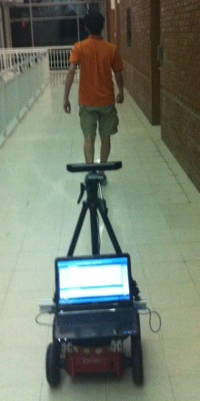
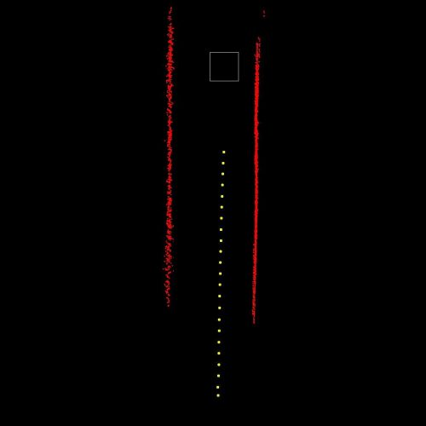
Mobile robot navigation for person following in indoor environments
Ninad Pradhan
Ph.D. Dissertation Defense
July 25 2013
Committee Members:
Dr. Tim Burg
Dr. Stan Birchfield
Dr. Ian Walker
Dr. Damon Woodard

Slide 2
Mobile robot navigation for person following in indoor environments
Person following in indoor environments
Mobile robot navigation in indoor environments
Follower classification
Workspace representation
Leader detection and tracking
Path planning
Map generation
Robot control

Slide 3
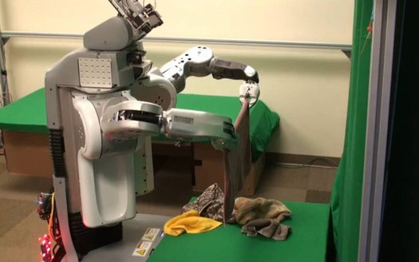
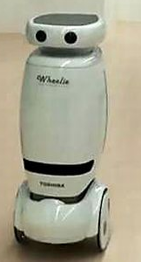

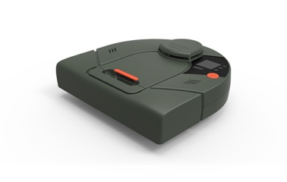
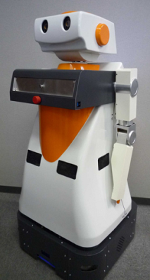
“Robots which operate in human-populated environments and assist humans in daily activities”.
Laundry robots
Restaurant servers
Service robots
Person followers
Vacuum cleaners
Luggage transporters

Slide 4
Museum tour guide
Service robot
‘Rhino’ – Buhmann (1995)
‘Minerva’ – Thrun (2000)
Home patient care
Telepresence
‘Flo’ – Roy (2000)
‘CompanionAble’ – Gross (2011)
Person following
Home oxygen therapy
‘Hein II’ – Tani (2011)
Speech recognition
Assistive personal robots
‘Grace’ – Kirby (2007)
‘Care-o-bot’ – Reiser (2009)

Slide 5
Doisy (2012)
Yoshimi (2006)
Pan-tilt robot head mechanism
Kinect skeletal tracker
Stationary obstacle path planning
Color based identification
Obstacle avoidance
Occlusion handling
Gross (2011)
Chen (2007)
Person following
Telepresence
Complete indoor map
Emergency event detection
Feature tracking
Disparity based segmentation
Motion segmentation
Brookshire (2010)
Miura(2010)
HOG person detection
Stereo estimation for depth
Outdoors person following
Short term occlusions
Laser map generation
Stereo based tracking

Slide 6
Robot follower
Person following
Human leader
From Yoshimi (2006):
Initialize to the leader
Follow the leader at his/her pace
Avoid obstacles
Resume contact with leader after occlusion

Slide 7

Research contribution
Classification system
Fully cooperative leader
Partially cooperative leader
Patient leader
Independent leader
Human leader
Ensures zero occlusions.
Creates exact path for robot
Ensures zero obstacles between leader and robot
Ensures zero occlusions.
Expects path planning for stationary obstacles.
Ensures all obstacles are low height and stationary.
Makes no effort to avoid occlusions.
Makes no effort to stay within sensor range.
Waits for robot to overcome occlusions.
Makes no effort to avoid occlusions.
Does not wait for robot to overcome occlusions.
Expects high level communication with robot.

Slide 8
Chen (2007)
Kirby (2007)
Brookshire (2010)
Yoshimi (2006)
Doisy (2012)
Miura (2010)
Satake (2009)
Weinrich (2012)
Gross (2011)
Classification system
Fully cooperative leader
Partially cooperative leader
Patient leader
Independent leader
Level 1
Level 2
Level 3
Level 4

Slide 9
Leader expectations
System requirements
Leader does not make an effort to avoid occlusions.
Leader does not make an effort to stay within sensor range.
Control robot motion to handle occlusions.
Establish and verify leader identity.
Leader does not create a path for the robot to follow.
Leader walks in an environment with stationary and moving obstacles.
Create a map to establish a workspace for path planning.
Plan a robot path around stationary and moving obstacles.
Level 3
System modules

Slide 10
Research contribution
Leader tracking
Kinect skeletal tracker
Appearance descriptor generation
Leader detection, occlusion inference
Kinect RGB-D sensor
Mapping
Manhattan rotation
Floor occupancy detection
Local environment map generation
Translation estimation
Pioneer P3-AT robot
Indoor environment
Navigation
Control input generation
Predictive fields navigation
Workspace generation
System modules

Slide 11
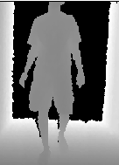
Leader tracking
Kinect skeletal tracker
Appearance descriptor generation
Leader detection, occlusion inference
Leader tracking
Kinect skeletal tracker
Appearance descriptor generation
Leader detection, occlusion inference
Kinect depth image
Skeletal detection
Detection details
Shotton (2011).
Depth-only detection.
Person and pose detection.
20 joints for pose, 19 bones.
Tracking status of skeleton.
Skeleton center in 3D (mm).
Tracking status of joint.
Position of joint in 3D (mm).

Slide 12
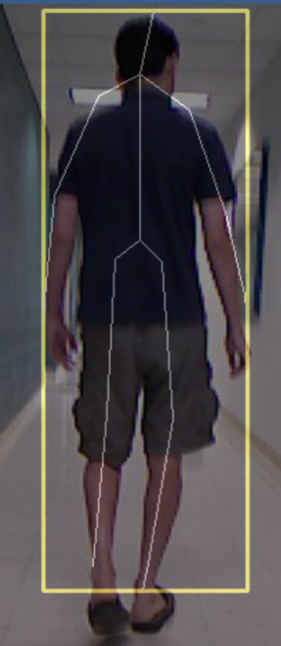
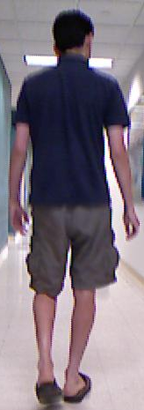

Research
contribution
Leader tracking
Kinect skeletal tracker
Appearance descriptor generation
Leader detection, occlusion inference
$$\left[\begin{matrix}\begin{matrix}H_{1} \\ \begin{matrix}S_{1} \\ a_{1}\end{matrix}\end{matrix} \\ b_{1} \\ \begin{matrix}⋮ \\ H_{19} \\ \begin{matrix}S_{19} \\ a_{19} \\ b_{19}\end{matrix}\end{matrix}\end{matrix}\right]$$
HSI color space
Extracted bone patch
Detection details
Skeleton overlay
L*a*b* color space
Person Descriptor
RGB image

Slide 13
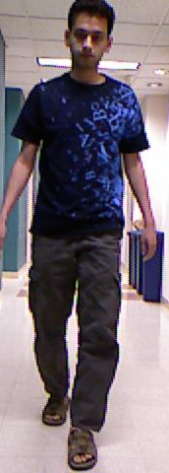
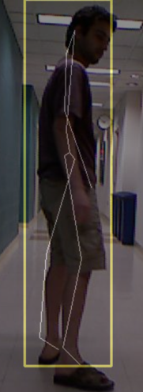
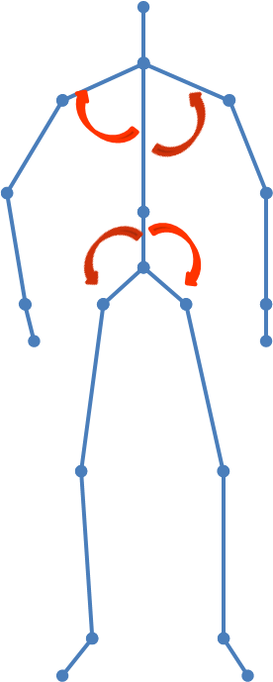
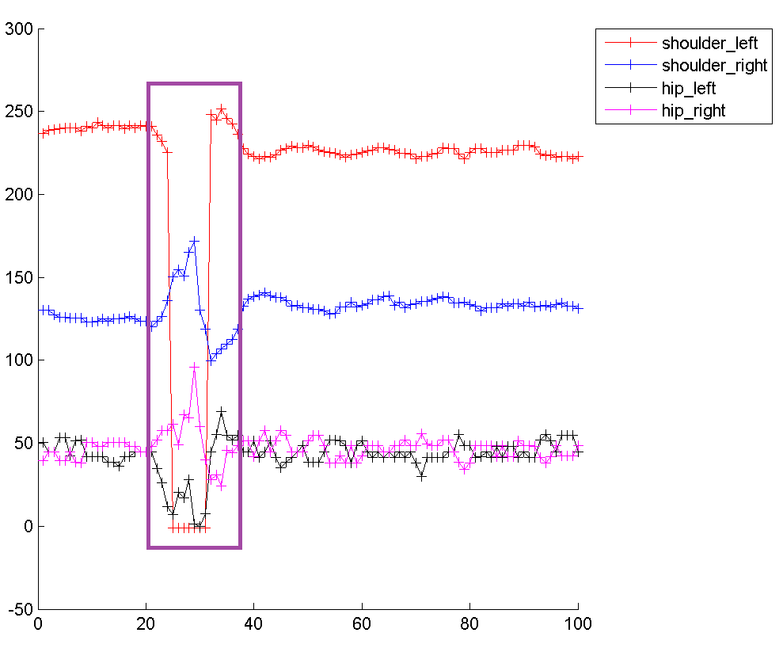
Research
contribution
Leader tracking
Kinect skeletal tracker
Appearance descriptor generation
Leader detection, occlusion inference
Leader
Descriptor
Occlusion types
Self-occlusion
Sensor range occlusion
Obstacle/person occlusion
Person Descriptor
Poor skeletal overlay
Bone angles to detect self-occlusion

Slide 14
Research
contribution
Leader tracking
Kinect skeletal tracker
Appearance descriptor generation
Leader detection, occlusion inference
Leader skeleton tracked?
No
Yes
Yes
Last position close to sensor range limit?
No
No
Bone angles okay?
Yes
Another descriptor matches leader descriptor?
Occlusion types
Descriptor matches leader descriptor?
Self-occlusion
No
Yes
Yes
No
Pause robot/ path planning
Follow person ‘exactly’
Set as recovered leader
Pause robot/ path planning
Sensor range occlusion
Obstacle/person occlusion
Occlusion inference and recovery
Self-occlusion
Sensor range occlusion
Obstacle/person
occlusion

Slide 15
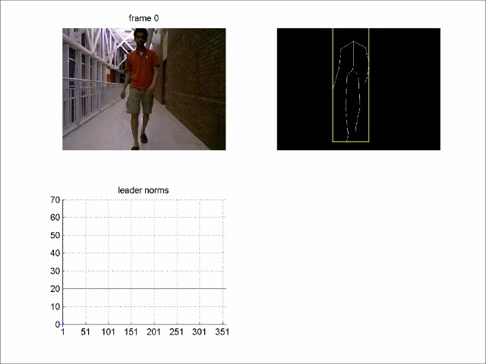
Leader tracking
Kinect skeletal tracker
Appearance descriptor generation
Leader detection, occlusion inference
Occlusion inference and recovery

Slide 16
System modules
Leader tracking
Kinect skeletal tracker
Appearance descriptor generation
Leader detection, occlusion inference
Kinect RGB-D sensor
Mapping
Manhattan rotation
Floor occupancy detection
Local environment map generation
Translation estimation
Pioneer P3-AT robot
Indoor environment
Navigation
Control input generation
Predictive fields navigation
Workspace generation

Slide 17
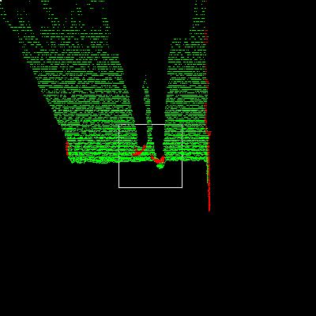
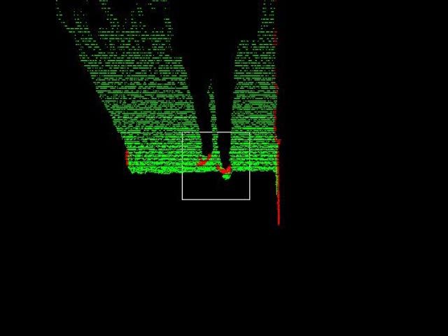
Mapping
Manhattan rotation
Floor occupancy detection
Local environment map generation
Translation estimation
What does the workspace look like?
Plan a robot path to overcome occlusions?
Simultaneous Localization and Mapping (SLAM)
Where is the robot located relative to the workspace?
Mapping
Manhattan rotation
Floor occupancy detection
Local environment map generation
Translation estimation
Floor plane equation
Occupancy map
Estimate inter-frame translations and rotations

Slide 18
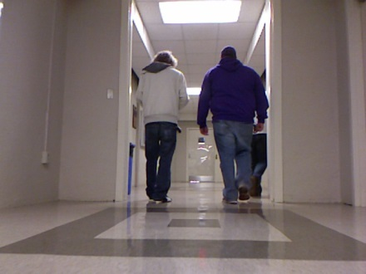
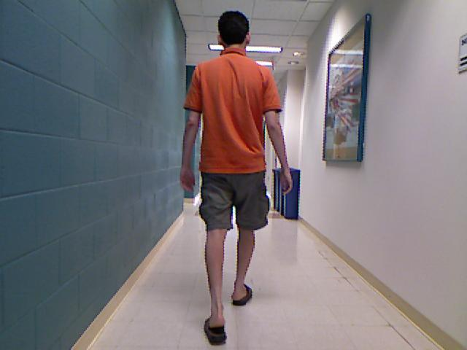
Mapping
Manhattan rotation
Floor occupancy detection
Local environment map generation
Translation estimation
3-D correspondences
Scan matching
Reasonable rotation estimates, though occasional failures were seen.
Poor translation estimates.
Direct 3D – Point cloud matching (ICP)
2D to 3D – Feature point matching
Too slow when matching entire point cloud
Inaccurate with sampled point cloud.
Unpredictable performance.
Too few features in some frames.
Poorly tracked features in some frames
Estimate inter-frame translations and rotations

Slide 19
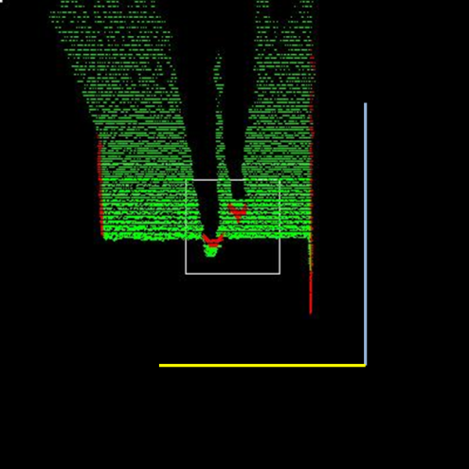
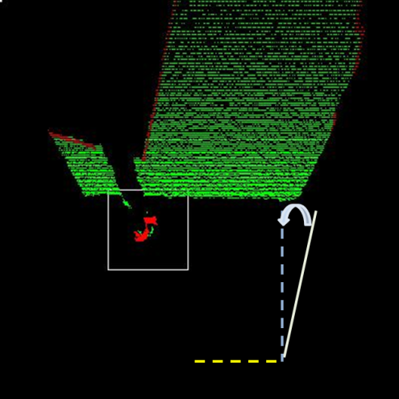







Research
contribution
Mapping
Manhattan rotation
Floor occupancy detection
Local environment map generation
Translation estimation
Estimate inter-frame translations and rotations
Manhattan assumption
Map initialization
Total rotation relative to reference
Inter-frame rotation estimate
$$R_{n}$$
$$R_{n−1}$$
$$t_{0}$$
$$⋯$$
$$t_{n−1}$$
$$t_{n}$$
$$R_{n−1}^{n}$$
Wall planes are mutually orthogonal
Find reference lines and create mutually orthogonal bins
No need for inter-frame correspondences
Previously used by:
Peasley (2012)
Furukawa (2009)

Slide 20
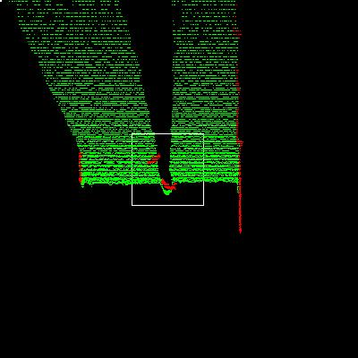
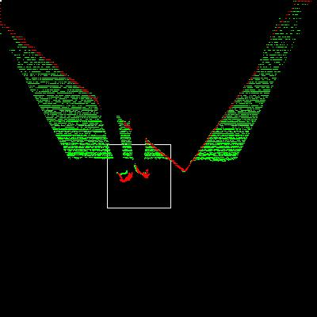
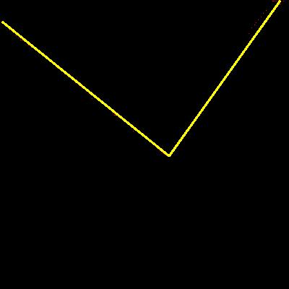
Mapping
Manhattan rotation
Floor occupancy detection
Local environment map generation
Translation estimation
Estimate inter-frame translations and rotations
Scan generation
Multi-line RANSAC
Total Manhattan rotation estimate
Reference orientation
Create a set of polar coordinate pairs relative to robot position
Robust line fitting to estimate a set of lines from scan data
Use inter-frame rotation model and RANSAC estimation

Slide 21




Research
contribution
Mapping
Manhattan rotation
Floor occupancy detection
Local environment map generation
Translation estimation
Robot motion input
Total Manhattan rotation estimate
$$R_{0}^{n}$$
$$\left(\begin{matrix}\dot{r} & ∆t\end{matrix}\right)$$
Inter-frame translation estimate
$$\left(\begin{matrix}∆x_{n−1}^{n} & ∆z_{n−1}^{n}\end{matrix}\right)$$
Total translation estimate
$$\left(\begin{matrix}x_{0}^{n} & z_{0}^{n}\end{matrix}\right)$$

Slide 22
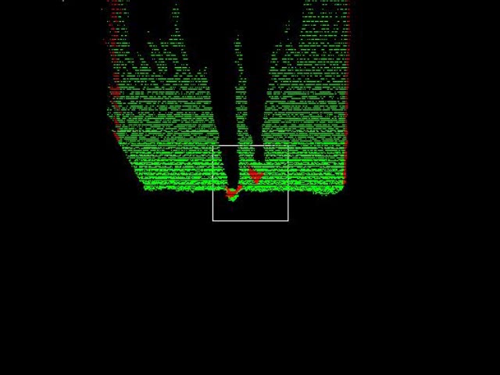
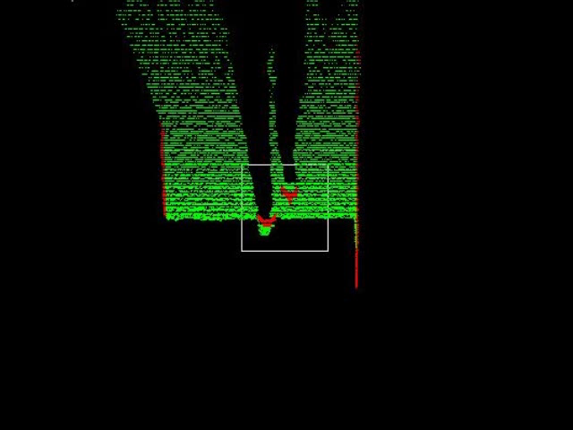
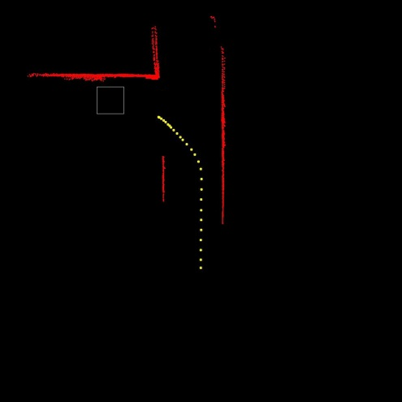
Research
contribution
Mapping
Manhattan rotation
Floor occupancy detection
Local environment map generation
Translation estimation
Total Manhattan rotation estimate
Robot workspace map
Total translation estimate
Straight line map
T-junction map

Slide 23
System modules
Leader tracking
Kinect skeletal tracker
Appearance descriptor generation
Leader detection, occlusion inference
Kinect RGB-D sensor
Mapping
Manhattan rotation
Floor occupancy detection
Local environment map generation
Translation estimation
Pioneer P3-AT robot
Indoor environment
Navigation
Control input generation
Predictive fields navigation
Workspace generation

Slide 24
Navigation
Control input generation
Predictive fields navigation
Workspace generation
Leader unobstructed?
Yes
No
‘Exact’ person following
Predictive fields navigation
Navigation
Control input generation
Predictive fields navigation
Workspace generation

Slide 25
Navigation
Control input generation
Predictive fields navigation
Workspace generation
Nonholnomic navigation functions
Tanner (2003, 2005, 2010)
Potential fields path planning
Navigation functions
Modified topology, gain tuning
Predictive fields navigation
Khatib (1986)
Krogh (1986)
Arkin (1987)
Rimon and Koditschek (1990, 1991, 1992)
Filippidis (2011,2012)
“Topological representation of the robot workspace in which the goal is the lowest point and obstacles are peaks. Goal attracts the robot, obstacles repel it.”

Slide 26
Research
contribution
Navigation
Control input generation
Predictive fields navigation
Workspace generation
‘Star-world’ transformations
Workspace representation
Navigation functions
Navigation functions
Can only be estimated for circular worlds.
Require non-circular worlds to be ‘star worlds’.
Require unknown shape transformation to map star world to a circular world.
Do not guarantee convergence for non star-world/circular workspaces
Predictive fields
Encapsulate practical workspaces using circular envelopes.
Do not need complicated transformations.
Retain all mathematical guarantees for arbitrary workspaces.
Similar to ‘union of ellipsoids’ by Tanner (2003)
Predictive fields navigation

Slide 27
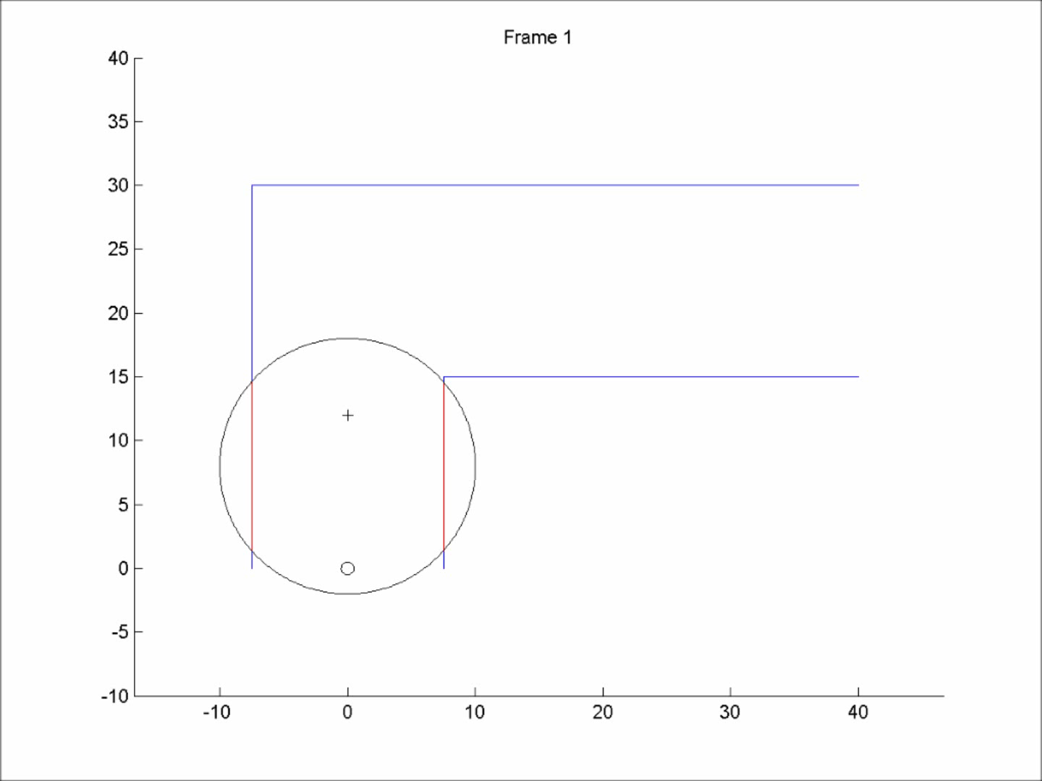
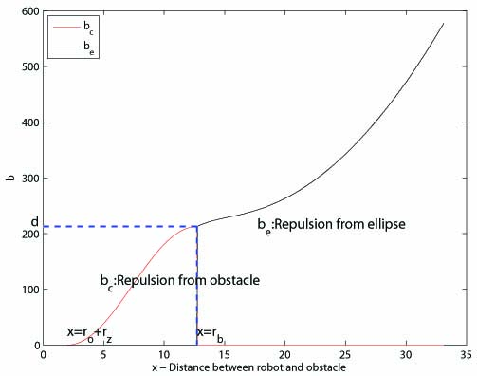
Research
contribution
Navigation
Control input generation
Predictive fields navigation
Workspace generation
‘Star-world’ transformations
Workspace representation
Navigation functions
Predictive fields navigation
No moving obstacles
Elliptical fields representation
Elliptical envelope represents direction and speed of obstacle.
Project obstacle along the major axis of its general ellipse.
Rimon-Koditschek (1992) do not allow moving obstacles.
Chen (2005,2007) showed that moving obstacles could be used.
No incorporation of the sense of motion of obstacles.
Can take robot along a route with collision hazards.
Redefine obstacle repulsion function based on elliptical field.

Slide 28
Research
contribution
Navigation
Control input generation
Predictive fields navigation
Workspace generation
‘Star-world’ transformations
Workspace representation
Navigation functions
Predictive fields navigation
No moving obstacles
Elliptical fields representation
Rimon-Koditschek (1992) do not allow moving obstacles.
Chen (2005,2007) showed that moving obstacles could be used.
No incorporation of the sense of motion of obstacles.
Can take robot along a route with collision hazards.
Robot stays out of path of collision hazard.
Moving obstacle model is useful in indoor populated environments.

Slide 29
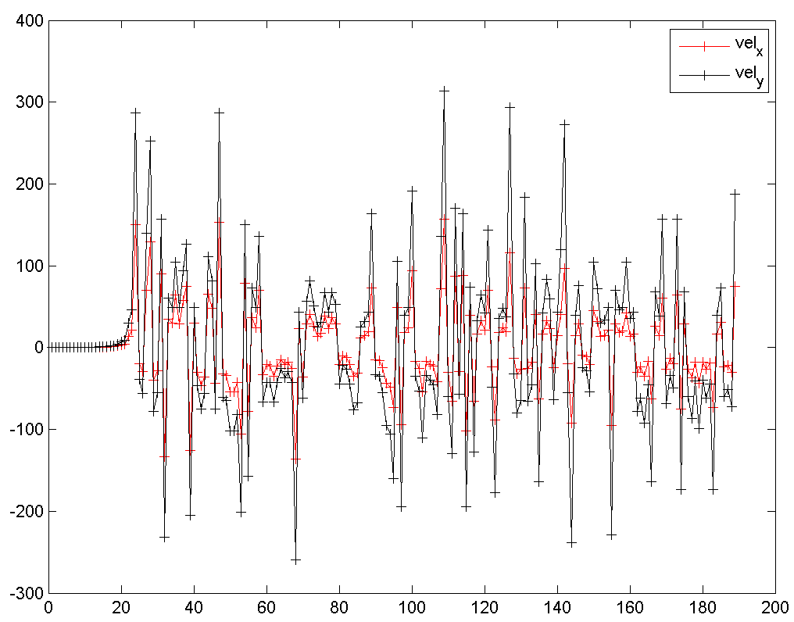
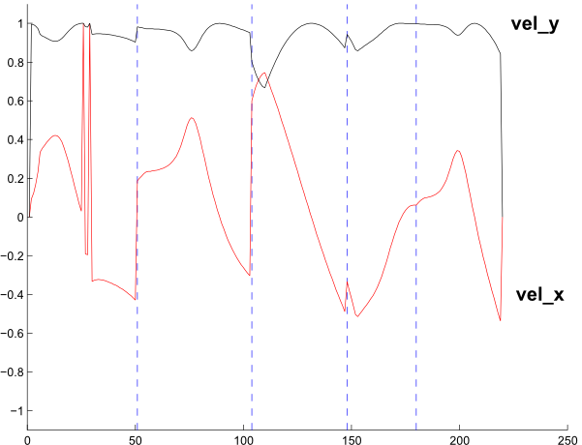
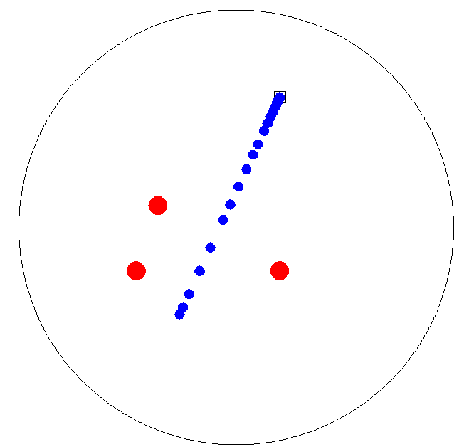


Research
contribution
Navigation
Control input generation
Predictive fields navigation
Workspace generation
‘Star-world’ transformations
Workspace representation
Navigation functions
No moving obstacles
Elliptical fields representation
Predictive fields navigation
Unpredictable control inputs
Normalized control input
$$u=−K\frac{{\left(\frac{∂φ}{∂q}\right)}^{T}}{\left\|\frac{∂φ}{∂q}\right\|+ε}$$
$$\dot{q}=u$$

Slide 30
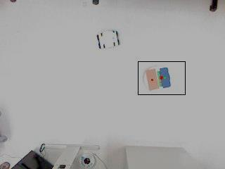
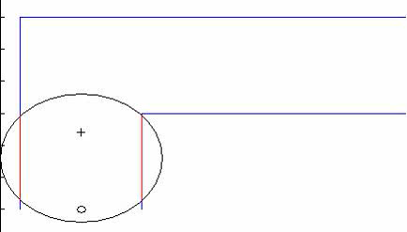
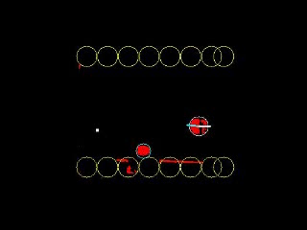
Research
contribution
Navigation
Control input generation
Predictive fields navigation
Workspace generation
Workspace representation
Elliptical fields representation
Predictive fields navigation
Normalized control input
Simulated workspace
Experimental verification
Generate waypoints to be able to track a moving goal.
One of the first experimental demonstrations of navigation functions.
Used the iRobot Roomba and Kinect to set up experiment.

Slide 31
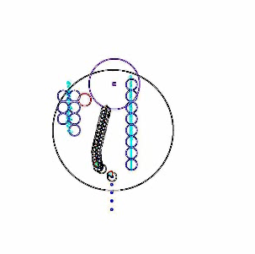
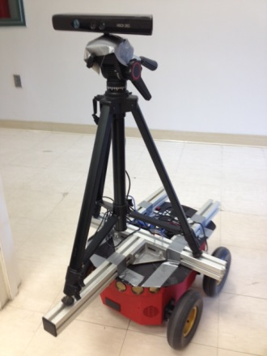
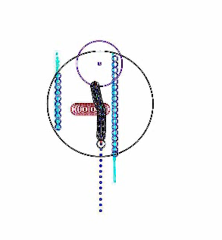
Research
contribution
Navigation
Control input generation
Predictive fields navigation
Workspace generation
Person following using predictive fields
Generate map
Detect leader occlusion
Create predictive fields workspace
Get and act on robot control input.
Continue `exact following’ when leader is reidentified.
Experimental verification
Single stationary obstacle
Single moving obstacle

Slide 32
Navigation
Mobile robot person following system
Control input generation
Predictive fields navigation
Workspace generation
Leader tracking
Kinect skeletal tracker
Appearance descriptor generation
Leader detection, occlusion inference
Kinect RGB-D sensor
Mapping
Manhattan rotation
Floor occupancy detection
Local environment map generation
Translation estimation
Pioneer P3-AT robot
Indoor environment

Slide 33
Mobile robot person following system
Person follower classification system
Experimental verification of navigation function path planning
Occlusion detection and recovery system
Questions?
Research contributions
Practical representation of robot workspaces
Simple mapping algorithm for indoor environments
Method to generate practical control inputs to robot
Path planning approach sensitive to obstacle motion

