Slide 1
Large Scale 3D Mapping of Indoor
Environments Using a Handheld RGBD Camera
Brian Peasley
PhD Candidate
Clemson University

Slide 2
What is 3D Mapping?
3D Reconstruction of an environment using multiple data points from a sensor and recovery of that sensors trajectory.

Slide 3
3D Mapping Outline
Static Scene
T
Sensor
Reading
Camera
Tracking
Integration
Model
Loop Closure
Detection
Loop
Closing

Slide 4
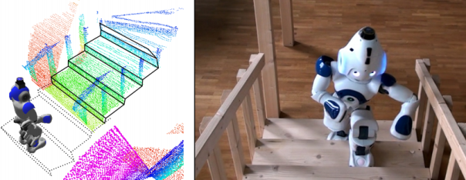
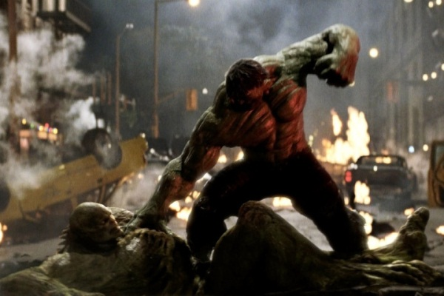
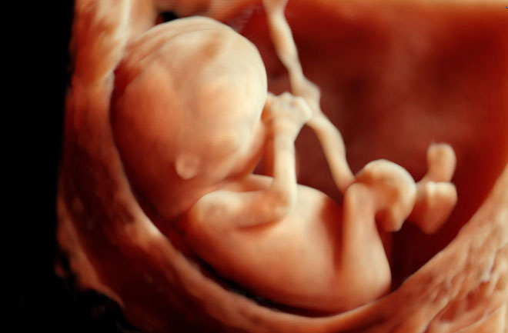
Why?
Robotics:
Navigation
Object Manipulation
Computer Graphics:
Augmented Reality
Compositing
Medical:
Aid In Surgery
Monitor Prenatal Development

Slide 5
Simple 3D Mapping System
Manhattan Constraint
All walls are parallel or perpendicular:
Mapping to Model
Reduce Drift
Obviate Loop Closures
Examine Multi-Resolution Hierarchical Representations
Memory efficient
Allows for large scale reconstructions
Sensor
Reading
Camera
Tracking
Integration
Model
Loop Closure
Detection
Loop
Closing

Slide 6
Simple 3D Mapping System
Traditionally estimate pose w.r.t. previous sensor reading
Sensor
Reading
Camera
Tracking
Integration
Model
Map to Model (errors do not compound)
Model

Slide 7
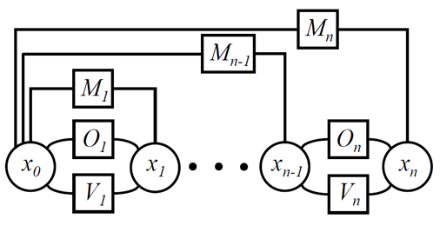
Simple 3D Mapping System
Model
All walls are parallel or perpendicular
Sensor
Reading
Camera
Tracking
Integration
Model
Manhattan
Constraint
Onboard
Odometry
Robot Pose
Visual
Odometry
B. Peasley, S. Birchfield, A. Cunningham, and F. Dellaert. “Accurate on-line 3D occupancy grids using Manhattan world constraints”, International Conference on Intelligent Robots and Systems (IROS), 2012.

Slide 8
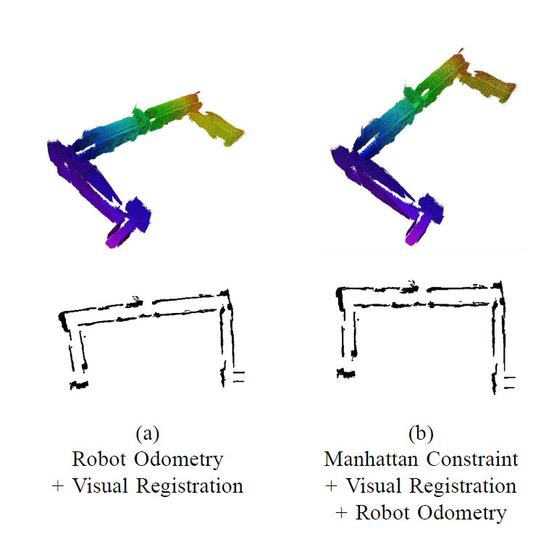
Simple 3D Mapping System

Slide 9
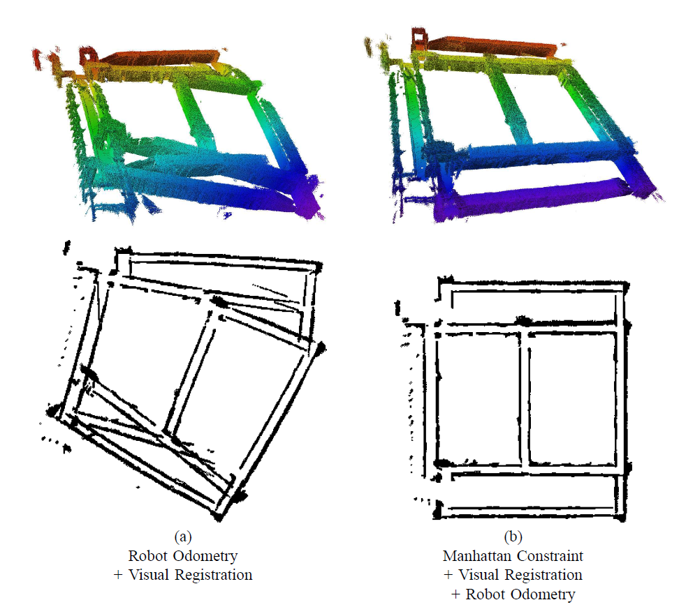
Simple 3D Mapping System

Slide 10
Simple 3D Mapping System
Sensor
Reading
Camera
Tracking
Integration
Model
53m x 53m x 4m
(30 mm resolution)
7,789 RGBD Images
@ 640x480
Point Clouds:
# 3D Points = 7,789 x (640 x 480)
1 Colorless 3D Point = 12 Bytes
1 Colored 3D Point = 15 Bytes
Reconstruction Memory Usage:
Colorless ~ 28.71 GB
Colored ~ 35.89 GB

Slide 11
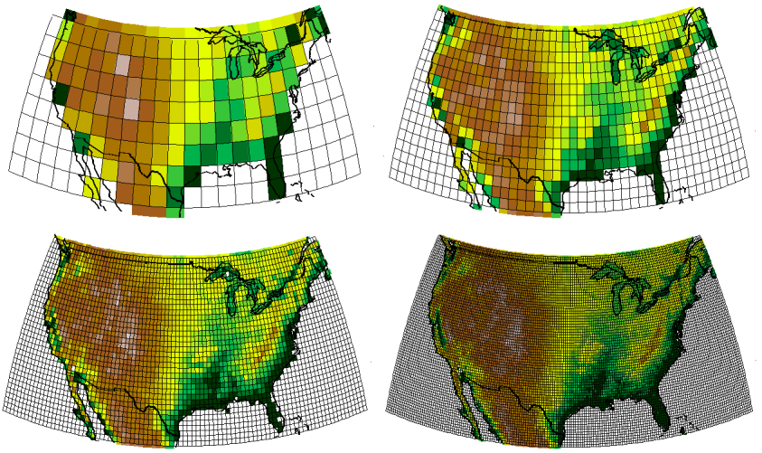
Simple 3D Mapping System
3D Occupancy Grid
Save reconstruction in a voxel volume.
3D binary image
Each voxel is occupied or free
More voxels = higher resolution
53m x 53m x 4m
(30 mm resolution)
7,789 RGBD Images
@ 640x480
To store as colored 3D occupancy Grid:
$$\left(@ 30 mm res\right)\frac{53,000}{30}∗\frac{53,000}{30}∗\frac{4,000}{30}\frac{cells}{grid}∗4\frac{bytes}{cell}=1.64\frac{GB}{grid}$$
$$\left(@ 4 mm res\right)\frac{53,000}{5}∗\frac{53,000}{5}∗\frac{4,000}{5}\frac{cells}{grid}∗4\frac{bytes}{cell}=702.25\frac{GB}{grid}$$

Slide 12
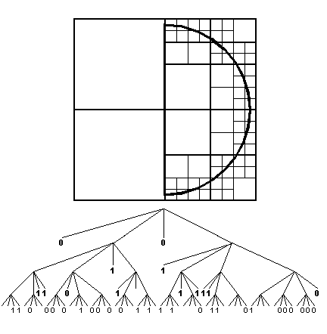
Simple 3D Mapping System
Octrees
Hierarchical Representation
Only allocates memory needed
Requires ~2.6 bits to store a voxel
Illustrated with Quadtrees and pixels
M. Botsch, A. Wiratanaya, and L. Kobbelt. Efficient High Quality Rendering of Point Sampled Geometry. In Thirteenth Eurographics Workshop on Rendering, 2002.

Slide 13
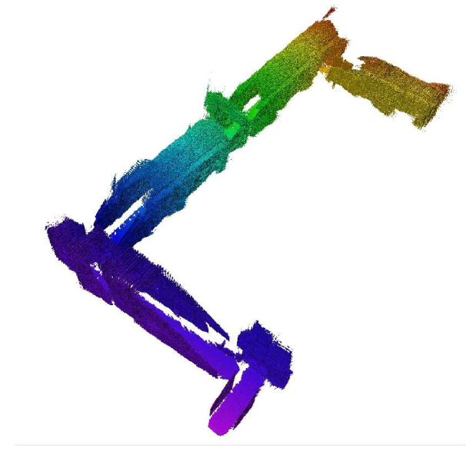
Simple 3D Mapping System
50m x 24m x 5m
(30 mm resolution)
3,300 RGBD Images
@ 640x480
53m x 53m x 4m
(30 mm resolution)
7,789 RGBD Images
@ 640x480
Colorless:
Point Cloud: 12.7 GB
Occ. Grid (30 mm): 22.2 MB
Occ. Grid (4 mm): 93.75 GB
Octree (30mm): 941 KB
Colorless:
Point Cloud: 28.7 GB
Occ. Grid (30 mm): 41.6 MB
Occ. Grid (4mm): 175.56 GB
Octree (30mm): 5.6 MB

Slide 14
Simple 3D Mapping System
What did we learn?
Sensor
Reading
Camera
Tracking
Integration
Model
Mapping to model:
Useful for reducing drift
World isn’t always as simple as a Manhattan World
Multi-Resolution Representation:
Greatly reduces the amount of memory required to store a reconstruction

Slide 15
Kinect Fusion
Sensor
Reading
Camera
Tracking
Integration
Model
R. A. Newcombe, S. Izadi, O. Hilliges, D. Molyneaux, D. Dim, A. J. Davison, P. Kohli, J. Shotton, S. Hodges, and A. Fitzgibbon. KinectFusion: Real-time Dense Surface Mapping and Tracking. In Proceedings of the 10th IEEE International Symposium on Mixed and Augmented Reality (ISMAR), pages 127-126, 2011.

Slide 16
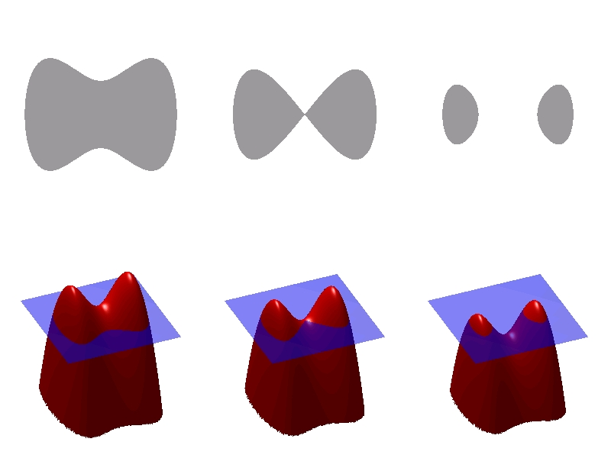
Kinect Fusion
Truncated Signed Distance Function (TSDF)
3D Voxel Volume
Each voxel contains signed distance to nearest surface
Distances bounded by an upper limit (truncated)
positive = inside an object
negative = outside an object

Slide 17
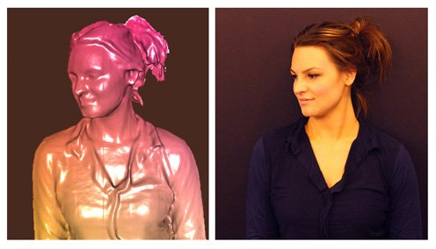
Kinect Fusion
Reconstructed Scene
Current
Frame
Surface
Estimation
Sensor
Reading
Camera
Tracking
Integration
Model
Last estimated pose

Slide 18
Kinect Fusion
Limitations
Environment Size
Reconstruction is bounded to a TSDF volume
TSDF memory consumption exponentially increases with size and resolution
Camera Tracking
Only uses depth, fails when little geometry is present
Cannot maintain tracking with sparse depth information
TSDF
TSDF

Slide 19
Camera Tracking
Iterative Closest Point (ICP)
Given two point clouds, find all matching points.
Correspondence
Family of algorithms that iteratively aligns two point clouds together in a 6 step process.
Weighting
Rejection
Error Metric
Minimize
Update

Slide 20
Camera Tracking
Projective Data Association (PDA)
p₀
p₃
p₂
p₁
P
Project p₀ onto D_{Q}
Compute q₀
q₃
Q
q₀
q₁
q₂
G. Blais and M. Levine. “Registering multiview range data to create 3D computer objects”, IEEE Transactions on Pattern Analysis and Machine Intelligence (PAMI), 1995.
D_{Q}

Slide 21
Camera Tracking
Overcoming Limitations of PDA
Limitations:
Fails in areas with few salient geometric features (flat walls, long hallways)
Clouds must be initially relatively close
Greatly affected by noisy or sparse depth data.
Lucas-Kanade Data Association (LKDA)
Maintains tracking in geometrical featureless environments
Clouds to not need to be closely aligned
Maintains tracking with sparse depth information
Correspondences only computed once

Slide 22
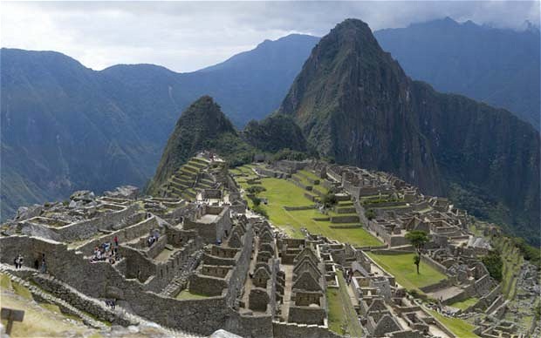
Camera Tracking
Lucas-Kanade
Iteratively align two images:
I
J
$$W(x,y;ζ)$$
Linearize about current estimate and solve a standard linear system.

Slide 23
Camera Tracking
Lucas-Kanade Data Association (LKDA)
Q
P
q_{i}
p_{i}
Project p_{i} onto C_{P}
Map to D_{Q}
$$\left[\begin{matrix}\overline{x} \\ \overline{y}\end{matrix}\right]=M(\tilde{x},\tilde{y})$$
C_{Q}
D_{Q}
C_{P}
D_{P}
B. Peasley and S. Birchfield, “Replacing Projective Data Association with Lucas-Kanade for KinectFusion”, International Conference on Robotics and Automation, 2013.

Slide 24
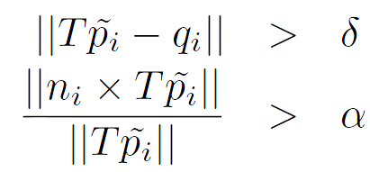
Camera Tracking
Iterative Closest Point (ICP)
LKDA
Correspondence
Projective Data Association
Sum of Squared distances between corresponding points “point-to-point”
Sum of squared distances from each source point to the plane containing the destination point “point-to-plane”
Weighting
Rejection
Error Metric
Lucas-Kanade Data Association
Minimize
Update

Slide 25
Camera Tracking
Point-to-Plane Error Metric and Minimization
p₀
p₂
p₃
p₁
n₀
n
Error Metric:
n₁
n₂
q₃
q₀
q₁
q₂
Iterative minimization: T contains non-linear components. Linearize about current estimation and solve linear system.

Slide 26
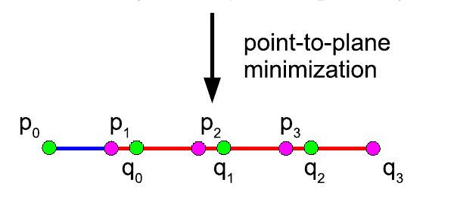
Camera Tracking
Point-to-Plane Limitation

Slide 27
Camera Tracking
Point-to-Point Error Metric and Minimization
p₀
p₂
p₃
p₁
$$E=\sum_{i=1}^{N}{{|\left|Tp_{i}−q_{i}\right||}^{2}}$$
Error Metric:
q₀
q₃
q₁
q₂
Minimization:
Iterative: Linearize about current estimation and solve linear system.
Direct: Procuste’s Analysis (sensitive too noise)

Slide 28
Camera Tracking
Choosing Error Metric
 | Convergence Speed | Alignment Accuracy | Direct Solution
Point-to-Plane | ✓ | ✓
Point-to-Point |  |  | ✓
*limited by geometry
Correspondence Accuracy inversely proportional to “amount of geometry”
(condition number of C)
$$C=\sum_{i=1}^{N}{\left[\begin{matrix}n_{x}^{i}n_{x}^{i} & n_{x}^{i}n_{y}^{i} & n_{x}^{i}n_{z}^{i} \\ n_{y}^{i}n_{x}^{i} & n_{y}^{i}n_{y}^{i} & n_{y}^{i}n_{z}^{i} \\ n_{z}^{i}n_{x}^{i} & n_{z}^{i}n_{y}^{i} & n_{z}^{i}n_{z}^{i}\end{matrix}\right]}$$
 | Low Geometry | High Geometry
Point-to-Plane |  | ✓
Point-to-Point | ✓

Slide 29
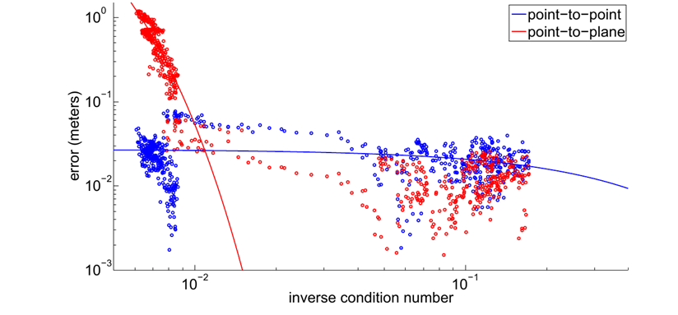
Camera Tracking
Error vs Condition Number
Low Geometry High Geometry

Slide 30
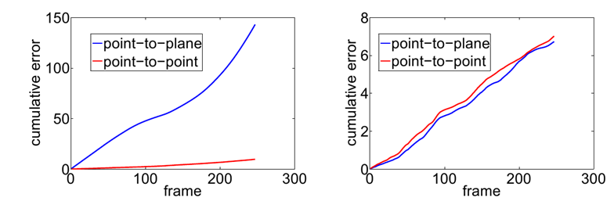
Camera Tracking
Cumulative Errors
Low Geometry High Geometry

Slide 31
Camera Tracking
Iterative Closest Point (ICP)
LKDA
Correspondence
Weighting
k = Number of iterations
$$T=\prod_{i=0}^{k−1}{T_{k−i}}$$
$$T=T_{k}T_{k−1}…T_{1}$$
Rejection
Error Metric
Minimize
Update

Slide 32
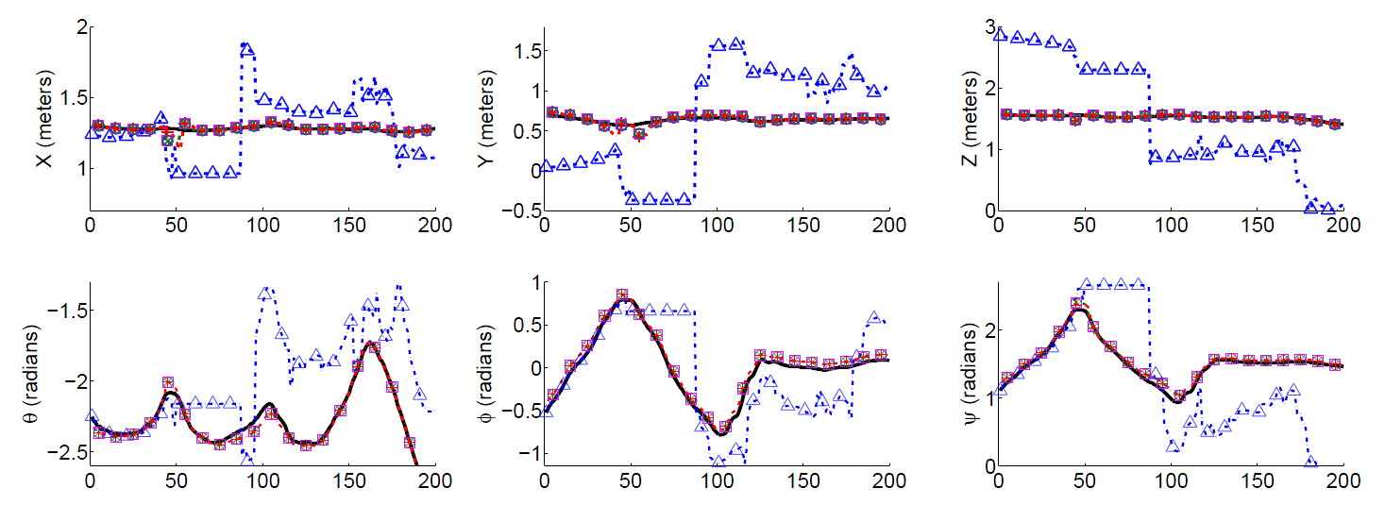
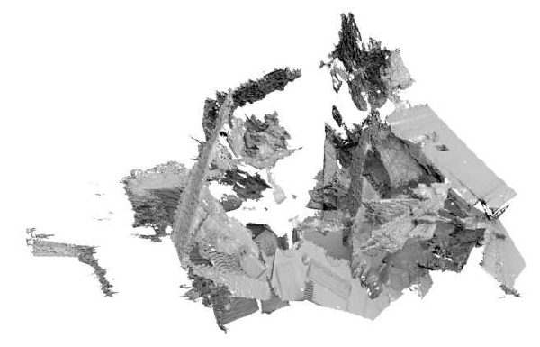
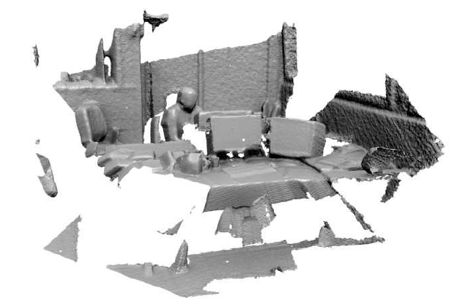
Camera Tracking
Outside Bounds of TSDF
Frame #
PDA
LKDA

Slide 33
Camera Tracking
Outside Bounds of TSDF
PDA
LKDA

Slide 34
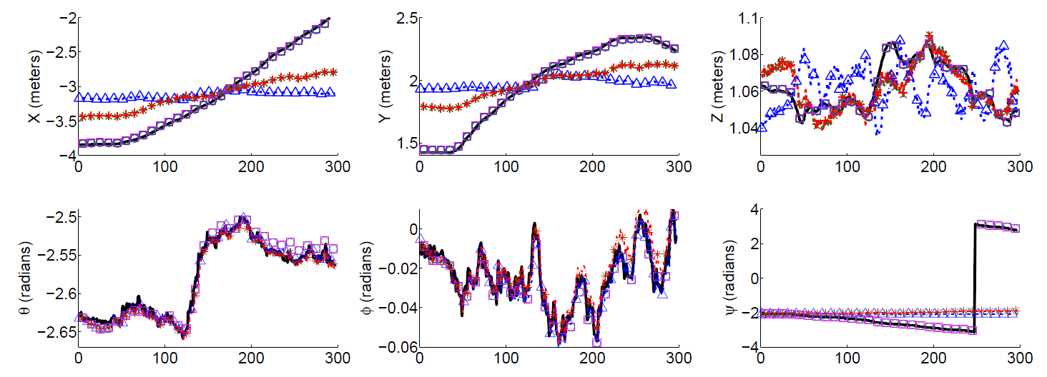
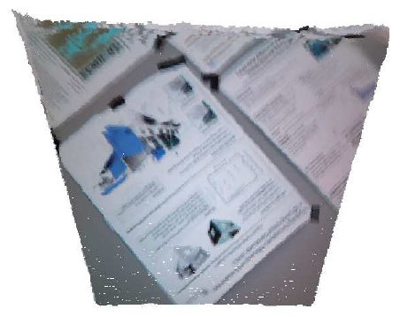
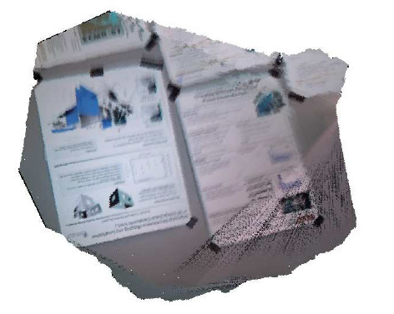
Camera Tracking
Flat Wall
Frame #
PDA
LKDA

Slide 35
Camera Tracking
Flat Wall
PDA
LKDA

Slide 36
Camera Tracking

Slide 37
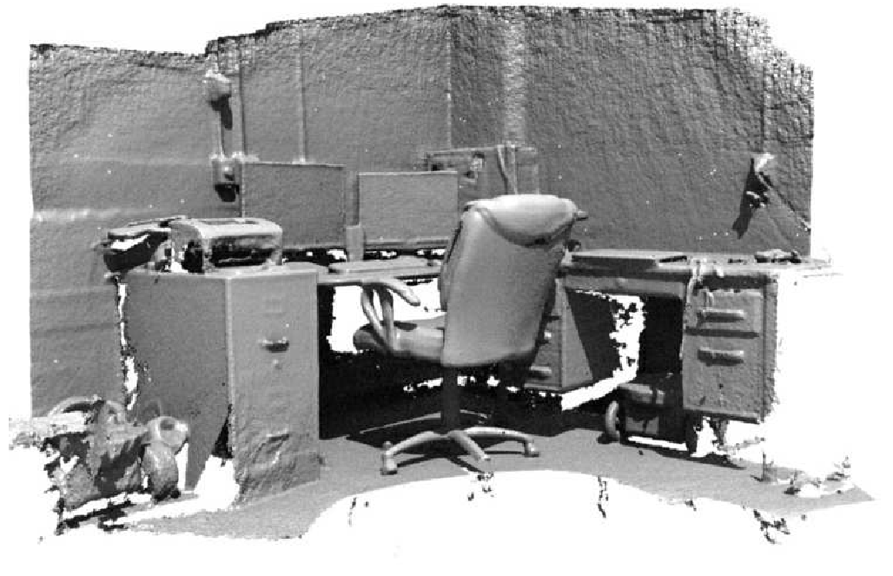
Camera Tracking

Slide 38
Kinect Fusion
Limitations
Environment Size
Reconstruction is bounded to a TSDF volume
TSDF memory consumption exponentially increases with size and resolution
Camera Tracking
Only uses depth, fails when little geometry is present
Cannot maintain tracking with sparse depth information
TSDF
TSDF

Slide 39
TSDF vs. Occupancy Grid
TSDF
Occupancy Grid

Slide 40
TSDF vs. Occupancy Grid
TSDF (4 Bytes per cell)
Occupancy Grid (1 byte per cell)
Negative
Occupied
Positive
Free

Slide 41
TSDF vs. Occupancy Grid
TSDF
Occupancy Grid
0
0

Slide 42
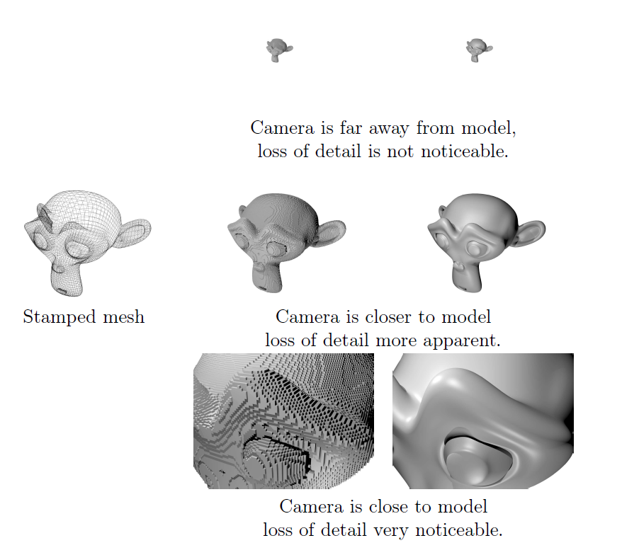
TSDF vs. Occupancy Grid

Slide 43
TSDF vs. Occupancy Grid
 | TSDF | Occ. Grid
Memory | Typically 4 bytes per cell | Typically 1 byte per cell (Can use 1 bit)
Continuous | Each 3D point can be interpolated to obtain distance to nearest surface | Each 3D point is classified as occupied or unoccupied
Noisy Data | Update step smooths surface | Techniques do exist to smooth surface, take a long time (MCMC). Memory goes up to 4 bytes per cell
Updating | More complex | Simple

Slide 44
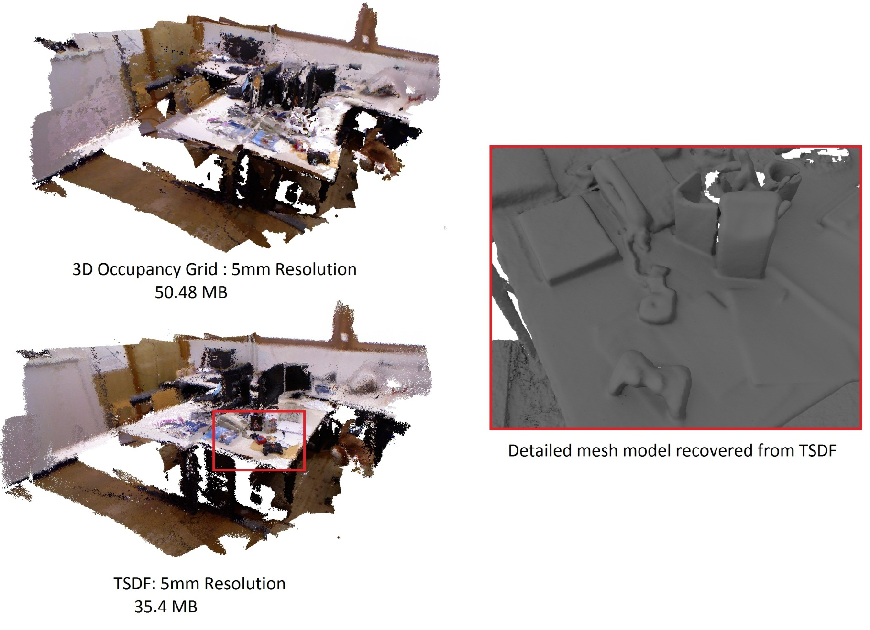
TSDF vs. Occupancy Grid

Slide 45
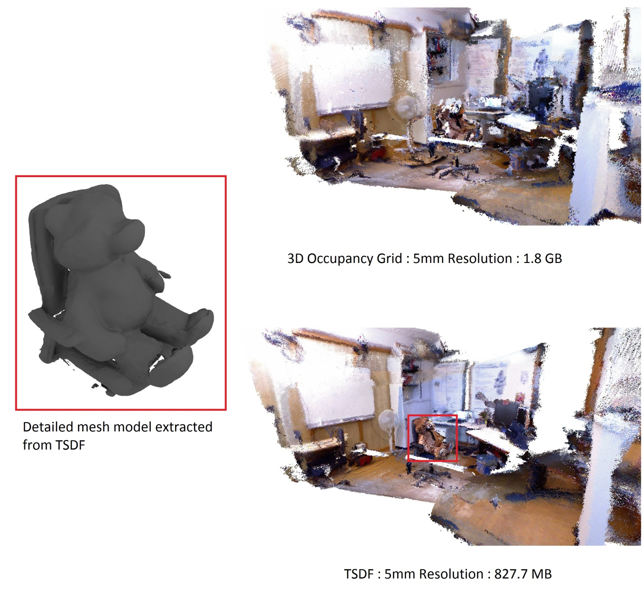
TSDF vs. Occupancy Grid

Slide 46
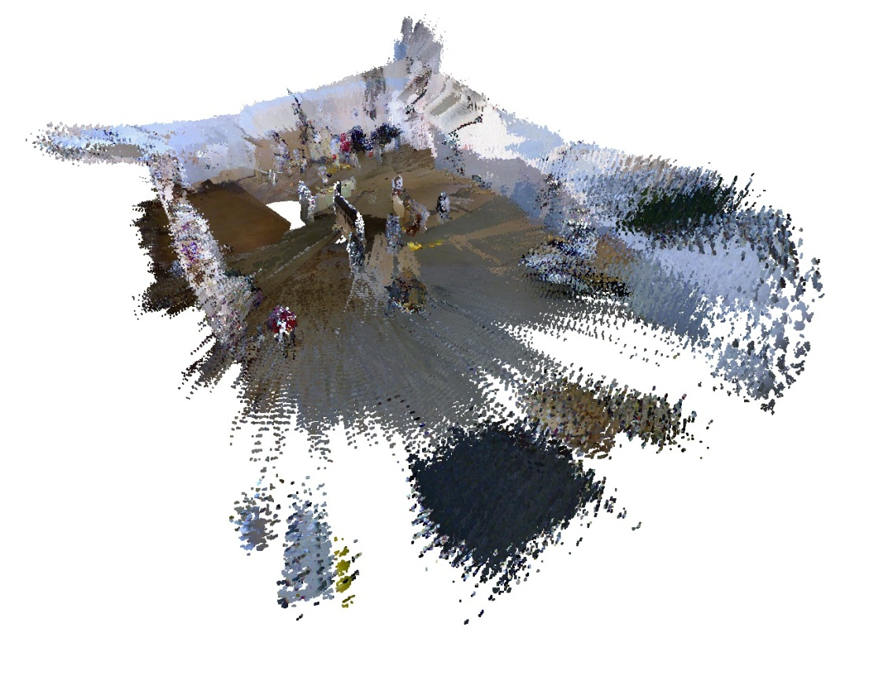
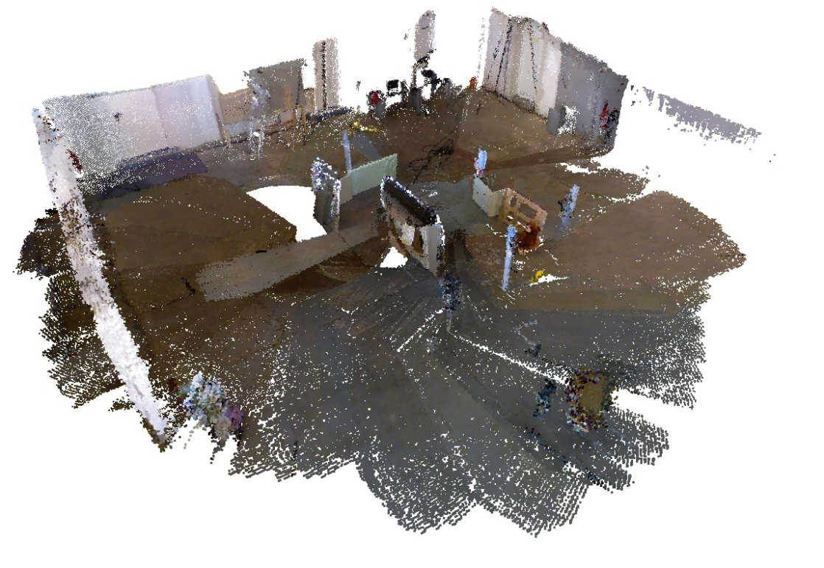
TSDF vs. Occupancy Grid

Slide 47
Loop Closing
Sensor
Reading
Camera
Tracking
Integration
Model
Loop Closure
Detection
Loop
Closing

Slide 48
Loop Closing
Estimated Trajectory
Close Loop
Same Point

Slide 49
Loop Closing
Graph Optimization
State
$$X_{1}$$
$$X_{2}$$
$$δ_{1,2}$$
$$δ_{1,3}$$
$$δ_{2,3}$$
$$x=\left[\begin{matrix}X_{0} \\ X_{1} \\ X_{2} \\ X_{3} \\ X_{4}\end{matrix}\right]$$
$$X_{3}$$
Measurement
(typically relative)
$$δ_{0,1}$$
$$δ_{3,4}$$
$$X_{4}$$
$$X_{0}$$
$$δ_{0,4}$$
$$r_{ab}(x)=δ_{a,b}−f_{ab}(x)$$
Actual
Observation
Predicted
Observation
$$c=\sum_{\left(a,b\right)ε ε}{r_{ab}^{T}{\left(x\right)Ω}_{ab}r_{ab}}(x)$$
Minimize

Slide 50
Loop Closing
Minimize
$$c=\sum_{\left(a,b\right)ε E}{r_{ab}^{T}{\left(x\right)Ω}_{ab}r_{ab}}(x)$$
Nonlinear
Solved Incrementally
“A little bit of math shows…”
$$J^{T}(\tilde{x})ΩJ(\tilde{x})Δx=J^{T}(\tilde{x})Ωr(\tilde{x})$$
Jacobian of the error (negative of residual)
w.r.t. the state
Increment to the state space
Residuals stacked vertically
$$K^{T}K$$
Linearized
State Space
K = Variances concatenated horizontally

Slide 51
Loop Closing
Iterative Techniques
 | Edges | Easily Trapped | Fast Convergence | Expensive
Newton-Rapshon | All | yes | yes | yes
Gradient Descent | All | yes | yes | yes
Conjugate Gradient Descent | All | yes | yes | yes
Simplex Methods | All | yes | yes | yes
Gauss-Seidel | All | yes | If near solution | no
Stochastic Gradient Descent | Single | no | no | no

Slide 52
Loop Closing
State Space
Global State Space (x, y, θ)
$$X_{0}=\left[\begin{matrix}0 \\ 0 \\ 0\end{matrix}\right]$$
$$X_{1}=\left[\begin{matrix}2 \\ 0 \\ 0\end{matrix}\right]$$
$$X_{2}=\left[\begin{matrix}4 \\ 0 \\ 0\end{matrix}\right]$$
$$X_{3}=\left[\begin{matrix}6 \\ 0 \\ 0\end{matrix}\right]$$
$$X_{0}=\left[\begin{matrix}0 \\ 0 \\ 0\end{matrix}\right]$$
$$X_{1}=\left[\begin{matrix}2 \\ 0 \\ 45\end{matrix}\right]$$
$$X_{2}=\left[\begin{matrix}4 \\ 0 \\ 0\end{matrix}\right]$$
$$X_{3}=\left[\begin{matrix}6 \\ 0 \\ 0\end{matrix}\right]$$

Slide 53
Loop Closing
State Space
Incremental State Space (Δx, Δ y, Δ θ)
$$X_{0}=\left[\begin{matrix}2 \\ 0 \\ 0\end{matrix}\right]$$
$$X_{1}=\left[\begin{matrix}2 \\ 0 \\ 0\end{matrix}\right]$$
$$X_{2}=\left[\begin{matrix}2 \\ 0 \\ 0\end{matrix}\right]$$
$$p_{0}$$
$$X_{0}=\left[\begin{matrix}2 \\ 0 \\ 45\end{matrix}\right]$$
$$X_{1}=\left[\begin{matrix}2 \\ 0 \\ 0\end{matrix}\right]$$
$$X_{2}=\left[\begin{matrix}2 \\ 0 \\ 0\end{matrix}\right]$$
Edwin Olson, J. Leonard, and S. Teller. Fast Iterative Optimization of Pose Graphs With Poor Initial Estimates. In Proceedings of the International Conference on Robotics and Automations (ICRA), pages 2262-2269, May 2006.
$$p_{i}=\sum_{j=0}^{i−1}{X_{j}}$$

Slide 54
Loop Closing
State Space
Relative State Space (Δx, Δ y, Δ θ)
$$X_{0}=\left[\begin{matrix}2 \\ 0 \\ 0\end{matrix}\right]$$
$$X_{1}=\left[\begin{matrix}2 \\ 0 \\ 0\end{matrix}\right]$$
$$X_{2}=\left[\begin{matrix}2 \\ 0 \\ 0\end{matrix}\right]$$
$$p_{0}$$
$$X_{0}=\left[\begin{matrix}2 \\ 0 \\ 45\end{matrix}\right]$$
$$X_{1}=\left[\begin{matrix}2 \\ 0 \\ 0\end{matrix}\right]$$
$$X_{2}=\left[\begin{matrix}2 \\ 0 \\ 0\end{matrix}\right]$$
$$p_{i}=\sum_{j=0}^{i−1}{R(}\sum_{k=0}^{j}{θ_{k}})X_{j}$$
$${{}_{}^{a}p}_{b}=\sum_{j=a}^{b−1}{R(}\sum_{k=a}^{j}{θ_{k}})X_{j}$$

Slide 55
Loop Closing
Proposed Approach
Two Phase System
Stochastic Gradient Descent with Relative State Space (POReSS)
RSS allows multiple poses to be effected in each iteration
SGD prevents from being trapped in local minima
Result: Quickly gets to a “good” solution
Drawback: Long time to convergence
Gauss-Seidel with Global State Space (Graph-Seidel)
Seed with output from POReSS
GSS only changes one pose at a time in each iteration
Gauss-Seidel allows for quick calculations
Result: Fast “fine tuning”

Slide 56
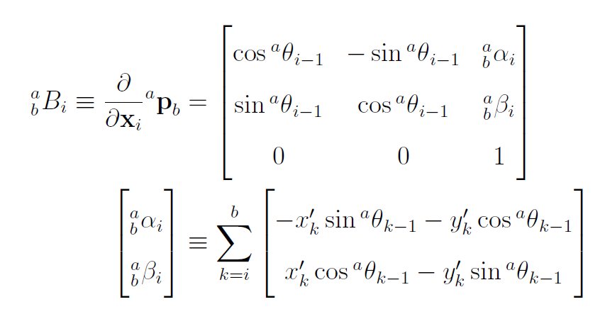
Loop Closing
Phase 1 Pose Optimization using a Relative State Space (POReSS)
$$Δx={\left(J^{T}(\tilde{x})ΩJ(\tilde{x})\right)}^{−1}J^{T}(\tilde{x})Ωr(\tilde{x})$$
Only Consider One Edge (SGD)
$$Δx=M^{−1}J_{ab}^{T}\left(\tilde{x}\right)Ω_{ab}r_{ab}(x ̃)$$
$M=diag\left(J^{T}(\tilde{x})ΩJ(\tilde{x})\right)$)
Precomputed
Computation of $J_{ab}^{}$
ISS
$${E_{ab}={−r}_{ab}={}_{}^{a}p}_{b}−δ_{a,b}$$
$$J_{ab}=\left[\begin{matrix}0 & ⋯ & I & ⋯ & I & 0 & ⋯\end{matrix}\right]$$
$$J_{ab}=\frac{∂E_{ab}}{∂x}$$
a+1 b
RSS
Between Consecutive nodes

Slide 57
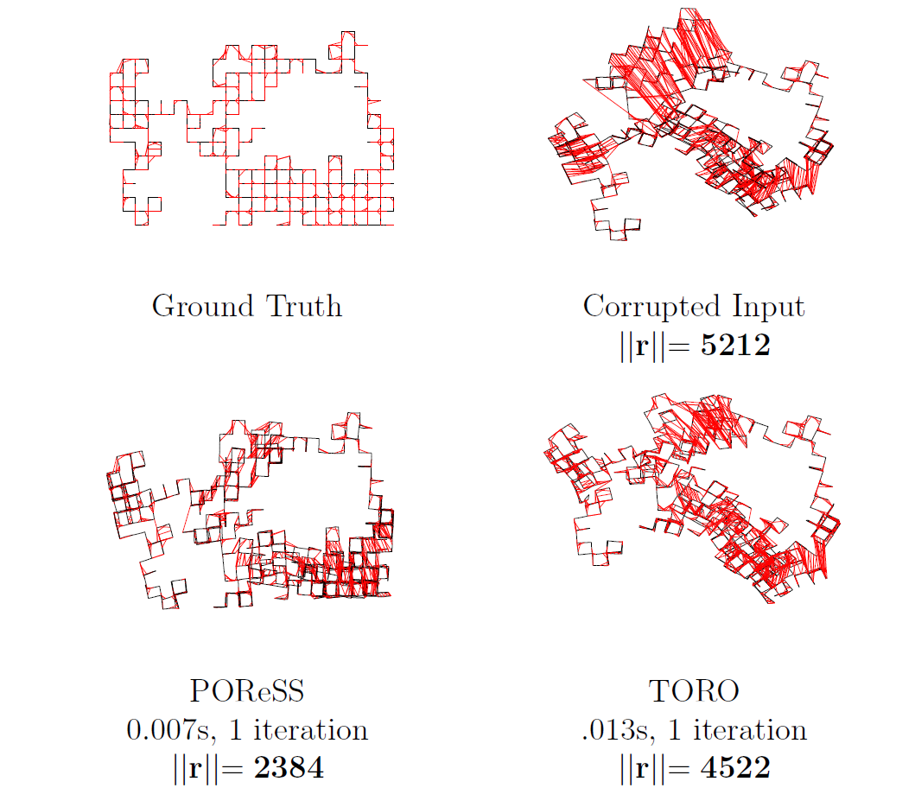
Loop Closing
Pose Optimization using a Relative State Space (POReSS)

Slide 58
Loop Closing
Phase Two Gauss-Seidel using Global State Space (Graph-Seidel)
Gauss-Seidel is a method for solving the standard linear system $Ax=b$
$$c=\sum_{\left(a,b\right)ε ε}{r_{ab}^{T}{\left(x\right)Ω}_{ab}r_{ab}}(x)$$
(nonlinear)
$$r_{ab}=\left[\begin{matrix}p_{b}−p_{a}−R(θ_{a})δ_{ab} \\ θ_{b}−θ_{a}\end{matrix}\right]$$
(GSS)
Evaluate $R(θ_{a})$ at current estimate
A$x=$b
Avoid explicitly calculating A and b, especially for large graphs. (Graph-Seidel)

Slide 59
Loop Closing
Phase Two Gauss-Seidel using Global State Space (Graph-Seidel)
A
x
b
A
Diagonal: Function of connected nodes diag($\sum_{(i,j)∈ε}{Ω_{ij}}$)
Everything else: Connectivity ($−Ω_{ij}$ if connected, 0 otherwise)
b
Sum of edges in – sum of edges out
constant

Slide 60
Loop Closing
Phase Two Gauss-Seidel using Global State Space (Graph-Seidel)
A (constant)
Diagonal: Function of connected nodes diag(($\sum_{(i,j)∈ε}{Ω_{ij}}$))
Everything else: Connectivity ($−Ω_{ij}$ if connected, 0 otherwise)
b
Sum of edges in – sum of edges out
$${diag\left(\sum_{(i,b)∈ε_{i}}{Ω_{ib}}\right)}^{−1}$$
$$\sum_{(i,b)∈ε_{i}}{{−Ω}_{ib}x_{b}}$$

Slide 61
Loop Closing
Phase Two Gauss-Seidel using Global State Space (Graph-Seidel)
Form linear system
$$Ax=b$$
$$Ax=b$$
Compute new state
Using Graph-Seidel

Slide 62
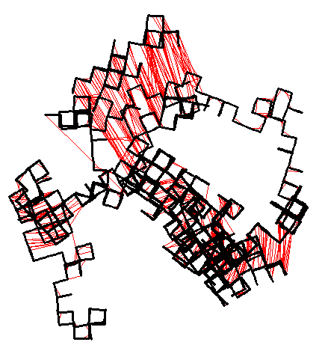
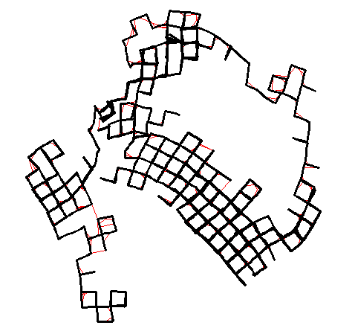
Loop Closing
Phase Two Gauss-Seidel using Global State Space (Graph-Seidel)

Slide 63
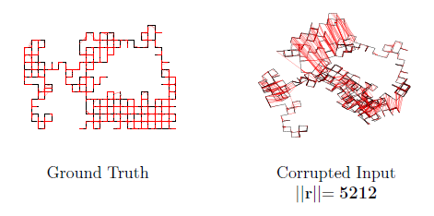
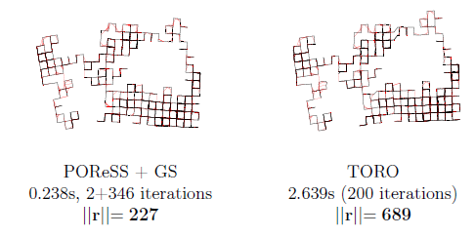
Loop Closing
POReSS + Graph-Seidel

Slide 64
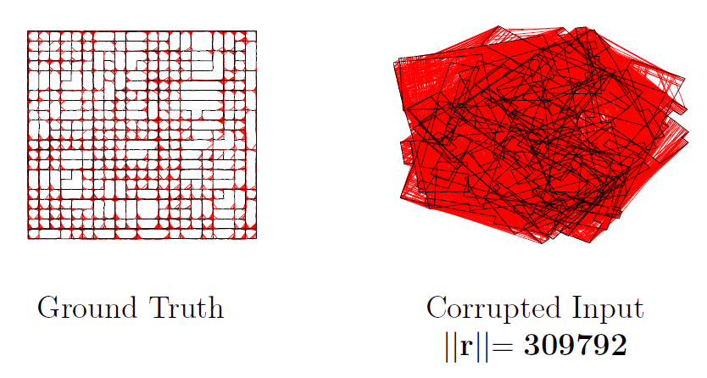
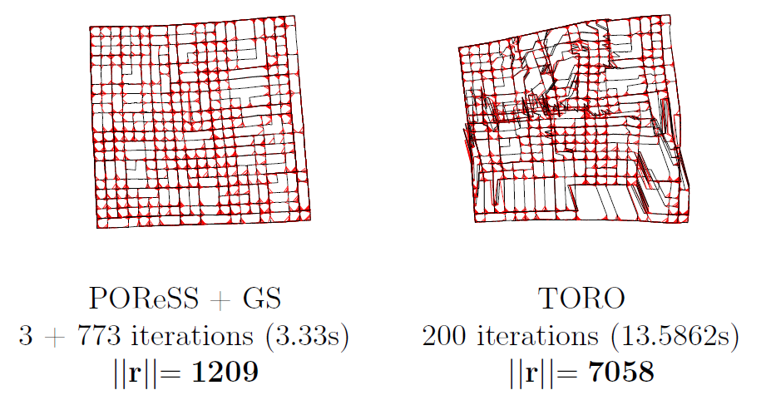
Loop Closing
POReSS + Graph-Seidel

Slide 65
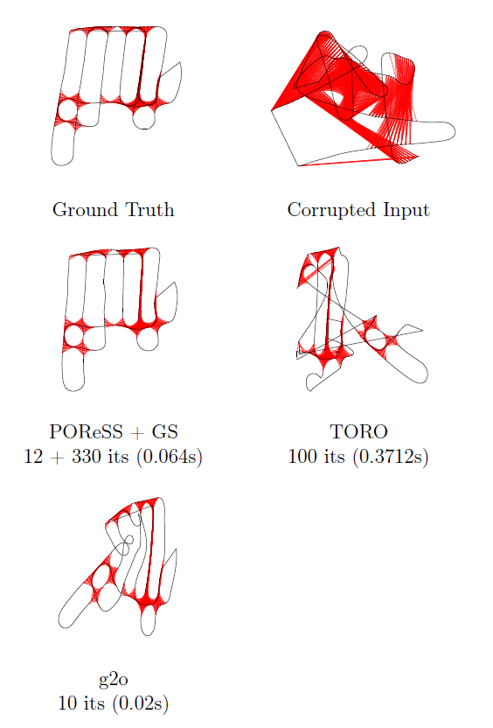
Loop Closing
POReSS + Graph-Seidel

Slide 66
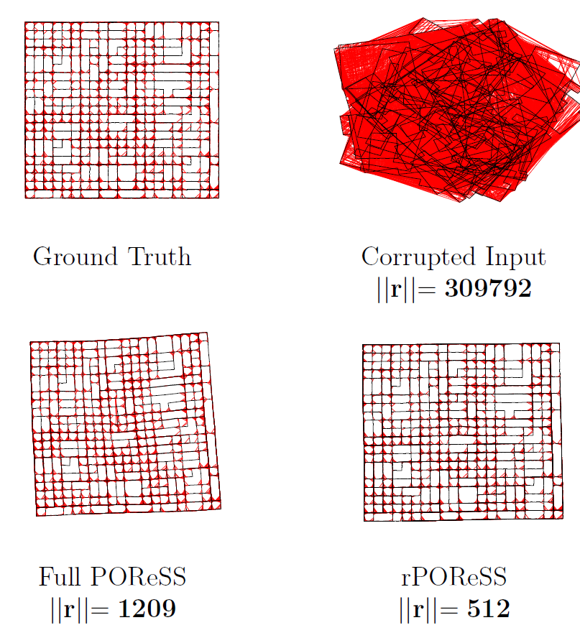
Loop Closing
rPOReSS
Majority of drift is caused by rotational errors
Remove rotational drift
Treat (x,y) components of poses as constants.
Greatly reduces complexity of Jacobian derivation
1xN

Slide 67
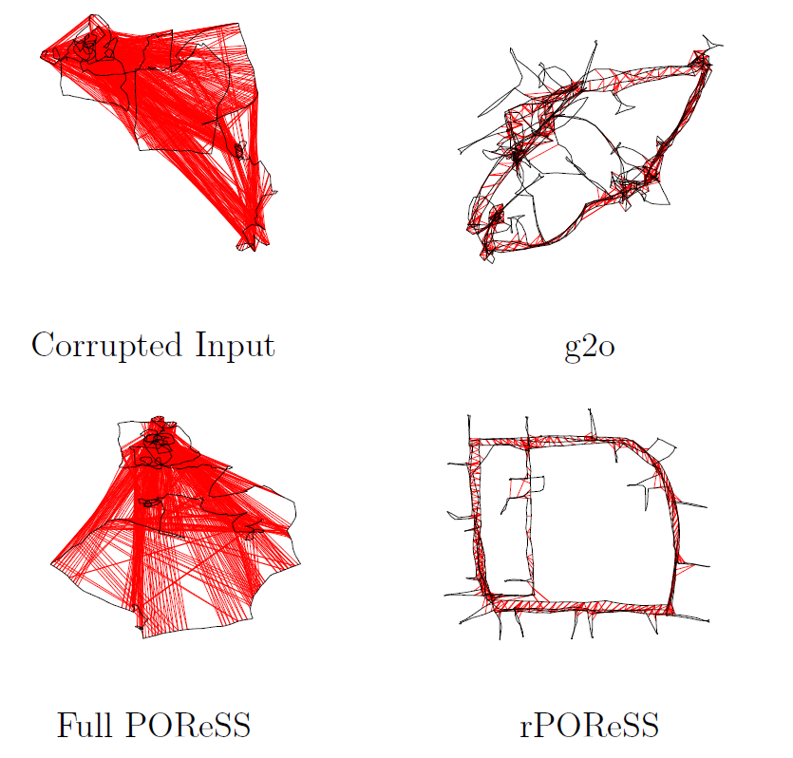
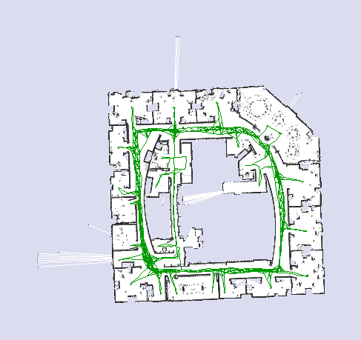
Loop Closing
rPOReSS

Slide 68
Loop Closing
rPOReSS

Slide 69
Loop Closing
irPOReSS
Incremental:
Rotational POReSS can be run incrementally
Goal is to keep graph “close” to optimized
Run Graph-Seidel whenever a fully optimized graph is desired.
Further iterations of POReSS will undo fine adjustments made by Graph-Seidel.

Slide 70
Loop Closing
irPOReSS

Slide 71
Loop Closing
irPOReSS

Slide 72
Conclusion
Simple Mapping System
Demonstrated power of mapping to model
Show capability of hierarchical multi-resolution volumes
Camera Tracking
Used color information to drive alignment of geometric data (LKDA)
Automatic selection of error metric
Integration
Examined several ways to represent the reconstruction.
Demonstrated the capabilities of the TSDF
Loop Closing
Proposed a two phase system of graph optimization
Proposed a method for graph optimization using a RSS
Proposed a version of Gauss-Seidel optimized for graphs.
Sensor
Reading
Camera
Tracking
Integration
Model
Loop Closure
Detection
Loop
Closing

Slide 73
Questions?

